Slide 1
Eligibility and Determining Local Thresholds: Facilitated Discussion
Marie Ireland, M.Ed., CCC-SLP, BCS-CL
Maribel Saimre, Ed.S.
Virginia Department of Education

Slide 2
VDOE Intended Outcomes
Review evaluation and eligibility requirements and guidance
LEAs identify opportunities to improve consistency
LEAs identify needs and develop a Local Action Plan

Slide 3
Take a moment to identify your intended outcomes and questions

Slide 4


Slide 5
Regulations, Policy and Guidance
Regulations must be followed
  Federal and state considerations
  Compliance
LEA Policy and Procedures
Guidance

Slide 6
Interpretive Authority
Once a law or regulation is written, LEAs have “interpretive authority”
  The right to interpret regulations and provide clarification to assist in the implementation of the regulation
Cannot conflict with law or regulations
Consider carefully any unintended exclusions or limitations

Slide 7
Interpretive Authority
Local interpretations may be written as:
  Policy
  Procedures
  Guidance

Slide 8
It is the LEA’s responsibility to provide interpretation.
Individual interpretation leads to inconsistency.

Slide 9
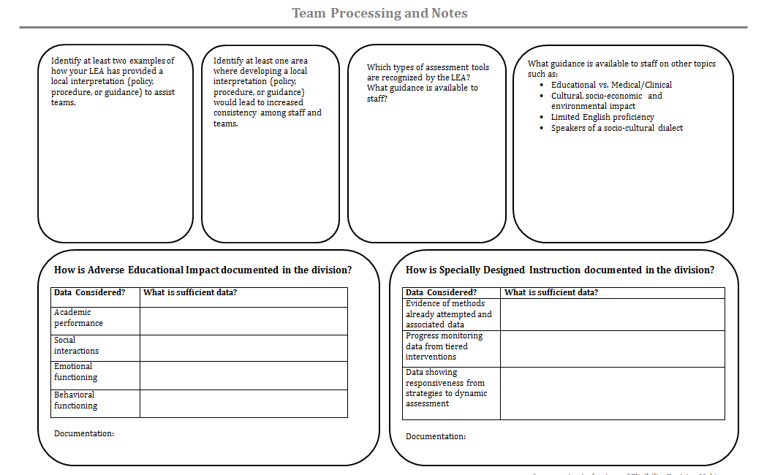
Team Processing and Notes

Slide 10
Identify two examples of how your LEA has provided a local interpretation (policy, procedure, or guidance) to assist teams.
Identify at least one area where developing a local interpretation or resource would lead to increased consistency among staff and teams.

Slide 11
Sources of Data
Existing Data includes:
Evaluations and information provided by the parent(s)
Current classroom-based data, assessments, and observations by teachers and related services providers
Screening Data
Grades
Historical information

Slide 12
Sources of Data
Newly Gathered Data Sources
Standardized Assessments
Informal
  Observations
  Outside information
  Data from school & community

Slide 13
Types of Assessment Data
Standardized and Norm-referenced tests
Criterion-referenced measures
Dynamic assessments
Development scales
Play-based assessments
Portfolio review and review of student file

Slide 14
Which types of assessment tools are recognized by the LEA?
What guidance is available to staff?

Slide 15
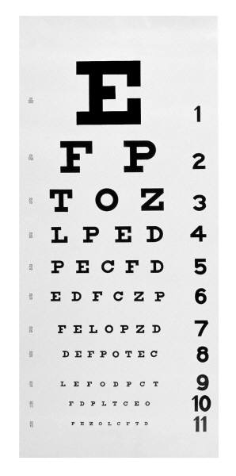

Slide 16
Educational Identification vs. Medical/Clinical Diagnosis
Medical clinical diagnosis is not sufficient for determining eligibility
Groups should address the difference between educational identification under IDEA and medical/clinical diagnosis
Students may meet criteria without having a medical/clinical diagnosis

Slide 17
Others Areas of Impact
Cultural, socio-economic and environmental impact
Limited English proficiency and/or speaker of a socio-cultural dialect

Slide 18
What guidance is available to staff on these topics?

Slide 19

Thoughts?
Concerns?

Slide 20
Eligibility
Determining if a child is or continues to be a child with a disability
There is no ‘dismissal criteria’ in Virginia

Slide 21
Virginia Eligibility Criteria
For any disability area the team must provide documentation that:
  Meets the federal definition
    Impairment
    Educational Impact
    Need for Specially Designed Instruction
  See Guidance on Evaluation and Eligibility (2009)
  or Virginia Regulations

Slide 22
For any disability area the team must provide documentation that:
Addresses all exclusionary criteria
  Lack of instruction in reading or math or LEP
  Provided high quality instruction
Addresses all required components
  Any ‘disability specific’ criteria
  Observation in learning environment
  Hearing screening

Slide 23
Team Review of Data for Eligibility
Look at all data for trends
Consider outside reports and information
Observation required for any eligibility
Examine any inconsistencies
Review criteria
Discuss educational need

Slide 24
Eligibility Reminders
“No single measure or assessment is used as the sole criterion”
8 VAC 20-81-70 C 11

Slide 25
Examining Thresholds and Documentation Requirements
Some included in regulation
  Criteria
  Evaluation components
Some are set by the LEA
  Thresholds
  Documentation sources

Slide 26
What is “adverse educational impact”?
Not just grades
Behaviors, social emotional and other issues are permitted
Impact is on student – not family or teacher

Slide 27
Educational Impact Examples
Academic
  Grades
  Difficulty with school work
Functional/ Social/ Emotional/ Behavioral
  Ability to interact in school setting is impacted
  Emotional state impacts ability to participate
  Behaviors impact ability to participate

Slide 28
Data Considered | What is sufficient data?
Academic performance
Social interactions
Emotional functioning
Behavioral functioning

Slide 29
How is “Adverse Educational Impact” documented in the division?
What data sources are considered?
What is sufficient data (threshold)?

Slide 30
What is “need for specially designed instruction”?
Instruction that is distinctly different from general education in:
  Content
  Methodology
  Delivery
    Intensity
    Setting
Not just “accommodations”

Slide 31
Data Considered | What is sufficient data?
Evidence of methods already attempted and associated data
Data showing responsiveness to strategies from dynamic assessment
Progress monitoring data from tiered interventions

Slide 32
How is Specially Designed Instruction documented in the division?
What data sources are considered?
What is sufficient data (threshold)?

Slide 33
Thoughts?
Concerns?

Slide 34
Specific Disability Criteria:
Establishing Local
Thresholds and Methods

Slide 35
General Process
Review specific disability criteria
What opportunities exist to:
  Establish data sources
  Set thresholds
  Provide guidance
  Clarify procedures or policy

Slide 36
Identify Opportunities
Identify staff leaders or resources
Strive for consistency
Develop guidance or resources
Seek additional professional development

Slide 37

SLD

Slide 38
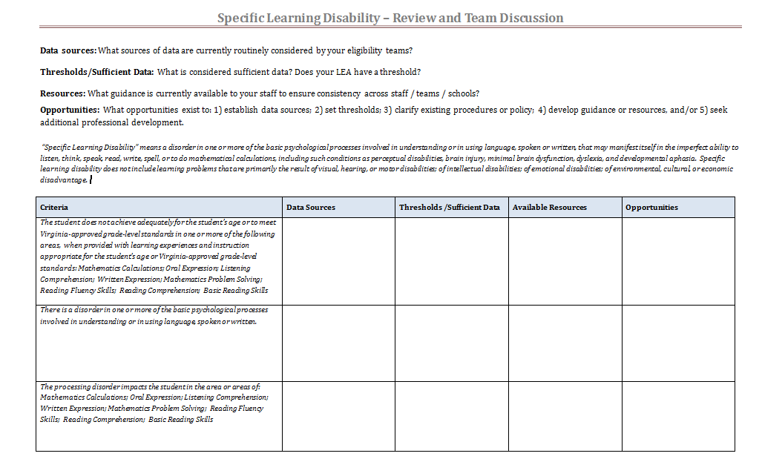
SLD Team Discussion

Slide 39
Additional Areas
Consider developing guidance or establishing thresholds for:
  Related services
    OT; PT; Assistive Technology
  Testing accommodations
    Read aloud
  Manifestation determination review

Slide 40
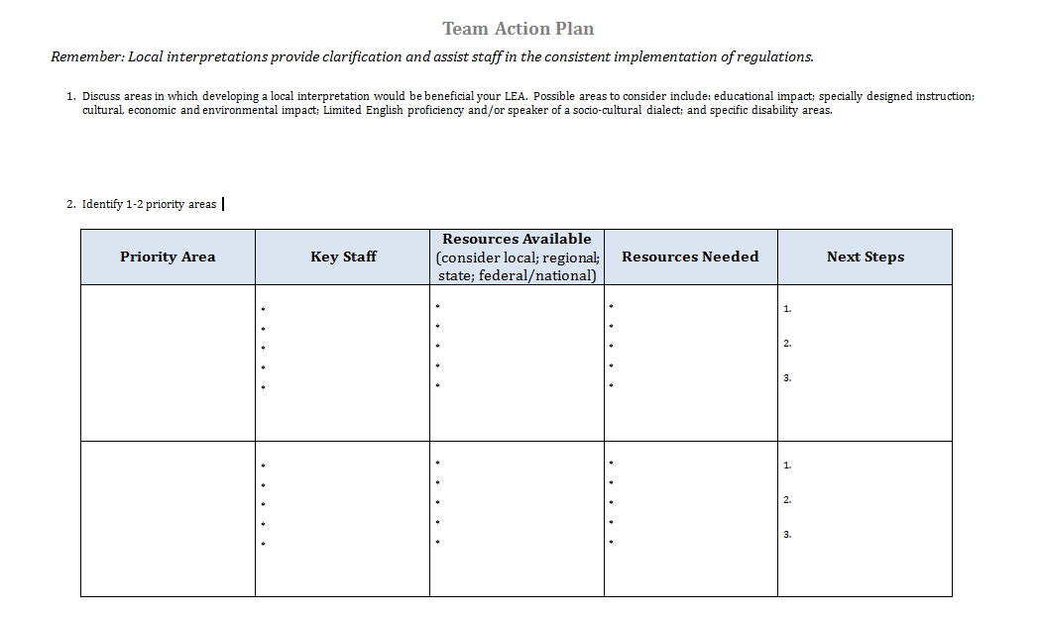
Action Planning

Slide 41
Resources
Materials from today’s session are available on the VDOE Special Education web page.

Slide 42
Thank you for coming!

