Slide 1
Office of Career and Technical Education
2024 VACTEA Annual Conference
New Course Application

Slide 2
Revised New CTE Program/Course Application

Slide 3
Background

Slide 4
Virginia’s Workforce Development Programs
The 2014 General Assembly directed the Joint Legislative Audit and Review Commission (JLARC) to assess how effectively Virginia’s workforce development programs meet the needs of employers and to examine the transparency of information on program expenditures and outcomes.
Report to the Governor and the General Assembly of Virginia

Slide 5
JLARC Findings
Some programs for teaching in-demand skills do not reflect the state’s labor market.
Develop criteria to measure whether new CTE courses proposed by school divisions are aligned with labor market demand.
Require school divisions’ CTE advisory committees to annually develop recommendations to improve the relevancy of CTE program offerings.

Slide 6
JLARC Recommendations
Develop specific criteria for determining whether new career and technical education courses proposed by school divisions are justified and only approve courses for which justification is demonstrated.
The criteria should include demonstrating that there is employer demand for the course that is not sufficiently met through other nearby training and education programs and that there are or will be job openings in the region in occupations associated with the course.

Slide 7
JLARC Recommendations
The Virginia Board of Education should amend the regulations governing career and technical education to require school divisions to incorporate labor market data in the criteria used to select the program areas that are the basis of their career and technical education programs
8VAC20-120-110. New career and technical education programs. The need for new career and technical preparation programs shall be based on student interests and labor market needs.

Slide 8
Getting Started
Prior to implementing a new CTE program/course, the application must be submitted by fax at 804-530-4560 or email to CTE@doe.virginia.gov
Contact the VDOE CTE cluster/program specialist for this program/course for assistance as needed.

Slide 9
Getting Started
Locate the revised Application for New CTE Program/Course Application on the VDOE website.
Provide school division and contact information:

Slide 10
Program Course Information

Slide 11
Content Area, Program/Course Identification, and Guidelines
Content Area
Program/Course Identification
Guidelines
Use Appendices A – I in the CTERS User’s Manual to identify the correct content area for the program/course.

Slide 12
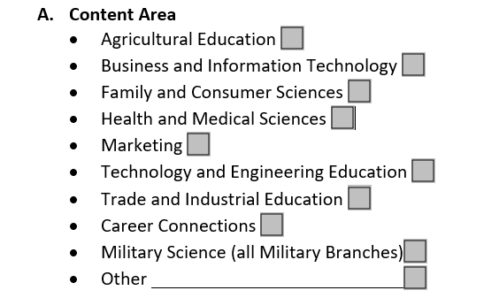
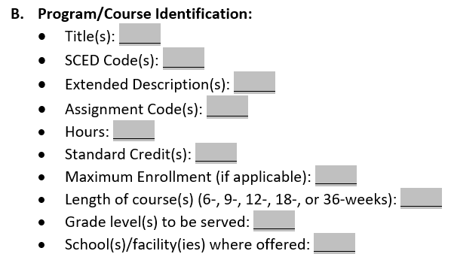
Content Area, Program/Course Identification, and Guidelines
Con

Slide 13
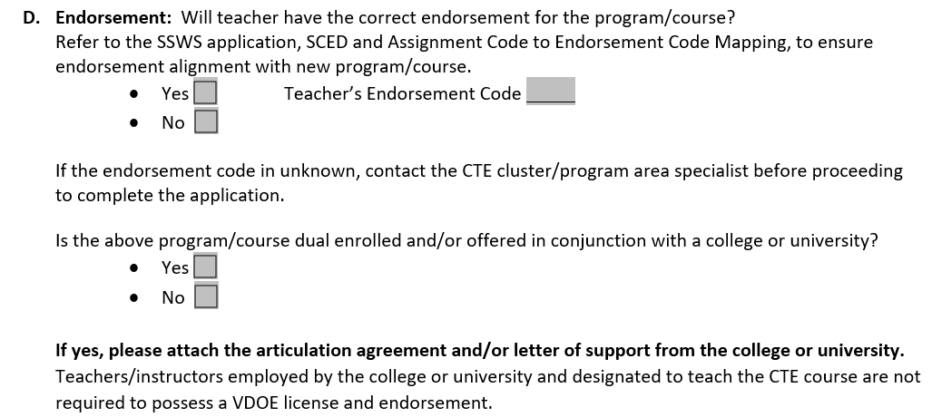
Endorsement

Slide 14
Endorsement
Endorsement
If you have access, refer to the SSWS application, SCED and Assignment Code to Endorsement Code Mapping, to ensure endorsement alignment with new program/course.
If you do not have access or have questions about the endorsement code, contact the CTE cluster/program area specialist before proceeding to complete the application.

Slide 15
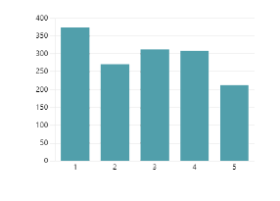
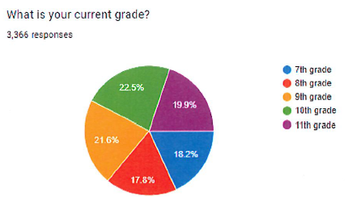
Competency Based Education and Evidence of Student Interest

Slide 16
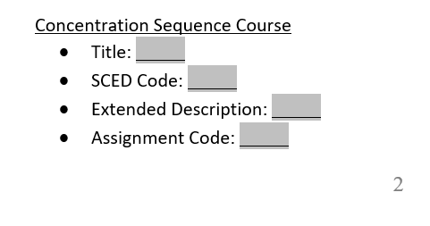
Concentration Sequence - Current

Slide 17
Concentration Sequence - Planned

Slide 18
Labor Market/Employment Needs Data

Slide 19
Labor Market/Employment Needs Data
H. Labor/Market/Employment Needs Data
Provide supporting evidence that there is alignment between your proposed CTE program or course and regional labor market demand.
Following the provided instructions, use the Trailblazers Labor Market Data Tool on the CTE Trailblazers web portal to supply labor market data for three to five occupations in your Local Workforce Development Area (LWDA) that are related to your proposed program or course.

Slide 20
Labor Market/Employment Needs Data
Additionally, on the VDOE website’s CTE Professional Development webpage, there is a recorded webinar, How to Use the Trailblazers Labor Market Tool for New Course Applications.

Slide 21
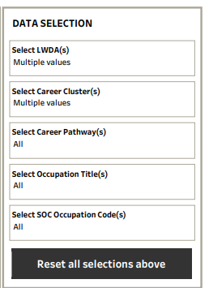
Labor Market Evaluation Criteria
Labor Market Evaluation Criteria are provided to help you narrow down and select three to five occupations that best support the need for your proposed program or course.
To best support the addition of the new program or course, include occupations that are in high demand or have high projected job growth rates and/or numbers.
Consider occupations related to identified courses in the concentration sequence across multiple clusters and pathways.

Slide 22
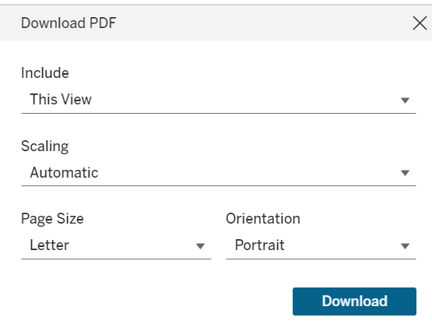
Labor Market Evaluation Criteria
Once you have made your selections, follow the instructions provided on the CTE Trailblazers web portal to print and save a screenshot of your final occupation selections in the Trailblazers data tool as a PDF document. Attach a copy of this PDF document to the application packet.

Slide 23
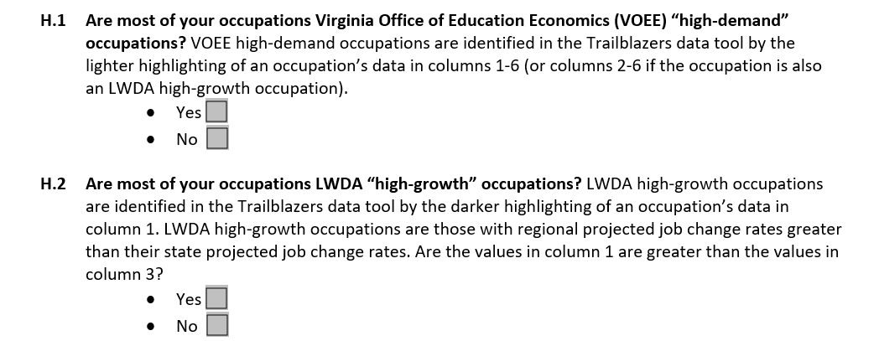
Labor Market Evaluation Criteria
Complete Questions H1 – H7 in the application
Refer to data in columns 1-6 of your Trailblazers Labor Market Data Tool search results to answer the questions about occupations you are considering for submission with your application.
You do not necessarily have to answer “yes” to every question (H1-H7), but the more you are able to do so, the stronger your application will be.

Slide 24
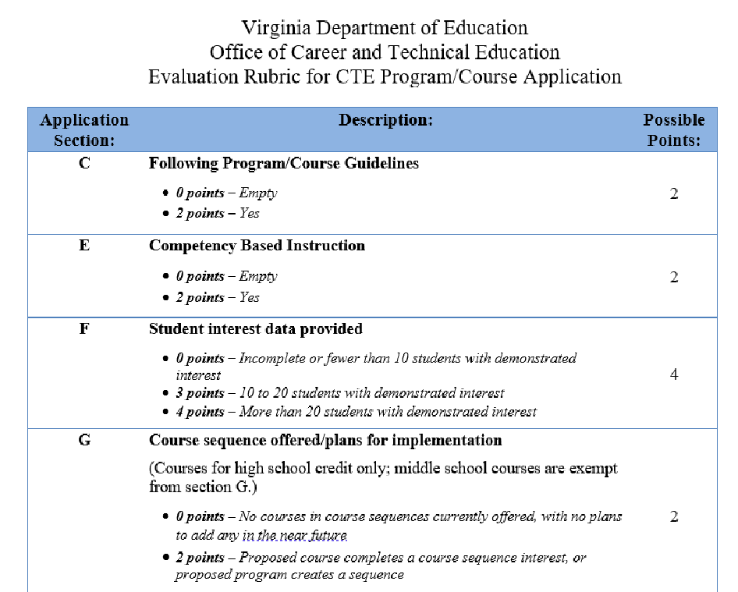
Helpful Resource: Evaluation Rubric
An Evaluation Rubric is provided as a resource to help ensure you have a solid application. Using the rubric, review and self-score your application.
High School (credit-bearing) courses require at least 21 points (24 possible)
Middle School (noncredit-bearing) courses require at least 19 points (22 possible)

Slide 25
Application Submission
Ensure the following documentation is submitted with this application:
Articulation agreement and/or letter of support from the college or university, if applicable (D)
Evidence of student interest (F)
Labor market data (H)
Evidence of growth (H.7)
Ensure the school division CTE Administrator and Superintendent sign the application.
Submit Application by fax at 804-530-4560 or email to CTE@doe.virginia.gov

Slide 26
Office of Career and Technical Education Contact Information

Slide 27
Office of Career and Technical Education
Director | Dr. Anthony Williams anthony.williams@doe.virginia.gov
Associate Director for Curriculum, Instruction, and Innovation | Kelly Davis kelly.davis@doe.virginia.gov
Associate Director for Program Administration and Workforce Development | William Hatch william.hatch@doe.virginia.gov
Program Administration and Workforce Development Coordinator | Sharon Acuff sharon.acuff@doe.virginia.gov
Curriculum and Instruction Coordinator | Karen Charney karen.charney@doe.virginia.gov

Slide 28
Curriculum and Instruction
Program Areas | Career Clusters | Specialists
Agricultural Education | Agriculture, Food & Natural Resources; Government & Public Administration | LaVeta Nutter laveta.nutter@doe.virginia.gov
Business and Information Technology | Business Management & Administration; Finance; Information Technology | Judith Sams judith.sams@doe.virginia.gov
Family and Consumer Sciences | Education & Training; Human Services | Heather Jones heather.jones@doe.virginia.gov
Health and Medical Sciences | Health Science | Crystal Stokes crystal.stokes@doe.virginia.gov
Marketing | Arts, A/V Technology & Communications; Hospitality & Tourism; Marketing | cte@doe.virginia.gov
Technology and Engineering Education | Energy; Science, Technology, Engineering & Mathematics | Dr. Lynn Basham lynn.basham@doe.virginia.gov
Trade and Industrial Education | Architecture & Construction; Law, Public Safety, Corrections & Security; Manufacturing; Transportation, Distribution & Logistics | cte@doe.virginia.gov

Slide 29
Planning, Adminstration, and Accountability
Data Collection, Reporting, and Accountability Specialist | Joseph Ryder joseph.ryder@doe.virginia.gov
Budget, Grants, and Program Support Specialist | Ashley Robbins ashley.robbins@doe.virginia.gov
Industry Credential Specialist | Jane Brown jane.brown@doe.virginia.gov
Planning, Administration, and Accountability Specialist | Bernard Williams bernard.williams@doe.virginia.gov

Slide 30
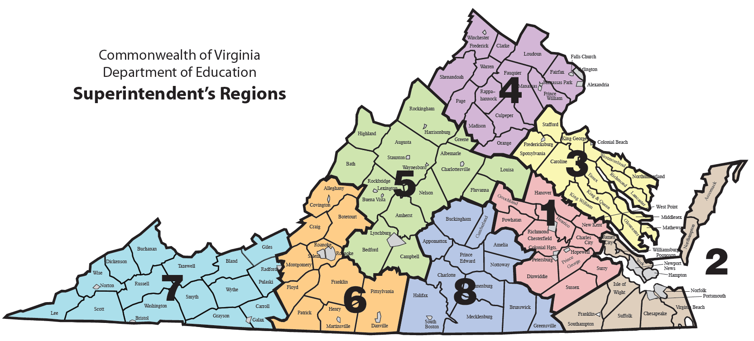
Secondary Workforce Development
Secondary Workforce Development Specialist Region 1 | Erika Temple erika.temple@doe.virginia.gov
Secondary Workforce Development Specialist Region 2 | Dr. Nikki Finley nikki.finley@doe.virginia.gov
Secondary Workforce Development Specialist Region 3 | Kristi Allison kristi.allison@doe.virginia.gov
Secondary Workforce Development Specialist Region 4 | Susan McNamara susan.mcnamara@doe.virginia.gov
Secondary Workforce Development Specialist Region 5 | Amy Hammond amy.hammond@doe.virginia.gov
Secondary Workforce Development Specialist Region 6 | Kim Radford kimberly.radford@doe.virginia.gov
Secondary Workforce Development Specialist Region 7 | Dr. Jan Huffman jan.huffman@doe.virginia.gov
Secondary Workforce Development Specialist Region 8 | Dr. Tammy Hurt tamantha.hurt@doe.virginia.gov

