Slide 1
The Virginia Literacy Act and Gifted Learners

Slide 2
Agenda
Overview of the Virginia Literacy Act
Supporting Gifted Students in the Classroom
Curriculum Review Process
VLA Support for Gifted Students

Slide 3
VLA Overview

Slide 4
How the VLA Will Improve Literacy
Virginia is taking the lead nationwide to reverse these trends and improve early literacy outcomes for the Commonwealth’s youngest learners.
Prepare Teachers
Align Curricula, Screening & Intervention Methods
Science-Based Reading Research
Evidence-Based
Literacy
Instruction
The Virginia Literacy Act
Partner with Families
Require Continuing Professional Development
Notes:
With the passage of the Virginia Literacy Act (VLA) in the 2022 General Assembly, Virginia is taking the lead nationwide to improve early literacy outcomes for Virginia’s young learners. Through the VLA, the Virginia Department of Education (VDOE) will support school divisions through a multi-year effort with tools, resources, technical assistance and funding.
Beginning in the 2024-2025 school year:
Every student in kindergarten to grade five will receive core literacy instruction based in scientifically based reading research and evidence-based literacy instruction, as defined in the VLA. Students in kindergarten through grade eight will also receive evidence-based supplemental instruction and intervention, as outlined in an individualized student reading plan, if they do not meet literacy benchmarks.
Every family will have access to online resources to support literacy development at home, and will be able to participate in the development of their child’s student reading plan, if their child does not meet literacy benchmarks.
Every teacher will use evidence-based literacy curriculum, assess student learning using approved literacy screeners, use student-level data to inform instruction and intervention, and participate in pre-service preparation or training on evidence-based literacy instruction.
Every reading specialist, in consultation with classroom teachers, will coordinate and oversee intervention for students not meeting literacy benchmarks, and will develop and monitor student progress on student reading plans, working closely with families and teachers.
Every division will develop a literacy plan, ensure the use of evidence-based literacy curriculum, staff enough reading specialists to support intervention needs, and provide professional development to support teachers, reading specialists, and principals.

Slide 5
Key Components of the VLA (1 of 2)
Defines Key Terms
Establishes the definition of evidence-based literacy instruction and science-based reading research.
Aligns Core Curricula, Screening and Intervention Methods
Requires both the core (K-5) instructional, supplemental (K-8) and intervention (K-8) programs be aligned with science-based reading research, as set out in a division-wide literacy plan.
Uses a screening model to identify students in need of intervention, and requires the development of reading plans for students designated in the high-risk band.
Adds a division-wide staffing ratio of one reading specialist per 550 students in K-5 and one reading specialist per 1,100 students in Grades 6-8.
Requires Continuing Professional Development and Training
Requires principals, teachers and reading specialists be provided with professional development in science-based reading research and evidence-based literacy instruction.

Slide 6
Key Components of the VLA (2 of 2)
Partners with Families
Ensures parents are engaged in the development of student reading plans and have access to resources to support literacy development at home.
Aligns Educator Preparation and Licensure
Requires certain educator preparation programs to ensure candidates have a program of coursework and demonstrate mastery in science-based reading research and evidence-based literacy instruction.
Stipulates that the literacy assessment for licensure or alternate route to licensure with certain endorsements include a test of science-based reading research and evidence-based literacy instruction.
Requires every person seeking initial licensure with certain endorsements complete study in science-based reading research and evidence-based literacy instruction.
Establishes a microcredential program for earning an add-on reading specialist endorsement (when needed).

Slide 7
VDOE- Virginia Literacy Act
Virginia Literacy Act Webpage
Virginia Literacy Act Updates
VALLSS Assessment Calendar
Student Reading Plan Guidance
Approved Core, Supplemental and Intervention Curriculum
Literacy Implementation Network Session
Resources and Explainers
Webinars and Presentations

Slide 8
Supporting Gifted Students in the Classroom
Notes:
In this segment, we will review the regulations for gifted services related to the Virginia Literacy Act, discuss school division responsibilities and division literacy plan expectations, explore common myths about the VLA and gifted students, and review potential next steps for divisions.

Slide 9
Regulations Governing Educational Services for Gifted Students (8VAC20-40-20)
“Identified gifted students shall be offered placement in an instructional setting that provides…appropriately differentiated curriculum and instruction provided by professional instructional personnel trained to work with gifted students.”
Per 8VAC20-40-20, “appropriately differentiated curriculum means curriculum and instruction modified to accommodate the accelerated learning aptitudes of identified students in their area of strength. Such curriculum and instructional strategies provide accelerated and enrichment options that recognize gifted students’ needs for (i) advanced content and pacing of instruction; (ii) original research or production; (iii) problem finding and solving; (iv) higher level thinking that leads to the generation of products; and (v) a focus on issues, themes, and ideas within and across areas of study.”
Each school board approves a Local Plan for Education of the Gifted that outlines gifted programming for the school division.
Notes:
I am aware that many of you are already familiar with the regulations that govern gifted education, but to level set with all, I want to review the service requirements of the regulations. Gifted students are required to be served in an instructional setting that provides appropriately differentiated curriculum and instruction. The definition of appropriately differentiated curriculum is on the slide. Please note that divisions have an obligation to ensure that students have access to differentiated curriculum that should include advanced content and pacing of instruction. As a local control state, gifted programming varies around the Commonwealth, but divisions must work internally to meet the needs of their gifted students in this way.

Slide 10
School Division Responsibilities
Ensure that identified gifted students (General Intellectual Aptitude and Specific Academic Aptitude-English) have access to the approved curriculum to strengthen foundational reading skills.
Ensure that identified gifted students (General Intellectual Aptitude and Specific Academic Aptitude-English) are placed in an instructional setting that provides appropriately differentiated curriculum.
Ensure that all requirements outlined in the Local Plan for Education of the Gifted are met.
School divisions will need to think flexibly about the structure of their literacy block to responsibly meet the needs of all students.
Notes:
School divisions will need to collaborate to ensure that provisions of the Virginia Literacy Act, regulations for gifted education, and school board approved local plans are working in harmony to meet the needs of their gifted students. Most likely, this will require flexibility in the literacy block.

Slide 11
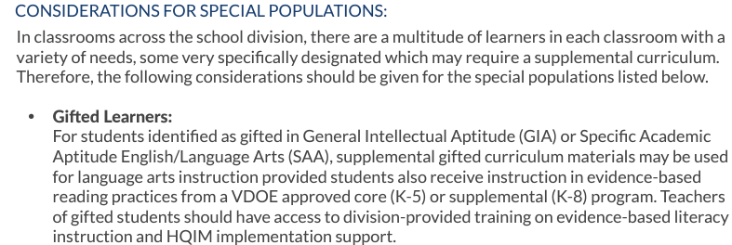
Division Literacy Plan Expectations
Per the instructions below, divisions have the ability to use additional resources to provide appropriately differentiated curriculum and instruction for identified gifted students.
Division Literacy Plan Instructions:
Divisions are expected to use instructional materials, including the core curriculum, to meet the needs of identified gifted students.
Notes:
Per the instructions of the Division Literacy Plan, divisions can use additional materials with the core curriculum to meet the needs of gifted students. While gifted students must have access to the core curriculum, flexibility exists for divisions to utilize additional or enrichment materials to ensure that gifted students experience growth during the language arts block. Data should be used to drive the use of other materials. If a gifted student has mastered certain areas, additional materials, including enrichment items in core curriculums, should be used to provide appropriately differentiated curriculum and instruction. If a gifted student is struggling in certain areas, greater and more consistent use of the core curriculum is expected.

Slide 12
Next Steps
Facilitate a collaborative work session between gifted coordinators and literacy leaders to ensure consistent messaging.
Review core curriculum to find opportunities for differentiation and if needed, provide additional resources for teachers to differentiate for gifted students. Many curriculums have built in extensions for advanced readers.
Locate the most recent copy of your division’s gifted local plan to review requirements for gifted students and ensure compliance.
Have division leaders observe gifted cluster classrooms to understand strengths and areas for growth in providing appropriate language arts materials for gifted students.
Notes:
For me, one of the biggest takeaways for divisions after this webinar is the need for increased communication and understanding between gifted education leaders and literacy leaders in divisions. This may require collaborative meetings that could include looking at core curriculum for enrichment opportunities. I also recommend reviewing your division's local plan for gifted education to ensure fidelity. Observations are beneficial in this work and I would encourage all division leaders to visit classrooms with gifted students to see if the current model is working for those students and if not, explore flexible options to meet the needs of all students. My contact information is on the last slide and as always, if I can support you in any way, please don't hesitate to reach out. I'm so pleased to introduce the VLP team and have them present on the review process.

Slide 13
Curriculum Review

Slide 14
Purpose of Curriculum Review
The rubrics were designed to:
Identify evidence-based instruction in core, supplemental, and intervention programs that are rooted in science-based reading research.
The rubrics were NOT designed to:
Evaluate programs for targeted or specific groups of students, such as special education, multilingual learners, gifted education, and the like.
The Bottom Line: ALL students benefit from evidence-based literacy instruction aligned to science-based reading research.

Slide 15
Core: Grades K-5
A core instructional program provides Tier 1 literacy instruction for all students in all major areas of literacy development (i.e., phonics, phonemic awareness, language development, vocabulary, comprehension, and writing) and uses evidence-based literacy instruction aligned to science-based reading research for students in whole and small group settings.

Slide 16
Supplemental: Grades K-5
A supplemental program provides additional evidence-based literacy instruction and practice on a specific literacy skill (i.e., phonemic awareness, phonics, fluency, vocabulary, comprehension, writing) aligned to science-based reading research.
The supplemental program is used to enhance a core instructional program during whole class or small group instruction.
Teachers use a supplemental program when the core instructional program does not provide adequate instruction or practice opportunities in a specific literacy skill to meet student needs.

Slide 17
Indicator Spotlight!
Core, Supplemental, and Intervention rubrics
each include indicators such as…
“Materials provide guidance on supporting multilingual learners."
“Text materials are inclusive and representative of a wide range of culturally diverse backgrounds and experiences.”
“Materials include annotations to support teachers on differentiation and scaffolding for students needing more support.”

Slide 18
Review Application for Special Populations (such as gifted and multilingual learners)
The rubrics are designed to evaluate programs intended for use with all students during core literacy instruction. They are not designed to evaluate programs for sub-groups of students.
Divisions may continue to use programs intended for these special populations outside of core literacy instruction.

Slide 19
A Note on Materials and Approaches
An approach is defined as a sequence of instructional routines designed for implementation of core, supplemental, or intervention programs. The instructional routines can include specific language or prompts. Approaches often require extensive teacher training before effective implementation can occur.
Materials are defined as resources that teachers incorporate to support instruction and facilitate student learning. These types of resources are online and in print and include books, text sets, magazines, newspapers, articles, workbooks, etc. Quality materials include content that supports literacy development. Materials do not require, nor often include, a scope and sequence, teacher’s manuals, implementation, or the like.
The curriculum review does not intend to evaluate materials nor approaches to the implementation of evidence-based literacy instruction.

Slide 20
How Does the VLA Support Gifted Students?

Slide 21
VALLSS: A Screener Aligned with Science
Better Data = Better Instruction
Subtests aligned with reading science and current research
Piloted with students across Virginia
Measures both language and decoding/encoding sides of the reading rope

Slide 22
What is the purpose of a screener?
Screening assessments serve as an early warning system to detect risk for reading difficulties.
Notes:
A screener allows us to know where a student scored on a continuum of risk for developing reading difficulties.

Slide 23
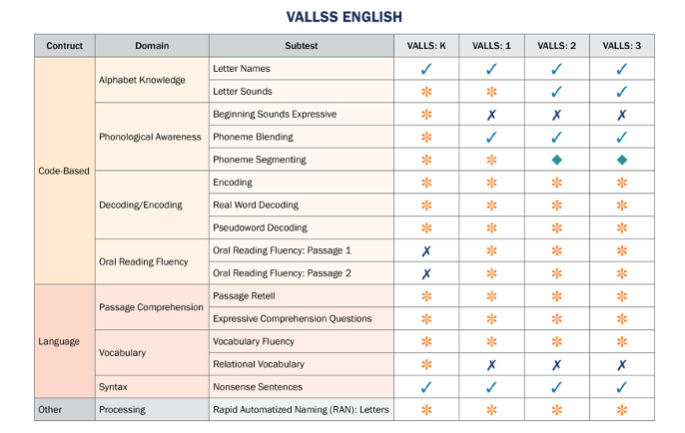
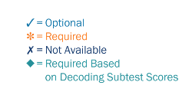
VALLSS Subtests

Slide 24
Instructional Indicators to help shape instruction
Instructional Indicators to help shape instruction
Focus on strengthening targeted skills
Grouping and serving students based on specific skills
Data informs how teachers spend instructional time with students
Indicates who needs instructional extensions or additional support

Slide 25
Evidence-Based Literacy Instruction
Evidence-Based Literacy Instruction
Explicit Instruction for all students
Use of Gradual Release Model
Differentiating scaffolding and support based on need
Meeting students where they are – reducing time spent on skills that are already mastered

Slide 26
Curricula Aligned with Reading Science
Curricula Aligned with Reading Science
Rubric aligned with reading science
Rigorous core instruction
Approved curricula selected by division

Slide 27
Professional Development for Reading Specialists and Teachers
Professional Development for Reading Specialists and Teachers
Canvas Courses
In-person Reading Institutes
Focused on meeting individual needs
Scaffolding and differentiation for students

Slide 28
Data informs use of instructional time
Data informs use of instructional time
Use of flexible small groups
Progress monitoring
Students receive extra instruction as long as needed, no longer stay in same group all year
Students can move forward to new skills more quickly
Progress monitoring

Slide 29
Resources
Resources
VALLSS Office Hours
Regional Literacy Coaches
Coaches' Office Hours
Canvas Courses
Canvas Connection Meetings

Slide 30
Strong Core Instruction for All Students
Strong Core Instruction for All Students
Intervention and gifted services provided in addition to Core instruction
Data helps determine where additional support, extension is provided

Slide 31
Contacts
Virginia Literacy Partnerships- literacy@virginia.edu
VDOE VLA Team: vla@doe.virginia.gov
Director of Advanced Learning:
Amanda.Nevetral@doe.virginia.gov
Virginia Literacy Act | Virginia Department of Education
Division Literacy Plans | Virginia Department of Education
Approved Core Instructional Programs for Grades K-5 | Virginia Department of Education
Intervention Instructional Program Guide & Supplemental Instructional Program Guide | Virginia Department of Education

