Slide 1
Virginia College Partnership Lab Schools Pipeline Update
College Partnership Lab School Standing Committee
June 10, 2024

Slide 2
Board of Education Recap (May 15, 2024)
There are 12 BOE-approved contracted lab schools currently total approximately $64.4M (planning grants, start-up awards, and committed operated funds) with roughly $10.61M remaining in the College Preparatory Lab School Fund.
  Five BOE-approved contract lab schools are currently securing baccalaureate public institution of higher education Fiscal Agent & Partners to meet new budget general condition language as stipulated in the final May 13 General Assembly and Governor's signed budget. FA&P applications will be submitted directly to the Board of Education and considered for approval at the June 21 business meeting.
Old Dominion University – Suffolk’s STEM Academy at Booker T. Washington Elementary School was approved 6-0.
  The total funding award will be determined at the June 21, 2024 Board of Education business meeting.
George Mason University – Frederick’s Shenandoah Valley Rural Regional College Partnership Lab School for Data Science Computing and Applications (DCSA) was approved 6-0.
  The total funding award will be determined at the June 21, 2024 Board of Education business meeting.
All remaining College Preparatory Lab School Funds will be allocated by the Board of Education at the June 21, 2024 business meeting.

Slide 3
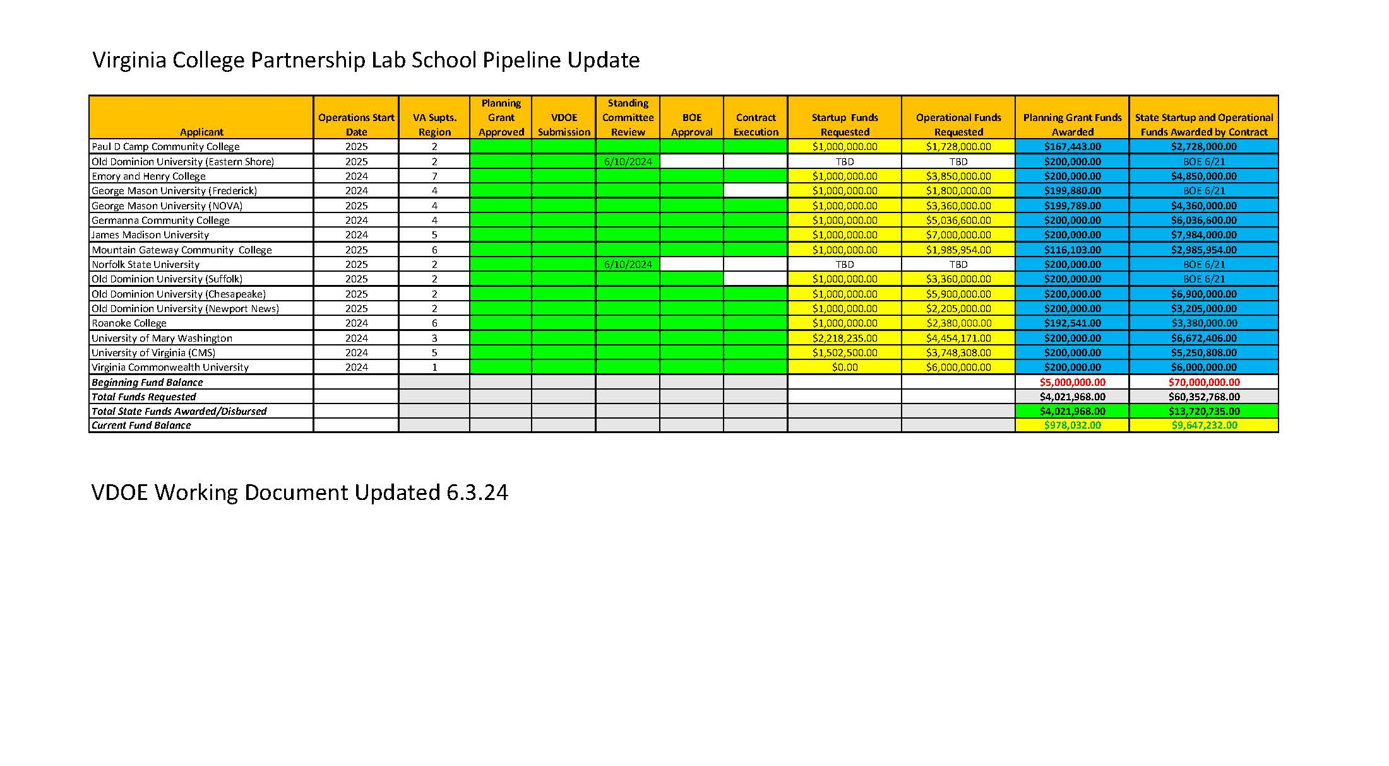

Slide 4
New Requirement: Lab School Sustainability Reporting
HB 6001 - Direct Aid General Conditions 31.c.
c. College partnership laboratory schools shall (i) reach financial sustainability by the end of their initial approval period as defined in § 22.1-349.8 of the Code of Virginia such that no additional state funding other than state funds received by a school division in support of Direct Aid for Public Education is required to support ongoing operations after the first contract renewal, and (ii) submit supporting information to the Board of Education demonstrating progress toward financial sustainability. The Board of Education shall report annually by November 1 to the Governor and Chairs of the House Appropriations and Senate Finance and Appropriations Committees on progress of college laboratory schools in meeting this financial sustainability requirement.

