Slide 1




The Aerospace Academy of the Eastern Shore
College Partnership Laboratory Schools
Standing Committee Meeting - June 10, 2024

Slide 2
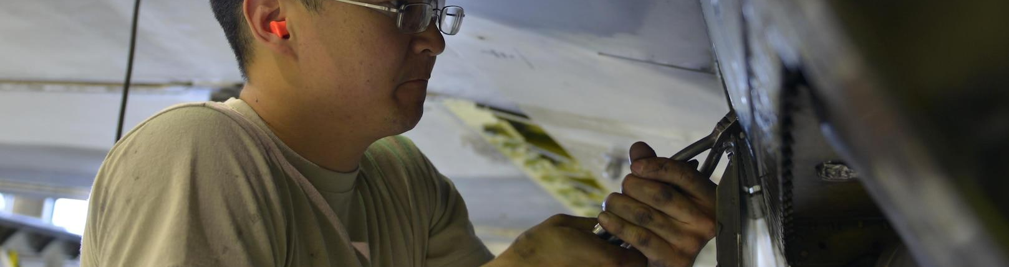
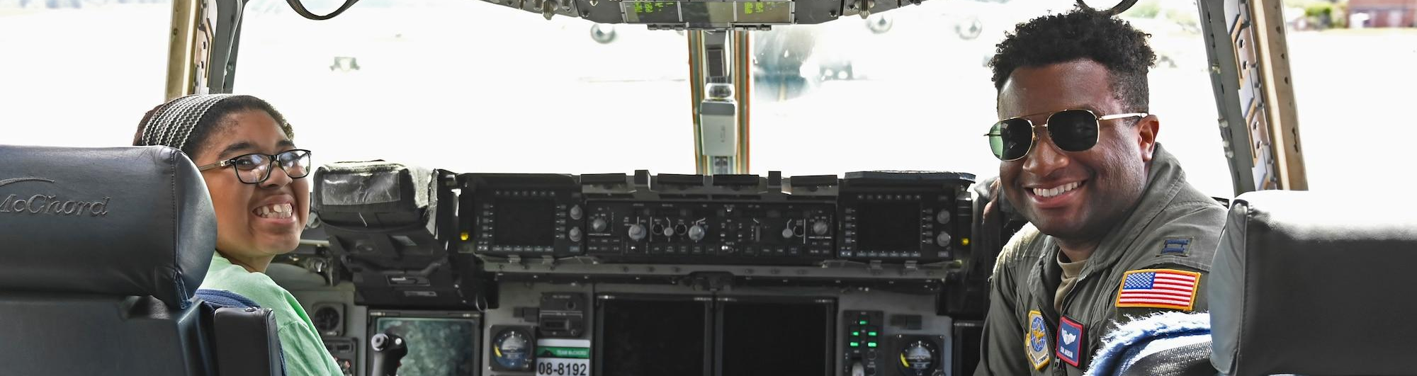
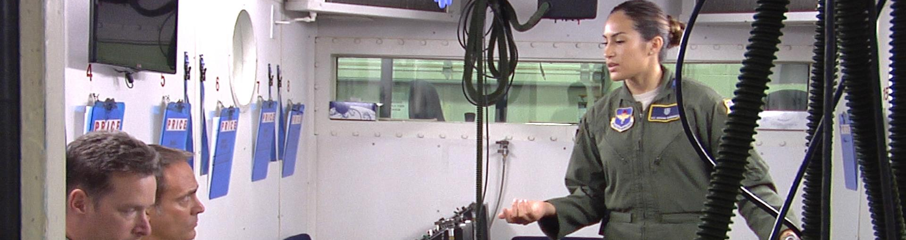
Why The Aerospace Academy of the Eastern Shore?
The state’s aerospace and unmanned systems industry workforce is projected to grow by 8.5% during the next decade, according to Secretary of Commerce and Trade Caren Merrick, with an economic impact of greater than $2 billion on the Eastern Shore.
The establishment of AAES in Accomack and Northampton counties, where the poverty rate exceeds 40% and the past two decades have seen an aging and decreasing population, can significantly contribute to the region’s economic growth. An educated and trained workforce can help bring aerospace supply chain businesses to the Eastern Shore.

Slide 3
AAES is guided by a mission and philosophy that emphasizes:
(1) a commitment to excellence in education
(2) the critical nature of student active agency and student voice in learning
(3) experimentation with pedagogical approaches and experiential learning
(4) innovative approaches to professional learning and educator preparation
(5) integration of research and teaching

Slide 4
AAES Mission
The mission of the Aerospace Academy of the Eastern Shore (AAES) is to provide at-risk and/or underrepresented populations access to the knowledge, skills and abilities needed to be successful in aerospace and adjacent industries identified as priorities by the GoVA Region 5 Economic Development Authority.
We seek to inspire students as future leaders in the aerospace industry; provide a dynamic laboratory for innovation in education; and collaborate around research to build and share knowledge of transformative practices.

Slide 5
AAES Vision
It is our vision that AAES will be an innovative, interdisciplinary school and the regional standard of excellence in preparation for the high-tech jobs in these high growth fields.

Slide 6
The Student Experience
During their first year, students will be introduced to the AAES program and learn about the Aerospace Information & Security Systems and Aerospace Engineering & Explorations pathways. Students will be engaged in a variety of activities, including possible summer camp and after-school opportunities as well as course-based projects exposing them to the pathways and future career options.

Slide 7
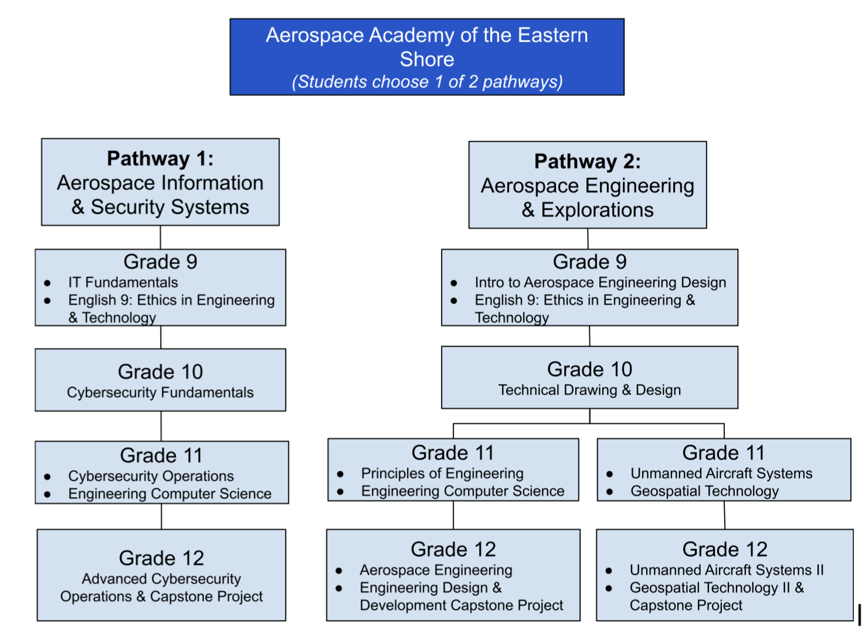
Student Pathway Options

Slide 8
Sample Student Schedule
A-Day (Block scheduling) 1st Semester (4 by 4) | B-Day (block scheduling) 2nd Semester (4 by 4)
Grade 9 English Language-Arts: Ethics in Engineering and Technology | Intro to Aerospace Engineering and Design
World History I | Elective
Algebra I | Health/PE
Spanish II | Earth Science
9th Grade
A-Day (Block scheduling) 1st Semester (4 by 4) | B-Day (block scheduling) 2nd Semester (4 by 4)
Grade 10 English Language-Arts (Honors) | Technical Drawing & Design
World History II | Elective
Algebra II | Health/PE
Spanish III | Biology (Honors)
10th Grade

Slide 9
Sample Student Schedule
A-Day (Block scheduling) 1st Semester (4 by 4) | B-Day (block scheduling) 2nd Semester (4 by 4)
Grade 11 English (Honors/DE) | VA & U.S. History DE
Unmanned Aircraft Systems I (DE) | Geospatial Technology I (DE)
Algebra II or Precalculus (DE) | Chemistry
Economics and Personal Finance | Suggested Elective - VASTS
11th Grade
Potential Schedule for 11th Grader, Engineering & Explorations -
Unmanned Vehicle Systems
A-Day (Block scheduling) 1st Semester (4 by 4) | B-Day (block scheduling) 2nd Semester (4 by 4)
Grade 11 English (Honors/DE) | Principles of Engineering
Engineering Computer Science | VA & U.S. History DE
Algebra II or Precalculus (DE) | Chemistry
Economics and Personal Finance | Suggested Elective - VASTS
11th Grade
Potential Schedule for 11th Grader, Engineering & Explorations -
Engineering focus

Slide 10
Sample Student Schedule
A-Day (Block scheduling) 1st Semester (4 by 4) | B-Day (block scheduling) 2nd Semester (4 by 4)
Grade 12 English (DE or Honors) | VA & U.S. Government DE
Unmanned Aircraft Systems II (DE) | Geospatial Technology II (DE) with Capstone Project
Precalculus DE/Calculus DE | Suggested electives - Aerospace Engineering or VESSS
Physics | Internship
12th Grade
Potential Schedule for 11th Grader, Engineering & Explorations -
Unmanned Vehicle Systems
A-Day (Block scheduling) 1st Semester (4 by 4) | B-Day (block scheduling) 2nd Semester (4 by 4)
Grade 12 English (DE or Honors) | Engineering Design & Development with Capstone Project
Aerospace Engineering | VA & U.S. Government DE
Precalculus DE/Calculus DE | Suggested Elective - VESSS
Physics | Internship
12th Grade
Potential Schedule for 11th Grader, Engineering & Explorations -
Engineering focus

Slide 11
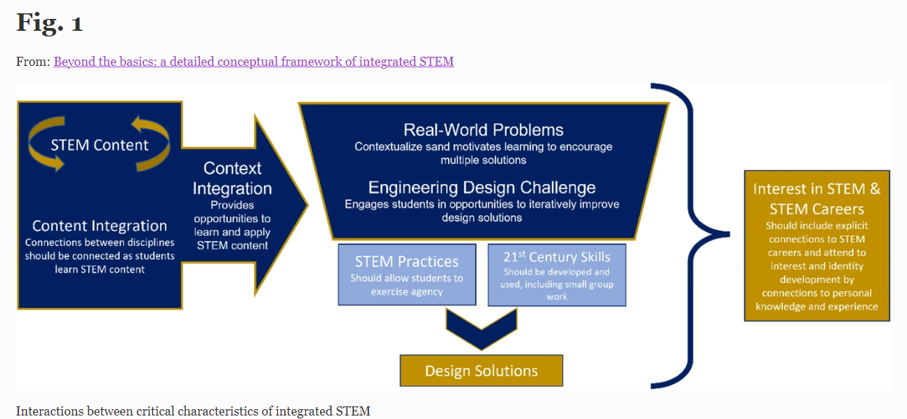
AAES Instructional Focus

Slide 12
AAES College & Career Opportunities
Students participating in AAES will have the opportunity to:
Earn DE (ESCC) & college credits (ODU)
Engage with regional aerospace Initiatives
Participate in a work-based learning experience
Develop an electronic portfolio
Gain job experience
Network with future employers
Earn industry certifications in aerospace-related fields

Slide 13
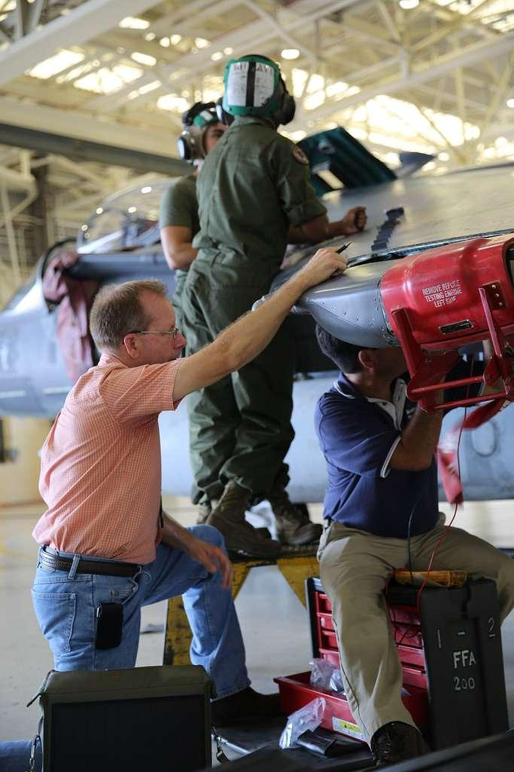
Business & Industry Partners
National Aeronautics and Space Administration (NASA) Wallops Flight Facility
Hampton Roads Workforce Council
The Nature Conservancy’s (TNC) Virginia Coast Reserve
Luminary Air Group
Virginia Space Grant Consortium
Hampton Roads Executive Roundtable
Sentinel Robotic Solutions
Amazon

Slide 14
Enrollment Projections
2024-2025 | 2025-2026 | 2026-2027 | 2028-2029 | 2029-2030
Start Up | 50 | 100 | 150 | 200

Slide 15
Teacher Preparation & Development
Preparing teacher candidates through rigorous, field-based residencies and apprenticeships
ODU Lab School Network PD Hub
Educator professional development through Virginia Space Grant Consortium

Slide 16
Research: Optimizing Impact
Researcher-practitioner partnerships among ODU faculty, ESCC faculty, Divisions, and Lab School staff
  Design-based research will emphasize data-informed decision making
Evidence-based models of teacher professional development
  Professional learning communities will focus on aerospace studies and integration with aerospace ecosystem
  Action research and lesson study will promote learning for pre-service teachers
Exploring opportunities for innovative scheduling
Studying innovative learning design
Evaluation: Establishing a Model
To what extent are the Lab School components being implemented as planned?
How are key stakeholders (e.g., students, parents, teachers, faculty) impacted by the Lab School?
In what ways can the Lab School’s sustainability strategies can serve as a model for others?
Collaboration with the ODU Lab School Network - schools, partners, broader lab school ecosystem

Slide 17
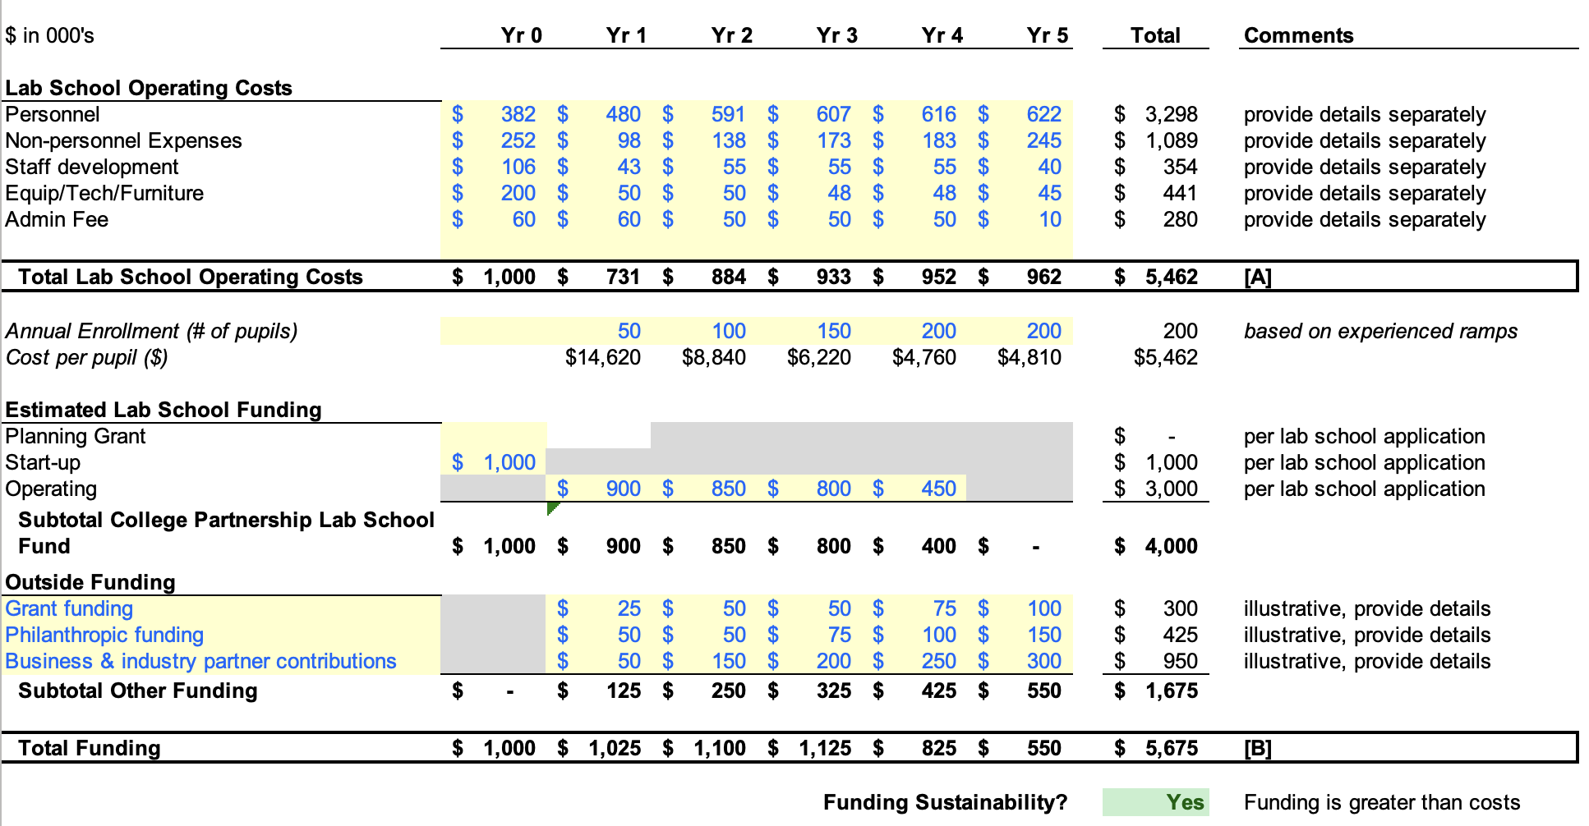

Slide 18
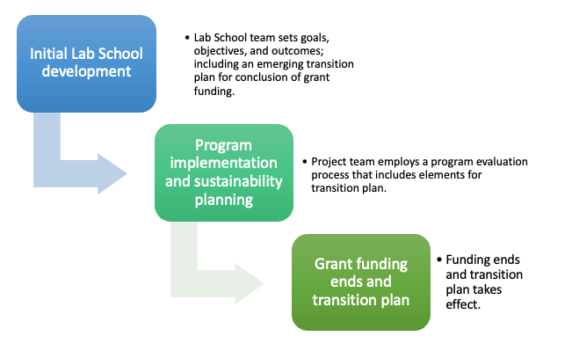
Sustainability Plan
Braided sustainability approach leveraging our Aerospace & STEM Regional Ecosystem
Grants
Development
Fundraising
Partnership position base funding
Institutional commitment

Slide 19
The Aerospace Academy of the Eastern Shore
College Partnership Laboratory Schools
Standing Committee Meeting - June 10, 2024

