Slide 1
Young Scholars Academy
Presenters:
Norfolk State University
Portsmouth Public Schools
Norfolk Public Schools
Virginia Department of Education
Lab School Standing Committee
June 10, 2024

Slide 2
Why Young Scholars Academy Lab School?
Proposes an innovative model that will...
Enhance early literacy skills by integrating knowledge of science, technology, arts, engineering, and mathematics (STEAM).
Encourage pursuits of curiosity through critical thinking and problem-solving skills.
Promote connections between STEAM and the real-world.
Goals:
Provide early learners with the foundational literacy skills necessary to engage in classroom instruction.
Teach critical thinking skills by utilizing a STEAM curriculum as the basis access to gifted education.
Engage families as partners by providing them with tools to support early learners at home.
CEO of Keithston Company

Slide 3
Young Scholars Academy Mission
Our mission is to:
Nurture a passion for reading and science, technology, engineering, art, and mathematics (STEAM).
Address the needs of underserved and low-socioeconomic populations by emphasizing early literacy through STEAM exposure.
Stimulate each student's innate abilities through critical thinking and experiential learning.
Collaborate in research for developmentally appropriate and culturally relevant instructional delivery practices.

Slide 4
Young Scholars Academy Vision
The vision of the Young Scholars Academy is to embrace the curiosity of young learners and foster a love of reading, learning, exploration, and collaboration relating to the STEAM fields.

Slide 5
Young Scholars Academy Instructional Focus
Supports literacy instruction to promote a natural curiosity.
Focuses on the integration of STEAM into classroom instruction.
Incorporates learning centers and experiential learning for real-world connections.
Provides teacher education candidates with a space to explore how learning occurs and how learners construct knowledge and acquire skills.
Engages future teacher education scholars in the work of building a safe, positive learning climate of openness, mutual respect, support, and inquiry.

Slide 6
A Day in the Life of A Young Scholars Academy Student
Young Scholars' Sample Schedule
8:30-9:15 am | Arrival and Morning Meetings
9:15-9:45 am | Whole Group – Language Comprehension
9:45-10:15 am | Whole Group - Phonics
10:15-11:15 am | Small Group with Reading Interventionist/Tutors
11:15-12:15 pm | Lunch and Recess
12:15-12:45 pm | Whole Group Writing
12:45-2:00 pm | Mathematics and Science Mini lesson Guided Practice w/experiential learning Small Group Wrap-up
2:00-2:45 pm | Social Studies
2:45-3:30 pm | Specials/Encores (Physical Education, Technology Lab, Art, Music, Media Center, Student Clubs)
3:30-4:00 pm | Daily Review, Exit Ticket, Prepare for Dismissal

Slide 7
Instructional Focus: STEAM
From: STREAMin³ CURRICULUM MODEL
OUTCOME
Creation and implementation of STEAM lessons that are grounded in inquiry, problem-solving, and process-based learning.
From: Stemming on STEM: A STEM Education Framework for Students with Disabilities

Slide 8
Instructional Focus: Core Skills
From: STREAMin³ CURRICULUM MODEL
Connections:
By combining the Core Skills and the Virginia's 5 C's connections to develop each student's ability to successfully learn and respond.
VDOE 5 Cs

Slide 9
Enrollment Projections
Year 1
30 students
Year 2
60 students
Year 3
120 students
Year 4
120 students

Slide 10
Impact for Pre-K3 – 2nd Grade Pre-service Teachers
Developing a Highly Qualified Teacher
Increased content knowledge and ongoing field experience
Enhanced instructional delivery methods, assessment skills, and classroom management techniques
Continuous engagement in action research to maximize learner success

Slide 11
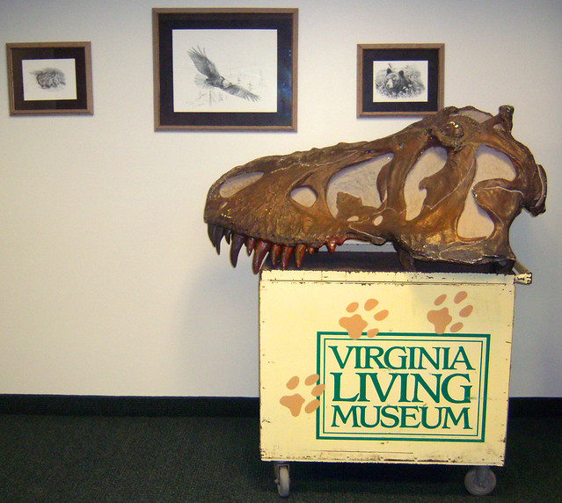
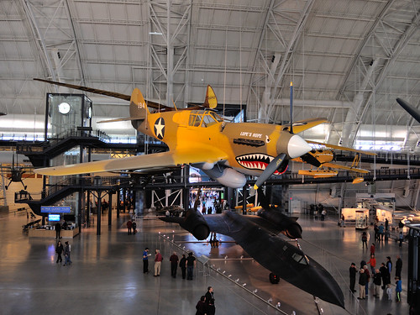
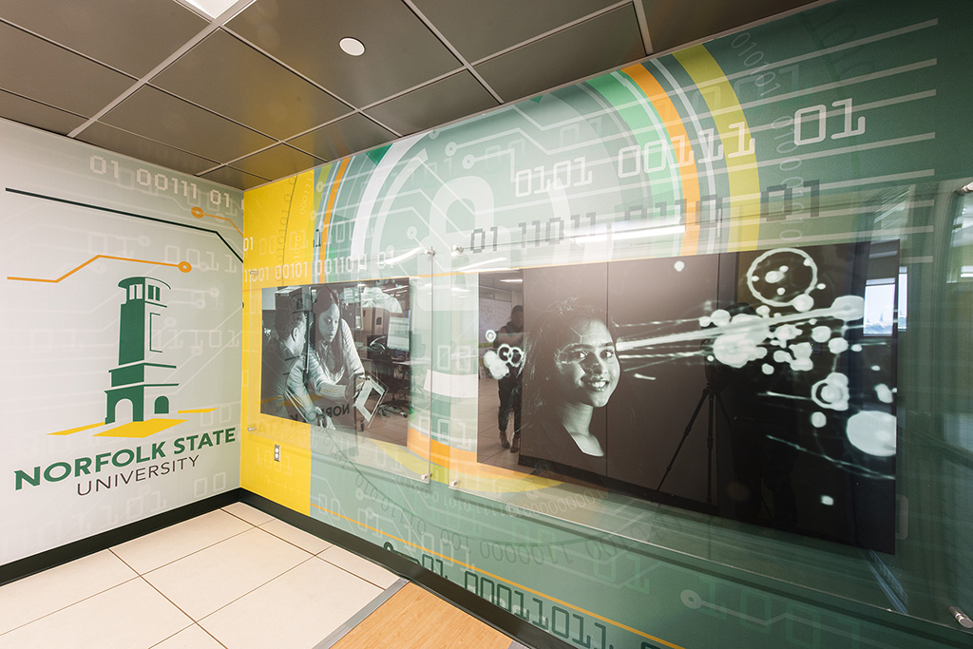
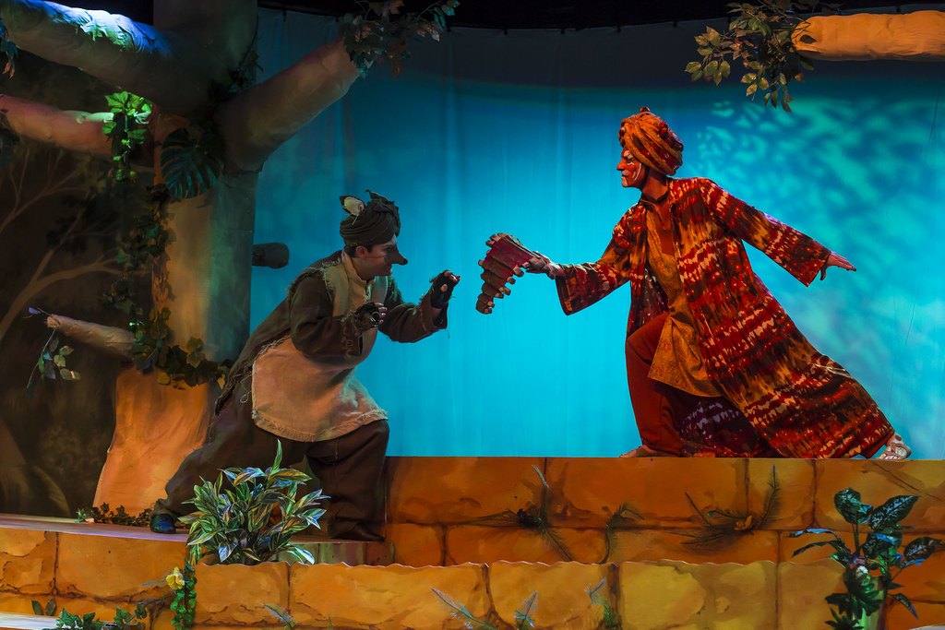
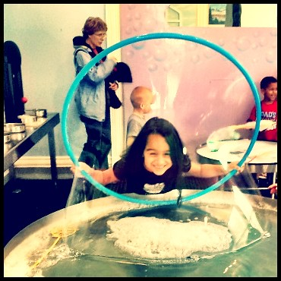
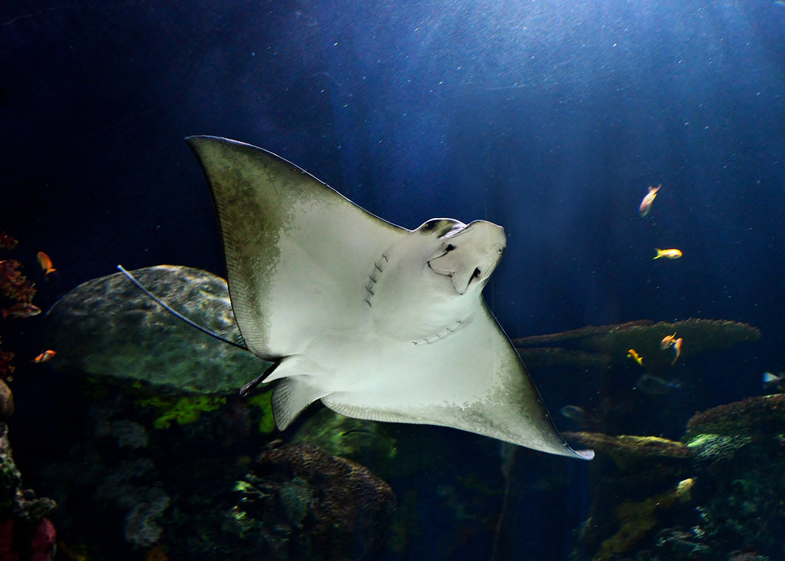
Partners and Potential Partners
Virginia Living Museum
Virginia Air & Space Center
NSU Cybersecurity Complex
The Hurrah Players
Children's Museum of Virginia
The Virginia Aquarium

Slide 12
Budget
 | Year 1 Baseline and Curriculum Development | Year 2 | Year 3 | Year 4
Academy Administrator | $25,000 | $25,000 | $25,000 | $25,000
Academy Research Director | $25,000 | $25,000 | $25,000 | $25,000
Reading Interventionist (NSU Campus) | $8,000 | $8,000 | $8,000 | $8,000
Reading Interventionists (6) | $60,000 x 6= $360,000 | $60,000 x 6= $360,000 | $60,000 x 6= $360,000 | $60,000 x 6= $360,000
Kindergarten Educator Curriculum Developer | $5,000 | $5,000 | $5,000 | $5,000
1st Grade Educator Curriculum Developer | $5,000 | $5,000 | $5,000 | $5,000
2nd Grade Educator Curriculum Developer | $5,000 | $5,000 | $5,000 | $5,000
Parent Academy Coordinator | $30,000 | $30,000 | $30,000 | $30,000
Experiential Learning Coordinator | $45,000 | $45,000 | $45,000 | $45,000
Gifted Education Consultant (NSU Campus) | $8,000 | $5,000 | $5,000 | $5,000
STEM Education Consultant (NSU Campus) | $8,000 | $5,000 | $5,000 | $5,000
Literacy Screeners | $30,000 | $30,000 | $30,000 | $30,000
Curriculum Developers: Early Childhood, STEM, Gifted, Reading, Art | $25,000
Elementary Educator (Kindergarten) |  | $50,000 | $50,000 | $50,000
Materials & Supplies | $100,000 | $90,000 | $90,000 | $90,000
Research & Assessment | $25,000 | $25,000 | $25,000 | $25,000
Marketing | $12,000 | $15,000 | $15,000 | $15,000
Professional Development | $70,000 | $80,000 | $80,000 | $80,000
Experiential Learning Opportunities | $100,000 | $130,000 | $130,000 | $130,000
Facilities/Renovations | $120,000
Furniture/Technology/Equipment | $80,000
Subtotal | $1,086,000 | $938,000 | $938,000 | $938,000
Fringe Costs | $46,320 | $47,840 | $47,840 | $47,840
Benefits Cost for Full-Time positions @ 30% | $153,000 | $136,500 | $136,500 | $136,500
Total | $1,285,320 | $1,122,340 | $1,122,340 | $1,122,340

Slide 13
Sustainability Plan
Revenue | Year 1 | Year 2 | Year 3 | Year 4 | Year 5 and Beyond
Lab School Grant Funding | $1,000,000 | $835,320 | $900,000 | $900,000
Existing NSU E & G Funding | $215,320 | $232,407 | $237,251 | $237,251 | $310,000
Reallocated PPS Funding |  |  |  |  | $300,000
Reallocated NPS Funding |  |  |  |  | $300,000
Existing Grants: CCAMPIS | $70,000 | $70,000 | $70,000 | $70,000
Other Grants |  |  |  |  | $200,000
Partnerships and Donors |  |  |  |  | $100,000
Total | $1,285,320 | $1,122,340 | $1,122,340 | $1,122,340 | $1,210,000

Slide 14
The Young Scholars Academy
A Lab School Partnership of
Norfolk State University, Portsmouth Public Schools, and Norfolk Public Schools
Thank You!

