Slide 1
Virtual Learning Advisory Committee (VLAC) Meeting
Tuesday, April 30, 2024
10:30AM-12:00PM
Department of Aging & Rehabilitative Services Building
Pursuant to the 2021 Appropriation Act language – SB7001 and meeting by electronic means set forth in subsection C of § 2.2-3708.2 of the Code of Virginia.

Slide 2
Welcome
Welcome
Opening Remarks
Educational Technology Plan
Virtual Learning
Virtual Virginia
Computer Science
Instructional Technology
Dr. Mervin B. Daugherty, Region I, Chesterfield County
Dr. Raymond L. Haynes, Region II, Hampton City Schools
Dr. Bernard Trey Davis, Region III, Richmond County Public Schools
Dr. Kevin Newman, Region IV, Manassas City Public Schools
Dr. Garett Smith, Region V, Staunton Public Schools (Mr. Tom Lundquist*)
Mr. C. Dwayne Huff, Region VI, Craig County Schools
Mr. Robert Graham, Region VII, Pulaski County Public Schools (Mr. Lincoln Whitaker*)
Mr. Robbie W. Mason, Region VIII, Charlotte County Public Schools (Ms. Karen Osborne*)
Mr. Rodney Jordan, Past President, Virginia School Boards Association
Ms. Amy Griffin, Executive Director, Virginia Association of School Superintendents
Dr. Mitzi Fehl-Seward, Vice President of Digital Learning, WHRO
Dr. Brian Mott, Executive Director, Virtual VA (Non-voting ex officio member)

Slide 3
Opening Remarks
Dr. Michelle Wallace,
Assistant Superintendent of Instruction

Slide 4

1: Access:
Strengthen schools and communities with a safe, secure, and robust technology infrastructure to support access to all educators, students, leaders, and families.
2. Use:
Promote leadership that supports learning experiences for all students that integrate innovative instructional practices by educators using technology and accessible instructional materials.
3. Design
Implement high expectations for every learner using educational technologies explicitly designed into rigorous, best-in-class standards of learning.
1: Access:
Strengthen schools and communities with a safe, secure, and robust technology infrastructure to support access to all educators, students, leaders, and families.
Virginia Educational Technology Plan

Slide 5
1.2. Extend broadband services to unserved and underserved areas.
Commonwealth Connection
Commonwealth Connection is a powerful tool developed by Department of Housing and Community Development (DHCD) and Virginia Tech that allows Virginians to discover broadband in their neighborhood and filter specific details.
All broadband information on Commonwealth Connection was provided by broadband providers in Virginia to help in the effort to get every Virginian fast and reliable access to the internet.
Residents, government representatives, and internet service providers, can use this tool to explore broadband throughout Virginia. This tool can help broadband providers and government representatives expand broadband for all Virginians.
The Virginia Telecommunication Initiative (VATI) extends broadband service to currently unserved areas. VATI prepares communities to build, utilize, and capitalize on telecommunications infrastructure with the goal of creating strong, competitive communities.
Community Anchor Institutions (CAI) consists of schools, government buildings, libraries, hospitals, colleges/universities, public safety, and other community organizations that assist vulnerable populations such as low-income, unemployed, and the elderly to get broadband access. One example is a library with free to use computers with broadband access.
Programs to Expand Access

Slide 6
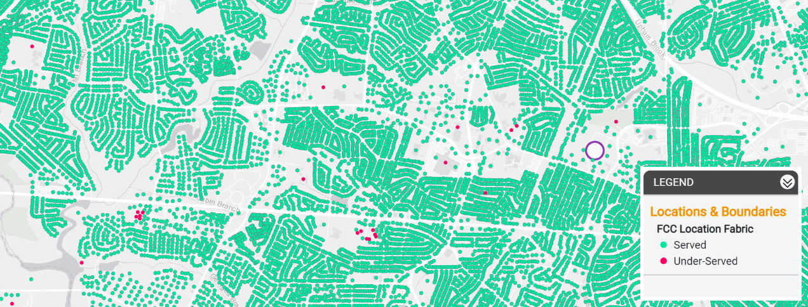
https://commonwealth-connection.com/
Notes:
a 911 address which has access to broadband. The red dots do not. Let’s take a few minutes to explore the map and look at your own addresses. FIVE MINUTE TIMER. I hope you have found our information on the Commonwealth Connection interesting and will share it with your communities. Now Reggie Fox, our virtual learning specialist, will lead us in a discussion about access.

Slide 7
Access Discussion
When we think about tenets of ACCESS, what are some opportunities that may be included in school division technology plans?
What action steps will you take to use the Commonwealth Connection?
What can the agency do to support virtual learning programs around ACCESS?

Slide 8

1: Access:
Strengthen schools and communities with a safe, secure, and robust technology infrastructure to support access to all educators, students, leaders, and families.
2. Use:
Promote leadership that supports learning experiences for all students that integrate innovative instructional practices by educators using technology and accessible instructional materials.
3. Design
Implement high expectations for every learner using educational technologies explicitly designed into rigorous, best-in-class standards of learning.
2. Use:
Promote leadership that supports learning experiences for all students that integrate innovative instructional practices by educators using technology and accessible instructional materials.
Virginia Educational Technology Plan

Slide 9
2.4. Leverage the power of virtual learning to enhance the availability, accessibility, and quality of online learning opportunities for students, educators, and other stakeholders.

Slide 10
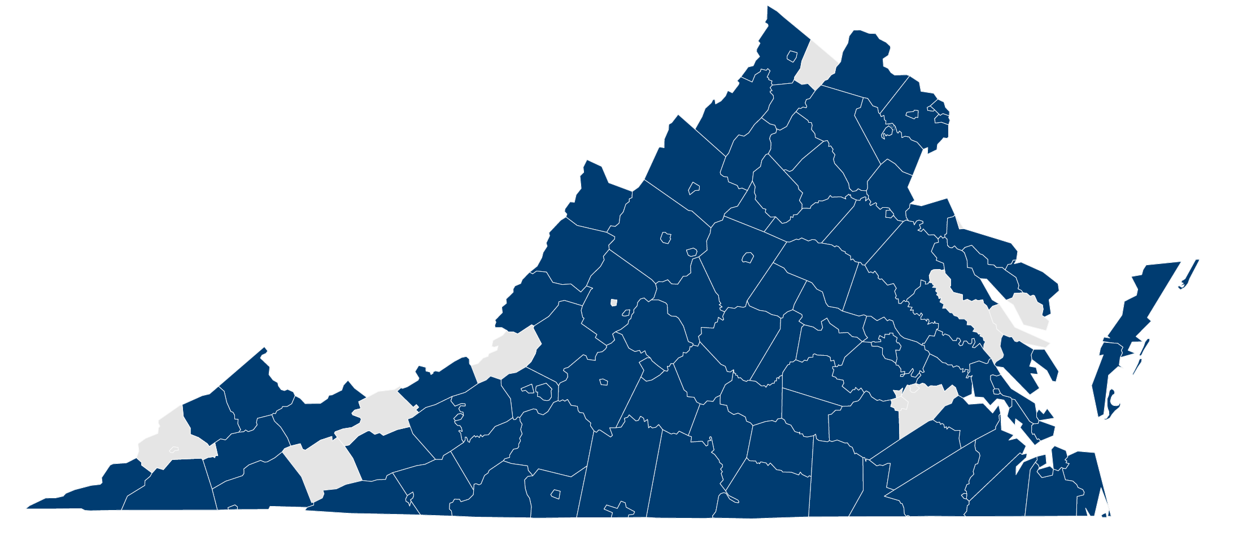
Statewide LMS
2.4.a. Provide a statewide learning management system (LMS) to support all educators and students in developing and accessing high quality and engaging content, multimedia, and communication.

Slide 11

Virtual Learning Programs
2.4. b. Expand the use of effective virtual learning programs (Virtual Virginia, multidivision online provider program, division-based virtual programs) to offer increased access to specialized curriculum and personalized, flexible instruction options to all students, regardless of geography or school division.

Slide 12
Multidivision Online Providers (MOP)
2024 MOP Submission Window (Jan. 1-Feb. 1)
24 Total MOP
One new MOP – Virtual Learning Academy (VLA)
68 Standards-based courses – new or revised
52 Elective courses
3 CTE courses

Slide 13
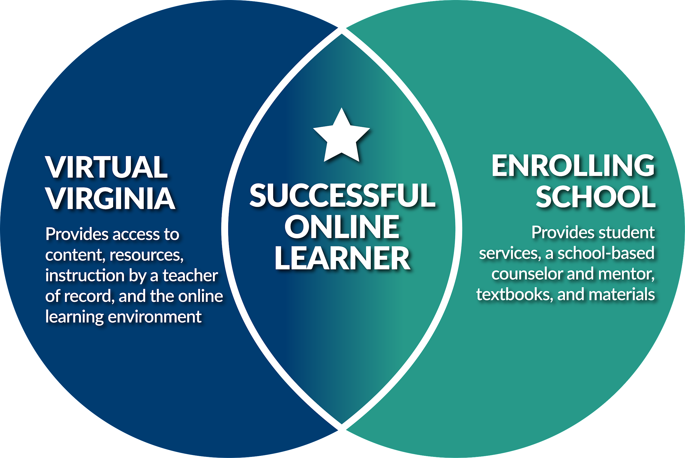
K–12 Instruction

Slide 14
Student Enrollment: Full-Time/Part-Time
Enrollment Table
Academic Year | Total Students | FT Online Students | %FT | PT Online Students | %PT
2023–2024* | 13,790 | 2,465 | 18% | 11,325 | 82%
2022-2023 | 14,162 | 1,866 | 13% | 12,296 | 87%
2021-2022 | 29,710 | 8,788 | 30% | 20,922 | 70%
*As of April 3, 2024

Slide 15
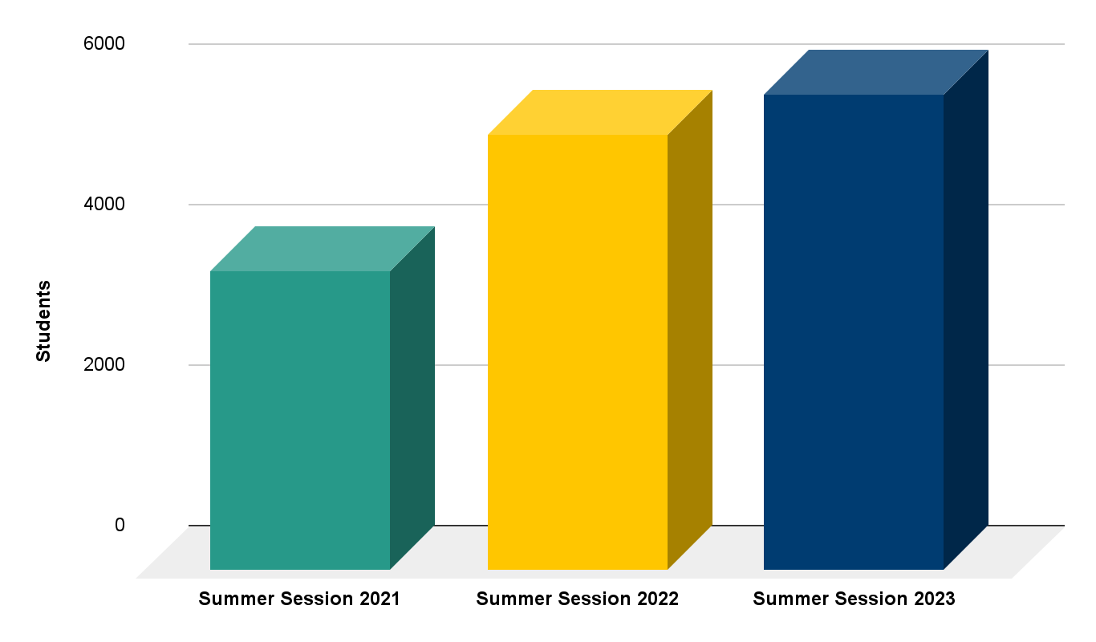
Summer Session Enrollment Summary
+9%

Slide 16

Professional Learning
2.4.c. Design effective, flexible virtual learning professional development on data-focused instructional strategies and resources maximizing every student’s learning experience and improving educational outcomes ( attendance, testing, grades, AP scores).

Slide 17

Professional Learning:
Spring Asynchronous Opportunity
Offered to all Virginia educators – 18 hours
Completers earn Certification Points and a Badge
Engaging and interactive content
What is Virtual Learning?
Engaging Successfully in a Virtual Environment
Communication, Collaboration, and Community
Online Engagement: Students, Families, and Community Stakeholders
Assessing Students
Digital Citizenship

Slide 18

Virtual Virginia Professional Learning Enrollment
Top 5 Opportunites
1. | Blended Learning Conference (2024)
2. | Statewide LMS Educator Credentials (Fall 2023)
3. | Statewide LMS Educator Credentials (Spring 2024)
4. | VDOE Teachers in Action (2024)
5. | Statewide LMS Technology Credentials (Spring 2024)
FY24 YTD
11,298 Enrollments as of April 2, 2024
VVAAS
Total number of educators enrolled | 795
New Educators in FY24 | 97

Slide 19
Use Discussion
In the USE section of the Ed Tech Plan, we leverage the power of Virtual Learning to provide online experiences for students and educators.
What are ways that divisions are implementing virtual learning in instructional programs?
How would you compare the quality of professional learning for educators in virtual learning settings to those in traditional settings?
What improvements should be made to our Virtual Learning experiences for students and educators?
Discuss any potential supports that VDOE may offer to enhance virtual learning USE throughout the Commonwealth.

Slide 20

1: Access:
Strengthen schools and communities with a safe, secure, and robust technology infrastructure to support access to all educators, students, leaders, and families.
2. Use:
Promote leadership that supports learning experiences for all students that integrate innovative instructional practices by educators using technology and accessible instructional materials.
3. Design
Implement high expectations for every learner using educational technologies explicitly designed into rigorous, best-in-class standards of learning.
3. Design
Implement high expectations for every learner using educational technologies explicitly designed into rigorous, best-in-class standards of learning.
Virginia Educational Technology Plan

Slide 21

3. Design
Implement high expectations for every learner using educational technologies explicitly designed into rigorous, best-in-class standards of learning.
3.3 Leverage technology for students to take an active role in demonstrating competency in their learning goals, building networks to personalize education, and progress towards workplace readiness.
3.4 Support for division leaders for resources to sustain technology initiatives and goals including those designed to support personalized learning environments.

Slide 22
2024 Computer Science Revisions
The Board of Education shall establish a regular schedule, in a manner it deems appropriate, for the review, and revision as may be necessary, of the Standards of Learning in all subject areas. Such review of each subject area shall occur at least once every seven years. Code of Virginia § 22.1-253.13:1.
The 2024 Computer Science Revisions will allow students to take an active role in demonstrating competency, personalize their education, and progress towards workplace readiness.

Slide 23
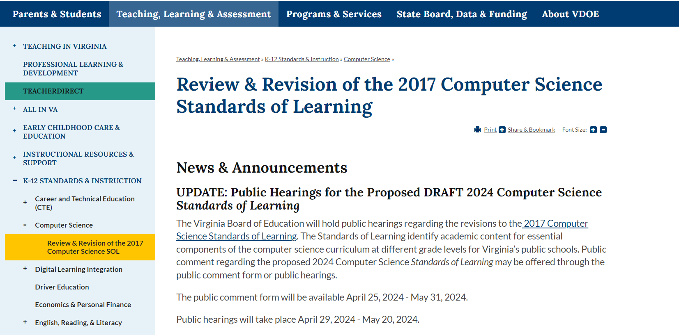
proposed draft of the 2024 computer science standards of Learning?

Slide 24
Proposed DRAFT 2024 Computer Science Standards
Activity

Slide 25
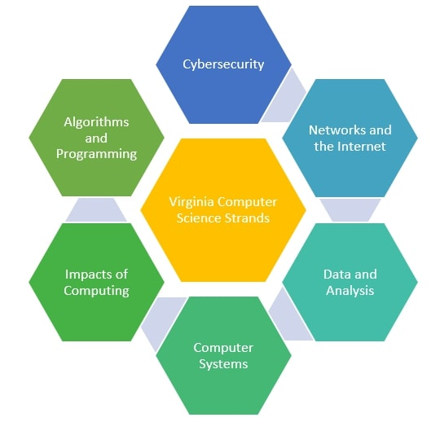
Computer Science Standards
Virginia Computer Science Standards:
Organized into six (6) content strands:
Algorithms and Programming
Computing Systems
Cybersecurity
Data and Analysis
Impacts of Computing
Networks and the Internet

Slide 26

Student Outcomes Activity
Activity requires 3 groups: Elementary (K-5), Middle School (6-8 and Middle School Elective), and High School (CSF, CSP, and PRG)
Each group will review the Proposed DRAFT standards and identify FIVE (5) important concepts and skills addressed in the standards and provide feedback on relevancy - 10 minutes
Group Discussion – 5 minutes

Slide 27
CS Standards Reflections & Feedback
What are initial thoughts concerning the proposed DRAFT 2024 Computer Science Standards of Learning?
What changes or additions should be considered for inclusion to meet the needs of all stakeholders and improve student outcomes?
What additional supports and/or resources could the VDOE provide to better inform parents and community members about the computer science content included in the Computer Science Standards of Learning?
Reflect upon these questions and the standards themselves and provide feedback using the Public Comment Form by May 31, 2024.

Slide 28
3. Design
Implement high expectations for every learner using educational technologies explicitly designed into rigorous, best-in-class standards of learning.
3.1 Develop and maintain instructionally sound implementation of all educational technology resources and systems.
3.2 Implement a framework for education technology integration for all students.

Slide 29
Unified, Direct Access Approach
Instructional Resources
Professional Learning
Public Information

Slide 30
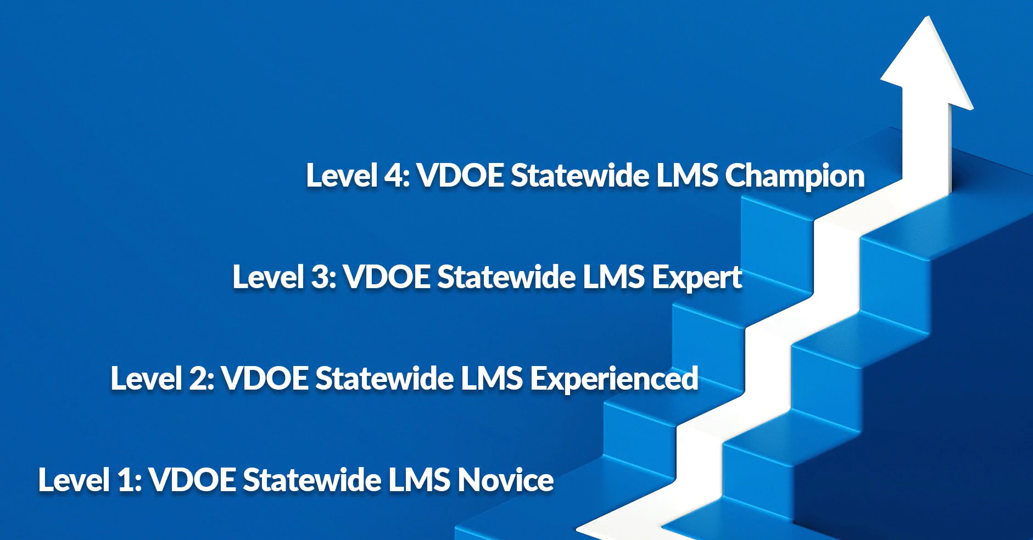
Internal Workforce Development
Leveled, structured course
  Multiple entry points
Provides choice and flexibility
  Facilitated
  Asynchronous
Includes experiential learning
  Resource Hub
  Course
  Virtual Conference Plan
Issues a certificate/badge certifying successful completion

Slide 31

BlueRidge PBS
GoOpenVA
Building a collection of resources of the podcast videos with resources to share with educators related to the episodes
Hosting a 12-week summer webinar series with supporting Canvas course
Virtual Virginia
Created the podcast in partnership to elevate effective practices in the classroom utilizing instructional design and technology

Slide 32
Internet Safety
2.3 Support students, educators, leaders, and families with resources for the purpose of advancing the goal of safe use of media and technology.
a. Develop and recommend a model policy to beter support the internet safety of all students and educators.
b. Model instructonal prac􀆟ces and instruc􀆟onal content on the safe use of media and technology by students and educators.
c. Integrate resources related to successful instruc􀆟onal prac􀆟ces, curricula, and other educator resources for the safe use of media and technology by students and educators.
Model Policy Concerning Internet Safety
Internet Safety Advisory Council Resource Hub in GoOpenVA
Internet Safety Advisory Council Statute

Slide 33
Design
How is your organization integrating technology in creative and innovate ways?
What operations support the explicit design of instructional technology systems into your organization?
What can the agency do to support initiatives to DESIGN high quality experiences to support the Educational Technology Plan?

Slide 34
1: Access:
Strengthen schools and communities with a safe, secure, and robust technology infrastructure to support access to all educators, students, leaders, and families.
2. Use:
Promote leadership that supports learning experiences for all students that integrate innovative instructional practices by educators using technology and accessible instructional materials.
3. Design
Implement high expectations for every learner using educational technologies explicitly designed into rigorous, best-in-class standards of learning.
Virginia Educational Technology Plan

Slide 35
Initial Data from the Speak Up Survey
Administrators & Teachers
85% report having access and use of virtual learning through school division operated programs, Virtual VA and MOP.
89% report using virtual learning opportunities for professional growth.
83% stated ways to measure student engagement through student feedback, making connections with content, and active learning.
Students
90% have access to and use a variety of devices completing school work.
80% report using technology to search for information, complete projects and take quizzes/tests.
65% face challenges when using technology with slow Internet connectivity and websites needed for instructional purposes are blocked.
Administrators, teachers, and students
The effective use of technology helps the user to be in control of his/her own learning, fosters deep learning, and increases engagement.
The most important skills to acquire by integrating technology are critical thinking, problem solving, and communication.

Slide 36

Speak Up Survey
The survey closes on May 31.
https://projecttomorrow.questionpro.com/VAregistration23

Slide 37
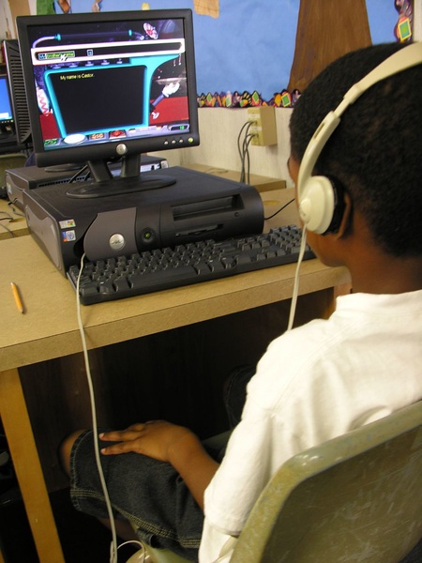
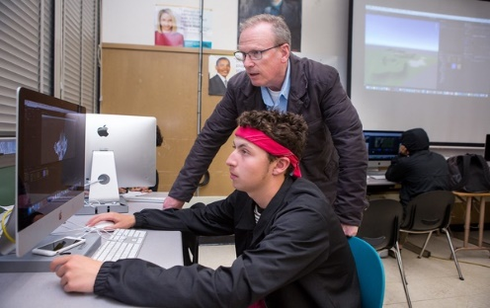

Questions & Collaboration
  Next meeting is November 2024.
  Email any questions or comments
  to VirtualPrograms@doe.virginia.gov by May 3rd, 2024.
Thank you for your commitment to virtual learning!

