Slide 1
Music and Early Literacy

Slide 2
“Integration of multiple modes of communication and expression can enhance or transform the meaning of the work beyond illustration or decoration” - National Council for Teachers of English (NCTE)

Slide 3
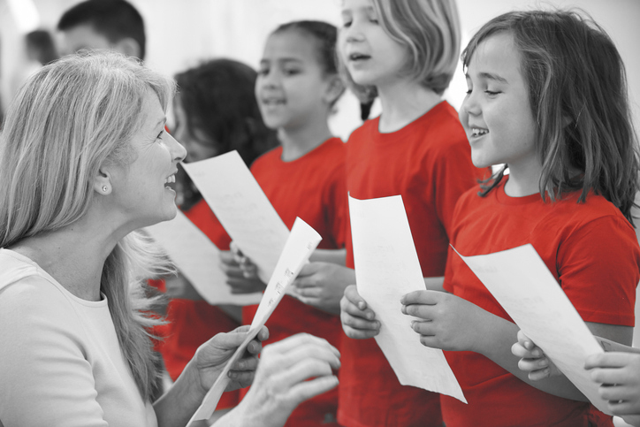
Music and Literacy Skills
Phonological awareness
Letter knowledge and print awareness
Word knowledge and vocabulary needs application
Comprehension with text and music
Improved reading skills, can also improve writing skills

Slide 4
VDOE Standards of Learning Correlations
2020 Fine Arts Standards of Learning Strand: Creative Process | 2017 English Standards of Learning Strand: Communication and Multimodal Literacies
K.1 The student will improvise and compose music. a) Improvise simple movement. b) Improvise melodic or rhythmic patterns. c) Improvise using instruments, voice, and music to enhance stories and poems. 1.1 The student will improvise and compose music. a) Improvise vocal responses to given melodic questions. b) Improvise body percussion. c) Improvise to enhance stories, songs, and poems. d) Compose simple rhythmic patterns represented by a variety of notational systems. 2.1 The student will improvise and compose music. a) Improvise simple rhythmic question-and-answer phrases. b) Improvise accompaniments, including ostinatos. c) Improvise to enhance stories, songs, and poems. d) Compose simple pentatonic melodies represented by a variety of notational systems. | K.2 The student will demonstrate growth in oral, early literacy skills. a) Listen and respond to a variety of text and media. b) Participate in a variety of oral language activities including choral and echo speaking and recitation. c) Tell stories orally. d) Participate in creative dramatics. 1.2 The student will demonstrate growth in oral early literacy skills. a) Listen and respond to a variety of print and media materials. b) Tell and retell stories and events in sequential order. c) Participate in a variety of oral language activities, including choral speaking and recitation. d) Participate in creative dramatics. 2.2 The student will demonstrate an understanding of oral early literacy skills. a) Create oral stories to share with others. b) Create and participate in oral dramatic activities. c) Participate in a variety of oral language activities, including choral speaking and recitation.

Slide 5
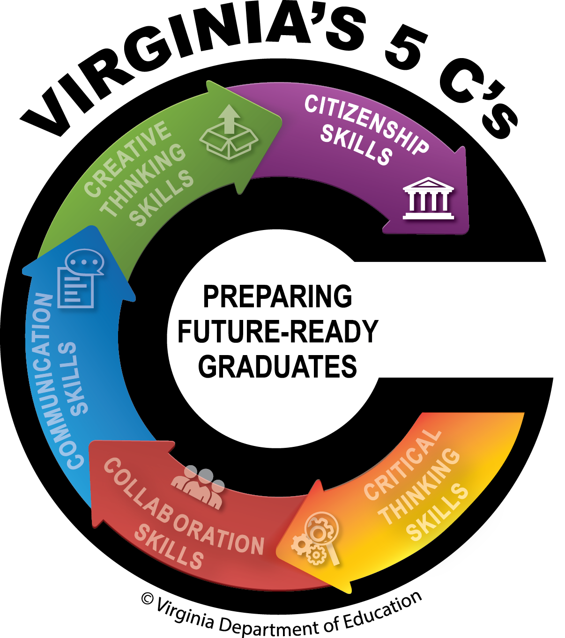
Music and Student Learning
teaches concentration and communication
develops listening and speech skills
actively engages students
inspires student imagination
allows students to express themselves
connects learning to students interests
connects students to their personal experiences and the world around them

Slide 6
Music and Literacy at School and at Home

Slide 7
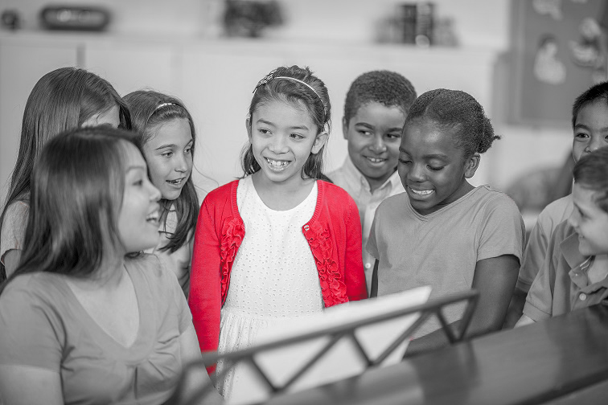
Listen, Sing, Play and Dance
Fun and engaging
Expand vocabulary
Explore music from a variety of genres and cultures
Ask questions about the lyrics and the music

Slide 8
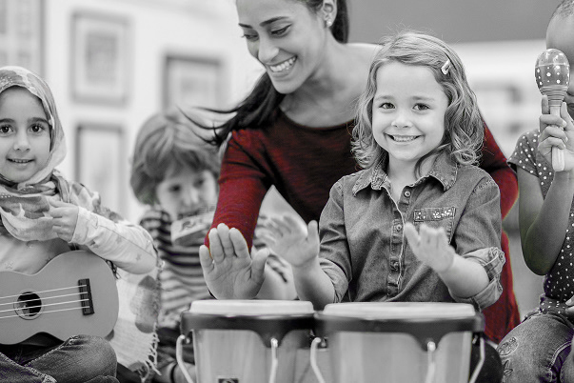
Steady Beat and Syllables
Tap/Clap/Stomp
Create DIY Music Instruments
Cups
Pots and Pans
Tupperware
Shakers

Slide 9
Rhymes and Vocabulary
Songs and Repetition
Songs for Comprehension
Memorize important skills
Letters
Parts of Speech
Spelling

Slide 10
Enhance Stories with Music
Improvise: add sound effects to the story
Improvise: add a melody to the words in the story
Compose and Arrange: compose a song to accompany the story, or that is inspired by the story.

Slide 11
Resources
Music and Literacy - National Council of Teachers of English (NCTE)
The Center for Arts Education
The Kennedy Center: Education
Wolf Trap | Institute for Early Learning Through the Arts

