Slide 1
Boost Your Child’s Reading through Phonological Awareness and Phonemic Awareness
Family Night
Kim Bausum-Brown

Slide 2
What is Phonological Awareness and Phonemic Awareness
Phonological Awareness
...the ability to hear and manipulate the sounds in spoken words and the understanding that spoken words and syllables are made up of sequences of speech sounds.
Phonemic Awareness
...the ability to hear and manipulate the individual sounds (phonemes) within words in spoken language. Phonemic awareness is a subset of phonological awareness.

Slide 3
What the research says…..
Ehri, 2001
PA is critical for learning to read any alphabetic writing system
Torgeson, 1998, 2004
Even before a student learns to read, we can predict with a high level of accuracy whether that student will be a good reader or a poor reader by the end of third grade and beyond using PA scores.
NHCHD,2000
Instruction in speech-sound awareness reduces and alleviates reading and spelling difficulties.
Cassar et al., 2005
…….at least 80% of all poor readers are estimated to demonstrate a weakness in phonological awareness or phonological memory. Readers with phonological processing weaknesses also tend to be the poorest spellers.

Slide 4
Research
“One of the best predictors of how well students will learn to read during their first two years of school is phonemic awareness … Those with poor phonemic awareness skills at the end of their kindergarten year are more likely to become poor readers than those with well-developed phonemic awareness skills.”
Vaughn, S., & Linan-Thompson, S. (2004). Research-based methods of reading instruction, grades K3. Alexandria, VA: ASCD, p. 9.

Slide 5
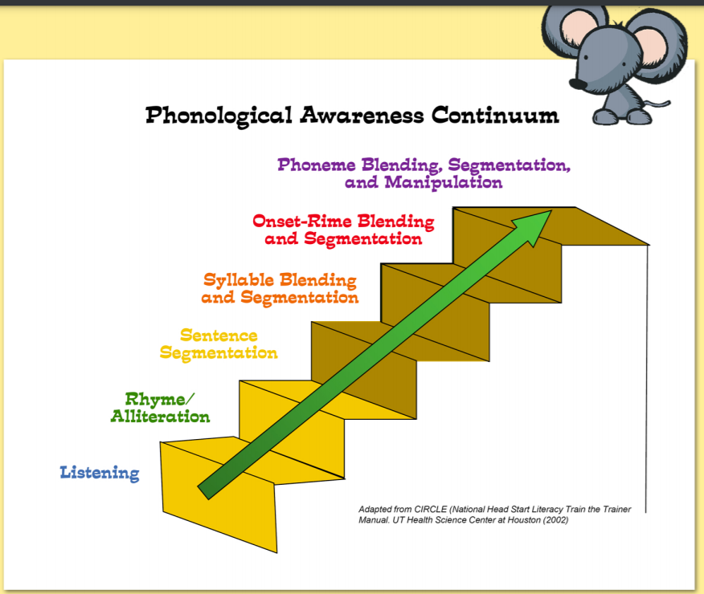
PA/Phonemic Awareness Continuum

Slide 6

Targeting Skills
Phonological Awareness Skills
Playing with whole-word sounds
Rhyming
Alliteration
Sentence segmentation
Playing with compound words
Playing with syllables
Playing with onset-rime
Phonemic Awareness
Playing with phonemes
(phonemic awareness)

Slide 7
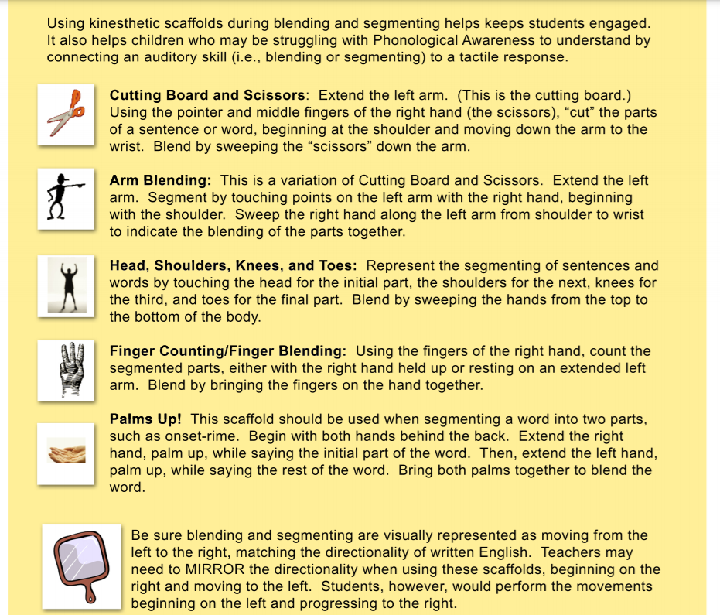
Kinesthetic Scaffolds

Slide 8

Phonological Awareness: PK and K
Playing with whole-word sounds
Rhyming
Alliteration
Sentence segmentation
Playing with compound words
Playing with syllables
Playing with onset-rime

Slide 9
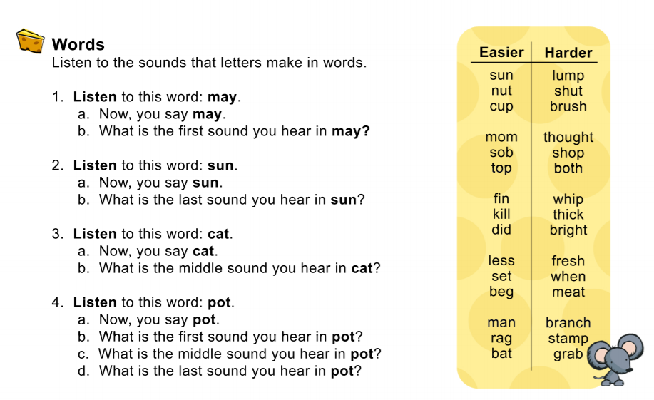
Sound that Letters Make in Words

Slide 10
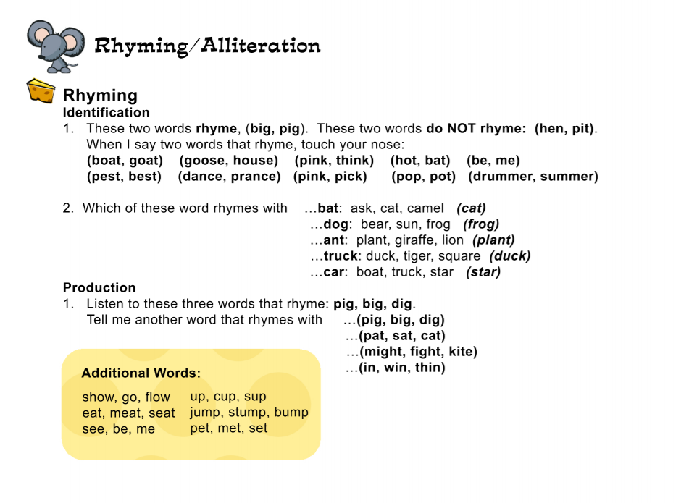
Rhyming/Alliteration

Slide 11
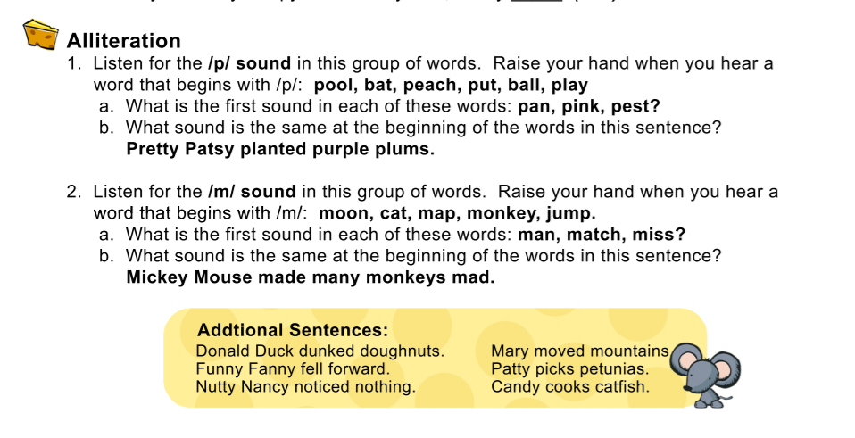
Alliteration

Slide 12
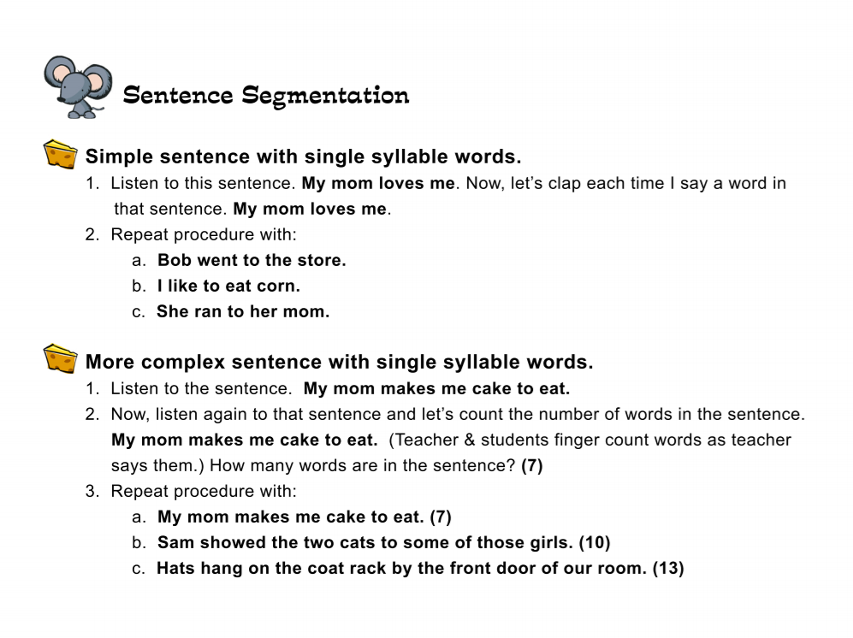
Sentence Segmentation

Slide 13
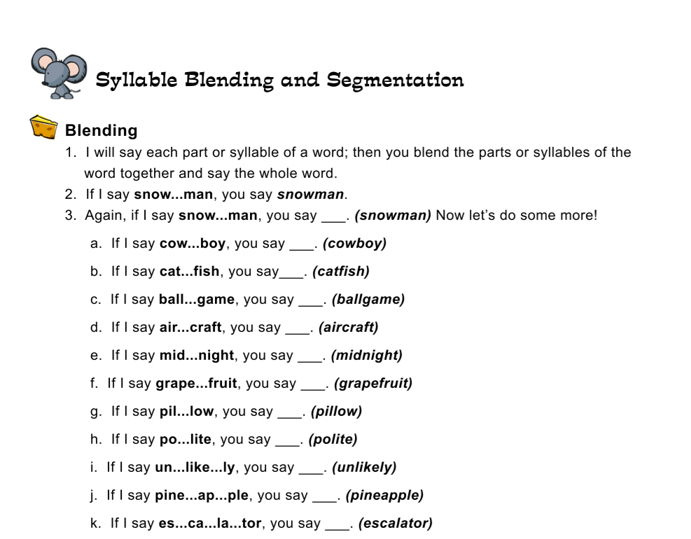
Syllable Blending and Segmentation

Slide 14
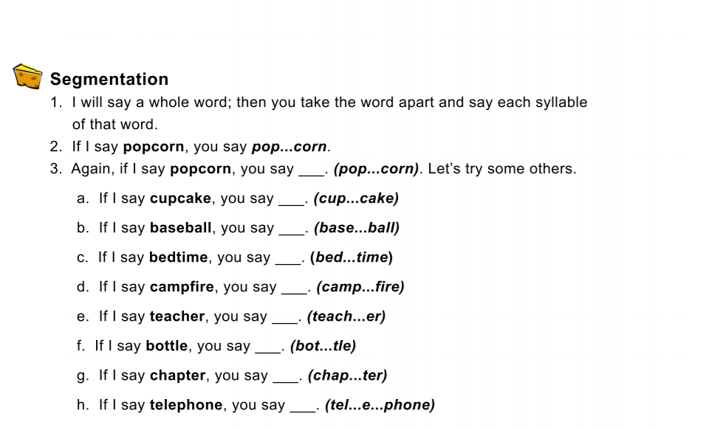
Segmentation

Slide 15
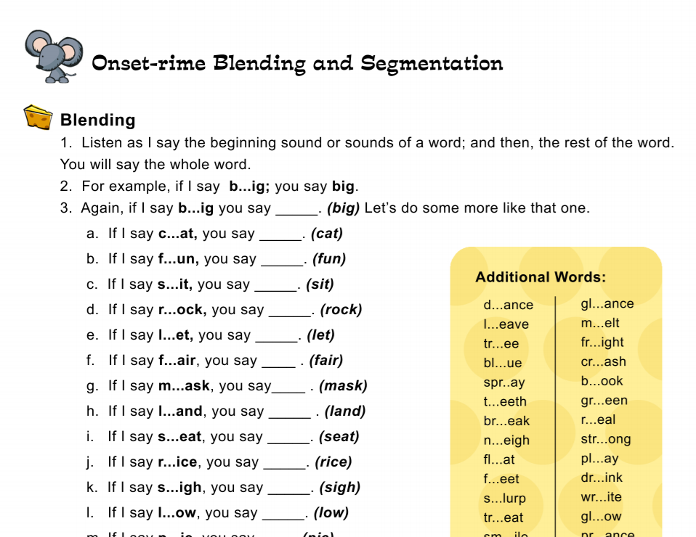
Onset-rime Blending and Segmentation

Slide 16
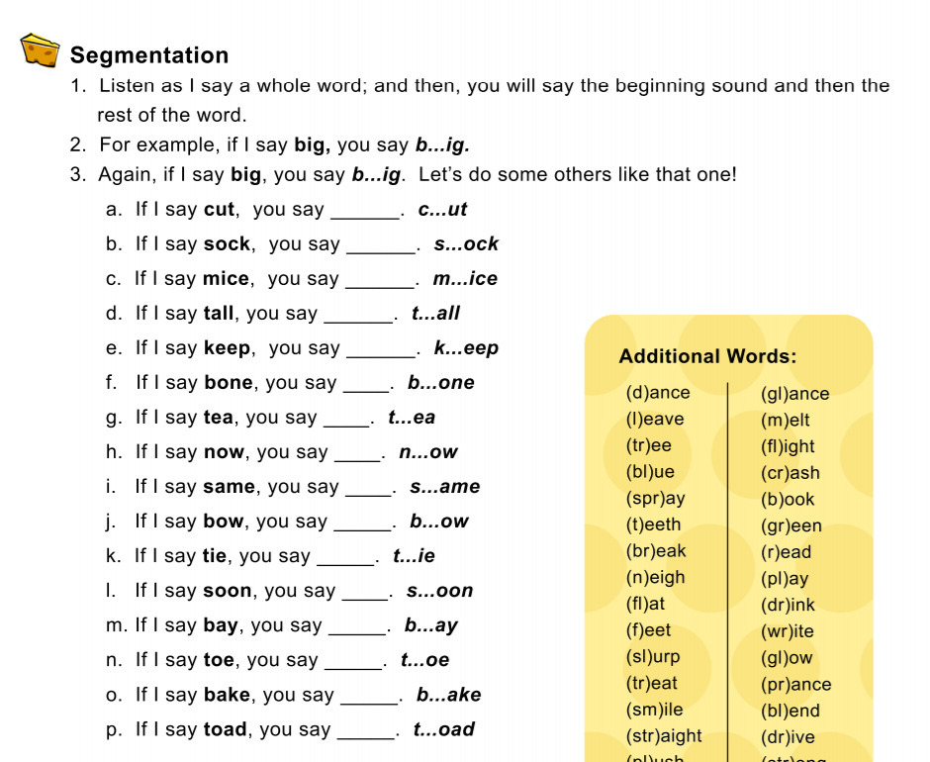
Segmentation Continued

Slide 17

Phonemic Awareness: K-2
Phoneme identification
Phoneme segmenting
Phoneme blending
Phoneme manipulation

Slide 18
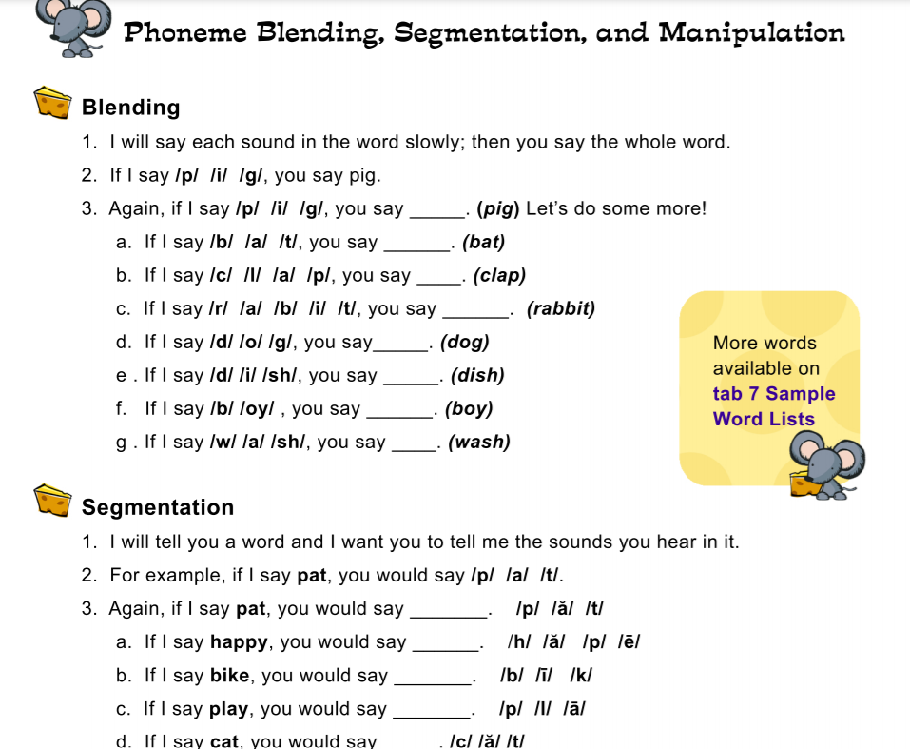
Phoneme Blending, Segmentation, and Manipulation

Slide 19
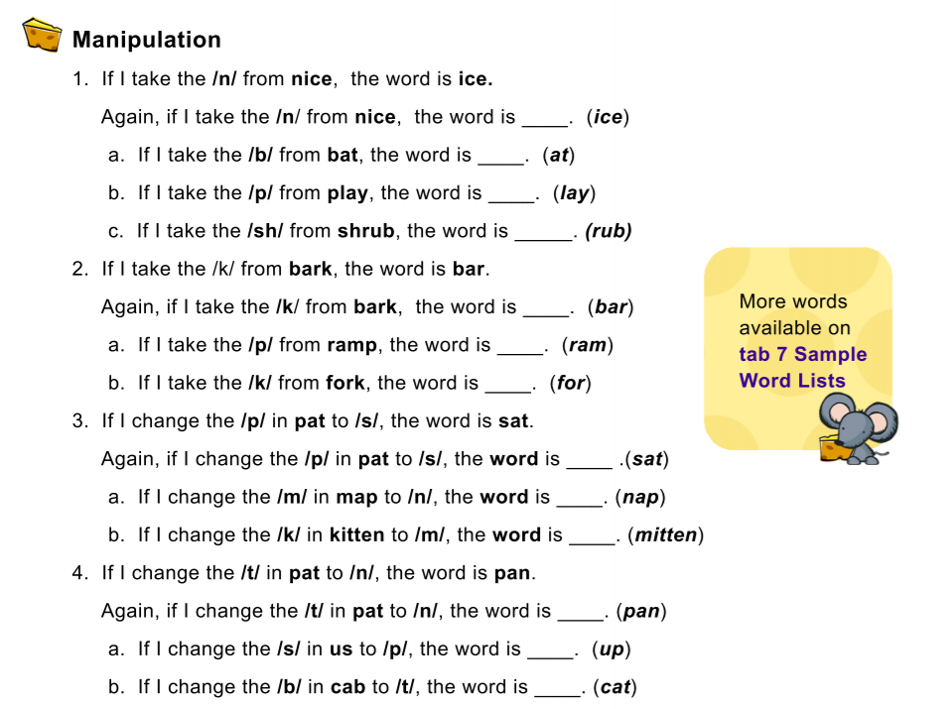
Manipulation

Slide 20
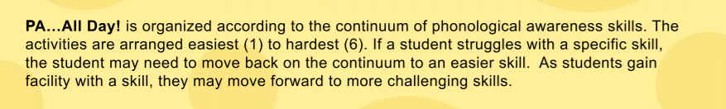
PA….ALL DAY!

Slide 21
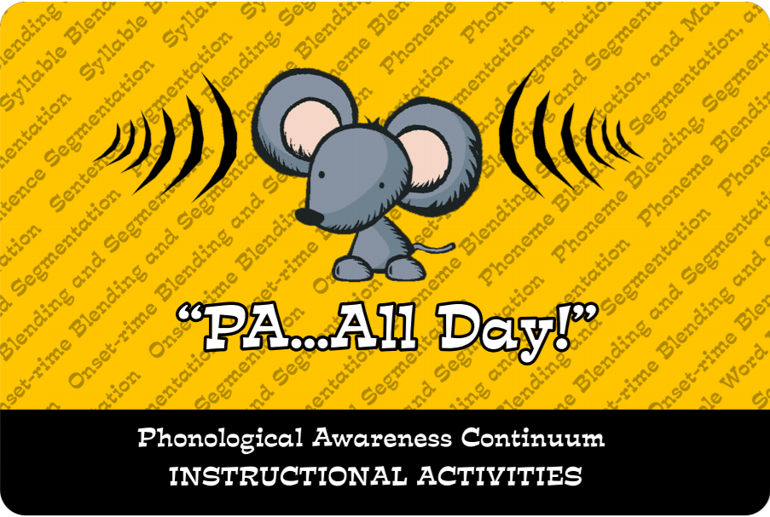
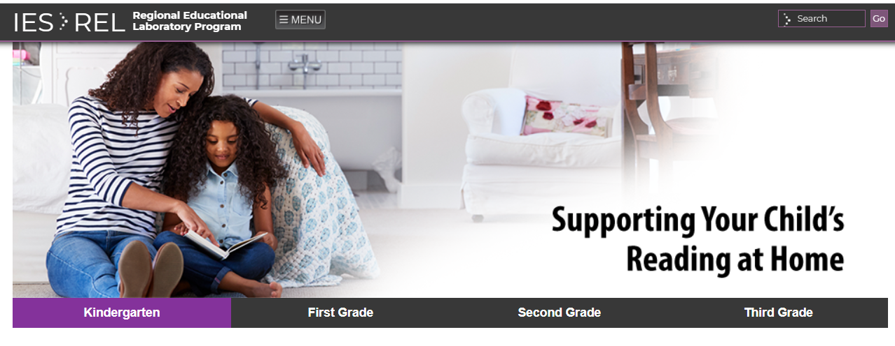
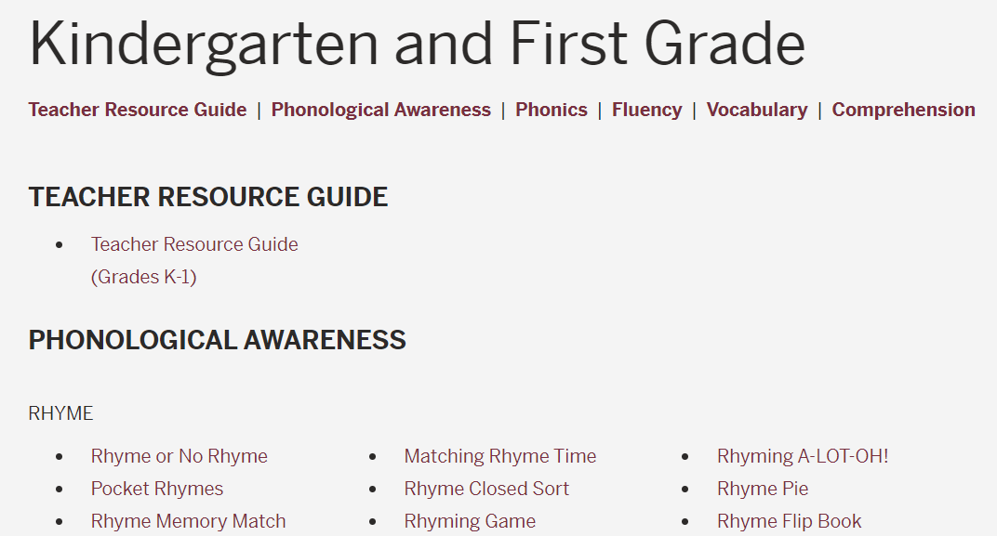
Resources
PA….ALL Day!
Flyer
Supporting Your Child’s Reading at Home
Florida Center for Reading Research
Kindergarten and First Grade
Second and Third Grade

Slide 22
Contact Information
Kim Bausum-Brown
Dyslexia and Specialized Reading Specialist
Department of Students Services and Special Education,
Office of Special Education Instructional Services
Kim.Bausum-Brown@doe.Virginia.go

