Slide 1
Chronic Absenteeism
Meeting Two
Dr. Lisa Coons
Emily Anne Gullickson

Slide 2
What is chronic absence?
Chronic absence is missing so much school for any reason that a student is academically at risk. Chronic absence is defined as missing 10 percent or more of school for any reason.
Chronic Absence
Excused
absences
Unexcused
absences
Suspensions
Chronic absence is different from truancy (unexcused absences only) or average daily attendance (how many students show up to school each day).
Notes:
Last revised: August 9, 2022
Chronic absence is when a student misses 10% or more of their days on roll for any reason, whether it is excused, unexcused or due to suspension. It is 2 days a month in the first month, 4 days in the second month, 6 days in the third month. It is different from truancy which only measures unexcused absences or average daily attendance which measures the average number of students that show up each day of school. Chronic absence is the rate of absenteeism that highly correlates with students falling off the path toward academic success.

Slide 3
Our Nation Faces an Attendance Crisis
Pre-pandemic: 8 million nationally (1 out of 10 in Virginia) students were chronically absent (missing 10% or more of school for any reason: excused, unexcused, suspension)
Chronic absence in Virginia has doubled. By the end of SY 2021-22, chronic absence affected more than 1 out of 5 students. Early data from districts and states for 2022-23 data show rates remain high.
Economically disadvantaged students and families, as well as Native American, Black, Latino/Hispanic and Pacific Islander students are disproportionately affected.
Chronic absenteeism is especially high in early grades as well as high school.
Notes:
Higher Chronic Absenteeism Threatens Academic Recovery from the COVID-19 Pandemic (Thomas S. Dee)
https://osf.io/bfg3p/
Our nation CONTINUES to face an attendance crisis.
According to Stanford University analysis, more than one out of four students are chronically absent. The current high levels of absenteeism are a sign of educational inequities that have been even further exacerbated during the pandemic. Children who are economically disadvantaged are disproportionately impacted as well as students who are in early elementary and high school.
Studies show that even after adjusting for poverty levels and race, children who skip more school get significantly worse grades.

Slide 4
COVID-19 Closures and Student Attendance Impact
  KEY TAKE-AWAYS
            In 2018-2019, 1 in 10 students were chronically absent.
            In 2022-2023, the number of chronically absent students nearly doubled.
            41,159 more students were chronically absent compared to their 2018-2019 peers.

Slide 5
COVID-19 Closures and Impact on Student Groups
  KEY TAKE-AWAYS
  1 in 4 Economically Disadvantaged and Student with Disabilities are chronically absent.
  1 in 5 Black students are chronically absent.
  1 in 5 Hispanic students are chronically absent.
  These groups missing the most school are the same groups that are suffering the most from learning loss.
  .

Slide 6
Reviewing Transportation Discussion

Slide 7

Parent & Family Engagement Strategies
©2023 Attendance Works. All rights reserved. Materials provided under the Apache License v. 2.0 as given at
https://www.attendanceworks.org/resources/usage-policy-customizing/
Notes:
Relationships All Year Round: Nurturing Showing up

Slide 8
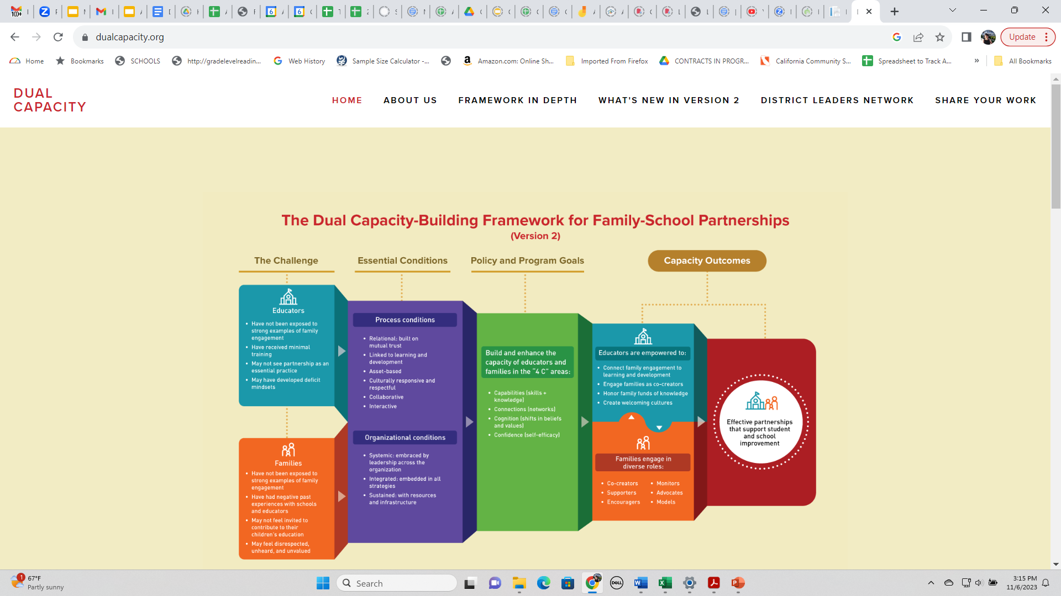
The Dual Capacity- Building Framework for Family-School Partnerships

Slide 9
Recognize that Going to School Reflects When Families Have…
Hope
for a better future
Faith
that school will help your child succeed
Voice
in decisions that affect them and their children
Access
to needed support and services
Notes:
Last revised: 11/15/2021
Going to school reflects when families have…
Hope for a better future
Faith that school will help their child to succeed
Voice in decisions that affect the and their children
Access to needed support and services
Each of these elements helps to promote a positive school environment that encourages daily attendance.

Slide 10
Changing the Power Dynamics and Shifting to a Partnership Approach
Problem Focused | to | Partnership Focused
Blame Family |  | Contact Family to Build Relationships using an asset-based approach
Use letters and robo calls to communicate with families |  | Start with Listening to Families; Find out Hopes, Dreams, School Experiences, Assets, Needs
Focus on what student and family don’t do |  | Highlight Strengths Even Amidst Challenges
Give Expert Advice about What to Do |  | Collaborate with Families and Encourage Practices that Build Upon Their Assets and Priorities
These concepts were adapted from this blog by the Search Institute: https://blog.searchinstitute.org/six-shifts-better-family-engagement
Notes:
This is an example of a mindset shift: From dependency to partnership; partnerships about belonging to schools
valuing family’s expertise

Slide 11

Forging Partnerships with Families to Support Engagement and Attendance
Engage in two-way, supportive communications about attendance and engagement throughout the school year
Provide tailored, personalized and caring messages to students and families who are chronically absent
Offer actionable steps to improve attendance
Make sure families receive updated health guidance, resources to meet basic needs as well as as support for learning at home
Notes:
Parents and family members are the first and primary educators in our students' lives; communication with and from these key stakeholders regarding attendance is critical. Parents can be, and are, the catalysts to change systemic or institutional barriers that might be causing students to miss too much school.

Slide 12

Additional Resources from Attendance Works
Handouts for Families
  Preschool, Elementary & Secondary Grades
  Available in English, Spanish, Chinese, Vietnamese, Tagalog and Creole https://www.attendanceworks.org/resources/handouts-for-families/
Sign up for the 2023 Attendance Awareness Campaign https://awareness.attendanceworks.org/contact/aam-updates/
Notes:
Use AW handouts to succinctly share some of the impact of good attendance and the consequences of chronic absence, as well as what parents can do to help their child get to school every day.

Slide 13
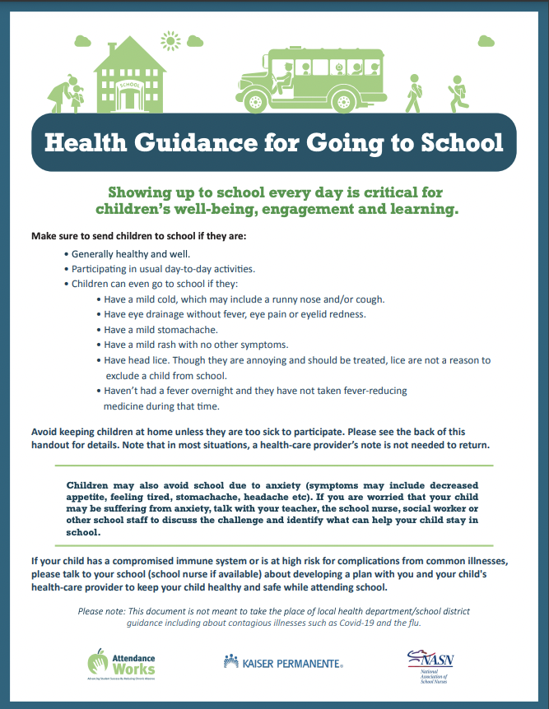
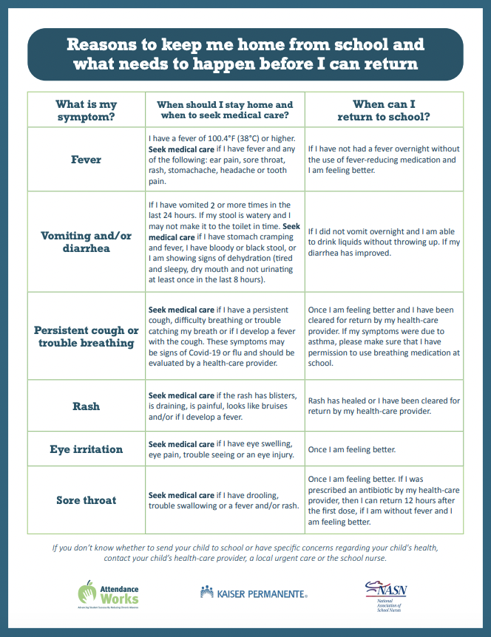
Check out our health guidance!
https://www.attendanceworks.org/resources/health-handouts-for-families/
Notes:
During the pandemic, we for good reasons became very cautious about keeping kids home due to illness. Though Covid is still with us, we have made significant progress in reducing its impact. Families are very confused about when to send kids to school or keep them home due to signes of illness. They want guidance. We have worked with KP and NASN to create this guidance to help families make good decisions about what to do when their child shows signs of illness – only keeping them home if truly necessary so children get back into regular routine of school.
If you are interested, share with your local health department and school district to make sure it is in keeping with what they advise. If is, share it broadly. If not, use it to think about how to update your local guidance and create your won.

Slide 14
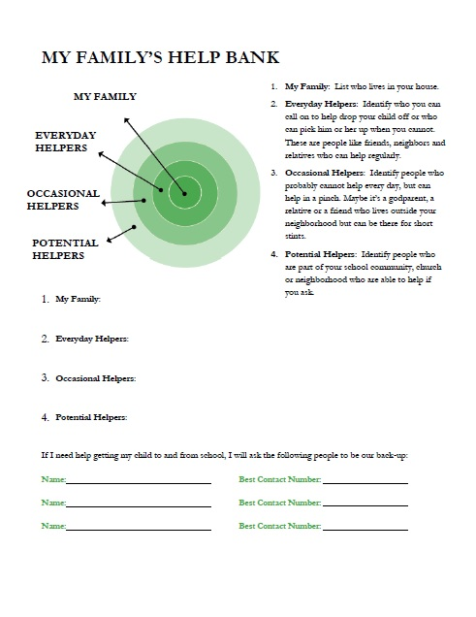
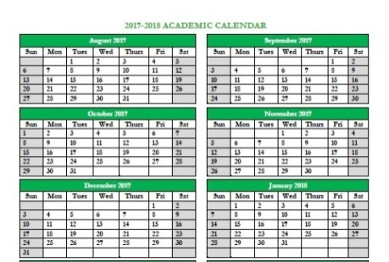

Encourage All Students and Families to Create a Success Plan
Set attendance goals
Make backup plans
Track absences
Recognize success!
http://www.attendanceworks.org/resources/student-attendance-success-plans/
Notes:
Student Attendance Success Plans are designed to help families or youth make a plan to get to school. The help bank portion identifies who can help – and widens the circle of support.

Slide 15
Targeted Outreach
Multi-tiered System of Support for Attendance
Tier 3
Intensive
Intervention
Students Missing 20% or More
Students Missing 10% - 19%
Tier 2
Early Intervention
All Students and Families
Tier 1
Universal Prevention
All Students and Families
Foundational Supports
Which Promote Positive Conditions for Learning

Slide 16
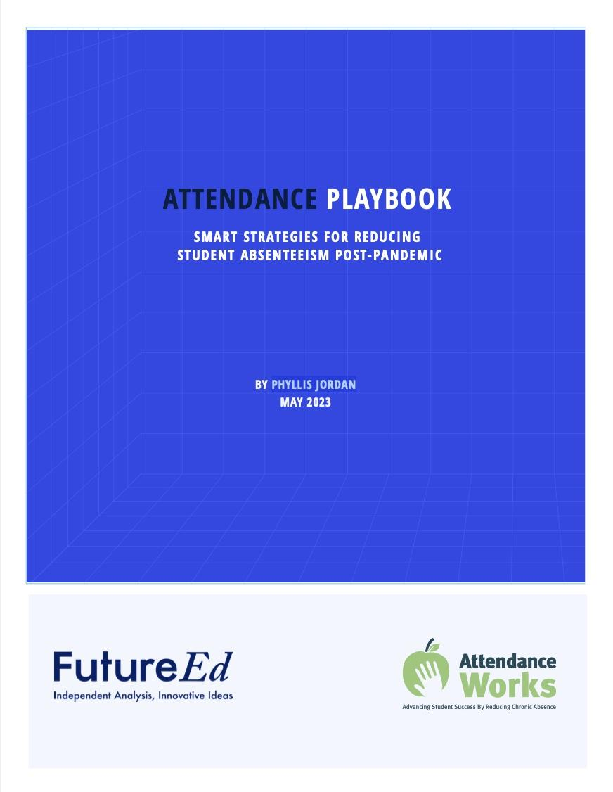
Interventions that can be found in the Attendance Playbook
TIER I: Foundational Support and
Schoolwide Prevention
Community Schools
Engaging with Families
Student-Teacher Relationships
Relevant—and Culturally Relevant—Instruction
Restorative Discipline Practices
Summer Learning and Afterschool Strategies
Positive Greetings at the Door
Incentives
Rethinking Recess
Healthy School Buildings
School-based Health Services
Telehealth
Free Meals for All
School Buses and Public Transit
A Safer Walk to School
Laundry at School
TIER II: Targeted Support
Early Warning Systems
Targeted Home Visits
Mentors and Tutors
Targeted Youth Engagement
Addressing Asthma
Mental Health Support and School Refusal
Students with Disabilities
Immigrant Students
TIER III: Intensive Support
Interagency Case Management
Housing Insecurity
Truancy
Attendance Playbook: https://www.future-ed.org/attendance-playbook/
Implementation Guide: https://www.attendanceworks.org/resources/attendance-playbook/
Special Thanks to FutureEd and AttendanceWorks

Slide 17



Illustrating the Gap
(interactive exercise for educators and families)
Instructions found in Bringing Attendance Home Toolkit
http://www.attendanceworks.org/resources/toolkits/bringing-attendance-home/
Notes:
Last revised: 11/15/2021
YouTube version from Teaching Attendance modules: https://www.youtube.com/watch?v=ZQxdJ9LHt1s
Video length: 4:22

Slide 18
Improving Attendance Matters
High School
Middle School
3rd Grade
PK-1st Grade
PK-1st Grade
Chronic Absence
3rd Grade
Inability to read on grade level
Middle School
Lower achievement
High School
More likely to drop out of high school
Notes:
Last Revised: July 22, 2022
SAY:
Attendance matters. Without students attending and engaging in learning—whether it is in a traditional bricks and mortar school, an online program or a high-quality afterschool program—none of our aspirations to make up for lost opportunities to learn can happen.
While showing up does not guarantee learning, a student who misses class cannot benefit. If a large number of students miss class, it is an indication of challenges that require systemic solutions.
While good attendance from preschool onward leads to academic progress, poor attendance has a number of negative effects. Research tells us that
CLICK.
Chronic absence in kindergarten and 1st grade can lead to the inability to read on grade level by the end of 3rd grade.
CLICK.
The inability to read on grade level by 3rd grade leads to lower academic achievement in middle school.
CLICK.
Students that do not read on grade level are 4 times more likely to drop out of high school.
-------------------------------------------------------------------------------------------------------
POSTIVE STATEMENTS (optional)
PreK-1st Grade:
Students who attend regularly in the early grades perform better on measures of academic and social and emotional capacities.
3rd Grade:
Students who attend school regularly are more likely to be able to read proficiently by the end of 3rd grade.
Middle School:
Students who attend school regularly are more likely to have passing grades in middle school.
High School:
Students who attendance regularly are more likely to graduate from high school.
College Completion:
Students to attend school regularly in high school are more likely to persist in college and graduate.

Slide 19
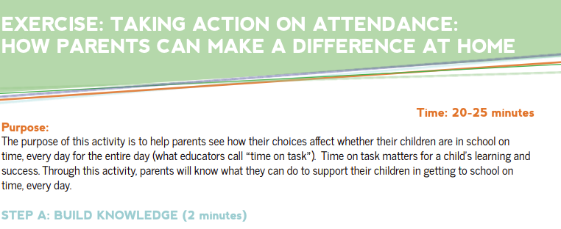
Parent Prep

Slide 20
Relationships are Essential at Every Level of Intervention

Slide 21
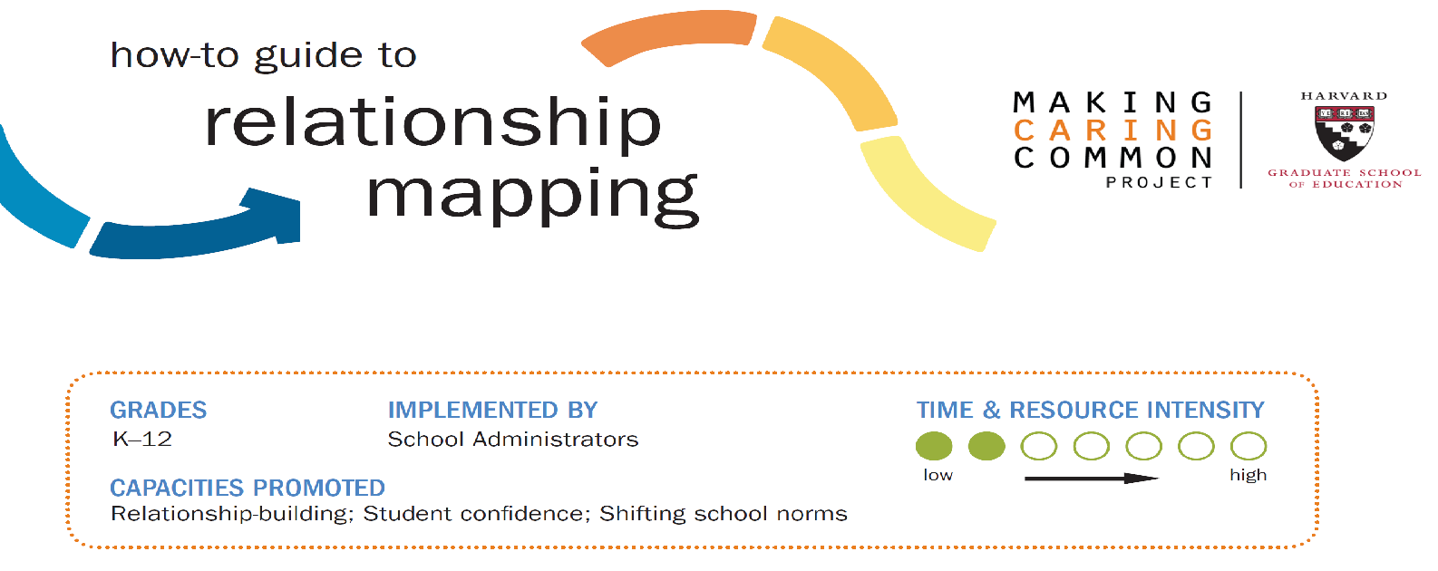
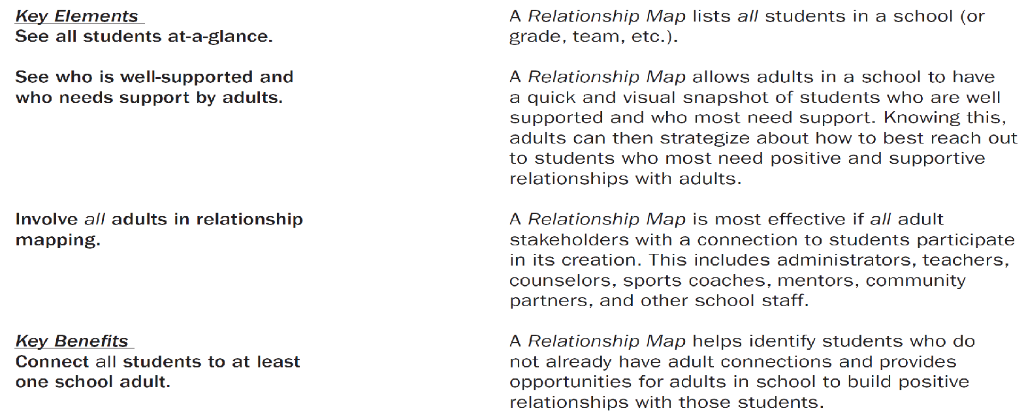
Download in-person and virtual versions of this guide at:
https://mcc.gse.harvard.edu/resources-for-educators/relationship-mapping-strategy
Notes:
Cecilia story: long list of student names

Slide 22
Resources for Intentional Relationship-Building
How to Guide Relationship Mapping guide
https://mcc.gse.harvard.edu/resources-for-educators/relationship-mapping-strategy
2x10 Relationship Strategy Bank https://www.scoe.net/media/e4olyyjr/sesion_2_relationship_strategy_bank.pdf
Edutopia – Relationship Building from Day 1
https://www.edutopia.org/article/relationship-building-day-1
Search Institute - Relationships Framework https://searchinstitute.org/resources-hub/developmental-relationships-framework

Slide 23
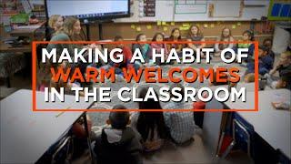
Re-establish
Routines & Rituals
Daily Wellness Check (e.g. Zones of Regulation, Mood Meter)
Whole Group Greeting (e.g. Go-around Questions, Circle Games)
Mindfulness/Grounding Exercises (e.g. Collective Breath)
Greetings at the Door (e.g. Smile, Call person by name)
Starting Each Class With a Warm Welcome: https://www.edutopia.org/video/starting-each-class-warm-welcome
Making Connections With Greetings at the Door: https://www.edutopia.org/video/making-connections-greetings-door

Slide 24
Recognizing Good and Improved Attendance

Slide 25
Some Common Pitfalls of Attendance Incentive Programs
Only recognize perfect attendance
Believe that incentives are the magic bullet to reducing absenteeism
Default to the pizza party (or whatever formula your school has used over and over)
Inadvertently leave out certain groups
Provide incentives at the wrong frequency or intensity levels
Too much lag time from behavior to delivery of incentive

Slide 26
More Effective Approaches to Incentives
Recognize good and improved attendance
Incorporate recognition and incentives as part of a comprehensive approach
Select incentives that are meaningful to students or families
Universal design - every student or family whose behavior you wish to change has the chance to succeed
Provide incentives more frequently and immediate, i.e. weekly

Slide 27
How to Build a Better Attendance Recognition Program
KEY QUESTIONS TO CONSIDER:
WHO - Whose behavior do we want to change? (Individual Student, Group of students, Family)
WHAT – What type of incentive should we select that we believe will motivate the change in behavior?
HOW - How can the incentive be implemented most effectively? This includes decisions about HOW MUCH? HOW OFTEN? AT WHAT TIME OF DAY, WEEK, MONTH OR YEAR? BY WHOM?
4. DID IT WORK AND HOW DO YOU KNOW? What do evaluation results of incentive-based approaches indicate about effectiveness and how to improve subsequent implementation?

Slide 28
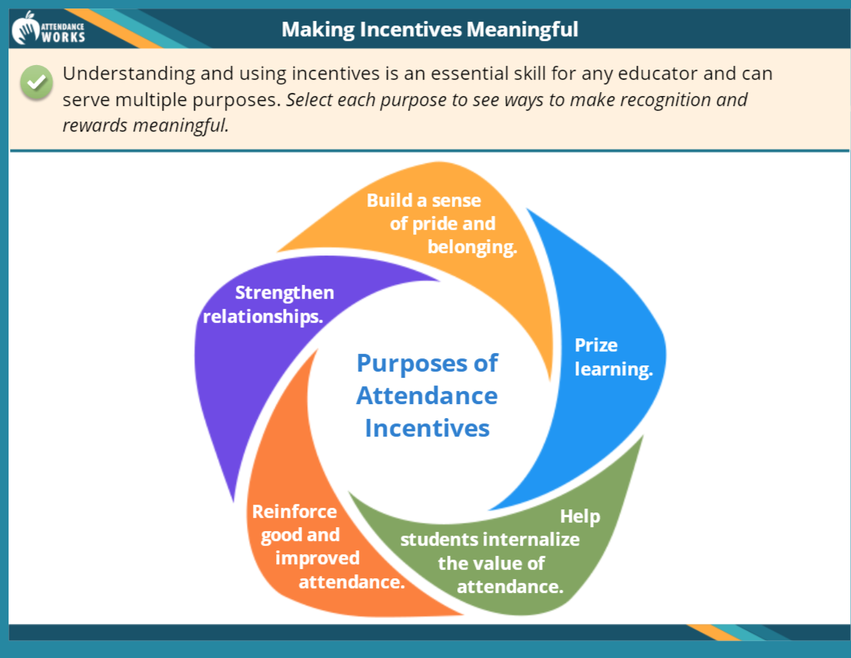
Making Incentives Meaningful
Notes:
Often, when we think of incentives, we go straight to perfect attendance certificates or pizza parties. The best ones I’ve seen are ones that achieve multiple purposes – they help reinforce good and improved attendance, strengthen a sense of belonging to the school community, strengthens relationships, helps students prize learning, and internalize the value of attendance as a value that they take with them after graduation.

Slide 29
Examples of Incentives (Elementary)
FOR STUDENTS
Students with Good and Improved Attendance have their names or pictures on the Attendance Wall
School PBIS bucks or points for being on time each day to use in “store” for items like pencils, stickers, books
Class works on spelling a word such as “TERRIFIC” and gets one letter for each day every student is in class. When they complete the word, students get to eat lunch with their teacher (or principal).
Extra Recess
Opportunities to help with morning announcements, morning greetings
FOR PARENTS
Gift cards, gas cards
Special awards at school or school board meetings

Slide 30
Examples of Incentives (Secondary)
Students with Good and Improved Attendance get a free dress pass
School PBIS bucks/points for being on time each day to use in “store” for items like books, flash drives
Grade level competitions with traveling trophy
Front of the lunch line pass
Homework passes
Free tickets to football games or dances
Access to a VIP lounge

Slide 31
Parent Engagement & Meaningful Engagement Strategies
Louisa County Schools

Slide 32
Parent Responsibility & Support
Dr. Keith Perrigan

Slide 33
Next Steps

