Slide 1
Prioritization of 2023 Mathematics SOL Content for the 2023-2024 School Year – Secondary
October 2, 2023
Notes:
Thank you for joining us this evening. As many of you are aware, the Virginia Board of Education approved the 2023 Mathematics Standards of Learning on August 31, 2023, with full implementation during the 2024-2025 school year. This webinar is the second in a series of three webinars that will address the transition of mathematics instruction to the 2023 Mathematics Standards of Learning during the 2023-2024 school year.

Slide 2

PURPOSE
This webinar will provide an overview of the Instructional Supports for Prioritization of Content Document. This resource highlights the prominent content changes between the 2016 Mathematics Standards of Learning (SOL) and the 2023 Mathematics Standards of Learning and includes instructional notes to support school divisions in making decisions about the prioritization of content during the 2023-2024 transition year.
Notes:
The purpose of today’s webinar is to provide an overview of the Instructional Supports for Prioritization of Content Documents. This resource includes the prominent content changes between the 2016 Mathematics Standards of Learning (SOL) and the 2023 Mathematics Standards of Learning and includes instructional notes to support school divisions in making decisions about the prioritization of content during the 2023-2024 transition year. In conjunction with the 2023 Mathematics Standards of Learning Overview of Revisions document, this document supports the transition of instruction during the 2023-2024 school year. School divisions may wish to use this document when planning for instruction, based upon the options for transitioning, and determining how to supplement existing curriculum to incorporate content from the 2023 Mathematics SOL. School divisions will determine how best to meet the needs of students when incorporating content during the transition year to prepare for full implementation of the 2023 Mathematics Standards of Learning during the 2024-2025 school year.

Slide 3
agenda
Welcome
Review of 2023 Mathematics SOL Documents
Transitioning from 2016 to 2023 Mathematics SOL
Prioritization of Content
Grade Level Examples of Transition

Slide 4
Overview of Transition Options

Slide 5
Educator Transition Team
The Virginia Department of Education partnered with a group of 26 K-12 educators from across the Commonwealth to develop a technical support document that will guide school divisions in next steps for implementation of the revised standards​.
Bedford County Public Schools |  | Harrisonburg City Public Schools
Chesterfield County Public Schools |  | Henrico County Public Schools
Essex County Public Schools |  | Louisa County Public Schools
Falls Church City Public Schools |  | Middlesex County Public Schools
Franklin County Public Schools |  | Norfolk Public Schools
Gloucester County Public Schools |  | Prince William County Public Schools
Goochland County Public Schools |  | Rockingham County Public Schools
Greene County Public Schools |  | Williamsburg James City Public Schools
Hanover County Public Schools |  | Virginia Beach City Public Schools
Notes:
The Virginia Department of Education has partnered with 26 educators from across the Commonwealth to support the work of developing technical support document that will guide school divisions in implementing the revised Mathematics Standards of Learning. These educators work in divisions across the state and represent large school divisions, small school divisions, and all in between. The varying perspectives of this team brings strength to this work as we are able to hear about the needs of all different divisions in regard to the support needed to implement the 2023 Mathematics SOL.

Slide 6
Transition Options - 2023-2024 School Year
Option 1
Full Crosswalk Year
Instruction in both 2016 Mathematics Standards of Learning and the 2023 Mathematics Standards of Learning
Option 2
Partial Crosswalk Year
Instruction in the 2016 Mathematics Standards of Learning with choices for prioritization of key content from the 2023 Mathematics Standards of Learning
Option 3
Instruction focused solely on 2016 Mathematics Standards of Learning
Options for Transitioning to the 2023 Mathematics Standards of Learning (Word | PDF)
Notes:
LINK FOR CHAT: Options for Transitions to the 2023 Mathematics SOL: https://www.doe.virginia.gov/home/showpublisheddocument/49005/638297632355100000
One of the documents that has been developed to support this transition is posted on the VDOE 2023 Mathematics Standards of Learning webpage. The link to this document is being placed in the chat. During the 2023-2024 school year, school divisions will select one of the following transition options to prepare for full implementation of the 2023 Mathematics Standards of Learning in 2024-2025.
Option 1: Full Crosswalk Year – students will receive instruction in both the 2016 Mathematics Standards of Learning and the 2023 Mathematics SOL.
Option 2: Partial Crosswalk Year – students will receive instruction in the 2016 Mathematics SOL with choices for prioritization of key content from the 2023 Mathematics Standards of Learning
Option 3: Students will receive instruction focused solely on the 2016 Mathematics Standards of Learning and use the 2023-2024 to prepare for full implementation of the standards during the 2024-2025 school year.

Slide 7
Supporting Documents Currently Available
Notes:
The VDOE in collaboration with our Mathematics Transition team has been very busy developing documents supporting the implementation of the 2023 Mathematics Standards of Learning. In the chat you will see a link to the webpage where these documents are located: 2023 Mathematics Standards of Learning | Virginia Department of Education

Slide 8
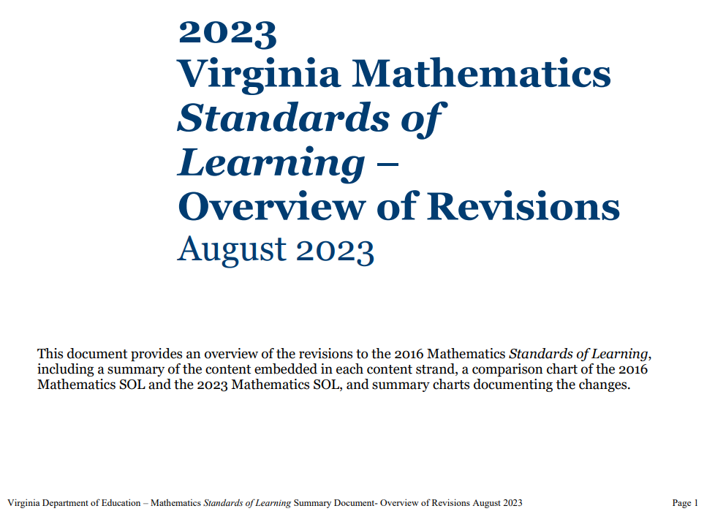
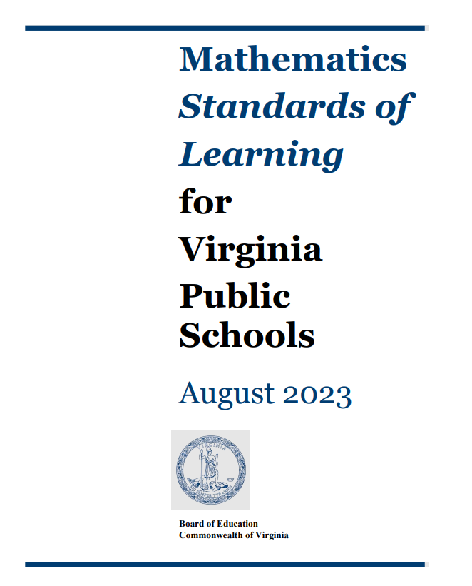
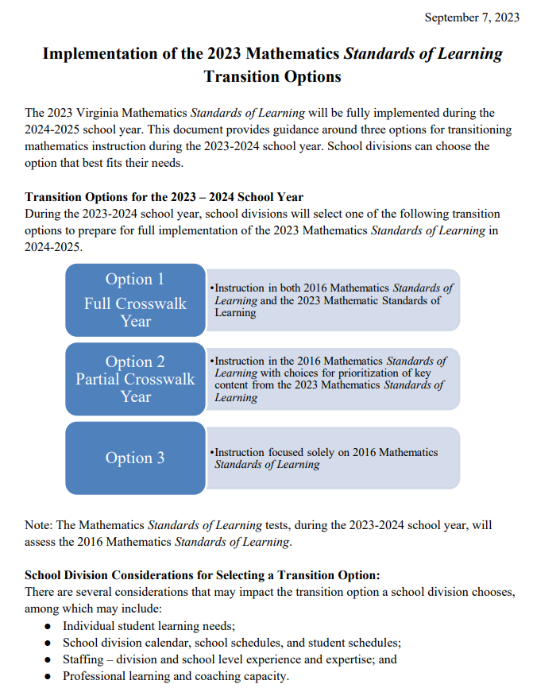
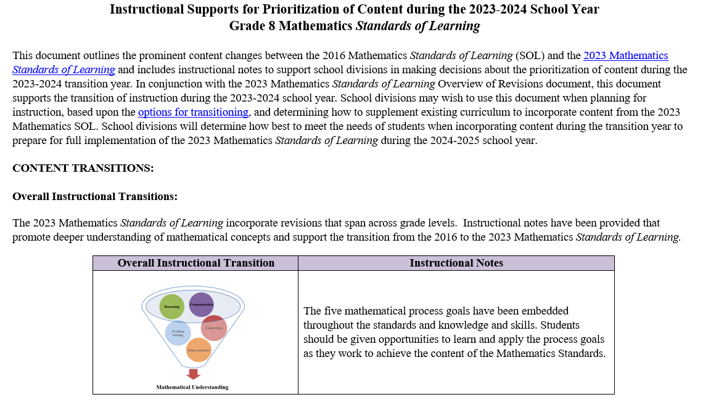
Current 2023 Mathematics SOL Documents
Notes:
Mathematics Standards of Learning documents
2023 Mathematics Standards of Learning Overview of Revisions documents
Implementation of the 2023 Mathematics Standards of Learning Transition Options document
Instructional Supports for Prioritization of Content during the 2023-2024 School Year
2023 Mathematics Standards of Learning | Virginia Department of Education

Slide 9
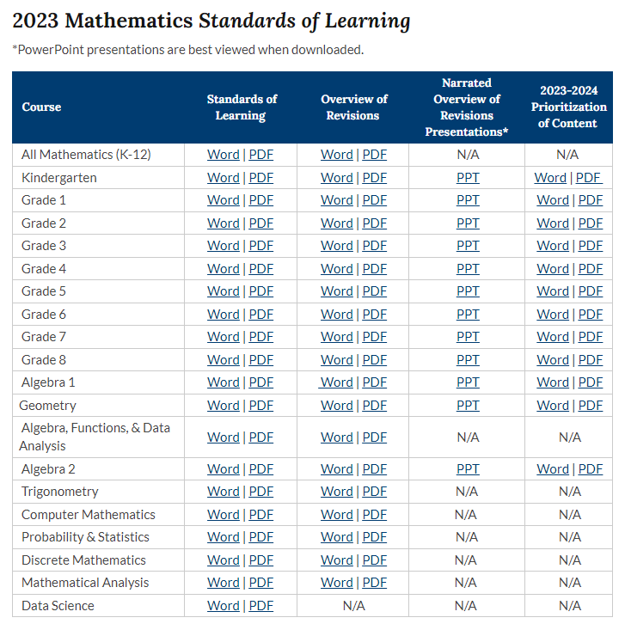
2023 Mathematics SOL Webpage
NEW

Slide 10
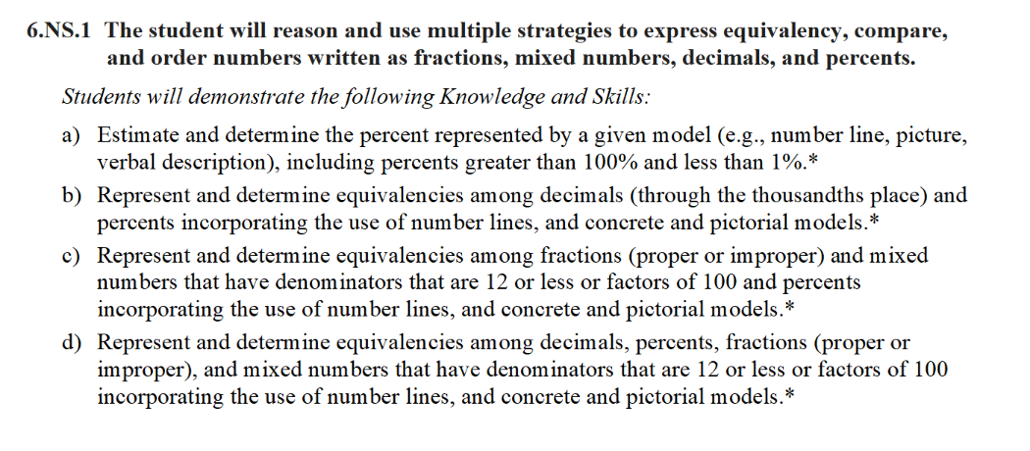
Standards Document
Notes:
The 2023 Mathematics Standards of Learning Document includes the standards and the knowledge and skills associated with each standard. This slide shows an example from the Grade 6 Standards Document.

Slide 11
Changes to Numbering of the SOL
Grade
6
First SOL within this strand
Number and Number Sense Strand
KEY: NS = Number and Number Sense; CE = Computation and Estimation; MG = Measurement and Geometry; PS = Probability and Statistics; PFA = Patterns, Functions, and Algebra
Notes:
The new numbering system for the standards makes it clear within which strand a standard exists. For instance, the sample shown on the screen highlights 6.NS.1. Six indicates the grade level; NS indicates the Number and Number Sense Strand; and 1 indicates that this is the first standard of learning in this strand. The key shown at the bottom of the screen provides the abbreviations for each of the strands.

Slide 12
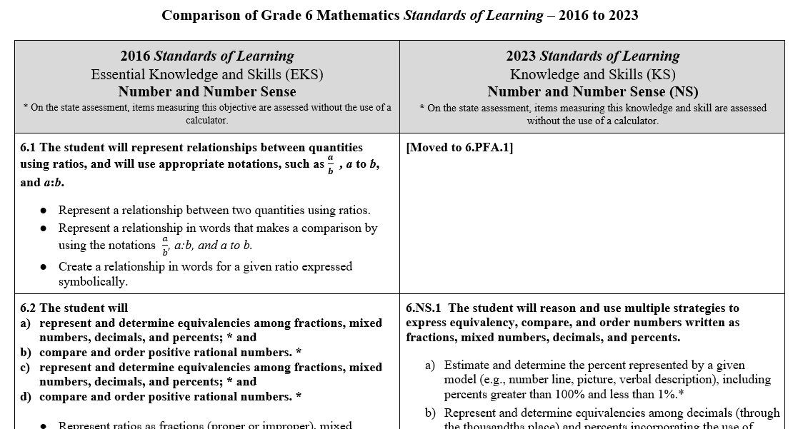
Overview of Revisions (2016 to 2023 Mathematics Standards of Learning) document
Notes:
An Overview of Revisions document has been created for each grade or course. These documents provide a detailed comparison between the 2016 Standards of Learning and the 2023 Standards of Learning.

Slide 13
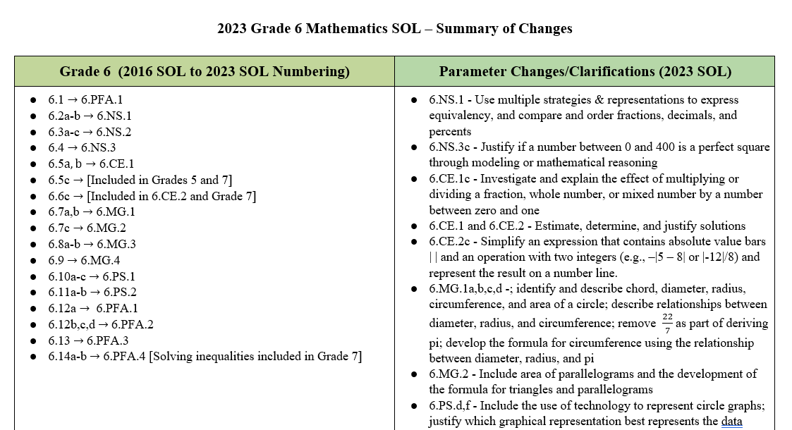
Overview of Revisions- Summary of Changes (1 of 2)
Notes:
At the end of the Overview of Revisions document there is a summary of changes table. One section of the table provides an overview of the changes to the numbering of the standards. Another section provides information regarding the prominent parameter changes and clarifications. Parameter changes and clarifications might be related to an increase or decrease in the limiters of the standards or the knowledge and skills; but might also be related to the depth of understanding of the content or scope of the content.

Slide 14
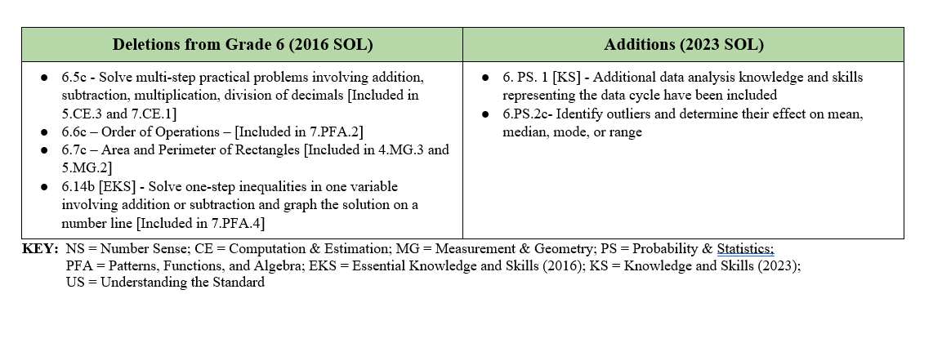
Overview of Revisions- Summary of Changes (2 of 2)
Notes:
The other two sections of the table include deletions from 2016 standards and addition of content to the 2023 standards.

Slide 15
Overview of Prioritization Documents

Slide 16
Purpose of Prioritization Document
Outlines the prominent content changes between the 2016 Mathematics Standards of Learning and the 2023 Mathematics Standards of Learning
Includes instructional notes to support the prioritization of content during the 2023-2024 transition year
School divisions will determine how best to meet the needs of students when incorporating content during the transition year
Notes:
The Instructional Supports for Prioritization of Content document outlines the prominent content changes between the 2016 Mathematics Standards of Learning (SOL) and the 2023 Mathematics Standards of Learning and includes instructional notes to support school divisions in making decisions about the prioritization of content during the
2023-2024 transition year.
In conjunction with the 2023 Mathematics Standards of Learning Overview of Revisions document, this document supports the transition of instruction during the 2023-2024 school year. School divisions may wish to use this document when planning for instruction, based upon the options for transitioning, and determining how to supplement existing curriculum to incorporate content from the 2023 Mathematics SOL.
School divisions will determine how best to meet the needs of students when incorporating content during the transition year to prepare for full implementation of the 2023 Mathematics Standards of Learning during the 2024-2025 school year.

Slide 17
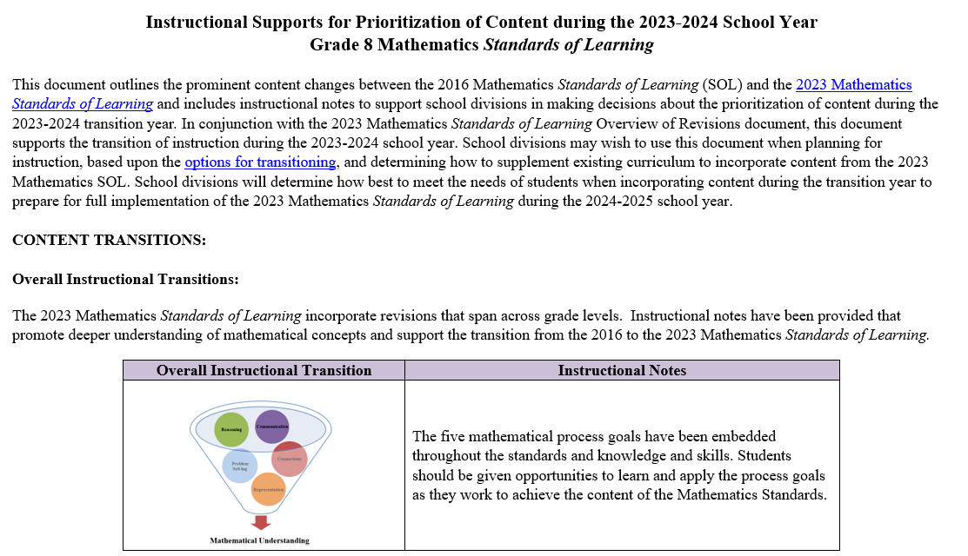
Mathematics Standards of Learning 2023-2024 School Year – Prioritization Notes
Notes:
There are Instructional Supports for Prioritization of Content for all grades levels of mathematics K-8, Algebra 1, Geometry and Algebra 2. These documents are all structured similarly and, as mentioned before, are most powerful when used in conjunction with the corresponding grade or course level Overview of Revisions document. Let’s look at the three common components of this document.

Slide 18
Content Transitions
Critical Instructional Transitions
Includes critical content that could cause gaps in student learning if instruction is not provided during the transition year
Overall Instructional Transitions
Includes overall content changes that span across grade levels and promote deeper understanding of concepts
Specific Instructional Transitions by Strand
Includes suggestions for transitioning from the 2016 to the 2023 Mathematics Standards of Learning by blending specific content from both sets of standards
Notes:
Each document includes three sections:
Critical Instructional Transitions: Includes critical content that could cause gaps in student learning if instruction is not provided during the transition year
Overall Instructional Transitions: Includes overall content changes that span across grade levels and promote deeper understanding of concepts
Specific Instructional Transitions by Strand: Includes suggestions for transitioning from the 2016 to the 2023 Mathematics Standards of Learning by blending specific content from both sets of standards

Slide 19
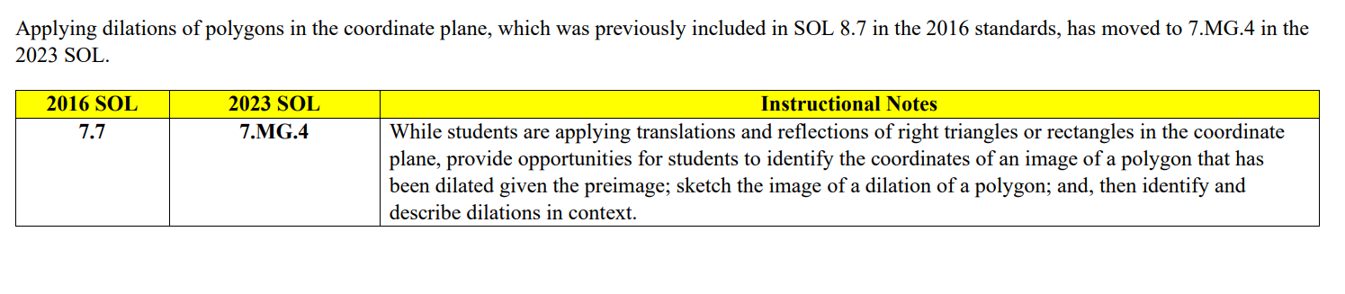
Critical Instructional Transitions
Example – Grade 7
The 2023 Mathematics Standards of Learning include critical content, as shown below, that could cause gaps in student learning if instruction is not provided during the transition year.
Notes:
Dilations has been moved from Grade 8 in the 2016 Standards to Grade 7 in the 2023 Standards. Current 7th graders may not learn this content unless it is part of this year's instruction. Critical instructional transitions are included in the grade or course documents only when applicable.

Slide 20
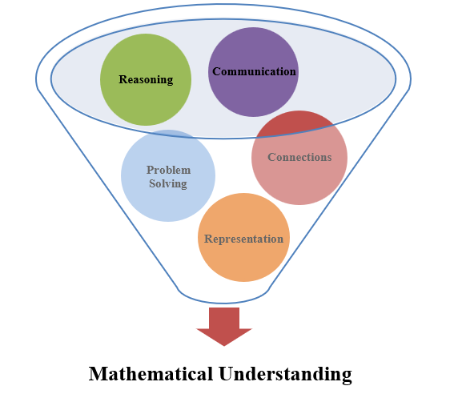
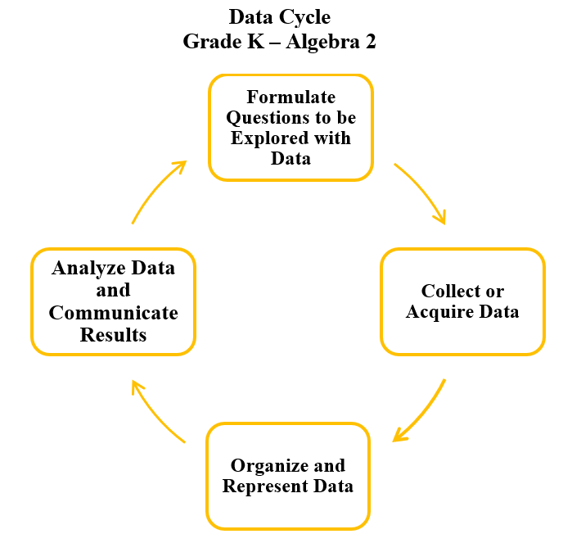
Overall Instructional Transition Example
The 2023 Mathematics Standards of Learning incorporate revisions that span across grade levels. Instructional notes have been provided that promote deeper understanding of mathematical concepts and support the transition from the 2016 to the 2023 Mathematics Standards of Learning.
Notes:
The 2023 Mathematics Standards of Learning incorporate additional changes that promote deeper understanding of concepts. Through the embedding of the five mathematical process goals and the infusion of the Data Cycle in standards addressing statistics, the 2023 SOL take a deeper dive into mathematics content. This section includes instructional notes that outline some of the instructional shifts that may be need to be considered, along with pointing out some of the content that may accompany these two overall transitions.

Slide 21
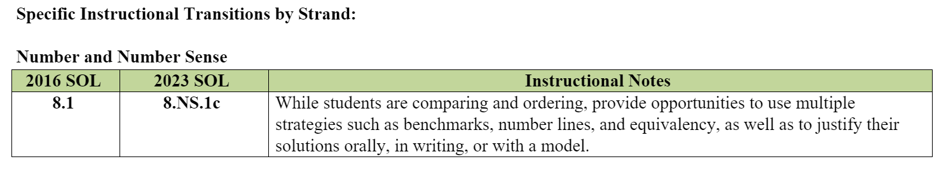
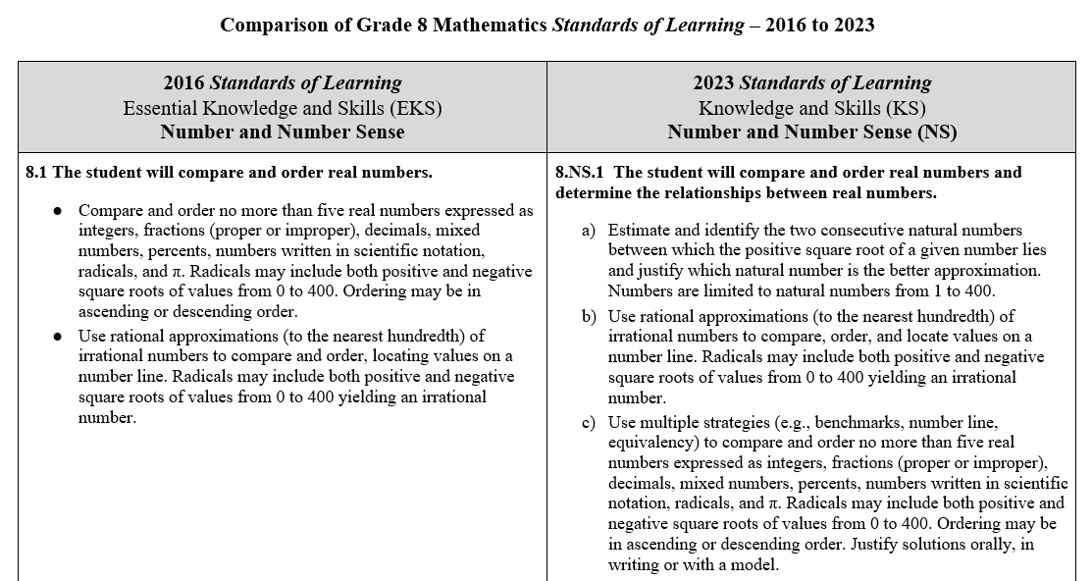
Specific Instructional Transitions by Strand
The 2023 Mathematics Standards of Learning incorporate revisions that are specific to a grade level or course. Instructional notes have been provided for specific standards that support the transition from the 2016 to the 2023 Mathematics Standards of Learning.
Notes:
The third section of the Instructional Supports for Prioritization of Content documents address revisions that are specific to a grade level or course and is intended to support divisions and teachers in making decisions about content that might be folded into the instruction during 2023-2024 based on the 2016 Mathematics SOL.

Slide 22
Specific Instructional Transitions – Secondary Prioritization Documents

Slide 23

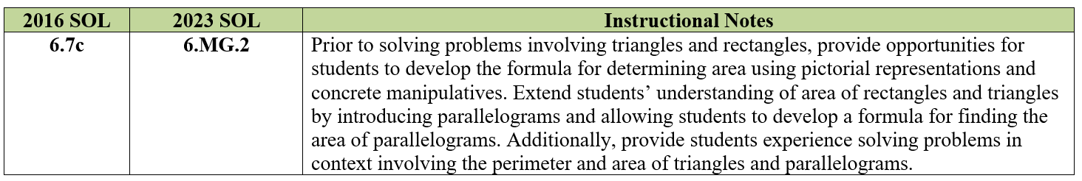
Standard 6.7c (2016) - Standard 6.MG.2 (2023)
2016 SOL | 2023 SOL
6.7 The student will c) solve problems, including practical problems, involving area and perimeter of triangles and rectangles. [Area and Perimeter of Rectangles included in Grades 4 and 5] Solve problems, including practical problems, involving area and perimeter of triangles and rectangles. (c) | 6.MG.2 The student will reason mathematically to solve problems, including those in context, that involve the area and perimeter of triangles, and parallelograms. Develop the formula for determining the area of parallelograms and triangles using pictorial representations and concrete manipulatives (e.g., two-dimensional diagrams, grid paper, etc.). Solve problems, including those in context, involving the perimeter and area of triangles, and parallelograms.
Revisions:
Area and perimeter of rectangles is deleted
Area and perimeter of parallelograms
Develop the formula for determining the area of parallelograms and triangles
Notes:
On the screen you are seeing an excerpt from Grade 6 Overview of Revisions Narrated PowerPoint showing a comparison between the 2016 SOL and the newly adopted 2023 SOL. As you can see the content of SOL 6.7c can now be found in 6.MG.2 of the 2023 standards with any changes highlighted in red.
An excerpt from the Grade 6 Prioritization document is shown on the screen. As Tina shared earlier in the presentation, school divisions may wish to use the Prioritization document when planning for instruction, based upon the options for transitioning, and determining how to supplement existing curriculum to incorporate content from the 2023 Mathematics SOL. Notice in this example, the Transition Team has provided instructional notes to support folding in this content – they are suggesting that prior to solving problems…….
Now let’s take a look at an example in Grade 7.

Slide 24
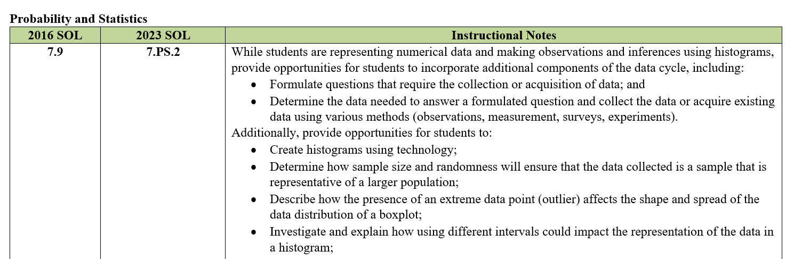
Standard 7.9 (2016) - Standard 7.PS.2 (2023) (1 of 2)
2016 SOL | 2023 SOL
7.9 The student, given data in a practical situation, will represent data in a histogram; Collect, organize, and represent data in a histogram. (a) | 7.PS.2 The student will apply the data cycle (formulate questions; collect or acquire data; organize and represent data; and analyze data and communicate results) with a focus on histograms. Formulate questions that require the collection or acquisition of data with a focus on histograms. Determine the data needed to answer a formulated question and collect the data (or acquire existing data) using various methods including (e.g., observations, measurement, surveys, experiments)., etc. Determine how sample size and randomness will ensure that the data collected is a sample that is representative of a larger population. Organize and represent numerical data using histograms with and without the use of technology. Investigate and explain how using different intervals could impact the representation of the data in a histogram.
Revisions:
Formulate questions that require the collection or acquisition of data
Determine how sample size and randomness ensure that the sample is representative of a larger population
Include the use of technology to represent histograms
Investigate and explain how using different intervals impacts the representation of data in a histogram
Notes:
On the screen you are seeing an excerpt from Grade 7 Overview of Revisions Narrated PowerPoint showing a comparison between the 2016 SOL and the newly adopted 2023 SOL. As you can see the content of SOL 7.9 can now be found in 7.PS.2 of the 2023 standards with any changes highlighted in red.
An excerpt from the Grade 7 Prioritization document is shown on the screen. Notice in this example, the Transition Team has provided instructional notes to support folding in this content – they are suggesting that while students are representing numerical data……
Now let’s take a look at an example in Grade 8.

Slide 25
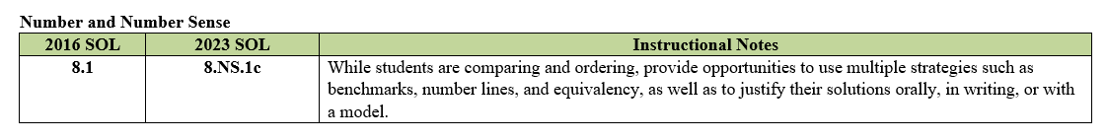
Standard 8.1 (2016) - Standard 8.ns.1bc (2023)
2016 SOL | 2023 SOL
8.1 The student will compare and order real numbers. Use rational approximations (to the nearest hundredth) of irrational numbers to compare and order, locating values on a number line. Radicals may include both positive and negative square roots of values from 0 to 400 yielding an irrational number. Compare and order no more than five real numbers expressed as integers, fractions (proper or improper), decimals, mixed numbers, percents, numbers written in scientific notation, radicals, and π. Radicals may include both positive and negative square roots of values from 0 to 400. Ordering may be in ascending or descending order. | 8.NS.1 The student will compare and order real numbers, and determine the relationships between real numbers. Use rational approximations (to the nearest hundredth) of irrational numbers to compare, order, and locate values on a number line. Radicals may include both positive and negative square roots of values from 0 to 400 yielding an irrational number. Use multiple strategies (e.g., benchmarks, number line, equivalency) to compare and order no more than five real numbers expressed as integers, fractions (proper or improper), decimals, mixed numbers, percents, numbers written in scientific-notation, radicals, and π. Radicals may include both positive and negative square roots of values from 0 to 400. Ordering may be in ascending or descending order. Justify solutions orally, in writing, or with a model.
Revisions:
Use multiple strategies to compare and order
Justify solutions orally, in writing, or with a model
Notes:
On the screen you are seeing an excerpt from Grade 8 Overview of Revisions Narrated PowerPoint showing a comparison between the 2016 SOL and the newly adopted 2023 SOL. As you can see the content of SOL 8.1can now be found in 8.NS.1b and c of the 2023 standards with any changes highlighted in red. 8.NS.1 bullet a corresponds with SOL 8.3a
An excerpt from the Grade 8 Prioritization document is shown on the screen. Notice in this example, the Transition Team has provided instructional notes to support folding in this content – they are suggesting that while students are comparing and ordering……

Slide 26
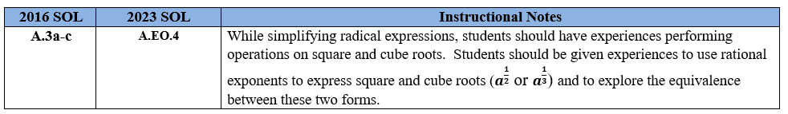
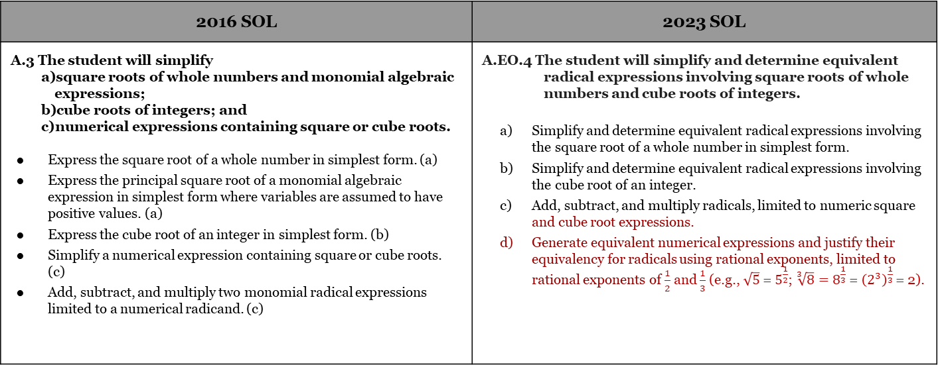
Standard A.3 (2016) - Standard A.EO.4 (2023)
2016 SOL | 2023 SOL
A.3 The student will simplify square roots of whole numbers and monomial algebraic expressions; cube roots of integers; and numerical expressions containing square or cube roots. Express the square root of a whole number in simplest form. (a) Express the principal square root of a monomial algebraic expression in simplest form where variables are assumed to have positive values. (a) Express the cube root of an integer in simplest form. (b) Simplify a numerical expression containing square or cube roots. (c) Add, subtract, and multiply two monomial radical expressions limited to a numerical radicand. (c) | A.EO.4 The student will simplify and determine equivalent radical expressions involving square roots of whole numbers and cube roots of integers. Simplify and determine equivalent radical expressions involving the square root of a whole number in simplest form. Simplify and determine equivalent radical expressions involving the cube root of an integer. Add, subtract, and multiply radicals, limited to numeric square and cube root expressions. Generate equivalent numerical expressions and justify their equivalency for radicals using rational exponents, limited to rational exponents of $\frac{1}{2}$ and $\frac{1}{3}$ (e.g., $\sqrt{5}$ = $5^{\frac{1}{2}}$; $\sqrt[3]{8}=8^{\frac{1}{3}}$ = ${\left(2^{3}\right)}^{\frac{1}{3}}$ = 2).
Revisions:
A.EO.4c – Students will add, subtract, and multiply radicals, including numeric cube root expressions.
A.EO.4d - Students will now explore rational exponents as equivalent to square and cube root notation.
Notes:
2016 SOL A.3, simplifying radical expressions, becomes the fourth standard within the Expressions and Operations strand, A.EO.4. The 2023 standards now clarify that students will perform addition, subtraction, and multiplication with expressions including cube roots as well as those with square roots. Additionally, with simplifying radical expressions, students will explore equivalencies of square and cube roots with rational exponents. The Instructional Supports for Prioritization of Content document provides notes about how, when teaching the 2016 Algebra Standard A.3, these revisions from the 2023 Mathematics SOL might be intertwined into instruction.

Slide 27
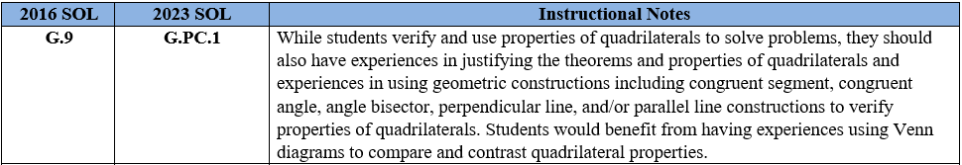
Standard G.9 - Standard G.PC.1
2016 SOL | 2023 SOL
G.9 The student will verify and use properties of quadrilaterals to solve problems, including practical problems. Solve problems, including practical problems, using the properties specific to parallelograms, rectangles, rhombi, squares, isosceles trapezoids, and trapezoids. Prove that quadrilaterals have specific properties, using coordinate and algebraic methods, such as the distance formula, slope, and midpoint formula. Prove the properties of quadrilaterals, using direct proofs. | G.PC.1 The student will prove and justify theorems and properties of quadrilaterals, and verify and use properties of quadrilaterals to solve problems, including the relationships between the sides, angles, and diagonals. Solve problems using the properties specific to parallelograms, rectangles, rhombi, squares, isosceles trapezoids, and trapezoids. Prove and justify that quadrilaterals have specific properties, using coordinate and algebraic methods, such as the slope formula, the distance formula, and the midpoint formula. Prove and justify theorems and properties of quadrilaterals using deductive reasoning. Use congruent segment, congruent angle, angle bisector, perpendicular line, and/or parallel line constructions to verify properties of quadrilaterals.
Revisions:
G.PC.1b - Students will prove and justify that quadrilaterals have specific properties
G.PC.1c – Students will prove and justify theorems and properties of quadrilaterals using deductive reasoning.
G.PC.1d - Students will use constructions to verify properties of quadrilaterals
Notes:
The G.9 2016 standard is now the G.PC.1 2023 Geometry standard.
The 2023 standard now includes having students prove and justify theorems of quadrilaterals and justify properties of quadrilaterals. Additionally, students will use congruent segment, congruent angle, angle bisector, perpendicular line, and/or parallel line constructions to verify the properties of quadrilaterals. Direct proofs are not specifically listed in the new standard but would fall under deductive reasoning to prove and justify the theorems and properties in the 2023 standards and should be included.

Slide 28
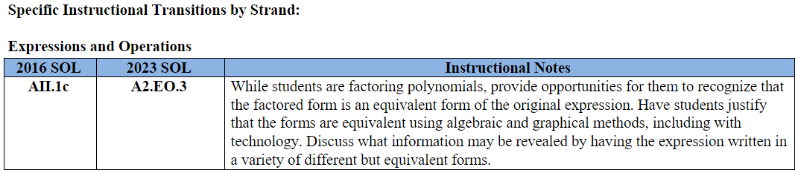
Standard AII.1C (2016) - Standard A2.EO.3 (2023)
2016 SOL | 2023 SOL
AII.1 The student will factor polynomials completely in one or two variables. Factor polynomials in one or two variables with no more than four terms completely over the set of integers. Factors of the polynomial should be constant, linear, or quadratic. (c) Verify polynomial identities including the difference of squares, sum and difference of cubes, and perfect square trinomials. (c) | A2.EO.3 The student will perform operations on polynomial expressions in two or more variables and factor polynomial expressions in one and two variables. Determine sums, differences, and products of polynomials in one and two variables. Factor polynomials completely in one and two variables with no more than four terms over the set of integers. Determine the quotient of polynomials in one and two variables, using monomial, binomial, and factorable trinomial divisors. Represent and demonstrate equality of polynomial expressions written in different forms and verify polynomial identities including the difference of squares, sum and difference of cubes, and perfect square trinomials.
Revisions:
A2.EO.3a - Students are asked to determine sums, differences, and products of polynomials in one and two variables.
A2.EO.3c - Students are asked to determine the quotient of polynomials in two or more variables using monomial, binomial, and factorable trinomial divisors.
A2.EO.3d – Students will represent and demonstrate equality of polynomial expressions written in different forms
Notes:
2016 standard AII.1c has been renumbered A2.EO.3. This standard is about performing operations on polynomial expressions. Part of this standard that is new to Algebra 2 is adding, subtracting, and multiplying polynomial expressions in one and two variables. Students will also divide polynomial expressions with one and two variables. The divisor in these expressions will be a monomial, binomial, or factorable trinomial divisor.
Students are still expected to factor a polynomial expression in one and two variables completely over the set of integers.
As with other 2023 standards, students will represent equivalent polynomial expressions written in different forms. Students will also continue to verify polynomial identities including the difference of squares, sum and difference of cubes, and perfect square trinomials.

Slide 29

Questions
vdoe.mathematics@doe.virginia.gov
Virginia Department of Education, 2023

