Slide 1
Student Behavior and Administrative Response Data Collection
2023-2024 School Year

Slide 2



WEBINAR PARTICIPATION
This presentation will be available to participants once all webinars have been completed

Slide 3
A
AGENDA
Data Collection Overview
New SBAR Model with Scenarios
Persistently Dangerous Events Form
Timeline and Resources
Questions

Slide 4
SBAR Data Collection Governance
Required by the Code of Virginia (§22.1-279.3:1) and used to satisfy federal assurances for ESSA, the Gun-Free Schools Act of 1994, and the Individuals with Disabilities Education Act (IDEA)
  Replaced the Discipline, Crime, and Violence Collection (DCV) in 2021-2022
  SBAR enables reporting of all administrative responses (behavioral interventions, instructional supports, and disciplinary sanctions) to student behaviors that occurred
    On school property, a school bus, or at a school-sponsored activity
    OR, occurred in the community with an administrative response from the school that resulted in the student being suspended or alternatively placed
  Allows VDOE to identify inequities in disciplinary outcomes, exclusionary practices, and school safety issues

Slide 5
SBAR Reporting Guidelines
  Report the events that occur in:
    your Local Education Agency (LEA)
    private schools for special education placements, for whom your LEA is responsible, when the administrative response results in a suspension, expulsion or report to law enforcement
    public regional programs
      regional programs must report SBAR independently of the LEA; regional program student data should not be included in the LEA files
        UNLESS the regional program has an exemption from SBAR reporting. In such cases, student discipline and response data will be reported by the responsible LEA.

Slide 6
New SBAR Model with Scenarios

Slide 7
Rethinking the SBAR Model
Why a new model?
  The current model requires data stewards to decide how to prioritize and connect behaviors with responses.
  As a result, we are seeing reporting similar to DCV i.e. one behavior per event and many behaviors do not have behavioral interventions, just sanctions reported.
  91% of events had only 1 behavior code reported
  22% of events had disciplinary sanctions and no behavioral interventions
  Source: 2022-2023 Preliminary SBAR

Slide 8
Rethinking the SBAR Model
2. Benefits of a new model
  Simplify reporting with clearer guidelines
    Will only consist of one record type instead of multiple record (eliminate possible over-reporting of responses)
    Will still allow for multiple behaviors, interventions, supports, and sanctions to be reported
  Increase data integrity and adherence to reporting requirements
    Will collect details regarding sanctions that allows VDOE to better identify who is sanctioning the student and for how long
    Will collect details regarding alternative placements that allows VDOE to better identify whether the placement is being applied as an instructional support or a sanction

Slide 9
Data File Layout
SBAR Data File includes:
A Record - Details about the submission type, school year and school division or regional center number
B Records
  Details about the event including location and time of occurrence
  Individual student behaviors that result in an administrative response
  Administrative responses include any behavioral intervention, instructional support, disciplinary sanction, alternative placement, and notification to law enforcement
  The type and number of victims involved in the event
RecordCount= # (Includes the A and total number of B records in your data file)

Slide 10
What’s new
Firearms Code is the code that best describes the Firearm used at the event. This data is collected under the authority of the Gun-Free Schools Act.
  1 = Handgun/Pistol
  2 = Rifle/Shotgun
  3 = More than one firearm type; Handgun, Pistol, Rifle, Shotgun
  4 = Other Firearm
  5 = Non-firearm weapons (use only if Behavior Code is PD6)

Slide 11
What’s New
4 Behavior Codes per Student per Event
3 Behavioral Intervention Codes
3 Instructional Support Codes
Disciplinary Sanction Fields
  The number of hours, days or length of time must be entered for sanction/s that are included in the administrator’s response
  Disciplinary Sanction Codes are obsolete

Slide 12
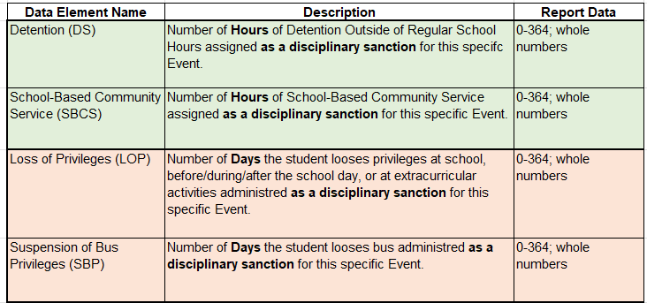
What’s New

Slide 13
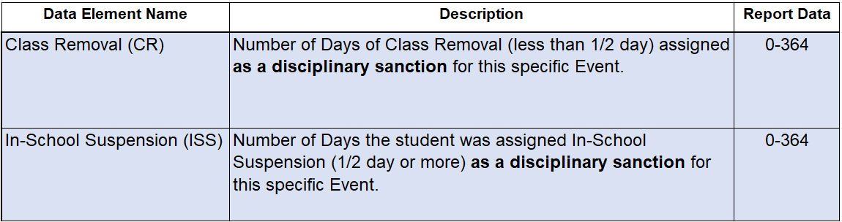
What’s New
Partial Days should be reported to the nearest hundredth place (2 decimal places). For example, use 0.5 for a half day, 0.17 to represent 1 hour in a 6-hour day, 0.17 to represent 1 period in a 6-period day, etc.

Slide 14
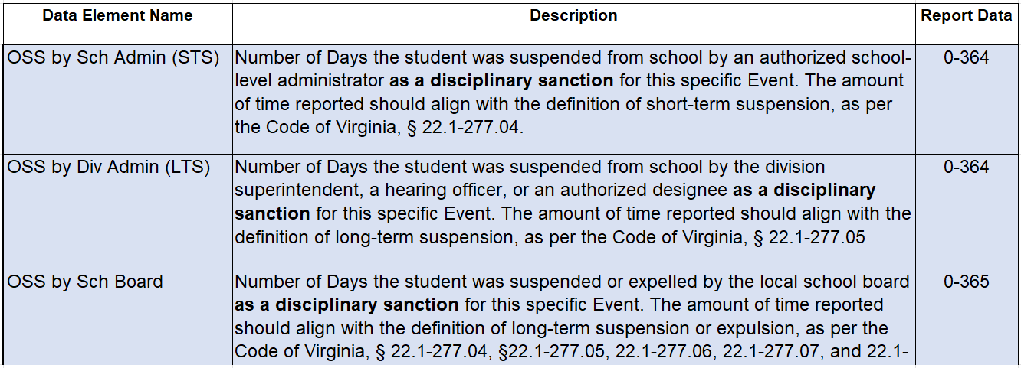
What’s New
Partial Days should be reported to the nearest hundredth place (2 decimal places). For example, use 0.5 for a half day, 0.17 to represent 1 hour in a 6-hour day, 0.17 to represent 1 period in a 6-period day, etc.

Slide 15
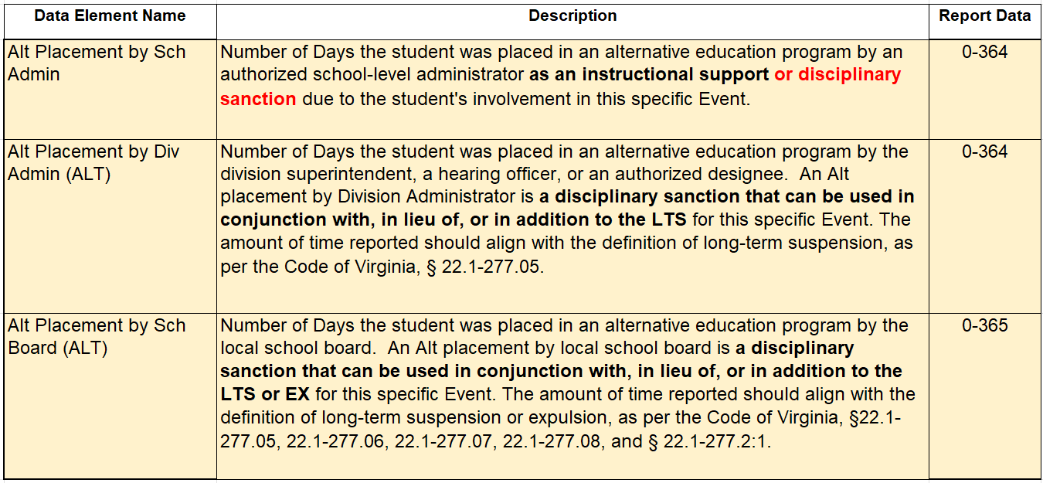
What’s New
Partial Days should be reported to the nearest hundredth place (2 decimal places). For example, use 0.5 for a half day, 0.17 to represent 1 hour in a 6-hour day, 0.17 to represent 1 period in a 6-period day, etc.

Slide 16
Administrative response without a sanction
The scenario is an example of how to report a behavioral intervention with no sanctions. When reporting only behavioral interventions and/or instructional supports with no sanctions, enter 0s in each sanction field which is the equivalent to “NONE”.
Record Type B | Local Event ID | Event Division | Event School | Date of Event | Time of Event | Location of Event | Firearms Confiscated | Weapons Confiscated | Firearms Code | Law Enforcement Flag | Notified of Charges Filed Flag | Notified of Conviction Flag | CAHO Flag | State Testing ID | Behavior Code 1 | Behavior Code 2 | Behavior Code 3 | Behavior Code 4 | Unknown Offender Code | Enrolled Division | Enrolled School
B | 1 | 99 | 999 | 9/15/2023 | 1 | 1 | 0 | 0 |  | N | N | N | N | 1119955555 | BSO15 | BSO16 |  |  |  | 99 | 999

Slide 17
Administrative response without a sanction cont.
The scenario is an example of how to report a behavioral intervention with no sanctions. When reporting only behavioral interventions and/or instructional supports with no sanctions, enter 0s in each sanction field which is the equivalent to “NONE”.
Behavioral Intervention Code 1 | Behavioral Intervention Code 2 | Behavioral Intervention Code 3 | Instructional Support Code 1 | Instructional Support Code 2 | Instructional Support Code 3 | Detention | School-Based Community Service | Loss of Privileges | Suspension of Bus Privileges | Class Removal | In-School Suspension | OSS by Sch Admin | OSS by Div Admin | OSS by Sch Board | Alt Placement by Sch Admin | Alt Placement by Div Admin (ALT) | Alt Placement by Sch Board (ALT) | Alt Placement Educational Agency | Alt Placement School | Aggravating Circumstances Flag | Student Victims | Staff Victims | Other Adult Victims | Other/Unknown Victims | Indeterminate Victims Flag | Filler | Filler | Filler | Filler
1 |  |  |  |  |  | 0 | 0 | 0 | 0 | 0 | 0 | 0 | 0 | 0 | 0 | 0 | 0

Slide 18
Entering Days for Loss of Privileges Sanction
A cheerleader has been tardy to school for the fourth time in the last 2 weeks. She said she just couldn't make it to the bus stop on time and her mom had to bring her to school after dropping her little brother off at daycare. The administrator called her mother and the cheer coach and then responded with a Loss of Privileges sanction (LOP), which means Gail will not be allowed to attend cheerleading practice for three days.
Behavior Code 1 | Behavior Code 2 | Behavior Code 3 | Behavior Code 4 | Unknown Offender Code | Enrolled Division | Enrolled School | Behavioral Intervention Code 1 | Behavioral Intervention Code 2 | Behavioral Intervention Code 3 | Instructional Support Code 1 | Instructional Support Code 2 | Instructional Support Code 3 | Detention | School-Based Community Service | Loss of Privileges | Suspension of Bus Privileges | Class Removal | In-School Suspension | OSS by Sch Admin | OSS by Div Admin | OSS by Sch Board | Alt Placement by Sch Admin | Alt Placement by Div Admin (ALT) | Alt Placement by Sch Board (ALT) | Alt Placement Educational Agency | Alt Placement School | Aggravating Circumstances Flag | Student Victims | Staff Victims | Other Adult Victims | Other/Unknown Victims | Indeterminate Victims Flag
BAP5 |  |  |  |  | 99 | 999 | 1 |  |  |  |  |  | 0 | 0 | 3 | 0 | 0 | 0 | 0 | 0 | 0 | 0 | 0 | 0

Slide 19
Entering Hours for School-Based Community Service
Three students were caught after school hours spray-painting graffiti outside on the school’s building. The principal contacted the students’ parents and arranged for them to spend 4 hours on Saturdays to help remove the graffiti. The students were also placed in ISS for 3 days.
Record Type B | Local Event ID | Event Division | Event School | Date of Event | Time of Event | Location of Event | Firearms Confiscated | Weapons Confiscated | Firearms Code | Law Enforcement Flag | Notified of Charges Filed Flag | Notified of Conviction Flag | CAHO Flag | State Testing ID
B | 20 | 99 | 999 | 8/18/2023 | 3 | 3 | 0 | 0 |  | N | N | N | N | 1443223333
B | 20 | 99 | 999 | 8/18/2023 | 3 | 3 | 0 | 0 |  | N | N | N | N | 2888822111
B | 20 | 999 | 999 | 8/18/2023 | 3 | 3 | 0 | 0 |  | N | N | N | N | 2223331112

Slide 20
Entering Hours for School-Based Community Service cont.
Three students were caught after school hours spray-painting graffiti outside on the school’s building. The principal contacted the students’ parents and arranged for them to spend 4 hours on Saturdays to help remove the graffiti. The students were also placed in ISS for 3 days.
Behavior Code 1 | Behavior Code 2 | Behavior Code 3 | Behavior Code 4 | Unknown Offender Code | Enrolled Division | Enrolled School | Behavioral Intervention Code 1 | Behavioral Intervention Code 2 | Behavioral Intervention Code 3 | Instructional Support Code 1 | Instructional Support Code 2 | Instructional Support Code 3 | Detention | School-Based Community Service | Loss of Privileges | Suspension of Bus Privileges | Class Removal | In-School Suspension | OSS by Sch Admin | OSS by Div Admin | OSS by Sch Board | Alt Placement by Sch Admin | Alt Placement by Div Admin (ALT) | Alt Placement by Sch Board (ALT) | Alt Placement Educational Agency | Alt Placement School | Aggravating Circumstances Flag | Student Victims | Staff Victims | Other Adult Victims | Other/Unknown Victims | Indeterminate Victims Flag
BSO14 |  |  |  |  | 99 | 999 | 1 |  |  |  |  |  | 0 | 12 | 0 | 0 | 0 | 3 | 0 | 0 | 0 | 0 | 0 | 0
BSO14 |  |  |  |  | 99 | 999 | 1 |  |  |  |  |  | 0 | 12 | 0 | 0 | 0 | 3 | 0 | 0 | 0 | 0 | 0 | 0
BSO14 |  |  |  |  | 99 | 999 | 1 |  |  |  |  |  | 0 | 12 | 0 | 0 | 0 | 3 | 0 | 0 | 0 | 0 | 0 | 0

Slide 21
Short Term Suspension & Instruction via Alt Program
This scenario shows two students involved in a fight during a basketball game. No one was injured. As a result, both students were given a short-term suspension with an alternative placement within their enrolled schooled as the instructional support.
Record Type B | Local Event ID | Event Division | Event School | Date of Event | Time of Event | Location of Event | Firearms Confiscated | Weapons Confiscated | Firearms Code | Law Enforcement Flag | Notified of Charges Filed Flag | Notified of Conviction Flag | CAHO Flag | State Testing ID
B | 1 | 99 | 999 | 9/1/2023 | 2 | 2 | 0 | 0 |  | N | N | N | N | 1112223333
B | 1 | 99 | 999 | 9/1/2023 | 2 | 2 | 0 | 0 |  | N | N | N | N | 4411111144

Slide 22
Short Term Suspension & Instruction via Alt Program Cont.
This scenario shows two students involved in a fight during a basketball game. No one was injured. As a result, both students were given a short-term suspension with an alternative placement as instructional support.
Behavior Code 1 | Behavior Code 2 | Behavior Code 3 | Behavior Code 4 | Unknown Offender Code | Enrolled Division | Enrolled School | Behavioral Intervention Code 1 | Behavioral Intervention Code 2 | Behavioral Intervention Code 3 | Instructional Support Code 1 | Instructional Support Code 2 | Instructional Support Code 3 | Detention | School-Based Community Service | Loss of Privileges | Suspension of Bus Privileges | Class Removal | In-School Suspension | OSS by Sch Admin | OSS by Div Admin | OSS by Sch Board | Alt Placement by Sch Admin | Alt Placement by Div Admin (ALT) | Alt Placement by Sch Board (ALT) | Alt Placement Educational Agency | Alt Placement School | Aggravating Circumstances Flag | Student Victims | Staff Victims | Other Adult Victims | Other/Unknown Victims | Indeterminate Victims Flag
BSC14 |  |  |  |  | 99 | 999 | 1 | 9 |  | 7 |  |  | 0 | 0 | 0 | 0 | 0 | 0 | 0 | 0 | 0 | 5 | 0 | 0 | 42 | 429
BSC14 |  |  |  |  | 99 | 999 | 1 | 9 |  | 7 |  |  | 0 | 0 | 0 | 0 | 0 | 0 | 0 | 0 | 0 | 5 | 0 | 0 | 42 | 429

Slide 23
Instruction via Alt Program
Towards the end of the school day, the student disrupted class several times, spoke to students in an uncivil manner and refused to comply with requests of staff. The principal immediately removed the student from class and placed her in ISS for 3 days. After meeting with the student’s parent and teachers, the student was sent to an alternative program as an alternative setting with instructional support. Parent involvement in intervention planning (BI 2) is required when Alt Placement by Sch Admin is greater than 10 days.
Behavior Code 1 | Behavior Code 2 | Behavior Code 3 | Behavior Code 4 | Unknown Offender Code | Enrolled Division | Enrolled School | Behavioral Intervention Code 1 | Behavioral Intervention Code 2 | Behavioral Intervention Code 3 | Instructional Support Code 1 | Instructional Support Code 2 | Instructional Support Code 3 | Detention | School-Based Community Service | Loss of Privileges | Suspension of Bus Privileges | Class Removal | In-School Suspension | OSS by Sch Admin | OSS by Div Admin | OSS by Sch Board | Alt Placement by Sch Admin | Alt Placement by Div Admin (ALT) | Alt Placement by Sch Board (ALT) | Alt Placement Educational Agency | Alt Placement School | Aggravating Circumstances Flag | Student Victims | Staff Victims | Other Adult Victims | Other/Unknown Victims | Indeterminate Victims Flag
BAP1 | RB6 | BSO3 |  |  | 39 | 399 | 2 |  |  | 4 |  |  | 0 | 0 | 0 | 0 | .17 | 3 | 0 | 0 | 0 | 30 | 0 | 0 | 74 | 452

Slide 24
Short-term Susp & ALT Placement Sanction
A student’s locker was searched because staff learned that he had threatened to harm his teacher. Staff did not find any weapons; however, they found written threats toward his teacher. The administrator reported the event to Law Enforcement. The student was suspended for 10 days with classwork provided. While out on suspension, the school board met and placed the student in an Alternative Placement School for the remainder of the year.
Behavior Code 1 | Behavior Code 2 | Behavior Code 3 | Behavior Code 4 | Unknown Offender Code | Enrolled Division | Enrolled School | Behavioral Intervention Code 1 | Behavioral Intervention Code 2 | Behavioral Intervention Code 3 | Instructional Support Code 1 | Instructional Support Code 2 | Instructional Support Code 3 | Detention | School-Based Community Service | Loss of Privileges | Suspension of Bus Privileges | Class Removal | In-School Suspension | OSS by Sch Admin | OSS by Div Admin | OSS by Sch Board | Alt Placement by Sch Admin | Alt Placement by Div Admin (ALT) | Alt Placement by Sch Board (ALT) | Alt Placement Educational Agency | Alt Placement School | Aggravating Circumstances Flag | Student Victims | Staff Victims | Other Adult Victims | Other/Unknown Victims | Indeterminate Victims Flag
BESO14 |  |  |  |  | 99 | 999 | 11 | 2 |  | 6 | 7 |  | 0 | 0 | 0 | 0 | 0 | 0 | 10 | 0 | 0 | 0 | 0 | 70 | 55 | 259 | Y | 0 | 1 | 0 | 0 | N

Slide 25
ALT Placement Sanction
The principal and superintendent were notified that a student was charged with robbing a local convenience store. The principal recommended to the superintendent to place the student in an alternative program at a local regional center.
Behavior Code 1 | Behavior Code 2 | Behavior Code 3 | Behavior Code 4 | Unknown Offender Code | Enrolled Division | Enrolled School | Behavioral Intervention Code 1 | Behavioral Intervention Code 2 | Behavioral Intervention Code 3 | Instructional Support Code 1 | Instructional Support Code 2 | Instructional Support Code 3 | Detention | School-Based Community Service | Loss of Privileges | Suspension of Bus Privileges | Class Removal | In-School Suspension | OSS by Sch Admin | OSS by Div Admin | OSS by Sch Board | Alt Placement by Sch Admin | Alt Placement by Div Admin (ALT) | Alt Placement by Sch Board (ALT) | Alt Placement Educational Agency | Alt Placement School | Aggravating Circumstances Flag | Student Victims | Staff Victims | Other Adult Victims | Other/Unknown Victims | Indeterminate Victims Flag
BESO18 |  |  |  |  | 99 | 999 | 11 | 2 |  | 7 |  |  | 0 | 0 | 0 | 0 | 0 | 0 | 0 | 0 | 0 | 0 | 100 | 0 | 55 | 259 | Y | 0 | 0 | 0 | 0 | N

Slide 26
Persistently Dangerous Event Form

Slide 27
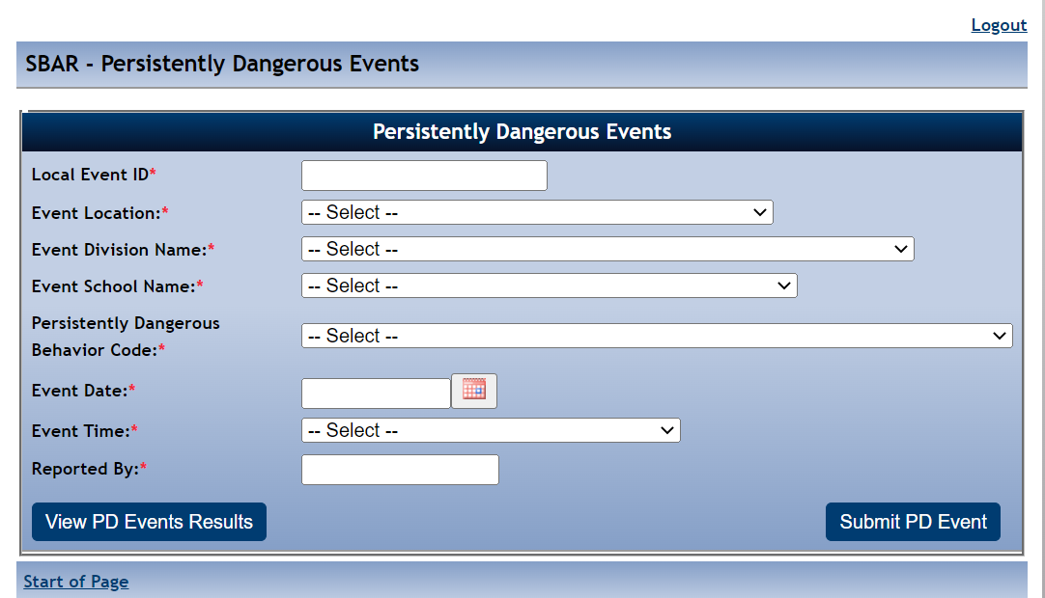
Reporting Persistently Dangerous Events
PD Event Form
PD Category 1 Behavior Codes must be entered within 10 days of the event
If there is an immediate response to a PD event that is pending investigation, then that response must be entered into SBAR
Entries in the form do not factor into the Persistently Dangerous Calculation
Entries will not be deleted

Slide 28
Reporting PD Events pending investigation
New Fields in the PD Event Form
Pending Investigation (Yes or No)
  Pending Investigation "Yes" will let VDOE know that the event is being investigated and there has not been a final response
2. Post Investigation Status (Substantiated or Not Substantiated)
  Post Investigation Status indicates the outcome of the investigation
  When the outcome is Not Substantiated, the PD Behavior Code that was entered in the PD Events Form does not have to be reported in the SBAR Data File.
  The user can report the appropriate Behavior Code for the local event id in the SBAR data file
  When the outcome is Substantiated, the user must report the exact PD Behavior Code that was entered in the PD Events Form for the local event id

Slide 29
Making Corrections to the PD Events Form
School Divisions and Regional Programs
VDOE
Will be able to modify data fields
  Event Location
  Event Division Name
  Event School Name
  Event Date
  Event Time
  Reported by
  Pending Investigation
  Post Investigation
Will modify Local Event ID and Persistently Dangerous Behavior Code Fields
Require Email and/or supporting documentation to modify Local Event ID and Persistently Dangerous Behavior Code Field

Slide 30
Timeline and Resources

Slide 31
SBAR Data Reporting Timeline 2023-2024
File Submission | Opening Date | Closing Date | Snapshot Date
Preliminary | February 1, 2024 | March 15, 2024 | First day of school through January 31st
End of Year | July 1, 2024 | August 16, 2024 (tentatively) | First day of school through June 30th
Pre-submission | After completion of EOY SBAR | When Preliminary and EOY are open | Any time- allows for checking file format and data edits

Slide 32
SBAR Application Support
Contact your local SSWS Account or back-up Account Manager if you need assistance with the following:
Assigning the SBAR application contact in ERA
  This is critical for VDOE to contact the correct person with important updates regarding SBAR
Determining rights and privileges to the SBAR application
  This includes setting up the SBAR collection manager, local approvers, and rights to submit the data or access reports
Establishing Superintendent Data Collection Approval (SDCA) account for Superintendent or Director
Notes:
If you need help, your local co-workers can assist you.
SSWS Account or back-up account manager
ERA contact

Slide 33
VDOE Contacts
Student Behavior And Administrative Response Collection website:
https://www.doe.virginia.gov/data-policy-funding/data-reports/data-collection/student-behavior-and-administrative-response-collection
Patricia Mealy, Data Specialist, Office of Data Services
Email: patricia.mealy@doe.virginia.gov or
resultshelp@doe.virginia.gov
Rebecca Kahila, School Safety and Discipline Specialist, Office of Student Services
Email: rebecca.kahila@doe.virginia.gov
Notes:
Other contact information:

Slide 34
Thank You
Notes:
This is the end of the presentation. Thank you.

