Slide 1
College Partnership Laboratory School Application Pipeline
Virginia Board of Education
College Partnership Laboratory School Standing Committee
October 3, 2023

Slide 2
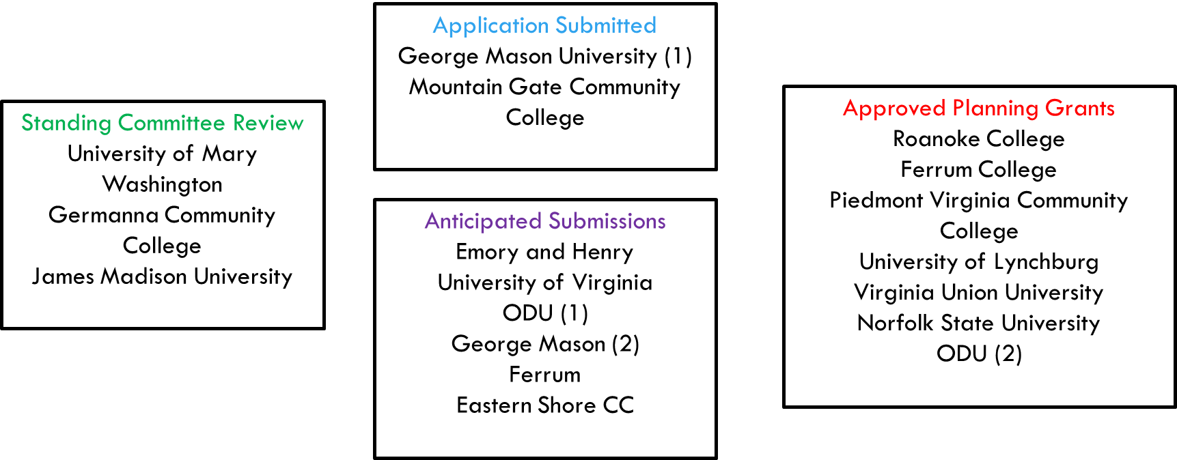
Current Application Pipeline (as of September 25, 2023)

Slide 3
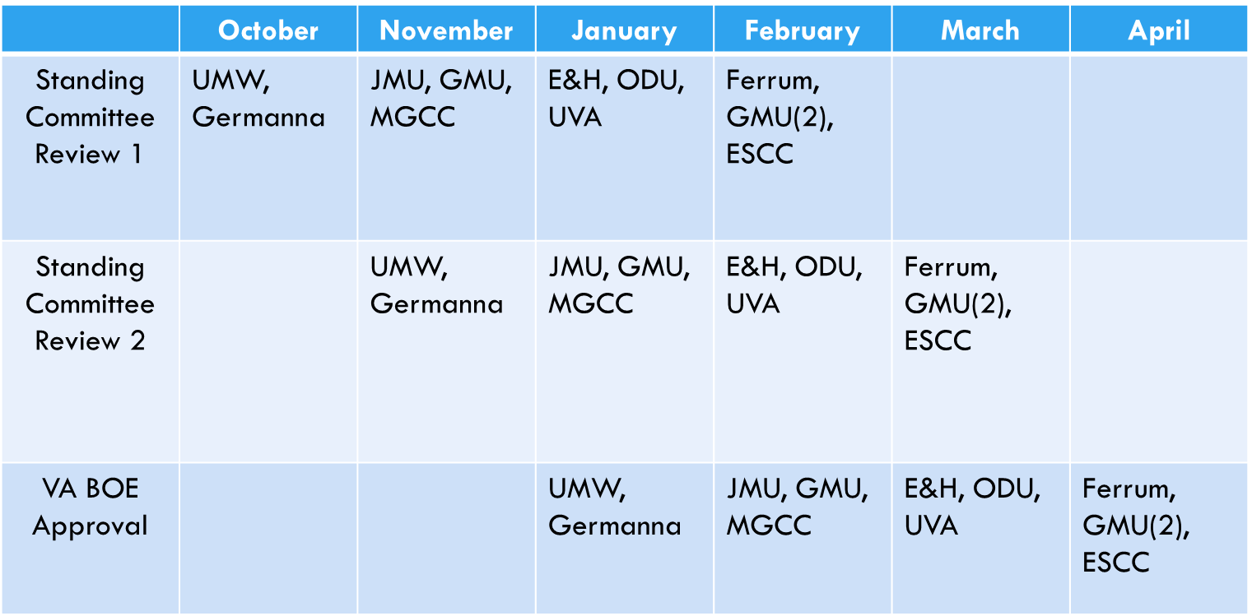
Anticipated Application Timeline

