Slide 1

2023 Mathematics Standards of Learning
Kindergarten
Overview of Revisions from 2016 to 2023
Notes:
Welcome to the Kindergarten presentation focused on the 2023 Mathematics Standards of Learning. The Proposed 2023 Mathematics Standards of Learning (SOL) were approved by the Board of Education on August 31, 2023.

Slide 2

Purpose
Overview of the 2023 Mathematics Standards of Learning
Highlight information in the Standards (including the Knowledge and Skills)
Referenced documents available at the Virginia Department of Education 2023 Mathematics Standards of Learning webpage.
Notes:
The purpose of this presentation is to provide a comparison of the 2016 mathematics standards of learning and the 2023 mathematics standards of learning and to highlight changes in the knowledge and skills.

Slide 3
Agenda
2023 Mathematics Standards of Learning Focus
Standards of Learning Supporting Documents
  Standards of Learning Document
  Overview of Revisions (2016 to 2023 Mathematics Standards of Learning) document
Comparison of 2016 to 2023 Standards
  Number and Number Sense
  Computation and Estimation
  Measurement and Geometry
  Probability and Statistics
  Patterns, Functions, and Algebra
Notes:
During this presentation, information will be shared regarding the 2023 Mathematics Standards of Learning documents that are currently available and the focus of the 2023 standards. Then a detailed comparison of the 2016 standards to the newly adopted 2023 standards will be provided.

Slide 4
2023 Mathematics Standards of Learning Focus
Notes:
The focus of the 2023 Mathematics Standards of Learning are included in the following slides.

Slide 5
2023 Standards of Learning Focus
The Mathematics Standards of Learning:
Include challenging mathematics content;
Reinforce foundational mathematics skills;
Support the application of mathematical concepts; and
Build coherently in complexity across grade levels.
Notes:
The mathematics standards of learning include challenging mathematics content, reinforce foundational mathematics skills, support the application of mathematical concepts, and build coherently in complexity across grade levels.

Slide 6
2023 Mathematics SOL Guiding Principles
Raise the Floor; Remove the Ceiling
Ensure Every Student Builds Strong Mathematics Foundational Skills
Master Critical Content
Integrate Mathematics Across All Content Areas
Prepare Teachers to Teach Mathematics Accurately and Effectively
Apply Mathematics to Better Use Technology
Notes:
There are six Guiding Principles included in the Virginia’s 2023 Mathematics Standards of Learning document that represent the values and beliefs upon which the revised standards were created. Preparing Virginia’s students to pursue higher education, to compete in a modern workforce, and to be informed citizens requires rigorous mathematical knowledge and skills. Students must gain an understanding of fundamental ideas in number sense, computation, measurement, geometry, probability, data analysis and statistics, and algebra and functions, and they must develop proficiency in mathematical skills. The six guiding principles are as follows:
Raise the Floor; Remove the Ceiling
Ensure Every Student Builds Strong Mathematics Foundational Skills
Master Critical Content
Integrate Mathematics Across All Content Areas
Prepare Teachers to Teach Mathematics Accurately and Effectively
Apply Mathematics to Better Use Technology

Slide 7
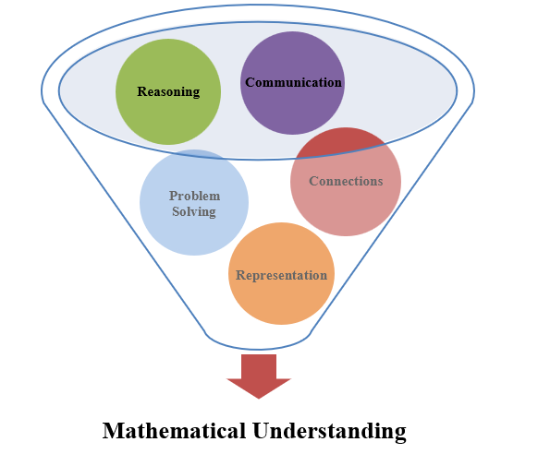
Mathematics Process Goals for Students
The content of the mathematics standards is intended to support the five process goals for students.
Notes:
The 2023 Mathematics Standards of Learning foster the application of the five mathematical process goals including reasoning, communication, problem solving, connections, and representation, and set students up to recognize and see mathematics in real-world applications. These processes support students in building understanding of mathematics.

Slide 8
Standards of Learning Supporting Documents
Notes:
Virginia Department of Education documents supporting the transition to the 2023 Mathematics Standards of Learning will now be shared. Additional resources supporting the implementation of the 2023 Mathematics Standards of Learning will be made available on the VDOE Mathematics SOL website.

Slide 9
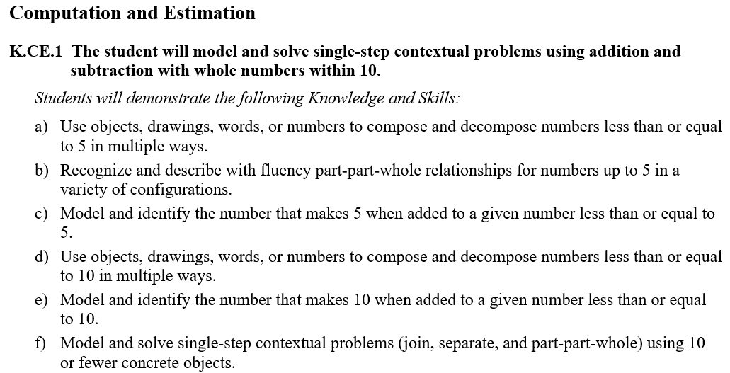
Standards Document
Notes:
The 2023 Mathematics Standards of Learning Document includes the standards and the knowledge and skills associated with each standard. This slide shows an example from the Kindergarten Standards Document.

Slide 10
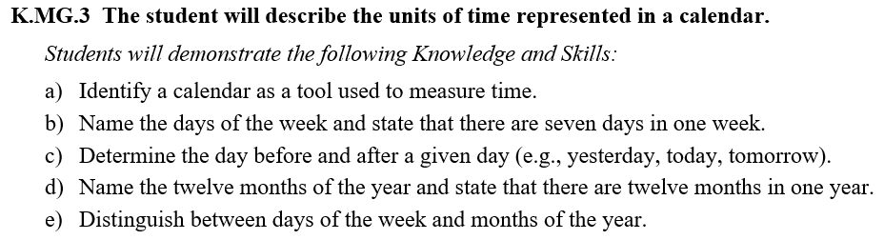
Changes to Numbering of the SOL
Third SOL within this strand
Grade
Measurement & Geometry Strand
KEY: NS = Number and Number Sense; CE = Computation and Estimation; MG = Measurement and Geometry; PS = Probability and Statistics; PFA = Patterns, Functions, and Algebra
Notes:
The new numbering system for the standards makes it clear within which strand a standard exists. For instance, the sample shown on the screen highlights K.MG.3. K indicates the grade level – Kindergarten in this instance; MG indicates the Measurement and Geometry Strand; and 3 indicates that this is the third standard of learning in this strand. The key shown at the bottom of the screen provides the abbreviations for each of the strands.

Slide 11
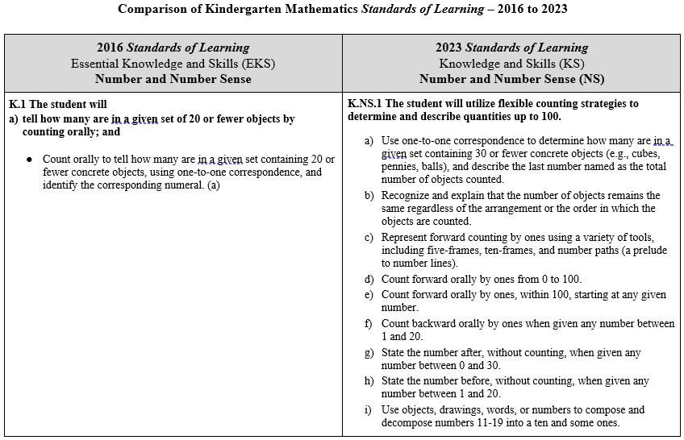
Overview of Revisions (2016 to 2023 Mathematics Standards of Learning) document
Notes:
An Overview of Revisions document has been created for each grade or course. This presentation provides a detailed comparison between the 2016 Standards of Learning and the 2023 Standards of Learning and is based upon the Overview of Revisions document.

Slide 12
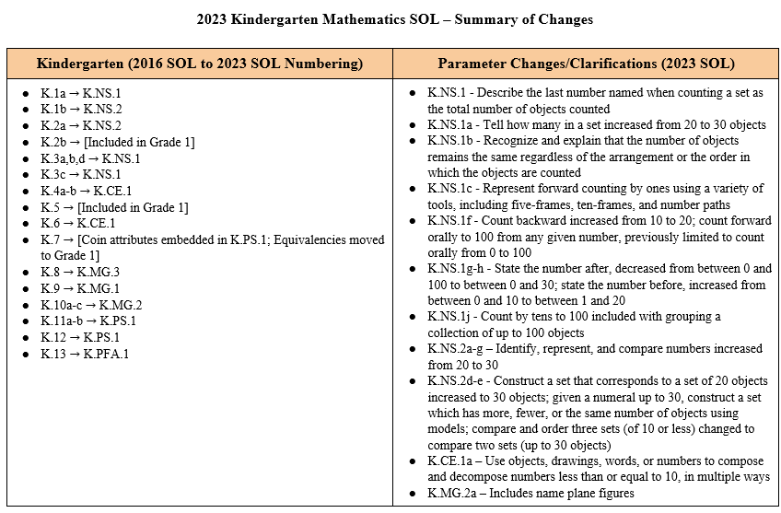
Overview of Revisions- Summary of Changes (1 of 2)
Notes:
At the end of the Overview of Revisions document there is a summary of changes table. One section of the table provides an overview of the changes to the numbering of the standards. Another section provides information regarding the prominent parameter changes and clarifications. Parameter changes and clarifications might be related to an increase or decrease in the limiters of the standards or the knowledge and skills; but might also be related to the depth of understanding of the content or scope of the content.

Slide 13
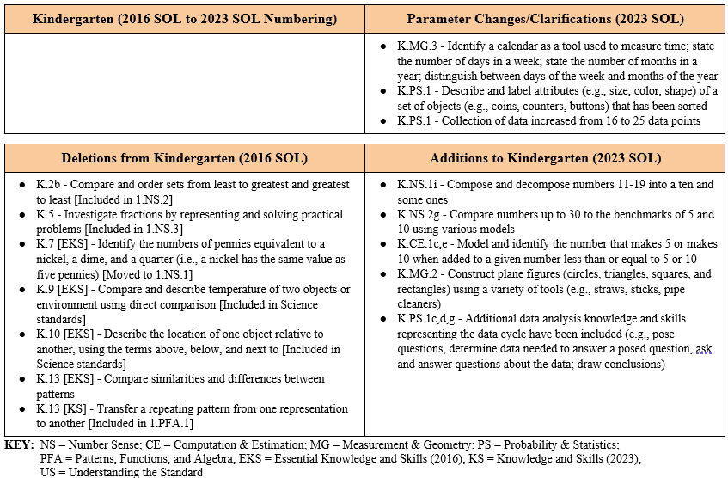
Overview of Revisions- Summary of Changes (2 of 2)
Notes:
The other two sections of the table include deletions from 2016 standards and addition of content to the 2023 standards.

Slide 14
Comparison of
2016 Mathematics SOL to 2023 Mathematics SOL
Notes:
During the remainder of the presentation, we will take a closer look at the revisions to the 2016 standards that resulted in the new 2023 standards.

Slide 15
Number & Number Sense
Notes:
Let’s take a look at the Number and Number Sense Strand.

Slide 16
Standard K.1a (2016) - Standard K.NS.1 (2023)
2016 SOL | 2023 SOL
K.1 The student will tell how many are in a given set of 20 or fewer objects by counting orally; Count orally to tell how many are in a given set containing 20 or fewer concrete objects, using one-to-one correspondence, and identify the corresponding numeral. | K.NS.1 The student will utilize flexible counting strategies to determine and describe quantities up to 100. Use one-to-one correspondence to determine how many are in a given set containing 30 or fewer concrete objects (e.g., cubes, pennies, balls), and describe the last number named as the total number of objects counted. Recognize and explain that the number of objects remains the same regardless of the arrangement or the order in which the objects are counted.
Revisions:
Count 30 or fewer objects (increased from 20)
Recognize and explain that the number of objects remains the same regardless of the arrangement or the order in which the objects are counted
Notes:
Throughout this presentation red text in the 2023 column indicates a parameter change or addition to the content at this level. Red text in the 2016 column provides notes about where content may have been moved or deleted. You will also see symbols that indicate content that is NEW to the grade level or course.
Content found in SOLk.1a is now located in SOL K.NS.1 a and b. The quantity of objects students will work with has increased from 20 to 30; Students will be asked to recognize and explain that the number of objects remains the same regardless of the arrangement or the order in which the objects are counted.

Slide 17
Standard K.1b (2016) - Standard K.NS.2 (2023)
2016 SOL | 2023 SOL
K.1 The student will b) read, write, and represent numbers from 0 through 20. Read, write, and represent numbers from 0-20 to include: Construct a set of objects that corresponds to a given numeral, including an empty set; Read and write the numerals from 0 through 20; – Identify written numerals from 0 through 20 represented in random order; Identify the numeral that corresponds to the total number of objects in a given set of 20 or fewer concrete objects; and Write a numeral that corresponds to a set of 20 or fewer concrete objects. | K.NS.2 The student will identify, represent, and compare quantities up to 30. Read, write, and identify the numerals 0 through 30. Construct a set of objects that corresponds to a given numeral within 30, including an empty set. Determine and write the numeral that corresponds to the total number of objects in a given set of 30 or fewer concrete objects or pictorial models.
Revisions:
Identify, represent, and compare numbers increased from 20 to 30
Notes:
SOL K.1 b is now SOL K.NS.2 a, b, and c. Clarity has been provided that students should be able to read, write and identify numerals and determine the numeral that corresponds to a set of objects. The number of objects that students are expected to work with has been increased from 20 to 30.

Slide 18

Standard K.2a (2016) - Standard K.NS.2 (2023)
2016 SOL | 2023 SOL
K.2 The student, given no more than three sets, each set containing 10 or fewer concrete objects, will compare and describe one set as having more, fewer, or the same number of objects as the other set(s); Compare and describe no more than three sets of 10 or fewer objects, using the terms more, fewer, and the same. Given a set of objects, construct a second set which has more, fewer, or the same number of objects | K.NS.2 The student will identify, represent, and compare quantities up to 30. Given a set of up to 30 objects, construct another set which has more, fewer, or the same number of objects using concrete or pictorial models. Given a numeral up to 30, construct a set which has more, fewer, or the same number of objects using concrete or pictorial models. Compare two sets containing up to 30 concrete objects or pictorial models, using the terms more, fewer, or the same as (equal to). Compare numbers up to 30, to the benchmarks of 5 and 10 using various models (e.g., five frames, ten frames, number paths [a prelude to number lines], beaded racks, hands) using the terms greater than, less than, or the same as (equal to).
Revisions:
Compare quantities up to 30
Comparison of sets will be limited to two sets
Compare numbers up to 30, to the benchmarks of 5 and 10 using various modes using the terms greater than, less than, or the same as (equal to)
Notes:
SOL K.2 a is now K.NS.2 d, e, and f in the 2023 standards. Students will compare sets with up to 30 objects; however, the number of sets students will work with has decreased from three sets to two sets. New to Kindergarten is the expectation that students will also compare numbers up to 30 to the benchmarks of five and ten using various models and describe the comparisons using the terms greater than, less, than, or the same as (equal to).

Slide 19
Standard K.2b (2016) -Deleted
2016 SOL | 2023 SOL
K.2 The student, given no more than three sets, each set containing 10 or fewer concrete objects, will compare and order sets from least to greatest and greatest to least [Deleted; included in Grade 1] Compare and order three or fewer sets, each set containing 10 or fewer concrete objects, from least to greatest and greatest to least.
Revisions:
Comparing sets from greatest to least and least to greatest has been removed from Kindergarten
Notes:
SOL K.2b - Comparing and ordering three sets of objects has been removed from Kindergarten; this content remains in grade 1. Students in Kindergarten will continue to compare two sets as shown on the previous slide.

Slide 20
Standard K.3 (2016) - Standard K.NS.1 (2023) - 1 of 2
2016 SOL | 2023 SOL
K.3 The student will a) count forward orally by ones from 0 to 100; b) count backward orally by ones when given any number between 1 and 10; Count forward orally by ones from 0 to 100. (a) Count backward orally by ones when given any number between 1 and 10. (b) | K.NS.1 The student will utilize flexible counting strategies to determine and describe quantities up to 100. Represent forward counting by ones using a variety of tools, including five-frames, ten-frames, and number paths (a prelude to number lines). Count forward orally by ones from 0 to 100. Count forward orally by ones, within 100, starting at any given number. Count backward orally by ones when given any number between 1 and 20.
Revisions:
Represent forward counting by ones using a variety of tools, including five-frames, ten-frames and number paths
Count forward orally by ones within 100, starting at any given number
Notes:
SOL K.3a and b is now K.NS.1. Clarification has been provided that students should represent forward counting by ones using a variety of tools and be able to count forward by ones, within 100, starting at any number.

Slide 21
Standard K.3 (2016) - Standard K.NS.1 (2023) – 2 of 2
2016 SOL | 2023 SOL
K.3 The student will identify the number after, without counting, when given any number between 0 and 100 and identify the number before, without counting, when given any number between 1 and 10; and count forward by tens to determine the total number of objects to 100. Identify the number after, without counting, when given any number between 0 and 100. (c) Identify the number before, without counting, when given any number between 1 and 10. (c) Count forward orally by tens, starting at 0, to determine the total number of objects up to 100. (d) | K.NS.1 The student will utilize flexible counting strategies to determine and describe quantities up to 100. State the number after, without counting, when given any number between 0 and 30. State the number before, without counting, when given any number between 1 and 20. Use objects, drawings, words, or numbers to compose and decompose numbers 11-19 into a ten and some ones. Group a collection of up to 100 objects ( e.g., counters, pennies, cubes,) into sets of ten and count by tens to determine the total (e.g., there are 3 groups of ten and 6 leftovers, 36 total objects).
Revisions:
State the number after, decreased from between 0 and 100 to between 0 and 30
State the number before, increased from between 0 and 10 to between 1 and 20
Use objects, drawings, words, or numbers to compose and decompose numbers 11-19 into a ten and some ones
Group a collection of objects up to 100 into sets of ten and count by tends to determine the total
Notes:
The content of SOL K.3 c and d can now be found in K.NS.1 g, h, i, and j of the 2023 standards. A parameter change to this standard includes having students state the number after, or the number before a given number. New content at this level, includes an explicit focus on developing students understanding of teen numbers by having students use objects, drawings, words, or numbers to compose and decompose numbers 11-19 into a ten and some ones. In addition to counting objects by tens students will group collections of up to 100 objects into sets of tens and leftover (ones) to determine the total.

Slide 22
Standard K.4 (2016) - Standard K.CE.1 (2023)
2016 SOL | 2023 SOL
K.4 The student will recognize and describe with fluency part-whole relationships for numbers up to 5; and investigate and describe part-whole relationships for numbers up to 10. Recognize and describe with fluency part-whole relationships for numbers up to 5 in a variety of configurations. (a) Investigate and describe part-whole relationships for numbers up to 10 using a variety of configurations. (b) | K.CE.1 The student will model and solve single-step contextual problems using addition and subtraction with whole numbers within 10. Use objects, drawings, words, or numbers to compose and decompose numbers less than or equal to 5 in multiple ways. Recognize and describe with fluency part-part-whole relationships for numbers up to 5 in a variety of configurations. Model and identify the number that makes 5 when added to a given number less than or equal to 5. Use objects, drawings, words, or numbers to compose and decompose numbers less than or equal to 10 in multiple ways. Model and identify the number that makes 10 when added to a given number less than or equal to 10.
Revisions:
Model and identify the number that makes 5 when added to a given number less than or equal to 5
Use objects, drawings, words, or numbers to compose and decompose numbers less than or equal to 10 in multiple ways
Model and identify the number that makes 10 when added to a given number less than or equal to 10
Notes:
SOL K.4 from the 2016 number sense standard has been included in the new Computation and Estimation standard K.CE.1 a and b. A new expectation at this level is that students will model and identify the number that makes 5 when added to a given number less than or equal to 5 and model and identify the number that makes 10 when added to a given number less than or equal to 10. Students will also be expected to use objects, drawings, words, or numbers to compose and decompose numbers less than or equal to 10 in multiple ways.

Slide 23
Standard K.5 (2016) - Deleted
2016 SOL | 2023 SOL
K.5 The student will investigate fractions by representing and solving practical problems involving equal sharing with two sharers. [Deleted; included in Grade 1] Share a whole equally with two sharers, when given a practical situation. Represent fair shares concretely or pictorially, when given a practical situation. Describe shares as equal pieces or parts of the whole (e.g., halves), when given a practical situation.
Revisions:
Fractions have been removed from Kindergarten
Notes:
SOL K.5 fraction content has been removed from Kindergarten; this content remains in Grade 1.

Slide 24
Computation & Estimation
Notes:
Now we will move on to the computation and estimation strand.

Slide 25
Standard K.6 (2016) - Standard K.Ce.1 (2023)
2016 SOL | 2023 SOL
K.6 The student will model and solve single-step story and picture problems with sums to 10 and differences within 10, using concrete objects. Model and solve various types of story and picture problems using 10 or fewer concrete objects. (Types of problems should include joining, separating, and part-part-whole scenarios.) | K.CE.1 The student will model and solve single-step contextual problems using addition and subtraction with whole numbers within 10. Model and solve single-step contextual problems (join, separate, and part-part-whole) using 10 or fewer concrete objects.
Revisions:
The terms "story and picture problems" have been changed to “contextual”
Notes:
SOL K.6 is now included in K.CE.1 - No content changes have been made to this standard; however, you will note that the phrase “story and picture problems” has been changed to include any “contextual” problem.

Slide 26
Measurement and Geometry
Notes:
The following slides represent changes to the measurement and geometry standards.

Slide 27
Standard K.7 (2016) - Deleted
2016 SOL | 2023 SOL
K.7 The student will recognize the attributes of a penny, nickel, dime, and quarter and identify the number of pennies equivalent to a nickel, a dime, and a quarter. [Coin attributes embedded in K.PS.1; Equivalencies moved to Grade 1] Describe the attributes (e.g., color, relative size) of a penny, nickel, dime, and quarter. Identify a penny, nickel, dime, and quarter. Identify the number of pennies equivalent to a nickel, a dime, and a quarter (i.e., a nickel has the same value as five pennies).
Revisions:
Coin attributes are embedded in K.PS.1 sorting and classifying objects
Equivalencies have been moved to Grade 1
Notes:
SOL K.7 Coin attributes are now integrated into K.PS.1 where students are sorting and classifying objects by their attributes. Coin equivalencies has been removed from Kindergarten and are now located in Grade 1.

Slide 28
Standard K.8 (2016) - Standard K.MG.3 (2023)
2016 SOL | 2023 SOL
K.8 The student will investigate the passage of time by reading and interpreting a calendar. Name the twelve months of the year. Name the seven days in a week. Determine the day before and after a given day (e.g., yesterday, today, tomorrow). | K.MG.3 The student will describe the units of time represented in a calendar. Identify a calendar as a tool used to measure time. Name the days of the week and state that there are seven days in one week. Determine the day before and after a given day (e.g., yesterday, today, tomorrow). Name the twelve months of the year and state that there are twelve months in one year. Distinguish between days of the week and months of the year.
Revisions:
Identify a calendar as a tool to measure time
State that there are seven days in one week and twelve months in one year
Distinguish between the days of the week and the months of the year
Notes:
SOL K.8 is now K.MG.3. In the new 2023 standards; students will identify a calendar as a tool to measure time. Students will continue to name the days of the week and months of the year but will now also state that there are seven days in one week and that there are twelve months in one year as well as be able to distinguish between the days of the week and the months of the year.

Slide 29
Standard K.9 (2016) - Standard K.MG.1 (2023)
2016 SOL | 2023 SOL
K.9 The student will compare two objects or events, using direct comparisons, according to one or more of the following attributes: length (longer, shorter), height (taller, shorter), weight (heavier, lighter), temperature (hotter, colder), volume (more, less), and time (longer, shorter). [Temperature included in Science standards] Compare and describe lengths of two objects as longer or shorter, using direct comparison (e.g., the bus is longer than the car). Compare and describe heights of two objects (as taller or shorter), using direct comparison. Compare and describe weights of two objects (as heavier or lighter), using direct comparison. Compare and describe temperature of two objects or environment (as hotter or colder), using direct comparison. Compare and describe volumes of two containers (as more or less), using direct comparison. Compare and describe the amount of time spent on tow events (as longer or shorter), using direct comparison. | K.MG.1 The student will reason mathematically by making direct comparisons between two objects or events using the attributes of length, height, weight, volume, and time. Use direct comparisons to compare, describe, and justify the: lengths of two objects using the terms longer or shorter; heights of two objects using the terms taller or shorter; weights of two objects using the terms heavier or lighter; volumes of two containers using the terms more or less; and amount of time spent on two events using the terms longer or shorter.
Revisions:
Temperature has been removed
Justify the direct comparisons between two objects or events
Notes:
SOL K.9 is now K.MG.1; note that temperature has been removed from the math standards but remains in the Kindergarten science standards. Students are now asked to justify direct comparisons between two objects or events.

Slide 30
Standard K.10 (2016) - Standard K.MG.2 (2023) – 1 of 2
2016 SOL | 2023 SOL
K.10 The student will identify and describe plane figures (circle, triangle, square, and rectangle); compare the size (smaller, larger) and shape of plane figures (circle, triangle, square, and rectangle); and Identify a circle, triangle, square, and rectangle (a) Describe the characteristics of triangles, squares, and rectangles, including number of sides and number of vertices. (a) Describe a circle using terms such as round and curved. (a) Compare and group plane figures (circle, triangle, square, and rectangle) according to their relative sizes (smaller, larger). (b) Compare and group plane figures (circle, triangle, square, and rectangle) according to their shapes. (b) Distinguish between examples and nonexamples of identified plane figures (circle, triangle, square, and rectangle). (b) | K.MG.2 The student will identify, describe, name, compare, and construct plane figures (circles, triangles, squares, and rectangles). Identify and name concrete and pictorial representations of circles, triangles, squares, and rectangles regardless of their orientation in space. Describe triangles, squares, and rectangles to include the number of sides and number of vertices. Describe a circle using terms such as round and curved. Distinguish between examples and nonexamples of identified plane figures (circles, triangles, square, and rectangles). Compare and contrast two plane figures using characteristics to describe similarities and differences. Construct plane figures (circles, triangles, squares, and rectangles) using a variety of materials (e.g., straws, sticks, pipe cleaners).
Revisions:
Name plane figures regardless of their orientation in space
Construct plane figures using a variety of materials
Notes:
SOL K.10 is now K.MG.2. Clarification has been made in this content that students will not only identify but will also name plane figures regardless of their orientation. New in the 2023 standards is constructing plane figures such as circles, triangles, squares, and rectangles using a variety of materials such as straws, sticks, pipe cleaners, etc. An example might be putting two squares together to form a rectangle.

Slide 31
Standard K.10 (2016) - Standard K.MG.2 (2023) – 2 of 2
2016 SOL | 2023 SOL
K.10 The student will describe the location of one object relative to another (above, below, next to) [Included in Science standards] and identify representations of plane figures (circle, triangle, square, and rectangle) regardless of their position and orientations in space. Identify pictorial representations of a circle, triangle, square, and rectangle, regardless of their position and orientation in space (c) Describe the location of one object relative to another, using the terms above, below, and next to. (c)
Revisions:
Describe the location of one object relative to another is included in the Science standards
Notes:
Note that SOL K.10c, describing the location of one object relative to another, has been removed from the mathematics standards; it remains part of the Kindergarten Science standards.

Slide 32
Probability and Statistics
Notes:
There are no probability standards in Kindergarten; however, there is greater emphasis on statistics as you will see in the following slides.

Slide 33
Standard K.11 (2016) - Standard K.PS.1 (2023) – 1 of 2
2016 SOL | 2023 SOL
K.11 The student will collect, organize, and represent data; and Collect data on categories identified by the teacher and/or student (e.g., number of siblings, types/numbers of pets, types of flowers in the garden). Data points, collected by students, should be limited to 16 or fewer for no more than four categories. (a) Represent data by arranging concrete objects into organized groups to form a simple object graph. (a) Represent gathered data, using pictures to form a simple picture graph (e.g., a picture graph of the weather for a month). (a) Represent gathered data in tables (vertically or horizontally). (a) | K.PS.1 The students will apply the data cycle (pose questions; collect or acquire data; organize and represent data; and analyze data and communicate results) with a focus on object graphs and picture graphs. Sort and classify concrete objects into appropriate subsets (categories) based on one attribute (e.g., size, shape, color, thickness). Describe and label attributes (e.g., size, color, shape) of a set of objects (e.g., coins, counters, buttons) that has been sorted. Pose questions, given a predetermined context, that require the collection of data (limited to 25 or fewer data points for no more than four categories). Determine the data needed to answer a posed question, and collect the data using various methods (e.g., counting objects, drawing pictures). Organize and represent a data set (vertically or horizontally) by sorting concrete objects into organized groups to form a simple object graph. Organize and represent a data set (vertically or horizontally) using pictures to form a simple picture graph.
Revisions:
Describe and label attributes of a set of objects which now include coins
Pose questions that require the collection of data and determine the data needed to answer a posed question
Collection of data by students increased from 16 to 25 or fewer data points
Notes:
The 2016 standards K.11, K.12 and part of K.7 are now included in K.PS.1. It is important to note that coins are now included in the objects students are asked to sort, classify, describe, and label (shown in ‘b’ on the slide).
New to all grade levels in the 2023 Standards Revision is greater emphasis on the application of the data cycle. In kindergarten students will continue to the focus on object graphs and picture graphs. As a part of the data cycle, students will also pose questions, determine the data needed to answer a posed question, and organize and represent data. The number of data points has increased from 16 to 25 data points.

Slide 34
Standard K.11 (2016) - Standard K.PS.1 (2023) – 2 of 2
2016 SOL | 2023 SOL
K.11 The student will read and interpret data in object graphs, picture graphs, and tables. Answer questions related to the gathered data displayed in object graphs, picture graphs, and tables: Read the graph to determine the categories of data and the data as a whole (e.g., the total number of responses) and its parts (e.g., five people are wearing sneakers); and Interpret the data that represents numerical relationships, including categories with the greatest, the least, or the same. (b) | K.PS.1 The students will apply the data cycle (pose questions; collect or acquire data; organize and represent data; and analyze data and communicate results) with a focus on object graphs and picture graphs. Analyze data represented in object graphs and picture graphs and communicate results: ask and answer questions about the data represented in objects graphs and picture graphs (e.g., how many in each category, which categories have the greatest, least, or the same amount of data); and draw conclusions about the data and make predictions based on the data.
Revisions:
Analyze data by asking questions and drawing conclusions about data
Notes:
In addition, Kindergarten students will analyze data by asking questions and drawing conclusions about the data.

Slide 35
Patterns, Functions & Algebra
Notes:
The final strand in Kindergarten is the Patterns, Functions and Algebra strand.

Slide 36
Standard K.12 (2016) – included in Standard K.PS.1 (2023)
2016 SOL | 2023 SOL
K.12 The student will sort and classify objects according to one attribute. [Included in K.PS.1] Identify the attributes of an object (e.g., color, size, shape, thickness) Sort objects into appropriate groups (categories) based on one attribute (e.g., size - large bears and small bears). Classify sets of objects into groups (categories) of one attribute. Label attributes of a set of objects that has been sorted. Name multiple ways to sort a set of objects.
Revisions:
Sort and classify objects has been embedded within K.PS.1
Notes:
SOL K.12 Sort and classify objects is now included within K.PS.1 as previously mentioned.

Slide 37
Standard K.13 (2016) - Standard K.PFA.1 (2023)
2016 SOL | 2023 SOL
K.13 The student will identify, describe, extend, create, and transfer repeating patterns. [Transfer included in 1.PFA.1] Identify and describe the core (the part of the sequence that repeats) found in repeating patterns of common objects, sounds, movements, and pictures. Extend a repeating pattern by adding at least two complete repetitions of the core to the pattern. Create a repeating pattern. Compare similarities and differences between patterns. [Deleted] Transfer a repeating pattern from one representation to another. [Deleted] | K.PFA.1 The student will identify, describe, extend, and create simple repeating patterns using various representations. Identify and describe the core found in repeating patterns. Extend a repeating pattern by adding at least two complete repetitions of the core to the pattern. Create and describe a repeating pattern using objects, colors, sounds, movements, or pictures.
Revisions:
Transfer repeating patterns removed
Compare similarities and differences between patterns has been removed
Notes:
SOL K.13 is now K.PFA.1. Transferring repeating patterns from one representation to another has been removed form Kindergarten; this content remains in Grade 1. Comparing similarities and differences between patterns has also been removed from Kindergarten; students in Grade 2 will make connections between two patterns.

Slide 38
Questions?
Contact the
Virginia Department of Education’s Mathematics Team at vdoe.mathematics@doe.virginia.gov
Notes:
This concludes the presentation on the 2023 Kindergarten Mathematics Standards of Learning revisions. It may be helpful to refer back to this presentation as you are using the Overview of Revisions document to plan for instruction. Should you have any questions, feel free to contact the Virginia Department of Education's Mathematics Team at the email address shown on the screen.

