Slide 1
2023 Mathematics Standards of Learning
Grade 6
Overview of Revisions from 2016 to 2023
Notes:
Welcome to the Grade 6 presentation focused on the 2023 Mathematics Standards of Learning. The Proposed 2023 Mathematics Standards of Learning (SOL) were approved by the Board of Education on August 31, 2023.

Slide 2
Purpose
Overview of the 2023 Mathematics Standards of Learning
Highlight information included in the Standards (including the Knowledge and Skills)
Referenced documents available at the Virginia Department of Education 2023 Mathematics Standards of Learning webpage.
Notes:
The purpose of this presentation is to provide a comparison of the 2016 mathematics standards of learning and the 2023 mathematics standards of learning and to highlight changes in the knowledge and skills.

Slide 3
Agenda
2023 Mathematics Standards of Learning Focus
Documents Currently Available
Standards of Learning Document
Overview of Revisions (2016 to 2023 Mathematics Standards of Learning) document
Comparison of 2016 to 2023 Standards
Number and Number Sense
Computation and Estimation
Measurement and Geometry
Probability and Statistics
Patterns, Functions, and Algebra
Notes:
During this presentation, information will be shared regarding the 2023 Mathematics Standards of Learning documents that are currently available and the focus of the 2023 standards. Then a detailed comparison of the 2016 standards to the newly adopted 2023 standards will be provided.

Slide 4
2023 Mathematics Standards of Learning Focus
Notes:
The focus of the 2023 Mathematics Standards of Learning are included in the following slides.

Slide 5
2023 Standards of Learning Focus
The Mathematics Standards of Learning:
Include challenging mathematics content;
Reinforce foundational mathematics skills;
Support the application of mathematical concepts; and
Build coherently in complexity across grade levels.
Notes:
The mathematics standards of learning include challenging mathematics content, reinforce foundational mathematics skills, support the application of mathematical concepts, and build coherently in complexity across grade levels.

Slide 6
2023 Mathematics SOL Guiding Principles
Raise the Floor; Remove the Ceiling
Ensure Every Student Builds Strong Mathematics Foundational Skills
Master Critical Content
Integrate Mathematics Across All Content Areas
Prepare Teachers to Teach Mathematics Accurately and Effectively
Apply Mathematics to Better Use Technology
Notes:
There are six Guiding Principles included in the Virginia’s 2023 Mathematics Standards of Learning document that represent the values and beliefs upon which the revised standards were created. Preparing Virginia’s students to pursue higher education, to compete in a modern workforce, and to be informed citizens requires rigorous mathematical knowledge and skills. Students must gain an understanding of fundamental ideas in number sense, computation, measurement, geometry, probability, data analysis and statistics, and algebra and functions, and they must develop proficiency in mathematical skills. The six guiding principles are as follows:
Raise the Floor; Remove the Ceiling:
Ensure Every Student Builds Strong Mathematics Foundational Skills:
Master Critical Content:
Integrate Mathematics Across All Content Areas:
Prepare Teachers to Teach Mathematics Accurately and Effectively:
Apply Mathematics to Better Use Technology:

Slide 7
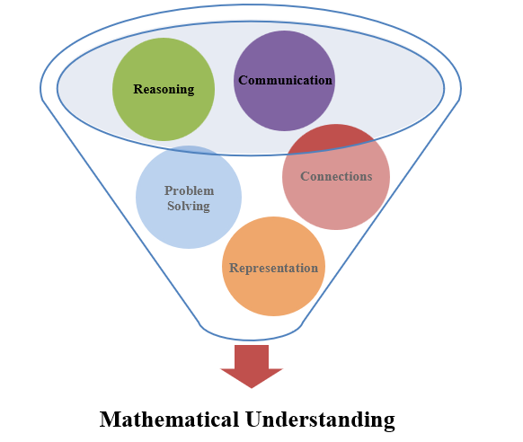
Mathematics Process Goals for Students
The content of the mathematics standards is intended to support the five process goals for students in building understanding.
Notes:
The 2023 Mathematics Standards of Learning foster the application of the five mathematical process goals including reasoning, communication, problem solving, connections, and representation, and set students up to recognize and see mathematics in real-world applications. These processes support students in building understanding of mathematics.

Slide 8
Standards of Learning Supporting Documents
Notes:
Virginia Department of Education documents supporting the transition to the 2023 Mathematics Standards of Learning will now be shared. Additional resources supporting the implementation of the 2023 Mathematics Standards of Learning will be made available on the VDOE Mathematics SOL website.

Slide 9
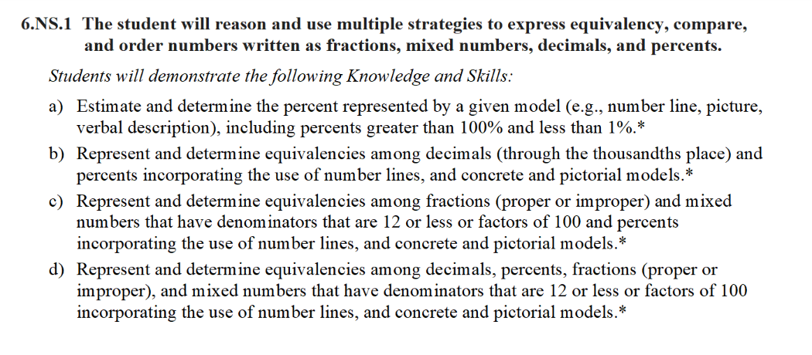
Standards Document
Notes:
The 2023 Mathematics Standards of Learning Document includes the standards and the knowledge and skills associated with each standard. This slide shows an example from the Grade 6 Standards Document.

Slide 10
Changes to Numbering of the SOL
First SOL within this strand
Grade
Number and Number Sense Strand
KEY: NS = Number and Number Sense; CE = Computation and Estimation; MG = Measurement and Geometry; PS = Probability and Statistics; PFA = Patterns, Functions, and Algebra
Notes:
The new numbering system for the standards makes it clear within which strand a standard exists. For instance, the sample shown on the screen highlights 6.NS.1. Six indicates the grade level; NS indicates the Number and Number Sense Strand; and 1 indicates that this is the first standard of learning in this strand. The key shown at the bottom of the screen provides the abbreviations for each of the strands.

Slide 11
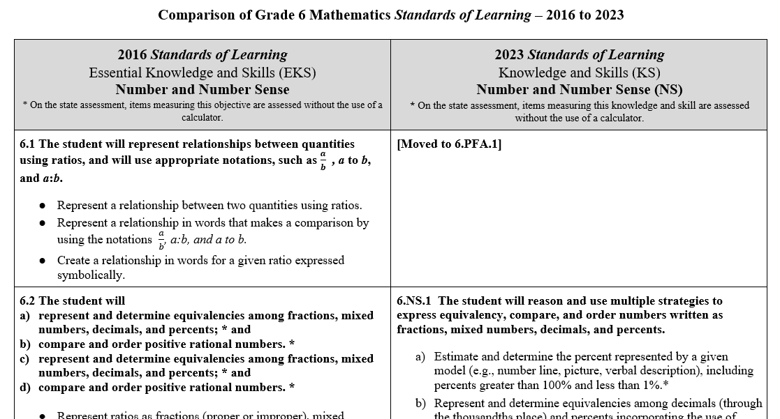
Overview of Revisions (2016 to 2023 Mathematics Standards of Learning) document
Notes:
An Overview of Revisions document has been created for each grade or course. This presentation provides a detailed comparison between the 2016 Standards of Learning and the 2023 Standards of Learning and is based upon the Overview of Revisions document.

Slide 12
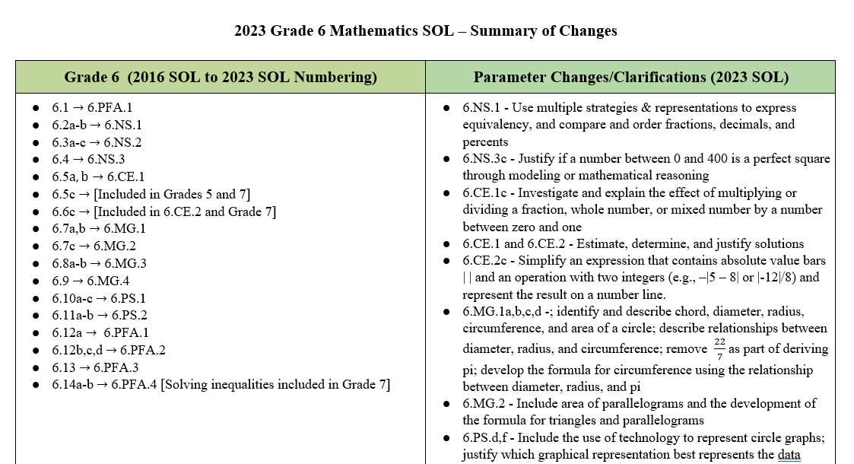
Overview of Revisions- Summary of Changes (1 of 2)
Notes:
At the end of the Overview of Revisions document there is a summary of changes table. One section of the table provides an overview of the changes to the numbering of the standards. Another section provides information regarding the prominent parameter changes and clarifications. Parameter changes and clarifications might be related to an increase or decrease in the limiters of the standards or the knowledge and skills; but might also be related to the depth of understanding of the content or scope of the content.

Slide 13
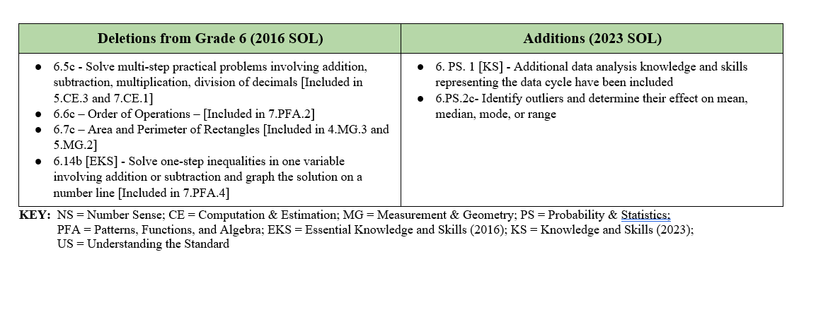
Overview of Revisions- Summary of Changes (2 of 2)
Notes:
The other two sections of the table include deletions from 2016 standards and addition of content to the 2023 standards.

Slide 14
Comparison of 2016 Mathematics SOL to 2023 Mathematics SOL
Notes:
During the remainder of the presentation, we will take a closer look at the revisions to the 2016 standards that resulted in the new 2023 standards.

Slide 15
Number & Number Sense
Notes:
We will first examine the changes that occurred in the Number and Number Sense strand.​​

Slide 16
Standard 6.1 (2016) - Standard 6.PFA.1 (2023)
2016 SOL | 2023 SOL
6.1 The student will represent relationships between quantities using ratios, and will use appropriate notations, such as ab , a to b, and a:b. Represent a relationship between two quantities using ratios. Represent a relationship in words that makes a comparison by using the notations ab, a:b, and a to b. Create a relationship in words for a given ratio expressed symbolically. | 6.PFA.1 The student will use ratios to represent relationships between quantities, including those in context. Represent a relationship between two quantities using ratios. Represent a relationship in context that makes a comparison by using the notations ab, a:b, and a to b. Represent different comparisons within the same quantity or between different quantities (e.g., part to part, part to whole, whole to whole). Create a relationship in words for a given ratio expressed symbolically.
Revisions:
This standard was moved to be with the proportional reasoning standard 6.PFA.1
Represent different comparisons within the same quantity or between different quantities
Notes:
Standard 6.1 in 2016 is now included in 6.PFA.1 in the 2023 Standards. An additional parameter for this standard includes representing different comparisons within the same quantity or between different quantities.

Slide 17
Standard 6.2 (2016) - Standard 6.NS.1 (2023) (1 of 2)
2016 SOL | 2023 SOL
6.2 The student will represent and determine equivalencies among fractions, mixed numbers, decimals, and percents; * and Represent ratios as fractions (proper or improper), mixed numbers, decimals, and/or percents. (a) Determine the decimal and percent equivalents for numbers written in fraction form (proper or improper) or as a mixed number, including repeating decimals. (a) Represent and determine equivalencies among decimals, percents, fractions (proper or improper), and mixed numbers that have denominators that are 12 or less or factors of 100. (a) | 6.NS.1 The student will reason and use multiple strategies to express equivalency, compare, and order numbers written as fractions, mixed numbers, decimals, and percents. Estimate and determine the percent represented by a given model (e.g., number line, picture, verbal description), including percents greater than 100% and less than 1%.* Represent and determine equivalencies among decimals (through the thousandths place) and percents incorporating the use of number lines, and concrete and pictorial models.* Represent and determine equivalencies among fractions (proper or improper) and mixed numbers that have denominators that are 12 or less or factors of 100 and percents incorporating the use of number lines, and concrete and pictorial models.* Represent and determine equivalencies among decimals, percents, fractions (proper or improper), and mixed numbers that have denominators that are 12 or less or factors of 100 incorporating the use of number lines, and concrete and pictorial models.*
Revisions:
Estimate and determine the percent represented by a given model
Represent and determine equivalence between decimal and percent, AND fraction and percent before determining equivalency among all three forms
Notes:
Standard 6.2a in 2016 is now 6.NS.1 in the 2023 Standards. An asterisk denotes “on the state assessment, items measuring this objective are assessed without the use of a calculator”. Note the asterisk in 2016 was included at the standard level; in 2023, the asterisk is included at the knowledge and skill level. In standard 6.NS.1, students will estimate and determine the percent represented by a given model. They will represent and determine equivalencies between decimals and percents and between fractions and percents prior to determining equivalency among all three forms.

Slide 18
Standard 6.2 (2016) - Standard 6.NS.1 (2023) (2 of 2)
2016 SOL | 2023 SOL
6.2 The student will b) compare and order positive rational numbers. Compare two percents using pictorial representations and symbols (<, ≤, ≥, >, =). (b) Order no more than four positive rational numbers expressed as fractions (proper or improper), mixed numbers, decimals, and percents (decimals through thousandths, fractions with denominators of 12 or less or factors of 100). Ordering may be in ascending or descending order. (b) | 6.NS.1 The student will reason and use multiple strategies to express equivalency, compare, and order numbers written as fractions, mixed numbers, decimals, and percents. Use multiple strategies (e.g., benchmarks, number line, equivalency) to compare and order no more than four positive rational numbers expressed as fractions (proper or improper), mixed numbers, decimals, and percents (decimals through thousandths, fractions with denominators of 12 or less or factors of 100) with and without models. Justify solutions orally, in writing or with a model. Ordering may be in ascending or descending order.*
Revisions:
Use multiple strategies to compare and order
Notes:
Standard 6.2b in 2016 is now 6.NS.1 in the 2023 Standards. In the new standard, emphasis is placed on using multiple strategies to compare and order rational numbers. Strategies could include using benchmark fractions, number lines and equivalency.

Slide 19
Standard 6.3 (2016) - Standard 6.NS.2 (2023)
2016 SOL | 2023 SOL
6.3 The student will identify and represent integers; compare and order integers; and identify and describe absolute value of integers. Model integers, including models derived from practical situations. (a) Identify an integer represented by a point on a number line. (a) Compare and order integers using a number line. (b) Compare integers, using mathematical symbols (<, >, =). (b) Identify and describe the absolute value of an integer. (c) | 6.NS.2 The student will reason and use multiple strategies to represent, compare, and order integers. Represent integers (e.g., number lines, concrete materials, pictorial models), including models derived from contextual situations, and identify an integer represented by a point on a number line. Compare and order integers using a number line. Compare integers, using mathematical symbols (<, >, =). Identify and describe the absolute value of an integer as the distance from zero on the number line.
Revisions:
No significant changes between the 2016 and 2023 standard
Notes:
Standard 6.3 in 2016 is now 6.NS.2 in the 2023 Standards. Students represent integers in a variety of ways including number lines, concrete materials and pictorial models.

Slide 20
Standard 6.4 (2016) - Standard 6.NS.3 (2023)
2016 SOL | 2023 SOL
6.4 The student will recognize and represent patterns with whole number exponents and perfect squares. Recognize and represent patterns with bases and exponents that are whole numbers. Recognize and represent patterns of perfect squares not to exceed ${20}^{2}$, by using grid paper, square tiles, tables, and calculators. Recognize powers of 10 with whole number exponents by examining patterns in place value. | 6.NS.3 The student will recognize and represent patterns with whole number exponents and perfect squares. Recognize and represent patterns with bases and exponents that are whole numbers. Recognize and represent patterns of perfect squares not to exceed ${20}^{2}$, by using concrete and pictorial models. Justify if a number between 0 and 400 is a perfect square through modeling or mathematical reasoning. Recognize and represent powers of 10 with whole number exponents by examining patterns in place value.
Revisions:
Justify if a number between 0 and 400 is a perfect square through modeling or mathematical reasoning
Notes:
Standard 6.4 in 2016 is now 6.NS.3 in the 2023 Standards. In addition to recognizing and representing patterns of perfect squares, students will also be asked to justify if a number is a perfect square using models or mathematical reasoning.

Slide 21
Computation & Estimation
Notes:
Now we will examine the changes that occurred in the Computation and Estimation strand.​​

Slide 22
Standard 6.5 (2016) - Standard 6.CE.1 (2023) (1 of 2)
2016 SOL | 2023 SOL
6.5 The student will multiply and divide fractions and mixed numbers; * Demonstrate/model multiplication and division of fractions (proper or improper) and mixed numbers using multiple representations. (a) Multiply and divide fractions (proper or improper) and mixed numbers. Answers are expressed in simplest form. (a) | 6.CE.1 The student will estimate, demonstrate, solve, and justify solutions to problems using operations with fractions and mixed numbers, including those in context. Demonstrate/model multiplication and division of fractions (proper or improper) and mixed numbers using multiple representations.* Multiply and divide fractions (proper or improper) and mixed numbers that include denominators of 12 or less. Answers are expressed in simplest form.* Investigate and explain the effect of multiplying or dividing a fraction, whole number, or mixed number by a number between zero and one.*
Revisions:
ADDED 6.CE.1c: Investigate and explain the effect of multiplying or dividing a fraction, whole number, or mixed number by a number between zero and one
Notes:
Standard 6.5a in 2016 is now 6.CE.1a, b and c in the 2023 Standards. In 6.CE.1b, denominators of the factors being multiplied or divided are limited to 12 or less. 6.CE.1c is a new expectation that asks students to investigate and explain the effect of multiplying or dividing a fraction, whole number, or mixed number by a number between zero and one.

Slide 23
Standard 6.5 (2016) - Standard 6.CE.1 (2023) (2 of 2)
2016 SOL | 2023 SOL
6.5 The student will b) solve single-step and multistep practical problems involving addition, subtraction, multiplication, and division of fractions and mixed numbers; and Solve single-step and multistep practical problems that involve addition and subtraction with fractions (proper or improper) and mixed numbers, with and without regrouping, that include like and unlike denominators of 12 or less. Answers are expressed in simplest form. (b) Solve single-step and multistep practical problems that involve multiplication and division with fractions (proper or improper) and mixed numbers that include denominators of 12 or less. Answers are expressed in simplest form. (b) | 6.CE.1 The student will estimate, represent, solve, and justify solutions to problems using operations with fractions and mixed numbers, including those in context. Estimate, determine, and justify the solution to single-step and multistep problems in context that involve addition and subtraction with fractions (proper or improper) and mixed numbers, with and without regrouping, that include like and unlike denominators of 12 or less. Answers are expressed in simplest form. Estimate, determine, and justify the solution to single-step and multistep problems in context that involve multiplication and division with fractions (proper or improper) and mixed numbers that include denominators of 12 or less. Answers are expressed in simplest form.
Revisions:
In addition to solving, students are asked to estimate the answer and justify their solution
Notes:
Standard 6.5b in 2016 is now 6.CE.1d and e in the 2023 standards. Students are asked to estimate the answer and justify their solution in addition to determining the answer.

Slide 24
Standard 6.5c (2016) - Deleted
2016 SOL | 2023 SOL
6.5 The student will c) solve multistep practical problems involving addition, subtraction, multiplication, and division of decimals. Solve multistep practical problems involving addition, subtraction, multiplication, and division with decimals. Divisors are limited to a three-digit number, with decimal divisors limited to hundredths. (c) | [Included in Grade 5 and Grade 7]
Revisions:
This standard is included in Grade 5 and Grade 7
Notes:
Standard 6.5c in 2016 has been deleted from the 2023 standards because it is included in grade 5 and grade 7.

Slide 25
Standard 6.6 (2016) - Standard 6.CE.2 (2023)
2016 SOL | 2023 SOL
6.6 The student will add, subtract, multiply, and divide integers; * solve practical problems involving operations with integers; and Model addition, subtraction, multiplication, and division of integers using pictorial representations or concrete manipulatives. (a) Add, subtract, multiply, and divide two integers. (a) Solve practical problems involving addition, subtraction, multiplication, and division with integers. (b) | 6.CE.2 The student will estimate, demonstrate, solve, and justify solutions to problems using operations with integers, including those in context. Demonstrate/model addition, subtraction, multiplication, and division of integers using pictorial representations or concrete manipulatives.* Add, subtract, multiply, and divide two integers.* Simplify an expression that contains absolute value bars | | and an operation with two integers (e.g., –|5 – 8| or $\frac{\left|−12\right|}{8}$) and represent the result on a number line. Estimate, determine, and justify the solution to one and two-step contextual problems, involving addition, subtraction, multiplication, and division with integers.
Revisions:
Simplify an expression that contains absolute value bars and an operation with two integers
In addition to solving, students are asked to estimate the answer and justify their solution
Notes:
Standard 6.6a,b in 2016 is now 6.CE.2 in the 2023 standards. Students will be simplifying expressions that contain absolute value bars and one operation with two integers in preparation for evaluating more complex numerical expressions using the order of operations in grade 7. Additionally, students are asked to estimate the answer and justify their solution in addition to determining the answer for contextual problems.

Slide 26
Standard 6.6c (2016) - Deleted
2016 SOL | 2023 SOL
6.6 The student will c) simplify numerical expressions involving integers. * Use the order of operations and apply the properties of real numbers to simplify numerical expressions involving more than two integers. Expressions should not include braces { } or brackets [ ], but may contain absolute value bars. Simplification will be limited to three operations, which may include simplifying a whole number raised to an exponent of 1, 2 or 3. (c) | [Included in 6.CE.2 and Grade 7]
Revisions:
Included in 6.CE.2 and Grade 7
Notes:
Standard 6.6c in 2016 has been deleted from the 6th grade standards for 2023. Students will simplify absolute value expressions in 6.CE.2c and will simplify numerical expressions using the order of operations in Grade 7.

Slide 27
Measurement and Geometry
Notes:
We will now look at the changes that occurred in the Measurement and Geometry strand.​

Slide 28
Standard 6.7 (2016) - Standard 6.MG.1 (2023)
2016 SOL | 2023 SOL
6.7 The student will derive π (pi); Derive an approximation for pi (3.14 or 227 ) by gathering data and comparing the circumference to the diameter of various circles, using concrete materials or computer models. (a) | 6.MG.1 The student will identify the characteristics of circles and solve problems, including those in context, involving circumference and area. Identify and describe chord, diameter, radius, circumference, and area of a circle. Investigate and describe the relationship between: diameter and radius; radius and circumference; and diameter and circumference. Develop an approximation for pi (3.14) by gathering data and comparing the circumference to the diameter of various circles, using concrete manipulatives or technological models.
Revisions:
Removed 22/7 as part of deriving pi
Identify and describe chord, diameter, radius, circumference, and area of a circle
Investigate and describe the relationship between diameter and radius, radius and circumference and diameter and circumference
Notes:
Standard 6.7a in 2016 is now 6.MG.1a, b and c in the 2023 standards. 22/7 has been removed as part of deriving pi. Students will identify and describe the parts of a circle and will investigate and describe the relationship between diameter and radius, radius and circumference and diameter and circumference.

Slide 29
Standard 6.7(2016) - Standard 6.MG.1 (2023)
2016 SOL | 2023 SOL
6.7 The student will b) solve problems, including practical problems, involving circumference and area of a circle; and Solve problems, including practical problems, involving circumference and area of a circle when given the length of the diameter or radius. (b) | 6.MG.1 The student will identify the characteristics of circles and solve problems, including those in context, involving circumference and area. Develop the formula for circumference using the relationship between diameter, radius, and pi. Solve problems, including those in context, involving circumference and area of a circle when given the length of the diameter or radius.
Revisions:
Develop the formula for circumference using the relationship between diameter, radius, and pi
Notes:
Standard 6.7b in 2016 is now 6.MG.1d and e in the 2023 standards. Prior to solving problems involving circumference, students will develop the formula for circumference using the relationship between diameter, radius and pi.

Slide 30
Standard 6.7c (2016) - Standard 6.MG.2 (2023)
2016 SOL | 2023 SOL
6.7 The student will c) solve problems, including practical problems, involving area and perimeter of triangles and rectangles. [Area and Perimeter of Rectangles included in Grades 4 and 5] Solve problems, including practical problems, involving area and perimeter of triangles and rectangles. (c) | 6.MG.2 The student will reason mathematically to solve problems, including those in context, that involve the area and perimeter of triangles, and parallelograms. Develop the formula for determining the area of parallelograms and triangles using pictorial representations and concrete manipulatives (e.g., two-dimensional diagrams, grid paper, etc.). Solve problems, including those in context, involving the perimeter and area of triangles, and parallelograms.
Revisions:
Area and perimeter of rectangles is deleted
Area and perimeter of parallelograms
Develop the formula for determining the area of parallelograms and triangles
Notes:
Standard 6.7c in 2016 is now 6.MG.2 in the 2023 standards. Finding the area and perimeter of rectangles has been removed because it is included in Grades 4 and 5. Finding the area and perimeter of parallelograms is a new expectation. Prior to solving problems involving perimeter and area of triangles and parallelograms, students will develop the formulas for determining the area using pictorial representations and concrete manipulatives.

Slide 31
Standard 6.8 (2016) - Standard 6.MG.3 (2023) (1 of 2)
2016 SOL | 2023 SOL
6.8 The student will identify the components of the coordinate plane; and Identify and label the axes, origin, and quadrants of a coordinate plane. (a) Identify the quadrant or the axis on which a point is positioned by examining the coordinates (ordered pair) of the point. Ordered pairs will be limited to coordinates expressed as integers. (a) | 6.MG.3 The student will describe the characteristics of the coordinate plane and graph ordered pairs. Identify and label the axes, origin, and quadrants of a coordinate plane. Identify and describe the location (quadrant or the axis) of a point given as an ordered pair. Ordered pairs will be limited to coordinates expressed as integers.
Revisions:
No significant changes between the 2016 and 2023 standard
Notes:
Standard 6.8a in 2016 is now 6.MG.3a and b in the 2023 standards.

Slide 32
Standard 6.8 (2016) - Standard 6.MG.3 (2023) (2 of 2)
2016 SOL | 2023 SOL
6.8 The student will b) identify the coordinates of a point and graph ordered pairs in a coordinate plane. Graph ordered pairs in the four quadrants and on the axes of a coordinate plane. Ordered pairs will be limited to coordinates expressed as integers. (b) Identify ordered pairs represented by points in the four quadrants and on the axes of the coordinate plane. Ordered pairs will be limited to coordinates expressed as integers. (b) Relate the coordinates of a point to the distance from each axis and relate the coordinates of a single point to another point on the same horizontal or vertical line. Ordered pairs will be limited to coordinates expressed as integers. (b) Draw polygons in the coordinate plane given coordinates for the vertices; use coordinates to determine the length of a side joining points with the same first coordinate or the same second coordinate. Ordered pairs will be limited to coordinates expressed as integers. Apply these techniques in the context of solving practical and mathematical problems. (b) | 6.MG.3 The student will describe the characteristics of the coordinate plane and graph ordered pairs. Graph ordered pairs in the four quadrants and on the axes of a coordinate plane. Ordered pairs will be limited to coordinates expressed as integers. Identify ordered pairs represented by points in the four quadrants and on the axes of the coordinate plane. Ordered pairs will be limited to coordinates expressed as integers. Relate the coordinates of a point to the distance from each axis and relate the coordinates of a single point to another point on the same horizontal or vertical line. Ordered pairs will be limited to coordinates expressed as integers. Draw polygons in the coordinate plane given coordinates for the vertices; use coordinates to determine the length of a side joining points with the same first coordinate or the same second coordinate. Ordered pairs will be limited to coordinates expressed as integers. Apply these techniques in the context of solving contextual and mathematical problems.
Revisions:
No significant changes between the 2016 and 2023 standard
Notes:
Standard 6.8b in 2016 is now 6.MG.3c, d, e and f in the 2023 standards.

Slide 33
Standard 6.9 (2016) - Standard 6.MG.4 (2023)
2016 SOL | 2023 SOL
6.9 The student will determine congruence of segments, angles, and polygons. Identify regular polygons. Draw lines of symmetry to divide regular polygons into two congruent parts. Determine the congruence of segments, angles, and polygons given their properties. Determine whether polygons are congruent or non-congruent according to the measures of their sides and angles. | 6.MG.4 The student will determine congruence of segments, angles, and polygons. Identify regular polygons. Draw lines of symmetry to divide regular polygons into two congruent parts. Determine the congruence of segments, angles, and polygons given their properties. Determine whether polygons are congruent or non-congruent according to the measures of their sides and angles.
Revisions:
No significant changes between the 2016 and 2023 standard
Notes:
Standard 6.9 in 2016 is now 6.MG.4 in the 2023 standards.

Slide 34
Probability and Statistics
Notes:
We will now discuss the changes that occurred in the Probability and Statistics strand.​

Slide 35
Standard 6.10 (2016) - Standard 6.PS.1 (2023) (1 of 2)
2016 SOL | 2023 SOL
6.10 The student, given a practical situation, will represent data in a circle graph; Collect, organize, and represent data in a circle graph. The number of data values should be limited to allow for comparisons that have denominators of 12 or less or those that are factors of 100 (e.g., in a class of 20 students, 7 choose apples as a favorite fruit, so the comparison is 7 out of 20, 720 , or 35%). (a) | 6.PS.1 The student will apply the data cycle (formulate questions; collect or acquire data; organize and represent data; and analyze data and communicate results) with a focus on circle graphs. Formulate questions that require the collection or acquisition of data with a focus on circle graphs. Determine the data needed to answer a formulated question and collect the data (or acquire existing data) using various methods (e.g., observations, measurement, surveys, experiments). Determine the factors that will ensure that the data collected is a sample that is representative of a larger population. Organize and represent data using circle graphs, with and without the use of technology tools. The number of data values should be limited to allow for comparisons that have denominators of 12 or less or those that are factors of 100 (e.g., in a class of 20 students, 7 choose apples as a favorite fruit, so the comparison is 7 out of 20, $\frac{7}{20}$ , or 35%).
Revisions:
Formulate questions that require the collection or acquisition of data
Determine factors that will ensure that the data collected is a sample representative of a larger population
Include the use of technology to represent circle graphs
Notes:
Standard 6.10a is now 6.PS.1a, b, c and d in the 2023 standards. Students will apply the data cycle with a focus on circle graphs. Students will formulate questions that require the collection or acquisition of data with a focus on circle graphs. They will also determine the factors that will ensure that the data collected is a sample that is representative of a larger population. Students should be given the opportunity to organize and represent data with and without the use of technology tools.

Slide 36
Standard 6.10 (2016) - Standard 6.PS.1 (2023) (2 of 2)
2016 SOL | 2023 SOL
6.10 The student, given a practical situation, will b) make observations and inferences about data represented in a circle graph; and c) compare circle graphs with the same data represented in bar graphs, pictographs, and line plots. Make observations and inferences about data represented in a circle graph. (b) Compare data represented in a circle graph with the same data represented in bar graphs, pictographs, and line plots. (c) | 6.PS.1 The student will apply the data cycle (formulate questions; collect or acquire data; organize and represent data; and analyze data and communicate results) with a focus on circle graphs. Analyze data represented in a circle graph by making observations and drawing conclusions. Compare data represented in a circle graph with the same data represented in other graphs, including but not limited to bar graphs, pictographs, and line plots (dot plots), and justify which graphical representation best represents the data.
Revisions:
Justify which graphical representation best represents the data
Notes:
Standard 6.10b and c in 2016 is now 6.PS.1e and f in the 2023 standards. In addition to analyzing data represented in circle graphs, students will compare data represented in circle graphs and other graphs and justify which graphical representation best represents the data.

Slide 37
Standard 6.11 (2016) - Standard 6.PS.2 (2023)
2016 SOL | 2023 SOL
6.11 The student will represent the mean of a data set graphically as the balance point; and determine the effect on measures of center when a single value of a data set is added, removed, or changed. Represent the mean of a set of data graphically as the balance point represented in a line plot. (a) Determine the effect on measures of center when a single value of a data set is added, removed, or changed. (b) | 6.PS.2 The student will represent the mean as a balance point and determine the effect on statistical measures when a data point is added, removed, or changed. Represent the mean of a set of data graphically as the balance point represented in a line plot (dot plot). Determine the effect on measures of center when a single value of a data set is added, removed, or changed. Observe patterns in data to identify outliers and determine their effect on mean, median, mode, or range.
Revisions:
ADDED: Observe patterns in data to identify outliers and determine their effect on mean, median, mode or range
Notes:
Standard 6.11 in 2016 is now 6.PS.2 in the 2023 standards. This standard includes a new expectation that students will observe patterns in data to identify outliers and determine their effect on mean, median, mode or range.

Slide 38
Patterns, Functions & Algebra
Notes:
Finally, we will look at the changes that have occurred in the Patterns, Functions, and Algebra strand.

Slide 39
Standard 6.12a (2016) - Standard 6.PFA.1 (2023)
2016 SOL | 2023 SOL
6.12 The student will represent a proportional relationship between two quantities, including those arising from practical situations; Make a table of equivalent ratios to represent a proportional relationship between two quantities, when given a ratio. (a) Make a table of equivalent ratios to represent a proportional relationship between two quantities, when given a practical situation. (a) | 6.PFA.1 The student will use ratios to represent relationships between quantities, including those in context. Represent a relationship between two quantities using ratios. Represent a relationship in context that makes a comparison by using the notations $\frac{a}{b}$, a:b, and a to b. Represent different comparisons within the same quantity or between different quantities (e.g., part to part, part to whole, whole to whole). Create a relationship in words for a given ratio expressed symbolically. Create a table of equivalent ratios to represent a proportional relationship between two quantities, when given a ratio. Create a table of equivalent ratios to represent a proportional relationship between two quantities, when given a contextual situation.
Revisions:
Ratios are included in this standard in bullets a through d.
Notes:
Standard 6.12a in 2016 is now 6.PFA.1 in the 2023 standards. As discussed in the number and number sense section, 6.PFA.1 now includes the 6.1 ratio standard from the 2016 standards.

Slide 40
Standard 6.12 (2016) - Standard 6.PFA.2 (2023) (1 of 2)
2016 SOL | 2023 SOL
6.12 The student will b) determine the unit rate of a proportional relationship and use it to find a missing value in a ratio table; Identify the unit rate of a proportional relationship represented by a table of values or a verbal description, including those represented in a practical situation. Unit rates are limited to positive values. (b) Determine a missing value in a ratio table that represents a proportional relationship between two quantities using a unit rate. Unit rates are limited to positive values. (b) | 6.PFA.2 The student will identify and represent proportional relationships between two quantities, including those in context (unit rates are limited to positive values). Identify the unit rate of a proportional relationship represented by a table of values, a contextual situation, or a graph. Determine a missing value in a ratio table that represents a proportional relationship between two quantities using a unit rate.
Revisions:
No significant changes in this portion of the standard.
Notes:
Standard 6.12b in 2016 is now 6.PFA.2a and b in the 2023 standards.

Slide 41
Standard 6.12 (2016) - Standard 6.PFA.2 (2023) (2 of 2)
2016 SOL | 2023 SOL
6.12 The student will c) determine whether a proportional relationship exists between two quantities; and d) make connections between and among representations of a proportional relationship between two quantities using verbal descriptions, ratio tables, and graphs. Determine whether a proportional relationship exists between two quantities, when given a table of values or a verbal description, including those represented in a practical situation. Unit rates are limited to positive values. (c) Determine whether a proportional relationship exists between two quantities given a graph of ordered pairs. Unit rates are limited to positive values. (c) Make connections between and among multiple representations of the same proportional relationship using verbal | 6.PFA.2 The student will identify and represent proportional relationships between two quantities, including those in context (unit rates are limited to positive values). Determine whether a proportional relationship exists between two quantities, when given a table of values, context, or graph. When given a contextual situation representing a proportional relationship, find the unit rate and create a table of values or a graph. Make connections between and among multiple representations of the same proportional relationship using verbal descriptions, ratio tables, and graphs.
Revisions:
Given a contextual situation representing a proportional relationship, find the unit rate and create a table of values or a graph.
Notes:
Standard 6.12c and d in 2016 are now 6.PFA.2c, d and e in the 2023 standards. An additional parameter in 2023 includes students finding the unit rate and creating a table of values or a graph when given a contextual situation representing a proportional relationship.

Slide 42
Standard 6.13 (2016) - Standard 6.PFA.3 (2023) (1 of 2)
2016 SOL | 2023 SOL
6.13 The student will solve one-step linear equations in one variable, including practical problems that require the solution of a one-step linear equation in one variable. Identify examples of the following algebraic vocabulary: equation, variable, expression, term, and coefficient. Represent and solve one-step linear equations in one variable, using a variety of concrete materials such as colored chips, algebra tiles, or weights on a balance scale. Apply properties of real numbers and properties of equality to solve a one-step equation in one variable. Coefficients are limited to integers and unit fractions. Numeric terms are limited to integers. | 6.PFA.3 The student will write and solve one-step linear equations in one variable, including contextual problems that require the solution of a one-step linear equation in one variable. Identify and develop examples of the following algebraic vocabulary: equation, variable, expression, term, and coefficient. Represent and solve one-step linear equations in one variable, using a variety of concrete manipulatives and pictorial representations (e.g., colored chips, algebra tiles, weights on a balance scale). Apply properties of real numbers and properties of equality to solve a one-step equation in one variable. Coefficients are limited to integers and unit fractions. Numeric terms are limited to integers.
Revisions:
Develop examples of algebraic vocabulary
Notes:
Standard 6.13 in 2016 is now 6.PFA.3 in the 2023 standards. In addition to identifying examples of algebraic vocabulary, students will develop their own examples.

Slide 43
Standard 6.13 (2016) - Standard 6.PFA.3 (2023) (2 of 2)
2016 SOL | 2023 SOL
6.13 The student will solve one-step linear equations in one variable, including practical problems that require the solution of a one-step linear equation in one variable. Confirm solutions to one-step linear equations in one variable. Write verbal expressions and sentences as algebraic expressions and equations. Write algebraic expressions and equations as verbal expressions and sentences. Represent and solve a practical problem with a one-step linear equation in one variable. | 6.PFA.3 The student will write and solve one-step linear equations in one variable, including contextual problems that require the solution of a one-step linear equation in one variable. Confirm solutions to one-step linear equations in one variable using a variety of concrete manipulatives and pictorial representations (e.g., colored chips, algebra tiles, weights on a balance scale). Write a one-step linear equation in one variable to represent a verbal situation, including those in context. Create a verbal situation in context given a one-step linear equation in one variable.
Revisions:
Confirm solutions using concrete manipulatives and pictorial representations
Write a one-step linear equation in one variable to represent a verbal situation, including those in context
Create a verbal situation in context given a one-step linear equation in one variable
Notes:
Standard 6.13 in 2016 is now 6.PFA.3 in the 2023 standards. Students will use a variety of concrete manipulatives and pictorial representations to confirm solutions to one-step linear equations in one variable. They will write a one-step linear equation to represent a verbal situation, including problems in context. Students will create a verbal situation in context given a one-step linear equation in one variable.

Slide 44
Standard 6.14 (2016) - Standard 6.PFA.4 (2023)
2016 SOL | 2023 SOL
6.14 The student will represent a practical situation with a linear inequality in one variable; and solve one-step linear inequalities in one variable, involving addition or subtraction, and graph the solution on a number line. Given a verbal description, represent a practical situation with a one-variable linear inequality. (a) Apply properties of real numbers and the addition or subtraction property of inequality to solve a one-step linear inequality in one variable, and graph the solution on a number line. Numeric terms being added or subtracted from the variable are limited to integers. (b) [Deleted; included in 7.PFA.4] Given the graph of a linear inequality with integers, represent the inequality two different ways (e.g., x < -5 or -5 > x) using symbols. (b) Identify a numerical value(s) that is part of the solution set of a given inequality. (a, b) | 6.PFA.4 The student will represent a contextual situation using a linear inequality in one variable with symbols and graphs on a number line. Given the graph of a linear inequality in one variable on a number line, represent the inequality in two equivalent ways (e.g., x < -5 or -5 > x) using symbols. Symbols include <, >, ≤, ≥. Write a linear inequality in one variable to represent a given constraint or condition in context or given a graph on a number line. Given a linear inequality in one variable, create a corresponding contextual situation or create a number line graph. Use substitution or a number line graph to justify whether a given number in a specified set makes a linear inequality in one variable true. Identify a numerical value(s) that is part of the solution set of a given inequality in one variable.
Revisions:
Write a linear inequality in one variable given a graph
DELETED: Solve one-step inequalities in one variable involving addition or subtraction and graph the solution on a number line
Use substitution or a number line to justify whether a given number in a specified set makes a linear inequality in one variable true
Notes:
Standard 6.14 in 2016 is now 6.PFA.4 in the 2023 standards. Students will write a linear inequality in one variable given a graph in addition to a situation in context. Solving one-step inequalities in one variable involving addition or subtraction and graphing the solution on a number line has been removed from 6.PFA.4 and is included in Grade 7. In 6.PFA.4d it is a new expectation for students to use substitution or a number line graph to justify whether a given number in a specified set makes the linear inequality in one variable true.

Slide 45
Questions?
Contact the
Virginia Department of Education’s Mathematics Team at vdoe.mathematics@doe.virginia.gov
Notes:
This concludes the presentation on the 2023 Grade 6 Mathematics Standards of Learning revisions. It may be helpful to refer back to this presentation as you are using the Overview of Revisions document to plan for instruction. Should you have any questions, feel free to contact a member of the Mathematics Team at the email address shown on the screen.

