Slide 1
2023 Mathematics Standards of Learning
Algebra 2
Overview of Revisions from 2016 to 2023
Notes:
Welcome to the Algebra 2 presentation focused on the 2023 Mathematics Standards of Learning. The Proposed 2023 Mathematics Standards of Learning (SOL) were approved by the Board of Education on August 31, 2023.​

Slide 2
Purpose
Overview of the 2023 Mathematics Standards of Learning
Highlight information included in the Standards (including the Knowledge and Skills)
Referenced documents available at the Virginia Department of Education 2023 Mathematics Standards of Learning webpage.
Notes:
Our purpose is to provide an overview of the changes to the standards and to highlight information included in the knowledge and skills.

Slide 3
Agenda
2023 Mathematics Standards of Learning Focus
Documents Currently Available
Standards of Learning Document
Overview of Revisions (2016 to 2023 Mathematics Standards of Learning) document
Comparison of 2016 to 2023 Standards
Expressions and Operations
Equations and Inequalities
Functions
Statistics
Notes:
During this presentation, information will be shared regarding the 2023 Mathematics Standards of Learning documents that are currently available and the focus of the 2023 standards. Then a detailed comparison of the 2016 standards to the newly adopted 2023 standards will be provided.

Slide 4
2023 Mathematics Standards of Learning Focus
Notes:
The focus of the 2023 Mathematics Standards of Learning are included in the following slides.

Slide 5
2023 Standards of Learning Focus
The Mathematics Standards of Learning:
Include challenging mathematics content;
Reinforce foundational mathematics skills;
Support the application of mathematical concepts; and
Build coherently in complexity across grade levels.
Notes:
The mathematics standards of learning include challenging mathematics content, reinforce foundational mathematics skills, support the application of mathematical concepts, and build coherently in complexity across grade levels.

Slide 6
2023 Mathematics SOL Guiding Principles
Raise the Floor; Remove the Ceiling
Ensure Every Student Builds Strong Mathematics Foundational Skills
Master Critical Content
Integrate Mathematics Across All Content Areas
Prepare Teachers to Teach Mathematics Accurately and Effectively
Apply Mathematics to Better Use Technology
Notes:
There are six Guiding Principles included in the Virginia’s 2023 Mathematics Standards of Learning document that represent the values and beliefs upon which the revised standards were created. Preparing Virginia’s students to pursue higher education, to compete in a modern workforce, and to be informed citizens requires rigorous mathematical knowledge and skills. Students must gain an understanding of fundamental ideas in number sense, computation, measurement, geometry, probability, data analysis and statistics, and algebra and functions, and they must develop proficiency in mathematical skills. The six guiding principles are as follows:
Raise the Floor; Remove the Ceiling:
Ensure Every Student Builds Strong Mathematics Foundational Skills:
Master Critical Content:
Integrate Mathematics Across All Content Areas:
Prepare Teachers to Teach Mathematics Accurately and Effectively:
Apply Mathematics to Better Use Technology:

Slide 7
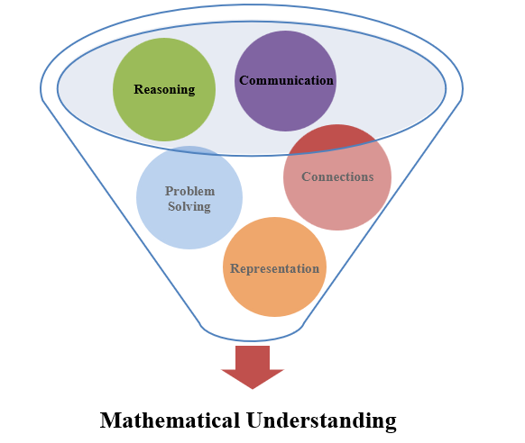
Mathematics Process Goals for Students
The content of the mathematics standards is intended to support the five process goals for students.
Notes:
The 2023 Mathematics Standards of Learning foster the application of the five mathematical process goals including reasoning, communication, problem solving, connections, and representation, and set students up to recognize and see mathematics in real-world applications. These processes support students in building understanding of mathematics.

Slide 8
Standards of Learning Supporting Documents
Notes:
Virginia Department of Education documents supporting the transition to the 2023 Mathematics Standards of Learning will now be shared.

Slide 9
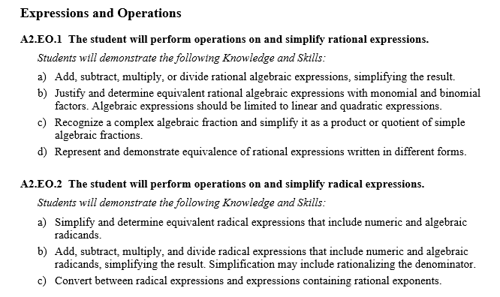
Standards Document
Notes:
The 2023 Mathematics Standards of Learning Document includes the standards and the knowledge and skills associated with each standard. This slide shows an example from the Algebra 2 Standards Document.

Slide 10
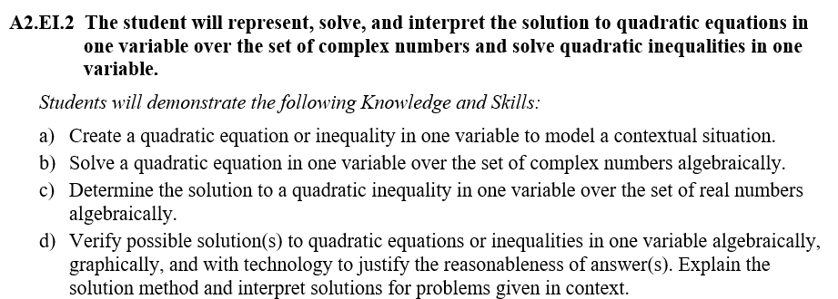
Changes to Numbering of the SOL
Second SOL within this strand
Course
Equations & Inequalities Strand
KEY: EO = Expressions and Operations; EI = Equations and Inequalities; F = Functions; ST = Statistics
Notes:
The new numbering system for the standards makes it clear within which strand a standard exists. For instance, the sample shown on the screen highlights A2.EI.2. A2 indicates the course, Algebra 2; EI indicates the Equations and Inequalities Strand; and 2 indicates that this is the second standard of learning in this strand. The key shown at the bottom of the screen provides the abbreviations for each of the strands.

Slide 11
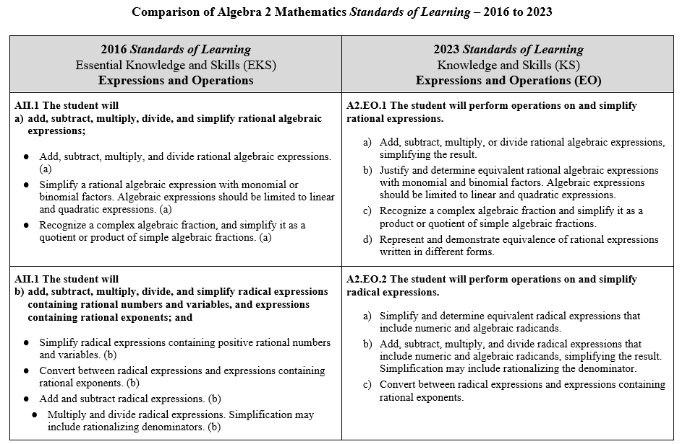
Overview of Revisions (2016 to 2023 Mathematics Standards of Learning) document
Notes:
An Overview of Revisions document has been created for each grade or course. This presentation provides a detailed comparison between the 2016 Standards of Learning and the 2023 Standards of Learning and is based upon the Overview of Revisions document.

Slide 12
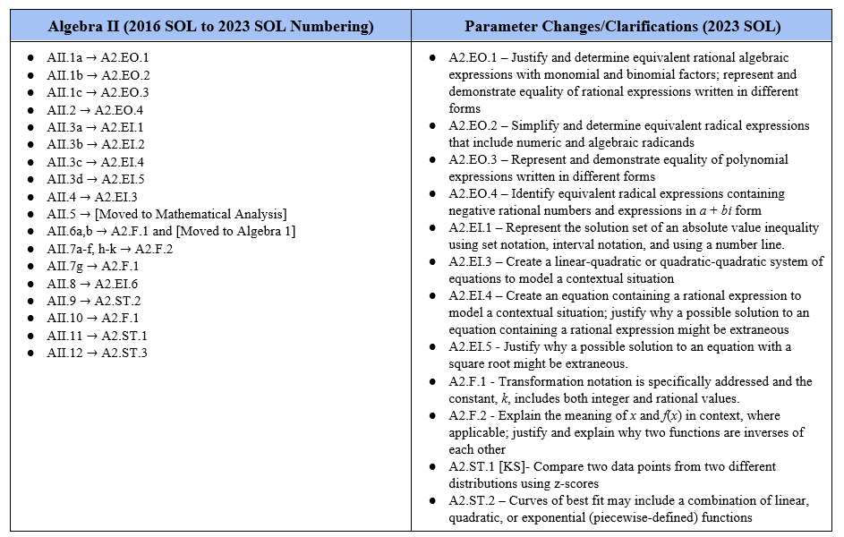
Overview of Revisions- Summary of Changes (1 of 2)
Notes:
At the end of the Overview of Revisions document there is a summary of changes table. One section of the table provides an overview of the changes to the numbering of the standards. Another section provides information regarding the prominent parameter changes and clarifications. Parameter changes and clarifications might be related to an increase or decrease in the limiters of the standards or the knowledge and skills; but might also be related to the depth of understanding of the content or scope of the content.

Slide 13
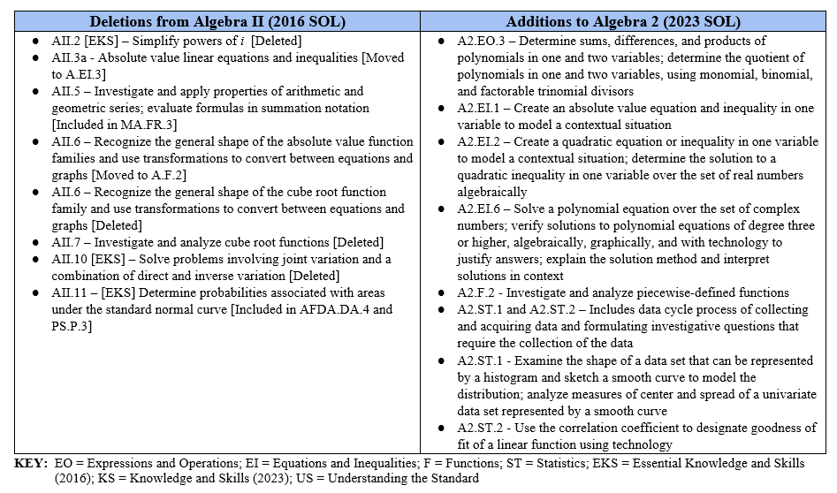
Overview of Revisions- Summary of Changes (2 of 2)
Notes:
The other two sections of the table include deletions from 2016 standards and addition of content to the 2023 standards.

Slide 14
Comparison of 2016 Mathematics SOL to 2023 Mathematics SOL
Notes:
During the remainder of the presentation, we will take a closer look at the revisions to the 2016 standards that resulted in the new 2023 standards.

Slide 15
Expressions & Operations
Notes:
We will first examine the changes that occurred in the Expressions and Operations strand.

Slide 16
Standard AII.1a (2016) - Standard A2.EO.1 (2023)
2016 SOL | 2023 SOL
AII.1 The student will add, subtract, multiply, divide, and simplify rational algebraic expressions; Add, subtract, multiply, and divide rational algebraic expressions. (a) Simplify a rational algebraic expression with monomial or binomial factors. Algebraic expressions should be limited to linear and quadratic expressions. (a) Recognize a complex algebraic fraction and simplify it as a quotient or product of simple algebraic fractions. (a) | A2.EO.1 The student will perform operations on and simplify rational expressions. Add, subtract, multiply, or divide rational algebraic expressions, simplifying the result. Justify and determine equivalent rational algebraic expressions with monomial and binomial factors. Algebraic expressions should be limited to linear and quadratic expressions. Recognize a complex algebraic fraction and simplify it as a product or quotient of simple algebraic fractions. Represent and demonstrate equivalence of rational expressions written in different forms.
Revisions:
A2.EO.1b - In addition to simplifying rational expressions, students are asked to justify their work.
A2.EO.1d - Students are asked to recognize that simplifying a rational expression creates an equivalent form of the expression.
Notes:
Throughout this presentation red text in the 2023 column indicates a change or addition to the content at this level. Red text in the 2016 column provides notes about where content may have been moved or deleted. You will also see symbols that indicate content that is NEW to the grade level or course.
In the 2016 Standards, AII.1 described the different types of expressions that students needed to work with. These expressions have been separated into different standards for the 2023 Standards.
2016 standard AII.1a has been renumbered A2.EO.1. This standard is about performing operations and simplifying rational expressions. New to the standard is having students recognize that simplifying a rational expression creates a different, but equivalent algebraic representation of the expression.

Slide 17
Standard AII.1B (2016) - Standard A2.EO.2 (2023)
2016 SOL | 2023 SOL
AII.1 The student will add, subtract, multiply, divide, and simplify radical expressions containing rational numbers and variables, and expressions containing rational exponents; Simplify radical expressions containing positive rational numbers and variables. (b) Convert between radical expressions and expressions containing rational exponents. (b) Add and subtract radical expressions. (b) Multiply and divide radical expressions. Simplification may include rationalizing denominators. (b) | A2.EO.2 The student will perform operations on and simplify radical expressions. Simplify and determine equivalent radical expressions that include numeric and algebraic radicands. Add, subtract, multiply, and divide radical expressions that include numeric and algebraic radicands, simplifying the result. Simplification may include rationalizing the denominator. Convert between radical expressions and expressions containing rational exponents.
Revisions:
A2.EO.2a - Students are asked to recognize that simplifying a radical expression creates an equivalent form of the expression.
Notes:
2016 SOL AII.1b has been renumbered A2.EO.2. This standard is about performing operations and simplifying radical expressions. As with A2.EO.1, students will recognize that simplifying an algebraic expression containing a radical expression creates a different, but equivalent algebraic representation of the expression.

Slide 18
Standard AII.1C (2016) - Standard A2.EO.3 (2023)
2016 SOL | 2023 SOL
AII.1 The student will factor polynomials completely in one or two variables. Factor polynomials in one or two variables with no more than four terms completely over the set of integers. Factors of the polynomial should be constant, linear, or quadratic. (c) Verify polynomial identities including the difference of squares, sum and difference of cubes, and perfect square trinomials. (c) | A2.EO.3 The student will perform operations on polynomial expressions and factor polynomial expressions in one and two variables. Determine sums, differences, and products of polynomials in one and two variables. Factor polynomials completely in one and two variables with no more than four terms over the set of integers. Determine the quotient of polynomials in one and two variables, using monomial, binomial, and factorable trinomial divisors. Represent and demonstrate equality of polynomial expressions written in different forms and verify polynomial identities including the difference of squares, sum and difference of cubes, and perfect square trinomials.
Revisions:
A2.EO.3a - Students are asked to determine sums, differences, and products of polynomials in one and two variables.
A2.EO.3c - Students are asked to determine the quotient of polynomials in one and two variables using monomial, binomial, and factorable trinomial divisors.
A2.EO.3d – Students will represent and demonstrate equality of polynomial expressions written in different forms
Notes:
2016 standard AII.1c has been renumbered A2.EO.3. This standard is about performing operations on polynomial expressions. Part of this standard that is new to Algebra 2 is adding, subtracting, and multiplying polynomial expressions in one and two variables. Students will also divide polynomial expressions with one and two variables. The divisor in these expressions will be a monomial, binomial, or factorable trinomial divisor.
Students are still expected to factor a polynomial expression in one and two variables completely over the set of integers.
As with other 2023 standards, students will represent equivalent polynomial expressions written in different forms. Students will also continue to verify polynomial identities including the difference of squares, sum and difference of cubes, and perfect square trinomials.

Slide 19
Standard AII.2 (2016) - Standard A2.EO.4 (2023)
2016 SOL | 2023 SOL
AII.2 The student will perform operations on complex numbers and express the results in simplest form using patterns of the powers of i. Recognize that the square root of –1 is represented as i. Simplify radical expressions containing negative rational numbers and express in a + bi form. Simplify powers of i. [deleted] Add, subtract, and multiply complex numbers. | A2.EO.4 The student will perform operations on complex numbers. Explain the meaning of i. Identify equivalent radical expressions containing negative rational numbers and expressions in a + bi form. Apply properties to add, subtract, and multiply complex numbers.
Revisions:
Students are no longer expected to simplify powers of i.
A2.EO.4b - Students are asked to recognize that simplifying a radical expression written in complex form creates an equivalent form of the expression.
Notes:
The 2016 SOL AII.2 has been renumbered as A2.EO.4 in the 2023 standards. This standard has students perform operations on complex numbers in the form a + bi. Students are no longer expected to simplify powers of i. The rest of the standard, including adding, subtracting, and multiplying complex numbers, is largely unchanged.

Slide 20
Equations & Inequalities
Notes:
We will now look at the changes that occurred in the Equations and Inequalities strand.

Slide 21
Standard AII.3a (2016) - Standard A2.EI.1 (2023)
2016 SOL | 2023 SOL
AII.3 The student will solve absolute value linear equations and inequalities; Solve absolute value linear equations or inequalities in one variable algebraically. Represent solutions to absolute value linear inequalities in one variable graphically. Solve equations and verify algebraic solutions using a graphing utility. | A2.EI.1 The student will represent, solve, and interpret the solution to absolute value equations and inequalities in one variable. Create an absolute value equation in one variable to model a contextual situation. Solve an absolute value equation in one variable algebraically and verify the solution graphically. Create an absolute value inequality in one variable to model a contextual situation. Solve an absolute value inequality in one variable and represent the solution set using set notation, interval notation, and using a number line. Verify possible solution(s) to absolute value equations and inequalities in one variable algebraically, graphically, and with technology to justify the reasonableness of answer(s). Explain the solution method and interpret solutions for problems given in context.
Revisions:
A2.EI.1a and A2.EI.1b - Students will be creating absolute value equations and inequalities to model a contextual situation.
A2.EI.1d- When representing the solution to an inequality, three representations are specified: set notation, interval notation, and a number line.
Notes:
In the 2016 Standards, AII.3 described the different types of equations that students needed to be able to solve. These equations have been separated into different standards for the 2023 Standards.
2016 SOL AII.3a has been renumbered as 2023 SOL A2.EI.1. This standard has students working with absolute value equations. In the 2016 Standards, students were asked to solve absolute value equations and inequalities. In the 2023 Standards, students are asked to represent, solve, and interpret the solution to absolute value equations and inequalities. Also new to the standard is creating an equation or an inequality to model a contextual situation. When representing the solution to an inequality, three representations are specified. These representations are set notation, interval notation, and a number line.

Slide 22
Standard AII.3B (2016) - Standard A2.EI.2 (2023)
2016 SOL | 2023 SOL
AII.3 The student will solve quadratic equations over the set of complex numbers; Solve a quadratic equation over the set of complex numbers algebraically. Calculate the discriminant of a quadratic equation to determine the number and type of solutions. Solve equations and verify algebraic solutions using a graphing utility. | A2.EI.2 The student will represent, solve, and interpret the solution to quadratic equations in one variable over the set of complex numbers and solve quadratic inequalities in one variable. Create a quadratic equation or inequality in one variable to model a contextual situation. Solve a quadratic equation in one variable over the set of complex numbers algebraically. Determine the solution to a quadratic inequality in one variable over the set of real numbers algebraically. Verify possible solution(s) to quadratic equations or inequalities in one variable algebraically, graphically, and with technology to justify the reasonableness of answer(s). Explain the solution method and interpret solutions for problems given in context.
Revisions:
A2.EI.2a - Students will be creating quadratic equations and inequalities to model a contextual situation.
A2.EI.2c - Students will be solving quadratic inequalities.
Notes:
2016 standard AII.3b has been renumbered as A2.EI.2 in the 2023 SOL. This standard has students working with quadratic equations. In the 2016 Standards, students were asked to solve quadratic equations. In the 2023 Standards, students are asked to represent, solve, and interpret the solution to quadratic equations. Also new to the standard is creating an equation to model a contextual situation.
The other new expectation is solving a quadratic inequality in one variable. Students are asked to create a quadratic inequality to model a contextual situation, and represent, solve, and interpret the solution to a quadratic inequality.

Slide 23
Standard AII.3C (2016) - Standard A2.EI.4 (2023)
2016 SOL | 2023 SOL
AII.3 The student will solve equations containing rational algebraic expressions; Solve rational equations with real solutions containing factorable algebraic expressions algebraically and graphically. Algebraic expressions should be limited to linear and quadratic expressions. Solve equations and verify algebraic solutions using a graphing utility. | A2.EI.4 The student will represent, solve, and interpret the solution to an equation containing rational algebraic expressions. Create an equation containing a rational expression to model a contextual situation. Solve rational equations with real solutions containing factorable algebraic expressions algebraically and graphically. Algebraic expressions should be limited to linear and quadratic expressions. Verify possible solution(s) to rational equations algebraically, graphically, and with technology to justify the reasonableness of answer(s). Explain the solution method and interpret solutions for problems given in context. Justify why a possible solution to an equation containing a rational expression might be extraneous.
Revisions:
A2.EI.4a - Students will be creating equations containing a rational expression to model a contextual situation.
A2.EI.4d - Students will be considering whether a possible solution to an equation containing a rational expression is extraneous.
Notes:
2016 standard AII.3c has been renumbered as 2023 standard A2.EI.4. This standard has students working with equations containing rational algebraic expressions. In the 2016 Standards, students were asked to solve equations containing rational algebraic expressions. In the 2023 Standards, students are asked to represent, solve, and interpret the solution to these equations. Also new to the standard is creating an equation to model a contextual situation. Additionally, students are asked to recognize that some of these equations may have an extraneous solution. Students will need to justify why a possible solution to the equation may be extraneous.

Slide 24
Standard AII.3D (2016) - Standard A2.EI.5 (2023)
2016 SOL | 2023 SOL
AII.3 The student will solve equations containing radical expressions. Solve an equation containing no more than one radical expression algebraically and graphically. Solve equations and verify algebraic solutions using a graphing utility. | A2.EI.5 The student will represent, solve, and interpret the solution to an equation containing a radical expression. Solve an equation containing no more than one radical expression algebraically and graphically. Verify possible solution(s) to radical equations algebraically, graphically, and with technology, to justify the reasonableness of answer(s). Explain the solution method and interpret solutions for problems given in context. Justify why a possible solution to an equation with a square root might be extraneous.
Revisions:
A2.EI.5c - Students will be considering whether a possible solution to an equation containing a radical expression is extraneous.
Notes:
2016 SOL AII.3d has been renumbered as 2023 standard A2.EI.5. This standard has students working with equations containing radical expressions. In the 2016 Standards, students were asked to solve equations containing radical expressions. In the 2023 Standards, students are asked to represent, solve, and interpret the solution to these equations. Additionally, students are asked to recognize that some of these equations may have an extraneous solution. Students will need to justify why a possible solution to the equation may be extraneous.

Slide 25
Standard AII.4 (2016) - Standard A2.EI.3 (2023)
2016 SOL | 2023 SOL
AII.4 The student will solve systems of linear-quadratic and quadratic-quadratic equations, algebraically and graphically. Determine the number of solutions to a linear-quadratic and quadratic-quadratic system of equations in two variables. Solve a linear-quadratic system of two equations in two variables algebraically and graphically. Solve a quadratic-quadratic system of two equations in two variables algebraically and graphically. Solve systems of equations and verify solutions of systems of equations with a graphing utility. | A2.EI.3 The student will solve a system of equations in two variables containing a quadratic expression. Create a linear-quadratic or quadratic-quadratic system of equations to model a contextual situation. Determine the number of solutions to a linear-quadratic and quadratic-quadratic system of equations in two variables. Solve a linear-quadratic and quadratic-quadratic system of equations algebraically and graphically, including situations in context. Verify possible solution(s) to linear-quadratic or quadratic-quadratic system of equations algebraically, graphically, and with technology to justify the reasonableness of answer(s). Explain the solution method and interpret solutions for problems given in context.
Revisions:
A2.EI.3a - Students will be creating equations containing a rational expression to model a contextual situation.
Notes:
2016 standard AII.4 has been renumbered as 2023 SOL A2.EI.3. This standard has students working with a system of equations. Students will continue to solve a system of equations that includes either two quadratic equations, or a linear equation and a quadratic equation. New to the standard is the expectation that students will create a system of equations to model a contextual situation.

Slide 26
Standard AII.8 (2016) - Standard A2.EI.6 (2023)
2016 SOL | 2023 SOL
AII.8 The student will investigate and describe the relationships among solutions of an equation, zeros of a function, x-intercepts of a graph, and factors of a polynomial expression. Define a polynomial function in factored form, given its zeros. Determine a factored form of a polynomial expression from the x-intercepts of the graph of its corresponding function. For a function, identify zeros of multiplicity greater than 1 and describe the effect of those zeros on the graph of the function. Given a polynomial equation, determine the number and type of solutions. | A2.EI.6 The student will represent, solve, and interpret the solution to a polynomial equation. Determine a factored form of a polynomial equation, of degree three or higher, given its zeros or the x-intercepts of the graph of its related function. Determine the number and type of solutions (real or imaginary) of a polynomial equation of degree three or higher. Solve a polynomial equation over the set of complex numbers. Verify possible solution(s) to polynomial equations of degree three or higher algebraically, graphically, and with technology to justify the reasonableness of answer(s). Explain the solution method and interpret solutions in context.
Revisions:
A2.EI.6a - Solving polynomial equations of degree three or higher is new to the 2023 standards
A2.EI.6c - Students will be solving a polynomial equation over the set of complex numbers
A2.EI.6d – Students will verify possible solutions to polynomial equations and explain and interpret solutions
Notes:
Standard A2.EI.6 is a largely new expectation that contains some elements from the 2016 standard AII.8. Since the 2016 AII.8 standard is in the Functions strand, we are including this as new content in the Equations and Inequalities strand in 2023. In this 2023 standard, students will represent, solve, and interpret the solution to a polynomial equation of degree three or higher. This includes determining a factored form of a polynomial equation from its zeros or x-intercepts and determining the number and type of solutions of a polynomial equation, which was content moved from SOL AII.8. In part c, students will solve a polynomial equation over the set of complex number. In part d) of SOL A2.EI.6, students will verify solutions of polynomial equations of degree three or higher using algebra, graphically, or with technology. Students will be able to explain the solution method and interpret solutions in context.

Slide 27
Functions
Notes:
We will now review the changes that occurred in the Functions strand.

Slide 28
Standard AII.5 (2016) - Deleted
2016 SOL | 2023 SOL
AII.5 The student will investigate and apply the properties of arithmetic and geometric sequences and series to solve practical problems, including writing the first n terms, determining the nth term, and evaluating summation formulas. Notation will include ∑ and a_{n}. Distinguish between a sequence and a series. Generalize patterns in a sequence using explicit and recursive formulas. Use and interpret the notations ∑, n, n^{th} term, and a_{n}. Given the formula, determine a_{n} (the n^{th} term) for an arithmetic or a geometric sequence. Given formulas, write the first n terms and determine the sum, S_{n,} of the first n terms of an arithmetic or geometric series. Given the formula, determine the sum of a convergent infinite series. Model practical situations using sequences and series. | [Moved to Mathematical Analysis]
Revisions:
Students are no longer expected to simplify powers of i.
Students are asked to recognize that simplifying a radical expression written in complex form creates an equivalent form of the expression.
Revisions:
Content from the 2016 standard AII.5 addressing sequences and series has moved to Mathematical Analysis
Notes:
2016 SOL AII.5 has been moved into Math Analysis for the 2023 Standards.

Slide 29
Standard AII.6 (2016) - Standard A2.F.1 (2023)
2016 SOL | 2023 SOL
AII.6 For absolute value, square root, cube root, rational, polynomial, exponential, and logarithmic functions, the student will recognize the general shape of function families; and use knowledge of transformations to convert between equations and the corresponding graphs of functions. Recognize the general shape of function families. (a) Recognize graphs of parent functions. (a) Identify the graph of a function from the equation. (b) Write the equation of a function given the graph. (b) Graph a transformation of a parent function, given the equation. (b) Identify the transformation(s) of a function. Transformations of exponential and logarithmic functions, given a graph, should be limited to a single transformation. (b) Investigate and verify transformations of functions using a graphing utility. (a, b) | A2.F.1 The student will investigate, analyze, and compare square root, cube root, rational, exponential, and logarithmic function families, algebraically and graphically, using transformations. Distinguish between the graphs of parent functions for square root, cube root, rational, exponential, and logarithmic function families. Write the equation of a square root, cube root, rational, exponential, and logarithmic function, given a graph, using transformations of the parent function, including f(x) + k; f(kx); f(x + k); and kf(x), where k is limited to rational values. Transformations of exponential and logarithmic functions, given a graph, should be limited to a single transformation. Graph a square root, cube root, rational, exponential, and logarithmic function, given the equation, using transformations of the parent function including f(x) + k; f(kx); f(x + k); and kf(x), where k is limited to rational values. Use technology to verify transformations of the functions.
Revisions:
The types of functions investigated will no longer include absolute value or polynomial functions for A2.F.1 in the 2023 standard.
A2.F.1b and A2.F.1c – Transformation notation is specifically addressed and the constant, k, includes both integer and rational values.
Notes:
In the 2023 standards, A2.F.1 is a combination of parts of multiple 2016 standards. 2016 SOL AII.6 has been renumbered as part of A2.F.1 in a) through c). This standard is about function families and transformations, and in the 2023 version absolute value and polynomial functions have been removed. Also in the 2023 version, transformation notation is specifically addressed and the constant, k, include both integer and rational values.

Slide 30
Standard AII.7 (2016) - Standard A2.F.2 (2023) 1 of 3
2016 SOL | 2023 SOL
AII.7 The student will investigate and analyze linear, quadratic , absolute value, square root, cube root, rational, polynomial, exponential, and logarithmic function families algebraically and graphically. Key concepts include domain, range, and continuity; intervals in which a function is increasing or decreasing; extrema; zeros; intercepts; Identify the domain, range, zeros, and intercepts of a function presented algebraically or graphically, including graphs with discontinuities. (a, d, e) Describe a function as continuous or discontinuous. (a) Given the graph of a function, identify intervals on which the function (linear, quadratic, absolute value, square root, cube root, polynomial, exponential, and logarithmic) is increasing or decreasing. (b) Identify the location and value of absolute maxima and absolute minima of a function over the domain of the function graphically or by using a graphing utility. (c) Identify the location and value of relative maxima or relative minima of a function over some interval of the domain graphically or by using a graphing utility. (c) | A2.F.2 The student will investigate and analyze characteristics of square root, cube root, rational, polynomial, exponential, logarithmic, and piecewise-defined functions algebraically and graphically. Determine and identify the domain, range, zeros, and intercepts of a function presented algebraically or graphically, including graphs with discontinuities. Compare and contrast the characteristics of square root, cube root, rational, polynomial, exponential, logarithmic, and piecewise-defined functions. Determine the intervals on which the graph of a function is increasing, decreasing, or constant. Determine the location and value of absolute (global) maxima and absolute (global) minima of a function. Determine the location and value of relative (local) maxima or relative (local) minima of a function.
Revisions:
Piecewise-defined functions are now included in A2.F2 for the 2023 Standards.
Linear and quadratic functions are no longer included in the 2023 standard as types of functions to investigate.
Notes:
The 2016 standard AII.7 is about investigating and analyzing different type of functions. SOL AII.7 has been spilt between SOL A2.F.1 and SOLA2.F.2 in the 2023 Standards . AII.7 a through e was renumbered into A2.F.2 a through e. In the types of functions listed, quadratic and linear functions were removed from the standard. Piecewise functions are a new addition to this standard in 2023.

Slide 31
Standard AII.7 (2016) - Standard A2.F.2 (2023) 2 of 3
2016 SOL | 2023 SOL
AII.7 The student will investigate and analyze linear, quadratic, absolute value, square root, cube root, rational, polynomial, exponential, and logarithmic function families algebraically and graphically. Key concepts include values of a function for elements in its domain; end behavior; vertical and horizontal asymptotes; For any x value in the domain of f, determine f(x). (f) Describe the end behavior of a function. (h) Determine the equations of vertical and horizontal asymptotes of functions (rational, exponential, and logarithmic). (i) | A2.F.2 The student will investigate and analyze characteristics of square root, cube root, rational, polynomial, exponential, logarithmic, and piecewise-defined functions algebraically and graphically. For any value, x, in the domain of f, determine f(x) using a graph or equation. Explain the meaning of x and f(x) in context, where applicable. Describe the end behavior of a function. Determine the equations of any vertical and horizontal asymptotes of a function using a graph or equation (rational, exponential, and logarithmic).
Revisions:
A2.F.2f - Explaining the meaning of x and f(x) in a context has been added to the 2023 Standards.
Notes:
2016 standard AII.7 f, h, and i was renumbered as 2023 SOL A2.F.2 f through h. For the sub-standard f in the 2023 standard, explaining the meaning of x and f(x) in context is a new addition.

Slide 32
Standard AII.7 (2016) - Standard A2.F.2 (2023) 3 of 3
2016 SOL | 2023 SOL
AII.7 The student will investigate and analyze linear, quadratic, absolute value, square root, cube root, rational, polynomial, exponential, and logarithmic function families algebraically and graphically. Key concepts include inverse of a function; and composition of functions, algebraically and graphically. Determine the inverse of a function (linear, quadratic, cubic, square root, and cube root). (j) Graph the inverse of a function as a reflection over the line y = x. (j) Determine the composition of two functions algebraically and graphically. (k) | A2.F.2 The student will investigate and analyze characteristics of square root, cube root, rational, polynomial, exponential, logarithmic, and piecewise-defined functions algebraically and graphically. Determine the inverse of a function algebraically and graphically, given the equation of a linear or quadratic function (linear, quadratic, and square root). Justify and explain why two functions are inverses of each other. Graph the inverse of a function as a reflection over the line y = x. Determine the composition of two functions algebraically and graphically.
Revisions:
Students are no longer expected to simplify powers of i.
Students are asked to recognize that simplifying a radical expression written in complex form creates an equivalent form of the expression.
Revisions:
A2.F.2i – Students will justify and explain why two functions are inverses of each other.
A2.F.2i - Determine the inverse of a function is now restricted to when given only a linear or quadratic function which would result in inverse functions that could be linear, quadratic and square root.
Notes:
2016 SOL AII.7 j and k was renumbered into SOL A2.F.2 i through k. Determining the inverse of a function algebraically and graphically is now restricted to when given only a linear or quadratic function, which would result in an inverse function that is linear, quadratic, and square root. Determining the inverse of a cubic or cube root function has been removed for the 2023 standards. New in the 2023 standard it now includes the expectations to be able to justify and explain why two functions are inverses of each other.

Slide 33
Standard AII.7.g (2016) - Standard A2.F.1.e (2023)
2016 SOL | 2023 SOL
AII.7 The student will investigate and analyze linear, quadratic, absolute value, square root, cube root, rational, polynomial, exponential, and logarithmic function families algebraically and graphically. Key concepts include connections between and among multiple representations of functions using verbal descriptions, tables, equations, and graphs; Represent relations and functions using verbal descriptions, tables, equations, and graphs. Given one representation, represent the relation in another form. (g) Investigate and analyze characteristics and multiple representations of functions with a graphing utility. (a, b, c, d, e, f, g, h, i, j, k) | A2.F.1 The student will investigate, analyze, and compare square root, cube root, rational, exponential, and logarithmic function families, algebraically and graphically, using transformations. Compare and contrast the graphs, tables, and equations of square root, cube root, rational, exponential, and logarithmic functions.
Revisions:
The 2016 version of this sub-standard includes polynomial functions, which is not a function addressed in the 2023 standard A2.F.1.
Notes:
2016 SOL AII.7g was renumbered into the 2023 standard A2.F.1 e. The 2016 version of this sub-standard includes polynomial functions, which is not a function addressed in the A2.F.1 standard.

Slide 34
Standard AII.8 (2016) - Standard A2.EI.6 (2023)
2016 SOL | 2023 SOL
AII.8 The student will investigate and describe the relationships among solutions of an equation, zeros of a function, x-intercepts of a graph, and factors of a polynomial expression. Define a polynomial function in factored form, given its zeros. Determine a factored form of a polynomial expression from the x-intercepts of the graph of its corresponding function. For a function, identify zeros of multiplicity greater than 1 and describe the effect of those zeros on the graph of the function. Given a polynomial equation, determine the number and type of solutions. | [Included in A2.EI.6]
Revisions:
Content included in A2.EI.6 in the Equations and Inequalities strand
Notes:
The 2016 SOL AII.8 was renumbered to A2.EI.6 in the 2023 Algebra 2 standards. AII.8 focused on the relationship between solutions, zeros, x-intercepts, and factors of polynomial expressions. In the 2023 standards, A2.EI.6 shifts the focus to solving and interpreting solutions to polynomial equations with a degree of three or higher. Note that A2.EI.6 is a standard in the Equations and Inequalities strand and was mentioned earlier in the presentation and is being mentioned here again because of its relationship to AII.8 content from the 2016 standards.

Slide 35
Statistics
Notes:
We will now review the changes that occurred in the Statistics strand.

Slide 36
Standard AII.9 (2016) - Standard A2.ST.2 (2023) 1 of 2
2016 SOL | 2023 SOL
AII.9 The student will collect and analyze data, determine the equation of the curve of best fit in order to make predictions, and solve practical problems, using mathematical models of quadratic and exponential functions. Determine an equation of the curve of best fit, using a graphing utility, given a set of no more than 20 data points in a table, graph, or practical situation. Make predictions, using data, scatterplots, or the equation of the curve of best fit. Solve practical problems involving an equation of the curve of best fit. Evaluate the reasonableness of a mathematical model of a practical situation. | A2.ST.2 The student will apply the data cycle (formulate questions; collect or acquire data; organize and represent data; and analyze data and communicate results) with a focus on representing bivariate data in scatterplots and determining the curve of best fit using linear, quadratic, exponential, or a combination of these functions. Formulate investigative questions that require the collection or acquisition of bivariate data and investigate questions using a data cycle. Collect or acquire bivariate data through research, or using surveys, observations, scientific experiments, polls, or questionnaires. Represent bivariate data with a scatterplot using technology. Determine whether the relationship between two quantitative variables is best approximated by a linear, quadratic, exponential, or a combination of these functions.
Revisions:
The data cycle is part of the 2023 SOL A2.ST.2 and includes formulating investigative questions that require the collection of bivariate data; which can be collected or acquired through research, surveys, observations, scientific experiments, polls, or questionnaires
A2.ST.2d - Curves of best fit can be represented by linear, quadratic, exponential, or a combination of these functions
Notes:
2016 SOL AII.9 has been renumbered to A2.ST.2 in the 2023 standards. In the 2023 standards, A2.ST.2 has an additional focus around the data cycle. SOL A2.ST.2 is divided in this presentation into two different slides due to the additional knowledge and skills added around the data cycle.
New to the standard for A2.ST.2 includes formulating investigative questions that require the collection of bivariate data; which is to be acquired through research, surveys, observations, scientific experiments, polls, or questionnaires. A parameter change for A2.ST.2 is that curves of best fit can be represented by linear, quadratic, exponential, or a combination of these functions.

Slide 37
Standard AII.9 (2016) - Standard A2.ST.2 (2023) 2 of 2
2016 SOL | 2023 SOL
AII.9 The student will collect and analyze data, determine the equation of the curve of best fit in order to make predictions, and solve practical problems, using mathematical models of quadratic and exponential functions. Determine an equation of the curve of best fit, using a graphing utility, given a set of no more than 20 data points in a table, graph, or practical situation. Make predictions, using data, scatterplots, or the equation of the curve of best fit. Solve practical problems involving an equation of the curve of best fit. Evaluate the reasonableness of a mathematical model of a practical situation. | A2.ST.2 The student will apply the data cycle (formulate questions; collect or acquire data; organize and represent data; and analyze data and communicate results) with a focus on representing bivariate data in scatterplots and determining the curve of best fit using linear, quadratic, exponential, or a combination of these functions. Determine the equation(s) of the function(s) that best models the relationship between two variables using technology. Curves of best fit may include a combination of linear, quadratic, or exponential (piecewise-defined) functions. Use the correlation coefficient to designate the goodness of fit of a linear function using technology. Make predictions, decisions, and critical judgments using data, scatterplots, or the equation(s) of the mathematical model. Evaluate the reasonableness of a mathematical model of a contextual situation.
Revisions:
A2.ST.2f - A new addition is the use of the correlation coefficient to designate the goodness of fit of a linear function.
Notes:
Continuing with the renumbering of the 2016 standard AII.9 to A2.ST.2 for the 2023 standards, another new addition to A2.ST.2 is having students use the correlation coefficient to designate the goodness of fit of a linear function.

Slide 38
Standard AII.10 (2016) - Standard A2.F.1 (2023)
2016 SOL | 2023 SOL
AII.10 The student will represent and solve problems, including practical problems, involving inverse variation, joint variation, and a combination of direct and inverse variations. Given a data set or practical situation, write the equation for an inverse variation. Given a data set or practical situation, write the equation for a joint variation. [Deleted] Solve problems, including practical problems, involving inverse variation, joint variation, and a combination of direct and inverse variations. | A2.F.1 The student will investigate, analyze, and compare square root, cube root, rational, exponential, and logarithmic function families, algebraically and graphically, using transformations. Determine when two variables are directly proportional, inversely proportional, or neither, given a table of values. Write an equation and create a graph to represent a direct or inverse variation, including situations in context.
Revisions:
Direct Variation is addressed in the Grade 7 Mathematics Standards of Learning.
A2.F.1d – Includes determining when two variables are directly or inversely proportional given a table of values, along with writing an equation and creating a graph to represent a direct or inverse variation, including contextual situations
Joint variation and a combination of direct and inverse variations has been removed in the 2023 Standards.
Notes:
SOL AII.10 from the 2016 standards was renumbered to be A2.F.1d in the 2023 standards. Note that A2.F.1d is in the Functions strand of the standards, whereas AII.10 in 2016 is in the Statistics strand. Direct variation is introduced in the Grade 7 Mathematics standards. A2.F.1d includes determining when two variables are directly or inversely proportional given a table of values, along with writing an equation and creating a graph to represent a direct or inverse variation, including contextual situations. Please note that joint variation, along with a combination of direct and inverse variation, is no longer included in the 2023 Algebra 2 standards.

Slide 39
Standard AII.11 (2016) - A2.ST.1 (2023) 1 of 3
2016 SOL | 2023 SOL
AII.11 The student will interpret and compare z-scores for normally distributed data; and apply properties of normal distributions to determine probabilities associated with areas under the standard normal curve. Solve problems involving the relationship of the mean, standard deviation, and z-score of a normally distributed data set. (b) Compare two sets of normally distributed data using a standard normal distribution and z-scores, given the mean and standard deviation. (b) Represent probability as area under the curve of a standard normal distribution. (c) Use the graphing utility or a table of Standard Normal Probabilities to determine probabilities associated with areas under the standard normal curve. (c) Use a graphing utility to investigate, represent, and determine relationships between a normally distributed data set and its descriptive statistics. (a, b, c) | A2.ST.1 The student will apply the data cycle (formulate questions; collect or acquire data; organize and represent data; and analyze data and communicate results) with a focus on univariate quantitative data represented by a smooth curve, including a normal curve. Formulate investigative questions that require the collection or acquisition of a large set of univariate quantitative data or summary statistics of a large set of univariate quantitative data and investigate questions using a data cycle. Collect or acquire univariate data through research, or using surveys, observations, scientific experiments, polls, or questionnaires.
Revisions:
In A2.ST.1, the data cycle includes formulating investigative questions that require the collection of a large set of univariate data; which is to be acquired through research, surveys, observations, scientific experiments, polls, or questionnaires.
Notes:
2016 SOL AII.11 has been renumbered to be A2.ST.1 in the 2023 standards. A2.ST.1 is another standard that now has a big focus on the data cycle. A2.ST.1a and b is similar to A2.ST.2a and b that we already talked about except it focuses on univariate data.

Slide 40
Standard AII.11 (2016) - A2.ST.1 (2023) 2 of 3
2016 SOL | 2023 SOL
AII.11 The student will identify and describe properties of a normal distribution; interpret and compare z-scores for normally distributed data; and Identify the properties of a normal distribution. (a) Describe how the standard deviation and the mean affect the graph of the normal distribution. (a) Solve problems involving the relationship of the mean, standard deviation, and z-score of a normally distributed data set. (b) Compare two sets of normally distributed data using a standard normal distribution and z-scores, given the mean and standard deviation. (b) Use a graphing utility to investigate, represent, and determine relationships between a normally distributed data set and its descriptive statistics. (a, b, c) | A2.ST.1 The student will apply the data cycle (formulate questions; collect or acquire data; organize and represent data; and analyze data and communicate results) with a focus on univariate quantitative data represented by a smooth curve, including a normal curve. Examine the shape of a data set (skewed versus symmetric) that can be represented by a histogram, and sketch a smooth curve to model the distribution. Identify the properties of a normal distribution. Describe and interpret a data distribution represented by a smooth curve by analyzing measures of center, measures of spread, and shape of the curve. Calculate and interpret the z-score for a value in a data set. Compare two data points from two different distributions using z-scores. Determine the solution to problems involving the relationship of the mean, standard deviation, and z-score of a data set represented by a smooth or normal curve. Compare multiple data distributions using measures of center, measures of spread, and shape of the distributions.
Revisions:
A2.ST.1c – Students will examine the shape of a data set that can represented by a histogram
A2.ST.1e - Data sets represented by a smooth curve will be described and interpreted and are not just restricted to normally distributed data
Notes:
Continuing with 2016 SOL AII.11 being renumbered as 2023 standard A2.ST.1, AII.11 addressed normally distributed data but now in A2.ST.1 the focus is on univariate data represented by a smooth curve, including the normal curve. Students are now expected to examine the shape of a data set that can be represented by a histogram. There is also a new expectation of not only describing the data distribution but also interpreting it as well. Just as in the 2016 standard, there is an expectation that students will need to interpret the z-score.

Slide 41
Standard AII.11 (2016) - A2.ST.1 (2023) 3 of 3
2016 SOL | 2023 SOL
AII.11 The student will apply properties of normal distributions to determine probabilities associated with areas under the standard normal curve. Represent probability as area under the curve of a standard normal distribution. (c) Use the graphing utility or a table of Standard Normal Probabilities to determine probabilities associated with areas under the standard normal curve. (c) [included in AFDA and P&S] Use a graphing utility to investigate, represent, and determine relationships between a normally distributed data set and its descriptive statistics. (a, b, c) | A2.ST.1 The student will apply the data cycle (formulate questions; collect or acquire data; organize and represent data; and analyze data and communicate results) with a focus on univariate quantitative data represented by a smooth curve, including a normal curve. Apply the Empirical Rule to answer investigative questions. Compare multiple data distributions using measures of center, measures of spread, and shape of the distributions.
Revisions:
Determining probabilities associated with areas under the standard normal curve has been removed from Algebra 2 and can now be found in Algebra Functions and Data Analysis (AFDA) and Probability and Stats.
A2.ST.1i - specifies the application of the Empirical Rule, which was implied, but not specified in the 2016 SOL
Notes:
2016 SOL AII.11c had students determining probabilities under the normal curve. In the 2023 mathematics standards, determining probability as area under the curve of normal distribution, using a graphing utility or table of Standard Normal Probabilities, is included in the Algebra, Functions, and Data Analysis (AFDA) standards and in the Probability and Statistics SOL. The 2023 standard A2.ST.1 also specifies the application of the Empirical Rule, which was implied, but not specified in the 2016 SOL.

Slide 42
Standard AII.12 (2016) - A2.ST.3 (2023)
2016 SOL | 2023 SOL
AII.12 The student will compute and distinguish between permutations and combinations. Compare and contrast permutations and combinations. Calculate the number of permutations of n objects taken r at a time. Calculate the number of combinations of n objects taken r at a time. Use permutations and combinations as counting techniques to solve practical problems. Calculate and verify permutations and combinations using a graphing utility. | A2.ST.3 The student will compute and distinguish between permutations and combinations. Compare and contrast permutations and combinations to count the number of ways that events can occur. Calculate the number of permutations of n objects taken r at a time. Calculate the number of combinations of n objects taken r at a time. Use permutations and combinations as counting techniques to solve contextual problems. Calculate and verify permutations and combinations using technology.
Revisions:
No significant changes between the 2016 and 2023 standard
Notes:
There are no significant changes between the 2016 Algebra II SOL AII.12 and the 2023 standard A2.ST.3.

Slide 43
Questions?
Contact the
Virginia Department of Education’s Mathematics Team at vdoe.mathematics@doe.virginia.gov
Notes:
This concludes the presentation on the 2023 Algebra 2 Standards of Learning revisions. It may be helpful to refer to this presentation as you are using the Overview of Revisions document to plan for instruction.
Should you have any questions, feel free to contact a member of the Mathematics Team at email address shown on the screen.

