Slide 1


VA Revised Early Literacy Screener

Slide 2
Literacy Screening in Virginia
Since 1997, PALS has been the state-supported literacy screener
  Developed in the 1990s and in use for 25 years
  Benchmark rates tied to state-allocated Early Intervention Reading Initiative (EIRI) funds for divisions to provide identified students with additional instruction and intervention
Challenge
  PALS narrow focus on code-based skills, now out of date with current science and best practices
Solution
  Develop, pilot, implement, and support new Pre-K through Grade 3 literacy screener that reflects science-based reading research and the results of which link back to and inform evidence-based literacy instruction
  Virginia Language and Literacy Screening System (VALLSS)

Slide 3
What is the purpose of a screener?
Risk for reading difficulties can be detected early, it serves as an early warning system.
The majority of students who have reading difficulties will not simply “catch up.”
A screener allows educators to better understand early literacy teaching targets
Pairing evidence-based classroom instruction with supplemental instruction in the early grades is the most effective approach to prevent later reading difficulties.

Slide 4
Strengthening Literacy in Virginia: The VLA
Align Curricula, Screening & Intervention Methods
Evidence-based Literacy Instruction
Science Based Reading Research
Prepare Teachers
The Virginia Literacy Act
Require Continuing Professional Development
Partner with
Families

Slide 5
Comprehensive System for Assessment
A comprehensive system for assessment promotes the careful selection of the right tool at the right time to get the right information to guide next steps for instruction and intervention.
Copyright © 2023 by the University of Virginia.

Slide 6
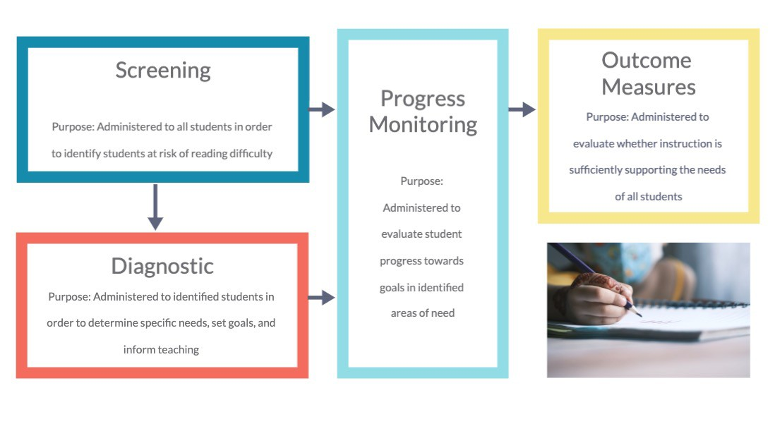
Comprehensive System for Assessment

Slide 7




Screening Tools Should Be
Evidence Based
Created based on the most up to date information
Valid
Does it measure what it purports to measure?
Sensitive
Will it accurately identify students who need extra support?
Efficient
Is it feasible to use with all students?

Slide 8
Why Update the Literacy Screener?

Slide 9
Simple View of Reading
Language Comprehension
=
Reading Comprehension
Decoding
X
Copyright © 2023 by the University of Virginia.

Slide 10




READING COMPREHENSION
FLUENCY
Prosody Accuracy
Rate
X
Orthography
DECODING/ENCODING
Word Knowledge Spelling
LANGUAGE COMPREHENSION
Phonemic Awareness
Alphabet Knowledge
Semantics/ Vocabulary
Morphology/ Syntax
Linguistic Knowledge

Slide 11


The revised screener will provide teachers with more information to use to shape instruction
Revised
The screener is being revised to align with the newest reading science
Aligned
New screening items will be aligned with items given across years
Expanded
The new screener will assess students in grades PreK-3 in both English and Spanish
Informed
The new screener is informed by rigorous research evidence on reading development

Slide 12
Revision Model
(Spanish & English)
Preschool (3’s and/or 4’s)
Kindergarten
Print Concepts
Alphabet Knowledge Phonological Awareness Rapid Automatized Naming Emergent Writing Language Comprehension
Grades 1 through 3
Phonological Awareness Rapid Automatized Naming Decoding and Encoding Oral Reading Fluency Language Comprehension
Alphabet
Phonolog Rapid Au Decoding Languag
Knowledge
ical Awareness
tomatized Naming
and Encoding
e Comprehension

Slide 13
Revision Aims
Extended to Pre-K 3yr-olds
Expanded coverage of skills
New screener aligned with current evidence base
More comprehensive and useful screening information
Better informed instruction and intervention
Improved reading and academic outcomes for Virginia students
Quality Spanish version
Vertically aligned across grades

Slide 14
Screener Revision Timeline
We are here
Pilot K-3 English & Spanish; Additional Pre-K validation
Soft launch K-3 English; Continue Spanish Pilot
Pre-K - Grade 3
Pilot Pre-K - Grade 3 English & Spanish
VALLSS Official Launch:
K-3 English
Soft Launch: Pre-K
- Grade 3 Spanish
2021-
2022
Fall 2022
2022-
2023
2023-
2024
Fall 2024
Fall 2025
VALLSS Official Launch:
Pre-K - Grade 3 Spanish
Launch VALLSS Pre-K (English)

Slide 15
Soft Launch: Fall 2023

Slide 16
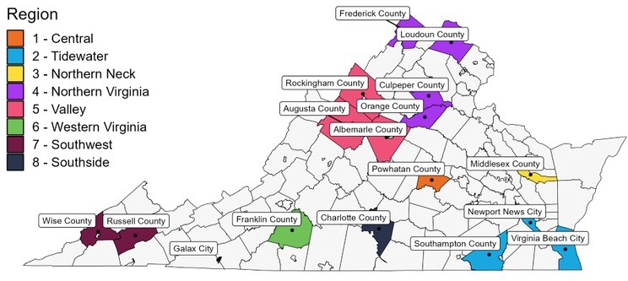
Participating Divisions
Participating in Grades K-3
Albemarle County Public Schools
Culpeper County Public Schools
Franklin County Public Schools
Galax City Public Schools
Middlesex County Public Schools
Orange County Public Schools
Rockingham County Public Schools
Russell County Public Schools
Southampton County Public Schools
Virginia Beach City Public Schools
Participating in Grades K-2
Augusta County Public Schools
Charlotte County Public Schools
Frederick County Public Schools
Loudoun County Public Schools
Newport News City Public Schools
Powhatan County Public Schools
Wise County Public Schools

Slide 17
Screener Revisions Activities (2023-24)
Continuing Spanish pilot in Pre-K through Grade 3
  Build overall sample size
  Administer Gold Standard measures for concurrent validity
Continuing English pilot in Pre-K through Grade 3
  Focus on 3rd grade to build sample size
  Additional data collection to assist with benchmarking, vertical scaling, and validation of supplemental items for progress monitoring
VALLSS K-3 Soft Launch
  17 divisions fully adopting VALLSS in lieu of PALS
  Teachers administer screener rather than data collectors
  Opportunities for feedback from the field

Slide 18
Resources and Support

Slide 19
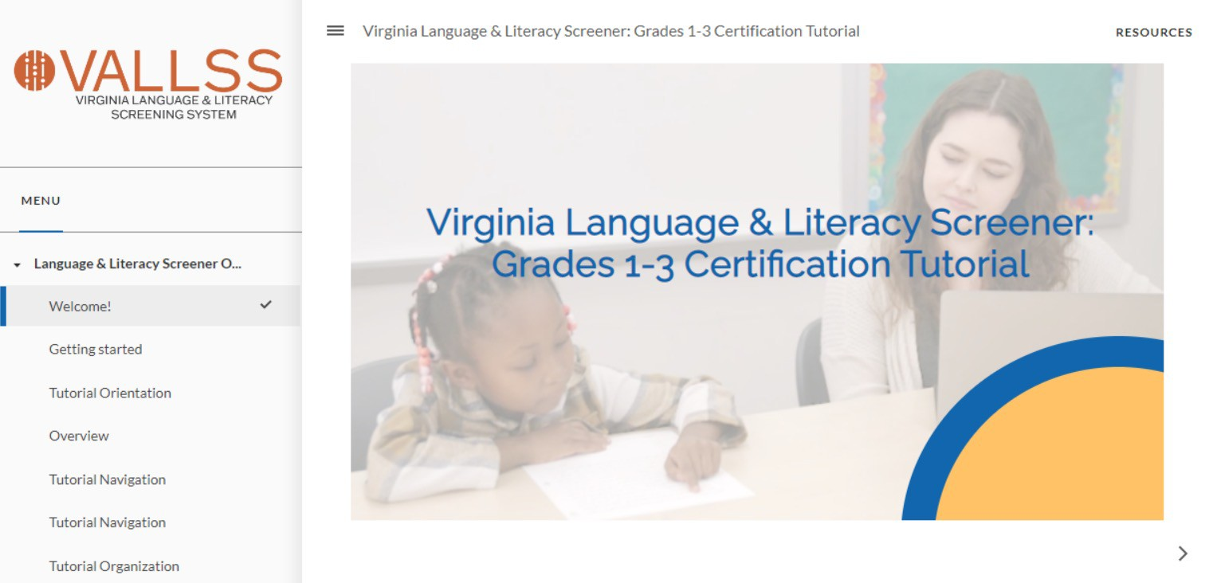
New Certification Tutorials – Kindergarten and Grades 1-3 (Grades 1-3 Example)

Slide 20
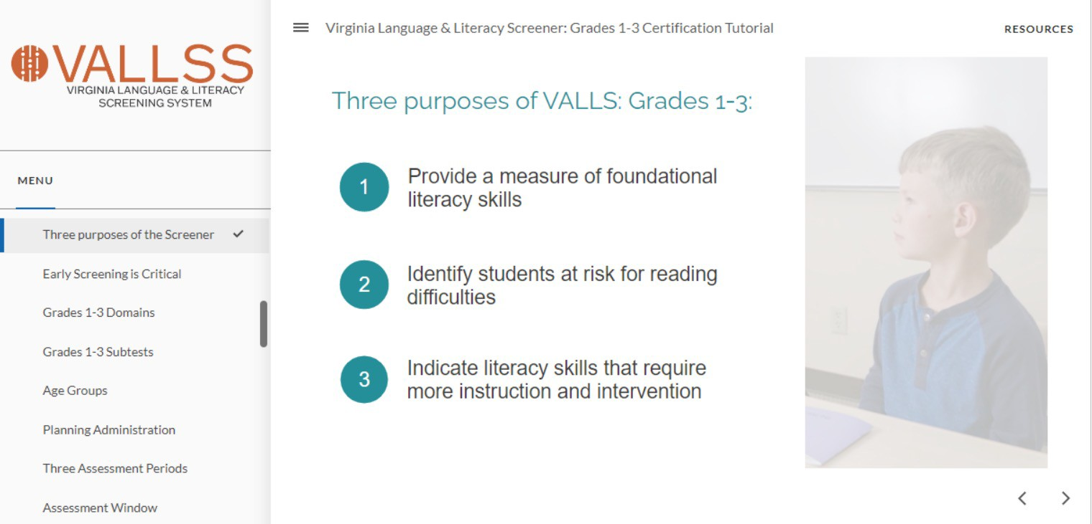
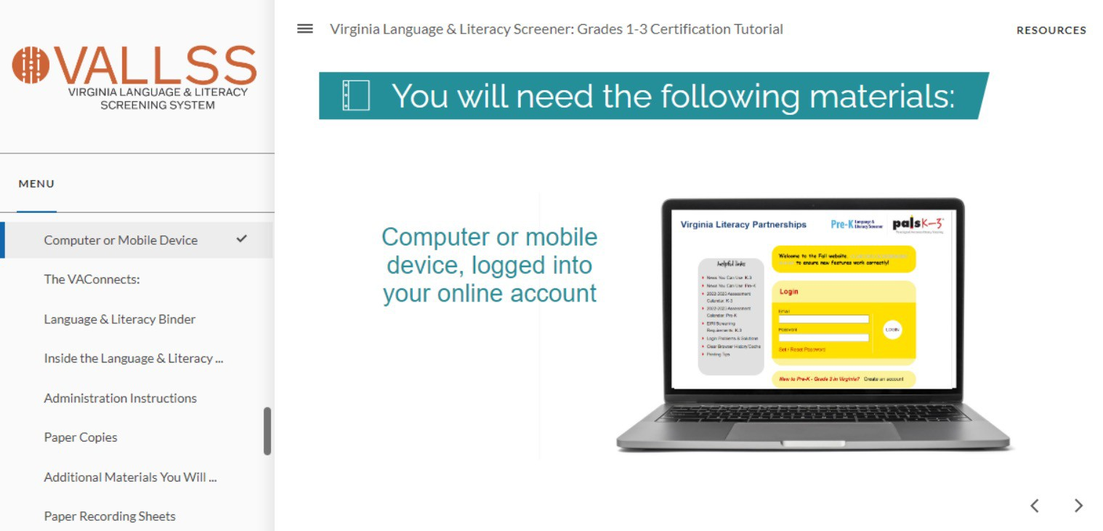
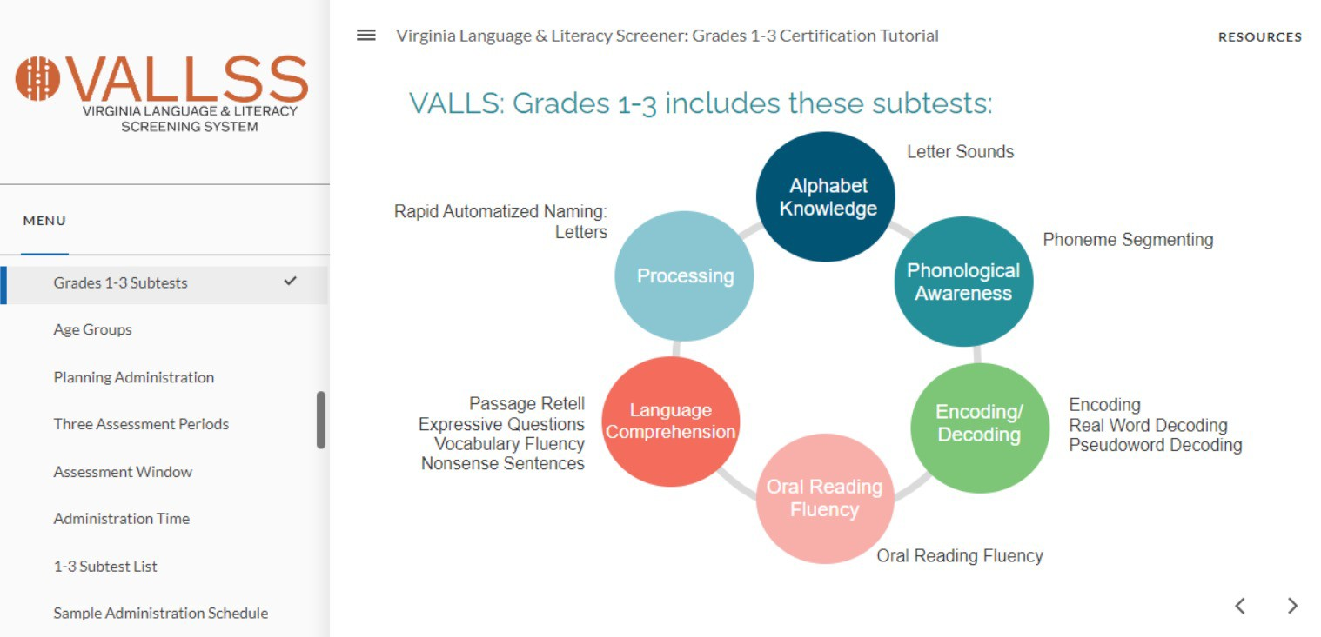
Overview module explains the background of the screener and walks through what is needed for administration and scoring

Slide 21
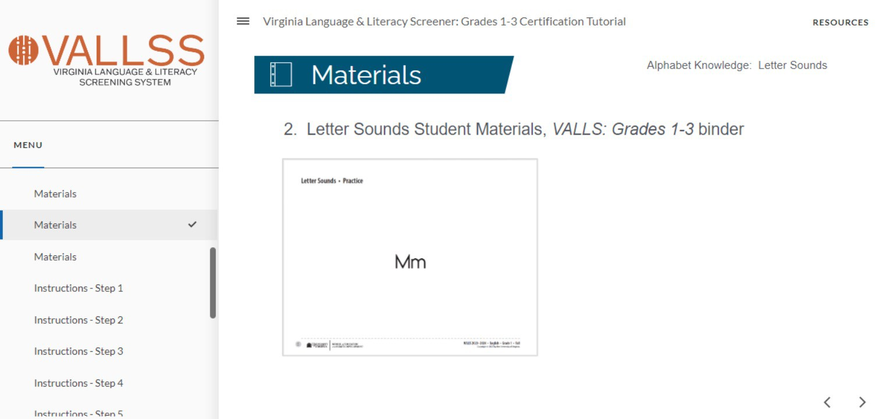
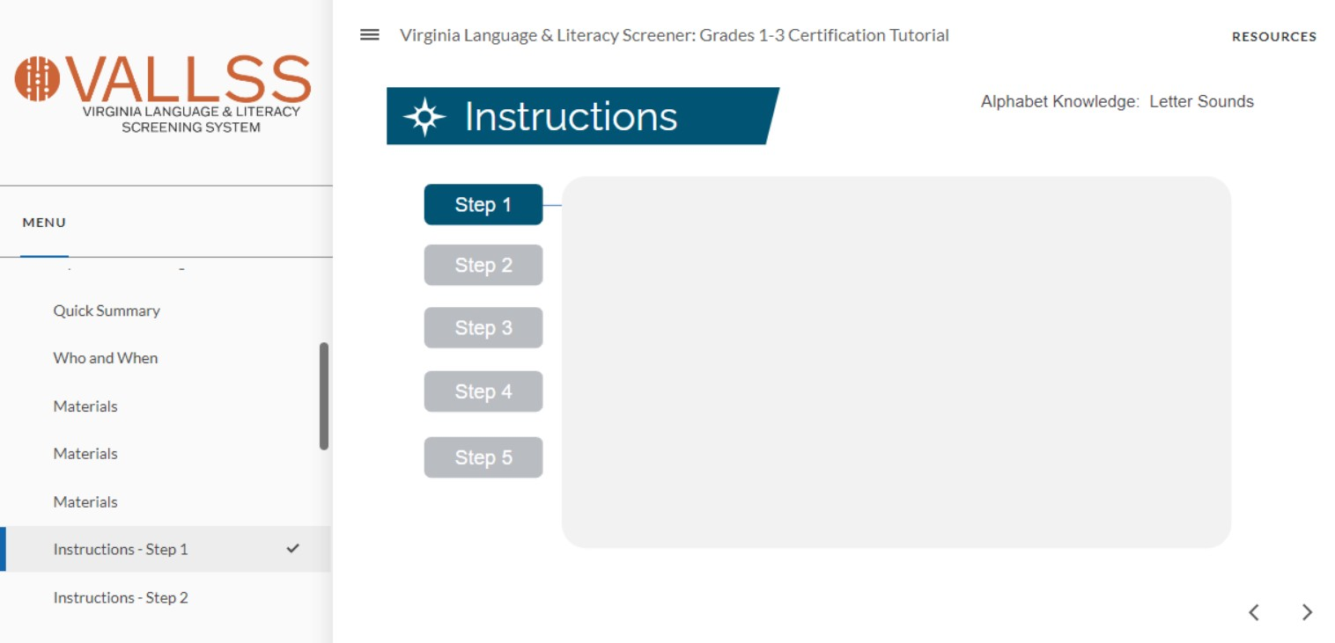
Subtest modules provide detailed materials, instructional prompts, scoring screencasts, video for each subtest

Slide 22
VLP Division Support & Assistance
VLP Hotline
  Designated VLP staff to respond to inquiries about the screeners
  Available via email and phone (same-day response)
  Field all questions related to VALLSS (e.g., administration, scoring, reports, using new online system, and more)
Remote and In-Person
  Divisions can request online or face-to-face consultations with VLP team members

Slide 23
Data and Reports

Slide 24

Data & Reports
Teacher Level
  Student Summary
  Class Summary
School Level
  Grade Level Summary (like Class Summary, but for all classes)
Division Level
  Data Download equivalent

Slide 25





Literacy Screener Provides Teachers
BAND OF RISK OR RISK STATUS FOR FUTURE READING DIFFICULTIES
INSTRUCTIONAL INDICATORS AT THE SUBTEST LEVEL

Slide 26
Band of Risk or Risk Status
Places student in high risk, moderate risk, or low risk groups
Low Risk | Students at lowest risk for reading difficulties Supplemental instruction not recommended
Moderate Risk | Requires additional explicit instruction Supplemental instruction is highly recommended based on student need.
High Risk | Most likely to have ongoing reading difficulties Students qualify for EIRI.

Slide 27
Instructional Indicators
Determines if student needs more instruction on a particular early literacy skill
Student | Letter Sounds | Phoneme Segmenting | Real Word Decoding | Pseudoword Decoding | Encoding
Abby
Jon
Jorge
Ana
Lillibeth

Slide 28
Subtest Scores and Instructional Indicators: What They DO Tell Us
Instructional Needs
Instructional Focus
Instructional Sequence
Whether a student continues to need extra explicit instruction and support in a particular skill
Plan instruction that improves overall early literacy abilities
Plan instruction with developmental sequence in mind

Slide 29
Timeline for Full Implementation

Slide 30
Screener Revision Timeline
We are here
Pilot K-3 English & Spanish; Additional Pre-K validation
Soft launch K-3 English; Continue Spanish Pilot
Pre-K - Grade 3
Pilot Pre-K - Grade 3 English & Spanish
VALLSS Official Launch:
K-3 English
Soft Launch: Pre-K
- Grade 3 Spanish
2021-
2022
Fall 2022
2022-
2023
2023-
2024
Fall 2024
Fall 2025
VALLSS Official Launch:
Pre-K - Grade 3 Spanish
Launch VALLSS Pre-K (English)

