Slide 1

Virginia’s Accountability System
Virginia State Board of Education
Chad Aldeman
September 14, 2023

Slide 2

Overall guiding principles for this work
The North Star is high expectations for every student. Proficiency definitions will be set by benchmarking against the demands of Virginia employers and higher education, as well as against states who have the most rigorous definitions of proficiency in the nation.
Transparency and access to actionable information will be a hallmark of our approach and our new system.
Student academic growth and proficiency are both vital measures, but the system must prioritize getting every student to proficiency/mastery.
The purpose of accountability is to build trust between schools, parents, and students through transparent, concrete, and easy to understand reporting. We must provide necessary supports and work alongside schools in need of help.
Stakeholder input is critical. Teachers, parents, students, and education leaders will inform the Board’s process to build a best-in-class accreditation and accountability system.

Slide 3
Where we have been and where we are going
Oct – Nov
2022
Board received framing presentations on accountability from leading experts
Feb – August
2023
Board participated in working sessions on accountability and accreditation
Sept
2023
Board adoption of new accountability metrics
Oct 2023 –
May 2024
VDOE builds out of new accountability system with regular Board updates and feedback sessions
Jun - Jul
2024
Board reviews and approves new accountability system
Aug 2024 -
Sept 2025
Implement full accountability system and release results

Slide 4
Virginia’s accreditation system identifies schools for improvement based on a rules-based system
Performance levels are assigned to each indicator.
Level One: At or Above Standard
Level Two: Near Standard
Level Three: Below Standard
Accreditation Status
Accredited:
All indicators are a Level One or Level Two.
Accredited with Conditions: At least one indicator is a Level Three.
Accreditation Denied:
A school fails to adopt and implement school division or school corrective action plans with fidelity.
In effect, any school could be flagged if *any indicator* is at a Level Three

Slide 5
Virginia’s current accreditation system also has “summative” ratings
Accredited With Conditions
It’s just that most schools are getting the highest rating: ”Accredited”
Accredited

Slide 6
Decision Point One: Achievement Indicator

Slide 7

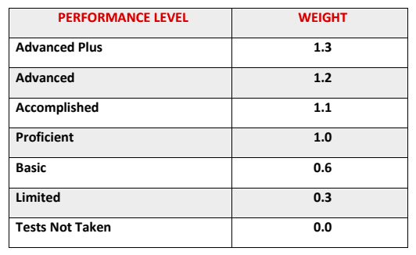
Achievement: % proficient versus an achievement index
An index creates a weighted score based on how many students score at each performance level
The Ohio index gives the greatest increase to students reaching Proficient
By giving some credit at lower levels, it gives schools an incentive to test all kids
Note: Virginia has fewer performance bands (4) than Ohio (6)
+.1
+.4
+.3

Slide 8
In Ohio, these two achievement measures produce *very* similar results
The correlation between the two approaches is 0.995
The main outliers are schools with very low participation rates
  Two schools might look similar on proficiency rate but look different on the index

Slide 9
What could the achievement index look like for Virginia?
Example 1: Achievement Weighted Index
Type | Weight | Students in Each | Points Received
No Testing | 0.00 | 25 | 0.00
Below Basic | 0.00 | 25 | 0.00
Basic | 0.50 | 25 | 12.50
Proficient | 1.00 | 25 | 25.00
Advanced | 1.50 | 25 | 37.50
 |  | Total | 75.00
Example 2: Participation Weighted Index
Type | Weight | Students in Each | Points Received
No Testing | 0.00 | 25 | 0.00
Below Basic | 0.25 | 25 | 6.25
Basic | 0.50 | 25 | 12.50
Proficient | 1.00 | 25 | 25.00
Advanced | 1.25 | 25 | 31.25
 |  | Total | 75.00

Slide 10
What would a pure proficiency measure look like compared to an index?
Example 3: Pure Proficiency
Type | Weight | Students in Each | Points Received
No Testing | 0.00 | 25 | 0.00
Below Basic | 0.00 | 25 | 0.00
Basic | 0.00 | 25 | 0.00
Proficient | 1.00 | 25 | 25.00
Advanced | 1.00 | 25 | 25.00
 |  | Total | 50.00

Slide 11
Virginia’s achievement measure
Option 1: Measure achievement through an index by weighting Virginia’s performance bands
Option 2: Measure achievement as the percentage of students who reach proficiency

Slide 12
Decision Point Two: Readiness Indicators

Slide 13
Elementary School Readiness Indicators
Descriptor | Measure | Definition | Rationale
Ready to Learn | Consistent Attendance/Chronic Absenteeism Measure (ESSA) | % of students who are absent for 10 percent or more of the school year | Students who missed 18+ days of school scored 18% lower in reading and 25% in math than students with regular attendance.
Ready to Read | 3rd grade literacy | % of students reading proficiently in 3rd grade* | Students who aren’t reading proficiently by 3rd grade are 4x less likely to graduate from high school**
*Note: This would effectively double-count 3rd grade reading SOL scores, in addition to counting them in the achievement indicator.
**See: https://www.aecf.org/resources/double-jeopardy

Slide 14
Middle School Readiness Indicators
Descriptor | Measure | Definition | Rationale
Ready to Learn | Consistent Attendance/Chronic Absenteeism Measure (ESSA) | % of students who are absent for 10 percent or more of the school year | Students who missed 18+ days of school scored 18% lower in reading and 25% in math than students with regular attendance.
Option 2a: Ready for Rigor | Advanced math courses | % of students taking advanced math who pass an End-of-Course math exam by the end of grade 8 | Middle school math scores are linked to higher graduation rates and future earnings*
Option 2b: Math –Proficient or Above | Math proficiency by 8th grade | % of students in 8th grade cohort proficient or advanced on Grade 8 math SOL test | Middle school math scores are linked to higher graduation rates and future earnings
*See: https://hanushek.stanford.edu/sites/default/files/publications/Hanushek%202022%20HESI%20EconomicCost.pdf

Slide 15
High School Readiness Indicators
Descriptor | Measure | Definition | Rationale
Ready to Learn | Consistent attendance | % of students who are absent for 10 percent or more of the school year | Missing school sets kids back academically*
Ready to Graduate | Graduation Rates | 4-year (and possibly extended-year) adjusted cohort graduation rates | Students do better when they persist and achieve high school diplomas**
Ready for College and Career | College and Career Readiness | % of graduates who: Earn early post-secondary opportunities Earn an industry credential in a high-demand occupation*** Enroll in college/College Readiness | Students need to be fully prepared to succeed in college, career, and life through exposure to a relevant and meaningful high school experience
Ready for Military | Military Readiness | ASVAB | Demonstrates students' ability to select career they want vs. career their score locks them into
*See: https://www.researchgate.net/publication/311388052_The_dynamics_of_chronic_absence_and_student_achievement and https://journals.sagepub.com/doi/full/10.1177/0042085915618709. **See: https://www.nber.org/papers/w16064. ***As determined by the Virginia Office of Education Economics.

Slide 16
Decision Point Three: Accountability Rating System

Slide 17
Based on the Board conversation in August, there are two points of discussion
Summative vs. Placemat | Weighting
How to make meaning from the accountability system? | How to balance indicators to identify schools in need of additional support?

Slide 18
How to make meaning from the accountability system?

Slide 19
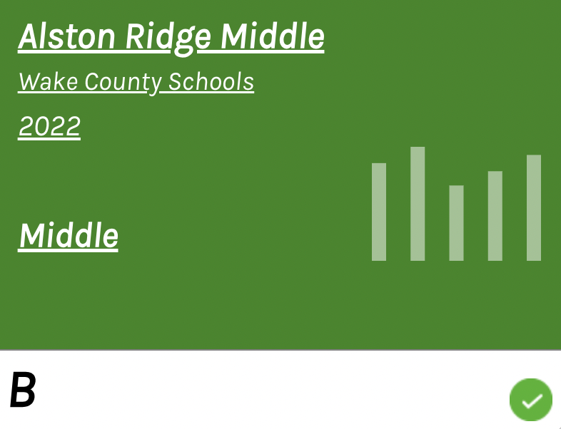
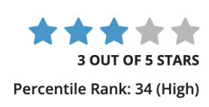
Option 1: Overall summative rating for all schools
Examples:
  North Carolina’s A-F grading system
  Maryland’s 5-star rating system
Pros:
  Simplifies to one measure
  Creates significant urgency around low ratings
Cons
  Overly simplified and may not share impact in each indicator
North Carolina School Report Card
Maryland
School Report Card

Slide 20
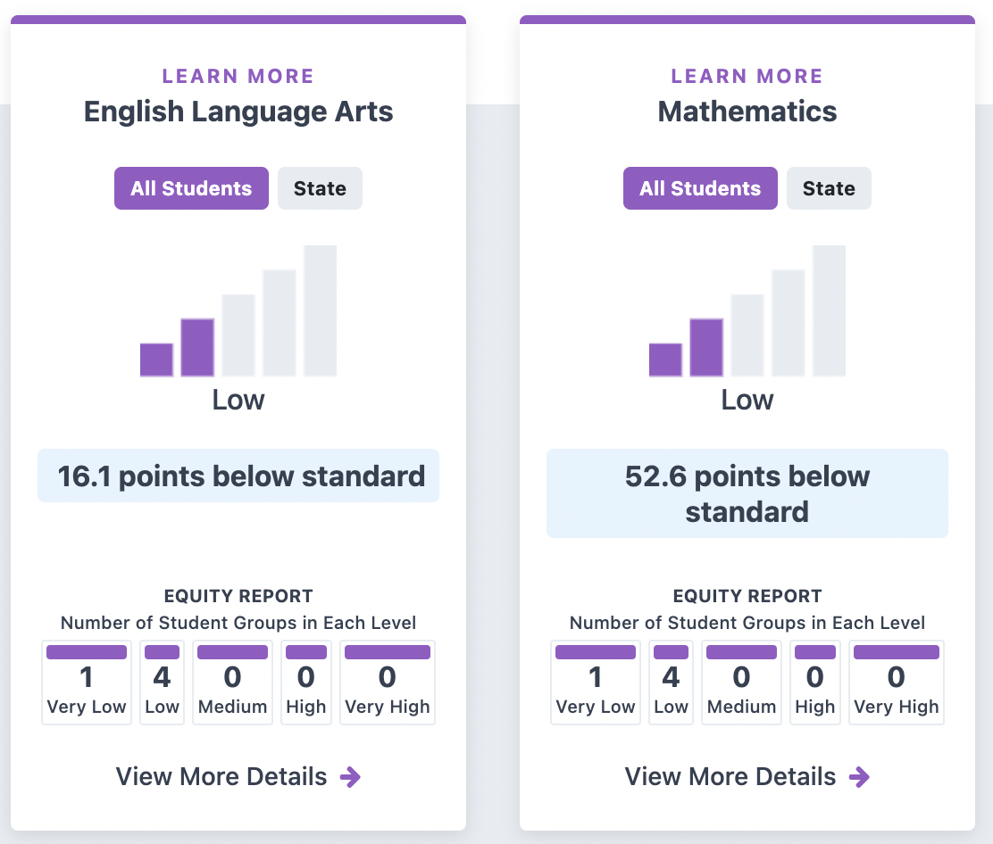
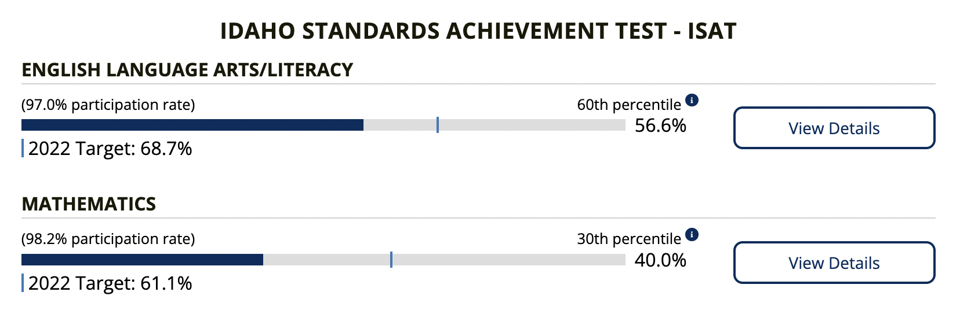
Option 2: Stop at category-level ratings for most schools
Examples:
  California
  Idaho
  Indiana (Indiana Graduates)
Pros:
  Shows transparency of impact in all components
  Allows educators and families to see how students are moving AND where students are in relation to targets
Cons
  May create confusion with multiple measures
  Does not have a single identifier for schools in need of support
California School Report Card
Idaho
School Report Card

Slide 21
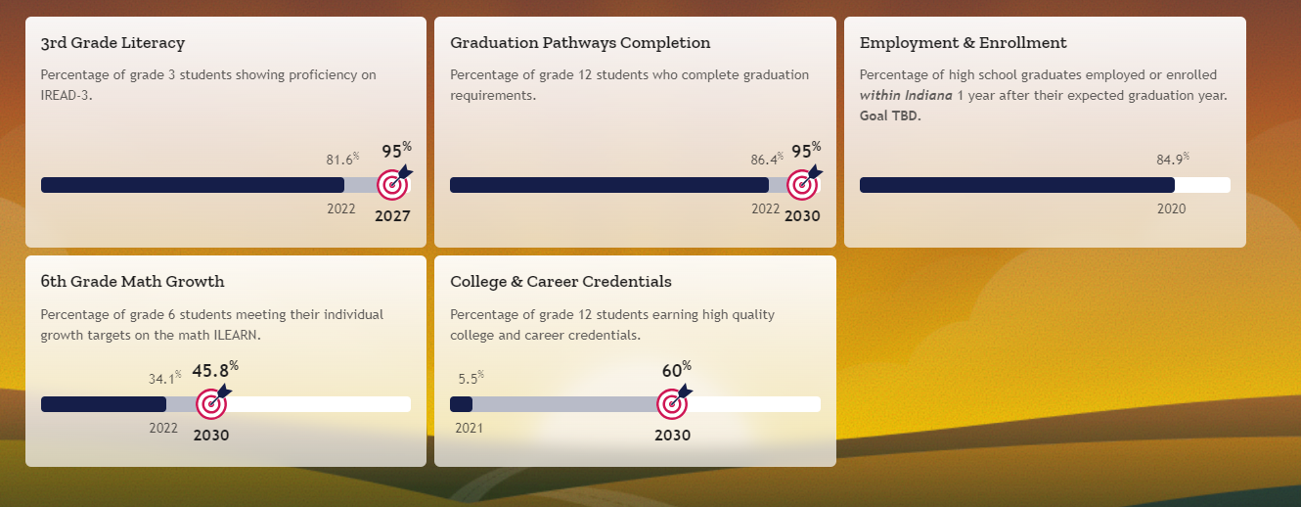

State Placemat Example: Indiana

Slide 22
Virginia’s rating system
Option 1:
Overall summative rating for all schools
Option 2:
Stop at category-level ratings for most schools

Slide 23
How to balance indicators to identify schools in need of additional support?

Slide 24
Based on the Board conversation in August, we developed two potential models.
The following slides have two models for weighting elementary/middle school indicators and two models for weighting high school indicators. The options follow this outline:
Model 1:
Two of the three indicators have the same weight
Model 2:
Each indicator has its own unique weight

Slide 25
Model 1: Elementary and Middle Schools
GROWTH
VVAAS in Reading
VVAAS in Math
VVAAS in Reading: Lowest Performers*
VVAAS in Math: Lowest Performers
ACHIEVEMENT
Reading
Math
Science
40%
40%
READINESS
Ready to Learn: Chronic Absence
Ready to Read or Ready for Rigor
20%
Notes: * may include English Language Proficiency assessments.

Slide 26
Model 2: Elementary and Middle Schools
30%
60%
GROWTH
VVAAS in Reading
VVAAS in Math
VVAAS in Reading: Lowest Performers*
VVAAS in Math: Lowest Performers
ACHIEVEMENT
Reading
Math
Science
READINESS
Ready to Learn: Chronic Absence
Ready to Read or Ready for Rigor
10%
Notes: * may include English Language Proficiency assessments.

Slide 27
Comparing the models: Elementary and Middle Schools
Model 1
Growth and Achievement Equally Weighted
Model 2
Achievement Weighted More than Growth

Slide 28
Model 1: High Schools
READINESS
Ready to Learn: Chronic Absence
Ready to Graduate: 4- and 5-Yr Grad Rate
Ready for Career: College, Career, and Military
ACHIEVEMENT
Reading
Math
Science
42%
42%
GROWTH
VVAAS in Reading*
VVAAS in Math
16%
Notes: * may include English Language Proficiency assessments.

Slide 29
Model 2: High Schools
30%
ACHIEVEMENT
Reading
Math
Science
READINESS
Ready to Learn: Chronic Absence
Ready to Graduate: 4- and 5-Yr Grad Rate
Ready for Career: College, Career, and Military
60%
GROWTH
VVAAS in Reading*
VVAAS in Math
10%
Notes: * may include English Language Proficiency assessments.

Slide 30
Comparing the options: High Schools
Model 1
Readiness and Achievement Equally Weighted
Model 2
Achievement Weighted More than Readiness

Slide 31
Next steps
Board decision on:
  Achievement
  Readiness
  Rating system
What would the Board like to discuss at the next meeting regarding the new accountability system?

