Slide 1

ALL IN VA
2023 Annual Standards of Learning Assessment Rates

Slide 2

2022-23 Key Findings
2022 NAEP results indicated a consequential drop. Virginia's drop in performance ranking across the country was the first flag that the honesty gap and transparency of SOL scores were flawed.
Changes in proficiency cut scores mattered. The lowered proficiency cuts for the 2020-21 SOL assessments masked the dramatic drops in post-pandemic student performance.
Grade 3-8 reading and math scores demand action. 2022-23 reading and math pass rates remain well behind their 2018-19 peers for both elementary and middle school students.
High school students are recovering from COVID-19 learning loss. While school divisions must monitor student's continued recovery, high school students have reasonably bounced back from missed learning experiences.
Chronically absent students suffer substantially compared to their peers. During the 2022-23 school year, chronically absent students performed 18% lower in reading and 25% lower in math than their peers.
When it comes to our students, we are ALL in VA.

Slide 3
Virginia NAEP Performance 2017-2022
NAEP Grade-4 Reading:
Change in Average Scale Score 2017-2022
-13.6 Point Change for Virginia Since 2017
NAEP Grade-4 Math:
Change in Average Scale Score 2017-2022

Slide 4
In Grades 3-8, over half of students are at-risk or have failed their Reading SOL
KEY TAKE-AWAYS
The lowering of proficiency cut scores resulted in students passing at "low proficient" rates who otherwise would have likely failed if the cut scores had not been lowered.
173,336 students were "low proficient/at risk" and 161,351 students did not pass reading in 2022-23, totaling 334,687 students.

Slide 5
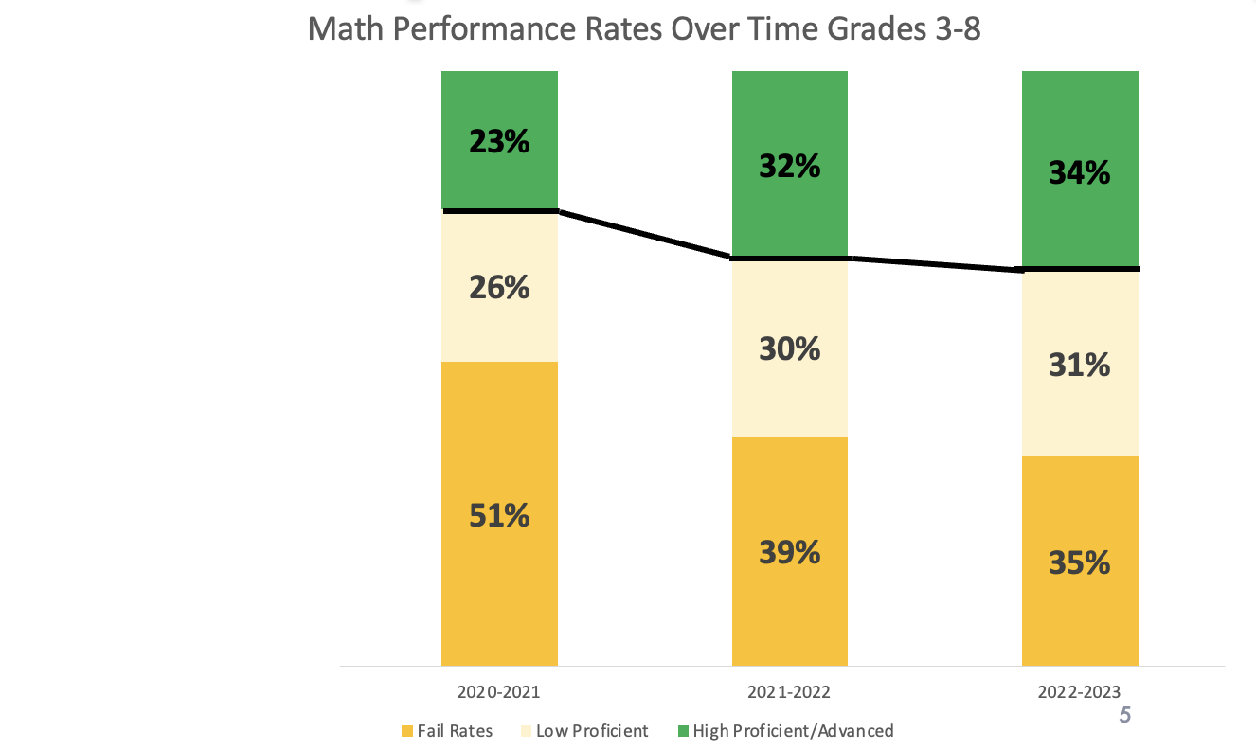
In Grades 3-8, two-thirds of students are at-risk or have failed their Math SOL
KEY TAKE-AWAYS
    Math pass rates have increased just 4 points in 2022-23 from the prior year, which is not on-track to regain the learning loss from the pandemic.
    153,180 students were at "low proficient/at risk" and 174,418 students did not pass mathematics in 2022-23, totaling 327,598.

Slide 6
Some Student Groups Experienced Significant Declines in Reading
KEY TAKE-AWAYS
44,259 Hispanic students failed, and 31,400 Hispanic students are in the "low proficient/at-risk" student group in Reading in 2022-23.
51,124 Black students failed, and 29,232 Black students are in the "low proficient/at-risk" student group in Reading in 2022-23.

Slide 7
Black and Hispanic Students Experienced Significant Declines in Math
KEY TAKE-AWAYS
Black and Hispanic students experienced the largest drops of 20 to 21 percentage points between 2018-19 and 2022-23, which is much larger than the 14-percentage point performance gap for all students.

Slide 8
Many Student Groups Experienced Significant Declines in Reading due to COVID-19
KEY TAKE-AWAYS
104,439 Economically Disadvantaged students have failed, and 80,072 Economically Disadvantaged students are in the "low proficient/at-risk" student group in Reading.
7 in 10 English Learner students failed their Reading SOL.
6 in 10 Students with Disabilities failed their Reading SOL.

Slide 9
Many Student Groups Experienced Significant Declines in Math due to COVID-19
KEY TAKE-AWAYS
112,516 Economically Disadvantaged students have failed, and 70,725 Economically Disadvantaged students are in the "low proficient/at-risk" student group in Math.
64% of English Learner students failed their Math SOL.
65% of Students with Disabilities failed their Math SOL.

Slide 10
High School Pass Rates are Near Pre-Pandemic rates
Students taking the high school End of Course (EOC) test are one point behind pre-pandemic trends and are demonstrating adequate learning recovery.
Students taking the high school End of Course (EOC) tests are five points behind pre-pandemic trends and have remained stable for two years in a row.

Slide 11
More Than Half of Virginia’s Students Are Not Meeting Proficiency Benchmarks In Reading and Math
207,995
166,119
407,543
173,336
153,180
161,351
105,154
174,418
In 2022-23, more than half of all 3rd through 8th graders are at risk or failed the Reading SOL.
In 2022-23, two thirds of all 3rd through 8th graders are at risk or failed the Math SOL.

Slide 12

Attendance
Matters
#AttendanceMattersVA

Slide 13
COVID-19 Closures and Student Attendance Impact
  KEY TAKE-AWAYS
            In 2018-2019, 1 in 10 students were chronically absent.
            In 2022-2023, the number of chronically absent students nearly doubled.
            41,159 more students were chronically absent compared to their 2018-2019 peers.

Slide 14
COVID-19 Closures and Grade 3-8 Student Attendance Impact on Reading
  KEY TAKE-AWAYS
    Students who missed 18+ days of school scored 18% lower than students with regular attendance.
  Students who missed 36+ days (2 months of school) scored 31% lower than students with regular attendance.

Slide 15
COVID-19 Closures and Grade 3-8 Student Attendance Impact on Mathematics
  KEY TAKE-AWAYS
    Students who missed 18+ days of school scored 25% lower than students with regular attendance.
  Students who missed 36+ days (2 months of school) scored 43% lower than students with regular attendance.

Slide 16
COVID-19 Closures and Impact on Student Groups
  KEY TAKE-AWAYS
  1 in 4 Economically Disadvantaged and Student with Disabilities are chronically absent.
  1 in 5 Black students are chronically absent.
  1 in 5 Hispanic students are chronically absent.
  These groups missing the most school are the same groups that are suffering the most from learning loss.
  .

Slide 17
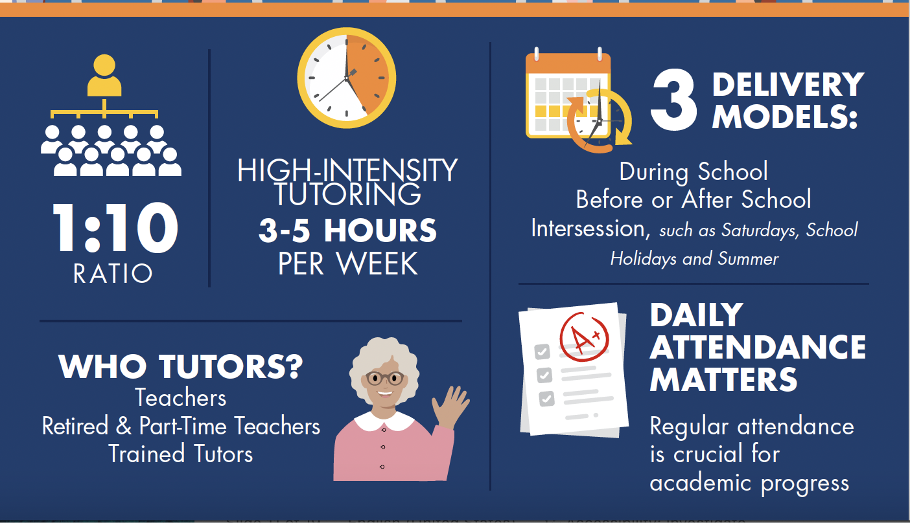
Action 1: High Intensity Tutoring (70%)

Slide 18
Action 2: Expand & Accelerate VLA (20%)
Instructional Materials
G4-8 Reading Specialists
Implementation/Leadership Network
VLA Preparation

Slide 19
Action 3: ALL In on Attendance (10%)
Chronic Absenteeism Campaign
Chronic Absenteeism Task Force
Chronic Absenteeism Playbook

Slide 20


