Slide 1
Alcohol and Other Drugs
Alcohol Facts
Alcohol is a depressant drug that slows the body's key functions, including breathing, heartbeat, and thinking.
Virginia 2022 statistics show there were
6,910 alcohol-related crashes
4,174 persons injured
274 persons killed
Alcohol, Crashes, & the Law
02
Effects of Other Drugs on Driving
Drugs that have similar affects as alcohol can be illegal drugs and over-the-counter medications (OTC). These can be purchased legally without a prescription and may cause drowsiness or impair driving ability.
Negative Peer Pressure is when others encourage inappropriate or dangerous behavior. Never let others influence your choices when driving.
Resisting Negative Peer Pressure

Slide 2
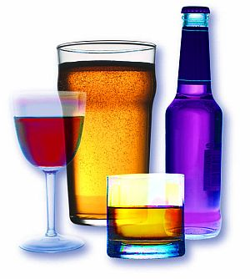
Alcohol Affects People in Different Ways
Experience with consumption of alcohol
Tolerance Variations
Medication Interactions
Gender
Mood at time of consumption
Age

Slide 3
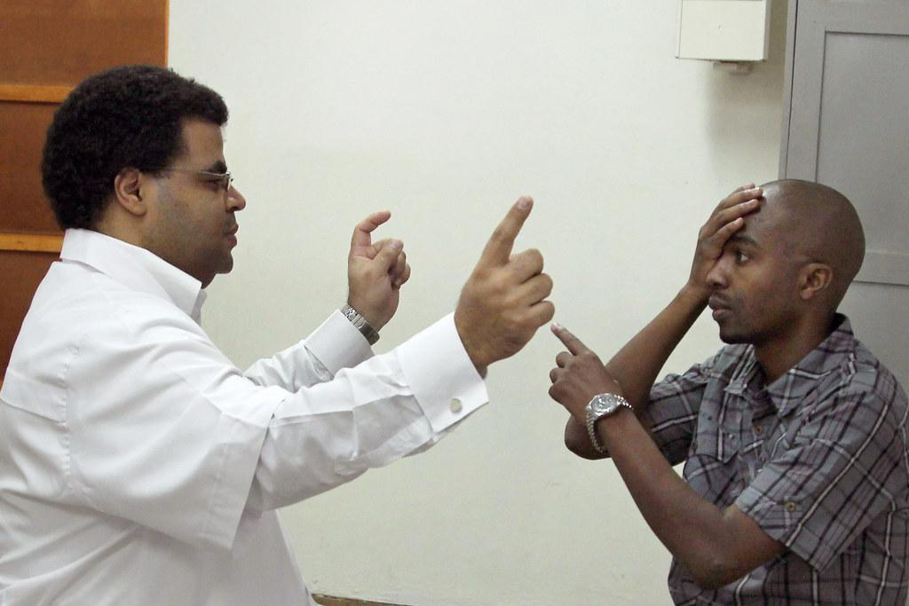
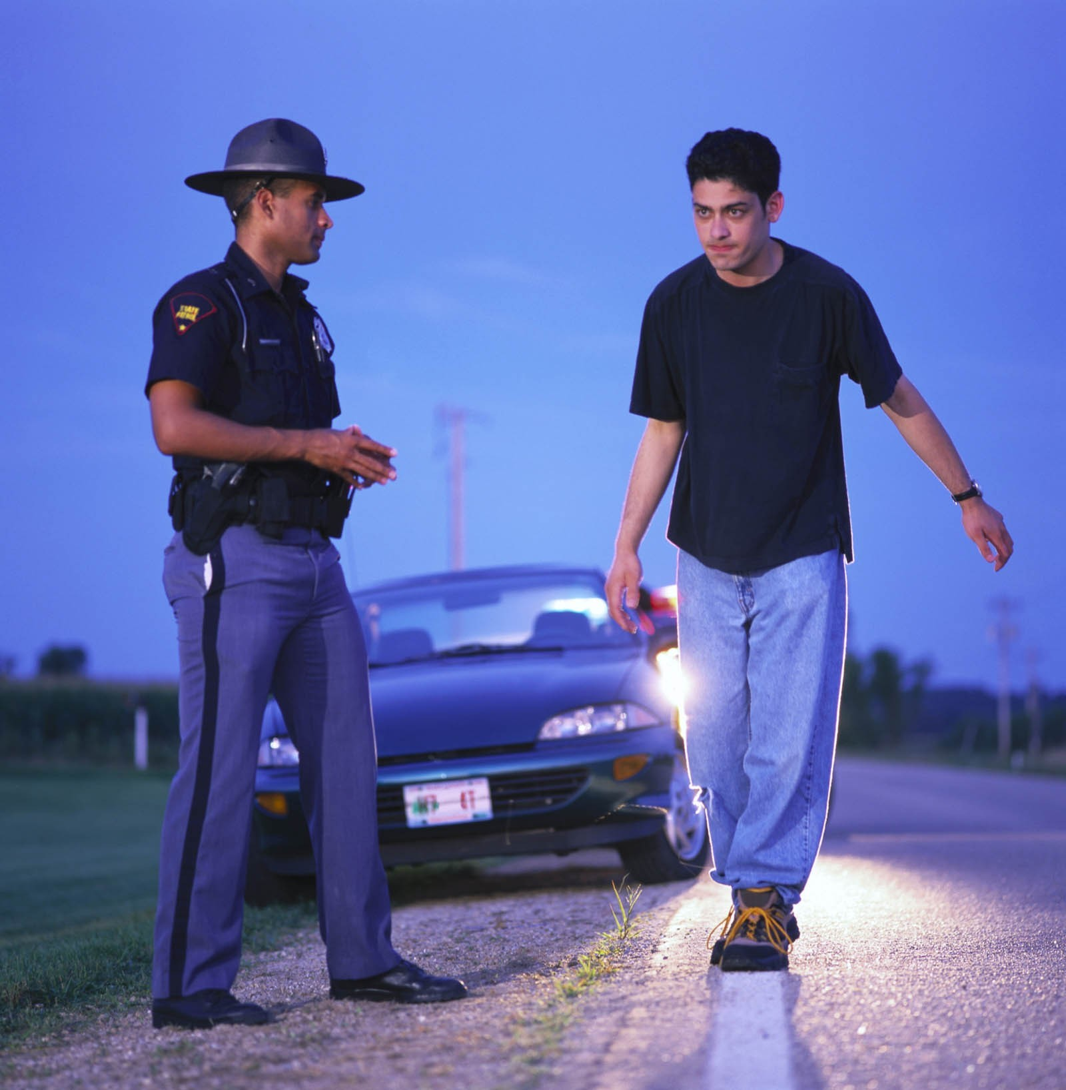
Alcohol can impair these areas of the Space Management System (SMS):
BY-NC-N
Inability to visually focus
Problems with double vision
Judgment of distance is unreliable
Problems with side (peripheral) vision
Lack of sharpness or visual acuity
Failure to distinguish colors
.
Response time slows
Night vision is problematic
Motor skills are impaired

Slide 4
Alcohol, DUI, and Crashes
Some factors that affect blood alcohol concentration (BAC) level: gender, body weight, drink size and type, food consumption, time spent drinking.
Virginia statistics show in 2022 there were
6,910 alcohol-related crashes
4,174 persons injured
274 persons killed
Size of Drink
Stats
12 oz. beer
24 oz. beer
Time is the only proven method to remove alcohol from the system. It takes roughly 1 hour to eliminate one drink.
In 2021, 15,988 persons were convicted of DUI
Approximately 2/3 male
Approximately 1/3 female

Slide 5
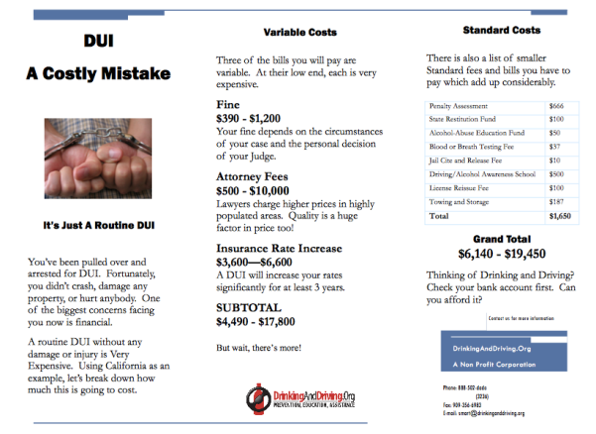
The Cost of Driving Under the Influence (DUI)
Notes:
Causes of fatigue
Physical strain (hard work)
Mental strain (stress)
Monotonous tasks (long driving trips)
Illness
Lack of sleep
Sun glare
Overeating
Riding in a warm passenger compartment

Slide 6
Driver Emotions
Do not drive when upset
Identify passenger impact on driving
Self-imposed driver anxiety
Ways to reduce driver stress
Identify situations that cause stress and understand that reactions to stressful driving situations can be contagious among drivers.
Be mindful of the impact passengers have on the driver, such as distractions, emotional stress, peer pressure for teens to engage in risky driving behaviors.
These include rushing to be on time, becoming irritated with other drivers, etc.
Allow yourself plenty of time
Drive the posted speed limit
Reduce distractions
Don’t drive when angry/emotional
Avoid driving at peak times
Plan your trip before leaving
Relax and concentrate on driving
Be polite to other drivers
.

Slide 7
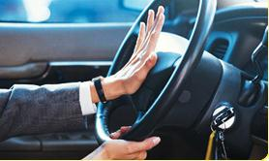
Types of Aggressive Driving and Road Rage
If you are convicted of aggressive driving, your license could be suspended for ten days or for as long as six months.
Verbal aggression: yelling, cursing, gesturing, honking, insulting.
Quiet Aggression (passive/aggressive): complaining, rushing, competing, resisting by not letting others in.
Road Rage: Occurs when a driver uses the vehicle or some other weapon to threaten or cause harm to another roadway user in response to a traffic incident.
Epic Aggression: cutting other drivers off, blocking, chasing, physically fighting, shooting.

