Slide 1
Overview of Revisions to the Board of Education’s Comprehensive Plan
Virginia Board of Education
Special Meeting
August 31, 2023

Slide 2
Overview of Presentation
Statutory Requirements for the Board’s Comprehensive Plan
The Board's Priorities and Goals in the Current Plan
Discussion of the Board's Priorities and Goals for the Revised Comprehensive Plan

Slide 3
Statutory Requirements for the Board’s Comprehensive Plan
Section 22.1-253.13:6(A) states that “[t]he Board shall adopt a statewide comprehensive, unified, long-range plan based on data collection, analysis, and evaluation.”

Slide 4
Statutory Requirements for the Board’s Comprehensive Plan
The plan must include the following elements:
the objectives of public education in Virginia, including strategies for first improving student achievement, particularly the achievement of educationally at-risk students, then maintaining high levels of student achievement;
an assessment of the extent to which these objectives are being achieved;
a forecast of enrollment changes;
an assessment of the needs of public education in the Commonwealth;
an analysis of the extent to which the Standards of Quality have been achieved and the objectives of the statewide comprehensive plan have been met; and
a long-range plan to integrate educational technology into the SOL and curricula, including career and technical education programs.

Slide 5
The Objectives of Education in the Current Plan
Objective 1: Allow for the development of the individual
Objective 2: Perpetuation of free government
Objective 3: Provision of skills that allow each student to participate in the economic health of the Commonwealth

Slide 6
The Board's Priorities and Goals in the Current Plan
Priority 1: Provide high-quality, effective learning environments for all students.
Priority 2: Advance policies that increase the number of candidates entering the teaching profession and encourage and support the recruitment, development, and retention of well-prepared and skilled teachers and school leaders.
Priority 3: Ensure successful implementation of the Profile of a Virginia Graduate and the accountability system for school quality as embodied in revisions to the Standards of Accreditation

Slide 7
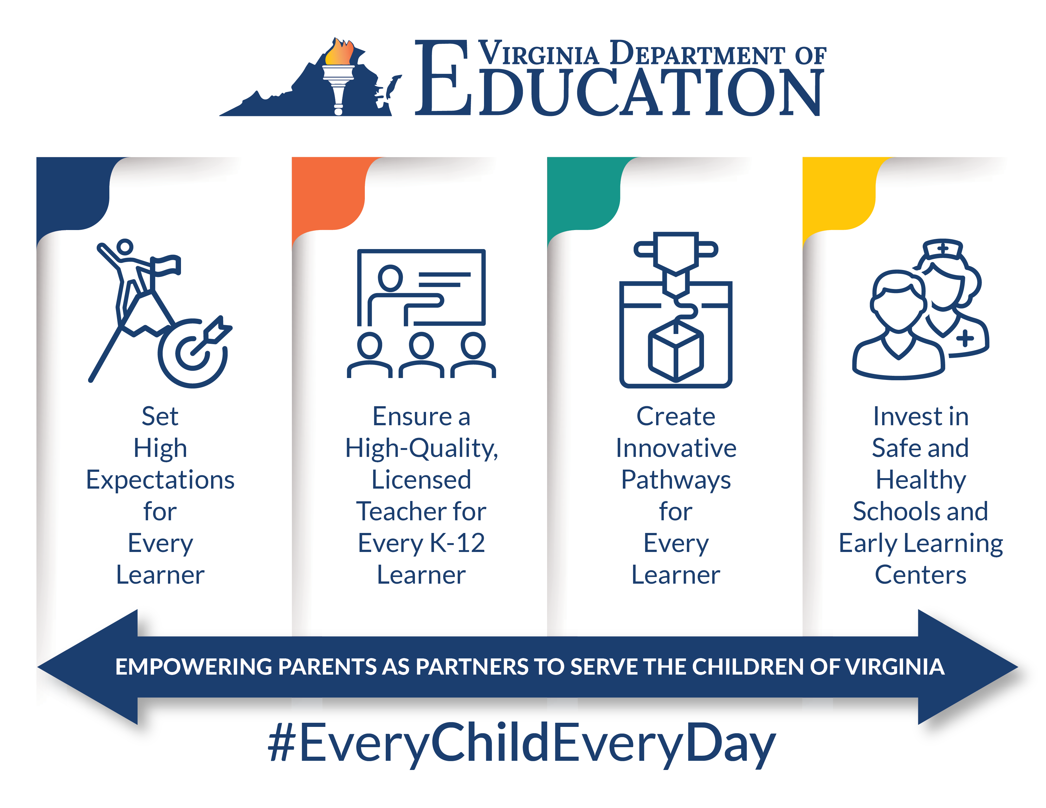

Slide 8
Discussion

