Slide 1
Promoting Readiness through Accountability Systems
Virginia State Board of Education
Alissa Peltzman
August 31, 2023

Slide 2
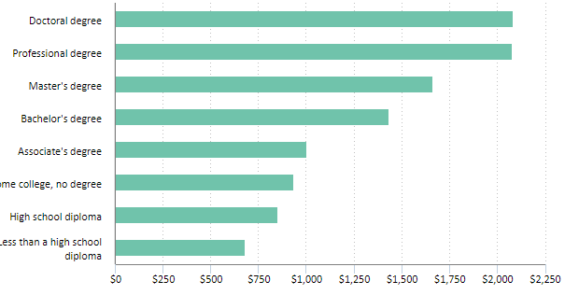
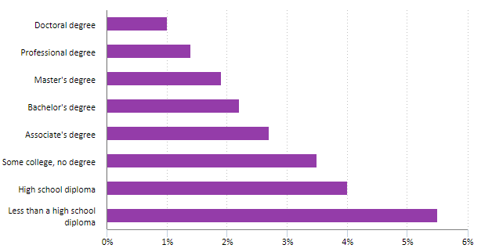
“Learn more, earn more”
Source: Bureau of Labor Statistics, 2022

Slide 3
How does Virginia currently measure Career Readiness?
Accreditation
An index that measures, for the graduating cohort, student preparation for college and careers while in high school. Credit is given for:
  Advanced coursework (College level courses)
  CTE courses and credentials
  JROTC coursework
  Credentials, work-based learning, and service learning
Chronic absenteeism is also included in accreditation system (percent of students missing 10% or more of days)
Federal Accountability
  Chronic absenteeism (percent of students missing 10% or more of days)

Slide 4
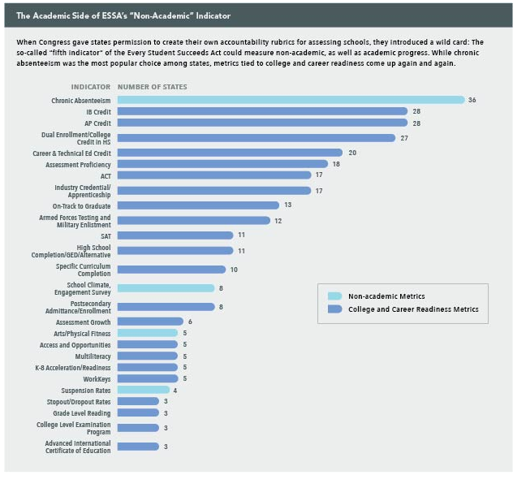
Non-academic Options: Connected to Career Readiness
Attendance
Literacy
Source: Future-Ed

Slide 5
Attendance
Measuring Attendance/Chronic Absenteeism:
    27 states measure how many students are missing more than 10% of school
    1 state measure students missing 5% or fewer days
    1 state measures how many students attend 97% or more of school days
    4 states and DC are measure how many students attend at least 90% of school days
    Attendance is a measure that can be included across all school levels (elementary, middle, and high schools).
    Attendance is also a measure that can be inclusive of grades K-2 in elementary school. (CCSSO, 2017)

Slide 6
Elementary and Middle School
Skill Development: Literacy and Math
Measuring Literacy in Elementary School:
  Three states are measuring the percentage of students who are reading at the appropriate grade level
  Often associated with 3rd Grade
  Measuring Math in Middle School:
  High school credit attainment in middle school (Career Readiness Metric Framework)
  Often associated with 7th or 8th grade advanced mathematics (Algebra I)
Sources: Future-Ed, Advance CTE and Education Strategy Group

Slide 7
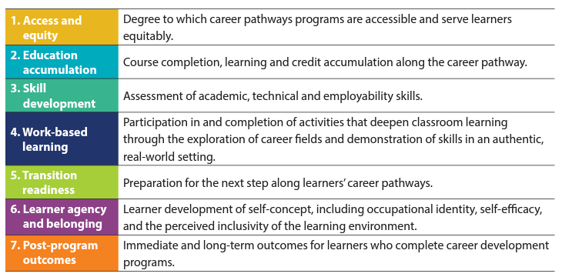
Career Readiness Metric Framework
Source: Advance CTE and Education Strategy Group, 2021

Slide 8

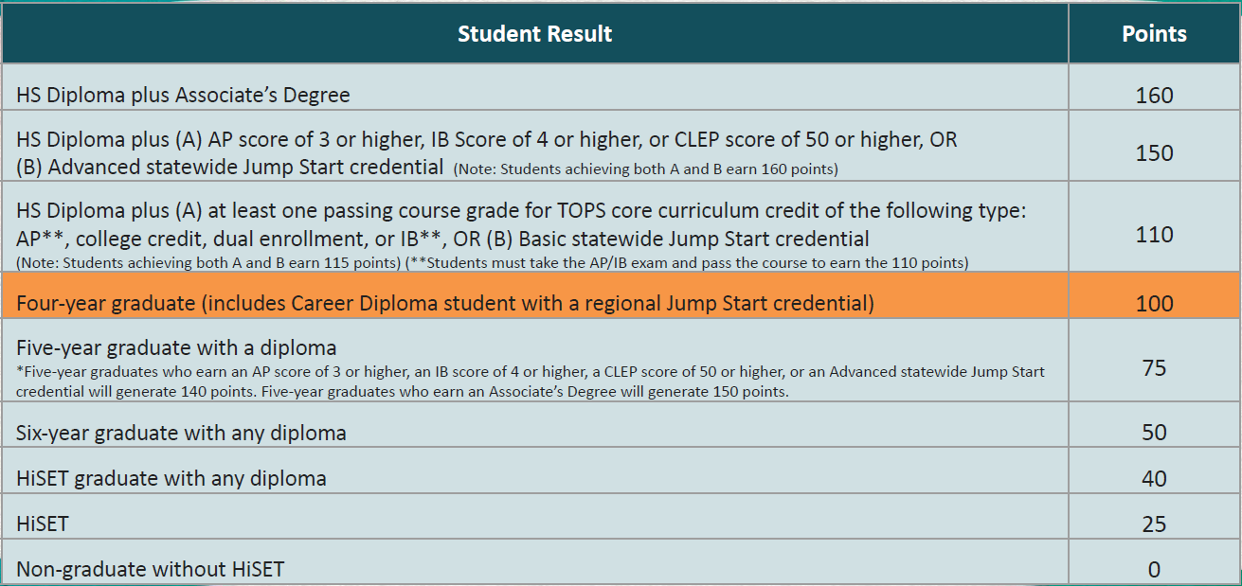
High School State Example: Louisiana

Slide 9
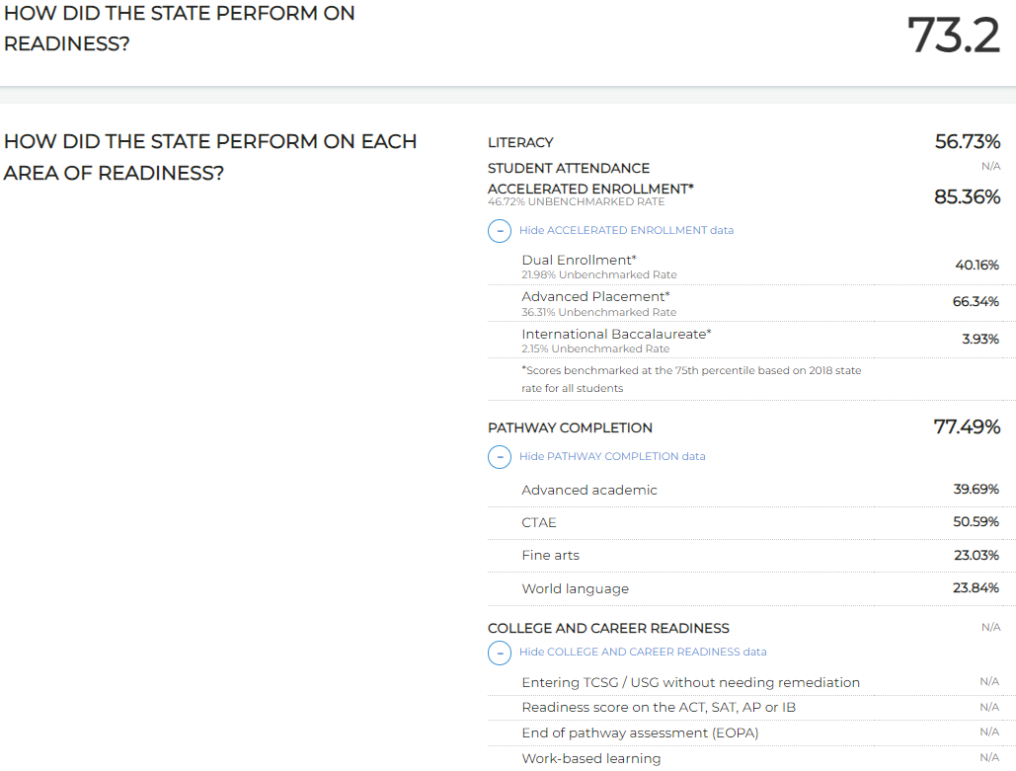

High School State Example: Georgia

Slide 10


High School
State Example: Tennessee
Ready Graduate indicator
Divides the number of on-time graduates meeting at least one Ready Graduate criterion by the total number of students in the cohort
To be considered Ready Graduates, students must meet at least one of the following four criteria:
Score a 21 or higher on the ACT (or 1060 or higher on the SAT)
Complete 4 early postsecondary opportunities (EPSOs)
Complete 2 EPSOs and earn an industry credential
Complete 2 EPSOs and early a score of military readiness on ASVAB AFQT

Slide 11

Career Readiness
Discussion

