Slide 1
Achievement Measures in Accountability Systems
Anne Hyslop
Virginia Board of Education Work Session
August 31, 2023

Slide 2
Accreditation Does Not Differentiate Schools
In Virginia, the system produces the same result for 90% of schools – accredited – and virtually all schools are either accredited or accredited with condition.
Source: Virginia Department of Education

Slide 3
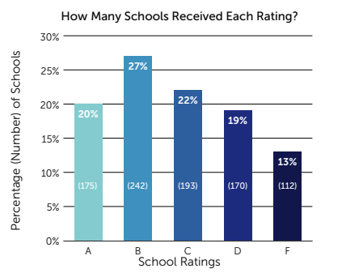
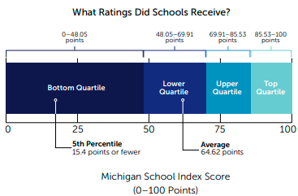
Accreditation Does Not Differentiate Schools
Other states do a better job differentiating between school performance.
Mississippi: 5 possible ratings, distributed fairly consistently, and no more than 27% of schools received the same result
Michigan: 0-100 point index, with an average score of 65 and a median score of 70 points
Source: All4Ed

Slide 4
The Role of Achievement in Accountability
Measuring and improving student academic outcomes – namely, whether students are meeting grade-level standards in core subject areas – has been a bedrock of school accountability systems for three decades.

Slide 5
Virginia’s Current “Achievement” Indicators
Most of Virginia’s “achievement” indicators do not measure the percentage of students in a school who are proficient because they use a “combined rate.”
  Academic Achievement: Mathematics
  Academic Achievement: English (reading and writing)
  Achievement Gap: Mathematics
  Achievement Gap: English (reading and writing)
  The Academic Achievement indicator in Science is measured based on pass rates alone.
School and Indicator | Annual Pass Rate | Accreditation Combined Rate
School A: Math | 56% | 88%
School A: Reading | 66% | 86%
School B: Math | 40% | 82%
School B: Reading | 58% | 82%
School C: Math | 91% | 97%
School C: Reading | 93% | 98%

Slide 6
Drawbacks of Using a Combined Rate
Lacks transparency for the public
  Unclear what is being measured: reading and math proficiency, reading and math growth, English language proficiency?
  On occasion, students can be counted twice, distorting the rate
Not a particularly valid measure of achievement
  Achievement (proficiency) rates often will be inflated because non-proficient students are counted for making progress.
  Student progress and growth can be recognized and rewarded in other ways in the accreditation system (i.e., by creating separate indicators just to measure growth).

Slide 7
Current Trends In Achievement Indicators
All states use achievement indicators in reading and math for accountability, but there are options:
  Performance Index
  Proficiency or “pass” rates
  Performance against proficiency “targets”
  Average scale scores
  Combined approaches (performance index and proficiency rates)
The Most Popular Methods Across States

Slide 8
Performance Index: Overview
Weighted calculation based on the achievement level attained by a student on a test
  All students can be included, even if they are not yet proficient.
Students scoring proficient are typically “unweighted.” In other words, they count as 1 in the calculation and schools receive full credit for each proficient student.
  Students scoring above proficiency net bonus points or extra credit—for example, 1.1.
  Students who are not yet proficient yield partial credit and could be assigned a weight of 0.5 or 0.25.

Slide 9




Performance Index: Overview
100 students in grades 3-5 at a school
Weights:
1.25 for Advanced
1.0 for Proficient
0.75 for Approaching
0.5 for Basic
20 score at the Advanced level
30 score at the Proficient level
30 score at the Approaching level
20 score at the Basic level
20 x 1.25 = 25
30 x 1.0 = 30
30 x 0.75 = 22.5
20 x 0.25 = 5
25 + 30 + 22.5 + 5 = 82.5 points

Slide 10
Performance Index: Benefits
Recognize performance at all levels of achievement, but provides schools greater credit for students meeting and exceeding grade-level proficiency
Emphasize proficiency in all subject areas
Calculation can easily be shown based on number of tests and weighting
Stakeholders can digest the meaning of the weighted calculation, especially when it’s paired with contextual information

Slide 11

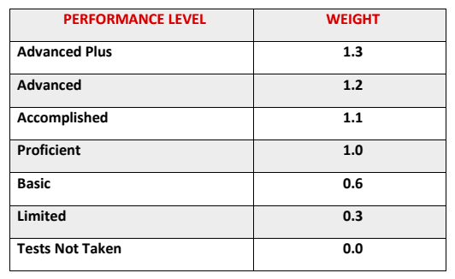
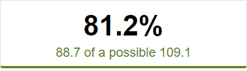
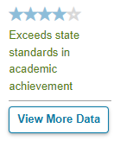
Performance Index: State Example
Each school is assigned a score on a performance index.
The percentage of tests taken in a school that fall into each of seven performance levels is determined.
These percentages are multiplied by a corresponding weight: proficient results are weighted 1, while results below proficient are weighted 0.6 or 0.3 and results above proficient are weighted 1.1, 1.2, or 1.3.
Weighted scores at each performance level are summed and compared to the maximum possible score to create an overall index score, which is then translated into a 1-5 star rating.

Slide 12
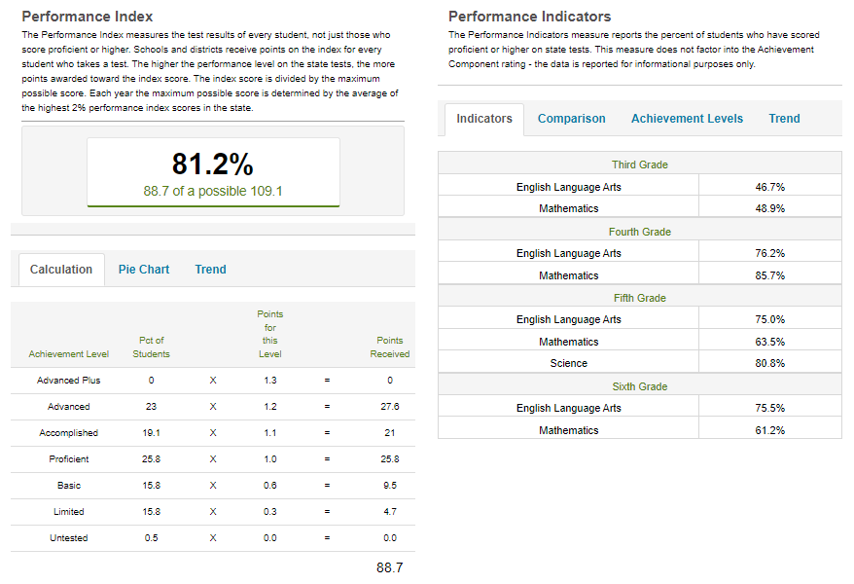
Performance Index: Reporting
Proficiency Rates: reported for each grade level and subject; not used for accountability
Performance Index: breakdown of weighted calculation by number of students at each performance level; used for accountability

Slide 13
Proficiency Rates: Overview
Unweighted percentage of students meeting or exceeding grade-level proficiency
  Only students that attain proficiency are included in the numerator.
  Schools do not receive “extra” credit for students at the highest achievement levels, nor “partial” credit for students scoring below proficient levels.

Slide 14
Proficiency Rates: Overview
100 students in grades 3-5 at a school
No Weights
Applied
20 score at the Advanced level
30 score at the Proficient level
30 score at the Approaching level
20 score at the Basic level
20 + 30
= 50% Proficient
100

Slide 15
Proficiency Rates: Benefits
Focuses on students meeting or exceeding grade-level proficiency
Emphasize proficiency in all subject areas
Straightforward calculation that is easy to understand
Students attaining “advanced” levels don’t mask or compensate for the performance of non-proficient students

Slide 16

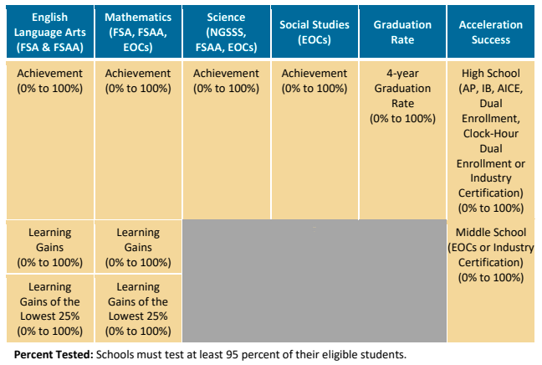
Proficiency Rates: State Example
Each achievement indicator is worth 100 points, based on a simple proficiency rate.
If 70% of students pass the state test in math, a school receives 70 points on that indicator; points across all indicators are summed and translated to an A-F grade
Student growth is measured separately in “learning gains” indicators.
Proficiency and growth indicators receive equal weight: 400 points each.

Slide 17
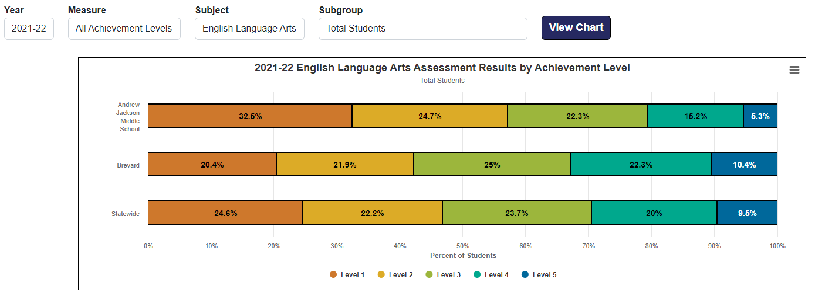
Proficiency Rates: reporting

Slide 18
Summary
Virginia | Ohio | Florida
Complex combined rate of achievement and growth, does not measure proficiency | Performance index based on achievement levels, with results that are proficient or above receiving a higher weight to generate a weighted score | Straightforward proficiency rate; if 70% of students pass the state test in math, a school receives 70 out of 100 points on the math achievement indicator
Difficult to understand, with multiple ways to “earn” points not based on proficiency | Becomes easy to understand when description of weights and calculation are shown, and additional context provided | Simplest to understand
Masks the percentage of students that are proficient by giving equal credit for non-proficient students who show gains | Recognizes performance at all levels by providing greater credit for students exceeding proficiency and partial credit for students below proficient | Focuses solely on attaining grade-level proficiency

Slide 19

Achievement
Discussion

