Slide 1
Understanding Student Growth
Virginia State Board of Education
Katrina Miller, Director of Education Partnerships at SAS
Notes:
Katrina

Slide 2

What we do...
Notes:
So what does SAS do? We are the largest, privately held software company in the world. In business for 44 years and we are a Leader in Data Management, Data Visualization and Analytics. To say it simply, We help Government and Education turn data into information for insights and decision making. Working with more than 3000 education institutions. And we take math very seriously, which is why I choose this picture of a pi sculpture on our SAS campus.

Slide 3




Who is SAS?
SAS is the world’s leader in analytics.
Leader
Analysts rank SAS as a leader in twelve different technology areas.
Experience
SAS has been applying analytics to the toughest business problems for more than four decades.
Technology
With SAS, you get flexible, user-friendly interfaces that accommodate different skill sets.
Innovation
SAS reinvests more than 20% of our revenue into research and development.
92 of the top 100 companies
on the Fortune 1000 list
are SAS customers.
Our software is installed at more than 83,000 business, government and university sites.
SAS has customers in 147 countries.

Slide 4

20+ Years of Experience
13 States using EVAAS
15 Million+ Students
425,000+ Educators
Ease of Implementation
Diagnostic & Customizable Reporting
Training and Professional Development
Educator Preparation Programs
Research
Consulting
EVAAS
Advantages
Notes:
Photos have a mask overlay to give the images style consistency
To change the photo, select the top layer, the mask, and Send to Back
Select the photo and and replace it with your new photo
With the photo still selected, Send to Back. This brings the mask back over the photo.

Slide 5
Where Is SAS Providing Student Learning Analytics and Reporting?
Notes:
Current states or district using EVAAS (LL studies and/or web reporting)
*Each state uses EVAAS differently; tailored to meet their needs
Tennessee since 1993
Ohio since 2002
Pennsylvania since 2002
North Carolina since 2005
Texas districts since 2007
Michigan since 2018
Florida since 2018
Idaho since 2021
Missouri 2021
Iowa since 2022
North Dakota since 2022
Virginia since 2022
Mississippi since 2022
A large urban school district in New Jersey since 2022
D.C. Public Schools since 2023

Slide 6
Growth vs. Achievement

Slide 7

Growth vs. Achievement
Change over time
Proficient
Start of the School Year
End of the School Year

Slide 8

Growth vs. Achievement
Proficient
Change over time
Start of the School Year
End of the School Year

Slide 9
Growth vs. Achievement
Change over time
Proficient
Change over time
Start of the School Year
End of the School Year

Slide 10



Growth vs. Achievement
Student Achievement:
Did these students reach the targeted proficiency level or performance level by the end of the school year?
Student Growth:
Did these students grow at the same rate compared to other students who took the same assessment in the same year based on where they started and ended the school year?

Slide 11
Measuring Student Growth
Growth Model Spectrum
Simple Gains
VVAAS
NRTs
Student Growth Percentiles
Value Tables
Model Complexity Spectrum

Slide 12
Achievement & Growth
Achievement
Growth
Measures student performance at a single point in time
Most closely related to family and economic background
Compares student performance to an external standard
Educators cannot control the entering achievement levels of their students
Measures student progress between all tested grades/subjects
More closely related to teaching and schooling effectiveness
Compares student performance to their own prior performance
Educators can influence the amount of growth their students make
+
=
A more complete picture of student learning
Notes:
Ultimately, high achievement should be an outcome of exceptional progress, so we must look at both if we want to truly reduce the achievement gap.

Slide 13
Leveraging VVAAS to Measure Student Growth

Slide 14
Layered Reporting: How can we use VVAAS?
Public Reports
How do divisions and schools compare in growth?
Growth Report
Are there issues at my division or school?
Diagnostic Report
Is the issue with all types of learners?
Students’ Projected
Scores
How do we best support our students?

Slide 15

01
PUBLIC REPORTING
Available for Divisions, Schools and Students
Notes:
4. Scatterplot:
The Scatterplot Report visually displays the growth and achievement of groups of students in Virginia’s public districts and schools. S report is useful in assisting districts and schools to establish a better picture of student performance by providing information on both achievement (where students are) and growth (how students are progressing). The pattern you see in the scatterplots can provide insight into the effects of educational practices and policies in your area.

Slide 16
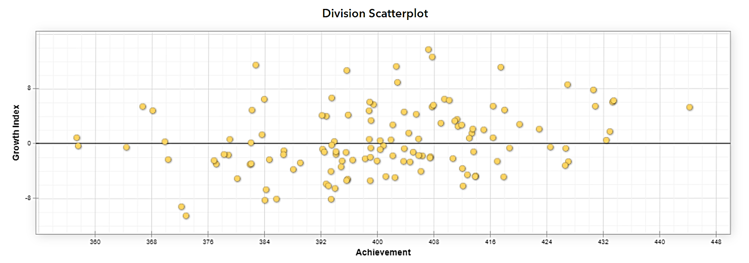

VVAAS Reports: SCATTERPLOTS
Note: This screenshot is from the Tennessee TVAAS site. Virginia does not yet have a public reporting site.

Slide 17
VVAAS Reports: SCATTERPLOTS
Note: This screenshot is from the Tennessee TVAAS site. Virginia does not yet have a public reporting site.

Slide 18

02
GROWTH
Available for Divisions, Schools and Students
Notes:
Growth (Value-Added) follows the growth of groups of students over time in order to estimate their growth.
With value-added assessment, educators get a sense of whether they are making appropriate academic growth for their students.
More specifically, value-added accomplishes this by following the same students over time thus looking at the growth of groups of students in order to make an accurate estimate of educational effectiveness.

Slide 19
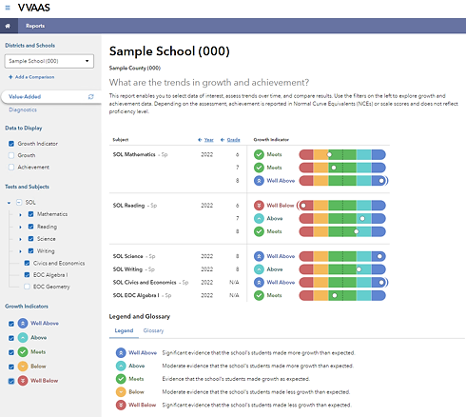
VVAAS Reports: GROWTH

Slide 20
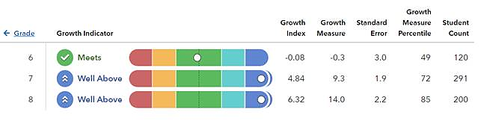
VVAAS Reports: GROWTH

Slide 21

04
STUDENT
REPORTS
Available for Divisions, Schools and Students
Notes:
3. Student Reports:
VVAAS projection reporting provides educators with information regarding the possible academic achievement, or performance, of an individual student on a future assessment. Projection reporting enables educators to assess the likelihood that students will reach a particular academic performance level on a future state assessment (SOL), or reach a particular benchmark on the ELLs assessment or college readiness exams. (ex: AP, PSAT, SAT, and ACT.)

Slide 22
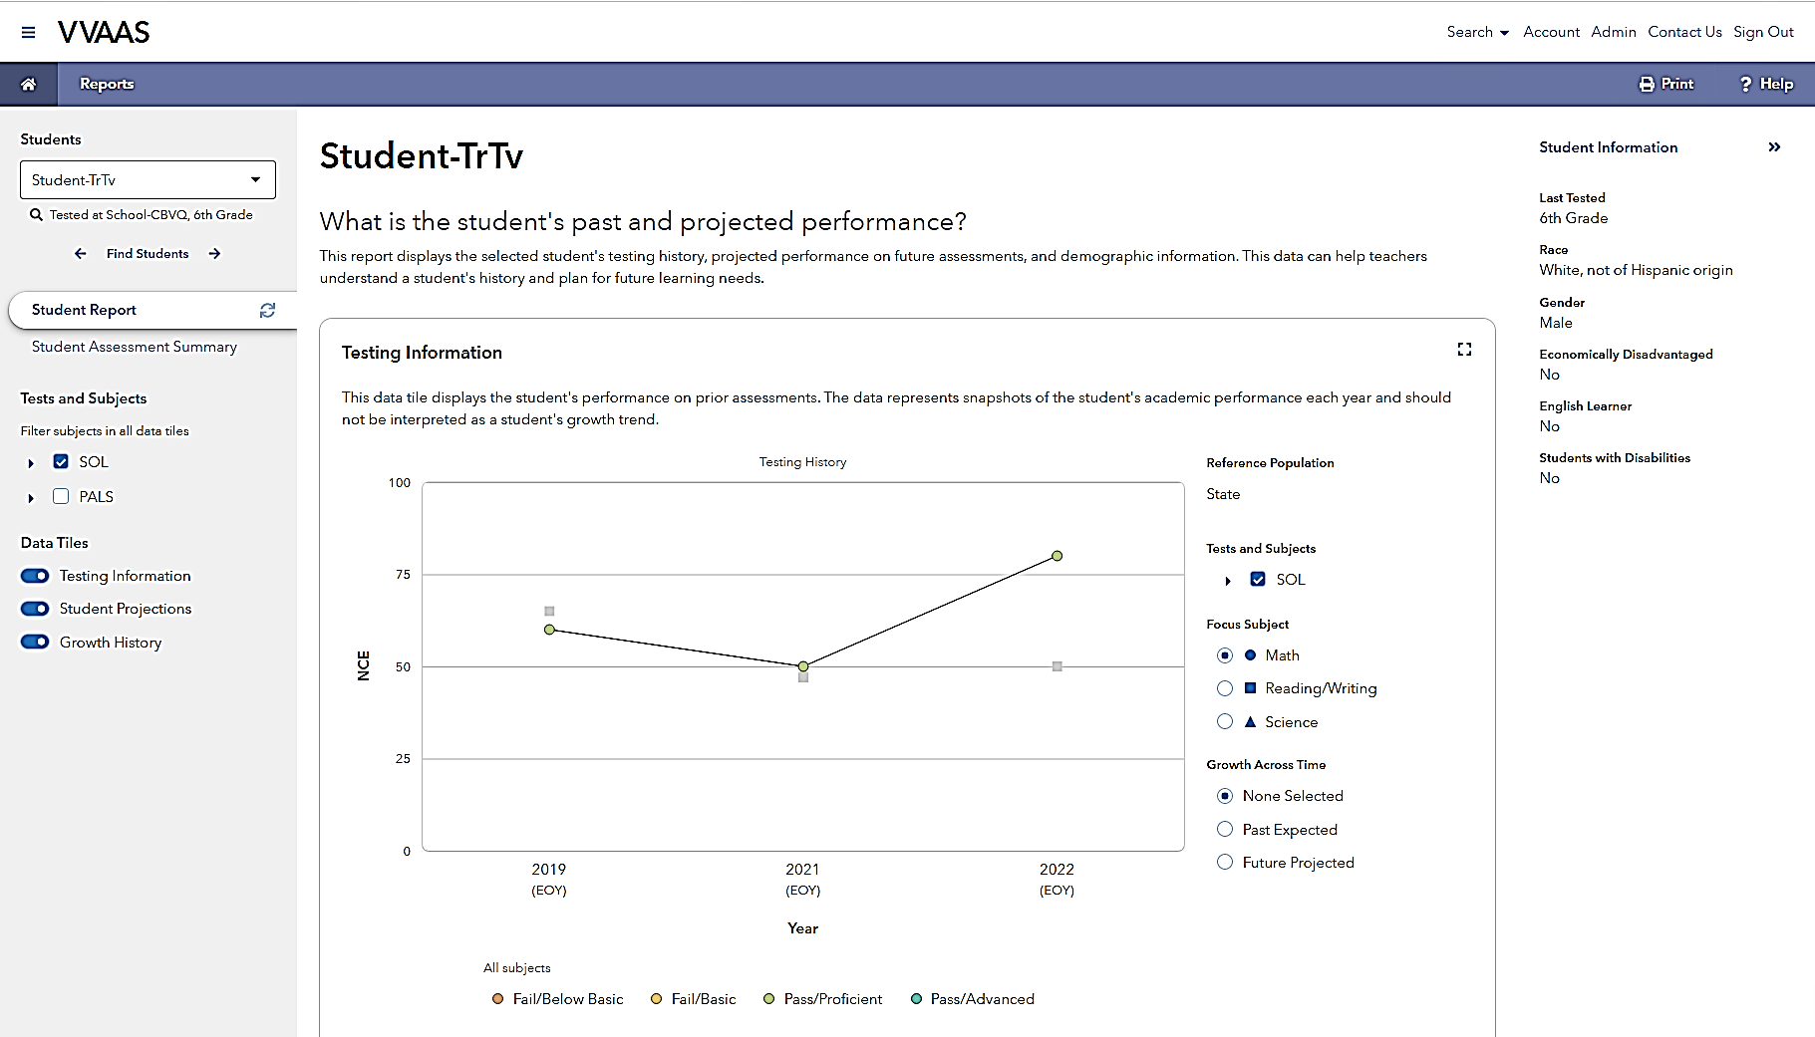
VVAAS Reports: STUDENT REPORTS

Slide 23
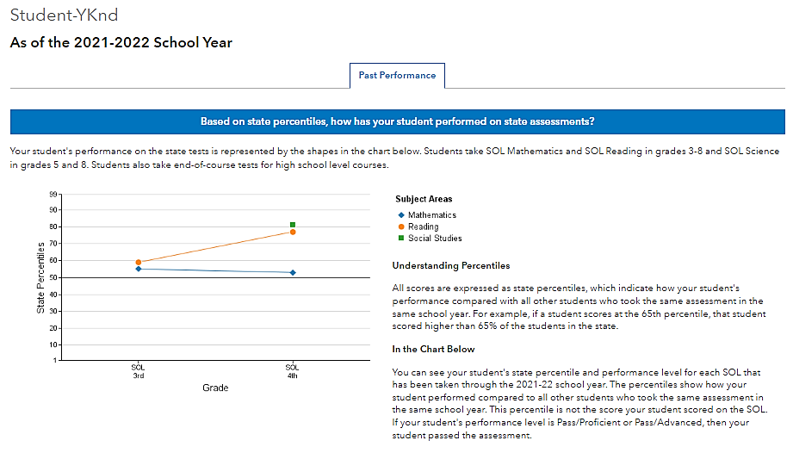
VVAAS Reports: STUDENT REPORTS

Slide 24
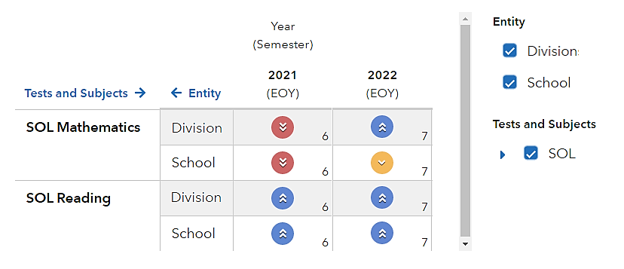
VVAAS Reports: STUDENT REPORTS

Slide 26

Growth
Discussion

