Slide 1
Virginia’s Accountability System
August 31, 2023

Slide 2
Where we have been and where we are going
Oct – Nov
2022
Board received framing presentations on accountability from leading experts
Feb – August
2023
Board participated in working sessions on accountability and accreditation
Sept
2023
Board adoption of new accountability metrics
Oct 2023 –
May 2024
VDOE builds out of new accountability system with regular Board updates and feedback sessions
Jun - Jul
2024
Board reviews and approves new accountability system
Aug 2024 -
Sept 2025
Implement full accountability system and release results

Slide 3
Accountability Overview Refresh
Virginia State Board of Education
Chad Aldeman
August 31, 2023

Slide 4
Purpose of Today's Session
Remind us why we’re all here
Learn more about trends and opportunities with growth, achievement, and career-readiness indicators
Discuss and gather input that will inform recommendations being brought to the Board in September

Slide 5
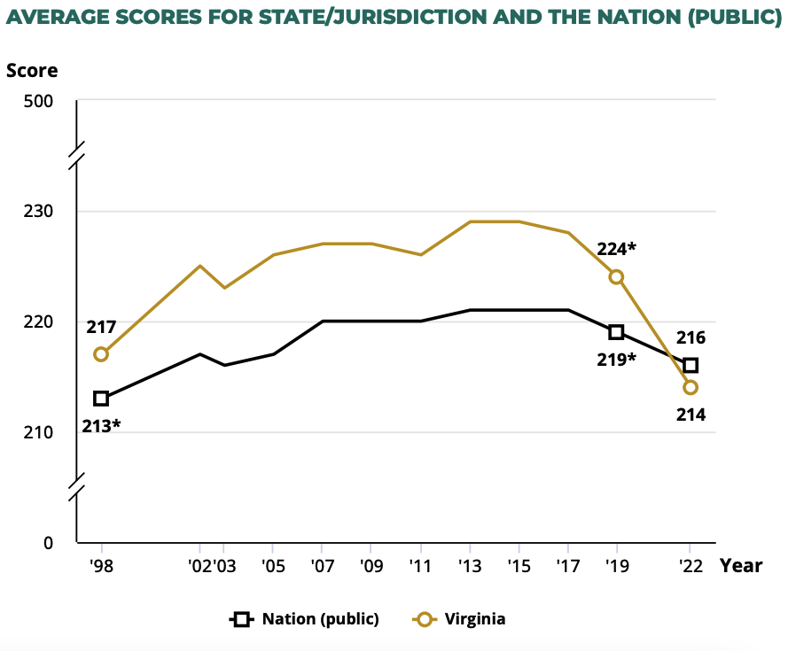
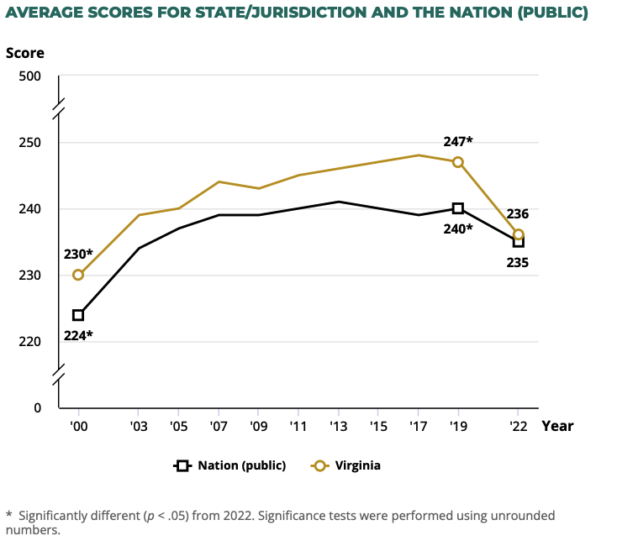
Why we’re all here: Virginia’s students are falling behind
Source: National Assessment of Educational Progress (NAEP) and Watershed

Slide 6
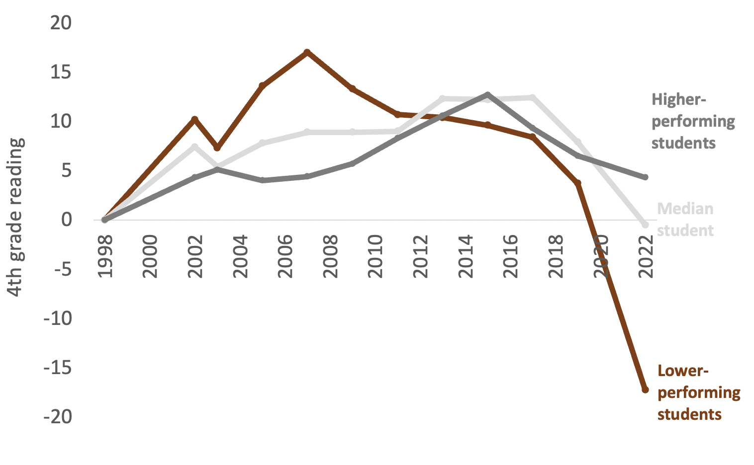
Virginia’s lower-performing students have suffered the biggest declines
Source: National Assessment of Educational Progress (NAEP)

Slide 7
Unfortunately, Virginia’s accreditation system is barely picking up on these NAEP trends
Accredited W/ Conditions
No school had their accreditation denied either year
Accredited

Slide 8
Moving forward we will bifurcate these two systems.
Virginia
Accreditation System
(Inputs)
Virginia Accountability System
(Outcomes)
Today we will focus on discussing opportunities for measures in the accountability system.

Slide 9
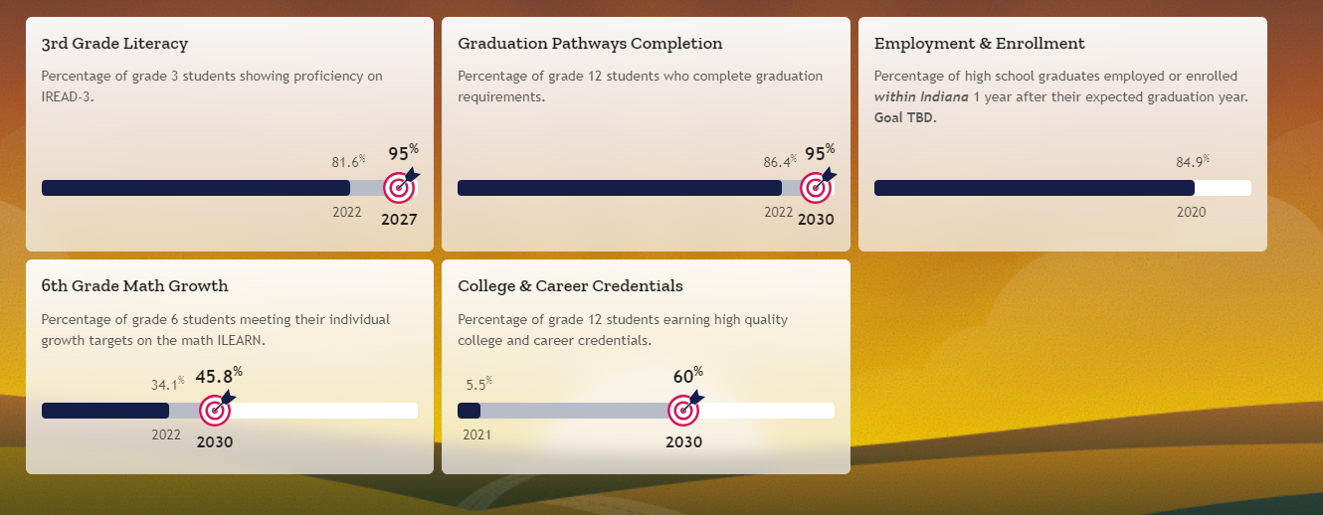
State Placemat Example: Indiana

Slide 10
Overall guiding principles for this work
The North Star is high expectations for every student. Proficiency definitions will be set by benchmarking against the demands of Virginia employers and higher education, as well as against states who have the most rigorous definitions of proficiency in the nation.
Transparency and access to actionable information will be a hallmark of our approach and our new system.
Student academic growth and proficiency are both vital measures, but the system must prioritize getting every student to proficiency/mastery.
The purpose of accountability is to build trust between schools, parents, and students through transparent, concrete, and easy to understand reporting. We must provide necessary supports and work alongside schools in need of help.
Stakeholder input is critical. Teachers, parents, students, and education leaders will inform the Board’s process to build a best-in-class accreditation and accountability system.

Slide 11
Today’s Discussion
We will learn more about the how we can measure
Growth
Achievement
Career Readiness
Discuss
What each indicator will measure
How to combine these indicators in Virginia’s new accountability system

