Slide 1
Master Schedule Data Collection
2023-2024
August 2023

Slide 2
A
AGENDA
2023-2024 MSC
Data Elements
Edits
Reminders
Timeline and Resources

Slide 3
Data Elements **NEW**
At Least 50% Course Enrollment Flag (F Record)
A flag to indicate a student was enrolled in a course, regardless of the section, at least 50% of the term reported.
Notes:
Not tied to teacher accountability
Will be used in VVAAS (Virginia Visualization Analytics System)
Should be reported by course: use enrollment and withdrawal dates to help determine this
Notes:
Students that transfer from one division to another, each division should determine if the student was enrolled in the course 50% of the time while attending their division
A student who transfers from one period to another, same course, the total amount of time enrolled in the course should be used. Add the amount of time enrolled in each section to determine if the student was enrolled 50% of the time that the course was offered.

Slide 4
Data Elements **NEW**
At Least 50% Course Enrollment Flag (cont.)
Values
Y = Yes, student was enrolled in the course at least 50% of the term reported
N= No, student was not enrolled in the course at least 50% of the term reported
Edits
Must be Y or N
Required on EOY 2023-2024 for grades PK-12

Slide 5
Data Elements **UPDATE**
SCED Course Level
Values added
A = Adaptive Course (Define Class Type is required)
C = College Preparatory (i.e. AP, IB, Dual Enrollment, Cambridge, etc)
Edits
Blank are no longer permitted
SCED Course Level A requires a DCT
SCED Course Level C and H must have a secondary SCED
SCED Course Level E (Enriched or Advanced) requires a non-secondary SCED
Elementary and Middle School courses only

Slide 6
Data Elements **Update**
Responsible Division (F Record)
Notes
Required starting with Fall MSC
In previous years, only regional centers were required to report a responsible division. This is being expanded to include all divisions and regional centers.
Edits
Blanks will not be permitted
Must be a valid VDOE assigned division number (<=207)

Slide 7
Edits
Record Types (A Record)
ABG Section Type for reporting will not be accepted (FATAL)
Record Types accepted on Fall MSC - ABCDEFGIJK
Record Types accepted on EOY MSC - ACDEFIJK
B Record
Teaching Experience fields can not be >50 (FATAL)
D Record
At least 1 Defined Class Type in the D record must be reported (Warning)
Multiple Records
Local Provider ID must remain the same across the MSC collections (FATAL)
Teacher Role Code 10 (Other Staff not Connected to a Section) should not be reported using a G record if associated with a D record (FATAL)
Notes:
Divisions will not be allowed to submit ABG records only.
Both a license number and SSN shouldn’t be report in the B record

Slide 8
Reminders
Divisions will no longer report MSC data for students served in a VDOE licensed Private School for Students with Disabilities.
VA Active SCED List
Added Transcript/Secondary Course column
Added a change log for the current and past school year
Work-based Learning -A student must be 15 years or older on Oct 1st
1 Cooperative Education
2 Registered Apprenticeship
9 Youth Registered Apprenticeship
Notes:
Divisions should continue to report students attending:
New Community (0701)
St. Mary’s (1241)
The Auburn School (1251)
Division should continue to report SRC and SBAR data for all funded students regardless of their placement

Slide 9
Report - Contracted MOPs for School Divisions
The following is a list of contracted MOPs as identified by your division in the Educational Registry Application (ERA) for this school year. Failure to report data for the selected MOPs will result in a FATAL error. Reporting MOPs not selected will also result in a FATAL error.
To be identified as a MOP, content and instruction must be provided.
Notes:
ERA and MSC must match
If a MOP is not selected in ERA then it can't be reported on MSC
If a MOP is selected in ERA then it must be reported on MSC

Slide 10
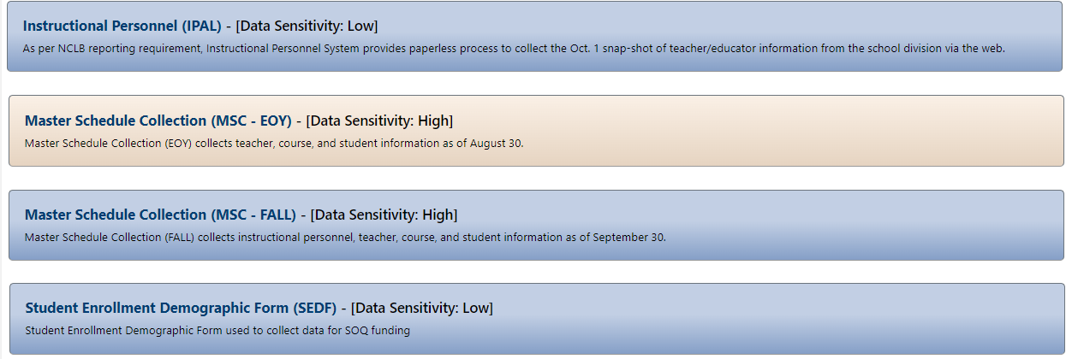
IPAL and SEDF Verification Report
IPAL and SEDF
IPAL and SEDF use data from MSC but are separate applications in SSWS that contain their own verification reports.
The SEDF approval link will not be active until an explanation is submitted and approved by DOE.
Notes:
SEDF must have an explanation submitted, even if teachers aren't over the threshold, before the approval link is active.
Click Send Explanations twice, once to save the list and the second time to send the explanations to VDOE for approval.

Slide 11
IPAL Rules
Line 5
Line 6
Line 7
Notes:
Secondary Courses
The one thing to keep in mind is secondary or transcript like courses require the lead teacher to be endorsed in the content.
Use the transcript column on the SCED list to determine if a SCED is secondary.
A special education teacher in a self contained special ed class must be endorsed in the content, not the DCT reported in a secondary course.
The DCT is only use to determine endorsement if a teacher is reported as an additional teacher.
Non-secondary Courses:
Line 5 and 6 - Elementary teachers can be endorsed in the content or the DCT reported.
Teacher of Record in a non-high school class taught to students in a self-contained special education classrooms who is not endorsed in the content but hold an endorsement for the DCT reported is allowed.
Line 7 - Reading Specialist, Gifted or Math Specialist must be endorsed in the content even if a DCT is reported. This is for secondary and non-secondary courses.
This is different than the requirements for a special education teachers.
This information is posted in SSWS under the Va Active SCED link in the right-side menu and under the IPAL application

Slide 12
timeline and Resources

Slide 13
MSC Data Reporting Timeline
MSC Opens | October 16, 2023
Division should have a successful submission | November 17, 2023
No changes should be made after | December 15, 2023
MSC Closes – all verifications due | December 22, 2023
Resubmission for corrections if needed | January 24th – 31st, 2024
Notes:
In addition to the VVAAS tool, Fall MSC data is used for state and federal reporting such as CTE grant funding, teacher licensure, and private day schools for special education placement. Timely and accurate submission of the data is essential for program implementation and funding.

Slide 14
MSC Application Support
Contact your local SSWS Account or back-up Account Manager if you need assistance with the following:
Assigning the MSC application contact in ERA
This is critical for VDOE to contact the correct person with important updates
Determining rights and privileges to the MSC application
This includes setting up the MSC collection managers, local IPAL and SEDF approvers, and rights to submit the data or access reports
Establishing Superintendent Data Collection Approval (SDCA) account for Superintendent or Director

Slide 15
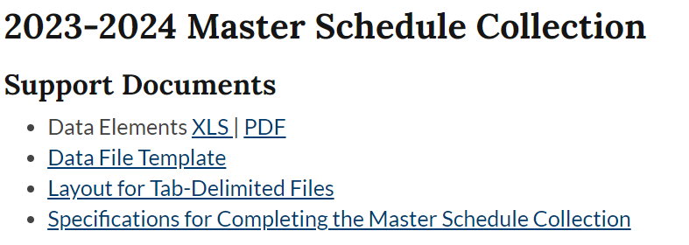
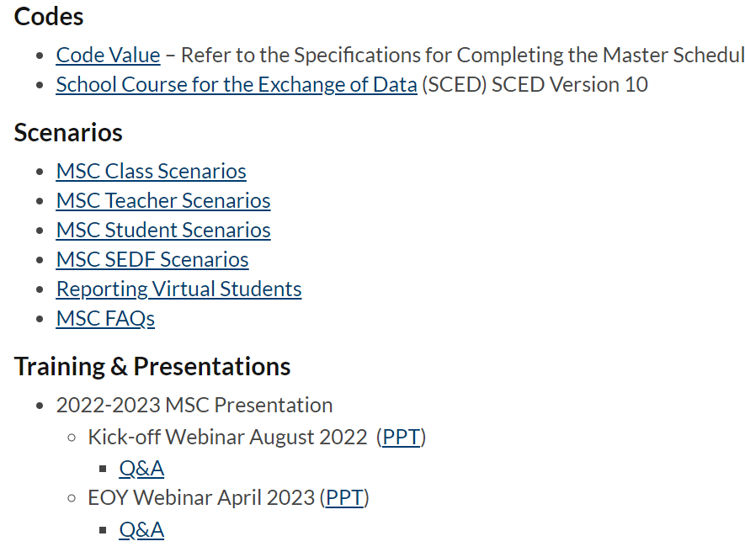
MSC Website
Data, Policy & Funding/Data & Reports/Data Collection/Master Schedule Collection

Slide 16
VDOE Contacts
Dana Ratcliffe, Educational Data Specialist, Office of Data Services
Email: Dana.Ratcliffe@doe.virginia.gov or
ResultsHelp@doe.virginia.gov 7:30 am to 4:00 pm, Monday through Friday except for state holidays
Carol Wells Bazzichi, Director of Data Collections, Office of Data Services
Email: Carol.WellsBazzichi@doe.virginia.gov
Joseph Ryder, Office of Career, Technical, and Adult Education
Email: JosephRyder@doe.virginia.gov
Susanna Wells, Office of Licensure and School Leadership
Email: Susanna.Wells@doe.virginia.gov

