Slide 1
Lab School for Innovation & Career Exploration
James Madison University
Rockingham County Public Schools
Blue Ridge Community College

Slide 2
Vision & Mission
The vision of the Lab School for Innovation & Career Exploration is to become an innovation hub for career exploration and workforce development through interdisciplinary, problem-focused application of solving community needs.
The mission of the Lab School for Innovation & Career Exploration is to provide students, pre-professionals, and professionals with collaborative and rigorous learning opportunities that improve the workforce in Virginia through reimagined teaching and learning.

Slide 3
Pre-professional Career Pathways

Slide 4
Career Pathways
Education
Health professions
Social services
Government/public relations
Aviation maintenance
Automotive technology
Business management
Information technology
Leveraging the strengths of JMU and BRCC

Slide 5
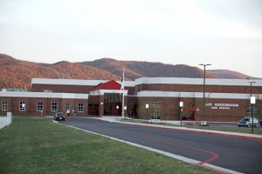
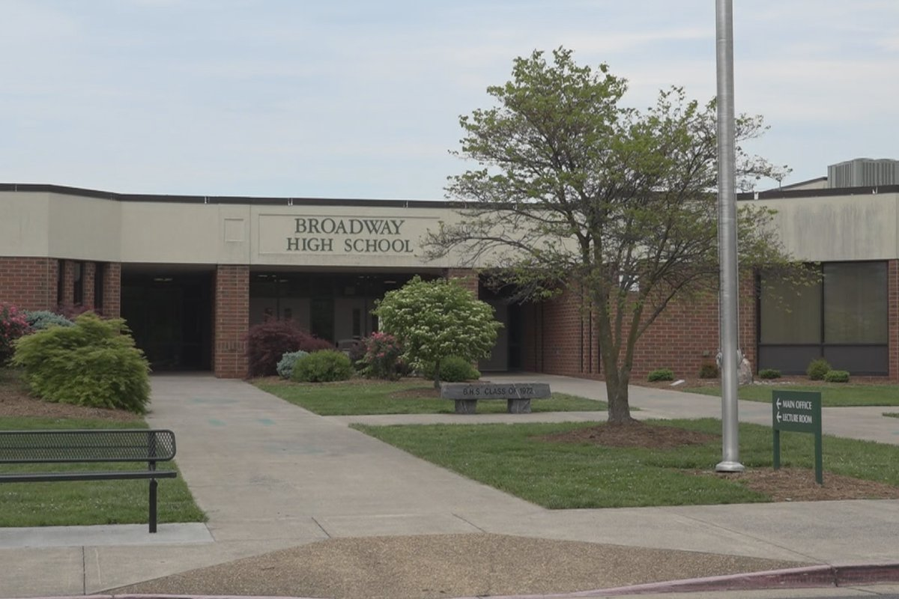
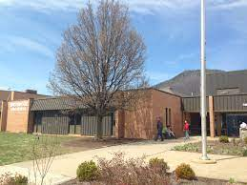
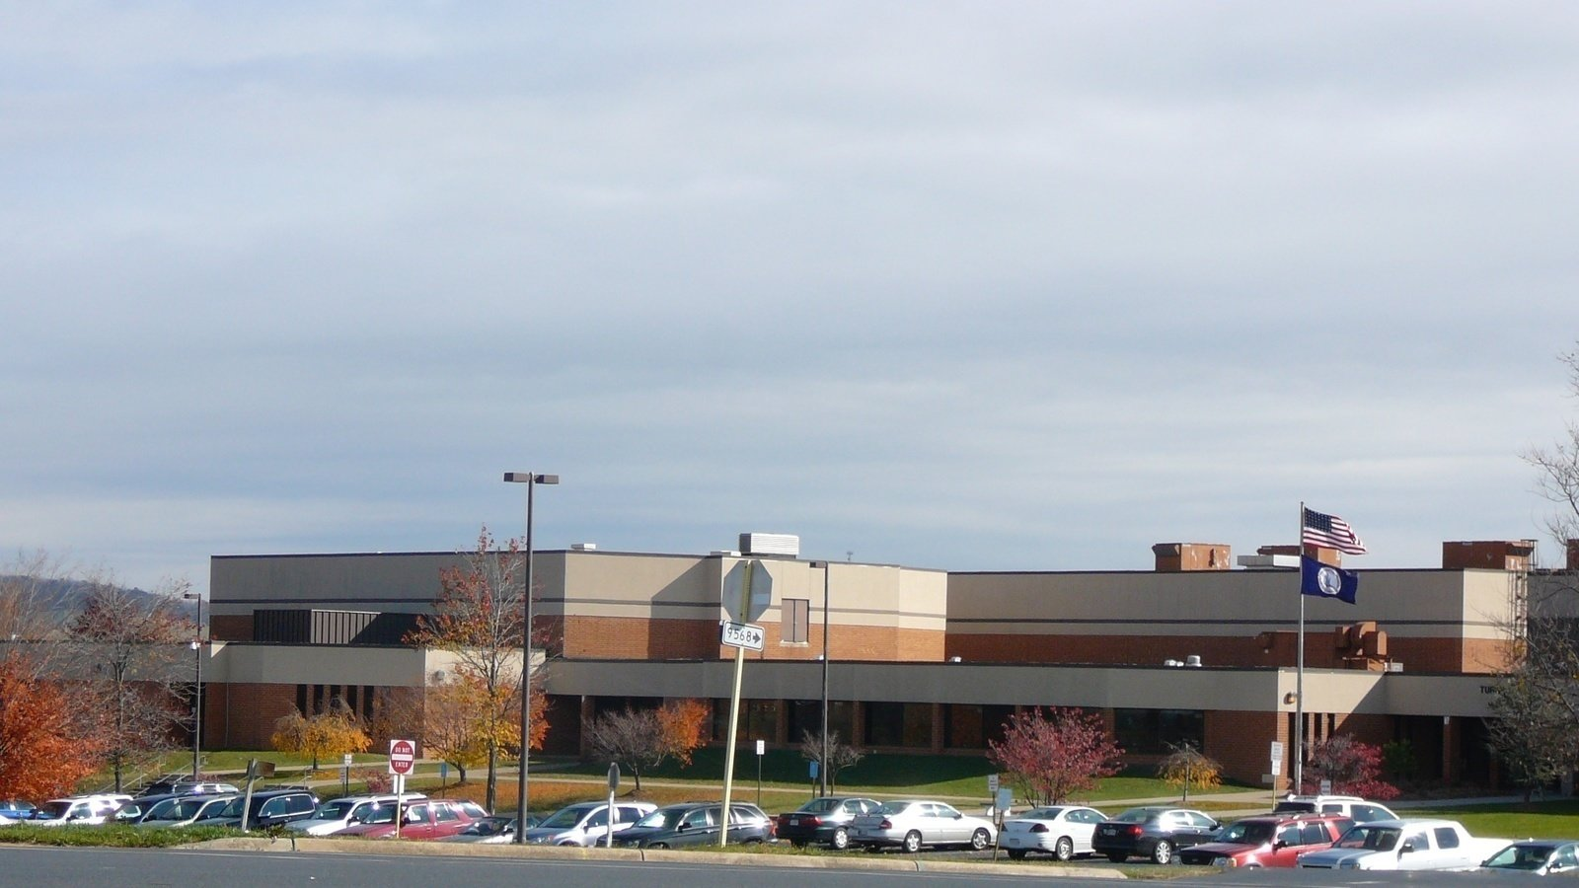
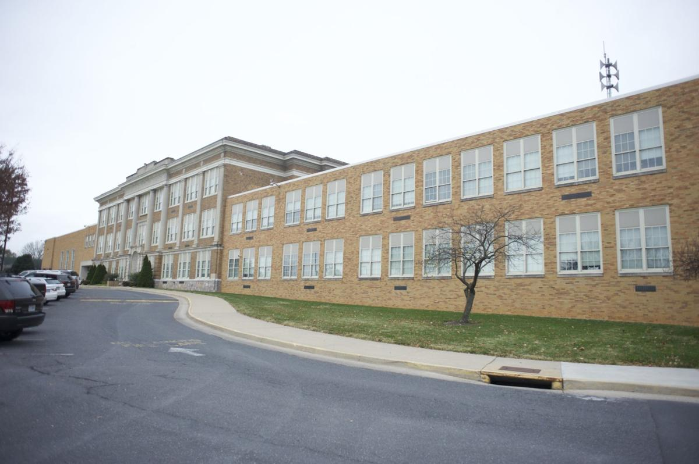
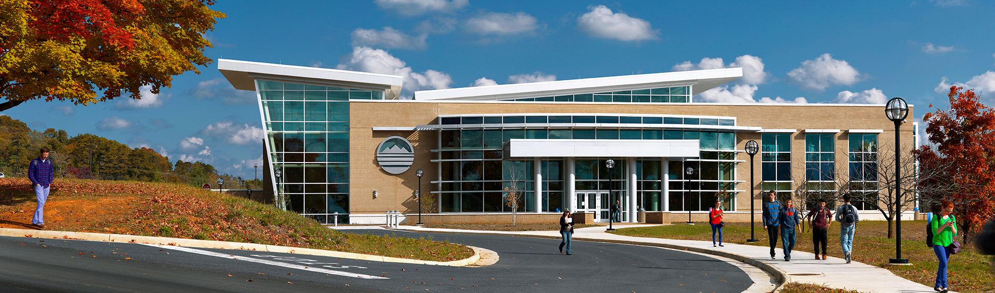
Locations for Lab School
East Rockingham High School
Broadway High School
Spotswood High School
Turner Ashby High School
JMU Memorial Hall
Blue Ridge Community College

Slide 6
Student Population
 | 2024-25 |  | 2025-26 |  | 2026-27 |  | 2027-28 |  | 2028-29
High School | Target | Grades | Target | Grades | Target | Grades | Target | Grades | Target | Grades
East Rockingham | 50 | 9 | 100 | 9-10 | 125 | 9-11 | 150 | 9-12 | 150 | 9-12
Broadway | 50 | 9 | 100 | 9-10 | 125 | 9-11 | 150 | 9-12 | 150 | 9-12
Spotswood |  |  | 50 | 9 | 100 | 9-10 | 125 | 9-11 | 150 | 9-12
Turner Ashby |  |  | 50 | 9 | 100 | 9-10 | 125 | 9-11 | 150 | 9-12
Total | 100 |  | 300 |  | 425 |  | 550 |  | 600

Slide 7

Sample Schedule
Elective Cohorts

Slide 8
Sample Interdisciplinary Course Description
My Place in This World I (9th Grade)
This is an interdisciplinary course that combines the curriculum frameworks from English 9, World Geography, Environment Science and Health/PE 9. Students will engage with the scientific principles, concepts, and methodologies required to understand the interrelationships of the natural world and human interaction, including their own well-being as a productive member of society. The course requires that students identify and analyze natural and human-made environmental problems, evaluate the relative risks associated with these problems, and examine alternative solutions for resolving or preventing them. As well, the interdisciplinary nature of this course will employ a project-based learning approach to address the standards for each content area and to build upon the 5 C’s, communication, critical thinking, collaboration, creativity, and citizenship.

Slide 9

Experiential Learning
Internships
Externships
Community Service

Slide 10

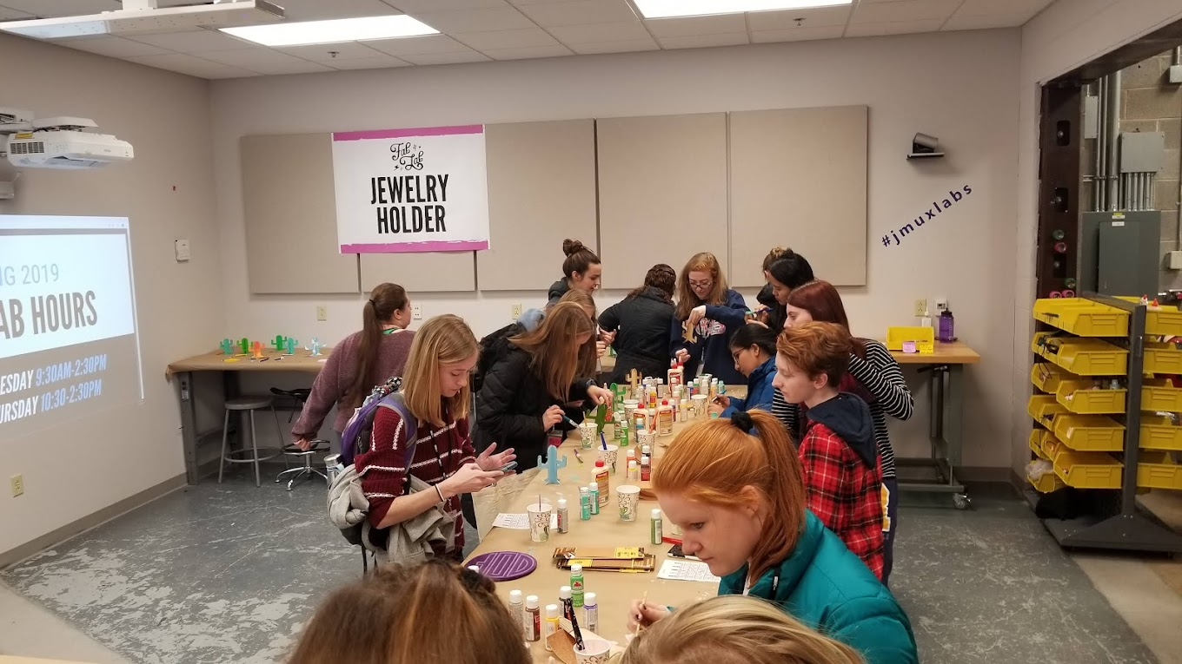
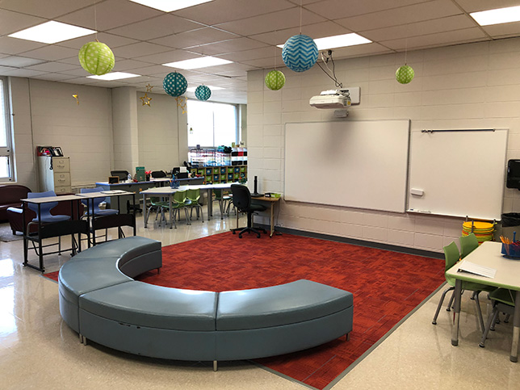
Innovative Learning Spaces

Slide 11

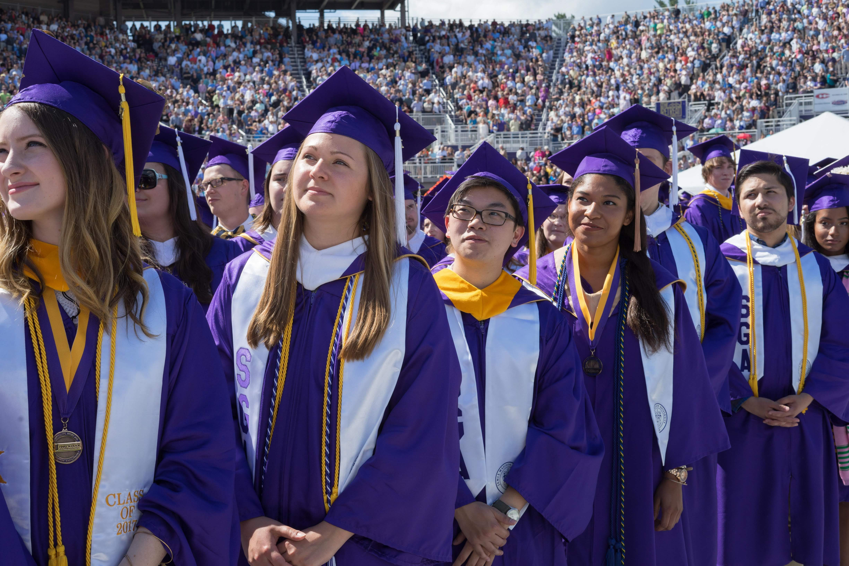

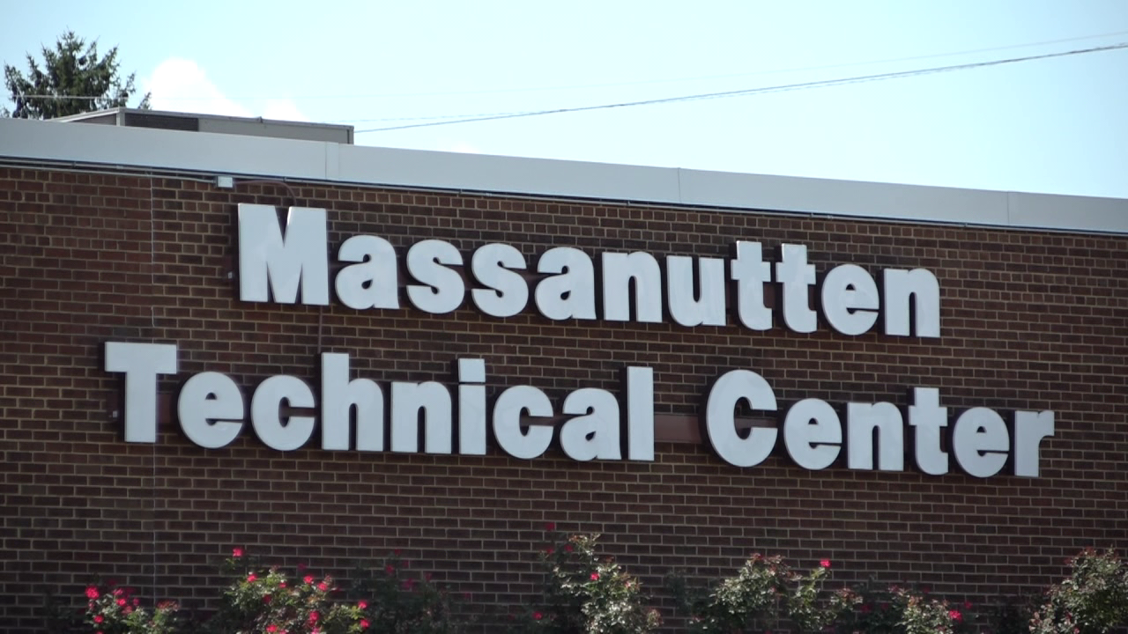
Student Voice & Choice
University Catalogs
9th Grade
10th Grade
11th Grade
12th Grade

Slide 12
Governance

Slide 13
Staffing
Year 1
Year 2
Year 3
Position | Number
Executive Director | 1
Teachers | 8
Paraprofessional | 4
Industry Experts | 4
JMU Faculty | 2
Blue Ridge Faculty | 2
JMU Pre-service | 4
Graduate Assistants | 2
Position | Number
Executive Director | 1
Teachers | 18.75
Paraprofessional | 8
Industry Experts | 4
JMU Faculty | 4
Blue Ridge Faculty | 4
JMU Pre-service | 8
Graduate Assistants | 4
Position | Number
Executive Director | 1
Assistant Director | 1
Teachers | 26.5
Paraprofessional | 4
Industry Experts | 8
JMU Faculty | 4
Blue Ridge Faculty | 4
JMU Pre-service | 8
Graduate Assistants | 4
Year 4
Year 5
Position | Number
Executive Director | 1
Assistant Director | 1
Teachers | 34.375
Paraprofessional | 4
Industry Experts | 8
JMU Faculty | 4
Blue Ridge Faculty | 4
JMU Pre-service | 8
Graduate Assistants | 4
Position | Number
Executive Director | 1
Assistant Director | 1
Teachers | 37.5
Paraprofessional | 4
Industry Experts | 8
JMU Faculty | 4
Blue Ridge Faculty | 4
JMU Pre-service | 8
Graduate Assistants | 4
1: 16 Ratio

Slide 14
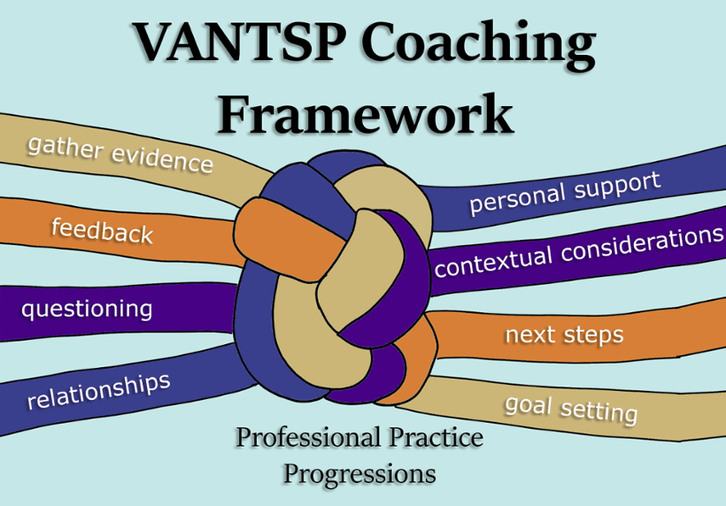
Professional Development/Support
Instructional support
Leadership support
Pre-service support

Slide 15
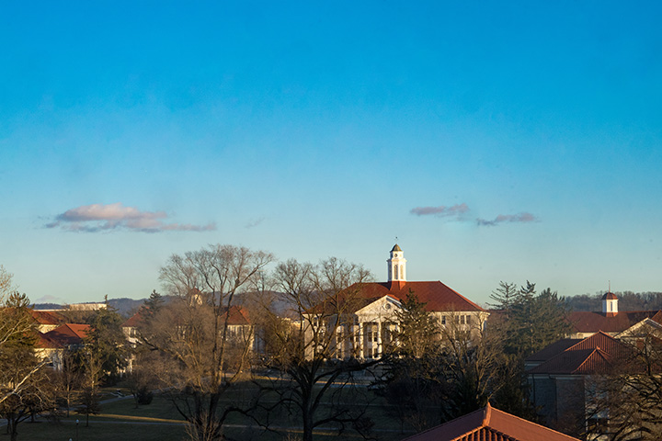
Finance
Tuition Model
$6000 per student
Similar to Regional Governor’s School
Sustainability

Slide 16

2023-2024 Start-up Year
Prepare academic spaces
Curriculum development/planning
Hiring Executive Director
Recruitment of students
$1.72M invested already!

Slide 17
Lab School for Innovation & Career Exploration
Opening Fall 2024

