Slide 1
Accountability &
Accreditation Discussion

Slide 2
State Board of Education Input Session
We hope that this opportunity for open dialogue and conversation helps to shape the bifurcation of the accountability and accreditation system.

Slide 3
Current Accreditation Model
Indicators
Academic Achievement: Mathematics
Academic Achievement: English (reading and writing)
Achievement Gap: Mathematics
Achievement Gap: English (reading and writing)
Academic Achievement: Science
Chronic Absenteeism
In addition, for high schools:
Graduation and Completion Index (GCI)
Dropout Rate
College, Career, and Civic Readiness Index (CCCRI)
Performance levels are assigned to each indicator.
Level One: At or Above Standard
Level Two: Near Standard
Level Three: Below Standard
Accreditation Status
Accredited:
All indicators are a Level One or Level Two.
Accredited with Conditions: At least one indicator is a Level Three.
Accreditation Denied:
A school fails to adopt and implement school division or school corrective action plans with fidelity.
The performance level is based
on measurement against performance benchmarks.

Slide 4
Determining Performance Levels in the Current Accreditation System
Example: Academic Achievement ─ English
Performance Level | Description
Level One | Current or cumulative three-year rate is greater than or equal to 75% OR Current year rate is in the Level Two range (is greater than 65% and less than 75%) and the school decreased the failure rate by at least 10% (R10) from the previous year.
Level Two | Current year or cumulative three-year rate is greater than 65% but less than 75% OR Current year rate is greater than or equal to 50% and less than or equal to 65% and the school decreased the failure rate by at least 10% (R10) from the previous year.
Level Three | Current year or cumulative three-year rate is less than or equal to 65% OR School has stayed at a Level Two or Three through four consecutive years. (Level Three - 4 Years Rating)
Actual Performance Benchmarks
Improvement Benchmarks

Slide 5
NAEP Grade-4 Reading: Percent Proficient or Above
Impact of Raising and Lowering Standards
3
4
1998- SOL Testing Begins
2003- Board of Education raises elementary reading accreditation standard.
2013- VDOE introduces more rigorous online reading tests.
2017- Board revises Standards of Accreditation.
2020- Board lowers cut scores of Reading SOL tests.
5
2

Slide 6


NAEP Grade-4 Math: Percent Proficient or Above

Slide 7
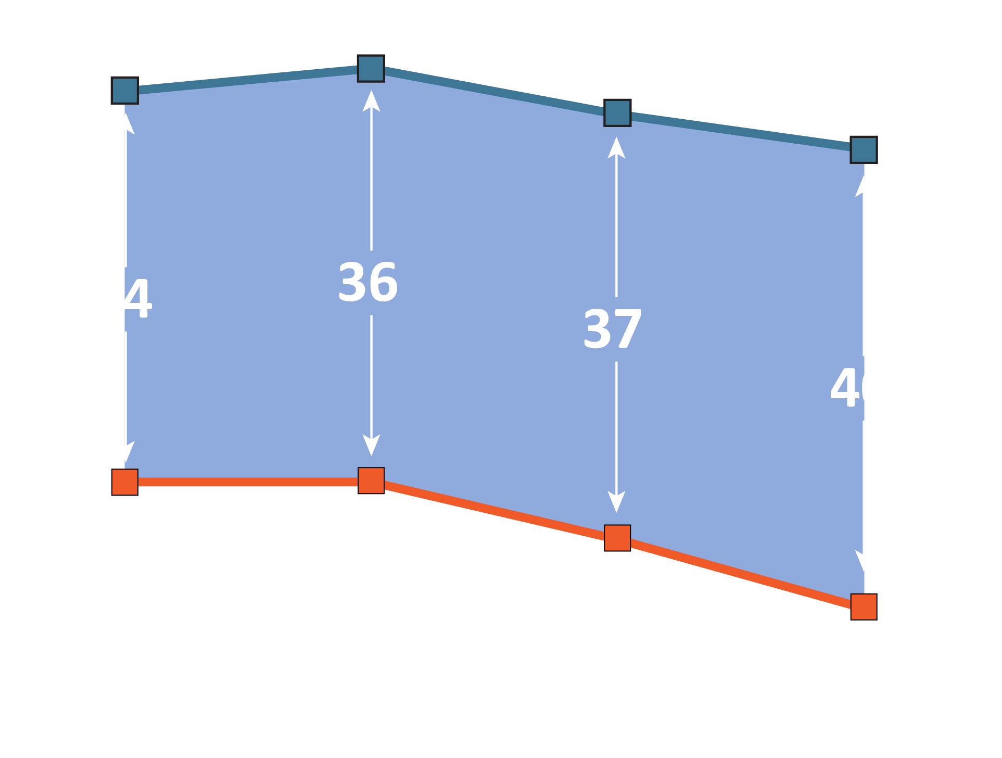
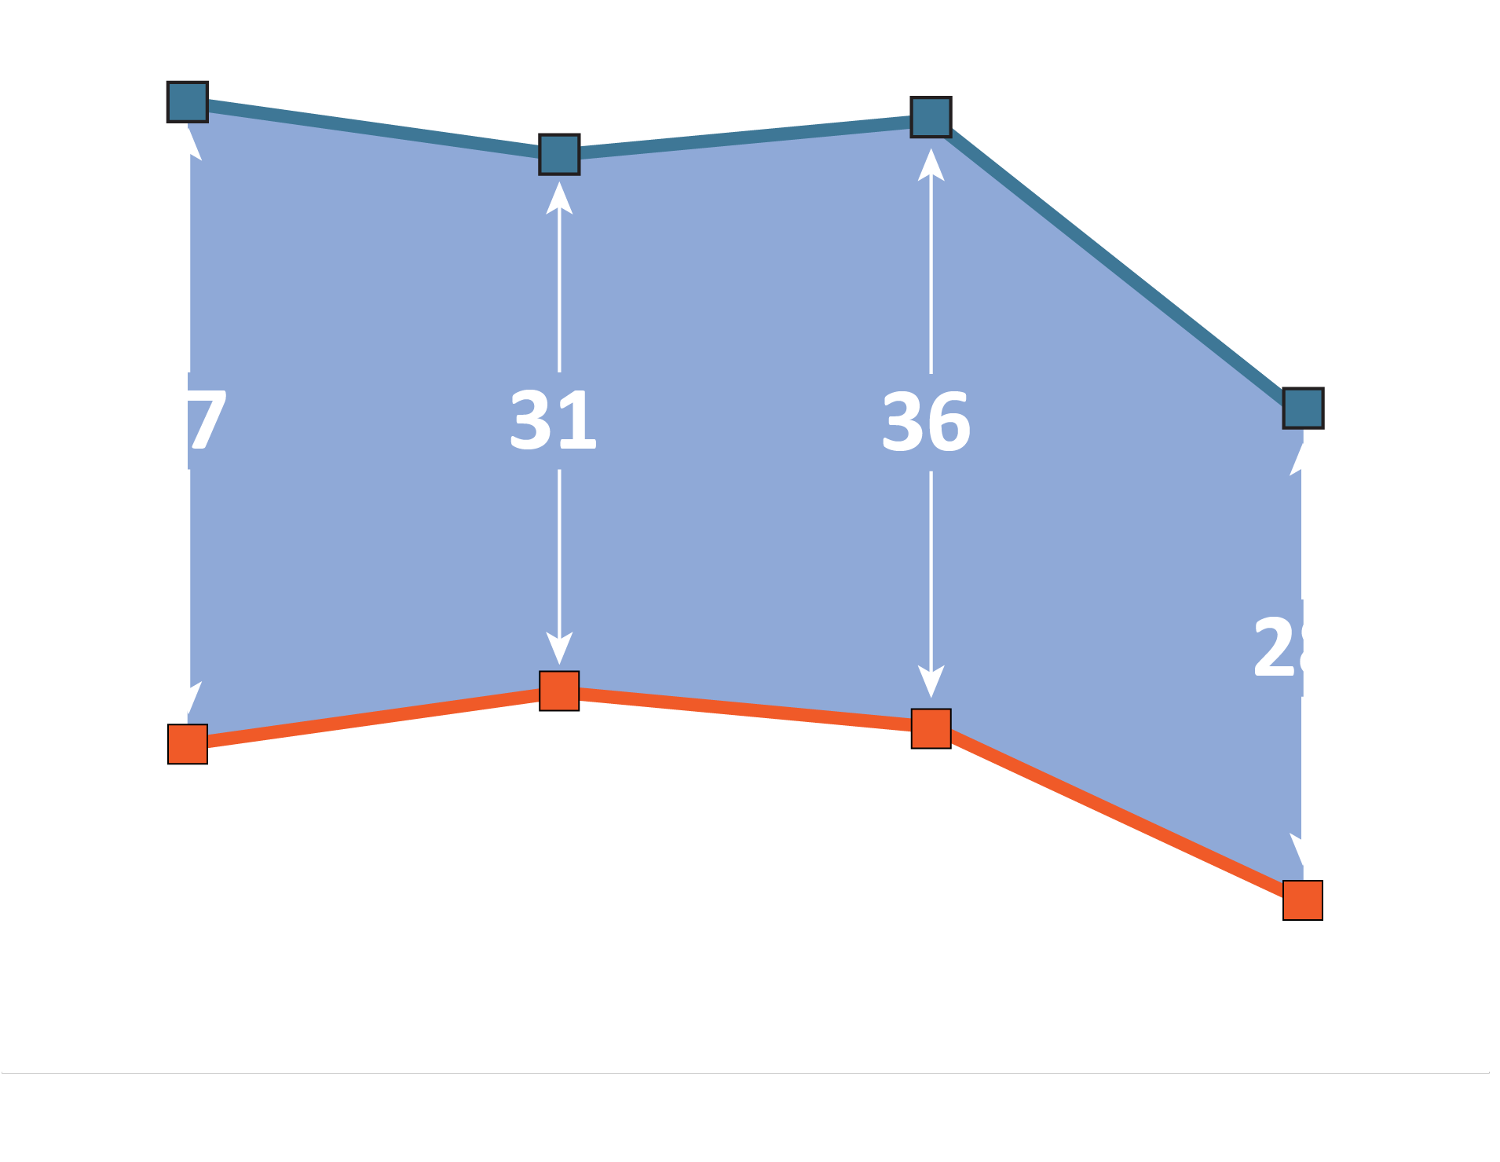
The “Honesty Gap” in Virginia
Grade-4 Reading: Percent Proficient and Above
Grade-4 Math: Percent Proficient and Above
Virginia SOL
Virginia NAEP
Honesty Gap

Slide 8
What becomes the Accountability rating system?
Achievement
Workforce Readiness
Growth

Slide 9
What inputs should be a part of Accreditation?

Slide 10
What is the planned redesign for the system of supports?
Instruction
HQ Teacher -prioritized placement
Staffing
Teachers
Professional Learning Support
Logistical and Operational
School Climate
Instructional Routines
Instructional Materials
Principals
Prioritized Placement Model
Instructional Support Cycles
Career Development
Parent Engagement
Parent Supports
Attendance
School Discipline
Instructional Delivery

