Slide 1
Update on Federal Elementary and Secondary School Emergency Relief (ESSER) Funds
Presented to the Board of Education
July 26, 2023

Slide 2
Elementary and Secondary School Emergency Relief (ESSER) Funding Overview
ESSER I, II, & III funds are provided to states under three separate federal acts:
Coronavirus Aid, Relief, and Economic Security (CARES) Act , Coronavirus Response and Relief Supplemental Appropriations (CRRSA) Act, and the American Rescue Plan Act (ARPA).
ESSER funding is the largest federal pandemic funding source for PreK-12 education, with broad areas of allowable use.
90% of funds must be allocated to Local Educational Agencies (LEAs - i.e., school divisions) based on Title I formula; 10% of funds available for state set-aside awards and state administration.

Slide 3
Elementary and Secondary School Emergency Relief (ESSER) Funding Overview
ARPA ESSER III requires 20% of LEA formula funds to be reserved to address learning loss.
School divisions filed initial applications with VDOE on their use of ESSER formula funding. Local plans are amended when significant spending changes are proposed and approved by VDOE (e.g., facilities upgrades) or for more minor changes (single budget line-item). 1,600+ such amendments have been made to local ESSER I, II, or III plans, with most technical/minor. Such changes can occur from the stakeholder consultation process.
Divisions also submitted updated ESSER III spending plans in December 2022 as directed by the Governor with increased focus on learning loss.
VDOE has posted links to the division websites where the plans are available: www.doe.virginia.gov.xlsx (live.com).

Slide 4
ESSER Funding Overview
Reimbursement/expenditure information is as of July 20.
Divisions and other entities may have obligated their ESSER funds (e.g., PO’s, contracts, payroll, etc.) and/or spent them, but have not yet filed for reimbursement with VDOE.
Divisions may file for reimbursement on a weekly cycle using VDOE’s online grant management system.
After each September 30th obligation deadline for ESSER funds, final reimbursements are processed by VDOE by December 31 each year and liquidated by late January.
Notes:
The next few slides provide updates on expenditures of ESSER funds, including LEA formula funds and VDOE expenditures of state set-aside funds awarded to LEAs, VDOE-directed projects, and VDOE state administration.

Slide 5
Status of ESSER LEA Formula Funds Spending
LEA formula reimbursements as of July 20, 2023.
 | Obligation Deadline | Awarded to LEAs | Expended & Reimbursed by VDOE | Balance | Percent Remaining
ESSER I | 9/30/22 | $214,739,273 | $214,463,369 | $275,904 | 0.1%
ESSER II | 9/30/23 | $845,352,520 | $674,747,037 | $170,605,483 | 20%
ESSER III | 9/30/24 | $1,899,890,002 | $788,675,095 | $1,111,214,907 | 58%
TOTALS |  | $2,959,981,795 | $1,677,885,501 | $1,282,096,294 | 43%

Slide 6
Metrics from ESSER Annual Performance Reports
As of June 30, 2022, the following amounts were reimbursed to LEAs from ESSER I, II, and III funds in the following federal reporting categories:
Physical Health and Safety: $138,987,115 (25%)
Academic, Social, and Emotional Support: $208,441,800 (38%)
Mental Health: $12,006,655 (2%)
Operational Continuity: $195,717,635 (35%)

Slide 7
Metrics from ESSER Annual Performance Reports
Across the above categories, expended funds were used in the following ways:
35% of all expended funds were used for Personnel/Benefits ($192,156,978)
25% of all expended funds were used for Materials & Supplies (items under $5,000) ($139,454,012)
23% of all expended funds were for Purchased Professional Services ($126,261,725)
11% of all expended funds were for Property (items $5,000 or more) ($62,665,154)
6% of funds were for Other Allowable Uses of Funds ($34,615,336)

Slide 8
School Division-reported Spent, Obligated, and Remaining ESSER II & III Formula Funds
*Data in red collected for Chapter 2 reporting requirement to General Assembly: ESSER III data from Dec. ’22-Jan. ‘23; ESSER II data from March-April ’23.
 | Awarded/ Budgeted | (Reimbursed to date by VDOE - as of July 20th) | Divisions Reported Spent | Divisions Reported Obligated | Divs. Reported Balance (award minus reported spent & oblg.)
ESSER II Formula Funds | $845,352,520 | $674,747,037 | $657,915,706 | $80,148,889 | $107,287,925
ESSER III Formula Funds | $1,899,890,002 | $788,675,095 | $591,458,061 | $557,249,560 | $751,182,381

Slide 9
Metrics from ESSER Annual Performance Reports
Early uses of ESSER formula funds included immediate COVID-19 responses, such as:
Attendance initiatives and family outreach
Cleaning and disinfection
Ventilation/air quality
Physical distancing
Home internet access
School division total FTE’s prior to the pandemic and subsequent years are reported and indicate ESSER funding helped maintain/increase division staffing. Total FTE’s employed by LEAs increased by 8,759 from 2018 to 2022:
Sept. 30, 2018: 188,883
Sept. 30, 2019: 191,787
Sept. 30, 2020: 191,135
Sept. 30, 2021: 194,076
Sept. 30, 2022: 197,642

Slide 10
ESSER State Set-aside Spending (LEA Awards, VDOE Projects, & VDOE Admin.)
Expenditures as of July 20, 2023; of the $328.9M awarded, $190.6M is awarded directly to LEAs.
 | Awarded/ Budgeted | Expended/ Reimbursed by VDOE | Balance | Percent Remaining
ESSER I | $23,859,919 | $23,652,133 | $207,786 | 0.9%
ESSER II | $93,928,058 | $70,568,198 | $23,359,860 | 25%
ESSER III | $211,098,889 | $51,863,932 | $159,234,957 | 75%
TOTALS | $328,886,866 | $146,084,263 | $182,802,603 | 56%

Slide 11
Summary Remarks - Superintendent Coons

Slide 12
New ESSER Expenditure Dashboard
While VDOE maintains a dedicated pandemic funds webpage at Federal Pandemic Relief Programs | Virginia Department of Education that includes information on ESSER, a dashboard to track use of ESSER funds is under development.
The next several slides show example screen shots of the dashboard being developed and some of the information it will provide.
Launch date of the dashboard is expected to be October 1, 2023.

Slide 13
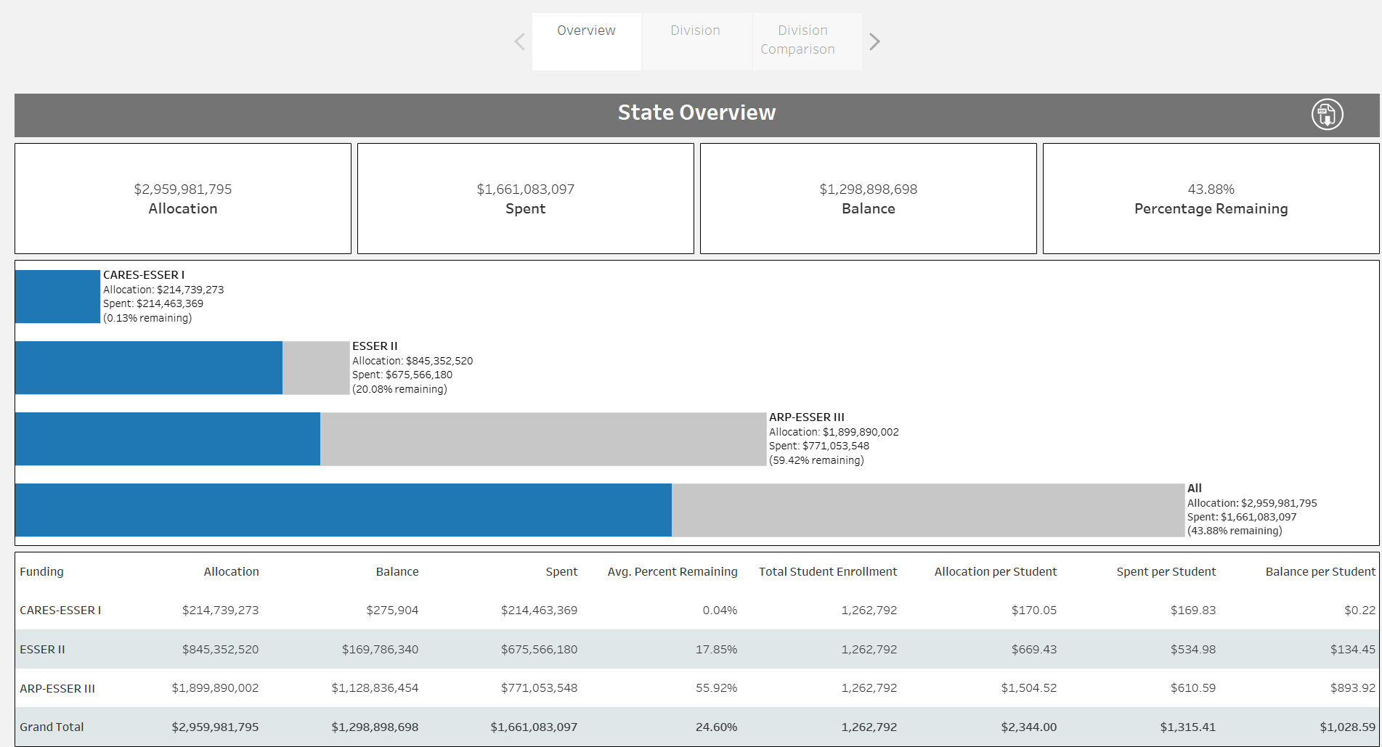
Overview Page

Slide 14
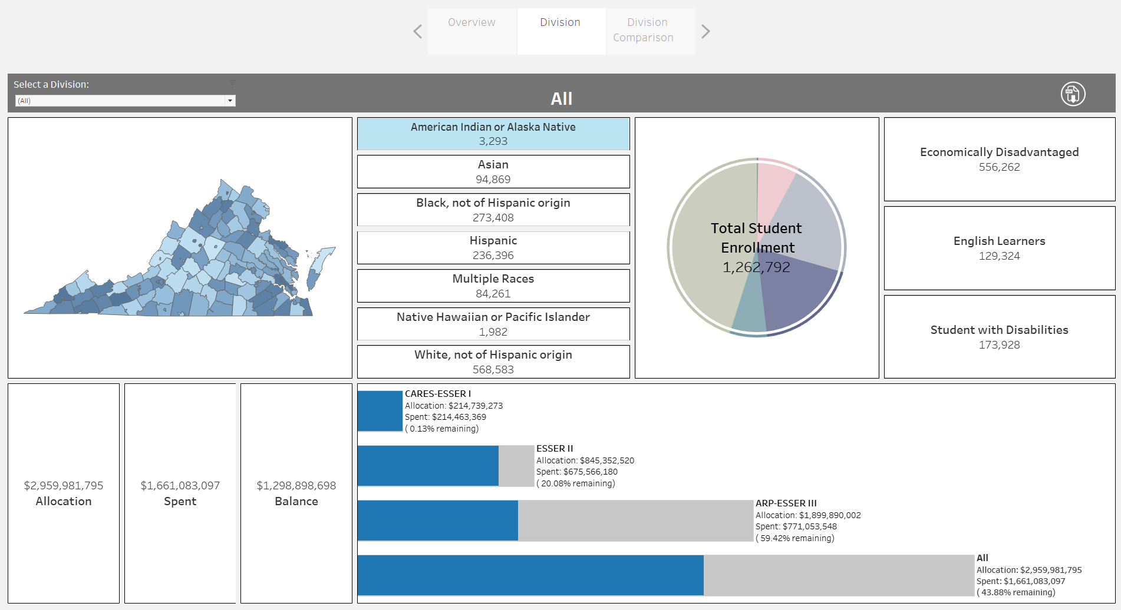
Division (Unfiltered)

Slide 15
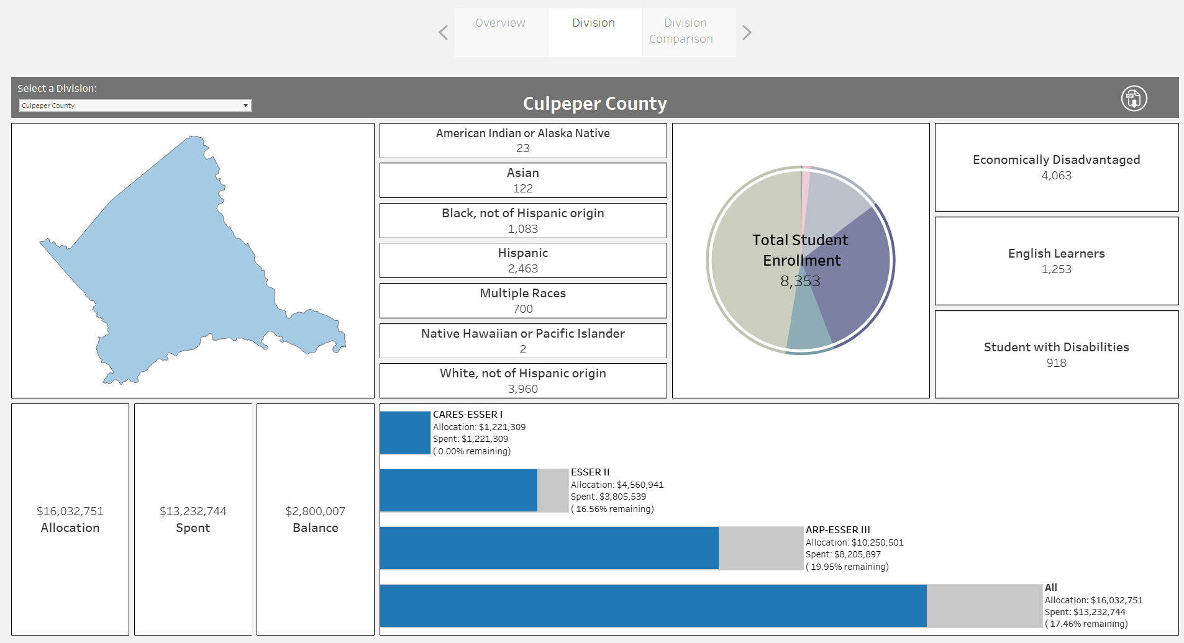
Division (Filtered)

Slide 16
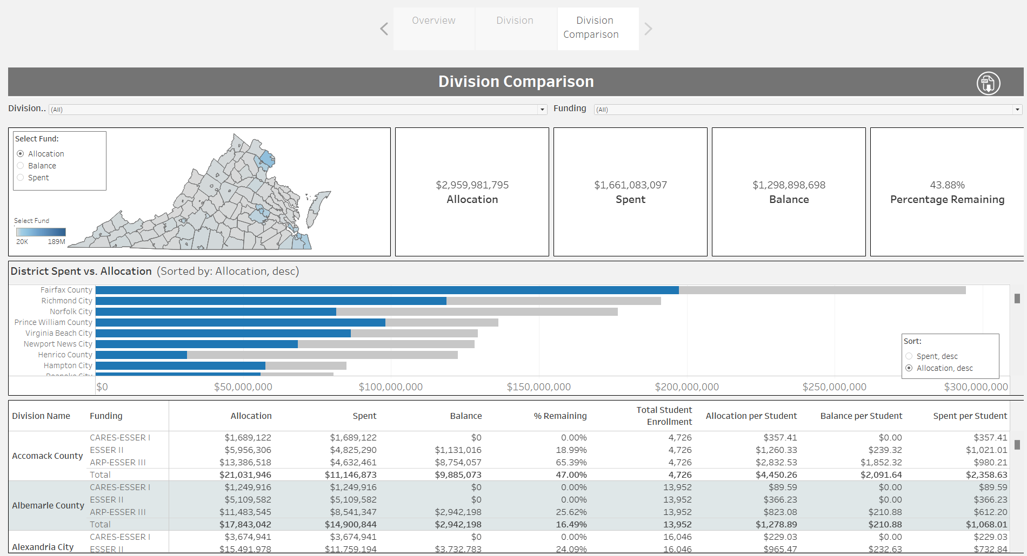
Division Comparison (Unfiltered)

Slide 17
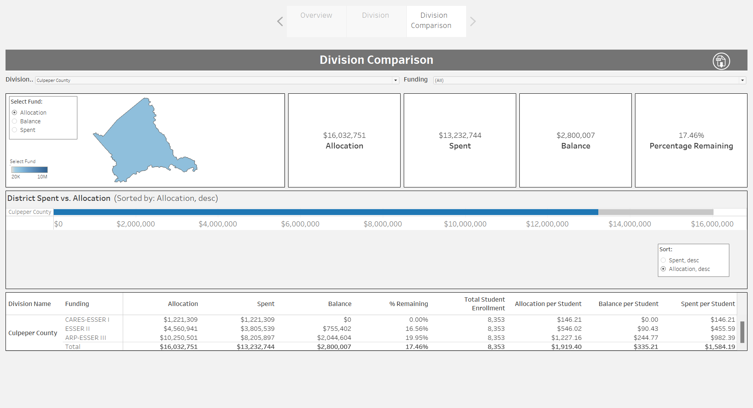
Division Comparison (Filtered)

Slide 18
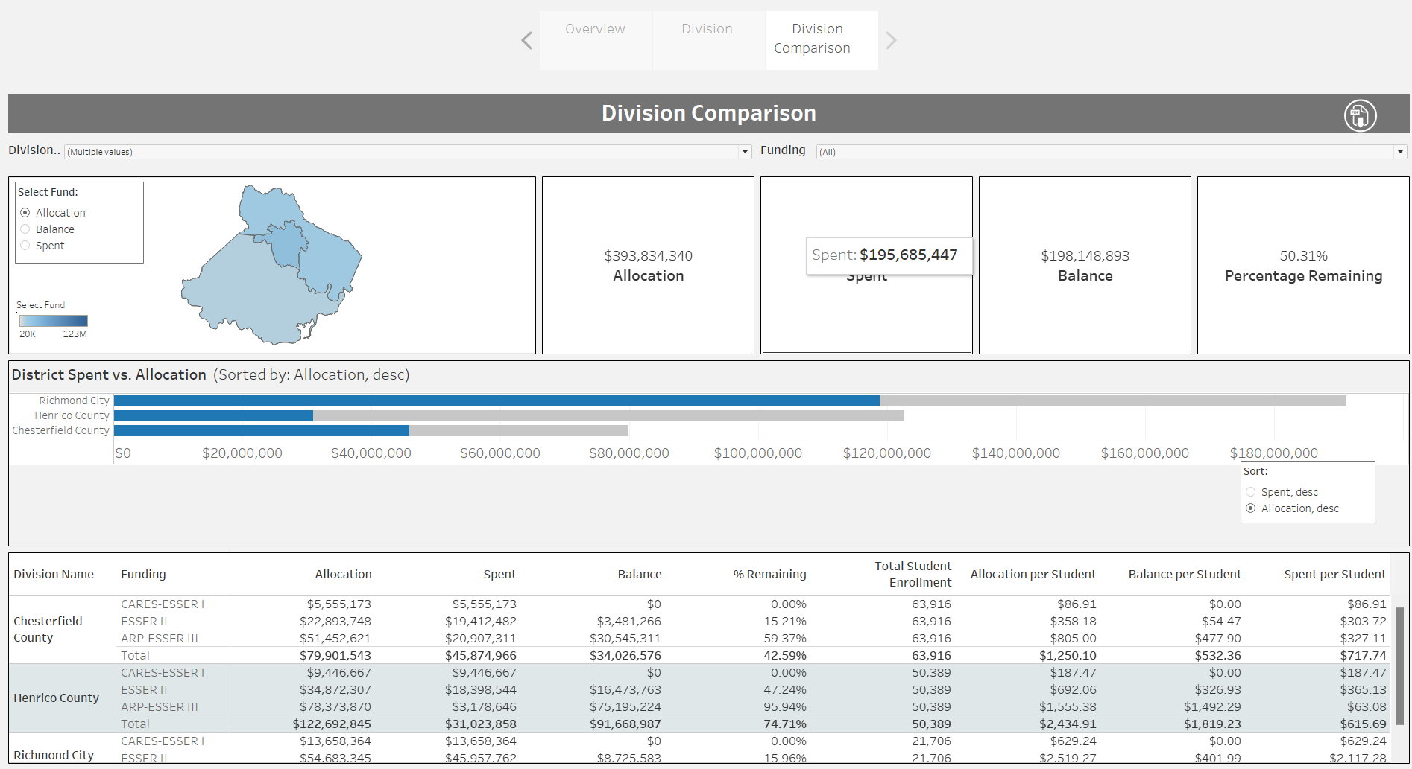
Division Comparison (Filtered)

