Slide 1
Comprehensive Strategies to Retain, Recruit, and Support Talented Teachers
Presentation to the Virginia Board of Education
Elizabeth Eaton
Aracelis Gray
January 23, 2019

Slide 2
About the ARCC
The ARCC builds state education agency (SEA) capacity to support local educational agencies (LEAs or districts) and low-performing schools
This assistance is designed to help educators close achievement gaps and improve the quality of instruction to improve outcomes for all children
The ARCC serves Kentucky, Tennessee, Virginia, and West Virginia, and responds to state and regional needs by supporting, scaling up, and sustaining statewide reforms

Slide 3
Our Services
Workshops, webinars, and conferences
Coaching, in-person advisories, and communities of practice
Collaborative planning and benchmarking
Customized tools and resources
Referrals to other technical assistance providers

Slide 4
2018-2019 ARCC Virginia Work Plan
Three initiatives based on identified needs and priorities
  Supporting Teacher Equity
  Building the Capacity of Dyslexia Advisors
  Supporting Algebra Readiness
Supporting Teacher Equity Initiative
  Conduct a scan of state policies and practices
  Contribute to the Board’s awareness of state and district strategies for educator compensation
  Support the Board’s efforts to gather evidence-based research on educator compensation

Slide 5
Background: Why Are Teachers Leaving and Ways to Keep Them

Slide 6
Teacher Turnover: What We Know
In the 2011-2012 school year, 84% of teachers remained at the same school, 8% moved to a different school, and 8% left teaching the following school year
Characteristics of teachers more likely to leave their school or the profession:
  Teachers of mathematics, science, special education, English language development, and foreign language
  Teachers of color
  Teachers under 30 or over 50
Characteristics of schools with teachers more likely to leave their school or the profession:
  Title I schools
  Schools serving a large percentage of students of color
  Smaller schools
Less than a third of teacher attrition across the country is due to retirement
Sources: Carver-Thomas & Darling-Hammond, 2017; U.S. Department of Education, National Center for Education Statistics, 2014

Slide 7
Teacher Turnover in Virginia
For the past six years, teacher turnover rates in Virginia have been above 10%
Source: Virginia Department of Education Instructional Personnel Data Collection System

Slide 8
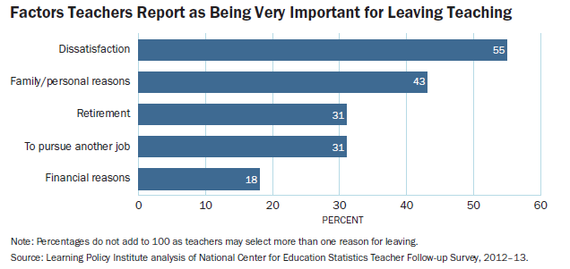
Why Are Teachers Leaving?
Source: Podolsky, Kini, Bishop, & Darling-Hammond, 2016

Slide 9
Reasons Teachers Leave: Dissatisfaction
Dissatisfaction with Accountability
Issues with assessments and accountability measures, and a lack of time to prepare students
Lack of Administrative Support
Issues included intrusions on teaching time, school discipline, and a lack of autonomy
Challenging Working Conditions
Issues included large class sizes, school culture and climate, classroom resources, and school facilities
Dissatisfaction with Teaching
Issues included dissatisfaction with teaching as a career and a lack of opportunities for leadership and advancement
Source: Podolsky, Kini, Bishop, & Darling-Hammond, 2016

Slide 10
Other Reasons Teachers Leave
Financial Reasons
Better Career Opportunities
Family/ Personal Reasons
18% identified financial reasons, including wanting or needing a better salary and benefits
28% left to pursue another career
37% cited personal life reasons for leaving, including pregnancy, child care, and caring for family
7% were concerned about job security
13% left to take courses to improve career opportunities in education
11% wanted a job more conveniently located
Source: Podolsky, Kini, Bishop, & Darling-Hammond, 2016

Slide 11
Predictors and Impacts of Teacher Turnover
Predictors | Impacts
Alternative Certification | Teacher Quality
Teacher Concentration | Student Achievement
Lack of Administrative Support | Increased Costs
Teacher Compensation | Staffing “Hard-to-Staff” Schools
 | Workforce Diversity
Source: Carver-Thomas & Darling-Hammond, 2017; Podolsky, Kini, Bishop, & Darling-Hammond, 2016

Slide 12
Beginning Teachers are Leaving Teaching at an Increasing Rate
The attrition rate for first-year teachers increased by 34% from 1988 to 2008.
Approximately
About
More than
12%
28%
41%
of all beginning teachers leave after three years
of all beginning teachers will leave within five years
of all beginning teachers leave teaching after their first year
Source: Ingersoll, Merrill, & Stuckey, 2014

Slide 13
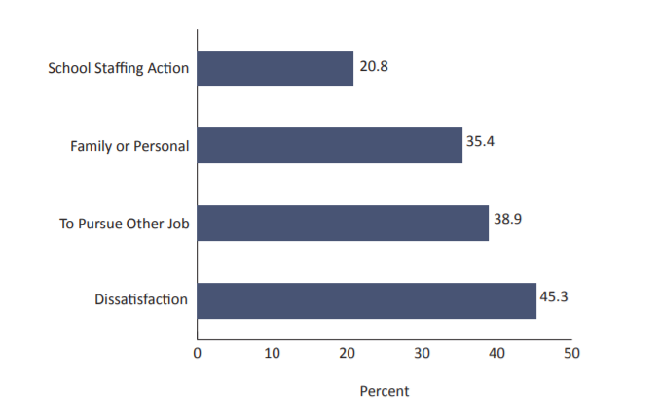
Reasons Beginning Teachers Leave
Reasons For Leaving Reported by First-Year Teachers
2008-2009
The most frequently cited reason new teachers gave for leaving teaching was dissatisfaction with a variety of school and working conditions, including:
  Salaries
  Classroom resources
  Student behavior
  Accountability
  Development opportunities
  Input into key decisions
  School leadership
Source: Ingersoll, Merrill, & Stuckey, 2014

Slide 14
Factors Influencing Teacher Retention and Recruitment
Induction and Support for New Teachers
Salaries and Compensation
Working Conditions
Source: Podolsky, Kini, Bishop, & Darling-Hammond, 2016

Slide 15
Induction and Support for New Teachers

Slide 16
Induction and Support for New Teachers
Induction is a system of support for beginning teachers
The majority of beginning teachers (84%) in 2011-2012 reported participating in an induction program
  78% reported receiving support from school principals and administrators
  73% of teachers reported receiving mentoring
  58% reported common planning time with teachers in their subject
Impact of induction programs depends on the quality of the support provided
  Research suggests induction programs in high-poverty schools may be of a lower quality with fewer resources to dedicate to support for beginning teachers
Sources: Podolsky, Kini, Bishop, & Darling-Hammond, 2016; Potemski & Matlach, 2014

Slide 17
Induction and Mentoring in Virginia
The 1999 Education Accountability and Quality Enhancement Act requires school districts in Virginia to provide mentor programs for first-year teachers
Virginia Guidelines for Mentor Teacher Programs require local school boards to:
  Establish mentor program objectives
  Manage the local mentor program
  Develop the program design
  Develop mentor selection criteria
  Establish school administrator responsibilities
  Develop mentor training
  Evaluate the effectiveness of the mentor program
Source: New Teacher Center, 2016

Slide 18



What The Research Says
Research suggests that beginning teacher induction and mentoring programs can positively affect teacher retention, students’ academic outcomes, and teacher quality, while saving costs.
Improve Retention – Teachers assigned a mentor during their first year in the classroom were more likely to teach for at least five years (Raue & Gray, 2015).
Enhance Learning and Instructional Practices – Beginning teachers who participated in some form of induction experienced higher academic gains, were more able to keep students on task, and demonstrated successful classroom management (Ingersoll & Strong, 2011).
Save Money– An analysis of a medium-size California school district suggests that induction pays off at $1.66 for every $1 invested. (Villar & Strong, 2007).

Slide 19
Characteristics of Comprehensive Induction and Mentoring Programs
Ensure appropriate timing and length
  North Carolina’s Beginning Teacher Support Program requires all beginning teachers to participate in a three-year induction program, and the program standards stipulate that “mentors are given protected time” to work with their mentees
Set criteria for programs and participants
  Illinois Induction Program Standards guide programs to match beginning teachers and mentors according to relevant factors, including certification, experience, current assignments and/or proximity of location
Source: New Teacher Center, 2016

Slide 20
Characteristics of Comprehensive Induction and Mentoring Programs
Provide ongoing resources and support for teachers and mentors
  Maryland state program regulations recommend “a reduction in the teaching schedule” for first-year teachers, to the extent possible, and requires school districts to provide initial and ongoing mentor training
Support program accountability
  Connecticut requires an outside evaluation of the Teacher Education And Mentoring (TEAM) program every three-to-five years and monitors district implementation to ensure program fidelity
Source: New Teacher Center, 2016

Slide 21
Implementation Considerations
Contextual factors affecting the success of induction and mentoring programs include:
  Using grade and subject as key matching criteria between mentors and beginning teachers
  Providing common planning time with teachers in the same subject
  Allocating time for regularly scheduled collaboration with other teachers
  Offering training for mentor teachers and providing time for coaching
  Fostering a supportive school culture with strong, committed leadership
Source: Education Commission of the States, 2016

Slide 22
Salaries and Compensation

Slide 23
Current State of Teacher Salaries
Teacher salaries today are between 14% and 25% lower than those for other professions available to college graduates
VA starting salaries for teachers with a bachelor’s degree range from a low of $30,407 to a high of $49,600, in 2016-17
  Among teachers with 30 years of experience the highest paid teacher earns over $66,500 more than the lowest paid teacher ($42,383 to $108,857)
VA’s 2016 average annual teacher salary ranks 30th among the 50 states ($50,834)
Sources: Allegretto & Mishel, 2016; Miller & D’Costa, 2017; National Education Association Research, 2017

Slide 24
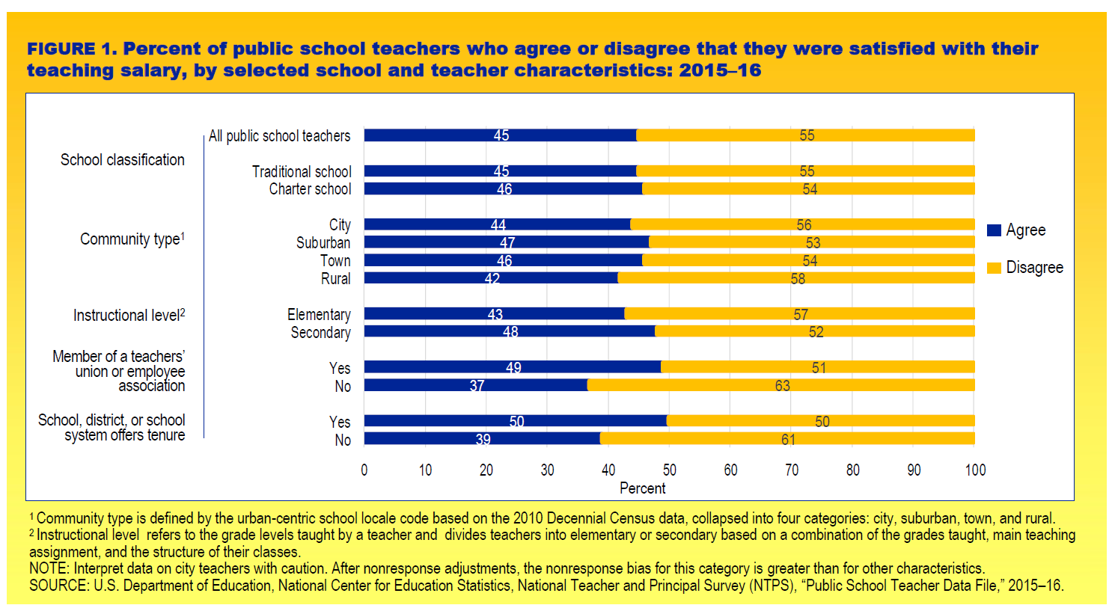
Teacher Satisfaction with Salary and Current Job

Slide 25
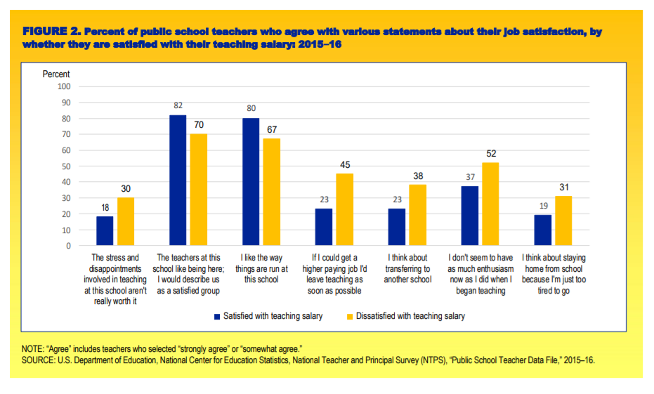
Teacher Satisfaction with Salary and Current Job

Slide 26
The Role of Compensation in Attracting and Retaining High Performing Teachers
Address teacher pay gap
Increase the teacher applicant pool
Improve composition of the workforce
Retain new teachers

Slide 27
Financial Incentives
Knowledge and skills-based compensation
  Tiered certification process that provides increased salaries at higher certification phases
  Compensation for prior work experience
Market based compensation
  Incentives designed to attract and retain teachers in hard-to-staff schools and subject areas
  Compensation for increased roles and responsibilities
Performance based incentives
  Tied to a teacher's effectiveness
  Compensation in the form of raise or an annual bonus
Other incentives
  Loan forgiveness, housing assistance, tuition reimbursements and scholarships to help fill shortages

Slide 28
Financial Incentives: Performance Based Pay
Growing in popularity despite opposition
  9 states require districts to consider performance in teacher pay
  49 of 124 districts tie a teacher’s evaluation rating to permanent increases in salary
Rationale
  Increase motivation to meet performance targets
  Attract and retain more effective teachers
  Exit underperforming teachers
Design options
  Evaluation rating determines effectiveness level
  Freeze salaries for underperformers
Source: National Council on Teacher Quality, 2018

Slide 29
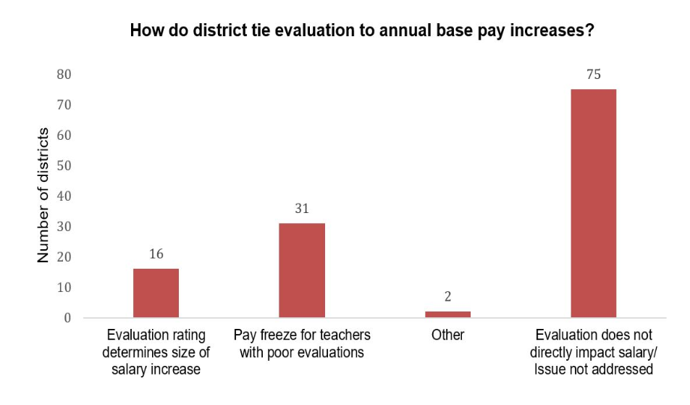
Financial Incentives: Performance Based Pay
Source: National Council on Teacher Quality, 2018

Slide 30
Financial Incentives: Market Based Pay
Rationale
  Address the inequitable distribution of high quality teachers in low-income and/or low-performing schools
  Address the shortage of qualified teachers in specific concentrations
Design options
  Bonuses, loan forgiveness, tuition reimbursements, salary supplements

Slide 31
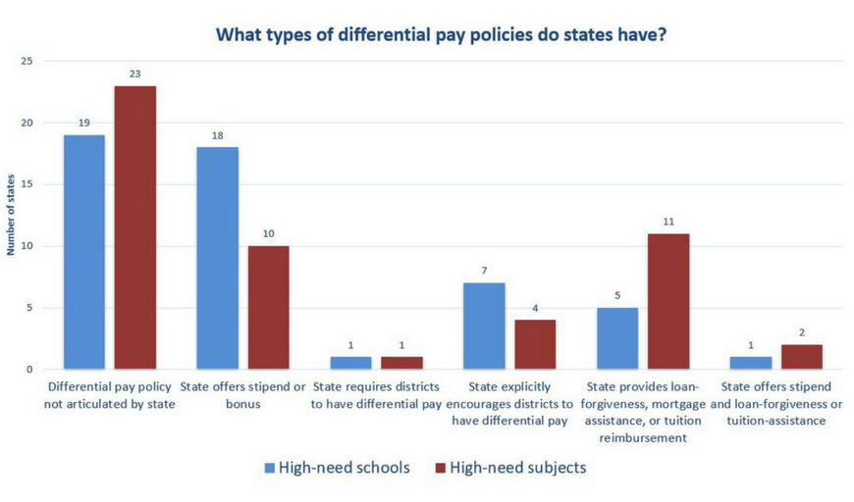
Financial Incentive Policies: High-Need Schools and Subjects
Source: National Council on Teacher Quality, 2018

Slide 32
Financial Incentives: What Does the Research Say?
Financial incentives can positively impact teacher recruitment and retention
  Hard-to-staff schools and subject areas
Financial incentives can improve student performance
  Meta-analysis finds that merit pay programs are associated with a modest, but statistically significant, positive effect on student test scores
Financial incentives can generate cost-savings and have the potential to produce benefits greater than costs
  Performance pay programs have an 87% change of producing benefits greater than costs
Successful programs couple financial incentives with other supports and opportunities for advancement

Slide 33
Effectiveness of Financial Incentives: Teacher Recruitment and Retention in Hard-to-Staff Schools
Teacher Incentive Fund
  Teachers in treatment schools were three percentage points more likely to return to their schools in Year 4 than those in control schools
  From Year 1 to 4, a slightly higher percentage of teachers stayed in treatment schools than control schools (51% versus 49%)
Talent Transfer Initiative
  Attracted high-performing teachers to fill vacancies in low-performing schools
  93% of transferred teachers remained in their assigned school
Tennessee Retention Bonus Program
  Awarded bonuses to effective teachers in low-performing schools choosing to return to the school the following year
  Teachers of tested subject areas were 20% more likely to remain in low-performing schools

Slide 34
Effectiveness of Financial Incentives: Teacher Recruitment and Retention in Hard-to-Staff Schools
North Carolina Bonus Program
  Retained math, science, and special education teachers in high poverty schools
  Reduced turnover rates of targeted teachers by 17%
Washington Challenging Schools Bonus Program
  Increased supply of NBCTs in high poverty schools
  Increased proportion of NBCTs by 07.-1.6% per year
San Francisco Quality Teacher and Education Act
  Encouraged recruitment of teachers to urban school district through overall salary increase for early-career teachers
  Increased applicant pool and quality of new hires

Slide 35
Effectiveness of Financial Incentives: Student Achievement
Teacher Incentive Fund
  Program led to higher student achievement in reading and math across all implementation years
  Increased in student reading achievement equivalent to about three to four weeks of learning
Talent Transfer Initiative
  Positive impact on test scores (math and reading) in targeted elementary classrooms equivalent to moving up each student by 4 to 10 percentile points relative to all students in their state
  No evidence of impacts on student achievement in middle school
The Equity Project
  Students who attended TEP for four years had test score gains equal to an additional 1.6 years of school in math, slightly less than half a year in English, and slightly more than half a year in science

Slide 36
Considerations for Implementation
Develop effective communication systems
Design rigorous and transparent evaluation systems
Use data management systems to link achievement data to payroll
Establish support structures

Slide 37
Working Conditions

Slide 38
The Role of Working Conditions
Teachers’ satisfaction with working conditions are a predictor of retention
Several workplace conditions associated with teacher turnover include:
  School culture
  Experiences with professional development
  Shared decision-making
  Time for professional collaboration and planning
Higher attrition rates in high-poverty schools are linked to dissatisfaction with working conditions, including school facilities, classroom resources (textbooks and supplies), fewer administrative supports, and large class sizes
Sources: Carver-Thomas & Darling-Hammond, 2017; Podolsky, Kini, Bishop, & Darling-Hammond, 2016

Slide 39
Research on Working Conditions
In a survey of over 2,000 current and former California teachers, opportunities to participate in school decision-making, the quality of staff relationships, and adequate time for planning were cited as reasons to stay in teaching
Schools with lower attrition rates are more likely to establish time for teachers to collaborate with other teachers, plan, and review student work; and support shared decision-making
A perceived lack of administrative support was the working condition that most often predicted teacher turnover
Sources: Carver-Thomas & Darling-Hammond, 2017; Podolsky, Kini, Bishop, & Darling-Hammond, 2016

Slide 40
Strategies for Improving Teacher Working Conditions
Implementation of school climate surveys
  North Carolina Teaching Conditions Standards and Survey
  Kentucky Teaching, Empowering, Leading, and Learning (TELL) Survey
Increase instructional support to principals
  Denver Public Schools system-level support
Supplement traditional professional development
  Tennessee Micro-credentialing Pilot
Support protected in-school time for planning, collaboration, and development
  Public Impact’s Opportunity Culture

Slide 41
Policy Considerations

Slide 42
Policy Considerations – Induction and Support
Consider requiring beginning educators to complete an induction program to gain a professional teaching license
Support the implementation of targeted induction and mentoring supports for new teachers in critical shortage areas, including mathematics, science, and special education
Review and update Virginia’s Guidelines for Mentor Teacher Programs

Slide 43
Policy Considerations – Salaries and Compensation
Assess the implementation of locally-developed compensation models that include measures of teacher effectiveness and growth
Encourage divisions to devise a plan to regularly evaluate and update pay floors and incentive programs
Require the development of differentiated pay plans that include a package of financial incentives and other supports required to recruit, retain, and develop the teacher workforce
Encourage divisions to revise their salary scale to front-load teacher compensation

Slide 44
Policy Considerations – Working Conditions
Develop and adopt formal standards for teaching and learning conditions
  Require/encourage divisions to conduct regular assessments of such conditions and incorporate the improvement of such conditions in school improvement plans
Explore the feasibility of micro-credentialing as an avenue for providing personalized learning to educators

Slide 45
Questions & Answers

Slide 46
Contact Us…
Elizabeth Eaton, ARCC VA State Coordinator
Elizabeth.Eaton@icf.com
Aracelis Gray, ARCC VA State Coordinator
Aracelis.Gray@icf.com

Slide 47
Supporting Information

Slide 48
Teacher Incentive Fund
Summary | The Teacher Incentive Fund, renamed the Teacher and School Leaders Incentive (TSL) program under the Every Student Succeeds Act, provides grants to support performance-based compensation systems for teachers and principals in high-need schools. TIF grants aim to reform compensation systems to reward educators for improving student achievement and increase the number of high-performing teachers in high-need schools and hard-to-staff subject areas.
Location of Implementation | The U.S. Department of Education has awarded more than 140 grants over five rounds of funding (2006, 2007, 2010, 2012, and 2016). The majority of these grants have been awarded to states or school districts.
Key Features | The 2010 TIF grants were designed to create comprehensive, performance-based compensation systems that could provide (1) incentives for educators to become more effective in improving student achievement in high-need schools, and (2) support for educators to improve their performance. Districts were required to (1) use measures of both student achievement growth and observations of classroom or school practices (at least two) to evaluate teachers’ and principals’ effectiveness, (2) offer educators bonuses based on their performance, (3) offer educators opportunities to earn additional pay for taking on extra roles or responsibilities, and (4) provide professional development to help educators understand the measures on which they were evaluated and improve their performance on those measures.
Financing Strategy | The program is federally funded program. Grants totaled $1.8 billion as of 2012.
Evaluation of Outcomes | Findings from a randomized controlled trial study of TIF implementation in a subset of 2010 grantees (10 districts and 131 schools) indicate that pay-for-performance had a small impact on student achievement and teacher retention rates. The study finds that student reading achievement increased by 1 to 2 percentile points across the four years of implementation, but difference in math achievement was only statically significant in one year. Impacts also varied across districts and schools. Among teachers working in study schools in Years 1, 2, or 3, those in treatment schools were three percentage points more likely to return to their schools in Year 4 than those in control schools. From Year 1 to 4, a slightly higher percentage of teachers stayed in treatment schools than control schools (51 versus 49%) A cost effectiveness analysis suggests that pay-for-performance programs can be as cost effective as class-size reduction (through four years of program implementation) and about as cost effective as providing transfer incentives for high-performing teachers to move to low-performing schools (at the end of two years).
Source: Chiang et al. (2017). Evaluation of the Teacher Incentive Fund: Final Report on Implementation and Impacts of Pay-for-Performance Across Four Years.

Slide 49
Talent Transfer Initiative
Summary | The Talent Transfer Initiative (TTI) was an intervention designed to test the effectiveness of financial incentives on recruiting high-performing teachers to low-performing schools.
Location of Implementation | 10 school districts across 7 states participated in the intervention
Key Features | Schools in participating districts were classified as: a) potential receiving schools – those with the lowest achievement in the district, based on school-average test scores in the most recent year or b) potential sending schools – all other schools in the district. The intervention offered $20,000 to the highest performing teachers if they transferred to and committed to staying in designated low-performing schools – in the same district – for at least two years. High performing teachers who were already teaching in potential sending schools were paid a retention stipend of $10,000 over two years if they remained in their school.
Financing Strategy | The TTI was federally funded.
Evaluation of Outcomes | Study findings indicate that 88% of the teacher vacancies in the receiving (low-performing) schools were filled by the highest-performing teachers through TTI. The intervention also had a positive impact on teacher-retention rates during the payout period - 93 versus 70%. After the payments stopped, the difference between cumulative retention of the high-performing teachers who transferred and their counterparts (60 versus 51%) was not statistically significant. In elementary schools, TTI had a positive impact on math and reading test scores. These impacts were positive in each of the two years after transfer, between 0.10 and 0.25 standard deviations relative to each student’s state norms. This is equivalent to moving up each student by 4 to 10 percentile points relative to all students in their state. In middle schools, there was no evidence that the intervention raised test scores. A cost analysis suggests that the cost of generating the impacts of TTI in elementary schools is cheaper than using an alternative policy such as class size reduction – by approximately $13,000 per teacher team. However, overall cost-effectiveness varied depending on a number of factors, such as what happens after the last installments of the incentive are paid out after the second year.
Source: Glazerman, S., Protik, A., Teh, B., Bruch, J., and Max, J. (2013). Transfer Incentives for High-Performing Teachers: Final Results from a Multisite Randomized Experiment

Slide 50
Tennessee Bonus Program
Summary | The Tennessee Retention Bonus Program was a one-year pilot program launched in 2013 to combat the high rates of teacher turnover among highly effective teachers in chronically low-performing schools. The attrition rate for highly effective educators increased to 23% when focused on the bottom 5% of schools in the state. The program enabled schools designated as “priority schools” the opportunity to offer a $5,000 retention bonus to any highly effective teacher (teachers rated at a level 5) who was teaching at the school. Level 5 teachers who accepted the bonus were required to complete the 2013-14 school year at the “priority school” to keep the bonus.
Location of Implementation | Tennessee (statewide based on location of priority schools)
Key Features | For most teachers, the $5,000 bonus represented approximately a 10% salary increase or the equivalent of a master’s degree moving from 10 to 15 years of experience on a district salary schedule.
Financing Strategy | State funded
Evaluation of Outcomes | Study findings indicate that the retention bonus program did not have an overall effect on teacher retention. However, additional analysis indicates that Level 5 tested-subject teachers who receive a retention bonus are approximately 20% more likely to remain teaching in a “priority school” when compared with tested-subject teachers just below the Level 5 cutoff.
Source: Springer, M., Swain, W., and Rodriguez, L. (2015). Effective Teacher Retention Bonuses: Evidence from Tennessee.

Slide 51
North Carolina Bonus Program
Summary | The North Carolina Bonus Program was operational from 2001-2004. The program awarded an annual bonus of $1,800 to certified math, science, and special education teachers working in middle schools and high schools with either high poverty rates or low test scores.
Location of Implementation | North Carolina (statewide)
Key Features | The program included two sets of eligibility criteria – at the school level (poverty and test scores thresholds) and at the individual teacher level (a teacher had to be certified and continue to teach the subject at the eligible school).
Financing Strategy | State funded
Evaluation of Outcomes | Using longitudinal data on teachers, the study estimates the impact of the bonus program on teacher turnover. Results suggest that the bonus program reduced the mean turnover rates of the targeted teachers by 17% or 5% points and that experienced teachers exhibited the strongest response to the program. Study findings also indicated that there was widespread misunderstanding about the bonus program among administrators and teachers, as well as skepticism that the size of the bonus would be sufficient to motivate teachers.
Source: Clotfelter, C.T., Glennie, E.J., Ladd, H.F. and Vigdor, J.L. (2008). Would higher salaries keep teachers in high poverty schools? Evidence from a policy intervention in North Carolina.

Slide 52
Washington Challenging Schools Bonus Program
Summary | The Challenging Schools Bonus (CSB) program awards a $5,000 bonus to teachers who earn certification through the National Board for Professional Teaching Standards (NBPTS) and work in high poverty schools. This bonus is in addition to the state’s standard bonus for NBCTs of approximately $5,000. Washington has awarded a salary incentive for NBCTs since the 1999-2000 school year. In
Location of Implementation | Washington
Key Features | The bonus is prorated by the proportion of time teachers spend in eligible “challenging” schools. Starting with the 2011-12 school year, the amount of the bonus was reduced to $3,000 for the first year a teacher earns certification.
Financing Strategy | State funded
Evaluation of Outcomes | A study of the effects of the NBCT bonus policy indicates that the Challenging Schools Bonus program increased the number of NBCTs in high poverty schools, and reduced turnover among certified teachers. Researchers estimate that over the first six years of the program, eligibility increased the proportion of NBCTs by about 07-1.6% points per year. The increase in the number of NBCTs was a result of an increase in the number of new NBCTs, the rate at which incumbent teachers earned certification, and a reduction in turnover among certified teachers. Specifically, the certification rates for previously uncertified teachers was about 0.7% higher in treated schools than in untreated schools (i.e., 42% increase); the proportion of newly hired teachers who were NBCTs increased by about 1.0-1.2% points (38%); and the turnover rate among NBCTs in CSB eligible school was 31-41% lower. On the other hand, the researchers did not find evidence that the bonus policy had an effect on student achievement.
Source: Cowan, J., and Goldhaber, D. (2017). Do Bonuses Affect Teacher Staffing, and Student Achievement in High Poverty Schools? Evidence from an Incentive for National Board Certified Teachers in Washington State.

Slide 53
San Francisco Quality Teacher and Education Act (QTEA)
Summary | The San Francisco Quality Teacher and Education Act (QTEA) of 2008, also known as Proposition A, introduced, among other reforms, a substantial overall teacher salary increase, retention bonuses, additional compensation/stipends to teachers who work at schools with high teacher turnover and in hard-to-fill subject areas, and a Master Teacher program. The salary policy was designed to encourage recruitment of teachers to an urban school district by providing a substantial overall salary increase targeted toward early-career teachers. Teachers with five or fewer years of prior experience stood to gain an 8-13% salary increase as a result of the policy, while those with six or more years of experience stood to gain substantially less.
Location of Implementation | San Francisco Unified School (district wide)
Key Features | Provided stipends for teachers in hard-to-staff schools of up to $2,000/year; stipends for credentialed teachers who teach hard-to-fill subjects of $1,000/year; and 4-Year Retention Bonus of $2,500 and 8-Year Retention Bonus of $3,000 to union certificated members.
Financing Strategy | The Act is funded through a qualified special tax of $198 per year per parcel of taxable real property, for a 20 year period
Evaluation of Outcomes | A study examined teachers with 2-15 years of experience who would have gained salary increases of 6% or more over their prior salary as a result of QTEA to determine whether QTEA increased teacher recruitment and retention. Findings indicate that QTEA’s higher salary increased the size of the applicant pool (from 27 to 37%) and the quality of new hires increased during the implementation of QTEA. For teachers hired in 2009-10, their quality scores were 0.34 of a standard deviation higher than teachers hired in the time period 2004-05 through 2007-08. a differential salary increase can improve a school district’s attractiveness within the local teacher labor market and increase both the size and quality of the teacher applicant pool, having the potential to increase the quality of new-hires. QTEA had little effect on retention.
.
Source: Hough, H., and Loeb, S. (2013). Salary Incentives and Teacher Quality: The Effect of a District-level Salary Increase on Teacher Recruitment.

Slide 54
The Equity Project
Summary | The Equity Project (TEP) is a charter school in New York City that opened in September 2009 as a 5th through 8th grade middle school (TEP now also serves students in Kindergarten, 1st grade, and 2nd grade) and serves primarily low-income and Hispanic students. TEP uses a three-pronged strategy to attract and retain master teachers. Specifically, TEP pays all of its regular master teachers – at all grade levels - an annual base salary of $125,000 and provides them with ongoing professional development and substantial professional responsibility. Apprentice teachers are paid a $65,000 to $85,000 annual salary commensurate with experience (elementary apprentice teachers require a teacher certification or temporary license but no teaching experience while middle school apprentice teachers require a minimum of 2 years of elementary, middle, or high school classroom experience). Middle school master teachers also the opportunity to earn an annual bonus of up to $25,000 during a teacher’s first year of eligibility, and increasing by $5,000 in each subsequent year. Teacher bonus compensation is based on the degree to which TEP's middle school meets goals for school-wide performance each year.
Location of Implementation | New York City (neighborhood specific)
Key Features | Starting salary on par with labor market and a substantial bonus based on school-wide performance goals
Financing Strategy | Relies on charter school public funds (no outside private funding)
Evaluation of Outcomes | A quasi-experimental study of TEP’s impacts over the course of its first 4 years indicates that by the end of the 2012–2013 school year, TEP’s impacts on student achievement were consistently positive across grades and subjects, with especially large effects in math. Using benchmarks for average annual learning gains, the research team found that, compared to similar students in comparable New York City public schools, students who attended TEP for four years had test score gains equal to an additional 1.6 years of school in math, an additional 0.4 years of school in English language arts, and an additional 0.6 years of school in science.
Source: Furgeson, J., McCullough, M., Wolfendale, C., and Gill, B. (2014). The Equity Project Charter School: Impacts on Student Achievement.

Slide 55
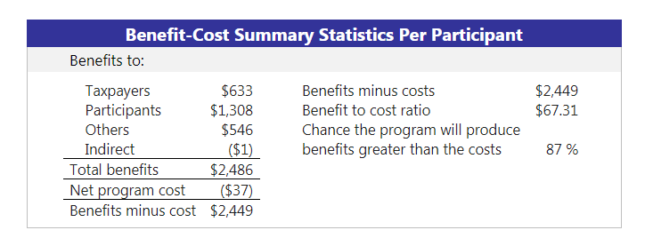
Teacher Performance Pay Programs: Benefit Cost Analysis
Notes: The estimates shown are present value, life cycle benefits and costs. All dollars are expressed in the base year chosen for this analysis (2017). The chance the benefits exceed the costs are derived from a Monte Carlo risk analysis.
Source: Washington State Institute for Public Policy (2018). Teacher performance pay programs: Pre-K to 12 Education
Benefit-cost Estimates.

Slide 56
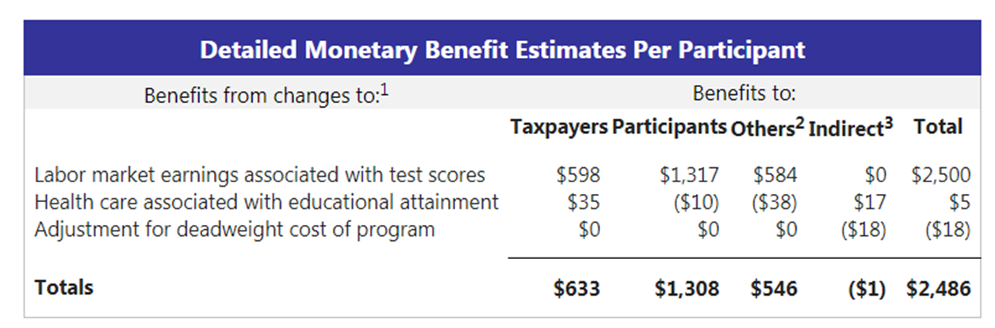
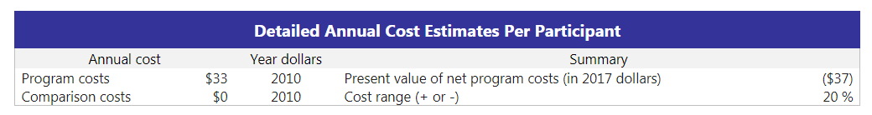
Teacher Performance Pay Programs: Benefit Cost Analysis
¹In addition to the outcomes measured in the meta-analysis table, WSIPP measures benefits and costs estimated from other outcomes associated with those reported in the evaluation literature. For example, empirical research demonstrates that high school graduation leads to reduced crime. These associated measures provide a more complete picture of the detailed costs and benefits of the program.
²“Others” includes benefits to people other than taxpayers and participants. Depending on the program, it could include reductions in crime victimization, the economic benefits from a more educated workforce, and the benefits from employer-paid health insurance.
³“Indirect benefits” includes estimates of the net changes in the value of a statistical life and net changes in the deadweight costs of taxation.
Source: Washington State Institute for Public Policy (2018). Teacher Performance Pay Programs: Pre-K to 12 Education
Benefit-cost Estimates.

Slide 57
Public Impact’s Opportunity Culture
Summary | The Opportunity Culture Model, introduced by Public Impact, provides teachers with restructured professional growth and career opportunities, based on their strengths, leadership skills, and impact on student achievement. The goal of an Opportunity Culture is to extend the reach of excellent teachers and their teams to more students, for more pay within available budgets. The new job models and age-appropriate use of technology in an Opportunity Culture allow teachers to focus on their strengths and interests and advance in their careers without being forced out of the classroom. When properly planned, an Opportunity Culture can pay all teachers more—and excellent teachers much more. Participating schools must follow the Opportunity Culture Principles, which require extending the reach of excellent teachers, often through teacher-led teams; paying teachers more within budget; providing in-school time for planning, collaboration, and development; and matching accountability to each person’s responsibilities.
Location of Implementation | Arizona, Arkansas, Georgia, Indiana North Carolina, New York, Texas (more than 160 schools in 20 districts and one state education agency)
Key Features | The Opportunity Culture hinges on a cycle of: teacher selectivity, opportunities for advancement, and higher pay for teacher leaders.
Financing Strategy | Varies based on implementation
Evaluation of Outcomes | A recent study found that Opportunity Culture schools significantly improved exposed students’ performance in mathematics, with evidence attributing these gains to the multi-classroom leader model. Reading impact was not noted, as learning gains were observed for students in both types of classrooms after multi-classroom leaders (MCLs) began leading some of the teachers in each school. Additionally, teachers who were on average at the 50th percentile in student learning gains, who then joined teams led by MCLs produced student growth matching or approaching that of excellent teachers, on average. Teams had a median of five teachers in addition to the MCL. Higher pay supplements for MCLs, provided through reallocations of school budgets, were associated with better outcomes for team teachers.
Source: Backes, B., and Hansen, M. (2018). Reaching Further and Learning More? Evaluating Public Impact's Opportunity Culture Initiative. CALDER Working Paper No. 181

