Slide 1
VQB5 Data Verification Mobile Phone Demo
Practice Year 2 (2022 – 2023)

Slide 2
How To Complete Data Verification
A Step-by-Step Guide

Slide 3
Data Verification: Step by Step Summary
Step 1
Log in to LinkB5 to and navigate to the Reports tab.
Step 2
Review the PY2 Quality Profile & determine if the Site Information is accurate.
Step 3
Click the link in the PY2 Quality Profile and go to the Data Verification Form.
Step 4
Complete and submit the Data Verification Form for data elements in the Site Information section in need of updates.
If the Site Information is accurate, there is no further action needed. If it is not accurate, continue to Step 3.
Download and open the VQB5 PY2 Quality Profile (2022-2023) report.
NOTE: Each site may only submit the form once.

Slide 4
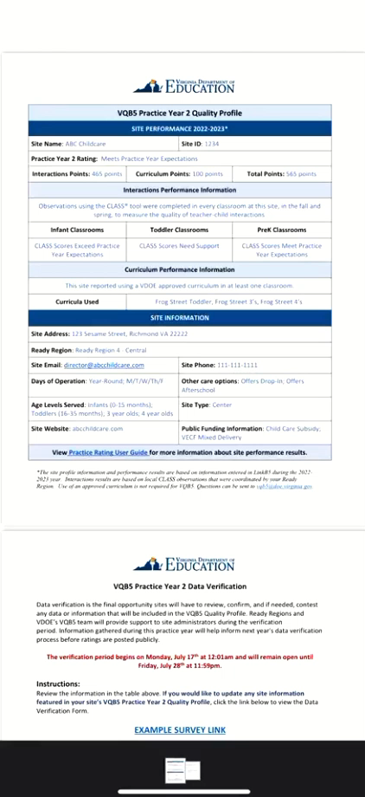
Completing the Form on a Mobile Device
For convenience, the Data Verification Form may be submitted on a mobile device. All steps and information for completing the form, including the information in this guide, will remain the same. Press play on the video below for an overview.
Note: This video has no sound.

Slide 5
Questions?
Contact VDOE at VQB5@doe.virginia.gov

