Slide 1
The Virginia Literacy Act
Advisory Work Group Meeting
June 8, 2023

Slide 2
Objectives
Build understanding of current implementation status of the VLA
Discuss and provide feedback on core curriculum adoption and implementation support for 2023-24

Slide 3
Agenda
Advisory Group Convenes
  Framing
  Review objectives and agreements
VLA Updates
Updates from Virginia Literacy Partnerships (VLP)
Small Group Discussion
Closing

Slide 4
Advisory Group Agreements
Meetings will be held on a quarterly basis.
Meetings will be available virtually.
This group will convene through December 2024.
VDOE staff will set agendas in partnership with the Co-Chairs.
Agendas will be approved at the start of each meeting.
VDOE will share the agenda and any pre-work one week in advance.
Members may email feedback or questions at any time to vla@doe.virginia.gov.

Slide 5
VLA Updates

Slide 6
Cycle I Results
The VDOE must recommend literacy instructional programs that provide evidence-based literacy instruction (EBLI) aligned with science-based reading research (SBRR) for approval by the Virginia Board of Education (VBOE).
Cycle I evaluated K-3 core instructional programs
Submitted a recommended Core Instructional Program Guide for first review on May 11 and final review on June 15.
  Includes information about the process, a list of recommended programs, and a “snapshot” of each approved program that summarizes the strengths and challenges, to help guide decision-making.
Initial recommended eight programs available online for public comment prior to June 15.

Slide 7
Call for Cycle II Materials
Cycle II includes:
  K-5 core literacy curricular programs,
  K-8 supplemental literacy programs, and
  K-8 literacy intervention programs.
Vendor submissions were due June 6
Divisions with locally created materials to contact VLP by July 1

Slide 8
Statewide Training for Reading Specialists
Each reading specialist shall have training in:
  science-based reading research and evidence-based literacy instruction practices.
  the identification of and the appropriate interventions, accommodations, and teaching techniques for students with dyslexia or a related disorder and shall serve as an advisor on dyslexia and related disorders.
Two-day in-person institutes followed by monthly online training series
Registration deadline is tomorrow (June 9)
The priority for this training is staff who will work as elementary reading specialists in the 2023-2024 school year and who already hold a reading specialist endorsement OR will hold one by the 2024-25 school year

Slide 9
Revision of Virginia literacy screener
Virginia is revising its K-3 screener to:
  Align with the most current evidence base
  Include more comprehensive and expanded coverage of skills
  Extend to Pre-K 3-year-olds
  Accurately identify students at risk of developing reading difficulties
  Provide instructionally-useful information for teachers
  Allow for measurement of growth over time and across grade levels as it is vertically-aligned
  Include a new and improved online score entry and reporting system
The updated screener will be known as the Virginia Language and Literacy Screening System (VALLSS)
  Seventeen school divisions will be piloting VALLSS in 2023- 2024; they will continue to receive EIRI funding
Virginia is also creating a vertically-aligned Spanish literacy measure (Pre-K through Grade 3) that is a parallel measure, not a translation.

Slide 10
High Level Timeline
Fall 2022 –
Cycle 1 reviews of K-3 core instructional programs launch
Spring/Summer 2023 – Board reviews recommended K-3 core instructional programs from Cycle I
Fall 2023 –
Pilot with new Virginia Literacy Screener launches
Board reviews proposed revisions to English SOLs
Summer 2024 – Statewide training for teachers and principals kicks off
Winter 2022 – Advisory Work Group launches
Summer 2023 – Statewide training for Reading Specialists kicks off
Cycle II reviews of K-5 core, K-8 supplemental, and K-8 intervention instructional programs begin
Winter-Spring 2024 – Board reviews recommended instructional programs from Cycle II
Fall 2024 –
Classrooms are using new screener, student reading plans and approved instructional programs
Teachers are supported to implement evidence-based literacy instruction based on students’ needs

Slide 11
Updates from VLP

Slide 12
Core Curriculum Adoption
Small Group Discussion

Slide 13
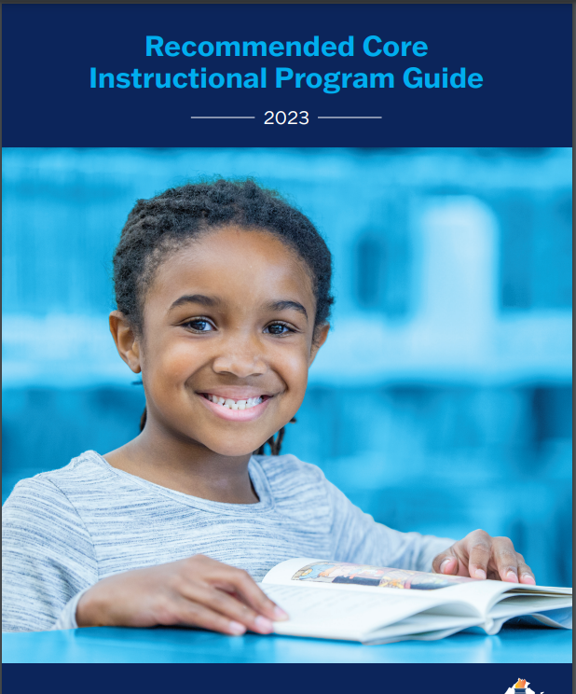
Core Curriculum Adoption Discussion
In your small group, please discuss the following questions:
  What does your division/community need now?
  What three steps are you planning to take this fall?
  What additional support might the VDOE provide?
  What additional questions do you have?
Each group will have a VDOE representative or Co-Chair capturing notes and facilitating the conversation.
Be prepared to have one representative from your group share ONE highlight from your conversation with the whole group.

Slide 14
Closing
Next meeting:
  Thursday, September 21 from 3:00 – 4:30 PM
Final reflections:
  Please share ONE WORD in the chat that describes how you’re leaving today’s meeting.
  Please fill out the exit survey to capture your feedback on today's meeting.
  Thank you for your commitment to this work!

