Slide 1
DRAFT 2023 Mathematics Standards of Learning

Slide 2
Objective and Agenda
The Draft 2023 Mathematics Standards of Learning (SOL) will be presented to the Board of Education for a first review. Updated standards documents along with detailed documents that provide a summary of the proposed changes to the 2016 Mathematics Standards of Learning will be presented.
Overview and Organization of Mathematics Standards of Learning
2023 Mathematics Standards of Learning Revision Timeline
Mathematics SOL Revision Stakeholder Input and Feedback
Draft 2023 Mathematics SOL Document
Support for Implementation of the 2023 Mathematics SOL
Discussion and Preliminary Feedback
Virginia Department of Education, 2023
Notes:
*Updated

Slide 3
Best in Class – Mathematics SOL
Through the engagement of a broad array of stakeholders, valuable input and feedback informed a revised set of standards that represent the best in class for all students in the Commonwealth.
Revisions to the standards will raise academic expectations for students and schools and provide clear and vertically coherent set of expectations to educators and families.
Instruction based on rigorous academic content standards will ensure that every student has access to educational experiences that prepare them for their postsecondary opportunities.
Clear and coherent academic standards allow for common expectations of proficiency for students, families, school staff, and assessment designers.
Virginia Department of Education, 2023
Notes:
*Updated

Slide 4
Standards of Quality
Standards of Quality, Section 22.1-253.13:1-B. ..
“The Board of Education shall establish a regular schedule, in a manner it deems appropriate, for the review, and revision as may be necessary of the Standards of Learning in all subject areas. Such review of each subject area shall occur at least once every seven years. Nothing in this section shall be construed to prohibit the Board from conducting such review and revision on a more frequent basis.”
Virginia Department of Education, 2023

Slide 5
Overview and Organization of Mathematics Standards of Learning

Slide 6
K-12 Mathematics Courses in Virginia
Mathematics Standards of Learning (SOL) - Grade Levels and Courses
Elementary School Grade Levels | Middle School Grade Levels | Mathematics Courses with End-of-Course (EOC) Assessments | High School Mathematics Courses
Kindergarten Grade 1 Grade 2 Grade 3 Grade 4 Grade 5 | Grade 6 Grade 7 Grade 8 | Algebra 1 Geometry Algebra 2 | Algebra, Functions, and Data Analysis Computer Mathematics Probability and Statistics Trigonometry Discrete Mathematics Mathematical Analysis Data Science
Virginia Department of Education, 2023

Slide 7
2023 Mathematics Standards of Learning Revision Timeline

Slide 8
Stakeholder Input and feedback Process
In-person and virtual meeting
State mathematics conferences
Written expert feedback
Online written public feedback
In-person and virtual hearings
Online written public input
In-person and virtual sessions
Public Comment Period
2016 SOL Input
Public Engagement Sessions
2016 SOL Input
External Stakeholder Feedback Draft 2023 SOL
Public Hearings Public Feedback Period
Draft 2023 SOL
February 2022 – August 2022
Input on 2016 Mathematics SOL
September 2022 – March 2023
Feedback on Draft 2023 Mathematics SOL
June 2023 – September 2023 Board of Education Driven Feedback
Virginia Department of Education, 2023
Notes:
*updated

Slide 9
Mathematics SOL Revision Process Timeline -2022
January - February 2022 | BOE Approves SOL Timeline and Public Comment Period -2016 Mathematics Standards of Learning
May - June 2022 | Public Engagement Sessions
June 2022 | Math Education Advisory Committee (MEAC) Meeting K-12 SOL Review Committee Convened
July - August 2022 | VDOE and K-12 Committee Leads Review Draft Mathematics SOL
September 2022 | Math Education Advisory Committee (MEAC) Meeting
November – December 2022 | External Review Committee Meetings Math Education Advisory Committee (MEAC) Meeting
Virginia Department of Education, 2023

Slide 10
Mathematics SOL Revision Process Timeline -2023
January – June 2023 | VDOE Prepares Draft 2023 Mathematics SOL for First Review by the Board of Education (BOE); Summary of Changes Documents presented to BOE at June Work Session
July 2023 (tentative) | BOE First Review of Draft 2023 Mathematics SOL
June – August 2023 (tentative) | Public Feedback Period – Draft 2023 Mathematics SOL
July - August 2023 (tentative) | Public Hearings In-Person Hearings Virtual Hearings
August/September 2023 (tentative) | BOE Final Review of Draft 2023 Mathematics SOL
Virginia Department of Education, 2023
Notes:
*Updated

Slide 11
Mathematics Education Advisory Committee (MEAC)
Role of Committee
Analyze Stakeholder Feedback
Review Draft 2023 Mathematics SOL
Provide Recommendations
Meetings
June 2022
September 2022
December 2022
Meeting – Following Public Comment Period
Virginia Department of Education, 2023

Slide 12
MEAC Members
Organization | Role
New Kent County Public Schools | Special Education Teacher
Augusta County Public Schools | Mathematics Supervisor
Academic Year Governor’s School | Roanoke Valley Governor’s School for Science and Technology Director
Loudoun County Public Schools | Gifted and Talented Supervisor Gifted Education Advisory Committee Lead
Nottoway County Public Schools | English Language Teacher
Kaiser Permanente Mid Atlantic | Senior Director, The Continuum
Lunenburg County Public Schools, School Board Member | School Board Vice Chairman
VA PTA Board of Directors (Fairfax) | Treasurer
Virginia PTA Board (Yorktown) | Member
Frederick County Public Schools | English Language teacher
Botetourt County | Elementary School Teacher
Rockingham County Public Schools | Middle School Math teacher
Norfolk State University | School of Education Professor
Longwood University | Associate Provost/Associate Vice President Academic Affairs
Northern Virginia Community College | Dean Natural Science and Mathematics
Spring Oaks Capital | CTO of Machine Learning focused Fintech
Dominion Energy – Talent Acquisition | Workforce Development & Planning Coordinator
Mission Support Office, U.S. Space Force | Director
Prince William County Public Schools | Middle School Mathematics Professional Development Specialist
Arlington City Public Schools | K-12 Mathematics Coordinator
Science Museum of Virginia | Virginia STEM Coordinator
Virginia Department of Education, 2023
Notes:
FPIA

Slide 13
Stakeholder Input Received on 2016 Standards
Public Input for Mathematics Standards of Learning Revision:
Public Comment Period: 141 submissions 138 general comments 211 additional grade level comments Public Engagement Sessions: 174 attendees 423 comments External Stakeholder Feedback: 480 attendees (approximately) 809 comments | Additional Subject Matter Experts: Virginia Two-Year Colleges and Four-Year Universities Content Professors Teacher Preparation Programs Pedagogy Child Development experts Leaders of State Mathematics Organizations Virginia Council of Teachers of Mathematics (VCTM) Virginia Mathematics & Science Coalition (VMSC) Virginia Council for Mathematics Supervision (VCMS) Virginia Council of Mathematics Specialists (VACMS)
Virginia Department of Education, 2023
Notes:
*updated

Slide 14
2016 Mathematics SOL Stakeholder Input
Sources of Input - 2016 Mathematics Standards of Learning | Dates | Number of Responses/Stakeholders
30-Day Public Comment Period (electronic) | February 2022 | 141 submissions 138 general comments (note: several comments represent large organizations) 211 additional grade level comments
Richmond Public Engagement Session | May 2022 | 10 attendees; 33 comments
Tidewater Public Engagement Session | May 2022 | 16 attendees; 35 comments
Northern Virginia Public Engagement Session | May 2022 | 16 attendees; 36 comments
Blacksburg Public Engagement Session | June 2022 | 2 attendees; 6 comments
Staunton Public Engagement Session | June 2022 | 4 attendees; 32 comments
Public Engagement Session (virtual) | June 2022 | 103 attendees; 184 comments
External Stakeholder Meeting 1 – Institutes of Higher Education/State Mathematics Organizations | November 2022 | 10 attendees; 15 comments
External Stakeholder Meeting 2 - Parents, Business Leaders, Community Members | December 2022 | 13 attendees; 82 comments
Virginia Department of Education, 2023
Notes:
*updated

Slide 15
Summary of Stakeholder Comments
Make no changes to the Mathematics SOL
Increase the rigor of the content, particularly at the elementary level
Greater focus on recall of basic facts in elementary grades
Reduce the number of standards/Go deeper, not wider
Embed the Mathematics Process Goals
Create connections between standards within and across grade levels/disciplines
Support the use of technology to inquire and advance thinking
Promote real-world application
Greater emphasis on data analysis
Focus on computational fluency
Virginia Department of Education, 2023

Slide 16
Draft 2023 Mathematics SOL Stakeholder Feedback
Sources of Feedback - Proposed Revised 2023 Mathematics Standards of Learning | Dates | Number of Responses/Stakeholders
Mathematics Education Advisory Committee (MEAC) Meeting | September 2022 | 16 attendees; 31 comments
Virginia Council for Mathematics Supervision (VCMS) | October 2022 | 120 participants; 302 comments
Virginia Council of Mathematics Specialists (VACMS) | October 2022 | 70 participants; 107 comments
External Stakeholder Meeting – Institutes of Higher Education, representatives from math organizations | November 2022 | 10 attendees; 81 comments
External Stakeholder Meeting – Parents, Business Leaders, Community Members | December 2022 | 13 attendees; 107 comments
Mathematics Education Advisory Committee (MEAC) Meeting | December 2022 | 10 attendees; 5 recommendations
Virginia Council of Teachers of Mathematics (VCTM) | March 2023 | 240 participants; 176 comments
Virginia Department of Education, 2023
Notes:
*updated

Slide 17
Upcoming Stakeholder Feedback
Expert Review:
Peter Coe (HS Standards) has extensive math standards, curriculum, and assessment knowledge and is well respected in state math standards analysis. He is providing feedback on HS rigor, coherence, and clarity.
Watershed Advisors Team (Grade Band Analysis) has extensive standards and analysis experience in Louisiana and multiple states. This group is facilitating the HB 585 workgroup and connecting national experts to this standards review and assessment work.
Draft 2023 Mathematics Standards of Learning
                Written Public Comment Summer 2023
                Public Hearings – in collaboration with the Board of Education
            MEAC Meeting – following Public Comment Period
Virginia Department of Education, 2023
Notes:
*updated

Slide 18
Summary of Changes
Draft 2023 Mathematics SOL

Slide 19
Increase Rigor and Depth
Rigor is being able to flexibly analyze and apply mathematics to different situations with a focus on concepts and relationships. It is not the ability to simply memorize a myriad of procedures. A rigorous approach to learning mathematics develops students’ understanding through making connections both within and across mathematics and to other areas of their lives. Rigor includes the development of problem-solving skills, conceptual understanding, procedural fluency, and essential mathematical processes and practices.
  Adapted from Mathematics with Rigor, Relevance, and Responsiveness (NCTM, 2021)
Virginia Department of Education, 2023

Slide 20
2023 Mathematics Standards of Learning Revision
Revisions to Increase Rigor and Depth – Areas of Focus | Highlights of Increased Content Rigor
Improve Vertical Coherence through grade levels Application and Connection of Concepts within a Grade/Course Additional Data Analysis to support postsecondary workforce expectations Embed the Mathematics Process Goals (Problem Solving, Connections, Communication, Representations, and Reasoning) | Reasoning, representing, communicating, problem solving and making connections in grades K-12 Data analysis and the use of a data cycle in grades K-12 Fraction understanding in grades 2-5 Recall and automaticity of basic facts in grades 1-4 Geometric relationships in grades 4-7 Proportional reasoning and algebraic thinking in grades 6-8 Translation of functions in grade 8, Algebra 1, AFDA, and Algebra 2
Virginia Department of Education, 2023
Notes:
*updated

Slide 21
Learning Progression of Basic Facts
Recalling Basic Facts with Automaticity (producing answers efficiently)
Using Reasoning Strategies
(recognizing patterns and using relationships to derive unknown facts)
Developing Conceptual Understanding (skip counting, constructing meaning of numbers and operations)
(Adapted from Baroody, 2006; Bay-Williams, 2021)
The acquisition of basic facts develops in three stages. These stages should not be perceived as distinct, discreet units. All three stages are critical to subsequent retention and recall of the basic math facts as well as the development of computational fluency in general.
Virginia Department of Education, 2023

Slide 22
2023 Draft Mathematics Fact Development (multiplication and division)
 | Grade 3 | Grade 4
Multiplication and Division
Developing Conceptual Understanding | Represent multiplication and division of whole numbers through 10x10 using a variety of approaches and models
Using Reasoning Strategies | Recognize and apply relationships between multiplication and division of whole numbers through 10x10 | Recognize and apply relationships between multiplication and division of whole numbers through 12x12
Recalling with Automaticity | Recall with automaticity the multiplication facts through 10x10 and corresponding division facts | Recall with automaticity the multiplication facts through 12x12 and corresponding division facts
Students continue to develop proficiency with and retention of basic facts through computation with larger whole numbers and rational numbers.
Virginia Department of Education, 2023

Slide 23
2023 Draft Mathematics Basic Fact Development (addition and subtraction)
 | Kindergarten | Grade 1 | Grade 2
Addition and Subtraction
Developing Conceptual Understanding | Compose and decompose numbers up to 10 | Compose and decompose numbers less than 20
Using Reasoning Strategies | Demonstrate with fluency part-whole relationships for numbers up to 5 | Demonstrate with fluency part-whole relationships to 10 | Demonstrate fluency with part-whole relationships to 20
Recalling with Automaticity |  | Recall with automaticity within 10 | Recall with automaticity within 20
Students continue to develop proficiency with and retention of basic facts through computation with larger whole numbers and rational numbers.
Virginia Department of Education, 2023

Slide 24
Components of Computational Fluency
Efficiency
  Selects an appropriate strategy
  Solves in a reasonable amount of time
Flexibility
  Adapts strategies
  Applies a strategy to a new problem
Accuracy
  Completes steps accurately
  Obtains correct solutions
Basic fact recall develops in tandem with computational fluency.
Efficiency
Accuracy
Flexibility
Computational Fluency
Virginia Department of Education, 2023

Slide 25
Improve Vertical Coherence (Computation of Whole Numbers Grades 1-4)
Grade 4:
Determine the sum or difference of two whole numbers, where addends and minuends do not exceed 10,000.
Grade 3:
Determine the sum or difference of two whole numbers where addends and minuends do not exceed 1,000.
Grade 2:
Determine the sum or difference of two whole numbers where addends or minuends do not exceed 100.
Grade 1:
Solve addition and subtraction problems within 20, using various strategies.
Draft 2023 Mathematics SOL
Virginia Department of Education, 2023

Slide 26


Improve Vertical Coherence - Understanding of Fractions (Grades 2-5)
Grade 2
Describe the relationship between the number of fractional parts needed to make a whole and the size of the parts.
Grade 3
Compose and decompose fractions (proper and improper) with denominators of 2, 3, 4, 5, 6, 8 or 10 in multiple ways with models.
Grade 4
Estimate and determine the sum or difference of two fractions (proper and improper) and/or mixed numbers, having like denominators limited to 2, 3, 4, 5, 6, 8, 10, and 12, and simplify the resulting fraction (with and without models). Addition and subtraction with fractions may include regrouping.
Grade 5
Compare (using symbols <, >, =) and order (least to greatest and greatest to least):
a set of no more than four decimals through thousandths;
a set of no more than four proper or improper fractions, and/or mixed numbers; and
a set of no more than four decimals, fractions, and/or mixed numbers
Draft 2023 Mathematics SOL
Virginia Department of Education, 2023

Slide 27
Improve Vertical Coherence - Geometric Relationships in Grades 4-7
Grade 4 - Area and Perimeter of Rectangles
Use concrete materials and pictorial models to develop a formula for the area and perimeter of a rectangle
Grade 6 - Circumference and Area of Circles
Develop the formula for circumference using the relationship between diameter, radius and pi.
Grade 7 - Volume and Surface Area of Rectangular Prisms and Cylinders
Develop the formulas for determining the surface area of rectangular prisms and cylinders using two-dimensional diagrams or nets.
Develop the formulas for determining the volume of rectangular prisms and cylinders using concrete objects and diagrams.
Describe how the formula V = Bh, when B is the area of the base and h is the height, can be used to determine the volume for both rectangular prisms and cylinders.
Grade 5 - Area of Right Triangles
Investigate and develop a formula to estimate and determine the area of a right triangle
Grade 6 - Area and Perimeter of Triangles, Rectangles, and Parallelograms.
Develop the formula for determining the area of parallelograms and triangles using manipulatives (e.g., two-dimensional diagrams, grid paper, etc.).
Draft 2023 Mathematics SOL
Virginia Department of Education, 2023

Slide 28
Improve Vertical Coherence
(Functions - Grade 8 through Mathematical Analysis)
Grade 8:
Key Characteristics of Linear Functions (slope; y-intercept; independent/
dependent variables)
Algebra I:
Compare and Contrast Linear Functions and Nonlinear Functions (Absolute Value, Exponential and Quadratic)
Algebra II:
Recognize a functional relationship between two variables: Linear Functions; Quadratic Functions; Exponential Functions; Piecewise Defined Functions and Rational Functions
Mathematical Analysis:
Model contextual problems using Exponential and Logarithmic functions
Draft 2023 Mathematics SOL
Virginia Department of Education, 2023

Slide 29
Greater Support for the Connection of Concepts within a Grade/Course - Congruence
Grade 2: Identify, describe, and create plane figures (including circles, triangles, squares, and rectangles) that have at least one line of symmetry and explain its relationship with congruency.
Explore a figure using a variety of tools (e.g., paper folding, geoboards, drawings, etc.) to show and justify a line of symmetry, if one exists.
Create figures with at least one line of symmetry using various concrete and pictorial representations.
Describe the two resulting figures formed by a line of symmetry as being congruent (having the same shape and size).
Draft 2023 Mathematics SOL
Virginia Department of Education, 2023

Slide 30
Greater Support for the Connection of Concepts - Grade 7 Proportional Reasoning
Grade 7 (Computation and Estimation): The student will solve problems, including those in context, involving proportional relationships.
Grade 7 (Measurement and Geometry): The student will solve problems and justify relationships of similarity using proportional reasoning.
Grade 7 (Patterns, Functions, and Algebra): The student will investigate and analyze proportional relationships between two quantities using verbal descriptions, tables, equations in y = mx form, and graphs, including problems in context.
Grade 7 (Measurement and Geometry): The student will apply translations, reflections, and dilations of right triangles and rectangles in the coordinate plane.
Draft 2023 Mathematics SOL
Virginia Department of Education, 2023

Slide 31
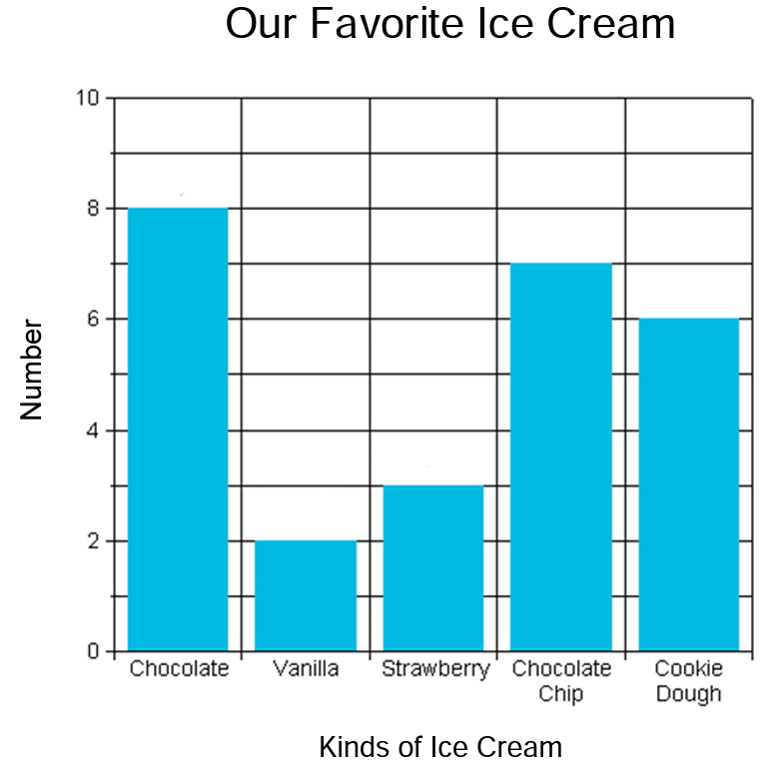
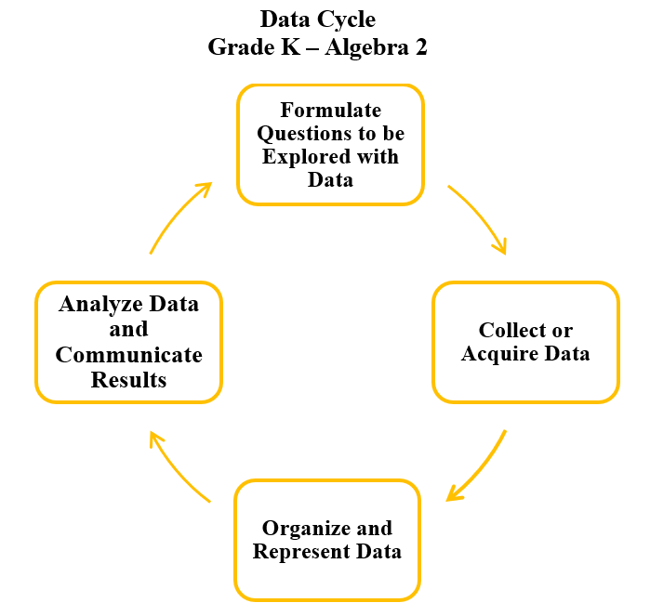
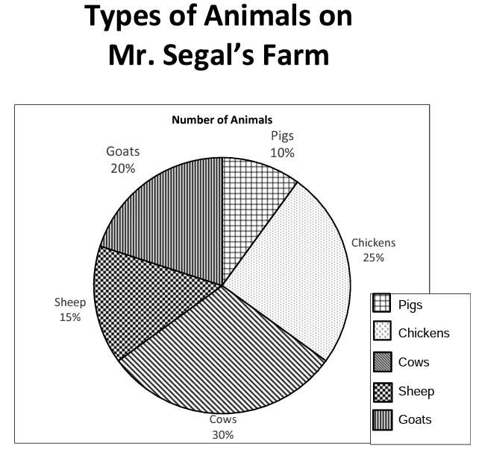
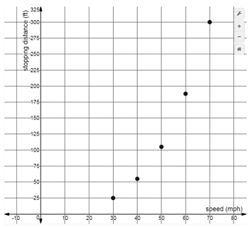
Additional Data Analysis to Support Post Secondary Thinking
Grade 2: The student will apply the data cycle (pose questions; collect or acquire data; organize and represent data; and analyze data and communicate results) with a focus on pictographs and bar graphs.
Grade 6: The student will apply the data cycle (formulate questions; collect or acquire data; organize and represent data; and analyze data and communicate results) with a focus on circle graphs.
Algebra 1: The student will apply the data cycle (formulate questions; collect or acquire data; organize and represent data; and analyze data and communicate results) with a focus on representing bivariate data in scatterplots and determining the curve of best fit using linear and quadratic functions.
Speed vs. Stopping Distance
Draft 2023 Mathematics SOL
Virginia Department of Education, 2023

Slide 32
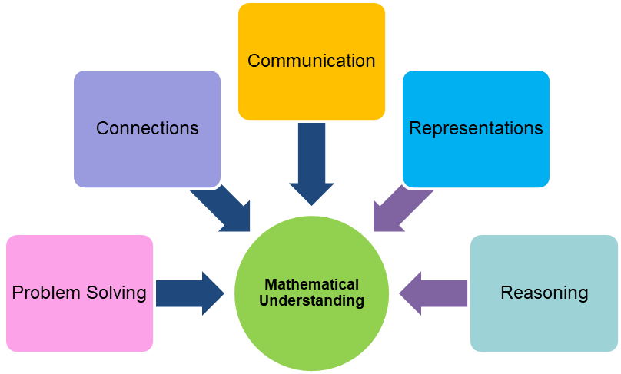
Embed the Mathematics Process Goals - Elementary
Grade 1: Describe and justify how shares are equal pieces or parts of the whole (e.g., halves, fourths), when given a contextual problem.
Grade 2: Investigate and explain the ten-to-one relationship among ones, tens, and hundreds, using models.
Grade 3: Apply patterns within the base 10 system to determine and communicate, orally and in written form, the place and value of each digit in a six-digit whole number (e.g., in 165,724, the 5 represents 5 thousands and its value is 5,000).
Grade 4: Estimate, represent, solve, and justify solutions to single-step and multistep problems, including those in context, using addition and subtraction with whole numbers
Draft 2023 Mathematics SOL
Virginia Department of Education, 2023

Slide 33
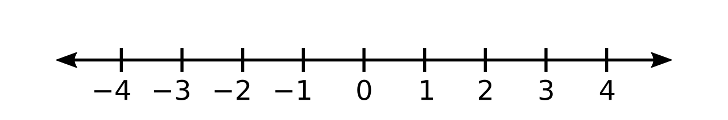
Embed the Mathematics Process Goals - Representation in Grades 6-8
Grade 6 - The student will estimate, represent, solve, and justify solutions to problems using operations with integers, including those in context.
Represent addition, subtraction, multiplication, and division of integers using pictorial representations or concrete manipulatives.
Grade 7 - The student will reason and use multiple strategies to compare and order rational numbers.
Use multiple strategies (e.g., benchmarks, number line, equivalency, etc.) to compare (using symbols <, >, =) and order (a set of no more than four) rational numbers expressed as integers, fractions (proper or improper), mixed numbers, decimals, and percents. Fractions and mixed numbers may be positive or negative. Decimals may be positive or negative and are limited to the thousandths place. Ordering may be in ascending or descending order. Justify solutions orally, in writing or with a model.
Grade 8 - The student will compare and order real numbers and determine the relationships between real numbers.
Use multiple strategies (e.g., benchmarks, number line, equivalency, etc.) to compare and order no more than five real numbers expressed as integers, fractions (proper or improper), decimals, mixed numbers, percents, numbers written in scientific notation, radicals, and π. Radicals may include both positive and negative square roots of values from 0 to 400. Ordering may be in ascending or descending order. Justify solutions orally, in writing or with a model.
Grade 6 - The student will reason and use multiple strategies to express equivalency, compare, and order numbers written as fractions, mixed numbers, decimals, and percents.
Use multiple strategies (e.g., benchmarks, number line, equivalency, etc.) to compare and order no more than four positive rational numbers expressed as fractions (proper or improper), mixed numbers, decimals, and percents (decimals through thousandths, fractions with denominators of 12 or less or factors of 100) with and without models. Justify solutions orally, in writing or with a model. Ordering may be in ascending or descending order.
Draft 2023 Mathematics SOL
Virginia Department of Education, 2023

Slide 34
Embed the Mathematics Process Goals - Secondary
Trigonometry: Apply trigonometric functions and their graphs to model periodic phenomena.
Geometry: Verify properties of similar figures and apply them to solve problems.
Algebra, Functions, and Data Analysis (AFDA): Communicate the description of an experiment and/or observational study, the resulting data, analysis, and validity of the conclusions.
Probability and Statistics:
Describe the shape, center, and spread of the sampling distribution of a proportion within the context of the problem.
Draft 2023 Mathematics SOL
Virginia Department of Education, 2023

Slide 35
Draft 2023 Mathematics
SOL Documents

Slide 36
Virginia Department of Education, 2023
2023 Draft Mathematics
Standards of Learning Documents
Draft 2023 Standards of Learning Documents | Summary of Changes Documents
Front Matter Information Grade level/Course Description Standards of Learning | Content Overview Standards of Learning Comparison of 2016 to 2023 Mathematics SOL Summary of Changes
Notes:
*Updated

Slide 37
Comparison of structure between 2016 Standards & 2023 Draft Standards
2016 Mathematics Standards of Learning
3.12 The student will define polygon; identify and name polygons with 10 or fewer sides; and combine and subdivide polygons with three or four sides and name the resulting polygon(s).
Draft 2023 Mathematics Standards of Learning
3.MG.4 The student will identify, describe, classify, compare, combine, and subdivide polygons. Students will demonstrate the following Knowledge and Skills: Describe a polygon as a closed plane figure composed of at least three line segments that do not cross. Classify figures as polygons or not polygons and justify reasoning. Identify and describe triangles, quadrilaterals, pentagons, hexagons, and octagons in various orientation, with and without contexts. Identify and name examples of polygons in the environment (triangles, quadrilaterals, pentagons, hexagons, and octagons). Classify and compare polygons (triangles, quadrilaterals, pentagons, hexagons, octagons). Combine no more than three polygons, where each has three or four sides, and name the resulting polygon (triangles, quadrilaterals, pentagons, hexagons, octagons). Subdivide a three-sided or four-sided polygon into no more than three parts and name the resulting polygon(s).
Virginia Department of Education, 2023
Notes:
*updated

Slide 38
Comparison of structure between 2016 Standards & 2023 Draft Standards
2016 Mathematics Standards of Learning
A.2 The student will perform operations on polynomials, including applying the laws of exponents to perform operations on expressions; adding, subtracting, multiplying, and dividing polynomials; and factoring completely first- and second-degree binomials and trinomials in one variable.
Draft 2023 Mathematics Standards of Learning
A.EO.2 The student will perform operations on and factor polynomial expressions in one variable. Students will demonstrate the following Knowledge and Skills: Determine sums and differences of polynomial expressions in one variable, including representing using concrete objects and their related pictorial and symbolic models. Determine the produce of polynomial expressions, including representing using concrete objects and their related pictorial and symbolic models. The factors should be limited to five or fewer terms (i.e., (4x + 2)(3x + 5) represents four terms and (x + 1)(2x² + x + 3) represents five terms). Factor completely first- and second-degree polynomials in one variable with integral coefficients. Identify prime polynomial expressions, where applicable. After factoring out the greatest common factor (GCF), leading coefficients should have no more than four factors. Determine the quotient of polynomials, using a monomial or binomial divisor, or a completely factored divisor. Represent and demonstrate equality of quadratic expressions in different forms (e.g., concrete, verbal, symbolic, and graphical).
Virginia Department of Education, 2023
Notes:
*Updated

Slide 39

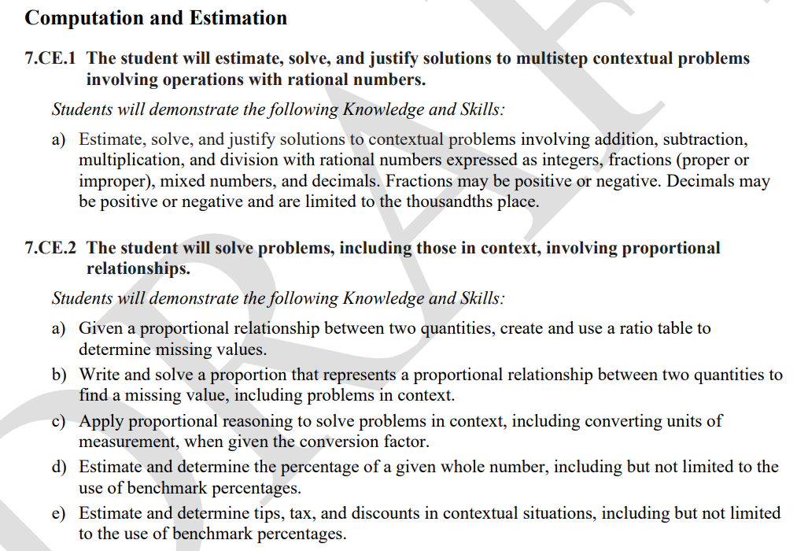
Sample Grade 7 Standards of Learning Document
Virginia Department of Education, 2023

Slide 40
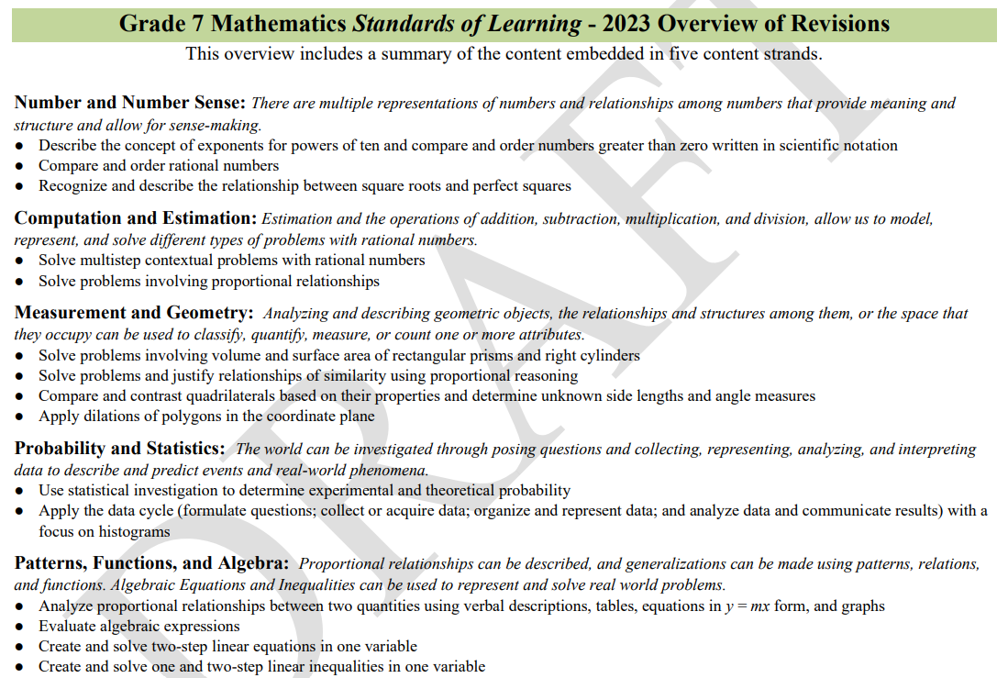
Sample Grade 7 Summary Document (1 of 4)
Virginia Department of Education, 2023

Slide 41
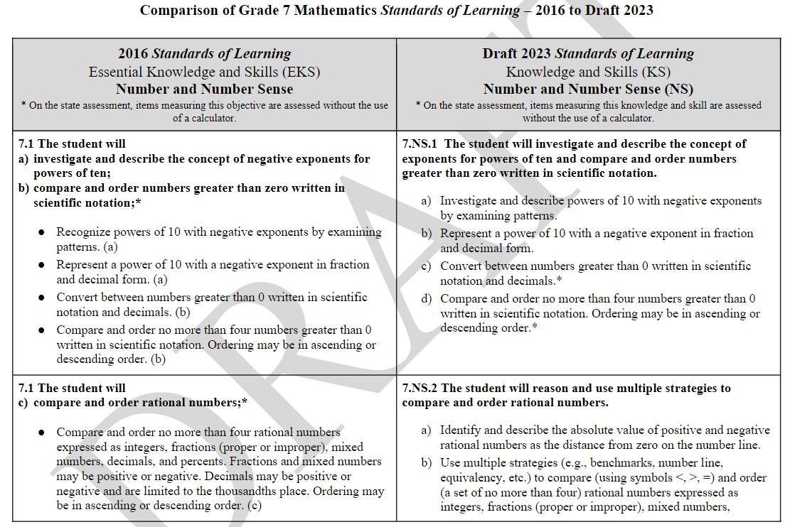
Sample Grade 7 Summary Document (2 of 4)
Virginia Department of Education, 2023

Slide 42
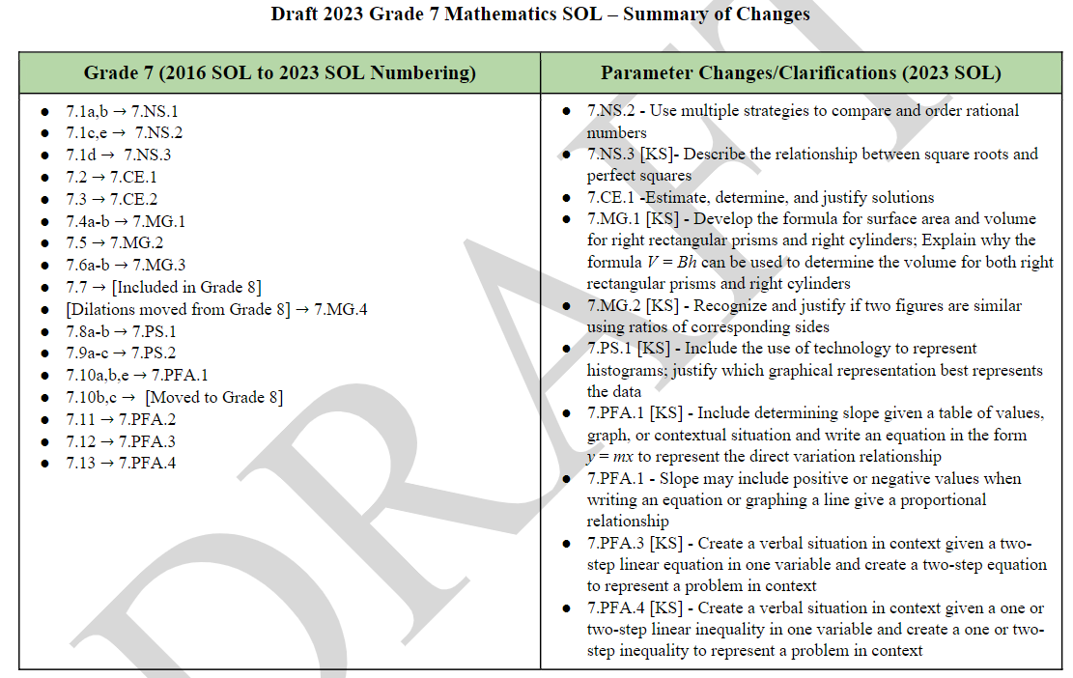
Sample Grade 7 Summary Document (3 of 4)
Virginia Department of Education, 2023

Slide 43
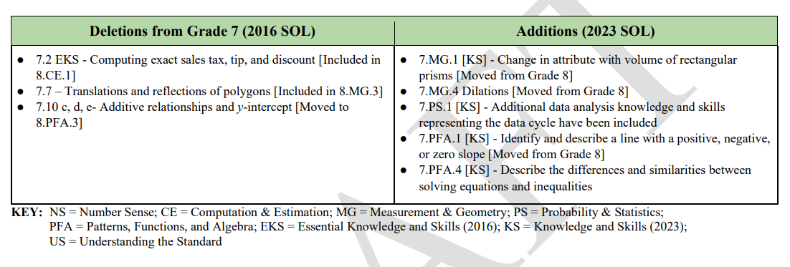
Sample Grade 7 Summary Document (4 of 4)
Virginia Department of Education, 2023

Slide 44
Primary References to Support Revision Process
National Assessment of Educational Progress (NAEP) Mathematics Framework (2026)
Mathematics Standards from Key Leader States
  Texas Essential Knowledge and Skills (TEKS) - Mathematics (2012)
  Massachusetts Mathematics Curriculum Framework (2017)
  Florida’s Benchmarks for Excellent Student Thinking (B.E.S.T.) Standards for Mathematics (2020)
  Minnesota K-12 Academic Standards in Mathematics (draft 2022)
  New Jersey Student Learning Standards - Mathematics (2016)
Pre-K–12 Guidelines for Assessment and Instruction in Statistics Education II (GAISE II, 2020)
Mathematics College and Career Readiness Standards (ACT, 2022)
SAT Suite of Assessments - Mathematics Test Details (2016)
Trends in International Mathematics and Science Study (TIMSS, 2022)
Programme for International Student Assessment (PISA, 2022 Draft)
Fordham Institute Report: The State of State Standards Post-Common Core (2018)
Assessment and Instruction in Statistics Education (GAISE) Report (2020)
Virginia Department of Education, 2023
Notes:
Add Fordham Institute

Slide 45
What does this mean for Mathematics Assessment?

Slide 46
Mathematics Assessment in Virginia Public Schools
Kindergarten – Virginia Kindergarten Readiness Program (VKRP) Early Mathematics Assessment System (EMAS)
Grades 3-8 – Mathematics Standards of Learning Assessments (Computer Adaptive Tests)
Grades 3-8 – Virginia Growth Assessments (Computer Adaptive Tests)
High School – Mathematics Standards of Learning End-of-Course Assessments (Form Tests)
  Algebra I
  Geometry
  Algebra II
Virginia Department of Education, 2023

Slide 47
Mathematics Assessment
Clarity in standards provides well-defined instructional expectations for students and educators as well as parents.
Clarity in standards with depth of expectations (e.g., apply and justify) allow for clear mastery expectations for teachers and assessment designers.
Depth of standards allows for clear-cut definitions through year assessment (entry, mid, and full mastery).
Depth of standards strengthens ability to provide gifted opportunities post mastery.

Slide 48
Next Steps

Slide 49
Next Steps Mathematics SOL Revisions
June 2023
BOE First Review of Draft 2023 SOL
August/September 2023
BOE Final Review of Draft 2023 SOL
June– August 2023
Public Hearings and Feedback Period
Draft 2023 SOL
2024-2025
Full Implementation 2023 Math SOL
2023-2024
Crosswalk Year
(2016 and 2023
Math SOL taught)
Virginia Department of Education, 2023
Notes:
*updated

Slide 50
Next Steps - Implementation of the 2023 Mathematics SOL – Professional Learning
Emphasis of Professional Learning
  Increase Rigor and Depth
  Vertical Coherence of Content
  Additional Data Analysis
  Connection of Concepts within a Grade/Course
  Mathematics Process Goals (Problem Solving, Connections, Communication, Representations, and Reasoning)
Professional Learning Delivery Models:
  In-person VDOE Professional Learning Institutes – four to five regional one-day sessions (200 educators at each)
  Synchronous Instructional Webinars – revision overviews and content supports
  Asynchronous Instructional Video Bytes – 3-to-5-minute content or pedagogy videos
  Asynchronous Summary of Changes Presentations
  VDOE Office Hours
Virginia Department of Education, 2023

Slide 51
Next Steps - Implementation of the 2023 Mathematics SOL – Instructional Resources
Standards of Learning Packaged Documents
Crosswalk from 2016 to 2023 Documents
Dynamic Instructional Guides
Parent Portal Resources
Gifted Math Opportunities
Desmos Mathematics Activities
Rich Mathematical Tasks
K-12 Intervention Resources
Virginia Department of Education, 2023

Slide 52
Discussion and Feedback

Slide 53

Questions
Virginia Department of Education, 2023

