Slide 1
innovation incubator: lab schools the first gathering of K-12, higher education, business and community groups on creating and growing sustainable lab schools Wednesday, May 3, 2023

Slide 2
Welcome Remarks Provided by Secretary of Education Aimee Guidera

Slide 3
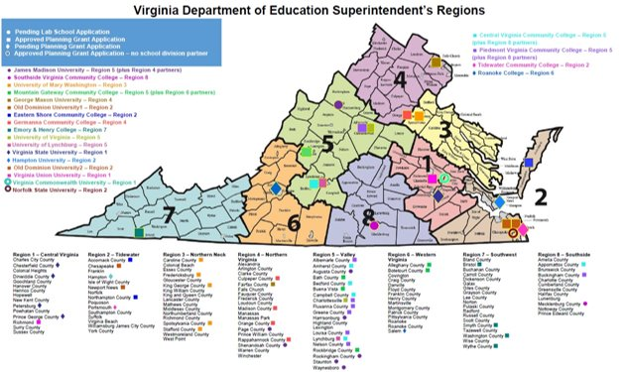
LAB SCHOOLS – REGION MAP

Slide 4
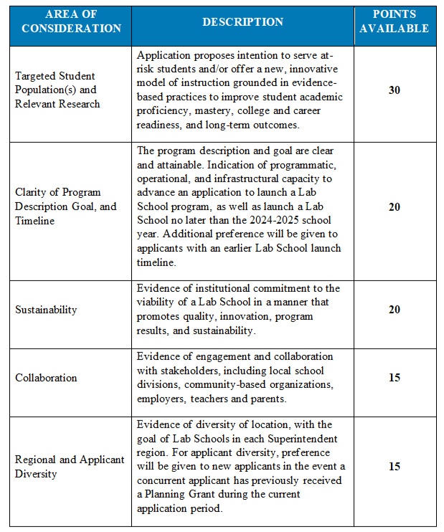
PLANNING GRANT APPLICATION EVALUATION RUBRIC

Slide 5
Lab School 101 Provided by Virginia Department of Education Chief of Staff Jeremy Raley

Slide 6
Background and History
Lab Schools originally created through legislation in 2010.
22.1-349(A) of the Code of Virginia, as amended by Chapter 2 of the 2022 Acts of Assembly, Special Session I defines College Partnership Laboratory School.
College Partnership Laboratory School Fund established through Section 22.1-349.2 of the Code of Virginia during 2022 General Assembly Special Session.
Significant investment by the General Assembly:
$5 million for planning grants to aid in drafting and submitting a Lab School application.
$20 million for initial start up grants to make one time purchases for launch.
$75 million for per-pupil operating grants to support ongoing expenses.

Slide 7
What is a Lab School?
An independent, innovative public school built on partnership and evidence that is open to all students through a lottery process

Slide 8
Key Elements of Lab Schools
Opportunities available to all students, with no barriers
Performance based programs that deliver outcomes
Serve as model programs across the Commonwealth
Administered and managed by a governing board
See Virginia Code Section 22.1-349.3 for more information.

Slide 9
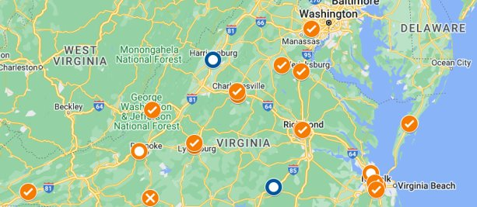
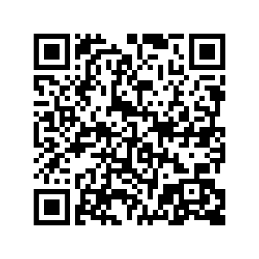
LAB SCHOOLS – ​WEBSITE & UPDATES
Interactive map allows other four- and two-year colleges and universities and higher education centers, as well as other Planning Grant Applicants, to identify Planning Grant Awardees.
It can also prompt private sector/industry partners on how they can get involved.

Slide 10
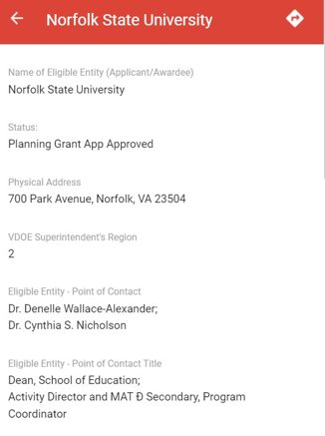
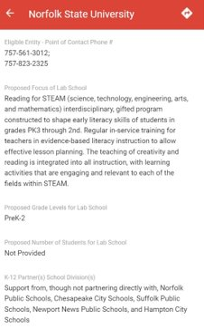
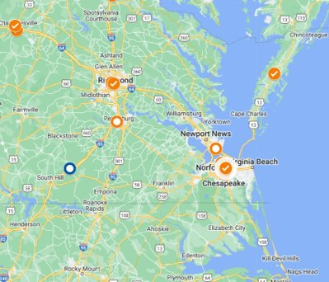
LAB SCHOOLS - INTERACTIVE MAP​

Slide 11
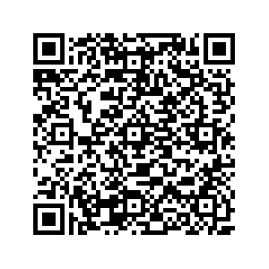
LAB SCHOOLS PAGE - FAQs
LAB SCHOOLS PAGE - FAQs

Slide 12
PLANNING GRANT APPLICATIONS
A total of 20 Planning Grants Applications have been received to date:
Awarded: 15 Planning Grants have been awarded
Pending: 3 Applications are in the pipeline, with Applicants receiving technical assistance, submitting additional detail or pending receipt of scores
Withdrawn: 1 Application has been withdrawn by the Applicant
Declined: 1 Application has been declined

Slide 13
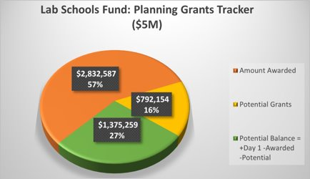
The College Partnership Laboratory Schools Fund, set out in § 22.1-349.2, provides $5M Planning Grants, of which:
The 15 Planning Grants Awards to date total:
$2.83 M
The Planning Grant Applications in the pipeline
or potential grants total: $792 K
PLANNING GRANT AWARDS
Contact Jeremy Raley, Chief of Staff, VDOE
804-546-1496
Jeremy.raley@doe.virginia.gov

Slide 14
Ro
Role of the Lab School Standing Committee
Provided by Joan Wodiska, Chair,
College Partnership Laboratory Schools Standing Commitee

Slide 15
COLLEGE PARTNERSHIP LABORATORY STANDING COMMITTEE
Appointed by the State Board of Education;
Develops procedures for receiving, reviewing, and ruling on applications;
Advises the State Board of Education.

Slide 16
STANDING COMMITTEE-MEMBERS
Board of Education Members
Mr. Bill Hansen
Mr. Andy Rotherham
Education and Professional Community Members
Ms. Joan Wodiska
Mr. John Bailey
Ms. Pam Moran

Slide 17
THE PROCESS TO CONSIDER LAB SCHOOL APPLICATIONS
Values public input and transparency
Adheres to state and federal law
Partners to achieve shared success
Demands integrity and high quality
Ensures durability and sustainability
Builds innovation ecosystem

Slide 18
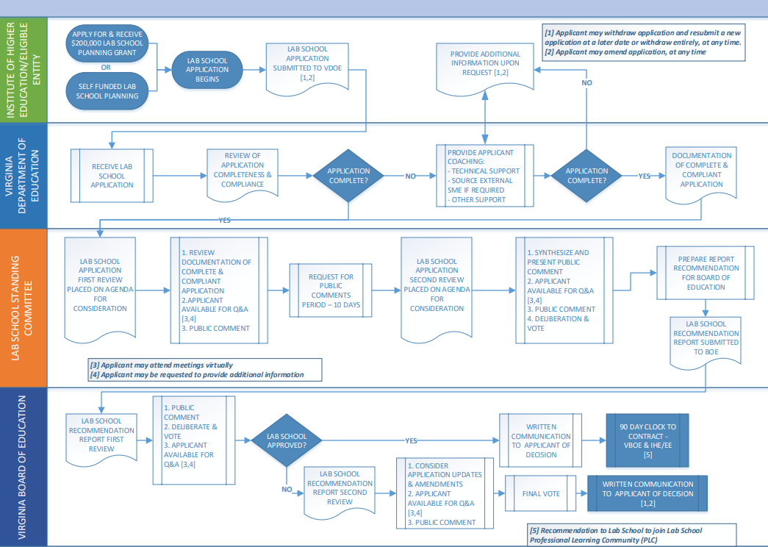
College Partnership Laboratory Committee Application Process

Slide 19
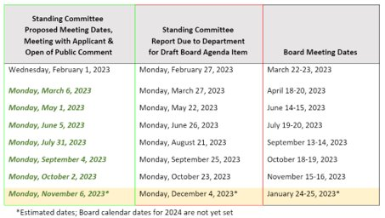
STANDING COMMITTEE-MEETINGS

Slide 20
FUTURE WORK
Build innovation ecosystem
Identify and solve points of friction
Support professional learning community
Learn together

Slide 21
15-Minute Break

Slide 22
Ro
Elevator Pitches by Lab School Applicants
Facilitated by Virginia Department of Education
Chief of Staff Jeremy Raley

Slide 23
LAB PAGE - FAQs
CENTRAL VIRGINIA COMMUNITY COLLEGE
Approved Planning Grant Application

Slide 24
SUMMARY
Proposal: CVCC proposes an inclusive and immersive educational environment that uses differentiated instructional methods, such as data driven inquiry method, work-based learning, problem-based learning and project-based learning within synergistic (work and education combined) classrooms. The vision is to create a seamless CTE pathway from middle school to community college to career.
Potential K-12 Education Partners: Amherst, Appomattox, Bedford, and Campbell County Public Schools and Lynchburg City Public Schools
Potential Higher Education Partners: Randolph College, Sweet Briar College, Liberty University, and the University of Lynchburg

Slide 25
TOP CHALLENGES / TOP OPPORTUNITIES
Top Challenges
Overcoming concerns about reducing LEA CTE program enrollment, focusing on collaboration and aligning CTE pathways
Structuring an agreement with LEA's that supports high school English and government instructors from school divisions teaching on campus
Recruiting business and industry leaders/trainers to collaborate with CVCC instructors and student teachers
Finding appropriate PD that supports our collaborative, PBL, and experiential design
Aligning local student-teacher programs with new Lab School concepts
Top Opportunities
Provides an opportunity for students to interact with business and industry
Uses experiential learning to develop critical thinking skills
Students work across programs in collaborative projects to better prepare them for the workforce
Students will have work-based learning opportunities
High school students will work with elementary and middle-school students to promote CTE programs
Teacher candidates from area 4-year institutions can perform internships to earn more about experiential learning methodologies and CTE programs
Integrate CTE and experiential learning with high school courses required for graduation

Slide 26
EASTERN SHORE COMMUNITY COLLEGE
Approved Planning Grant Application

Slide 27
SUMMARY
Proposal: ESCC proposes The Aerospace Academy Lab School of Eastern Shore, a Pre-K-12th grade STEM school focused on increasing awareness of STEM careers, specifically in the aerospace industry. There will also be increased dual enrollment opportunities for high school aged students.
K-12 Education Partners: Northampton County Public Schools, Accomack County Public Schools
Nonprofit Partners: Cal Ripken, Sr. Foundation
Industry Partners: NASA Wallops Flight Facility, Virginia Commercial Space Flight Authority, and Southwest Virginia Higher Education Center

Slide 28
TOP CHALLENGES / TOP OPPORTUNITIES
Top Challenges
Buy in to the aerospace curriculum
Development of comprehensive secondary/post secondary curriculum
Identification of personnel and budget lines for each area of development
Identification of program management for planning and implementation
Top Opportunities
Opportunity to create generational change for the Shore
Impact on social mobility
Expand aspirations of our students
Strengthen ties to our industry partners and aligning curriculum to workforce needs
Demonstrate that you don’t have to be a rocket scientist to work at Wallops, e.g., STEAM-H is part of the needs in the aerospace industry

Slide 29
LAB PAGE - FAQs
EMORY & HENRY COLLEGE
Approved Planning Grant Application

Slide 30
SUMMARY
Proposal: Emory and Henry proposes the Southwest Virginia Healthcare Excellence Academy Laboratory School, a high school career academy for 10th-12th graders to serve as a “pipeline” for preparing future healthcare professionals to meet the workforce shortages in Southwest Virginia.
K-12 Education Partners: Smyth County, Wythe County, Washington County, and Bristol County Public Schools, A. Linwood Holton Governor’s School Higher Education partners: Virginia Highlands Community College, Wytheville Community

Slide 31
LAB PAGE - FAQs
GERMANNA COMMUNITY COLLEGE
Approved Planning Grant Application

Slide 32
SUMMARY
Proposal: GCC proposes The Piedmont Regional Pathway to Teaching (PRPT), a Pre-K-12th grade school meant to streamline the educational and licensure process for future teachers and provide students with rigorous, hands-on instruction in schools and a route to completion and placement in as little as two years after high school graduation.
K-12 Education Partners: Culpeper County Schools, Orange County Schools, Madison County Schools, Rappahannock County Schools
Higher Education Partners: Laurel Ridge Community College, James Madison University

Slide 33
LAB PAGE - FAQs
GEORGE MASON UNIVERSITY
Approved Planning Grant Application

Slide 34
SUMMARY
Proposal: GMU proposes an Accelerated College Pathways Academy focused on IT, expanding Mason's tech talent degree programs, and having students graduate with an Associate's degree along with their high school diploma.
K-12 Education Partners: Fairfax County
Higher Education Partners: Northern Virginia Community College
Nonprofit Partners: Fairfax County Economic Development Administration, Northern Virginia Technology Council
Industry Partners: GMU proposed building on their pre-existing relationships with private partners such as Booz Allen, Genesis Works, Amazon Web Services, Boeing, Peraton

Slide 35
LAB PAGE - FAQs
MOUNTAIN GATEWAY COMMUNITY COLLEGE
Approved Planning Grant Application

Slide 36
SUMMARY
Proposal: MGCC proposes a high school IT Academy focused on cybersecurity, cloud community, and IT technical support. Students will be able to earn credentials in various coding languages, including AWS Certified Cloud Practitioner.
K-12 Education Partners: Alleghany Highlands County, Bath County, Rockbridge County, Botetourt County, and City of Buena Vista Public Schools
Higher Education Partners: Virginia Military Institute, Washington & Lee University, Radford University
Nonprofit Partners: Impact Advisors, Rockbridge Regional Public Safety Communication Center

Slide 37
LAB PAGE - FAQs
NORFOLK STATE UNIVERSITY
Approved Planning Grant Application

Slide 38
SUMMARY
Proposal: NSU proposes a PreK-2nd grade "reading for STEAM" (science, technology, engineering, arts, and mathematics) gifted school focused on early literacy skills. The school will provide an opportunity for early identification of Gifted and Talented education among underrepresented student.
Nonprofit Partners: Top Ladies of Distinction Hampton Roads Chapter

Slide 39
TOP CHALLENGES / TOP OPPORTUNITIES
Top Challenges
•Recruiting Highly Qualified Teachers
•Retaining Highly Qualified Teachers
•Having enough space to grow
Top Opportunities
•Opportunity to positively impact K-12 education
•Opportunity to meet the needs of diverse learners
•Opportunity to engage in meaningful research that positively impacts diverse student populations
•Opportunity to impact teacher education candidates as they develop
•Opportunity to support families with the education of their children

Slide 40
LAB PAGE - FAQs
OLD DOMINION UNIVERSITY (IB MIDDLE YEARS)
Approved Planning Grant Application

Slide 41
SUMMARY
Proposal: ODU proposes an International Baccalaureate middle school (6-8) that incorporates computer science into the IB Middle Years program. The curriculum will be designed to prepare students for three tracks in high school – a career track, an IB track, and a dual enrollment track with Tidewater Community College.
K-12 Education Partners: Chesapeake City Public Schools
Higher Education Partners: Tidewater Community College
Nonprofit Partners: Computer science network led by CodeVA

Slide 42
TOP CHALLENGES / TOP OPPORTUNITIES
Top Challenges
•Staffing during times of teacher shortage
•Teacher licensure regulations
•Time required for professional development
•Logistics (i.e. – scheduling)
•Navigating different research approval structures
•Alignment of vision across institutions
•Leadership turnover
•Marketing/messaging the Lab School
Top Opportunities
•Intersecting ecological system (connection of the university to the local school division and the community)
•Creates sustainability and the ability to scale.
•Create opportunities to grow the teacher pipeline (industry, pre-service, and career switcher)
•Lab School focus aligns with university priorities and able to leverage university resources to support Lab School initiative.
•Committed partners
•Experienced team members with launching large-scale initiatives
•Preparing our students to meet the demand of the maritime industry

Slide 43
LAB PAGE - FAQs
OLD DOMINION UNIVERSITY (MARITIME)
Approved Planning Grant Application

Slide 44
SUMMARY
Proposal: Old Dominion University proposes a Maritime and Coastal Innovation Collaboratory, a STEM/CTE high school focused on the maritime industry. One pathway will include a strong focus on career and technical education and prepare students for careers immediately after graduating from high school. A second pathway will focus on preparing students for college programs designed to produce graduates ready for STEM careers in the maritime field.
K-12 Education Partners: Newport News Public Schools
Industry Partners: Virginia Space Grant; Newport News Shipbuilding-Huntington Ingalls Industries; Maritime Advisory Board for School of Supply Chain, Logistics, and Maritime Operations; 757 Regional Internship Collaborative; Reinvent Hampton Roads; and the Maritime Industrial Base Ecosystem

Slide 45
TOP CHALLENGES / TOP OPPORTUNITIES
Top Challenges
•Staffing during times of teacher shortage
•Teacher licensure regulations
•Time required for professional development
•Logistics (i.e. – scheduling)
•Navigating different research approval structures
•Alignment of vision across institutions
•Leadership turnover
•Marketing/messaging the Lab School
Top Opportunities
•Intersecting ecological system (connection of the university to the local school division and the community)
•Creates sustainability and the ability to scale.
•Create opportunities to grow the teacher pipeline (industry, pre-service, and career switcher)
•Lab School focus aligns with university priorities and able to leverage university resources to support Lab School initiative.
•Committed partners
•Experienced team members with launching large-scale initiatives
•Preparing our students to meet the demand of the maritime industry

Slide 46
LAB PAGE - FAQs
PIEDMONT VIRGINIA COMMUNITY COLLEGE
Approved Planning Grant Application

Slide 47
SUMMARY
Proposal: PVCC proposes on high-demand, high-wage pathways in advanced manufacturing and Information Technology (IT). The Lab School will be designed as an accelerated education-to-employment three-tier, employer-driven, stackable credential model to provide students a clear pathway to earn multiple credentials and immediately enter the workforce to gain mid-skill employment to meet regional workforce demand for skilled advanced manufacturing and IT technicians. Students will earn both high school and college credit upon successful course completion.
Potential K-12 Education partners: Albemarle, Charlottesville City, Louisa, Fluvanna, Greene, Nelson, and Buckingham County Public School

Slide 48
LAB PAGE - FAQs
UNIVERSITY OF LYNCHBURG
Approved Planning Grant Application

Slide 49
SUMMARY
Proposal: The University of Lynchburg proposes a K-5 school focused on early literacy instruction and the science of reading.
K-12 Education Partners: Lynchburg City Public Schools

Slide 50
LAB SCHOOLS PAGE - FAQs
UNIVERSITY OF MARY WASHINGTON
Approved Planning Grant Application

Slide 51
SUMMARY
Proposal: UMW proposes a computer and data science high school focused on preparing students for college, career opportunities, and the teaching profession. They are considering extended school year, work-based learning opportunities, and innovative instructional approaches.
K-12 Education Partners: Stafford County, King George, Caroline, Spotsylvania, and Fredericksburg City Public Schools
Nonprofit Partners: Each locality’s Economic Development Authority, George Washington Regional Commission and Chamber of Commerce, CodeVA lab school network
Industry Partners: Amazon, DHL, local cybersecurity firms, government agencies such as Dahlgren and Quantico

Slide 52
TOP CHALLENGES / TOP OPPORTUNITIES
Top Challenges
Navigating the governance structure
Funding sustainability
Top Opportunities
Spurring regional collaboration
Building capacity for instructional innovation
Exploring ways to support and mutually benefit K-12 and IHEs

Slide 53
LAB PAGE - FAQs
UNIVERSITY OF VIRGINIA
Approved Planning Grant Application

Slide 54
SUMMARY
Proposal: UVA proposes at 7th and 8th grade STEM+CS lab school focused on developing a community of practice around education that incorporates interdisciplinary, project-based, computing-rich learning experiences; develop technical skills for future workforce success by solving real-world and community-based problems with computational tools; and engaging students by incorporating their voices and choices throughout the learning process.
K-12 Education Partners: Charlottesville City Schools Higher Education partners: Piedmont Virginia Community College Nonprofit partners: Tech-Girls, Charlottesville Women in Tech, Boys and Girls Club of Central Virginia

Slide 55
LAB PAGE - FAQs
VIRGINIA COMMONWEALTH UNIVERSITY
Approved Planning Grant Application

Slide 56
SUMMARY
Proposal: VCU proposes to combine their Teacher Residency program with CodeRVA develop a workforce of teachers that are able to provide computer science-focused education to their future students.
K-12 Education partners: CodeRVA Regional High School

Slide 57
LAB PAGE - FAQs
VIRGINIA UNION UNIVERSITY
Approved Planning Grant Application

Slide 58
SUMMARY
Proposal: VUU proposes the Promise Academy Lab School, a 6-12th grade school with a focus on the sciences, technology, engineering, arts, and math (STEAM). Beginning in 10th grade, students will be required to get a credential in one of four industry area, and 11th and 12th graders with a 2.5 GPA or higher will automatically be enrolled in VUU’s Dual Enrollment program through Virginia Union Technical College (VUTCH) so that they graduate with an Associates’ degree.
K-12 Education Partners: Richmond Public Schools
Industry Partners: Altria, Genworth, Bank of America, Capital One, IBM, and Dominion Energy
Nonprofit Partners: Communities In Schools (CIS), the Gloucester Institute, Junior Achievement, Higher Achievement and Leadership Metro Richmond

Slide 59
PLANNING GRANTS-PIPELINE
The following Planning Grant Applicants have submitted applications, received technical assistance from VDOE, and/or are resubmitting information for further consideration in the Planning Grant evaluation process

Slide 60
LAB PAGE - FAQs
HAMPTON UNIVERSITY
Planning Application Under Consideration

Slide 61
SUMMARY
Proposal: Hampton proposes a K-5 school with a focus on the visual and performing arts.
K-12 Education partners: Hampton City Public Schools

Slide 62
TOP CHALLENGES / TOP OPPORTUNITIES
Top Challenges
Strong partnership with Hampton City Schools
Themed programmatic thrust aligned with a robust and vigorous curriculum
Paralleled pathway developmental approach from Kinder-15
Pre-existing parental choice
External partnerships
Top Opportunities
Notification of status of lab school planning grant
Operations
Selection of governing board

Slide 63
LAB PAGE - FAQs
ROANOKE COLLEGE
Planning Application Under Consideration

Slide 64
SUMMARY
Proposal: Roanoke proposes a grades 9-12 Lab School to serve at-risk high school students with an inquiry-based Career Pathways in Education (Teacher Preparation), STEM, and Communications and Civic Leadership, including field-based research components, courses with community connection opportunities, General Education courses, and dual enrollment credits.
K-12 Education partners: Salem City Schools
Higher Education Partners: Virginia Western Community College

Slide 65
LAB PAGE - FAQs
TIDEWATER COMMUNITY COLLEGE
Planning Application Under Consideration

Slide 66
SUMMARY
Proposal: Tidewater proposes a high-quality pre-K that will feed directly into the public school kindergarten classroom, plus professional development and support for teachers.
K-12 Education partners: Portsmouth City Public Schools
Nonprofit partners: Ready Regions, established by the Virginia Early Childhood Foundation, Minus 9 to 5, VB GrowSmart, United Way
Higher Education Partners: Eastern Virginia Medical School (EVMS)

Slide 67
APPROVAL TO LAUNCH-PIPELINE
The following Applicants have submitted applications to launch, which are being reviewed for completeness and compliance by the VDOE and being considered by the Lab Schools Standing Committee.
The State Board of Education will then consider the Standing Committee's recommendation on the Application.

Slide 68
LAB PAGE - FAQs
JAMES MADISON UNIVERSITY
Launch Application Under Consideration

Slide 69
SUMMARY
Proposal:
High school environment focused on innovation by leveraging interdisciplinary techniques to prepare students, building on their academic interests and social potential through engagement in learning, the community, and civic responsibilities.
In addition, the Lab School will act as an incubator for the growth and development of preprofessional teacher education students within JMU's teacher preparation and licensure programs.
Five optional pathways are contemplated for Juniors and Seniors:
1. Return to their home/neighborhood high schools;
2. Apply and enroll in a Regional Governor's School;
3. Pursue licensing or certification in a career and technical field through collaborative partnerships of the Lab School;
4. Pursue an associate's degree through collaborative partnerships of the Lab School; or
5. Engage in the general studies curriculum through Interdisciplinary Liberal Studies (IDLS) at JMU while maintaining a community engagement course at the Lab School.
K-12 Partners: Augusta, Harrisonburg, Page, Rockingham, Shenandoah, Staunton, and Waynesboro County Public Schools

Slide 70
LAB PAGE - FAQs
SOUTHSIDE VIRGINIA COMMUNITY COLLEGE
Launch Application Under Consideration

Slide 71
SUMMARY
Proposal: High school career literacy Lab School with a focus on preparing all students for jobs that have been specifically identified by the GoVA Region 3 Economic Development Authority as credible and needed in this area of Virginia and beyond, and to provide pathways to the identified careers.
K-12 Partner: Mecklenburg County Public Schools

Slide 72
Lunch With remarks by Virginia Department of Education Superintendent of Public Instruction Lisa Coons

Slide 73
Best Practices to Design, Launch and Sustain an Innovative Public School
Moderator:
McKenzie Snow, Deputy Secretary of Education
Panelists:
Mashea Ashton, Founder and CEO, Digital Pioneers Academy
Joel Herbst, Assistant Dean and Superintendent of Schools, Florida Atlantic University College of Education

Slide 74
15-Minute Break

Slide 75
Thematic Breakout Groups

Slide 76
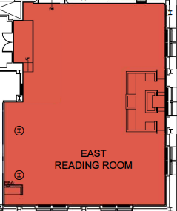
Map of Breakout Locations
MARITIME
HEALTHCARE
COMP. SCIENCE/STEM/SEMIS
CONSTRUCTION
AVIATION/
AEROSPACE

Slide 77
Debrief and Conclusion Provided by Virginia Department of Education Chief of Staff Jeremy Raley

