Slide 1
Learning Pathways in Virginia:
A Historical Perspective
Jeremy Raley, Ed.D.
Chief of Staff
Jeremy.Raley@doe.virginia.gov
June 5, 2023

Slide 2

Highlights
Definition for Lab School in Virginia
Additional Personalized Learning Pathways Options in Virginia
Current Lab Schools Progress – June 2023
Q/A
Notes:
As I discuss lab schools today we’ll look at the definition of a lab school, explore lab schools as a general type of alternative school model, then look at the current landscape around lab schools.

Slide 3
What is a lab school?

Slide 4
Laboratory Schools Have a Long History
First university schools in US at Harvard, Yale, College of William and Mary, University of Pennsylvania
Collaboration between universities to run a school to support development of a future teacher workforce
Most famous is the Dewey Lab School at University of Chicago
Notes:
While university run schools go back several hundred years in the US, the concept of a model laboratory school run for the purposes of training teachers really picked up in the US starting in 1820. In 1895 the lab school at University of Chicago was founded, and served to influence John Dewey, an influential educator whose writings have influenced American education.

Slide 5
College Partnership Lab Schools
Pursuant to § 22.1-349.1(A) of the Code of Virginia, as amended by Chapter 2 of the 2022 Acts of Assembly, Special Session I, a "College Partnership Laboratory School” (or Lab School) means a public, nonsectarian, nonreligious school in the Commonwealth established by a public institution of higher education, public higher education center, institute, or authority; or an eligible private institution of higher education as defined in § 23.1-628 related to the Tuition Assistance Grant Program.
Section 22.1-349.1(B) states that Lab Schools are designed to:
Stimulate innovative programs in preschool through grade 12;
Provide opportunities for innovation in instruction and assessment;
Provide teachers with an avenue for delivering innovative instruction and school scheduling, management and structure;
Encourage performance-based educational programs;
Establish high standards for both teachers and administrators;
Encourage greater collaboration between pre-kindergarten and postsecondary program providers; and
Develop model programs.
https://www.doe.virginia.gov/teaching-learning-assessment/specialized-instruction/laboratory-schools
Notes:
[Animation on this slide to pull up bulleted list of lab school purpose]
In short, new legislation from 2022 defines a lab school in Virginia as one created by a public school that encourages innovation, performance-based education programs with high standards, encouraging greater collaboration with preK and post-secondary providers.

Slide 6
What is a lab school?
An independent, innovative public school built on partnership and evidence that is open to all students through a randomized selection process (lottery).
Notes:
This definition does not require the university partner to run a teacher education program. Before we dive deeper into our interest in lab schools at this time, let’s look at some alternatives.

Slide 7
What is a lab school?
Opportunities available to all students, with no barriers
Performance based programs that deliver outcomes
Serve as model programs across the Commonwealth
Administered and managed by a governing board
Notes:
This definition does not require the university partner to run a teacher education program. Before we dive deeper into our interest in lab schools at this time, let’s look at some alternatives.

Slide 8
Additional Personalized Learning Pathway Options
Notes:
For our purposes, we’re going to examine some public school models that differ from traditional, public schools as we know them.

Slide 9
Additional Options
Charter Schools
Governor’s Schools
  Summer Residential Governor’s Schools
  Summer Regional Governor’s Schools
Innovative High Schools
Networked School Programs
  International Baccalaureate (IB) Schools
  New Tech Network Schools
Dual Enrollment
Laboratory Schools
Notes:
As I discuss lab schools today we’ll look at the definition of a lab school, explore lab schools as a general type of alternative school model, then look at the current landscape around lab schools.

Slide 10

Charter Schools
In Virginia, charters are nonsectarian alternative public schools located within a school division and under the authority of a local school board.
https://www.doe.virginia.gov/teaching-learning-assessment/specialized-instruction/charter-schools
https://law.lis.virginia.gov/vacodefull/title22.1/chapter13/article1.2/
Notes:
There are currently 7 charters in Virginia. The definition around performance-based instruction and assessment and innovative programs is similar to the definition for laboratory schools; charters should provide teachers with a vehicle for establishing schools with alternative innovative instruction and school scheduling, management and structure.
Charter school legislation in Virginia first appeared in 1998. provide teachers with a vehicle for establishing schools with alternative innovative instruction and school scheduling, management and structure.
First 8 charters appeared starting in 1992-2002.
The schools operating today each provide a special program of study.

Slide 11
Governor’s Schools
Started in 1973 with foundation of first summer residential program
Virginia Governor's Schools provide some of the state's most able students academically and artistically challenging programs beyond those offered in their home schools.
summer residential,
summer regional, and
academic-year programs
Notes:
Governor’s school programs serve over 7500 students and focus on our most gifted students.

Slide 12
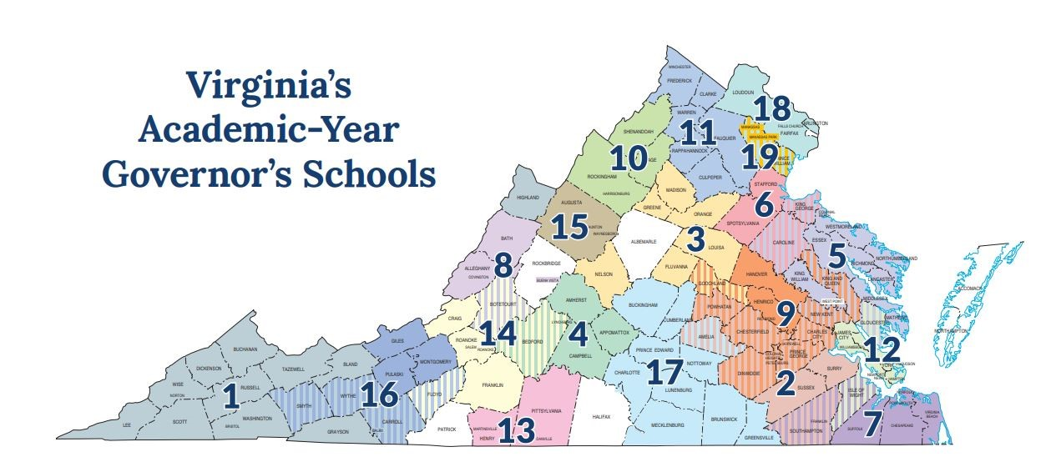
Governor’s Schools
Notes:
Currently, 19 Academic-Year Governor's Schools provide students with acceleration and exploration in areas ranging from the arts to government and international studies, and to mathematics, science, and technology. The Academic-Year Governor's Schools are established as "joint schools" by Virginia school law. As such, they are typically managed by a regional governing board of representatives from the school boards of each participating division. The regional governing board is charged with developing policies for the school including the school's admissions process. While these processes differ from school to school, all applicants are assessed using multiple criteria by trained evaluators who have experience in gifted education and the focus area of the specific Academic-Year Governor's School. Students can only attend an Academic-Year Governor's School program if their school division is a participating public school division and the students are selected by the Academic-Year Governor's School program through a competitive admission process.

Slide 13
Summer Residential Governor’s Schools
Targeting the needs of high school juniors and seniors
Students live on a college or university campus
Students receive intensive educational experiences in specialty areas such as visual and performing arts, mathematics, science, technology, or through mentorship programs
https://www.doe.virginia.gov/teaching-learning-assessment/specialized-instruction/governor-s-schools/summer-residential-governor-s-schools
Notes:
Summer Residential Governor’s Schools provide high school juniors and seniors with intensive educational experiences in visual and performing arts; humanities; mathematics, science, and technology; or through mentorships in marine science, or engineering.
Each Summer Residential Governor’s School focuses on one special area of interest. Students live on a college or university campus for up to four weeks each summer. During this time, students are involved in classroom and laboratory work, field studies, research, individual and group projects and performances, and seminars with noted scholars, visiting artists, and other professionals. In the three mentorships, students are selected to work side-by-side with research scientists, physicians, and a variety of other professionals.

Slide 14
Summer Regional Governor’s Schools
Typically focused on elementary and middle school populations
Variety of formats
Typically housed at public school or college campus
1-4 week period
Two schools are residential
Notes:
Twenty Summer Regional Governor's Schools are available throughout the state. The Summer Regional Governor's Schools exist in a variety of formats. Most often, groups of school divisions design these programs to meet the needs of their local gifted elementary and middle school students. These schools provide exciting opportunities in the arts, sciences, and humanities. The Department of Education approves each Summer Regional Governor's School and evaluates each program as funding permits.
These are typically housed at a public school or on the campus of a college, community college, or university. The lengths of programs vary, with some lasting a week or less while others may last four or more weeks. Most students return to their homes at the end of each day's activities; however, the University of Virginia's College at Wise, Southside, and Valley/Ridge Summer Regional Governor's Schools are residential.

Slide 15
Innovative High Schools
Code RVA established in Fall of 2016
Regional Magnet School for Computer Science
Currently serves over 350 students from Regions I and VIII
Multiple pathways for students to earn Associates degree and industry credentials
Personalized learning experiences
Workplace readiness/internships
Lottery system in place for selection of students
https://codrva.org
Notes:
The New Tech high school in Napa, CA launched a national and now international program around schools who focus on project-based approaches to learning. Membership into the network gives schools a rigorous program that innovates with curriculum and the use of technology to aid learning.

Slide 16
Networked School Programs
These options operate as public schools but use curriculum, professional development, and use their support network to sustain specific programs of learning at an additional cost to join the network.
These programs often operate as special programs within a division.
Notes:
We’re going to look at two examples of school network programs: International Baccalaureate and New Tech.

Slide 17
International Baccalaureate (IB) Schools
These are defined as programs by an international association of schools who share curriculum for elementary, middle, and high schools.
Virginia schools can apply to become an IB program, there are 43 high school programs and 41 middle years programs currently in the Commonwealth
Currently are 5,600 IB schools across 159 countries
Teachers receive significant investment in professional development
https://www.ibo.org/programmes/find-an-ib-school/
Notes:
International Baccalaureate schools are viewed by many as rigorous programs that well-prepare students for a college experience after high school.
To become an IB school, school leaders apply through IB and initiate an authorization process. The process provides guidance and support to a school through an application process and a significant professional development program for the school’s staff. During a school’s candidacy phase, schools align to the IB philosophy and the program they have chosen.

Slide 18
New Tech Network (NTN) Schools
NTN Schools prioritize student engagement through investigation of real-world problems
NTN schools invest in high levels of teacher professional development
4 New Tech schools in Virginia
https://newtechnetwork.org/impact/
Notes:
The New Tech high school in Napa, CA launched a national and now international program around schools who focus on project-based approaches to learning. Membership into the network gives schools a rigorous program that innovates with curriculum and the use of technology to aid learning.

Slide 19
Dual Enrollment
Notes:
Before we pivot back to lab. Schools, it should be noted that a number of high schools have offered dual-enrollment programs we wanted to highlight this type of cooperative program between public schools and our community colleges.

Slide 20
Dual Enrollment
Students can earn college credits while enrolled in high school
Advance College Academies permit high school students to earn an associates degree from the participating college alongside their high school diploma
Students electing for a four-year degree can save money and time by applying these earned credits
Notes:
These regional opportunities afford high school students the option to work toward an associate degree while attending high school with simultaneous enrollment in dual enrollment courses. Some programs leverage the use of teachers from the students’ own school who have been vetted by the participating community college, offering additional convenience. Students seeking a four-year degree at another institution can often apply the credits earned from this experience and save a considerable amount of tuition fees, and in some cases graduate early.

Slide 21
Laboratory Schools
Notes:
As we transition now back to lab schools, these are of special interest to the Youngkin Administration who sees this option as an alternative for students and their families.

Slide 22
Lab School Concept in Virginia
Hampton University operated a lab school between 1870 and 1996.
Virginia State University ran a laboratory school from 1895-1948. Over the years it targeted different grade levels but ended before its closing as a laboratory high school.
Old Dominion University operates the Children’s Learning & Research Center with preK-3 and prek-6.
Virginia Commonwealth University operates the Child Development Center as a preschool program.
Notes:
Virginia’s experience with lab schools in the past has focused on historically black colleges and pre-school and elementary education programs. The ODU program was established in 1967 and the VCU program started as Belle Bryan Nursery over 100 years ago. Both ODU and VCU’s programs offer lab experiences to their education students.

Slide 23
Lab Schools
The recent conversation regarding lab schools in Virginia started with Governor McDonnell's administration in 2010.
Funding was provided with start-up grants to four universities although no schools were created from the 2010 legislation and planning funding grants.
Notes:
In March 2010, Governor Bob McDonnell signed into legislation an “Opportunity to Learn” agenda, establishing college laboratory schools in the Commonwealth. The bill had been supported by Republican Del. Chris Peace and Democrat Del. Jennifer McClellan. These schools would be tied to universities offering teacher preparation programs while offering more flexibility, innovation, and autonomy, outside of the traditional public school system. Despite providing start-up grants for these new lab schools to George Mason University, James Madison University, Longwood University, and Virginia State University, no schools were created out of this new legislation, despite supporting planning with grants in 2012.

Slide 24
$100M in College Partnership Laboratory Fund
2022 special session of the GA approved $100M total:
  $5M for planning grants to support submitting an application to the BOE
  $20M for initial start-up grants, one-time purchases
  $75M for per-pupil operating grants
Notes:
Section 22.1-349.2 of the Code of Virginia establishes the College Partnership Laboratory Fund (the Fund) for the purposes of establishing or supporting Lab Schools. During its 2022 Special Session, the General Assembly appropriated $100 million into the Fund to be allotted for the following uses:
$5 million for planning grants to support eligible entities in the design of new college Lab Schools and to assist in drafting and submitting a Lab School application to the Board.
$20 million for initial start-up grants for approved Lab Schools to make one-time purchases for expenses necessary to launch a Lab School.
$75 million (or the balance of the fund) for per-pupil operating grants to support ongoing expenses for the operation and maintenance of a Lab School.

Slide 25
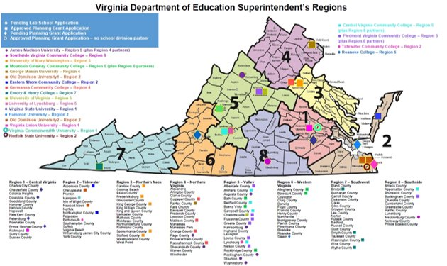
Current status
Notes:
This definition does not require the university partner to run a teacher education program. Before we dive deeper into our interest in lab schools at this time, let’s look at some alternatives.

Slide 26
Current Status
16 grants awarded for planning, 2 still under consideration
2 applications received and being reviewed
https://www.doe.virginia.gov/teaching-learning-assessment/specialized-instruction/laboratory-schools

Slide 27
Q/A

Slide 28

Jeremy.Raley@doe.virginia.gov

