Slide 1
The Virginia Literacy Act
First Review of Core Instruction Program Guide

Slide 2
Objective and Agenda
Objective:
First review of Core Instructional Program Guide
Agenda:
Overview of the Virginia Literacy Act (VLA)
Review Process for Core Instructional Programs
Core Instructional Program Guide
Next Steps

Slide 3
Overview of the VLA

Slide 4
Why We Need the VLA
To...
Virginia must...
Which will help...
Reverse the trend in literacy levels
Provide support for increasing
numbers of at-risk readers
Ensure all children read at benchmark in K-5
Address learning loss from the pandemic
Provide teachers with evidence-based instructional strategies and curricula

Slide 5
Key Components of the VLA
Defines Evidence-Based Literacy Instruction and Science-Based Reading Research
Aligns Core Curricula, Supplemental, and Intervention Materials
Requires all divisions to use core instructional (K-5), supplemental (K-8), and intervention (K-8) programs in grades K-8 that are aligned with science-based reading research, as set out in their literacy plan.
Adds a division-wide staffing ratio of one reading specialist per 550 students in K-5 and one reading specialist for each 1,100 students in 6-8.
Requires Professional Development for Reading Specialists, Teachers, and Principals
Partners with Families
Ensures parents are engaged in student reading plans and have access to resources.
Aligns Educator Preparation and Licensure
Requires certain educator preparation programs to ensure candidates have a program of coursework and demonstrate mastery in science-based reading research and evidence-based literacy instruction.
Requires literacy assessment for licensure or alternate route to licensure with certain endorsements.
Establishes a micro-credential program for add-on reading specialist endorsement.

Slide 6
High Level Timeline
Fall 2022 –
Cycle 1 reviews of K-3 core instructional programs launch
Spring/Summer 2023 – Board reviews recommended K-3 core instructional programs from Cycle I
Fall 2023 –
Pilot with new Virginia Literacy Screener launches
Board reviews proposed revisions to English SOLs
Summer 2024 – Statewide training for teachers and principals kicks off
Winter 2022 – Advisory Work Group launches
Summer 2023 – Statewide training for Reading Specialists kicks off
Cycle II reviews of K-5 core, K-8 supplemental, and K-8 intervention instructional programs begin
Winter-Spring 2024 – Board reviews recommended instructional programs from Cycle II
Fall 2024 –
Classrooms are using new screener, student reading plans and approved instructional programs
Teachers are supported to implement evidence-based literacy instruction based on students’ needs

Slide 7
Review Process for Core Instructional Programs

Slide 8
Development of Rubrics
The VDOE partnered with Virginia Literacy Partnerships (VLP) at the University of Virginia to design and implement a rigorous and comprehensive review process that is unique to Virginia, starting with the development of rubrics by grade band. To produce the rubrics, VDOE and VLP:
Examined rubrics in other states that have similar requirements or passed similar legislation;
Sought and incorporated feedback from national experts, Virginia K-12 educators and colleagues in higher education;
Simulated program review using rubrics with commercially available core K-3 curriculum in summer of 2022;
Posted rubrics online and shared with vendors in advance; and
Ensured that rubrics fully align with the law.

Slide 9
Process for Reviews
Using the established rubrics, VLP and VDOE then facilitated reviews of K-3 core instructional programs through a robust process led by Virginia educators.
Reviewers included competitively-selected teachers, reading specialists, administrators, division representatives, and other educational leaders from all 8 regions of Virginia.
The facilitator team was comprised of literacy experts who trained reviewers during both Phase I and Phase II to norm on the rubrics and guide the process.
Reviewers independently evaluated programs using a comprehensive rubric. Facilitators met with review teams weekly to compile review findings and build consensus.
Facilitators then integrated findings to reach a final result and normed across all program submissions.

Slide 10
Two-Phase Process
To ensure alignment, the VDOE, with VLP, employed a two-phase process:
 | Phase I | Phase II
Objective | Ensure programs are aligned to science-based reading research, as well as Virginia Standards of Learning | Delve deep into program and all materials to determine how aligned the program is to science-based reading research
Duration | 4 weeks | 8 weeks
Focus of Evaluation | Programs were assessed using a broad evaluative rubric | Programs were assessed using detailed evaluation of all components of literacy instruction
Impact | Programs that were clearly misaligned did not move to Phase II (e.g., programs with three cueing) | Programs that were not recommended may address gaps and apply during Phase II of the next cycle

Slide 11
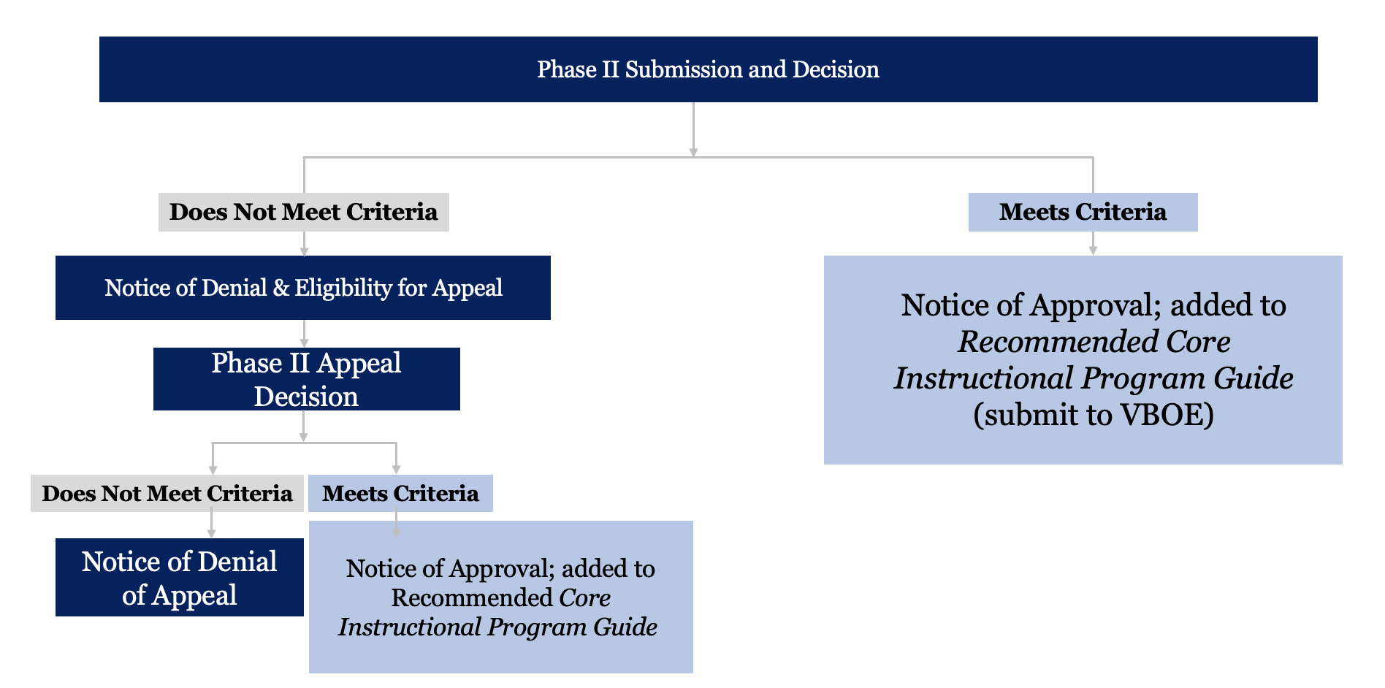
Opportunity to Appeal
Vendors that did not meet expectations had an opportunity to appeal after each phase.
Review teams, facilitators, and additional literacy experts evaluated additional evidence provided and made a final determination for each program.
2 programs appealed in Phase I
3 programs appealed in Phase II
These appeals did not result in any changes in determination.

Slide 12
Alignment with Textbook Adoption
To support local procurement, the VDOE worked with VLP to align this review process with the textbook adoption process by:
Requiring vendors to complete all certification forms;
Demonstrating correlations with the Standards of Learning (SOLs);
Soliciting reviewers who included educators and content specialists, represented all regions of Virginia and completed conflict of interest forms;
Providing for public examination of materials prior to final review by the Board; and
Establishing a mechanism for ongoing public comment.

Slide 13
Core Instructional Program Guide

Slide 14
Core Instructional Program Guide
The Core Instructional Program Guide aims to clearly communicate the results of this rigorous review process and to equip educators and decision makers with the necessary information to determine what program will best support the literacy instruction of students in their division.
This guide includes:
A list of K-3 core instructional programs that Virginia educators determined to:
Consist of EBLI, aligned with SBRR; and
Correlate with Virginia SOLs.
A “Snapshot,” which is an overview of each approved program that summarizes the strengths and challenges of each program to help guide decision-making.

Slide 15
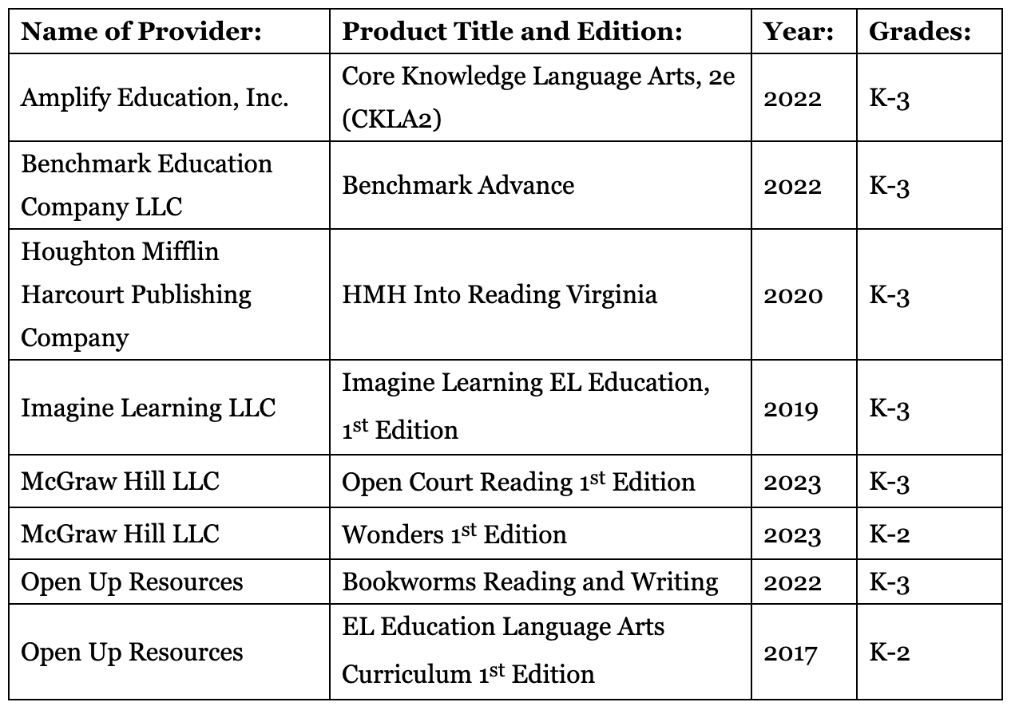
Approved Core Instructional Programs

Slide 16
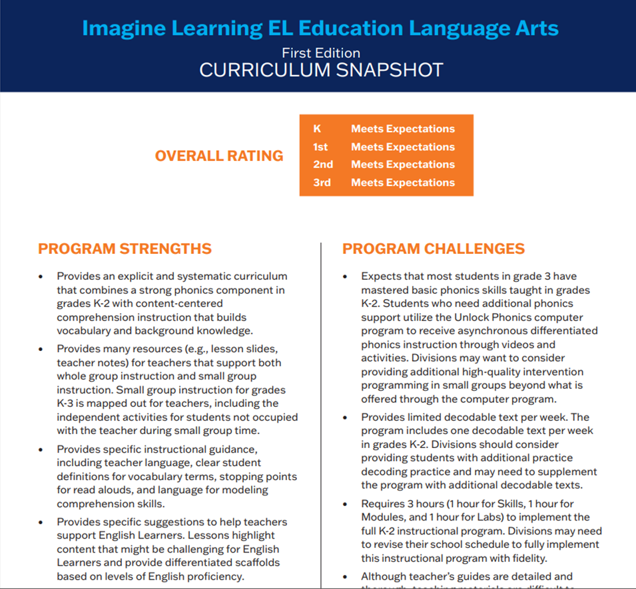
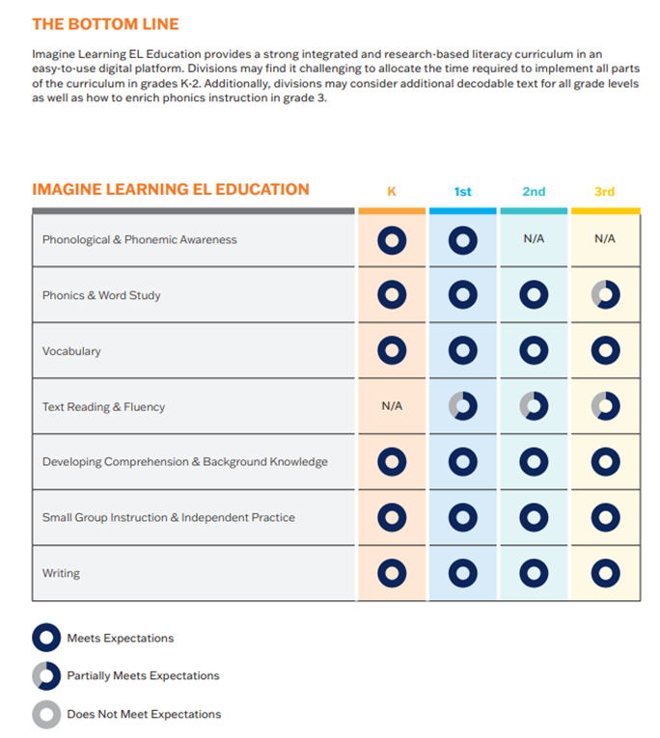
Example of Curriculum Snapshot

Slide 17
Next Steps

Slide 18
Next Steps
VBOE will review the Core Instructional Program Guide for approval at its next meeting on June 15th.
Materials will be available for public review for 30 days prior to this meeting.
Cycle II of instructional program reviews will be open to K-5 core, K-8 supplemental, and K-8 intervention and will be launched in May.
The VDOE, in partnership with VLP, will develop curriculum adoption tools and resources for divisions.
The VDOE, in partnership with VLP, will integrate the Core Instructional Program Guide into its statewide training for reading specialists that launches this summer. Throughout 2023-2024, statewide literacy coaches will support reading specialists to prepare for classroom-level application of core instructional programming.

