Slide 1
Virtual Learning Professional Learning Series
Webinar 8: Virtual Learning in VA
Wednesday, APRIL 26th, 2023
1:00-1:30 p.m. – Part 1
1:30-2:00 p.m. – Part 2

Slide 2
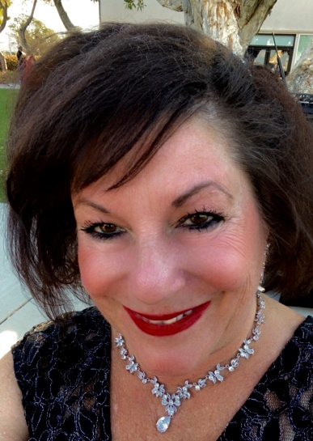
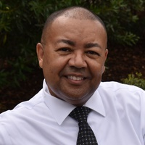



VDOE Virtual Learning Team
Dr. Meg Foley
meg.foley@doe.virginia.gov
(804) 786-0877
Coordinator of Virtual Learning
Reginald Fox
reginald.fox@doe.virginia.gov
(804) 371-5663
Virtual Learning Specialist
Twitter: @VDOE_News
Facebook: @VDOENews

Slide 3
Virtual Learning in Virginia
To provide school divisions, schools, staff, and stakeholders with information related to virtual learning in Virginia with emphasis on policies, procedures, professional development, and implementation of virtual programs.

Slide 4

Agenda
PART 1:
3rd Party Course Correlation and Alignment to Standards
  Correlation Alignment Requirements
  Course Correlation Template
  Course Correlation Samples
  Questions
PART 2:
Closing the 2022-23 school year
  Monitoring Report
  End of Year Surveys
  Final Reporting, Communication with Stakeholders
  MOP Renewal
  Preparing for 2023-24

Slide 5
Preparing to close the 2022-23 school year

Slide 6
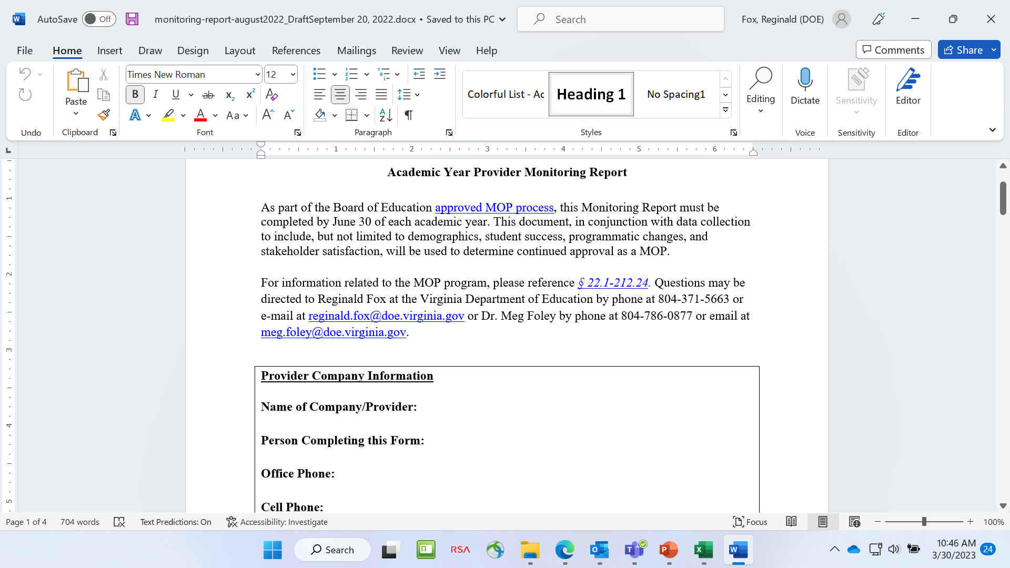
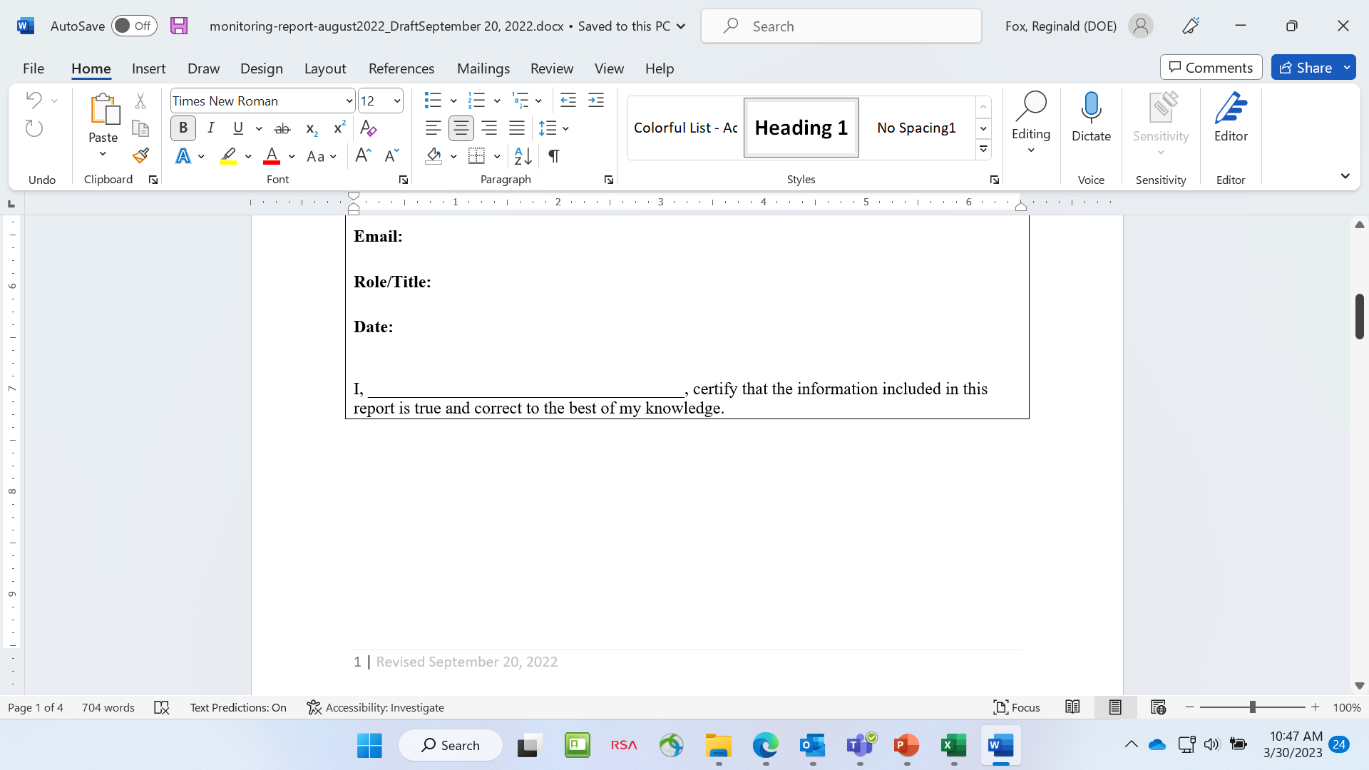
Monitoring Report
Update programmatic information.
You will receive an email with the Monitoring. Report as an attachment.
Review existing information on website and determine if updates are appropriate.

Slide 7
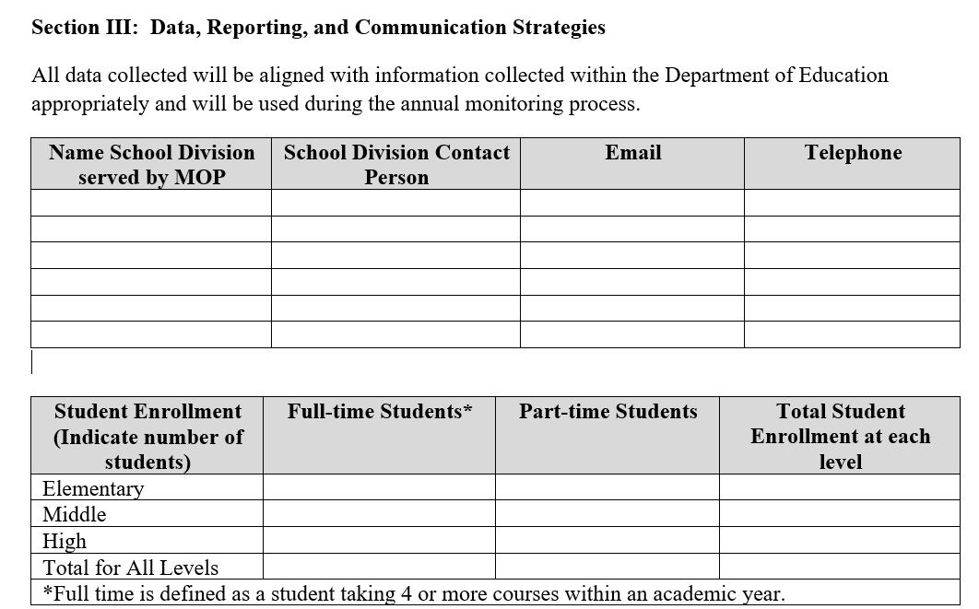
Monitoring Report

Slide 8
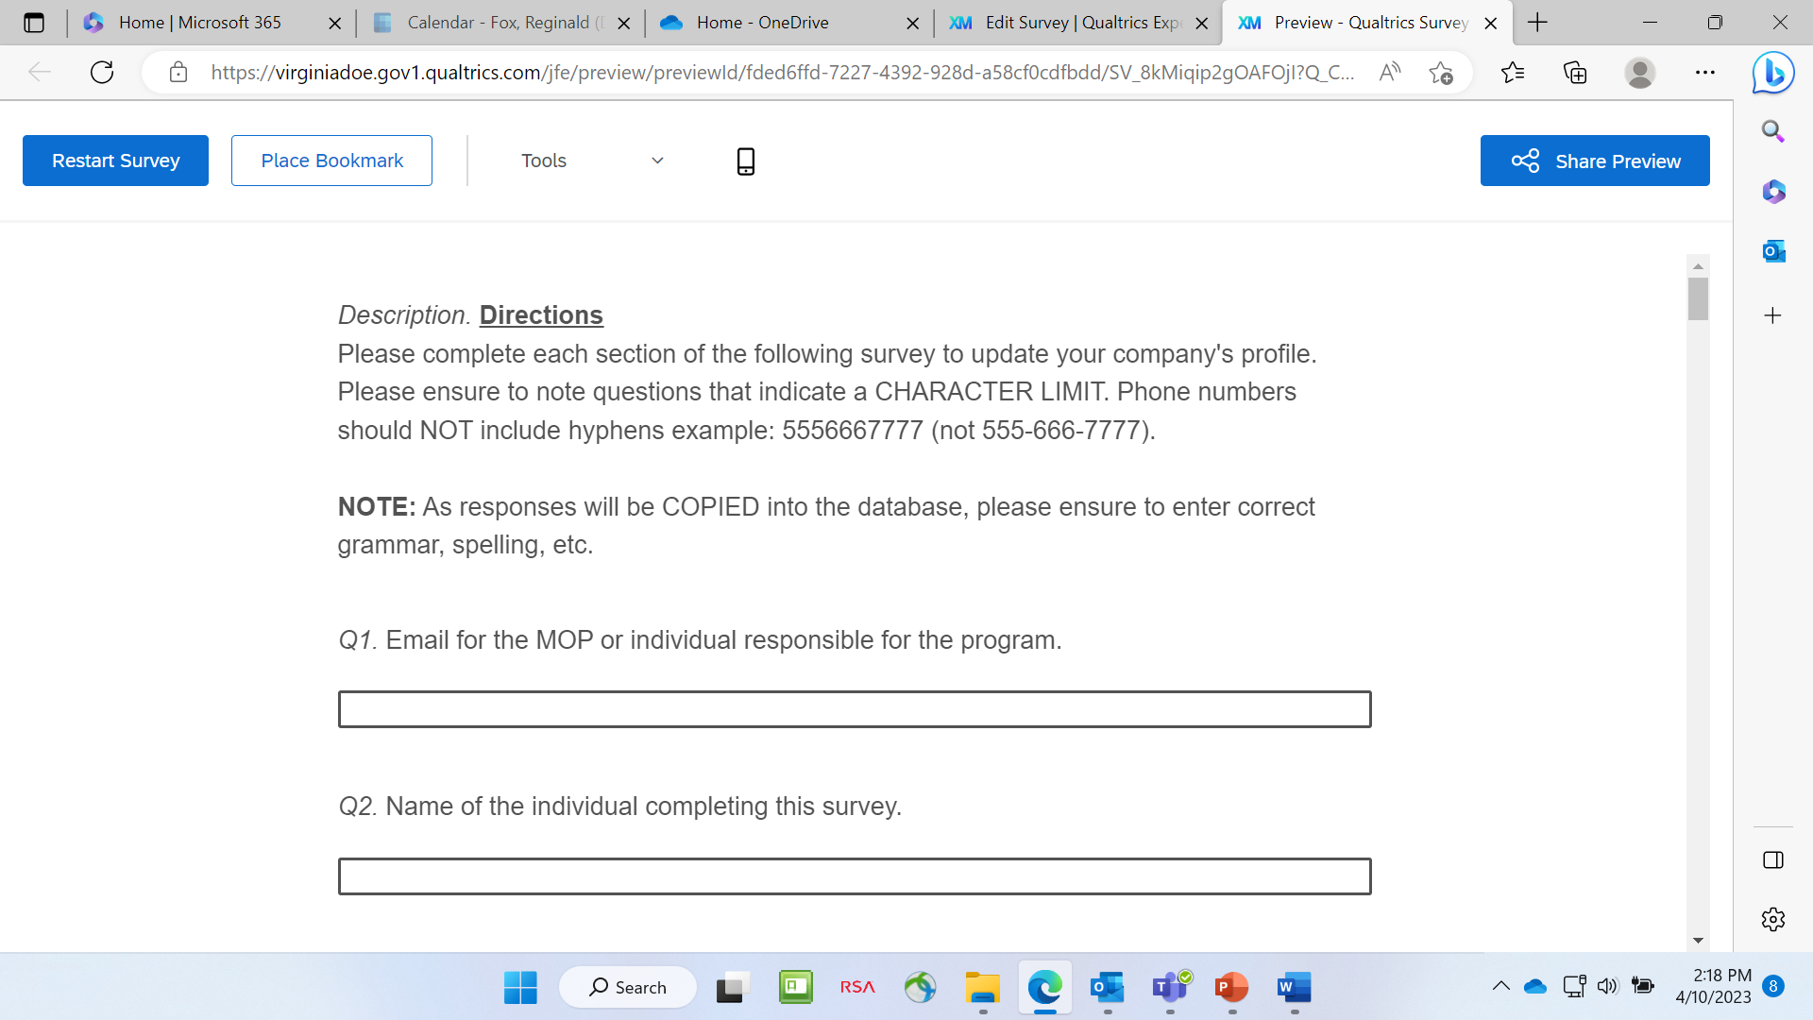
MOP Profile Questionnaire (Qualtrics)
(new VDOE Survey Program)
Provide important information to update the AMOP Profile.
Review existing information on AMOP website to determine if updates are necessary.
See Note: As responses will be COPIED into the AMOP database, please ensure to enter correct grammar, spelling, and be consistent in submitting courses.
You will receive an email with the survey link to enter the information into Qualtrics.

Slide 9
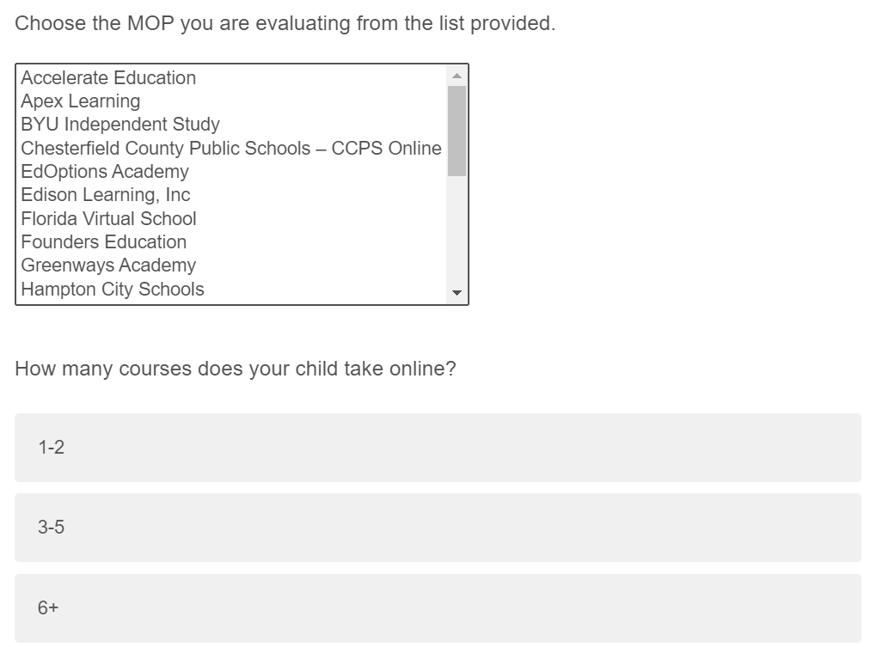
End of year Surveys
The VDOE survey provides important feedback from parents and students.
You will receive an email with the survey link to share with parents and students.

Slide 10
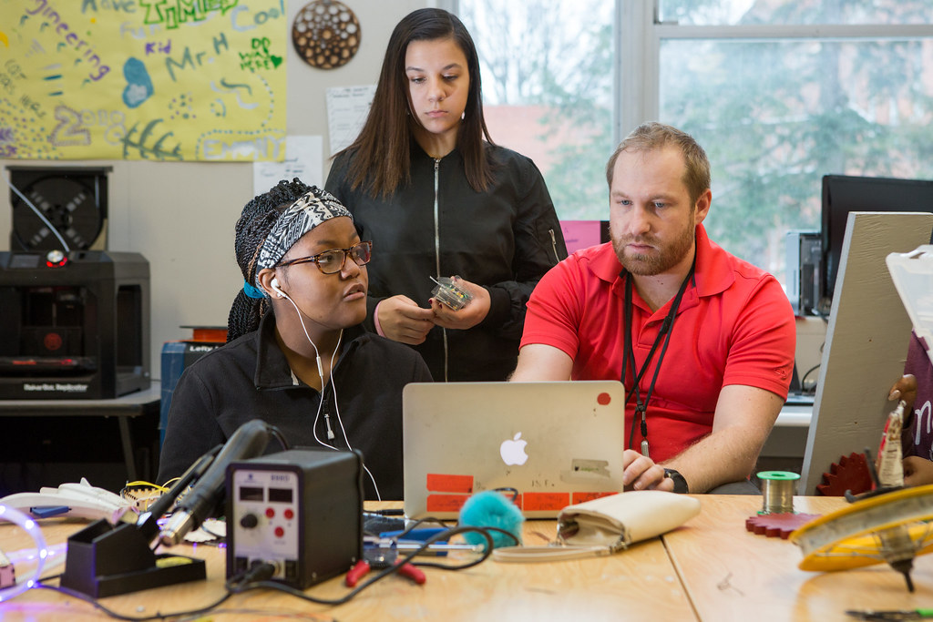
Final Reporting & & Communication
Complete and submit all grades respectively to schools.
Communicate with school division staff to provide accurate data and ensure that all reporting is complete.
Complete the Monitoring Report, Profile Report, and surveys.

Slide 11
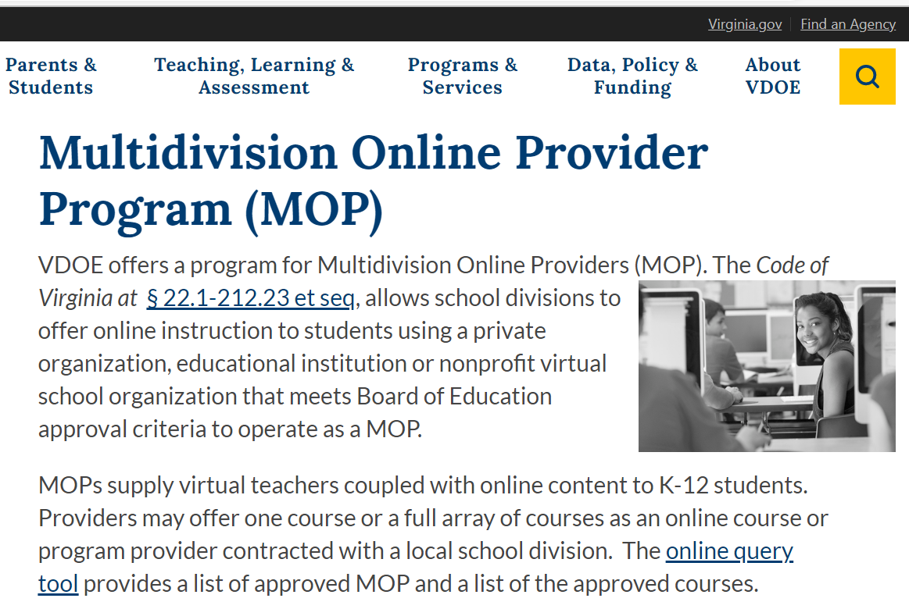
Preparing for 2023-24
Ensure that all teachers and administrators are licensed appropriately in Virginia.
Communicate with all school division staff, parents, and students.
Ensure that stakeholders have access to the course requirements, expectations, and orientation.
Communicate regularly with stakeholders to ensure that all students are successful.

Slide 12
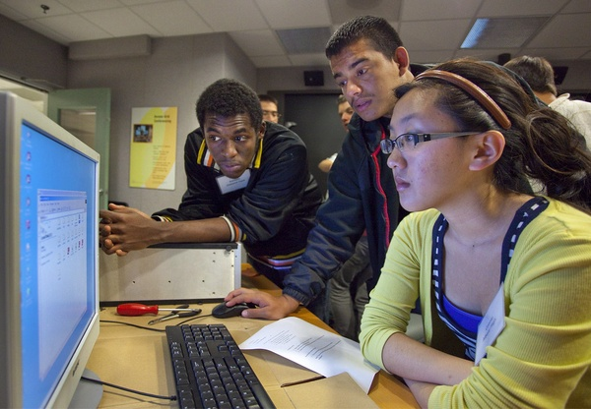

Questions?

Slide 13

Enjoy the rest of the year

Slide 14
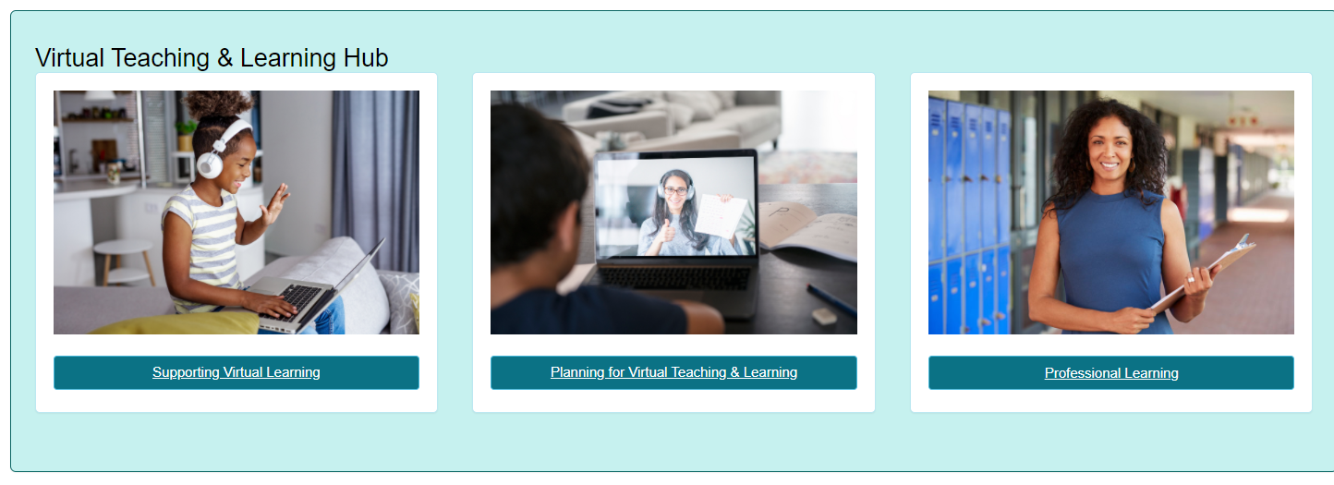
Thank you for participating!
Additional information may be found at Virtual Learning Professional Learning website.
VDOE Virtual Learning HUB
Dr. Meg Foley
meg.foley@doe.virginia.gov
(804) 786-0877
Coordinator of Virtual Learning
Reginald Fox
reginald.fox@doe.virginia.gov
(804) 371-5663
Virtual Learning Specialist

