Slide 1
Virtual Learning Professional Learning Series
Webinar 8: Virtual Learning in VA
Wednesday, APRIL 26th, 2023
1:00-1:30 p.m. – Part 1
1:30-2:00 p.m. – Part 2

Slide 2
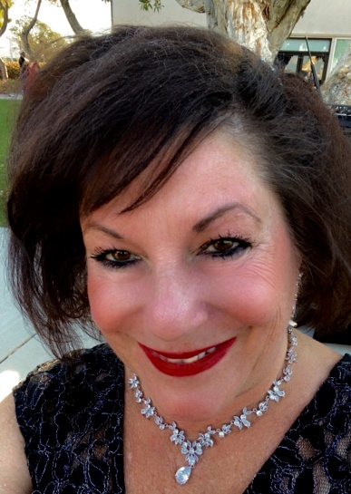
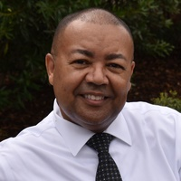



VDOE Virtual Learning Team
Dr. Meg Foley
meg.foley@doe.virginia.gov
(804) 786-0877
Coordinator of Virtual Learning
Reginald Fox
reginald.fox@doe.virginia.gov
(804) 371-5663
Virtual Learning Specialist
Twitter: @VDOE_News
Facebook: @VDOENews

Slide 3
Virtual Learning in Virginia
To provide school divisions, schools, staff, and stakeholders with information related to virtual learning in Virginia with emphasis on policies, procedures, professional development, and implementation of virtual programs.

Slide 4

Agenda
PART 1:
3rd Party Course Correlation and Alignment to Standards
  Correlation Alignment Requirements
  Course Correlation Template
  Course Correlation Samples
  Questions
PART 2:
Closing the 2022-23 school year
  Monitoring Report
  End of Year Surveys
  Final Reporting, Communication with Stakeholders
  MOP Renewal
  Preparing for 2023-24

Slide 5
3rd Party Course Correlation and Alignment to standards

Slide 6

Correlation Alignment Requirements
SOL course submissions must include a 3rd party correlation report verifying a 90% or higher correlation on its Upper level Standards.
An Upper level Standard is considered met if 90% or higher of its Lower level Objectives, Concepts, and Skills are met.

Slide 7
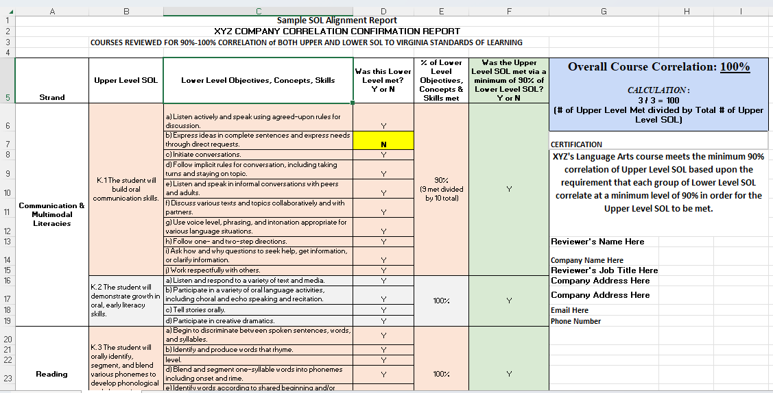
Course Correlation sample

Slide 8
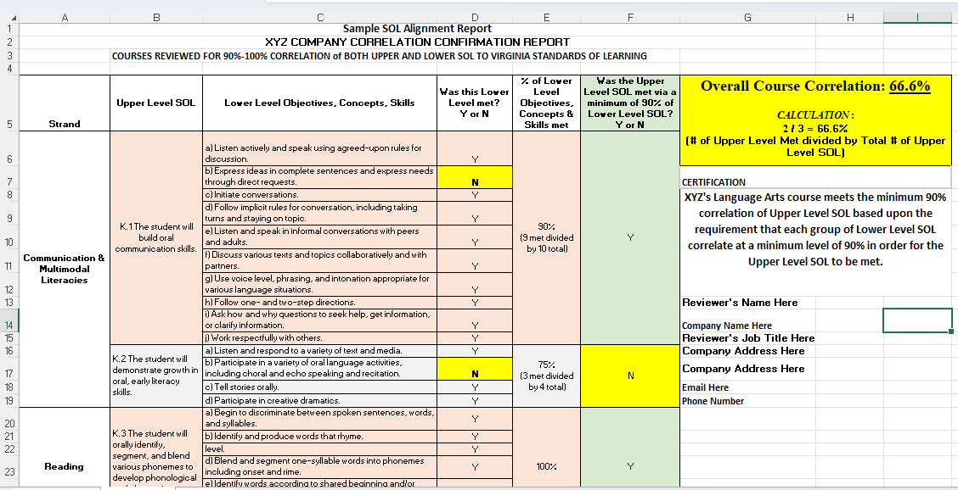
One-third of instructional objectives not met

Slide 9


Questions?

Slide 10
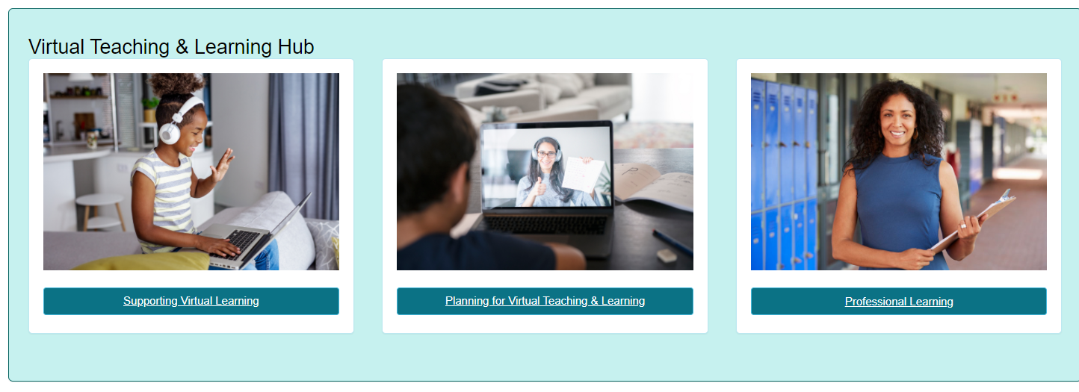
Thank you for participating!
Additional information may be found at Virtual Learning Professional Learning website.
VDOE Virtual Learning HUB
Dr. Meg Foley
meg.foley@doe.virginia.gov
(804) 786-0877
Coordinator of Virtual Learning
Reginald Fox
reginald.fox@doe.virginia.gov
(804) 371-5663
Virtual Learning Specialist

