Slide 1
Strengthening Quality in Early Childhood Classrooms: VQB5 Practice Years Update
Board Work Session
April 19, 2023

Slide 2
Objectives and Agenda
This presentation will review current research related to measuring and supporting quality in birth-to-five classrooms, along with an update on Virginia’s Unified Measurement and Improvement System (VQB5).
Virginia’s School Readiness Data and Why School Readiness Matters
Measuring and Improving Quality in Early Childhood in Virginia
VQB5 Practice Year Successes and Challenges

Slide 3

Our Shared Vision
We envision a Virginia where all children have the opportunity to enter school ready.
All families have affordable access to and support to choose the option that meets their unique needs.
All early childhood programs that take public funds benefit from measurement and supports for improvement, ensuring quality choices are available for all families.
Programs are rewarded for continual improvement and educators are adequately compensated.
Overall Virginia’s early childhood system is unified, data-driven, and resource-effective so families can work, go to school, or pursue employment and children have every opportunity to be successful.
Notes:
Erin

Slide 4
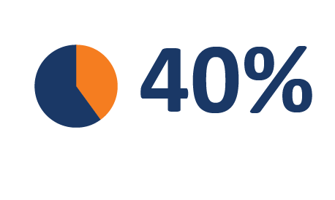
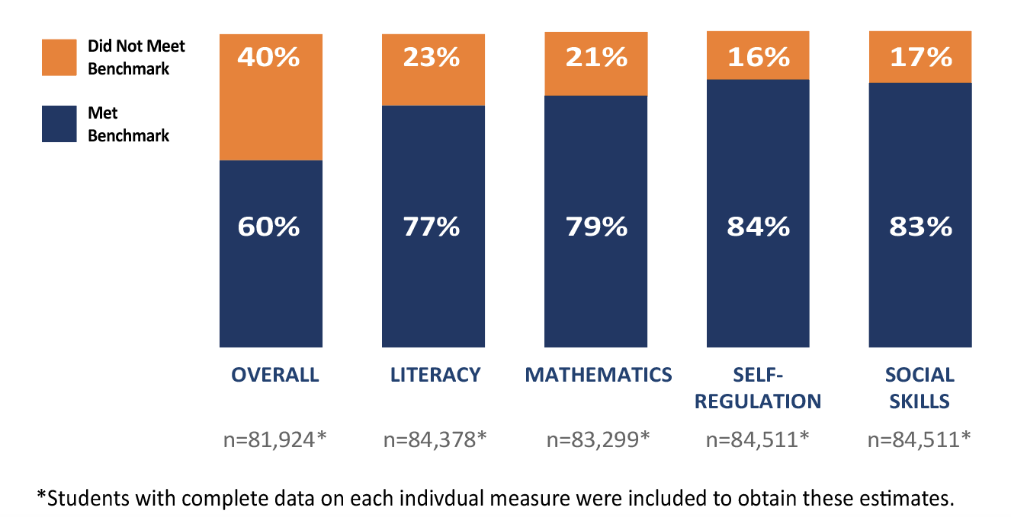
School Readiness in Virginia
of Virginia’s kindergarteners began the 2022-2023 school year still needing to build skills in Literacy, Mathematics, Self-Regulation and/or Social Skills.*
Notes:
Students falling below the benchmark were more likely to be students of color, students from low-income families, English language/multilingual learners, and students with disabilities.
Comparison of VKRP Fall 2022 kindergarten data across demographic subgroups shows that historically marginalized students were more likely to be categorized as below the overall benchmark. These patterns illustrate continued disparities in educational opportunities and experiences.
-53% of students from low-income backgrounds started the school year below the overall benchmark.
-49% of Black students, and 56% of Hispanic students started the school year below the overall benchmark.
-66% of English Learners started the school year below the overall benchmark.
-64% of students identified as having a disability started the school year below the overall benchmark.

Slide 5
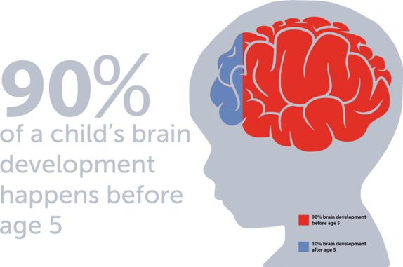
Brain Development and School Readiness

Slide 6
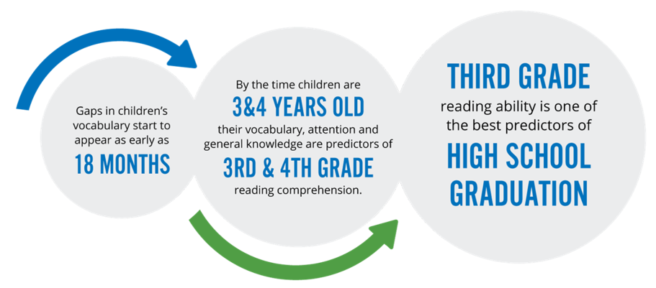
Early Childhood is the Foundation
https://www.firstthingsfirst.org/early-childhood-matters/early-literacy/

Slide 7
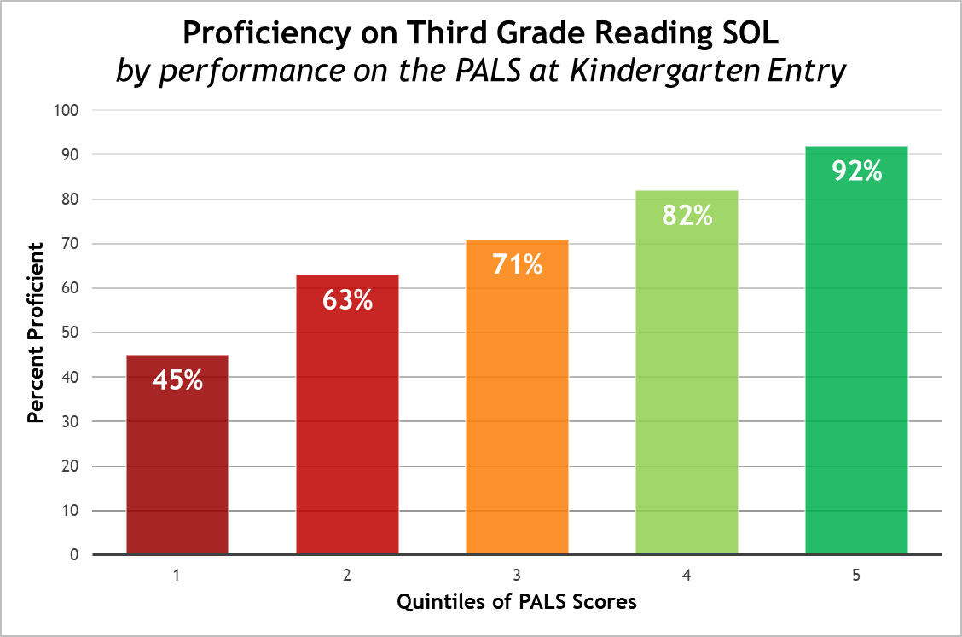
Linking Readiness to 3rd Grade Outcomes

Slide 8
Overview of Publicly-Funded ECCE
Program | # of Children Served FY23 | Approx. Investment Per-Child, FY23 | Typical Dosage | Family Expectations | Setting
Virginia Preschool Initiative (VPI) | 22,290 (92% 4-year-olds) | $8,359 ($6,353 in state funds) | 990 hours/year | Child or family at risk; free to family; not connected to parental work status | Primarily schools; some child day centers
Mixed Delivery Preschool Grant Program (MDG) | 1,250 (3- and 4-year-olds) | Between $12,000-14,000 | Full-day, full year (~2,600 hours/year) | Child or family at risk; free to family; not connected to parental work status | Child day centers and family day homes
Early Head Start (EHS) and Head Start (HS) | 13,766 (80% 3- and 4- year-olds) | Between $9,507-$17,911 | 1,380 hours/year (EHS) 1,020 hours/year (HS) | Household up to 100% FPL; free to family; not connected to parental work status | Schools, child day centers, and family day homes
Child Care Subsidy Program (CCSP) | 36,185 (58% birth-5) | Average ~$11,000 | Up to full-day, full year (~2,600 hours/year) | Household up to 85% SMI; family contribution of $0-180 child/month; dependent on parental work status | Child day centers and family day homes
Note: Early Childhood Special Education is federally- funded through IDEA Part B; dosage, funding and setting vary based on children’s needs.
Notes:
Data note: VPI numbers include late enrollment; CCSP as of 12/2022
Data sources: https://docs.google.com/presentation/d/1Kv6-wbJvi601XKuTvpjZEtvduGJz4o1k/edit#slide=id.p1 and “DRAFT_Early Childhood Biennial Budget Proposals_5.9.22 FOR GOV” (slides 5 and 12)
Notes:
VPI: VPI set rate is 8,359 per-child. State contribution for VPI is $6,353; the difference ($2,006 per-child) is paid by local match.
K-12 enrollment this from https://p1pe.doe.virginia.gov/buildatable/fallmembership
VPI notes:
Pburg was allocated 221 slots by the state formula, was grants additional slots through redistribution for a total of 247 slots , and served 175 4 year olds in FY23. They requested and were granted 40 3 year old slots, and served 40 in FY23.
For Pburg the total per pupil amount is $8359, Of that amount the state pays $6,344.48 and Pburg pays $2014.52
For FY24 Pburg has been allocated 221 4 year old slots, and they are welcome to request more via Spring Application, where they can also request 3s
Funding at the state level is more complicated. For the vast majority of localities the per pupil amount is $8,359. However, it is $8,516 in counties of Stafford, Fauquier, Spotsylvania, Clarke, Warren, Frederick, and Culpeper and the Cities of Fredericksburg and Winchester, and its $8,959 in Planning district 8.
The state/local split is based on Local Composite index and is capped at 50%. So Pburg LCI is .241 so they pay 24.1% where as Fairfax LCI is over .5 so they pay 50%
HS Note - FY23 Head Start enrollment reflects funded enrollment to reflect the expectation that VA will progress toward full enrollment initiatives.
Key Eligibility Provisions in the CCSP​
Age of child​
Children under age 13 or under age 18 if physically or mentally unable to care for himself or herself, or is under a court order​
Parental activity requirement​
All available parents in the household are working, in an education or training program, or searching for work​
Household income​
For families with at least one young child: 85 percent state median income (~$96,900 for a family of 4)​

Slide 9
Examples of Publicly-funded Classrooms
Publicly-funded “classrooms” work differently from K-12.
Classroom A in a School:
All children are publicly-funded.
Classroom B in a Family Day Home Business:
Only 1 child is publicly-funded. Other children pay tuition.
Classroom C in a Non-Profit Child Care Center:
Multiple sources of public and private funding.

Slide 10
Both Access and Quality Matter
Access + Quality
More Choices for More Families
Improved School Readiness Outcomes

Slide 11
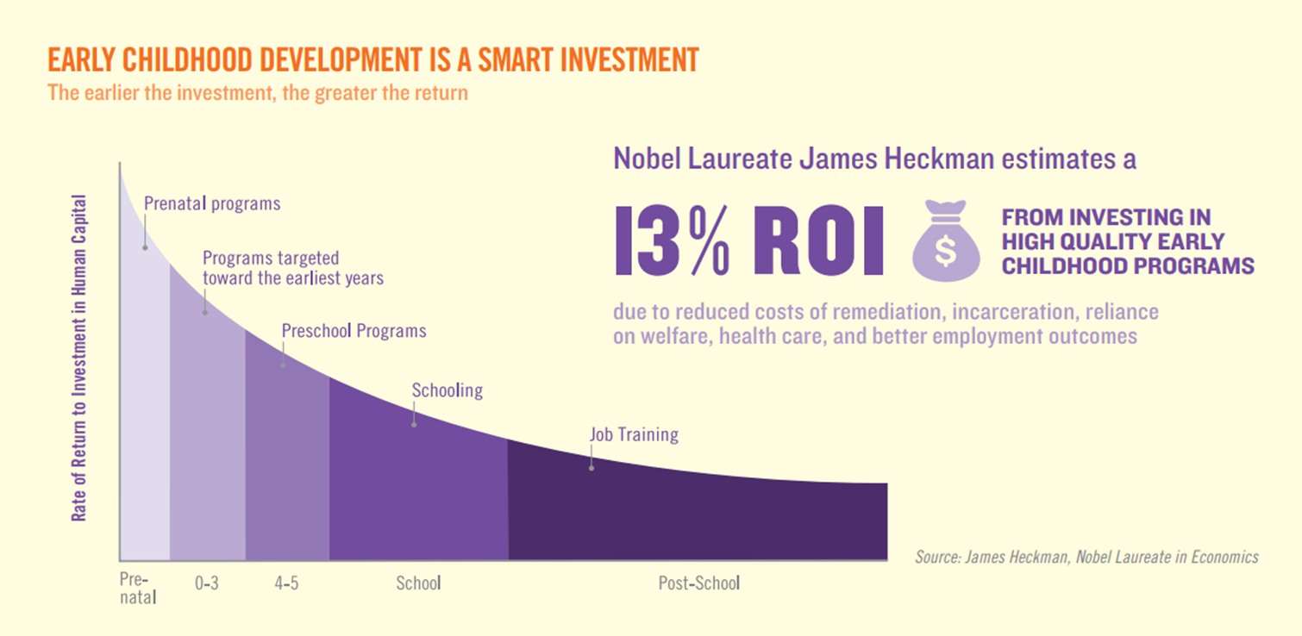
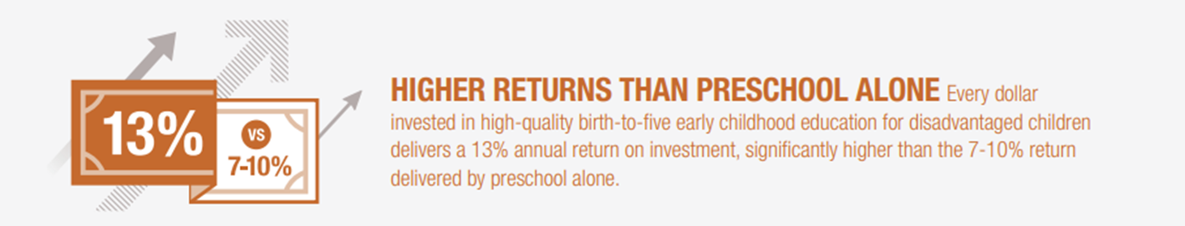
Quality Early Childhood as Investment

Slide 12
Why Economists Care About Quality
According to Federal Reserve Economist James Heckman:
Investing early in education produces better economic, health, and social outcomes in childhood and adulthood.
Policymakers who invest in high-quality early learning programs from birth can permanently boost IQ and social-emotional skills that create productive, independent adults.
Child care functions as early learning in the real world—child care without high quality learning is a huge missed opportunity.
Attaching quality to child care provides two generations of benefits—it helps parents grow their income and children grow smarter.
Investing in high-quality child care quickly pays for itself in income gains among parents in the first five years and beyond.
https://heckmanequation.org/

Slide 13
The Early Childhood Workforce
Teachers are key to the quality of early childhood experiences that prepare children for school and support Virginia’s working families.
Setting | Preparation Requirements | Average Hourly Compensation | Pre-Pandemic Rate of Turnover | 2022 Rate of Turnover
Family Child Care Educator | Must be 18 and have a HS education and 3 months experience | $14.84 | N/A | N/A
Child Care Educator | Must be 18 and have experience, training and/or CDA/AA | $14.84 | 28-33% | 38-49%
School Educator | BA Degree and Teaching License (Provisional License) | $25.39 | 8-11% | 25-29%
While 39% of child care lead teachers have household incomes of less than $25,000 annually, only 1% of school-based lead teachers are in this category.
Notes:
However, child care teachers often receive very low wages and limited benefits.
As of 2022, teachers reported an hourly wage of $14.80, which is equivalent to $12.97 in 2019 real-dollar value and fewer than half of these educators have access to benefits. Inflation-adjusted wages for early educators have increased on average by just $0.71 per hour since 2019.
Early educators working in child care also have substantially lower levels of education and income compared to early educators working in school-based settings.
For instance, only 31 percent of lead teachers in child care centers hold college degrees.
Just under forty percent of lead teachers working in child care centers have household incomes under $25,000.
At the time of the survey, over one-half FDH (52%) had household incomes below $45,000, 42% were food insecure, and many relied on public assistance, including Medicaid, unemployment benefits, or access to school meals for their own children. (. A previous survey of family day home providers in Virginia revealed that pre-pandemic, in May 2019, over one-quarter were food insecure and about three-quarters were experiencing some degree of financial insecurity.1) SEE PARTNERSHIPS
Actual verbiage from regs:
A. Providers and substitute providers shall be 18 years of age or older.
B. Providers licensed after and substitute providers employed after June 30, 2010, shall have:
1. (i) A high school program completion or the equivalent or (ii) evidence of having met the requirements for admission to an accredited college or university;
2. Three months of programmatic experience;
Lead teachers at schools reported making an average of $25.39 per hour on last spring’s workforce survey (May 2022; response rate of 61% for school teachers)For pre-pandemic turnover rates, our only source of data is verification from the Year 1 RCT – so it’s worth noting that a) these are a select group of regions and sites, not necessarily representative of the state, and b) that they are for an 8-month period (May 2019 – January 2020) rather than a full year, like the current rates from the LB5 analysis (September 2021 – September 2022). But anyway, we have (documented here):4% - 11% for schools:
4% turnover for lead teachers, 8% for assistant teachers in Fairfax (across both those who were and were not eligible RB5)
8% turnover for lead teachers, 11% for assistant teachers in the rest of the PDG (all of whom were eligible for RB5)
17% - 33% for centers:
17% turnover for lead teachers, 25% for assistant teachers in Fairfax (across both those who were and were not eligible RB5)
28% turnover for lead teachers, 33% for assistant teachers in the rest of the PDG (all of whom were eligible for RB5)

Slide 14
Overview of VQB5

Slide 15
VQB5: Unified Measurement and Improvement
In response to state law, the Board has established a unified measurement and improvement system (VQB5), for all publicly-funded birth-to-five early childhood programs.
The VDOE piloted and then scaled VQB5, working with multiple stakeholders and communities to develop the new system.
VQB5 included two Practice Years.
In the fall 2023, all publicly-funded birth-to-five programs, will be required to participate in VQB5, with the first quality ratings published in fall of 2024.
This will likely include ~3,600 schools, child care, and family day home programs with ~12,000 "classrooms."

Slide 16
VQB5 Theory of Change
To prepare all children for kindergarten, Virginia’s early childhood system must ensure they have access to quality teaching and learning experiences that meet their unique needs.
Working together, through VQB5, Virginia will:
UNIFY around shared and equitable expectations for quality.
MEASURE and strengthen teacher-child interactions and curriculum use in all publicly-funded birth-to-five programs.
IMPROVE supports for educators, prioritizing those who need it most.

Slide 17
VQB5 Guiding Principles
VQB5 must…..
Impact quality and result in improved school readiness for children.
Use measures that can distinguish levels of quality and demonstrate growth over time.
Provide clear, actionable information, resources, and incentives for improvement.
Be affordable for providers and the state.
Scale for use in up to 4,000 sites and up to 12,000 classrooms.
Increase opportunity for all children in 1) the outcomes that are measured, and 2) the process for making and using the system.
Serve as a resource for families.

Slide 18
VQB5 Components
VQB5 measures the quality of infant, toddler, and preschool teaching and learning using two nationally-recognized quality indicators.
Interactions | Curriculum
Measure teacher-child interactions and instruction in a developmentally-appropriate way using the Classroom Assessment Scoring System (CLASS) | Measure the use of approved curricula* that are aligned with Virginia’s Early Learning and Development Standards
Research shows that stimulating and supportive interactions between teachers and children and effective use of quality curricula promote children’s holistic learning and development, resulting in improved school readiness.
*Use of an approved curriculum in VQB5 is optional. There is no curriculum requirement.

Slide 19
Continuous Quality Improvement
PREPARE
Leaders and educators understand what is being measured and why
RECOGNIZE, REFLECT, AND ADJUST
Leaders and educators use data to recognize growth, reflect on what works, and make adjustments to address challenges and gaps
MEASURE AND IMPROVE
All infant, toddler, and preschool classrooms are observed and consistent information is collected to understand the experience of all children
SUPPORT
Leaders and educators receive professional development that addresses their unique classrooms
GIVE FEEDBACK
Leaders provide educators with individualized feedback on their classroom’s strengths and opportunities for growth

Slide 20
VQB5 Annual Timeline
VQB5 uses an annual measurement and improvement cycle summarized below. VDOE and Ready Regions provide ongoing support to the field at every step in the process, gathering data and participant feedback to continually strengthen the system.
Summer | Fall | Winter | Spring
Program registration and preparation for fall CLASS observations. | Local CLASS observations and curriculum use information for every classroom entered in LinkB5. | Programs use information from fall to engage in professional development based on program and classroom needs. | Local CLASS observations and curriculum use information updated (if needed) for every classroom entered in LinkB5.
Reflect and Prepare
Measurement, Feedback, and Support for Every Classroom
External CLASS observations are used at every site to gather information, support local observers, and provide additional feedback.
Notes:
Lucy

Slide 21
Overview of the Practice Years
Notes:
Now we'll share successes/challenges - but overall VA is well positioned for full year of required participation.

Slide 22
Successes to Build On
Here are the key successes that Virginia should build on as it prepares for full implementation of VQB5:
Virginia is on track for full scale implementation by Fall 2023.
Teacher-child interactions are improving for all groups.
Virginia has increased the number of classroom observers.
More sites are using approved curriculum.
Virginia has fully established Ready Regions, the regional infrastructure needed to implement VQB5.
The educator incentive program, RecognizeB5, supports more child care and family day home educators.
There is positive support for VQB5 in the field.

Slide 23
Success #1 – On Track for 100% Participation
There has been significant growth in the number of sites participating.
71% of all Centers are participating.
Nearly 95% of all Head Start sites are in VQB5 currently.
76% of all Public Schools are participating.
77% of all FDHs are participating.
Notes:
77% of all FDHs participating
71% of all Centers participating
76% of all Schools participating

Slide 24
Success #2 - Teacher-Child Interactions are Improving for All Age Groups
Local CLASS scores from Fall 2022 show an improvement in teacher-child interactions when compared to Fall 2021 scores.
540
1,020
1,188
2,198
2,959
4,538
NOTE: These are not necessarily the same classrooms in both Fall samples.​
Notes:
Inside bar is # of observations in each age-level
Above bar is average CLASS score

Slide 25
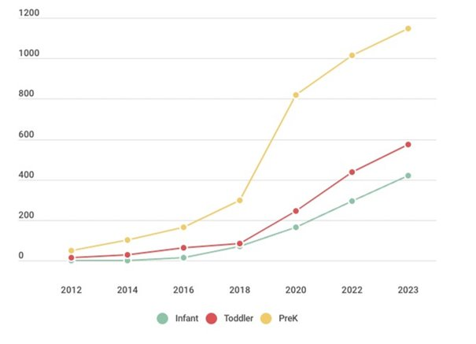
Success #3 - More CLASS Observers
Virginia has significantly increased the number of certified CLASS observers to support local implementation of the statewide VQB5.
1,148
573
422
All Certified Observers with a Virginia Address
(As of 12/31/22)
Notes:
Classroom Proportions | Observers Proportions
Infant: 13% | 20%
Toddler 27% | 27%
PreK 61% | 54%
(1,005 unique observers doing Local according to local inventories/Jan 2023 —for our information)
Comparison #s of local observers from fall to total certified in VA (note since a few RR's used observers from other states, this wouldn't be an exact match)
Fall LB5 observers - % of Total in VA
Infant 208/422 - 50%
Toddler 408/573 - 70%
PreK 809/1148 - 70%
Prop. Of classrooms by age
Compare to prop. Of observers by age

Slide 26
Success #3 - More CLASS Observers
Virginia's current number of observers, and the age-levels for which they’re certified, nearly mirrors the age-level distribution of classrooms.

Slide 27
Success #4 – More Use of Curriculum
Use of an approved curriculum increased across all site types during Practice Year 1, with the greatest increase in family day homes and child care.

Slide 28
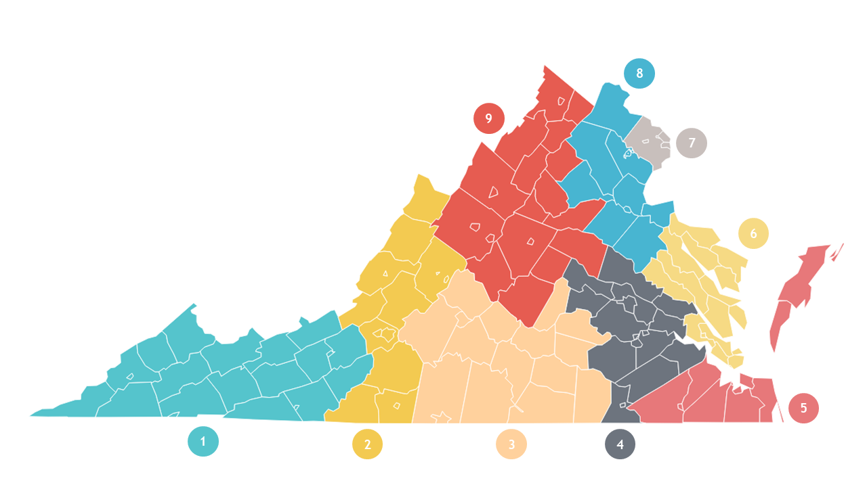
Success #5 - Ready Regions are Leading
Ready Regions are established and providing VQB5 coordination, accountability, and family engagement statewide.
Ready Regions launched in July 2022. They have:
Recruited and engaged 2,600+ sites to opt in to Practice Year 2
Established regional structures, staffing teams and partnerships
Completed 7,000+ local CLASS observations in fall 2022
Supported more than 22,800 users to use LinkB5
Hired staff to lead family engagement and coordinated enrollment efforts
Engaged in frequent collaboration with state improvement partners to align professional development and prioritize supports for sites who need support the most
Ready Regions Website
Notes:
Ready Regions were establish & are already making an impact by …..
Coordinated XXX number of local observations
Site participation XXX number
Hired XXX
Family Engagement
Coordinated enrollment

Slide 29
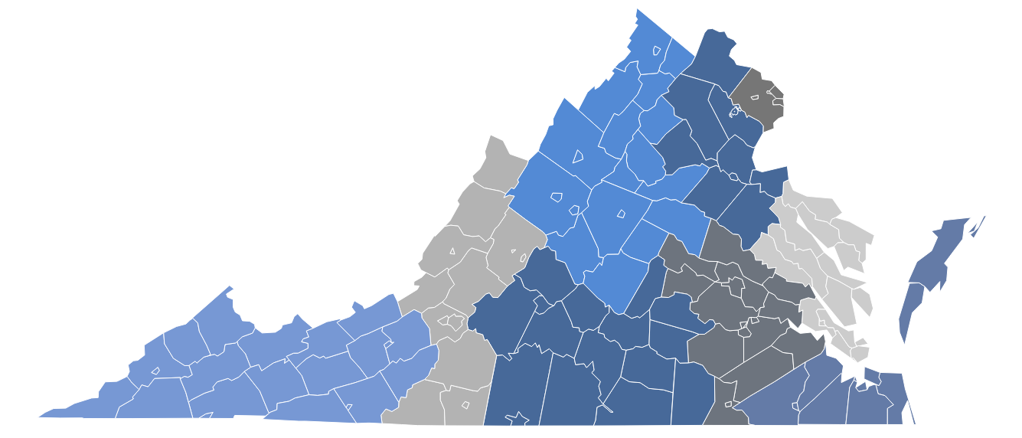
Success #6 – RecognizeB5
RecognizeB5 will distribute approximately $25M to over 11,400 early childhood educators in 2022-2023.
RecognizeB5 awards a financial incentive ($2500 in FY23) to eligible child care and family day home teachers to help support, retain, and reward talented, yet undercompensated, early educators in non-school early learning settings.
2,326
EDUCATORS AWARDED
2,166
EDUCATORS AWARDED
894
EDUCATORS AWARDED
966
EDUCATORS AWARDED
722
EDUCATORS AWARDED
1,871
EDUCATORS AWARDED
771
EDUCATORS AWARDED
686
EDUCATORS AWARDED
1,085
EDUCATORS AWARDED

Slide 30
Success #7: Field Support for VQB5
The field continues to express widespread support for VQB5:
Positive Feedback for VQB5
Unified approach across all birth-to-five programs
Individualized feedback from local and external CLASS observations
Appreciation of increased curriculum options
Sharing PY1 results privately has helped programs learn how VQB5 works
Training and technical assistance received from regional and state partners
Increased alignment and collaboration with improvement partners
Having actionable data to target and prioritize supports for programs
Financial incentive for childcare and family day homes (RecognizeB5)
Overall appreciation of having the opportunity to practice and provide feedback to the state

Slide 31
Challenges to Address
Here are the key challenges that Virginia will address as it prepares for full implementation of VQB5:
Roughly 25% of publicly-funded sites are not yet participating.
Many sites were missing local observations in Practice Year 1.
There are inconsistencies in local observation scores.
A small percentage of sites require intensive support.
There is variation in curriculum implementation by site type.
Workforce challenges (e.g., teacher retention) continue to challenge quality improvement efforts.
Virginia addresses each challenge in the revised VQB5 Guidelines.

Slide 32
Challenge #1 - Non-Participating Sites
About 26% of sites across the state are not yet participating in VQB5.

Slide 33
Challenge #1 - Non-Participating Sites
There are some sites not yet participating, with similar non-participation trends across all site types.
29% of all Centers are not yet participating
24% of all Public Schools are not yet participating
23% of all FDHs are not yet participating
Notes:
The %s here represent the % of all sites, within that type, not participating. So 29% of all centers are not participating. 23% of all FDHs are not participating. 24% of all public schools are not participating.

Slide 34
Challenge #2 – Missing Observations
In Practice Year 1, 410 sites were missing at least one local classroom observation, resulting in incomplete ratings.

Slide 35
Challenge #3 – Score Inconsistencies
Based on Fall 2022 data in classrooms that received both a local and an external observation, there are inconsistencies: 30% - 43% are not within one point of each other.

Slide 36
Challenge #4 – Sites that Require Additional Support
One in three sites that scored very low in Practice Year 1 did not participate in any state-supported improvement efforts.
Practice Year 1 identified that 17 sites had a "Needs Support" rating. This means that on average, classrooms at this site are scoring in the low range of teacher-child interactions.
Represented 4 family day homes and 13 child care centers, and were spread across 8 regions.
In addition to having consistently low range CLASS scores, none of these sites were using an approved curriculum.
All 17 sites were prioritized for coaching, access to curriculum and improvement resources in Practice Year 2. Yet only 11 of 17 are currently participating in coaching.

Slide 37
Challenge #5 –Curriculum Use in Classrooms vs. Sites
In Practice Year 1, 22% of classrooms were not using an approved curriculum while only 15% of sites lacked access overall. Sites, especially publicly-funded private sites, are not yet prepared to provide a curriculum for every classroom.
Classrooms
Sites
Using Approved Curriculum
Not Using Approved Curriculum

Slide 38
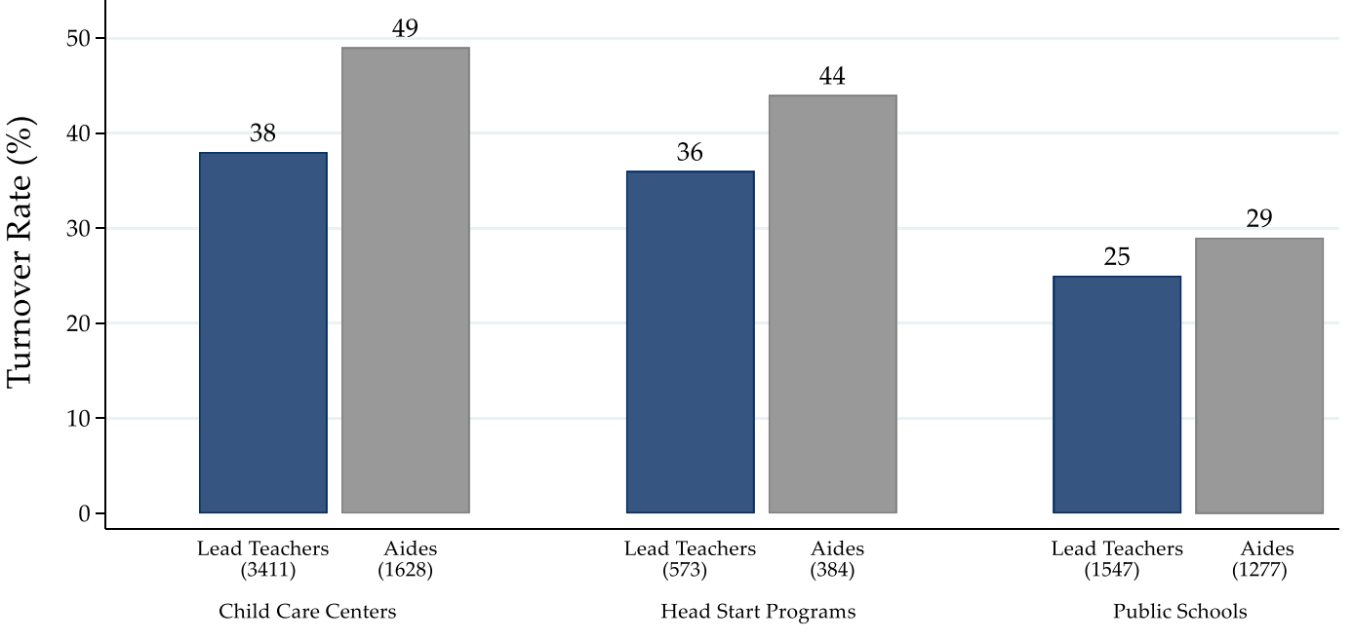
Challenge #6 – Workforce Challenges
High teacher turnover in child care settings continues to create quality challenges. Data shows that 37% of teachers left their sites over the year.
Early Childhood Teacher Turnover in Virginia by Sector and Role
Fall 2021-Fall 2022
Research from Virginia’s child care sector shows that competitive wages are a primary driver of staff retention, with staff in the lowest wage quartile being twice as likely to turn over in a given year relative to those in the highest wage quartile.
see-partnerships.com/virginia
Notes:
Chart reference

Slide 39
Addressing Challenges in 2023-2024
Challenge | Approach
1. Non-Participation | Clarify participation requirements, with clear consequences for sites who do not participate.
2. Incomplete Observations | Establish clear action steps and consequences for incomplete CLASS observations to support the most complete collection of data for the site.
3. Local CLASS Scoring Inconsistencies | Increase the use of external observations and establish a score replacement protocol when inconsistencies in observation scores occur.
4. Classrooms That Require Additional Support | Prioritize classrooms with low CLASS scores for coaching/TA supports and require sites that receive a “Needs Support” rating to participate in additional improvement planning.
5. Variation in Curriculum Use Across Site Types | Continue to keep curriculum use optional, while also increasing options and targeted supports to sites who are not yet using curriculum in at least one classroom.
6. Workforce Challenges | Collect teacher and classroom list information in LinkB5 across all publicly-funded sites to better understand how teachers and classroom quality impact child outcomes for future investment decisions. Continue RecognizeB5 and increase amount to $3,000 per teacher in centers and family day homes.

Slide 40
Questions?

Slide 41
VQB5 2023-2024
Appendix Slides

Slide 42
VQB5 Legislation
Code of Virginia § 22.1-289.05. Uniform measurement and improvement system; regional entities; establishment.
The Board shall establish a uniform measurement and improvement system designed to provide parents and families with information about the quality and availability of publicly funded providers. Such system shall include:
  Service provision and performance targets for children from birth to age five that align with standards for kindergarten readiness and early elementary grades;
  Consistent quality standards;
  Outcome-based measurements; and
  Incentives to encourage participation and improvement.
All publicly funded providers shall be required to participate in the uniform measurement and improvement system established pursuant to subsection A. All other child day programs may participate in such system. Any participation in such system shall comply with all applicable federal laws and regulations, including the federal Head Start Act (42 U.S.C. § 9801 et seq.), as amended, and associated regulations.
The Board shall establish consequences for publicly funded providers that fail to participate in the uniform measurement and improvement system established pursuant to subsection A or persistently fail to meet minimal quality standards.
The Board shall establish a system of regional entities that will be responsible for coordinating early childhood care and education services, guiding quality improvement of such services and coordinated access to such services for families and implementing the uniform measurement and improvement system.

Slide 43
Publicly-Funded Providers
“Publicly-funded provider” means any (i) educational program provided by a school division or local government to children between birth and age five or (ii) child day program that receives state or federal funds in support of its operations that serves three or more unrelated children.
This definition is intended to capture funding sources that support direct early childhood care and educational services for young children. These public funding sources include:
Virginia Preschool Initiative (VPI)
Early Childhood Special Education (ECSE or IDEA Part B, Section 619 preschool)
Title I Preschool
Head Start/Early Head Start
Virginia’s Child Care Subsidy Program
Local government child care assistance, such as Fairfax’s Child Care Assistance and Referral (CCAR) program
Federal Child Care Access Means Parents in School (CCAMPIS)
Virginia Early Childhood Foundation (VECF) Mixed Delivery
Federal Department of Defense Military Child Care Fee Assistance (MCCYN)

Slide 44
Continual Field Engagement
Virginia continues to engage the field at every step in the process.
Local CLASS Observations Webinar (798 views) | PY2 Mid-Year Program Leaders Webinar (259 Views)
Subsidy Vendor Information Webinar (710 views) | External CLASS Observation survey (90 responses)
ECSE Coordinator Information Webinar (638 views) | CLASS-ICP Pilot Focus Groups (40 participants)
Curriculum Refresher webinar and Get-To-Know-You Curriculum series (491 views) | RR PY1 Data Deep Dives – (9 regional partner meetings) Presentations to stakeholder groups (40 presentations)
Improvement Partner Quarterly Webinars (300 views on avg) | Overview of 2023-2024 VQB5 Guidelines Webinar Part 1 (755 views)
Ongoing engagement with the field through… Weekly office hours with Ready Regions and Monthly TA support LinkB5 TA Hotline Support and Ready Regions Focus Groups Coaching Collaboration Bi-monthly meetings with state and regional partners RecognizeB5 Help Center to support educators
Information about VQB5 has also been shared broadly through weekly Readiness Connections e-newsletter and webinar recordings available on the Quality Measurement and Improvement (VQB5) webpage.

Slide 45
VQB5 Quality Ratings
VQB5 Quality Ratings will be calculated at the end of the academic year using the following point system. Quality Ratings from the 2023-2024 year will be posted publicly in the fall of 2024.
Interactions Points (700 total points) | Average of all local CLASS scores from the fall and the spring (all classrooms at a site) x 100
Curriculum Points (100 total points) | Programs using an approved curriculum in at least one classroom, by May 31st, will receive 100 points added to their score
Total Points | Interactions Points + Curriculum Points = Total Points
Quality Ratings | Exceeds Expectations = 700 - 800 points Meets Expectations = 400 - 699 points Needs Support = 100 - 399 points
Notes:
Lucy

Slide 46
Local and External Observations
Fall Practice Year 2
Fall Observation Completion August-December 2022 | Local Observations | External Observations
Total Number of Classrooms Observed | 7,473 | 1,627
Classroom Completion: By Age-Level
Pre-K | 4,415 | 951
Toddler | 2,081 | 417
Infant | ​977 | ​259
Site Type Completion
Public School | ​2,158 | ​475
Affiliated Center | 1,228 | 291
Stand-Alone Center | 3,620 | 762
Family Day Home | 467 | 99
This fall, over 9,000 classrooms received observations and feedback
Notes:
Kris

Slide 47
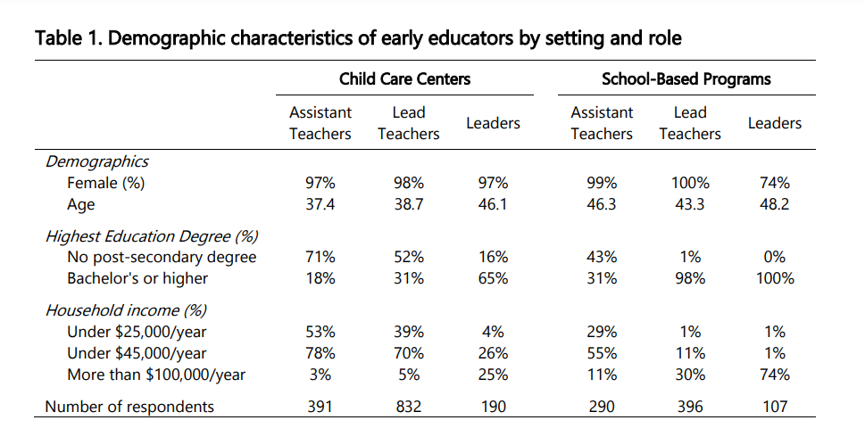
Workforce Comparison
There are stark contrasts between school-based and child care educators.
From See-Partnerships Report (Sept 2020) Who Teaches Virginia’s Youngest Children?

