Slide 1
Final Review of a Proposal to Adopt Special Provisions to Suspend the Use of the Chronic Absenteeism Indicator for the Determination of Accreditation Status in Accreditation Year 2023-2024
Presentation to the Virginia Board of Education at the April 20, 2023, Business Meeting

Slide 2
Proposal to Adopt Special Provisions
8VAC20-131-380.F.3
The board may adopt special provisions related to the measurement and use of a school quality indicator as prescribed by the board. The board may also alter the inclusions and exclusions from the performance level calculations by providing adequate notice to local school boards.
VDOE is requesting the Board suspend the use of the chronic absenteeism indicator for the determination of accreditation status in accreditation year 2023-2024 (based on 2022-2023 school year data).

Slide 3
Suspending the Use of Chronic Absenteeism in the Determination of Accreditation ( 1 of 3)
All indicators receive a rate and performance level, including chronic absenteeism.
The performance for all indicators is reported on the School Quality Profiles for the school and division, including chronic absenteeism.

Slide 4
Suspending the Use of Chronic Absenteeism in the Determination of Accreditation ( 2 of 3)
The requirements of 8VAC20-131-400. Application of the school quality indicator performance levels to actions apply to all indicators, including the chronic absenteeism indicator.
“In determining required actions for schools and school divisions, levels of performance shall be considered separately for each school quality indicator. Responses and actions to be taken by school divisions and schools, under the leadership of division superintendents and school principals, according to the performance level of each school quality indicator are as prescribed in subsections B, C, and D of this section.”

Slide 5
Suspending the Use of Chronic Absenteeism in the Determination of Accreditation ( 3 of 3)
The accreditation status of a school will be determined using the performance levels of all indicators except chronic absenteeism.
  In the current accreditation system, if at least one indicator is a Level Three, the school is Accredited with Conditions.
  Suspending the use of the chronic absenteeism indicator results in a school being Accredited if the only indicator with a Level Three is chronic absenteeism.

Slide 6
Application of the School Quality Indicator Performance Levels to Actions

Slide 7
Application of Performance to Action: Level Two (1 of 3)
8VAC20-131-400.C. Level Two. If a school quality indicator is at Level Two, the school and its school division shall have primary responsibility to revise and implement its multi-year school improvement plan.
In developing such plan, the school and its school division shall determine the issues and conditions that are likely contributing to the school's performance on the indicator and plan and implement essential actions and research-based strategies designed to improve performance on the indicator to achieve the Level One standard.

Slide 8
Application of Performance to Action: Level Two (2 of 3)
Schools with a Level Two performance level in chronic absenteeism will complete the following actions per 8VAC20-131-400.C.
School division and school staff shall:
Identify factors related to the school's performance on the indicator as part of the school's comprehensive needs assessment.
Use the results of the comprehensive needs assessment to develop and revise the multi-year school improvement plan to address the factors identified in the needs assessment that are related to the performance on the indicator...

Slide 9
Application of Performance to Action:
Level Two (3 of 3)
Implement the essential actions and research-based strategies with fidelity;
Regularly evaluate evidence of the school's progress in implementing the plan, monitor changes on the school quality indicator, and make adjustments as warranted; and
Evaluate the progress of the school quality indicators at Level Two at the end of each year and assess the results of the school improvement plan actions at the end of two years. If no progress is made within the two-year period on such school quality indicators, the plan shall be revised.

Slide 10
Application of Performance to Action:
Level Three (1 of 3)
8VAC20-131-400.D Level Three.
1. Corrective action plans. If any school quality indicator is at Level Three, the school and school division shall work cooperatively and in consultation with the department to develop a corrective action plan, which shall be incorporated as a component of the school's comprehensive, unified, long-range plan.
In developing such plan, the school and school division, in consultation with the department, shall determine the issues and conditions that are likely contributing to the school's performance on the indicator and plan and implement essential actions and research-based strategies to achieve improvement to the Level One standard.

Slide 11
Application of Performance to Action:
Level Three (1 of 3)
(continued from 8VAC20-131-400.D.1)
All schools with indicators at Level Three must undergo an academic or other review, as appropriate, conducted by the department, or under its guidance, to further identify required actions to improve student achievement and the school quality indicators that are at Level Three.

Slide 12
Application of Performance to Action:
Level Three (3 of 3)
8VAC20-131-400.D.1.b. In consultation with department staff, school division and school staff shall:
(1) Identify factors related to the school's performance on the indicators at Level Three as part of the school's comprehensive needs assessment;
(2) Use the results of the comprehensive needs assessment to develop a multi-year corrective action plan that addresses the factors identified in the needs assessment that are related to the performance on the indicator through essential actions and research-based strategies; [Steps 3 and 4 not listed.]
(5) Implement the approved corrective action plan with fidelity; and
(6) Meet regularly with department staff to monitor evidence of the school's progress in implementing the plan, to track improvement on the indicator, and to identify next steps.

Slide 13
Professional Learning and Intervention Strategies

Slide 14
Professional Learning Opportunities
Chronic Absenteeism Collaborative Learning Cohorts: 72% of school divisions participated in the cohorts which included:
  E-Learning series presented by Attendance Works;
  Fall in-person collaborative sessions that included a panel of school leaders who shared promising practices; and
  Spring virtual session included three school teams sharing strategies and breakout collaboration.
Resources: Virginia's One Stop for Improving Attendance Canvas Course, Academic Review Tool, Attendance Modules on the VDOE Website, and Additional Webinars

Slide 15
Intervention Strategies
Sample action steps being taken by school and division leaders:
Conducting weekly attendance team meetings;
Tracking attendance data and conducting root cause analyses;
Communicating frequently with parents (e.g. social media, postcards home, personalized phone calls, home visits, announcements at all school events);
Building positive relationships (e.g. student ambassadors, mentors, professional development for all staff); and
Providing tiered interventions based on data and student needs.

Slide 16
Division and School Highlights (1 of 5)
Caroline County Public Schools – Sample actions implemented to address chronic
absenteeism:
CARE teams (School Counselors, School Social Worker, Family Engagement Coordinator, Special Education Coordinator, School Psychology Team Member) meet regularly with the goal of identifying students in need, then engaging families, building relationships, and linking students and parents to community resources;
Division-wide tiered intervention structure for core, targeted, and intense interventions;
Empathy interviews with students;
Attendance flier in monthly division newsletter to families; and
Summer 2022 Book Study Engage Every Family and targeted home visits to rising ninth graders that have been identified to build relationships and assist families with getting ready for the start of the school year.

Slide 17
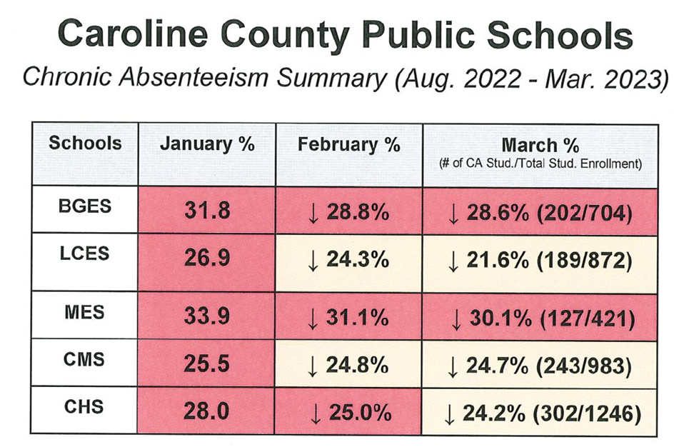
Division and School Highlights (2 of 5)
Caroline County Public Schools – Sample actions implemented to address chronic absenteeism continued:
Family events held across the county at community locations to establish positive relationships with families outside of the school setting.
Caroline County Public Schools – Improvements:

Slide 18
Division and School Highlights (3 of 5)
Manassas City Public Schools - Sample actions implemented to address chronic absenteeism:
All schools have full-time bilingual family liaisons to enhance outreach to families in general, and specifically about the importance of regular attendance and the connection between absenteeism and dropouts.
Formal attendance teams meet regularly and the middle and high schools have enhanced systems for tracking and analyzing data.
School counselors utilize reflection surveys with students to identify root causes and develop appropriate prevention and intervention strategies.
High school has implemented Evening School as a way to serve students who need alternative scheduling, in an attempt to combat both chronic absenteeism and the high number of dropouts.

Slide 19
Division and School Highlights (4 of 5)
Manassas City Public Schools – Improvements:
At the high school, 26.5% of students had missed 10% or more of membership days as of March 10, 2023, down from 29.3% at the same time in 2021-22.
Students enrolled in the Evening School are attending regularly and reaching out to administration when they need to miss due to illness, family issues, etc. Students have reported feeling more connected to the program than they did during the traditional school day.

Slide 20
Division and School Highlights (5 of 5)
Lee County High School – Sample actions implemented to address chronic absenteeism:
Attendance team meets regularly to review attendance data and identify individual student needs and which team member is responsible for providing support;
Personalized contact to students and families through phone calls, letters, meetings, and home visits to discuss how the school can help remove barriers to attendance and clarify the importance of attendance;
Created a new Chronic Absenteeism Facilitator position to lead attendance teams and the efforts to improve attendance;
Connecting efforts to improve attendance with efforts to reduce drop out rates; and
Increased proactive parent communication regarding attendance.
Lee County High School - Improvements:
During the 2021-2022 school year the Chronic Absenteeism rate for Lee High School was 40%, current data indicates the chronic absenteeism rate is 20%.
Notes:
J

Slide 21
Engage VA
The 2022 General Assembly appropriated $3.5 million for VDOE to contract with a provider to help school divisions with support and coaching for disengaged, chronically absent and struggling students. VDOE contracted with Graduation Alliance to create Engage Virginia which will provide online support for up to 18,500 students statewide.
Engage Virginia services are available to students, families and schools at no cost through a partnership between VDOE and Graduation Alliance.
To date 47 divisions have opted to participate in the program and approximately 10,000 students have been referred.

Slide 22
Chronic Absenteeism Data

Slide 23
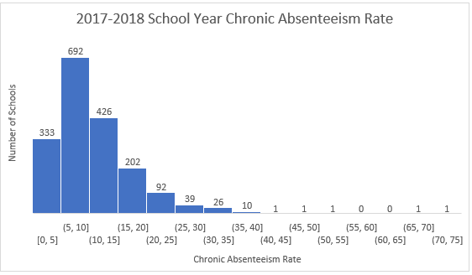
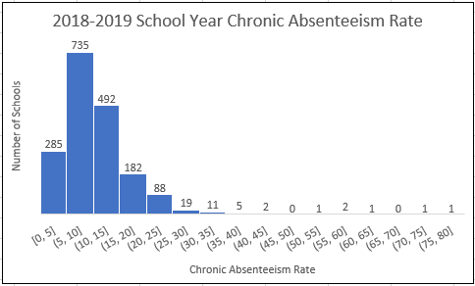
Historical Chronic Absenteeism Data
(1 of 3)
 | 2017-2018 | 2018-2019 | 2020-2021 | 2021-2022
Mean | 10.69 | 10.43 | 12.15 | 19.99
Median | 8.96 | 9.18 | 8.69 | 18.19

Slide 24
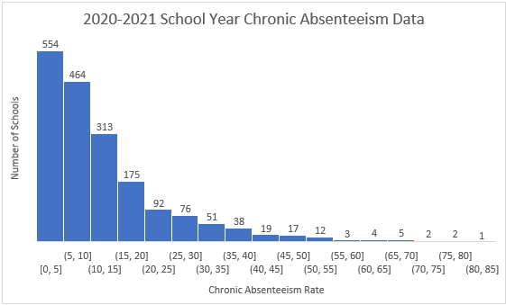
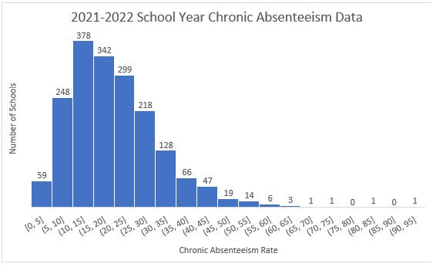
Historical Chronic Absenteeism Data
(2 of 3)
 | 2017-2018 | 2018-2019 | 2020-2021 | 2021-2022
Mean | 10.69 | 10.43 | 12.15 | 19.99
Median | 8.96 | 9.18 | 8.69 | 18.19

Slide 25
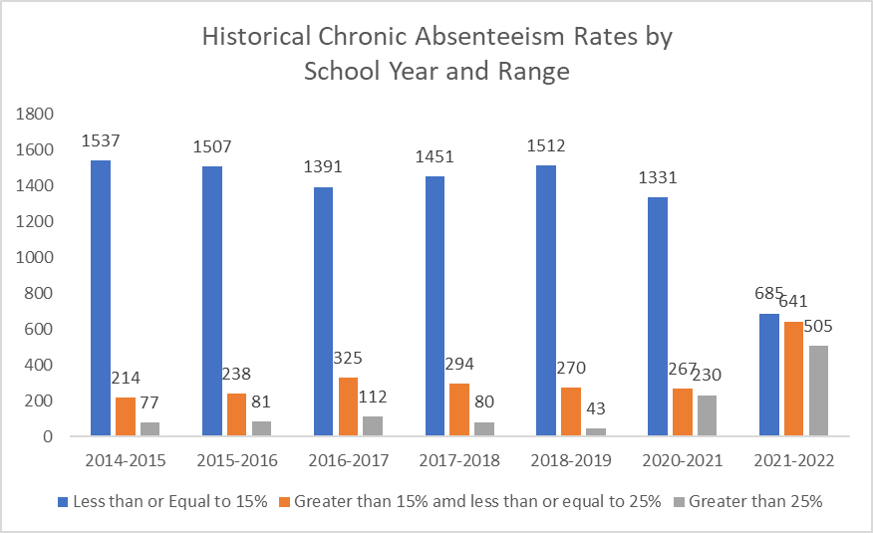
Historical Chronic Absenteeism Data
(3 of 3)
Data Notes:
The accreditation model based on the 2017 SOA was first implemented using 2017-2018 school year (SY) data.
In school year 2020-2021, divisions used locally defined definitions of “meaningful engagement” to determine whether a student was counted as present.

Slide 26
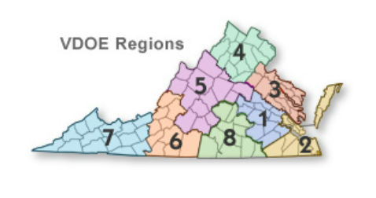
VASS Survey
The Virginia Association of School Superintendents (VASS) collected estimations from school divisions on the number of schools in their divisions, through February 28th, that had a chronic absenteeism rate greater than 25%.
There were 85 divisions that responded to the survey, representing all Superintendent Regions, and 1035 schools.
Of those schools, 25.3% had a chronic absenteeism rate over 25%. In the two years prior to the pandemic, approximately 2-4% of schools had that level of chronic absenteeism.

Slide 27
Accreditation Ratings
The VASS survey data for the 2022-2023 school year is similar to the actual 2021-2022 school year data:
  VASS survey data for the 2022-2023 school year: 25.3% of schools had a chronic absenteeism rate above 25%.
  2021-2022 school year data: 27.58% of schools had a chronic absenteeism rate above 25%.
If the VASS estimations are an accurate reflection of the 2022-2023 school year data, then approximately 28% of schools will be Accredited with Conditions based on their chronic absenteeism performance level.

Slide 28
Request to Adopt Special Provisions (1 of 2)
Division leaders report that school divisions are making considerable efforts to re-engage students in school.
It is unclear whether the chronic absenteeism indicator is a measure of the divisions efforts to address chronically absent students.
  There is still concern that COVID-19, the flu, and RSV absences are influencing chronic absenteeism.

Slide 29
Request to Adopt Special Provisions
(2 of 2)
Because of the number of absences school division leaders are reporting, the Board is being asked to approve the adoption of special provisions (8VAC20-131-380.F.3) to suspend the chronic absenteeism indicator from the determination of school accreditation status for accreditation year 2023-2024 (based on 2022-2023 school year data).
In doing so, the earned performance level and chronic absenteeism rate will still be assigned to and reported for schools based on the current year’s performance only.
The school will be required to implement improvement strategies as required under 8VAC20-131-400. Application of the school quality indicator performance levels to actions.

