Slide 1
College Partnership Laboratory Schools
State Board of Education Meeting
Thursday, March 23, 2023

Slide 2
Lab Schools –
Website & Updates
Interactive and Superintendent’s Region Map of Applications to date, awards, and pipeline

Slide 3
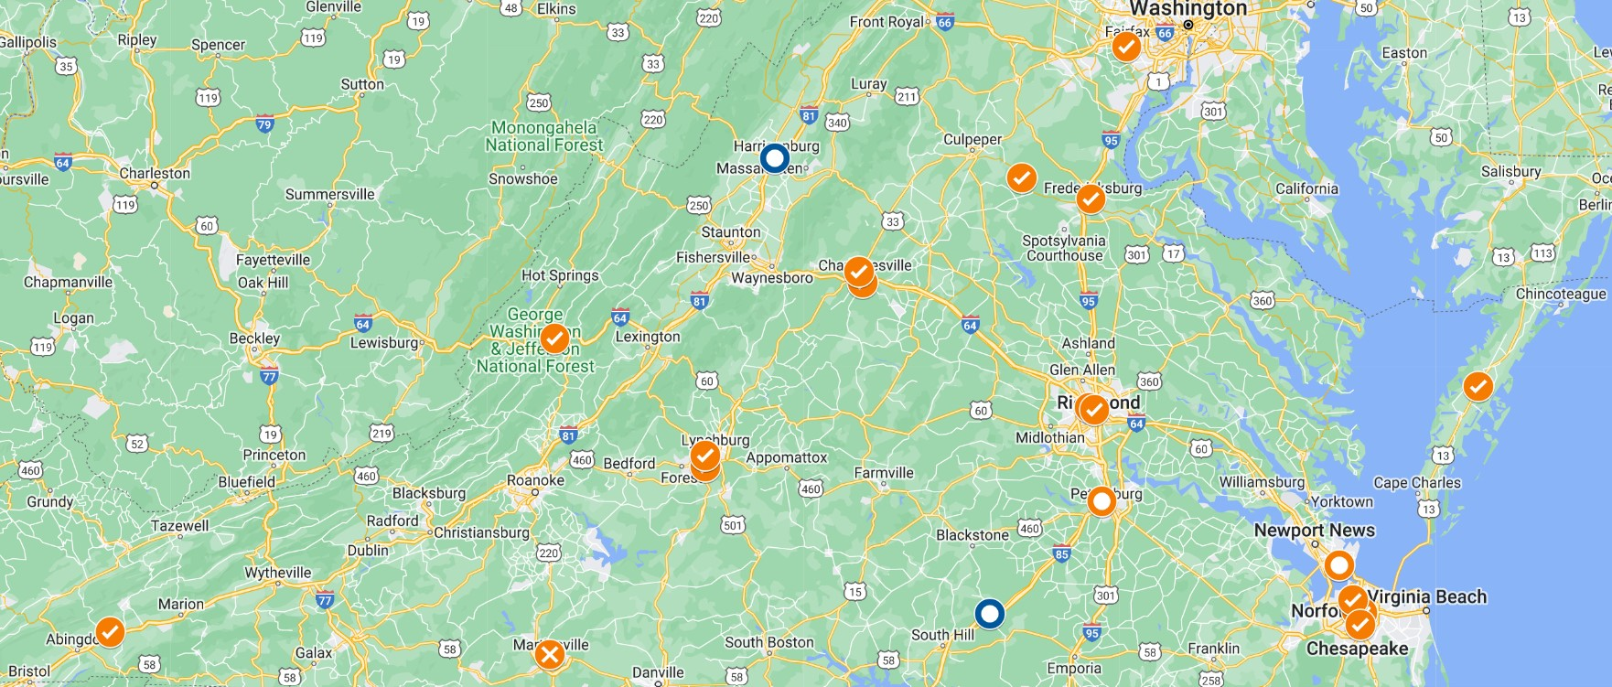
              Lab Schools - Interactive Map
VDOE’s Lab Schools page now has a Planning Grant and Lab School Applications interactive map, which provides the status of each applicant/awardee, the location and focus of the proposed Lab School, and a list of the proposed community, school division, and private sector/industry partners.
This tool allows other four and two year colleges and universities and higher education centers, as well as other Planning Grant Applicants, to identify Planning Grant Awardees, and can be used to assist private sector/industry partners in identifying how they can get involved.

Slide 4
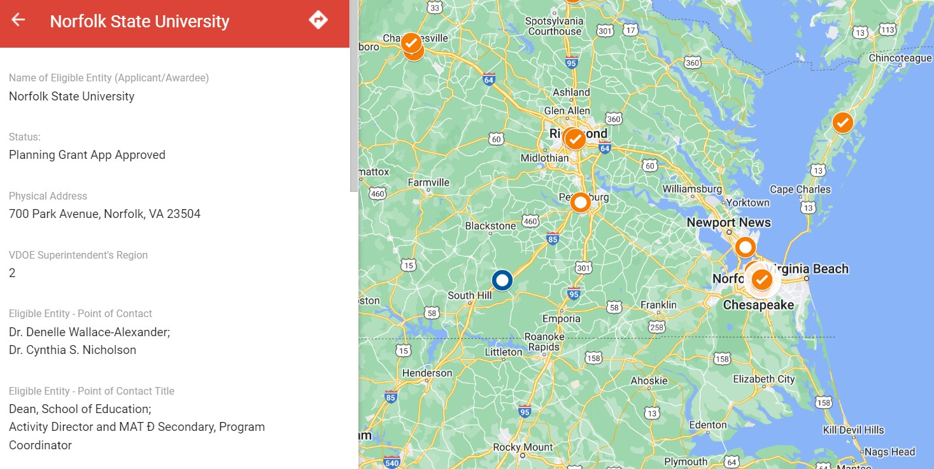
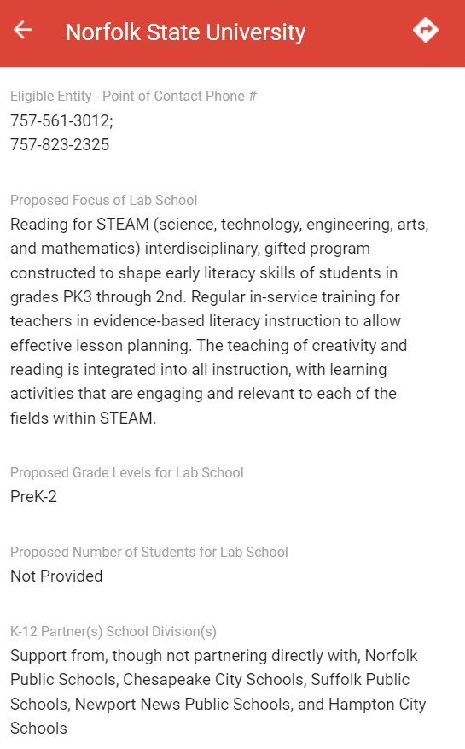
              Lab Schools - Interactive Map

Slide 5
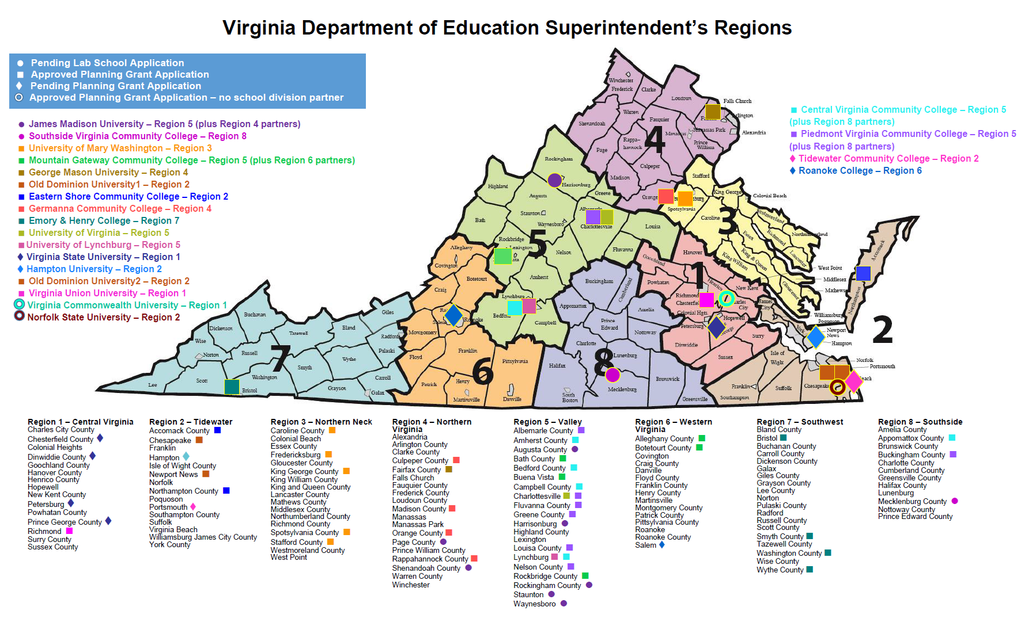
              Lab Schools – region map

Slide 6

              Lab Schools Page - faqs
A new subpage has been created on the Lab Schools page with a detailed Lab Schools FAQs section to assist potential Applicants and community, schools, and private sector/industry partners.
What benefits do Lab Schools seek to achieve?
What student populations do Lab Schools serve?
Who can start a Lab School?
My institution is considering starting a Lab School, is there funding to support planning?
Are Lab Schools public schools?
What if my business or organization does not meet the definition of an entity eligible to open a Lab School, am I still able to support the opening of a Lab School?
Are Lab Schools subject to all the same laws as public schools?
What do you need to start a Lab School?
How do I submit my application for a Lab School?
What happens to my application once submitted?

Slide 7
              Lab Schools Page - faqs
Are there geographic limitations on establishing a Lab School?
Is there a limit to the number of Lab School Applications an eligible entity may submit?
Who governs a Lab School?
Who should serve on the Governing Board of the Lab School?
Can donations and gifts be made to Lab Schools?
Could my institution charge tuition to students at a Lab School?
My institution intends to submit a Lab School application: is there funding to support start-up once approved?
My institution has been approved by the Board, is there money to support Lab School operations?
Can the Per-Pupil Funding Operating Grants be used to cover dual enrollment credits?
Is there funding for students with disabilities at Lab Schools?
Is there a deadline for accessing grants?

Slide 8
Planning Grant Applications and Awards
Planning Grant Applications to date, awards, and pipeline

Slide 9
              Planning Grant applications
  A total of 20 Planning Grants Applications have been received to date:
    Awarded: 15 Planning Grants have been awarded
    Pending: 3 Applications are in the pipeline, with Applicants receiving technical assistance, submitting additional detail or pending receipt of scores
    Received: 1 Application has been received and is pending assignment to the Funding Evaluation Review Committee for scoring
    Declined: 1 Application has been declined

Slide 10
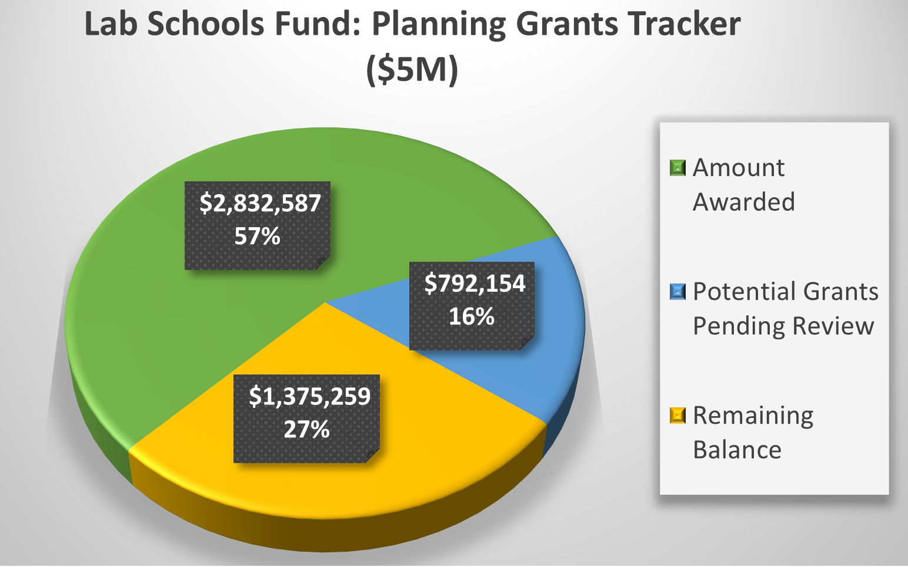
              Planning Grant Awards
Chapter 2 of the 2022 Acts of Assembly, Special Session I, appropriated $5.0 M to the College Partnership Laboratory Schools Fund (§ 22.1-349.2) for Planning Grants, of which:
  The 15 Planning Grants Awards to date total $2.83 M
  The Planning Grant Applications in the pipeline, or potential grants, total $792 K

Slide 11
Approved Planning Grants
Approved Planning Grant Applications (15)
University of Mary Washington Proposal: UMW proposes a computer and data science high school focused on preparing students for college, career opportunities, and the teaching profession. They are considering extended school year, work-based learning opportunities, and innovative instructional approaches. K-12 Education partners: Stafford County, King George, Caroline, Spotsylvania, and Fredericksburg City Public Schools Nonprofit partners: Each locality’s Economic Development Authority, George Washington Regional Commission and Chamber of Commerce, CodeVA lab school network Industry partners: Amazon, DHL, local cybersecurity firms, government agencies such as Dahlgren and Quantico
Mountain Gateway Community College Proposal: MGCC proposes a high school IT Academy focused on cybersecurity, cloud community, and IT technical support. Students will be able to earn credentials in various coding languages, including AWS Certified Cloud Practitioner K-12 Education partners: Alleghany Highlands County, Bath County, Rockbridge County, Botetourt County, and City of Buena Vista Public Schools Higher Education partners: Virginia Military Institute, Washington & Lee University, Radford University Nonprofit partners: Impact Advisors, Rockbridge Regional Public Safety Communication Center
George Mason University Proposal: GMU proposes an Accelerated College Pathways Academy focused on IT, expanding Mason’s tech talent degree programs, and having students graduate with an Associates’ degree along with their high school diploma. K-12 Education partners: Fairfax County Higher Education partners: Northern Virginia Community College Nonprofit partners: Fairfax County Economic Development Administration, Northern Virginia Technology Council Industry partners: GMU proposed building on their pre-existing relationships with private partners such as Booz Allen, Genesis Works, Amazon Web Service, Boeing, Peraton

Slide 12
Approved Planning Grants
Old Dominion University (Maritime) Proposal: Old Dominion University proposes a Maritime and Coastal Innovation Collaboratory, a STEM/CTE high school focused on the maritime industry. One pathway will include a strong focus on career and technical education and prepare students for careers immediately after graduating from high school. A second pathway will focus on preparing students for college programs designed to produce graduates ready for STEM careers in the maritime field. K-12 Education partners: Newport News Public Schools Industry partners: Virginia Space Grant; Newport News Shipbuilding-Huntington Ingalls Industries; Maritime Advisory Board for School of Supply Chain, Logistics, and Maritime Operations; 757 Regional Internship Collaborative; Reinvent Hampton Roads; and the Maritime Industrial Base Ecosystem
Virginia Commonwealth University Proposal: VCU proposes to combine their Teacher Residency program with CodeRVA develop a workforce of teachers that are able to provide computer science-focused education to their future students. K-12 Education partners: CodeRVA Regional High School
Eastern Shore Community College Proposal: ESCC proposes The Aerospace Academy Lab School of Eastern Shore, a Pre-K-12th grade STEM school focused on increasing awareness of STEM careers, specifically in the aerospace industry. There will also be increased dual enrollment opportunities for high school aged students. K-12 Education partners: Northampton County Public Schools, Accomack County Public Schools Nonprofit partners: Cal Ripken, Sr. Foundation Industry partners: NASA Wallops Flight Facility, Virginia Commercial Space Flight Authority College, and Southwest Virginia Higher Education Center

Slide 13
Approved Planning Grants
Germanna Community College Proposal: GCC proposes The Piedmont Regional Pathway to Teaching (PRPT), a Pre-K-12th grade school meant to streamline the educational and licensure process for future teachers and provide students with rigorous, hands-on instruction in schools and a route to completion and placement in as little as two years after high school graduation. K-12 Education partners: Culpeper County Schools, Orange County Schools, Madison County Schools, Rappahannock County Schools Higher Education partners: Laurel Ridge Community College, James Madison University
Emory and Henry College Proposal: Emory and Henry proposes the Southwest Virginia Healthcare Excellence Academy Laboratory School, a high school career academy for 10th-12th graders to serve as a “pipeline” for preparing future healthcare professionals to meet the workforce shortages in Southwest Virginia. K-12 Education partners: Smyth County, Wythe County, Washington County, and Bristol County Public Schools, A. Linwood Holton Governor’s School Higher Education partners: Virginia Highlands Community College, Wytheville Community
University of Virginia Proposal: UVA proposes at 7th and 8th grade STEM+CS lab school focused on developing a community of practice around education that incorporates interdisciplinary, project-based, computing-rich learning experiences; develop technical skills for future workforce success by solving real-world and community-based problems with computational tools; and engaging students by incorporating their voices and choices throughout the learning process. K-12 Education partners: Charlottesville City Schools Higher Education partners: Piedmont Virginia Community College Nonprofit partners: Tech-Girls, Charlottesville Women in Tech, Boys and Girls Club of Central Virginia

Slide 14
Approved Planning Grants
University of Lynchburg Proposal: The University of Lynchburg proposes a K-5 school focused on early literacy instruction and the science of reading. K-12 Education partners: Lynchburg City Public Schools
Old Dominion (IB Middle Years) Proposal: ODU proposes an International Baccalaureate middle school (6-8) that incorporates computer science into the IB Middle Years program. The curriculum will be designed to prepare students for three tracks in high school – a career track, an IB track, and a dual enrollment track with Tidewater Community College. K-12 Education partners: Chesapeake City Public Schools Higher Education partners: Tidewater Community College Nonprofit partners: Computer science network led by CodeVA
Virginia Union University Proposal: VUU proposes the Promise Academy Lab School, a 6-12th grade school with a focus on the sciences, technology, engineering, arts, and math (STEAM). Beginning in 10th grade, students will be required to get a credential in one of four industry area, and 11th and 12th graders with a 2.5 GPA or higher will automatically be enrolled in VUU’s Dual Enrollment program through Virginia Union Technical College (VUTCH) so that they graduate with an Associates’ degree. K-12 Education partners: Richmond Public Schools Industry partners: Altria, Genworth, Bank of America, Capital One, IBM, and Dominion Energy Nonprofit partners: Communities In Schools (CIS), the Gloucester Institute, Junior Achievement, Higher Achievement and Leadership Metro Richmond

Slide 15
Approved Planning Grants
Norfolk State University Proposal: NSU proposes a PreK-2nd grade “reading for STEAM” (science, technology, engineering, arts, and mathematics) gifted school focused on early literacy skills. The school will provide an opportunity for early identification of Gifted and Talented education among underrepresented students. Nonprofit partners: Top Ladies of Distinction Hampton Roads Chapter
Central Virginia Community College Proposal: CVCC proposes an inclusive and immersive educational environment that uses differentiated instructional methods, such as data driven inquiry method, work-based learning, problem-based learning and project-based learning within synergistic (work and education combined) classrooms. The vision is to create a seamless CTE pathway from middle school to community college to career. Potential K-12 education partners: Amherst, Appomattox, Bedford, and Campbell County Public Schools and Lynchburg City Public Schools Potential Higher Education partners: Randolph College, Sweet Briar College, Liberty University and the University of Lynchburg
Piedmont Virginia Community College Proposal: PVCC proposes on high-demand, high-wage pathways in advanced manufacturing and Information Technology (IT). The Lab School will be designed as an accelerated education-to-employment three-tier, employer-driven, stackable credential model to provide students a clear pathway to earn multiple credentials and immediately enter the workforce to gain mid-skill employment to meet regional workforce demand for skilled advanced manufacturing and IT technicians. Students will earn both high school and college credit upon successful course completion. Potential K-12 Education partners: Albemarle, Charlottesville City, Louisa, Fluvanna, Greene, Nelson, and Buckingham County Public Schools

Slide 16
Planning Grants - Pipeline
The following Planning Grant Applicants have submitted applications, received technical assistance from VDOE, and/or are resubmitting information for further consideration in the Planning Grant evaluation process:
Virginia State University Proposal: VSU proposes a PreK-12th grade S.T.E.M lab school. The school will incorporate social-emotional skill building, computational thinking, and computer science skills into all grades. K-12 Education partners: Petersburg, Chesterfield, Prince George, and Dinwiddie Public Schools Higher Education partners: Richard Bland College and Brightpoint Community College Potential nonprofit partners: CodeVA, Science Museum of Virginia, Virginia Literacy Foundation, Communities in Schools, Boys & Girls Club, Urban League, YMCA Industry partners: Amazon, Dominion Energy, LEGO
Tidewater Community College Proposal: Tidewater proposes a high-quality pre-K that will feed directly into the public school kindergarten classroom, plus professional development and support for teachers. K-12 Education partners: Portsmouth City Public Schools Nonprofit partners: Ready Regions, established by the Virginia Early Childhood Foundation, Minus 9 to 5, VB GrowSmart, United Way Higher Education Partners: Eastern Virginia Medical School (EVMS)

Slide 17
Planning Grants - Pipeline
Hampton University Proposal: Hampton proposes a K-5 school with a focus on the visual and performing arts. K-12 Education partners: Hampton City Public Schools
Roanoke College Proposal: Roanoke proposes a grades 9-12 Lab School to serve at-risk high school students with an inquiry-based Career Pathways in Education (Teacher Preparation), STEM, and Communications and Civic Leadership, including field-based research components, courses with community connection opportunities, General Education courses, and dual enrollment credits. K-12 Education partners: Salem City Schools Higher Education Partners: Virginia Western Community College

Slide 18
Planning Grants - Declined
New College Institute Proposal: NCI proposes the COLLABSCHOOL@NCI, a 6-12 STEM school with a focus on foundational computer science education for all students. Three or more career pathways will be planned through sequenced courses, culminating in industry credentials that can help students to be admitted into apprenticeship programs and/or count towards coursework at a community college. Potential Higher Education partners: Radford University’s IMPACT Lab, the Virginia Tech STEMbot Research Initiative of the I-STEM Ed graduate program, Longwood University’s School of Education Potential nonprofit partners: CodeVA Potential industry partners: Eastman Chemical Co.

Slide 19
Planning Grants – Roll-up
Name of Eligible Entity (Applicant/Awardee) | Status: | VDOE Supt's Region | GRADE LEVELS | LAB SCHOOL INDUSTRY/AREA OF FOCUS | Proposed Grade Levels for Lab School | Proposed Number of Students for Lab School | K-12 Partner(s) School Division(s)
Central Virginia Community College | Planning Grant App Submitted | 5 | High School | CTE + COLLEGE & CAREER PATHWAYS | 11-12 | 200 students | Amherst, Appomattox, Bedford, and Campbell County Public Schools and Lynchburg City Public Schools
Eastern Shore Community College | Planning Grant App Approved | 2 | All (PreK-12) | AEROSPACE INDUSTRY + COLLEGE & CAREER PATHWAYS | PreK-12 | Not provided | Accomack County Public Schools and Northampton County Public Schools
Emory & Henry College | Planning Grant App Approved | 7 | High School | HEALTHCARE INDUSTRY CAREER PATHWAYS | 10-12 | Initial cohort: 32 students Total future cohort: 96 students | Smyth County Public Schools Also, Wythe County, Washington County, and the City of Bristol, and the A. Linwood Holton Governor’s School
George Mason University | Planning Grant App Approved | 4 | High School | INFORMATION TECHNOLOGY PATHWAYS + ACCELERATED COLLEGE, ASSOCIATE DEGREE, CREDENTIALS | 11-12 | Initial cohort: 30 students in 11th grade and 30 students in 12th grade Total future cohort: Potential to expand to additional students and/or grade levels as the program develops | Fairfax County Public Schools
Germanna Community College | Planning Grant App Approved | 4 | All (PreK-12) | ACADEMIC LEARNING LOSS + TEACHER PREPARATION & LICENSURE | PreK-12 | Initial cohort: 24 students Total future cohort: Not provided | Culpeper County Public Schools Orange County Public Schools Madison County Public Schools Rappahannock County Public Schools

Slide 20
Planning Grants – Roll-up
Hampton University | Planning Grant App Submitted | 2 | Elementary (K-5) | ARTS, INCLUDING DIGITAL | K-5 | 300 students | Hampton City Schools
James Madison University | Lab School Application Submitted | 5 | High School | INTERDISCIPLINARY + COLLEGE & CAREER PATHWAYS, WITH TEACHER PREPARATION | 9-12 | Initial cohort: 100 Freshmen and 100 Sophomores Future total cohort: 400 students | Augusta, Harrisonburg, Page, Rockingham, Shenandoah, Staunton, and Waynesboro County Public Schools
Mountain Gateway Community College | Planning Grant App Approved | 6 | High School | INFORMATION TECHNOLOGY & CYBERSECURITY PATHWAYS + CERTIFICATIONS | 10-12 | Not provided | Alleghany, Bath, Botetourt, and Rockbridge County Public Schools
New College Institute | Planning Grant App Not Approved | 6 | All (K-12) | INTEGRATIVE STEM & EXPERIENTIAL LEARNING | K-12 | Not provided | Franklin County Public Schools
Norfolk State University | Planning Grant App Approved | 2 | Elementary (PreK-2) | READING FOR STEAM GIFTED + IN-SERVICE TEACHER TRAINING | PreK-2 | Not Provided | Support from, though not partnering directly with, Norfolk Public Schools, Chesapeake City Schools, Suffolk Public Schools, Newport News Public Schools, and Hampton City Schools
Old Dominion University | Planning Grant App Approved | 2 | High School | MARITIME INDUSTRY + COLLEGE & CAREER PATHWAYS & IN-SERVICE TEACHER TRAINING | 9-12 | Initial cohort: Pilot group of 100 students Future cohort: Gradually move to increase to a full high school program of 100 students per level in grades 9-12; 400 students total. | Newport News Public Schools
Old Dominion University | Planning Grant App Approved | 2 | Middle School | COMPUTER SCIENCE IB + COLLEGE & CAREER PATHWAYS | 6-8 | Not provided | Chesapeake City Public Schools

Slide 21
Planning Grants – Roll-up
Piedmont Virginia Community College | Planning Grant App Approved | 5 | High School | HIGH SCHOOL: ADVANCED MANUFACTURING & IT COLLEGE & CAREER PATHWAYS + DUAL ENROLLMENT | 11-12 | 80 students | Potential partnering school divisions: Albemarle County Public Schools Charlottesville City Schools Louisa County Public Schools Fluvanna County Public Schools Greene County Public Schools Nelson County Public Schools Buckingham County Public Schools
Roanoke College | Planning Grant App Submitted | 6 | High School | HIGH SCHOOL: EDUCATION, STEM & COMMUNICATIONS COLLEGE & CAREER PATHWAYS | 9-12 | 25 students | Salem City Schools
Southside Virginia Community College | Lab School Application Submitted | 8 | High School | CAREER LITERACY PATHWAYS | 9-12 | Not provided | Mecklenburg County Public Schools
Tidewater Community College | Planning Grant App Submitted | 2 | PreK | KINDERGARTEN READINESS + PRE-SERVICE & IN-SERVICE TEACHER TRAINING | PreK | 20 students | Portsmouth Public Schools
University of Lynchburg | Planning Grant App Approved | 6 | Elementary (K-5) | EARLY LITERACY & SCIENCE OF READING | Beginning with grades K-1, adding grade levels up to 5th grade | 140 students | Lynchburg City Public Schools

Slide 22
Planning Grants – Roll-up
University of Mary Washington | Planning Grant App Approved | 3 | High School | COMPUTER & DATA SCIENCE + COLLEGE & CAREER PATHWAYS | 9-12 | 400 students | Stafford County Public Schools
University of Virginia | Planning Grant App Approved | 5 | Middle School | STEM & COMPUTER SCIENCE | 7-8 | 599 students | Charlottesville City Schools
Virginia Commonwealth University, Richmond Teacher Residency Program | Planning Grant App Approved | 1 | High School | COMPUTER SCIENCE + PRE-SERVICE TEACHER RESIDENCY & IN-SERVICE TRAINING | 9-12 | 345 or more students | Henrico County Public Schools
Virginia State University | Planning Grant App Submitted | 1 | Elementary (PreK-5) OR Middle & High School (6-12) | STEM PROGRAMMING & INITIATIVES | PreK-12 | Not provided | Petersburg Public Schools, and in partnership with Chesterfield, Dinwiddie, and Prince George Public Schools
Virginia Union University | Planning Grant App Approved | 1 | Middle & High School | STEAM | 6-12 | Not Provided | Richmond Public Schools

Slide 23
Lab School Application Guidelines
Updates to Lab School Application Guidelines

Slide 24
Lab School Application Guidelines
With the Board’s approval at the February meeting, VDOE made substantiative and administrative improvements to the “Guidelines for Submission and Approval of College Partnership Laboratory School Applications."
Key changes include:
  Eliminated one-year barrier from time of Lab School Application submission to launch of a Lab School;
  Eliminated nine-month barrier prior to opening for Applicant to enter into a contract with the Board – reduced to statutory 90-days within approval of Lab School by Board;
  Eliminated six-month barrier prior to opening that local school board must apply for initial waivers (if any) to SBOE on behalf of Applicant; and
  Reduced six-month barrier that Applicant must have all school leadership of the Lab School retained on contract down to two months prior to opening.

Slide 25
Standing Committee – Members, Process, Meetings, and Applications
Standing Committee’s Members, Process, Proposed Calendar for 2023 Meetings, and Received Lab School Applications

Slide 26
Standing Committee - Members
Board of Education Members Mr. Bill Hansen Mr. Andy Rotherham Education and Professional Community Members Ms. Joan Wodiska Mr. John Bailey Ms. Pam Moran

Slide 27
Standing Committee - Process
Standing Committee: The process for the Board’s Standing Committee to review the Lab School Applications, develop recommendations, and deliver a report to the Board is as follows:
Receive the Lab School Application from the Department after it has been reviewed for completeness by the Department; Review the Lab School Application; Meet with and interview the Applicant. Provide a public comment period on the Lab School Application; Develop and provide a written report of recommendations to the Board based on elements of the Application and any public comment; and Provide a copy of the written report to the Applicant.

Slide 28
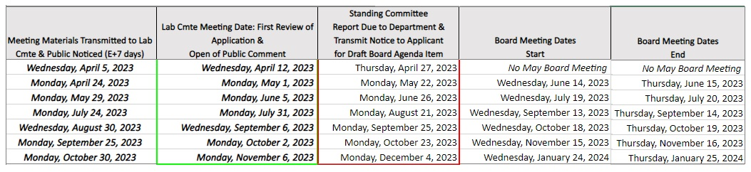
Standing Committee - Meetings
Standing Committee: Please see the proposed calendar for 2023 Standing Committee Meetings. For eligible entities to target the submission of a Lab School Application for Board approval, submission dates to the Standing Committee prior to their next successive meeting is an important target to share.

Slide 29
Standing Committee -
Lab School Applications
Two Lab School Applications have been received and have been provided to the Standing Committee: James Madison University (JMU) JMU Application is in the review and public comment process with the Standing Committee Southside Virginia Community College (SVCC) SVCC is currently in the process of resubmitting their Lab School Application after receiving technical assistance from VDOE

Slide 30
Standing Committee - Next Steps
Lab School Application: Standing Committee reviewing and suggesting revisions to 2011 application document
  The Planning Grant Application has already been updated to capture more data on community, school, and private sector/industry partnerships.
Recommendations to Board: Write and submit report to the Board on the Lab School Applications received to date:
  JMU: pending technical assistance to Standing Committee from VDOE and OAG staff
  SVCC: pending resubmission by SVCC

