Slide 1
Timeline for the Development and Revisions to the Science Standards of Learning
Brendon Albon, Director of STEM and Innovation
Anne Petersen, Science Coordinator

Slide 2
Proposed Timeline
Standards and Curriculum Framework (CF) Development (11 Courses)
2018 Science Standards and CF Revision (13 grade levels/courses)
Anticipated adoption of the 2025 Science Standards of Learning (24 courses)
Implementation
2026-2027 Crosswalk
2027-2028 Full Implementation
2023
2024
2025
2026-2028
Notes:
Timeline extended to account for the large number of courses. Eleven approved courses do not currently have standards or curriculum frameworks in place. These are being developed for the 11 courses to ensure students have content and expectations across the Commonwealth. Timeline is also extended to allow the advisory board and stakeholders time to review and provide feedback on the large number of documents that will be a part of the 2025 Science Standards of Learning.

Slide 3
History of Content Guidelines
Currently 33 laboratory science courses on the Board of Education Approved Courses to Satisfy Graduation Requirements for the Standard, Advanced Studies, and Modified Standard Diplomas in Virginia Public Schools.
Eleven of these advanced level courses currently do not have standards or expectations.
Content Guidelines were constructed to support instruction of these courses with the intent that these become standards during the 2025 revision.

Slide 4
Standards Development
Environmental Science
Biology II: Advanced Survey of Biology Topics
Biology II: Anatomy and Physiology
Biology II: Ecology
Biology II: Genetics
Chemistry II
Earth Science II: Advanced
  Survey of Earth Science Topics
Earth Science II: Geology
Earth Science II: Oceanography
Earth Science II: Astronomy
Physics II
The standards will ensure that all students enrolled in these courses receive the same rigorous content and meet the high expectations appropriate for advanced level coursework.
The standards will align to descriptions in the School Courses for the Exchange Database (SCED) used to communicate courses across divisions and to higher education.

Slide 5
Standards Revision
Standards to be part of the revision process include:
K-6 Science
Life Science
Physical Science
Biology I
Chemistry I
Earth Science I
Physics I
Key features of the revision process include
Science Education Advisory Board
Public feedback on 2018 Science Standards of Learning and Curriculum Frameworks
Stakeholder feedback throughout the revision process (to include institutes of higher education, parents, business and organizations, and K-12 educators)
Extended feedback windows on the proposed draft standards due to the extensive number of documents to be part of the 2025 Science Standards of Learning.

Slide 6
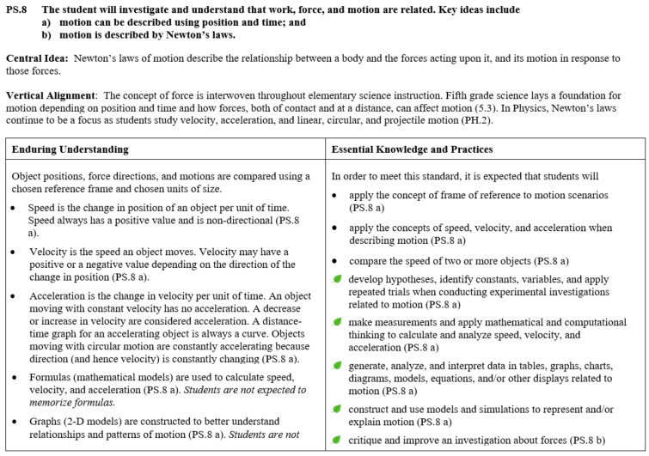
Structure of the 2018 Science Curriculum Framework (CF)
The Standard is identified
The Central Idea of the standard is summarized
Vertical Alignment provides guardrails for instruction and can shape pre-assessment
Students are expected to know all Enduring Understandings and be able to do all Essential Knowledge and Practices
Guardrails (in italics) exist for both instructional and assessment purposes
Specifics in standard are indicated for ease of alignment
The “leafs” indicate integration of Scientific and Engineering Practices
Notes:
Looking at the curriculum framework, the first thing we see is the standard. The standard was written to support teachers as they develop questions to guide student understanding of science concepts.
The Central Idea is a short summary of the standard and should be at the forefront of planning science instruction and assessments.
The Vertical Articulation identifies content across grade levels. In planning science instruction, teachers often identify and activate student prior knowledge. Knowing what science concepts were taught in previous grades is useful in this regard. Teachers should use pre-assessments to determine current levels of student knowledge and material in this section is a good starting point.
This table unpacks the standards into Enduring Understandings, we see on the left, and Essential Knowledge and Practices, we see on the right. This is essential in planning science instruction.
The Enduring Understandings identifies concepts that students are expected to know as a result of science instruction. The Essential Knowledge and Practices identifies what students should be able to do as a result of science instruction.
Looking further into the table, you will see some parts are italicized. These italicized parts exist to provide guardrails for both instructional and assessment purposes. In this case, for example, we can see that “Formulas … are used to calculate speed, velocity, and acceleration. However, “Students are not expected to memorize formulas.”
At the end of each Enduring Understanding and Essential Knowledge and Practice you will see that it is aligned to a specific standard.
And lastly, you will see that in the Essential Knowledge and Practices that some items are bulleted while other items have a leaf. The leafs indicate integration of the Scientific and Engineering Practices!

