Slide 1
The Impact of School Funding Reform on Student Achievement
Presentation to the
Virginia Board of Education
July 26, 2018

Slide 2
Presentation Overview
Education funding in Virginia and national comparisons
Relationship between reforms in education funding and student achievement
Funding needed to raise student achievement in Virginia

Slide 3
Education Funding in Virginia
Is School Funding Fair? A National Report Card¹
  Fair is defined as a state finance system that ensures equal educational opportunities by providing a sufficient level of funding that is distributed to districts within the state to account for additional needs generated by student poverty
  Evaluates states on four separate but interrelated measures of fairness
  Takes into account factors that influence costs, such as geography, regional labor markets, and population density
1 Baker, B. D., Farrie, D. & Sciarra, D. (2018). Is school funding fair: A national report card. Available online at:
http://www.edlawcenter.org/assets/files/pdfs/publications/Is_School_Funding_Fair_7th_Editi.pdf

Slide 4
Education Funding in Virginia
From Is School Funding Fair? A National Report Card¹
Fairness Measures | Results for Virginia
Adjusted state and local per pupil funding | Virginia ranks 29th, down from 21st in 2007
Distribution of funds to high poverty schools | High poverty divisions receive $0.89 for every dollar low poverty divisions receive
State education spending relative to state fiscal capacity | Earned C and D grades on education dollars spent for every $1,000 generated by economic productivity and personal income, respectively
Proportion of children attending public school and income disparity between public and nonpublic school families | Virginia ranks 29th in income disparity between public and nonpublic families
1 Baker, B. D., Farrie, D. & Sciarra, D. (2018). Is school funding fair: A national report card. Available online at:
http://www.edlawcenter.org/assets/files/pdfs/publications/Is_School_Funding_Fair_7th_Editi.pdf

Slide 5
Relationship Between Funding and Achievement: Logic Model
Short
Reductions in student-to-teacher ratios
Increases in teacher salaries
Medium
Higher academic outcomes
Smaller income-based achievement gaps
Long
More completed years of education
Reduction in adult poverty

Slide 6
Relationship Between Funding and Achievement: Research History
Early research:
  Cross-sectional analysis of students in 1965-66 found school resources unrelated to student achievement on standardized tests²
  Replicable results through the 1980s³
Limitations:
  Tests scores are imperfect measures of learning
  Funding low-achieving schools creates artificial negative relationship between funding and outcomes
More recently:
  Court-mandated school finance reforms in the 1970’s and 1980’s, coupled with advances in research methodology, indicate a stronger link between funding and student outcomes
  Research is still inconclusive
2 Coleman, J. S. (1966). Equality of education opportunity. Inter-university Consortium for Political and Social
Research (Ann Arbor, MI).
3 Hanushek, E. (1986). The economics of schooling: Production and efficiency in public schools. Journal of Economic Literature, pp. 1141-77.

Slide 7
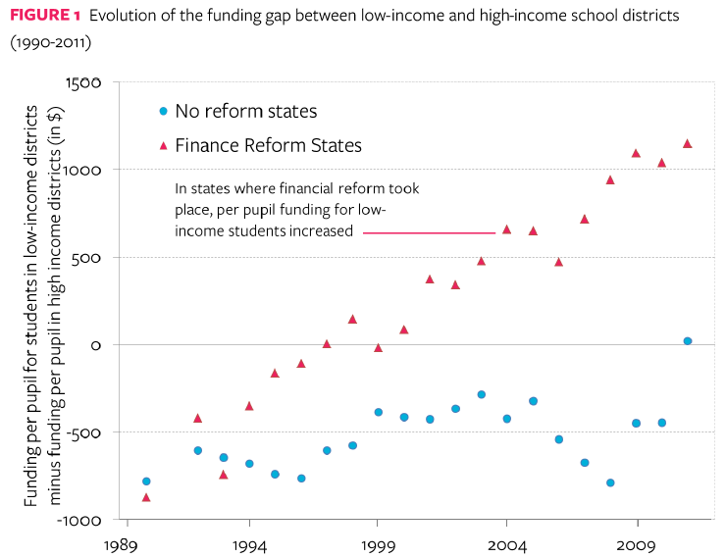
Relationship Between Funding and Achievement
“…this increase was not accomplished by redistributing money from rich to poor districts, but rather by increasing state
funding across the board, with larger increases in low income districts.”⁴
4 Lafortune, J., Rothstein, J. & Schanznebach, D. (2016). Can school finance reforms improve student achievement?
Available online at: http://www.irle.berkeley.edu/files/2016/IRLE-Can-school-finance-reform-improve-student-achievement.pdf

Slide 8
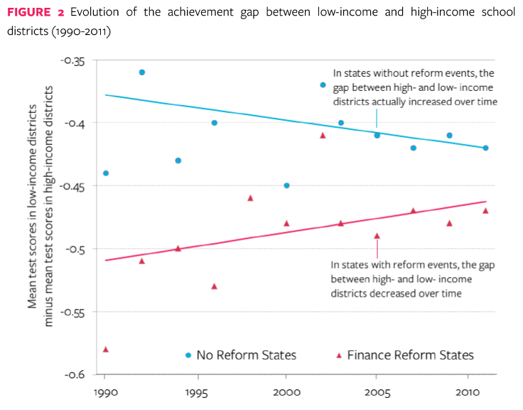
Relationship Between Funding and Achievement (continued-1)
“…effect [size] of school finance reforms is twice as large as the effect implied by class-size reduction…”⁴
4 Lafortune, J., Rothstein, J. & Schanznebach, D. (2016). Can school finance reforms improve student achievement?
Available online at: http://www.irle.berkeley.edu/files/2016/IRLE-Can-school-finance-reform-improve-student-achievement.pdf

Slide 9
Relationship Between Funding and Achievement (continued-2)
Evaluations of state-specific reforms:
  Improved test scores in low income districts^{5,6}
  Increased college attendance for non-poor children in low income districts⁷
Across state reforms:
  Mixed evidence on the effect of high school dropouts⁸
  No significant change in distribution of test scores⁹
  Reduced gap on SAT scores between high and low income students¹⁰
  10 percent increase in per-pupil spending each year for all 12 years of public school is associated with:¹¹
    0.43 additional years of completed education
    9.5% higher earnings
    6.8 percentage point reduction in annual incidence of adult poverty
See full reference list on slide 12

Slide 10
Funding Needed to Raise Student Achievement in Virginia
National Education Cost Model¹²
  Based on two longitudinal data panels of school funding and student outcomes
  Estimates costs associated with reaching average levels of student achievement
  Does not show what funding might be necessary to close the achievement gap
12 Baker, B. D., Weber, M. Srikanth, A., Kim, R. & Atzbi, M. (2018). The real shame of the nation: The causes and
consequences of interstate inequity in public school investments. Rutgers University. Available online at:
https://drive.google.com/file/d/1cm6Jkm6ktUT3SQplzDFjJIy3G3iLWOtJ/view

Slide 11
Funding Needed to Raise Student Achievement in Virginia
Virginia Current Per Pupil Spending and Predicted Costs
of Achieving National Average Outcomes¹²
12 Baker, B. D., Weber, M. Srikanth, A., Kim, R. & Atzbi, M. (2018). The real shame of the nation: The causes and
consequences of interstate inequity in public school investments. Rutgers University. Available online at:
https://drive.google.com/file/d/1cm6Jkm6ktUT3SQplzDFjJIy3G3iLWOtJ/view

Slide 12
References
From slide 9:
  5 Guryan, J. (2001). Does money matter? Regression-discontinuity estimates from education finance and reform in Massachusetts. National Bureau of Economic Research. Available online at: http://www.nber.org/papers/w8269
  6 Roy, J. (2011). Impact of school finance reform on resource equalization and academic performance: Evidence from Michigan. Education Finance and Policy, 6 (2), pp. 137-67.
  7 Hyman, J. (2016). Does money matter in the long run? Effects of school spending on educational attainment. Education Policy Initiative Working Paper 09-2016. University of Michigan.
  8 Hoxby C. M. (2001). All school finance equalizations are not created equal. The Quarterly Journal of Economics, pp. 1189-1231.
  9 Downes, T. A. & Figlio, D. (1998). School finance reforms, tax limits, and student performance: Do reforms level up or dumb down? Mimeo. University of Wisconsin.
  10 Card. D. & Payne, A. A. (2002). School finance reform, the distribution of school spending, and the distribution of student test scores. Journal of Public Economics, 83 (1), pp. 49-82.
  11 Jackson, C. K., Johnson, R. C. & Persico, C. (2015). The effects of school spending on educational and economic outcomes: Evidence from school finance reforms. National Bureau of Economic Research Working Paper Series. Available online at: http://www.nber.org/papers/w20847

