Slide 1
2018 Virginia Science Standards of Learning
Attachment C
BOE Initial Review
June 28, 2018

Slide 2
Support for 2018 Revision
The 2018 Science Standards of Learning were informed by:
Teachers, Science and STEM division and school leaders;
Public comment;
NGSS, TIMMS, NAEP standards and frameworks;
Virginia IHE and businesses;
State agency education specialists; and
Science, STEM, and education support organizations.
Notes:
The Science Standards of Learning revision process was an informed, collaborative effort that included stakeholders in K-12 education, science organizations, businesses, and institutes of higher education within the Commonwealth. A steering committee of science leaders as well as review committees composed of science leaders, school administrators, and K-12 teachers met to review both national and international science standards and curriculum and to review public comment on the 2010 Science Standards of Learning. These documents and comments aided in the review of the 2010 Science Standards and suggested revisions were made by the committees.

Slide 3
Revision Highlights
Rewording of the standards to be more conceptual in nature and to support the development of essential questions and deeper learning;
reorganization of the science skills and processes to show vertical alignment and to support the integration of scientific inquiry and engineering design into content instruction;
explicit integration of the 5C’s into the science processes and skills;
introduction of yearly themes K-6 to support; and
increased vertical alignment of science concepts.
Notes:
When looking at the strike through version of the Science Standards of Learning, the changes seem substantial. In actuality, the science content did not change significantly. The big ideas of science are the same; the suggested changes were made to assist teachers in the development of essential questions. The shift in language in the science standards includes a conceptual approach to the standards vs lists of terminology.
The science skills and processes were also reorganized to provide teachers with categories of skills; these categories allow for an easier vertical articulation of the skills and processes. In order to support Virginia’s Profile of a Graduate, the science skills and processes categories have been aligned to each of the 5 C’s (see next slide). As students use the science while conducting investigations and “doing” science, they will be building their workplace readiness skills.
In the revised version of the Science Standards of Learning, yearly themes have been included in the K-6 standards. Many times in elementary science instruction, science concepts are taught in isolation. The themes were developed to guide teachers and students in how concepts relate to form a big picture in science. Due to these themes, some content has been reorganized between grade levels. This reorganization does not include additional content demands on the Standards of Learning Assessment; instead, the reorganization allows for concepts to be covered in a more cohesive manner allowing for content connections. The reorganization also allows for the more abstract concepts to be covered in a later grade thus allowing time for students to reach a higher level of cognitive maturation.

Slide 4
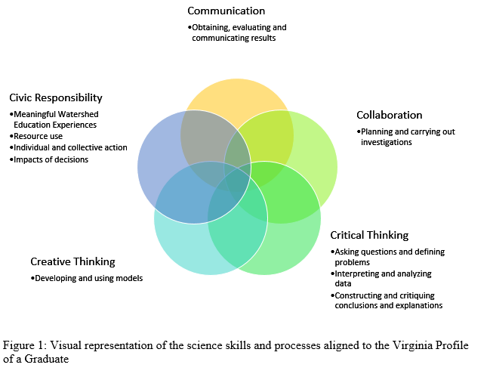
Skills and Processes with Profile of a Graduate
Notes:
The Virginia Profile of a Graduate promotes the development and use of communication, collaboration, critical and creative thinking skills and the applications of civil responsibility (5 C’s); these skills are to be reflected in the instruction of all subjects K-12. The Science Standards of Learning are intentionally developed to support the 5C’s through the science skills and processes.
Communication relates to the science processes and skills category of evaluating and communicating results.
Collaboration relates to the science processes and skills category of planning and carrying out investigations.
Critical thinking relates to the science processes and skills categories of asking questions and defining problems and interpreting and analyzing data.
Critical thinking relates to the science processes and skills categories of developing and using models and asking questions and defining problems.
Civic Responsibility is not reflected in a particular science processes and skills category; however, it can be seen in the student expectations within the curriculum framework. These include the conducting of action projects as part of their Meaningful Watershed Education Experience (MWEE) that are to be conducted at each grade band level and through issue definition and community and environmental impacts which support the content standards.

Slide 5
A Sample Change
2010 Standard
3.5 The student will investigate and understand relationships among organisms in aquatic and terrestrial food chains. Key concepts include
producer, consumer, decomposer;
herbivore, carnivore, omnivore; and
predator and prey.
2018 Revised Standard
3.5 The student will investigate and understand that aquatic and terrestrial ecosystems support a diversity of plants and animals. Key ideas include
ecosystems are made of living and nonliving components of the environment; and
relationships exist among organisms in an ecosystem.
Notes:
As you can see in the example above, the 2010 Science Standards often provided teachers with lists of vocabulary. These lists fostered a learning environment that focused on regurgitating vocabulary terms vs a focus on the instruction of science concepts. The revised standards were developed to focus on concepts. From these revised standards, teachers should be able to generate essential questions to lead instruction. For example, what are the components of an environment? What are the living components of an environment? Nonliving components? What types of relationships exist between organisms in an ecosystem? Explain the different type of relationships you would expect to experience in an ecosystem. How would you model relationships in an ecosystem?
These questions allow for a deeper understanding of the concepts vs defining terms.

Slide 6
STEM and the Science Standards
Emphasis continues to be the inclusion of inquiry and the vertical development of scientific skills and processes K-12.
Engineering and iterative thinking opportunities are included when they can support content.
Engineering practices embedded within the science skills and processes as appropriate.
Notes:
The integrated approach to teaching Science, Technology, Engineering, and Mathematics (STEM) is a focus of education nationwide. Not only is an integrated approach needed to build cross-curricular connections, it is also important in creating a STEM workforce and STEM literate citizens. Iterative thinking, a type of thinking that is the foundation of engineering design, is a type of thinking that should be developed K-12. The skills needed to work through a problem, analyze data collected, and to revise a solution to better meet the guidelines of a problem, leads to the development of the iterative thinking mindset. Since engineering is the application of science and mathematical concepts, a strong foundation in each of these disciplines is needed. It is also important that educators make explicit connections between engineering activities and the foundational science and mathematical concepts that support the activity.
In order to promote integrated instruction and iterative thinking, the science standards of learning include:
Emphasis on inquiry and the continual development of skills and processes K-12.
Engineering and iterative thinking opportunities included in the standards when they can support content.
Engineering practices embedded within the science skills and processes as appropriate.

Slide 7
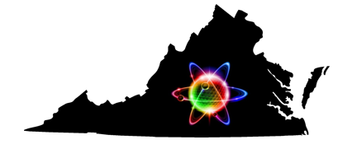
Questions?

