Slide 1
Follow-up on Data Requests from Board of Education April 2018 Retreat
Virginia Board of Education
Work Session
June 27, 2018

Slide 2
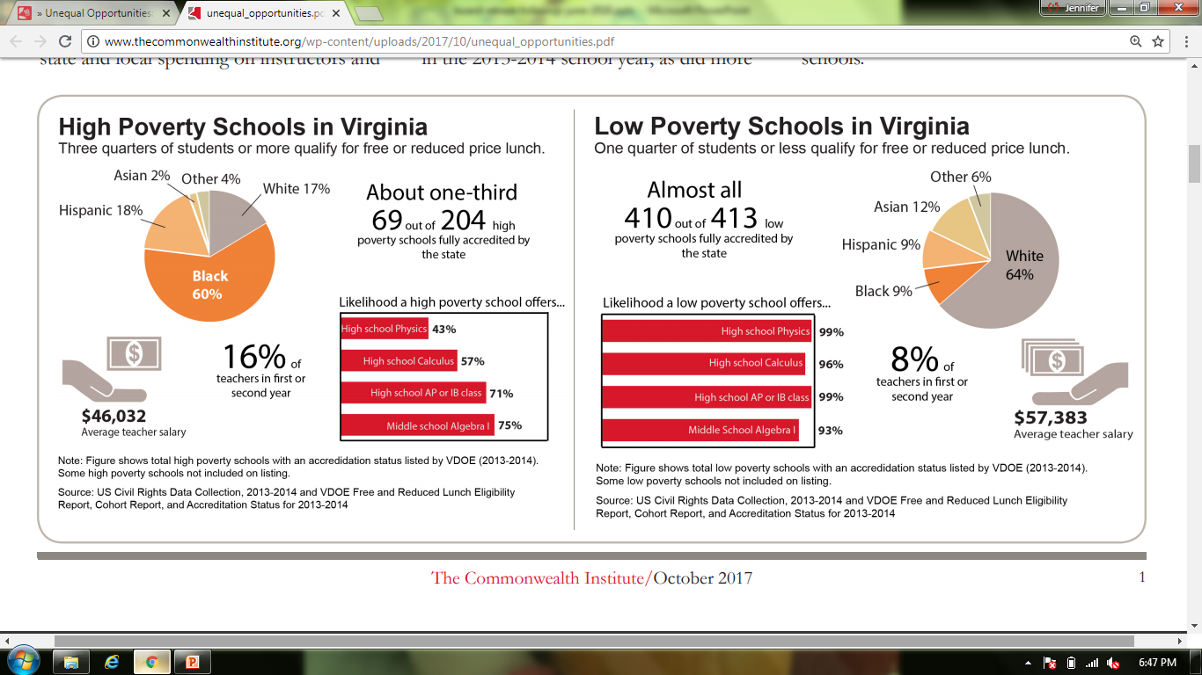
Virginia Teacher Salary in High and Low Poverty Schools
Additional context on average salaries within high and low poverty schools
High Poverty Schools
Low Poverty Schools
Source: Duncombe, C. (October 2017). Unequal Opportunities: Fewer Resources, Worse Outcomes for Students in Schools
with Concentrated Poverty. The Commonwealth Institute.
Notes:
In 2017, The Commonwealth Institute reported that average teacher salaries in high poverty schools were significantly lower than average teacher salaries in low poverty schools.
To determine high and low poverty schools, the Commonwealth Institute ranked schools by student poverty, defined as the percent of students eligible for free- and reduced-price meals. High poverty schools represent the highest 25% of schools in poverty. Low poverty schools represent the lowest 25% of schools in poverty.
The analysis is based on data from 2013-14.

Slide 3
Virginia Teacher Salary in High and Low Poverty Schools
Data indicates a substantial gap between teacher salaries in high and low poverty schools over time
Source: Virginia Department of Education Teacher Salary Report, 2013-14 and 2017-18 Data
Notes:
We first examined the most current data available through the Virginia Department of Education Teacher Salary Report to determine whether the salary gap between high and low poverty schools improved, worsened, or stayed the same since the 2013-14 school year (the data year analyzed for the Commonwealth Institute report).
While average salaries have increased in both high and low poverty schools by approximately 7 percent, there is still a substantial gap in average salaries for teachers in high and low poverty schools. In 2017-2018, the average salary of teachers in high poverty schools was $11,997 less than the average salary of teachers in low poverty schools.

Slide 4
Virginia Teacher Salary in High and Low Poverty Schools
The gap between teacher salaries in high and low poverty schools is smaller for schools in the same division
Source: Virginia Department of Education Instructional Personnel Report, 2017-2018 Data
Notes:
Teacher salary schedules are set at the division level, and with some exceptions and typically based on highest degree earned and teaching experience. Customarily, teachers with the same degree, same experience level, and teaching in the same division will receive the same salary. Examining salaries in high and low poverty schools in the same division tells us whether the gap in salaries is due to local economic factors or whether it is related in some way to the distribution of teachers in those schools.
In Virginia, there are 12 divisions that have both high poverty and low poverty schools. In those divisions, on average, teachers in high poverty schools receive $3,599 less than teachers in low poverty schools.
The salary gap between high and low poverty schools in the same division is 70 percent less than the salary gap between high and low poverty schools across the state. This indicates that the large salary gap across the state more likely reflects the geographical location of high and low poverty schools. For example, high poverty schools are more likely to be located in rural locations, where salaries are lower overall, compared to low poverty schools in suburban, affluent communities where salaries are higher.

Slide 5
Virginia Teacher Salary in High and Low Poverty Schools
Teachers in high poverty schools are less likely to have graduate degrees compared to teachers in low poverty schools in the same division
Source: Virginia Department of Education Instructional Personnel Report and Teacher Licensure System, 2017-2018 Data
Notes:
The salary gap between high and low poverty schools in the same division is most likely due to the distribution of teachers’ experience or degree level given how divisions typically structure salary schedules. Some divisions may provide incentives to teachers who teach hard-to-fill subjects or hard-to-staff schools. The department does not collect any information on this. The department also does not have a method to determine years of teaching experience for all teachers.
We do collect information on teacher degree level. In low poverty schools, teachers are more likely to have a graduate degree (Masters or above) than teachers in high poverty schools (64 percent in low poverty schools compared to 54 percent in high poverty schools). This may account for some of the difference in salary. High poverty schools are also more likely to have teachers with provisional licenses (8 percent in high poverty schools compared to 5 percent in low poverty schools).
While pay structures incentivize advanced degrees, and many teachers who enter the profession with bachelor’s degrees go onto obtain their masters after entering the profession, most research demonstrates that teachers with master’s degrees are, on average, no more likely to raise student test scores than those without. There is some evidence that secondary math and science teachers (and their students) may benefit from holding advanced degrees in their content area.

Slide 6
Route to Endorsement for Virginia Teachers New to the Profession
More than one-third of first year teachers receive endorsements through approved programs in Virginia
Source: Virginia Department of Education Instructional Personnel Report and Teacher Licensure System, 2016-2017 Data
Notes:
We examined routes to endorsement for new Virginia teachers. Teachers can have multiple endorsements. These data represent 4,753 teachers and 5,568 endorsements.
Over one-third of teachers within their first year of teaching received an endorsement from a Virginia approved program.

Slide 7
Completion Rates for Teacher Preparation Programs
Neither SCHEV nor USED Title II report completion rates by program
A lack of formal entry requirements make it difficult to determine when a student enters a program
Determining completion rates for teacher preparation program would require additional data collection from colleges and universities

Slide 8
Teacher Turnover and Division Salary Schedules
Although research suggests that providing larger salary increases to newer teachers as a method of early-career retention, very few divisions in Virginia “front-load” their salary schedules
Examining the relationship between teacher turnover and salary schedule would require additional data from divisions

