Slide 1
Teacher Shortages in the U.S. and Virginia
Presentation to
the Virginia board of education
Stephanie Aragon
Kate Wolff
March 22, 2018

Slide 2
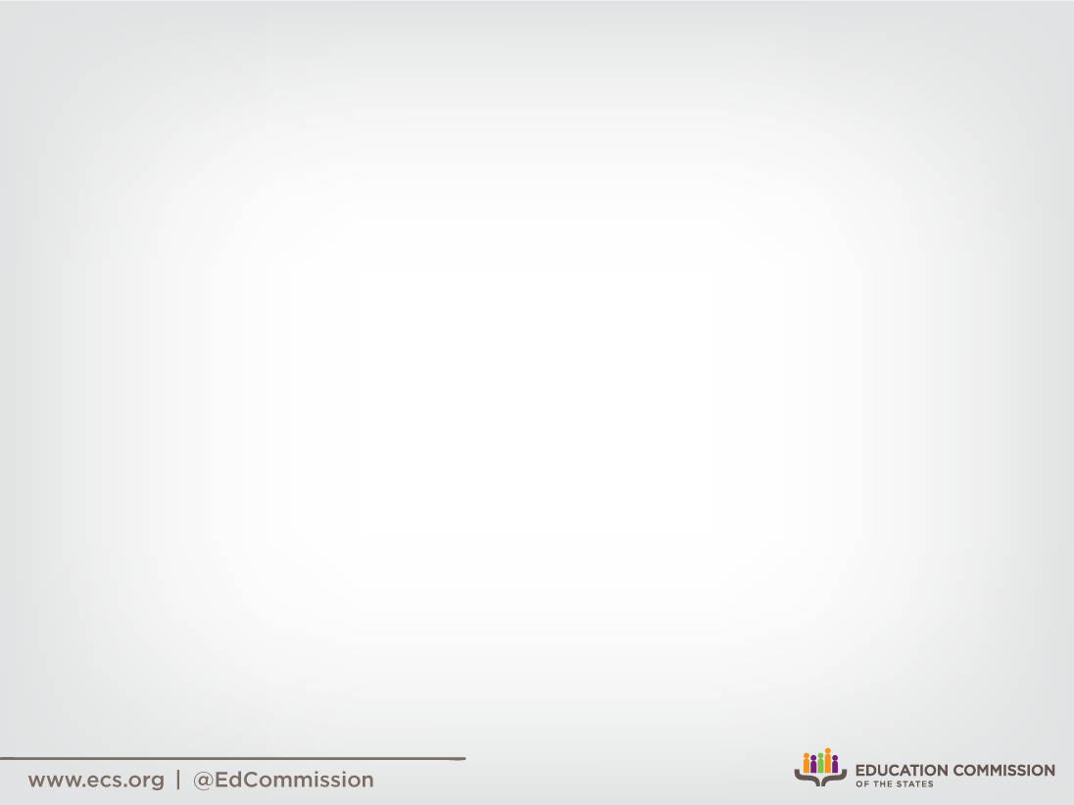

Slide 3
ECS Commissioners
Peter Blake, Director, State Council of Higher Education for Virginia
Ralph Northam, Governor, Commonwealth of Virginia
Kristen Amundson, President and CEO, National Association of State Boards of Education
Steven Landes, Chair, House Education Committee, Virginia House of Delegates
Stephen Newman, Chair, Senate Education and Health Committee, Virginia Senate
Joan Wodiska, Senior Federal Affairs Counsel, National Conference of State Legislatures

Slide 6
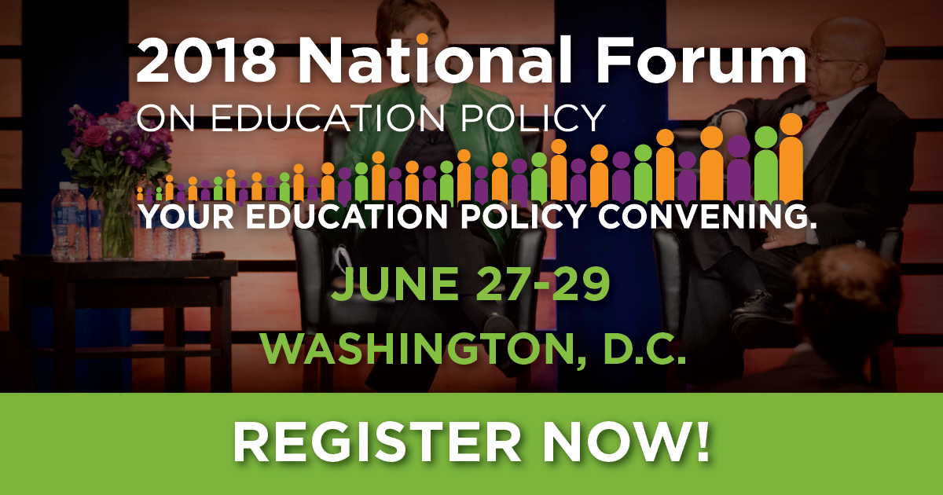
2018 National Forum

Slide 7

Teacher shortages in the US:
What we know
Teacher shortages are impacted by mismatched supply and demand.
Teacher shortages are impacted by state policies.
Teacher shortages are often confined to schools with specific characteristics.
Teacher shortages are often confined to certain subject areas.
Decorative: Center for Public Education,
The Teacher Pipeline: An Overview of Teacher Shortages
Notes:
State and districts across the nation are struggling to staff their schools. The severity of the shortage problem varies significantly by state, district, school and subject. While some attrition is expected and necessary, persistent shortages can be costly and negatively impact workforce quality and student outcomes.
FIRST: While national numbers suggest an overabundance of new teacher candidates, many states struggle to align their own candidate supply with their workforce needs, and as a result, face real teacher shortage crises. For example, many preparation programs produce an overabundance of elementary teacher candidates, and an underabundance of special education candidates. (IL supply and demand study: 9-1 elementary, 2-1 SPED).
SECOND: State policies can inhibit teacher recruitment and retention. For instance, varying teacher credential requirements across the states can make it difficult for a credentialed special education teacher to transfer from one state to the next. Some states are addressing this by changing certification requirements for special education teachers so that training is not based on disability category, but rather on the level of student support needed. As states unify credentialing requirements, in-state and out-of-state recruitment becomes easier. States who fail to do so may struggle to increase recruitment numbers.
THIRD: READ BULLET. As we all know, urban, rural, high-poverty, high minority and low-achieving schools face persistent staffing challenges. Although the reported staffing challenges are less today than they were 15 years ago, challenges remain.
FINALLY: Teacher shortages are often confined to certain subject areas such as special education, math and science.
CUT:
For instance: According to Illinois' supply-and-demand report from 2011, roughly nine new elementary-teacher certificates were issued in the state in 2009 for every one first-time teacher hired in 2010. By comparison, only two special education certificates were issued per slot.

Slide 8

Teacher shortages in the US:
Causes
Teacher shortages stem primarily from issues related to:
Recruitment: Lack of respect for/interest in the profession or in shortage areas; misalignment of supply and demand; outdated and disconnected licensure requirements.
Retention: A stagnant profession tied to outdated pay structures; insufficient support or irrelevant professional development; little room for meaningful advancement.
Equity: Changing student demographics vs. stagnant teacher workforce demographics.
Inadequate implementation
Decorative: Center for Public Education,
The Teacher Pipeline: An Overview of Teacher Shortages
Notes:
Teacher shortages stem primarily from issues related to: recruitment, retention, equity AND inadequate implementation.
Cut:
National labor market data suggest turnover rates in public education are actually lower than turnover rates in most other industries. But high retention rates in some schools mask high attrition rates in others. Efforts to address shortages should be less about recruiting teachers generally, and more about recruiting and retaining the right teachers, in the right subjects for the right schools.

Slide 9
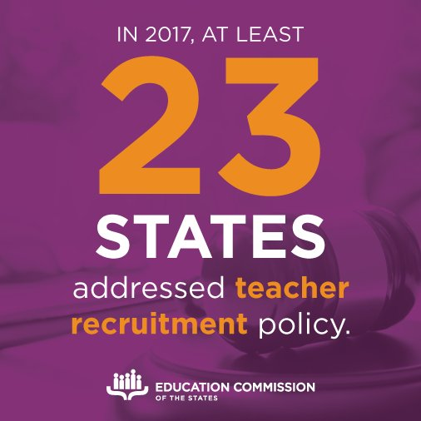
Teacher Shortages in the US:
State Strategies
Notes:
Refer to Teacher Policy Snapshot.
In 2017, at least 47 bills were enacted in 23 states to recruit teachers to high needs schools and subjects. Strategies include:
Research and Data Collection: Convening work groups and collecting teacher supply and demand data.
State and District Innovations: Giving state and local education agencies the flexibility to design their own targeted teacher recruitment strategies.
Career Pathways and Grow-Your-Own Programs: Creating career pathways and grow-your-own programs for high school students.
Preparation and Licensure: Altering teacher preparation and licensure requirements.
Financial Incentives: Providing financial incentives such as scholarships/grants, loan forgiveness and hiring bonuses/salary increases.
Retired Teachers: Providing incentives for retired teachers to return to the profession.
There are promising, research-based practices (from preparation all the way to advancement) that have the potential to reduce teacher shortages. It seems Virginia is onto many of them. If you are interested in the research evidence behind any particular approach, please let me know so that I can send you summary information

Slide 10
Teacher Shortages in Virginia:
Problem and Causes
Problem | Causes
Shrinking teacher pipeline. Growing number of unfilled teaching positions. High rates of inexperienced teachers, especially in high-poverty schools. High attrition. Teacher-student diversity gap. | Costly and outdated pathways into the profession. Increasingly negative perception of the profession. Undesirable working conditions once in the classroom.
Source: Preliminary Report from the Advisory Committee on Teacher Shortages (2017)
Notes:
Problem
Shrinking teacher pipeline. Declining student enrollment in EPPS. (13,500 in 2008-09, 11,400 in 2014-15). Completion numbers remain relatively constant, but are expected to drop in the coming years due to declining enrollment.
Growing number of unfilled teaching positions. In hard-to-staff positions such as science and math, but also in subjects such as foreign language, ESL, and English. The number of unfilled teacher positions has increased by 40 percent in ten years, from 760 to 1,080.
High rates of inexperienced teachers (<3 years), especially in high-poverty schools, but also in low-poverty schools. More than one in every five teachers in high-poverty schools are considered inexperienced.
High attrition. Higher than the national average. (10.2% compared to under 8% nationally.)
Teacher-student diversity gap. The number of minority teachers is not keeping pace with the increasingly diverse student body. 79% of teachers are white, but 49% of Virginia’s students are non-white.
Causes
Costly and outdated pathways into the profession. Most traditional pathways require individuals complete a five year or master’s degree program to become teachers.
Increasingly negative perception of the profession.
Undesirable working conditions once in the classroom.

Slide 11

Content Major Requirements
Virginia
To obtain a license in Virginia, teachers must:
Complete academic degrees in the arts and sciences (or equivalent), except in health, physical, and career and technical education. Candidates in early/primary education preK-3, elementary education (preK-6) middle education (6-8), and special education programs may complete a major in interdisciplinary studies or its equivalent.
8VAC20-542-20
Notes:
Refer to handout.
Undergraduate majors in teaching are prohibited; only permitted at graduate level. In practice, students must major in a subject matter discipline and complete a teacher training program. Content major requirements in Virginia have prompted the creation of 5 year teacher preparation/master’s degree programs, which have become a common route to licensure in the state.

Slide 12
Content Major Requirements
Virginia – 2
Endorsement | Academic Requirements
Elementary (PreK-6) | Graduate from an approved EPP in Elementary Education PreK-6. EPPs may require either an 1) an Interdisciplinary Studies major, focusing on English, Math, History and Social Sciences, or Science, OR 2) a major in English, Math, History and Social Sciences, or Science OR Have a BA or higher in Liberal Arts and Sciences major (or equivalent), fulfilling 57-credit hour requirements in English, Math, Science, History, Social Science, Arts and Humanities
Middle School (Grades 6-8) | Graduate from an approved EPP in Middle Education 6-8 with at least one area of academic preparation from the areas of English, Mathematics, Science, and History and Social Sciences OR Have a degree in Liberal Arts and Sciences (or equivalent), fulfilling a minimum of 21 semester hours in at least one area of academic preparation (concentration) that will be listed on the license and completed minimum requirements for those areas in which the individual is not seeking an area of concentration.
Secondary (Grades 6-12) | Graduate from an approved EPP in the subject area OR Complete a major in the content area or meet minimum coursework requirements
Sources: 8VAC20-542-110; 8 VAC 20-22-160; 8VAC20-542-120; 8 VAC 20-22-170
Notes:
Refer to table.
Teacher Licensure Pathways in Virginia:
Primary pathway: Most teachers follow a four-year undergraduate degree with a postgraduate teacher preparation program of one or two years that leads to a preliminary credential. Some programs also lead to a master’s degree in addition to a credential.
“Blended” or “Integrated Pathway”: Some teachers go through intensive programs that integrate academic content and teacher preparation as an undergraduate. Programs provide candidates with a bachelor’s degree and a preliminary teaching credential. Elementary and middle school teachers often major in Liberal Studies or Interdisciplinary Studies, emphasizing a breadth of subject matter. High school teachers, requiring content expertise, pursue single subject credentials.
Alternate pathway: Through alternate routes, teachers work in the classroom while completing coursework in a teacher preparation program. Applicants must already have completed a bachelor’s degree.

Slide 13
Content Major Requirements
United States
Elementary
In 2014, Virginia was one of 14 states reporting requiring a bachelor’s degree with a major in a subject area or academic content area for at least one initial credential issued at the elementary level (up from 13 in 2011).
Virginia was one of only two states (VA and CT) that had a content-specific degree standard in place for all initial credentials at the elementary level. NJ and ND dropped these requirements for at least some candidates between 2011 and 2014.
Sources: Preparing and Credentialing the Nation’s Teachers: The Secretary’s Ninth and Tenth Reports (USED, 2013, 2016)
Notes:
We are unable to state with certainty which states permit education/teaching undergraduate majors, as several states do not articulate major requirements. Recent research suggests the majority of teacher candidates in the country (58 percent in 2011-12) enter teaching with education degrees (e.g. Curriculum Studies or Mathematics Education), awarded by a school of education.
States are more likely to require that candidates have a bachelor’s degree with a major in a subject area or academic content area for an initial teaching credential at the middle school or secondary level than at the elementary level. However, a growing number of states require that candidates have a subject area or academic content area bachelor’s degree for all initial teaching credentials, regardless of the level.
Elementary
In 2014, Virginia was one of 14 states (ND, TX, AR, MS, TN, GA, IL, IN, DC, MD, NJ, CT, NH, HI) reporting requiring a bachelor’s degree with a major in a subject area or academic content area for at least one initial credential issued at the elementary level (up from 13 in 2011).
Virginia was one of only two states (VA and CT) that had a content-specific degree standard in place for all initial credentials at the elementary level. NJ and ND dropped these requirements for at least some candidates between 2011 and 2014.
Most states (45) also assess elementary candidates’ content knowledge, though only 22 (including VA) require content tests with separate passing scores in each subject area.
Cut:
Note: A content-specific bachelor’s degree does not necessarily imply that the content of the degree is the same as the content of the credential.
According to the National Council on Teacher Quality’s 2017 scan, 17 states require elementary candidates obtain a major, minor or concentration in an academic subject area. Of these, 13 (including VA) do not require that the major/minor or concentration be in a core academic area (e.g. interdisciplinary studies, liberal arts are also permitted.)
NM is the only state that requires elementary candidates obtain a major in a core academic area. CT, MS and OK require a minor or concentration in a core academic area.

Slide 14
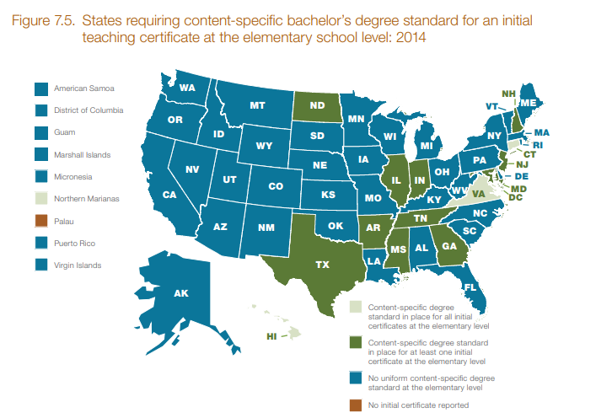
Content Major Requirements
United States – 3
Source: Preparing and Credentialing the Nation’s Teachers: The Secretary’s Tenth Report (USED, 2016)

Slide 15
Content Major Requirements
United States - 4
Middle School
In 2014, Virginia was one of 20 states reporting requiring a bachelor’s degree with a major in a subject area or academic content area for at least one initial credential issued at the middle school level (count unchanged from 2011).
Virginia was one of only 11 states that had a content-specific degree standard in place for all initial credentials at the middle school level (down from 13 in 2011).
Sources: Preparing and Credentialing the Nation’s Teachers: The Secretary’s Ninth and Tenth Reports (USED, 2013, 2016)
Notes:
Middle School
In 2014, Virginia was one of 20 states reporting requiring a bachelor’s degree with a major in a subject area or academic content area for at least one initial credential issued at the middle school level (count unchanged from 2011).
Virginia was one of only 11 states (ND, MO, IN, VA, HI, NY, VT, CT, DE, MD, DC) that had a content-specific degree standard in place for all initial credentials at the middle school level (down from 13 in 2011).
Most states (45) also assess middle school candidates’ content knowledge, though only 27 (including VA) require a single-subject test for every core subject a middle school teacher is licensed to teach.
CUT:
Note: A content-specific bachelor’s degree does not necessarily imply that the content of the degree is the same as the content of the credential.
According to the National Council on Teacher Quality’s 2017 scan, 15 states require middle school candidates obtain a major, minor or concentration in the subject area they are licensed to teach. Of these, only five (IN, MA, OK, RI, WI) required a major in a core academic area, and seven states (FL, GA, IA, NJ, OH, PA, WV) required a minor or concentration in a core academic area. The remaining three states (NY, TN, VA) do not require the major/minor be in a core academic area (e.g. interdisciplinary studies, liberal arts).

Slide 16
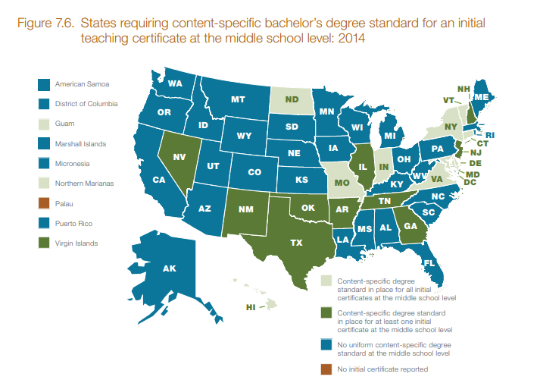
Content Major Requirements
United States - 5
Source: Preparing and Credentialing the Nation’s Teachers: The Secretary’s Tenth Report (USED, 2016)

Slide 17
Content Major Requirements
United States - 6
High School
In 2014, Virginia was one of 28 states reporting that they required a bachelor’s degree with a major in a subject area or academic content area for at least one initial credential issued at the secondary level (up from 25 in 2011).
Virginia was one of 14 states that had a content-specific degree standard in place for all initial credentials at the secondary level (down from 16 in 2011).
Sources: Preparing and Credentialing the Nation’s Teachers: The Secretary’s Ninth and Tenth Reports (USED, 2013, 2016)
Notes:
High School
In 2014, Virginia was one of 28 states reporting that they required a bachelor’s degree with a major in a subject area or academic content area for at least one initial credential issued at the secondary level (up from 25 in 2011).
Virginia was one of 14 states that had a content-specific degree standard in place for all initial credentials at the secondary level (down from 16 in 2011).
Virginia is also one of 41 states requiring a single-subject for every subject a teacher is licensed to teach. Though 20 states do not require a single-subject test to earn an endorsement.

Slide 18
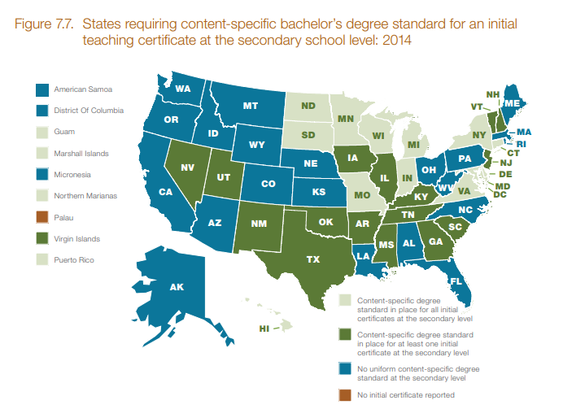
Content Major Requirements
United States - 7
Source: Preparing and Credentialing the Nation’s Teachers: The Secretary’s Tenth Report (USED, 2016)
Notes:
Middle School
In 2014, Virginia was one of 20 states reporting requiring a bachelor’s degree with a major in a subject area or academic content area for at least one initial credential issued at the middle school level (count unchanged from 2011).
Virginia was one of only 11 states (ND, MO, IN, VA, HI, NY, VT, CT, DE, MD, DC) that had a content-specific degree standard in place for all initial credentials at the middle school level (down from 13 in 2011).
Virginia is also one of 27 states that requires a single-subject test for every core subject a middle school teacher is licensed to teach.
CUT:
Note: A content-specific bachelor’s degree does not necessarily imply that the content of the degree is the same as the content of the credential.
According to the National Council on Teacher Quality’s 2017 scan, 15 states now require elementary candidates obtain a major, minor or concentration in an academic subject area. Of these, only five (IN, MA, OK, RI, WI) required a major in a core academic area, and seven states (FL, GA, IA, NJ, OH, PA, WV) required a minor or concentration in a core academic area. The remaining three states (NY, TN, VA) do not require the major/minor be in a core academic area (e.g. interdisciplinary studies, liberal arts).
Most states (45) also assess elementary candidates’ content knowledge, though only 22 (including VA) require content tests with separate passing scores in each subject area.

Slide 19
Arguments for Rigorous
Content Knowledge Requirements
Elementary teacher candidates should be broadly educated and proficient in the academic content they will deliver to their students.
Middle schools rarely assign one teacher to teach all subjects. Middle school teachers need greater expertise in their subjects than elementary teachers.
Secondary teachers are usually specialists who teach specific subjects in departmentalized school settings. As such, secondary teachers must be experts in the subject matter they teach.
Source: 2017 Teacher Policy Yearbook (National Council on Teacher Quality, 2017)
Notes:
Elementary teacher candidates should be broadly educated and proficient in the academic content they will deliver to their students. Elementary teacher candidates are responsible for delivering a wide variety of content, and should: 1) obtain a broad liberal arts education, and 2) complete a content concentration (15 hours or more) in an academic subject area.
Middle school teachers need greater expertise in their subjects than elementary teachers. Middle schools rarely assign one teacher to teach all subjects. The state should require that all new middle school teachers pass a separately scored subject-matter test in every core academic area for which they are licensed to teach.
Secondary teachers are usually specialists who teach specific subjects in departmentalized school settings. As such, secondary teachers must be experts in the subject matter they teach. The state should require that all new secondary teachers pass a separately scored subject-matter test in every subject they are licensed to teach. The state should also require that all secondary teachers pass a separately scored subject-matter test when adding subject-area endorsements to an existing license

Slide 20
Arguments Against
Content Major Requirements
Content major requirements may be seen as:
An unnecessary hurdle when coursework and/or content assessment requirements are already in place.
A barrier to entry/completion for new teacher candidates, who are required to meet professional studies and content area requirements.
Too expensive and even cost-prohibitive, especially given average teacher salaries.
Source: 2017 Teacher Policy Yearbook (National Council on Teacher Quality, 2017)
Notes:
Though content knowledge requirements may be valuable, content major requirements may be seen as:
An unnecessary hurdle when coursework and/or content assessment requirements are already in place.
A barrier to entry/completion for new teacher candidates, who are required to meet professional studies and content area requirements, and are often unable/not permitted to do so within a period of four years.
Too expensive and even cost-prohibitive, especially given average teacher salaries. (Burdens teachers with additional debt.)
Cut:
Students must carefully coordinate major requirements with professional education courses to complete all coursework requirements within four years. Teachers are often required to complete 5-year programs and/or advanced degrees to meet requirements for licensure.

Slide 21

Content Knowledge Requirements
Research Summary
Strong subject matter knowledge can impact student achievement.
Coursework requirements may be more meaningful than major requirements.
In addition to a strong grasp of the subject itself, knowledge of teaching methods and how to teach a particular subject is especially important.
Notes:
Generally: The selectivity of one’s college, the name of one’s degree or certificate, or the label associated with one’s route or program have small or insignificant relationships with effectiveness. (The type of college, degree, entry route of type of teaching certificate matter little.) Education degrees, even are no more likely to lead to increased student achievement or reduced attrition among beginning school teachers. The type of training provided, though, may impact teacher effectiveness (including opportunities to learn about content and content-specific teaching methods, opportunities for student teaching, residencies)
It is increasingly common for states to hold all candidates (elementary through secondary) to some content knowledge requirements- assessment, coursework and/or degree though the standards vary depending on grade span, and sometimes even subject area.
Research suggests:
Strong subject matter knowledge, especially at the middle and high school levels, can impact student achievement.
The research generally is not fine-grained enough to make it clear how much subject-matter knowledge is important for teaching specific courses and grade levels.
Some critical number of courses is helpful, but it is inconclusive about the necessity of a subject major.
In addition to a strong grasp of the subject itself, knowledge of teaching methods and how to teach a particular subject is especially important.
Cut:
Still, there are potential benefits to supporting master’s degrees:
Teachers who are more qualified (e.g. higher assessment scores and college competitiveness) are more likely to obtain advanced degrees
Teachers with advanced degrees, or teachers working on obtaining advanced degrees may benefit from more career mobility (high quality schools, better pay, leadership positions).
Schools may benefit from spillover effect. (Ongoing training may infuse a knowledge base of new teaching techniques that spill over to fellow teachers who are not enrolled in degree programs.)
Math and Science Teachers:
Beginning Math and Science teachers tend to have more subject-matter content education and more graduate-level education, and less pedagogical and methodological preparation than other teachers. Math and science teachers are far more likely than other new teachers to hold non-education degrees (awarded no a non-education department or school).

Slide 22

Advanced Degrees
Research Summary
Most research demonstrates that teachers with master’s degrees are, on average, no more likely to raise student test scores than those without.
There is some evidence that secondary math and science teachers (and their students) may benefit from holding advanced degrees in their content area
Source: State Information Request: Teachers’ Advanced Degrees (Education Commission of the States, 2017)
Notes:
Though most new teachers in the country are prepared through traditional routes in undergraduate programs, a growing number of new teachers are being prepared in graduate-level programs. Data from 2011-12 found that 23 percent of teachers enter the profession with advanced degrees (up from 16 percent in 2003-04). This may be due to stricter requirements for licensure, which include: major requirements and/or content and professional studies coursework requirements for initial licensure. This may also be due to alternative routes to certification, which are aimed at individuals who have already obtained their BA degrees.
State licensing and pay structures incentivize advanced degrees in many states, and many teachers who enter the profession with bachelor’s degrees go onto obtain their masters after entering the profession. In 2017 while no states required teachers to have advanced degrees for initial/probationary licensure, four states (CT, KY, MD and NY) required a master’s degree or its equivalent in coursework for professional/non-probationary licensure. In 2011-12, 56 percent of teachers had a masters degree or higher. The percentage of teachers with Master’s degrees or higher varies significantly by state (for example: in 2011-12 88 percent of teachers in NY held master’s degrees compared to 33 percent in South Dakota.)
Research suggests: read slides

Slide 23
Considerations
If regulations were revised to create a Bachelor’s Degree in Teaching:
Would teacher preparation programs reintroduce it?
Can teacher preparation programs strike the right balance between subject knowledge and pedagogy?
Would the content coursework requirements for the new degree be any different than the content coursework requirements already in place for Liberal Arts and Sciences and/or Interdisciplinary Studies majors?
  If so, could students reasonably meet content and professional studies coursework requirements within four years?
Would content area assessment requirements remain unchanged, and would students with a Bachelor’s Degree in Teaching receive adequate preparation to pass the assessments?
Notes:
If regulations were revised to create a Bachelor’s Degree in Teaching:
Would teacher preparation programs reintroduce it? This was an issue in CA: Federal law states that Pell grants can’t be given to students in 5th year credentialing programs if the college also has a four-year credentialing program for education majors.
Would the content coursework requirements for the new degree be any different than the content coursework requirements already in place for Liberal Arts and Sciences and/or Interdisciplinary Studies majors? Could students reasonably meet content and professional studies coursework requirements within four years?
What coursework requirements would remain in to ensure candidates are adequately prepared for their subject areas(s) (i.e. broad content knowledge for elementary candidates, and deeper content knowledge for middle school candidates)?
Would content area assessment requirements remain unchanged, and would students with a Bachelor’s Degree in Teaching receive adequate preparation to pass the assessments?
Can the state consider a program audit, to 1) compare preparation routes/providers in the state, 2) consider how other states are preparing candidates for effective teaching in four years?
What other quick wins might the Board consider to address teacher shortages?

Slide 24

Questions?
Stephanie Aragon
saragon@ecs.org
303-299-3614
Notes:
Lot of talking at you, I would now like to open it up for a little Q&A discussion.

