Slide 1
Kindergarten
History and Social Science
Fall Institute
2016

Slide 2
Disclaimer
Reference within this presentation to any specific commercial or non-commercial product, process, or service by trade name, trademark, manufacturer or otherwise does not constitute or imply an endorsement, recommendation, or favoring by the Virginia Department of Education.

Slide 3
Questions to Ask During Planning
Essential Components in Planning an Effective Lesson
using the
2015 History and Social Science Standards of Learning
What do students need to know and understand by the end of this lesson?
What do students need to do during this lesson?
Which historical thinking skills are best suited for this standard?
What other content material should be added to provide historical context and richness to the lesson in order to maximize student understanding of the standard?
What student learning experiences would be most effective during this lesson?
How can I check for understanding effectively and accurately to measure the students’ content knowledge and historical thinking skills?

Slide 4

It starts with the . . .

Slide 5
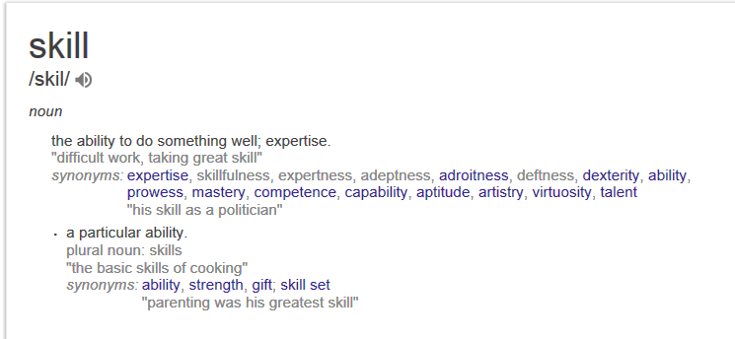

Slide 6
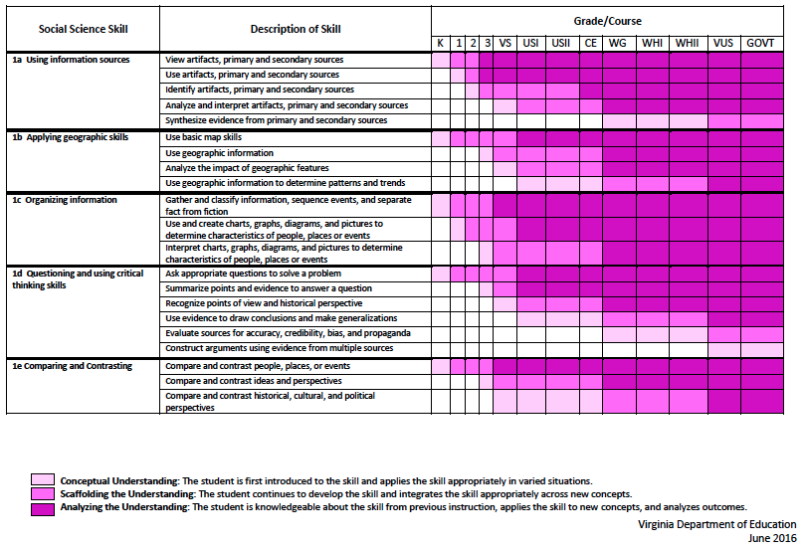
2015 SOL Skill Progression
⇧
Notes:
⇧

Slide 7
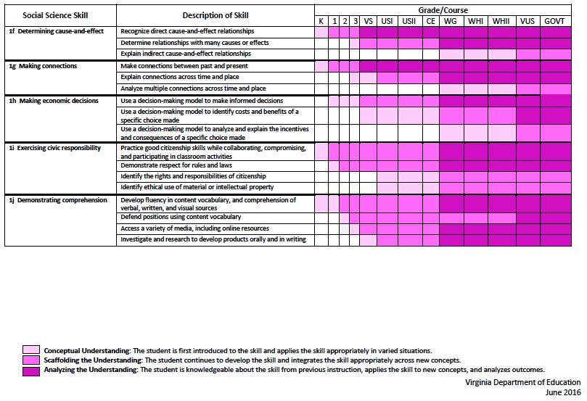
2015 SOL Skill Progression
⇧
2008 Standards:
Understand content
2015 Standards:
Understand content by applying the skill.
Skills are aligned with English Standards
Notes:
Discussion: Conceptual Understanding, Scaffolding the Understanding, Analyzing the Understanding
Arrow will rise up upon click after discussion to summarize difference between 2008 and 2015, then skills aligned with English SOLs. Great opportunity for common planning!
Purpose of today is to “teach” a lesson demonstrating skill based instruction, moving away from Lecture (Sit and Get)

Slide 8
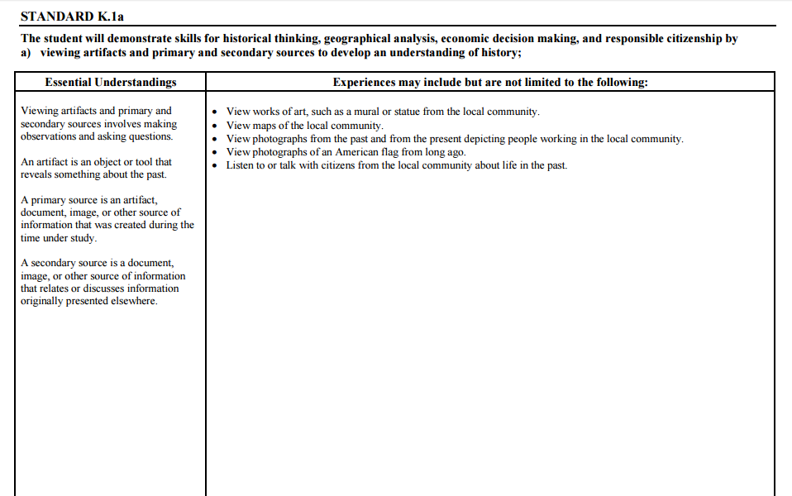
Experiences for Essential Skills
What are Experiences?

Slide 9
Experiences
Bring attention to the Experiences and describe what they are and how they can be used.
Provide teachers with “experiences” and give them an opportunity to:
  discuss what they are and how they can be used; and
  develop their own to share with the group.

Slide 10
The experiences should be –
engaging,
rigorous with higher level thinking questions,
relevant (connecting time periods, places, and events to the present day).

Slide 11
Experiences
Are . . .
Are NOT. . .
Engaging- promoting discussion, collaboration, and understanding
Opportunities to practice social science skills using various content
Varied throughout the lesson to help students make connections
Worksheets
Specific to one Standard, topic, or course

Slide 12

How can Kindergarten history & social science skills be incorporated into standards-based lessons?
Notes:
Good practice: Use of aim/objective to give students a concrete goal for the lesson. “By the end of class/end of unit/etc., you should be able to…”

Slide 13
Good practice
Use of aim/objective to give students a concrete goal for the lesson.
“By the end of class/end of unit/etc., you should be able to…”

Slide 14

Today we will . . .
Practice strategies to incorporate new standards-based skills into daily lessons to teach and check for understanding of content

Slide 15
History and Social Science
Standards of Learning 2016 Fall Institute
Welcome
Meet-and-Greet
Agenda for the day
  Presentation of Learning Experiences
  Creating Skill Experiences
Questions

Slide 16
Today’s Working Norms
Be engaged
Be open to new ideas
Limit sidebar conversations
Laptop/Cell phone use

Slide 17
Grounding:
Who Are We?
Introduce yourself to a shoulder partner
  Name, position, school/location you teach
  What is your favorite unit/topic to teach in Social Studies? Why?
Geography
American Indians
Ancient Cultures
Famous Americans
History
Civics
Economics

Slide 18

Just Like Me
When you hear something that applies to you-
Stand up and say…
Just like me!

Slide 19
Implementing the new Social Studies Curriculum!
Getting Ready for 2017-2018

Slide 20
What are these experiences teachers are to provide for the students?
The experiences should be –
engaging,
rigorous with higher level thinking questions,
relevant (connecting time periods, places, and events to the present day).

Slide 21
How do I plan for these experiences?
When planning for these experiences you should think about how we learn about the past.
    Asking questions.
    Gathering the sources, organize them, and evaluate the evidence in the sources.
    Drawing conclusions that are supported by the evidence in the sources.

Slide 22
Questions to ask about the past….
How?
What?
When?
Where?
Who?

Slide 23
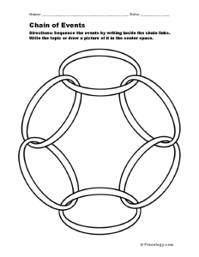
Things to consider→
Cause and Effect- events from the past have a short term and long term (often times unforeseen) effects on the development of societies.

Slide 24
Things to consider→
Change and Continuity- focus on change over time; understanding what changed and what remained the same, fosters a deeper understanding of the uneven pace for which events unfolded throughout history.

Slide 25

Things to consider→
Turning Points- focuses on events of great significance that caused individual experiences and societal developments to go in a different direction.

Slide 26

Things to consider→
Using the Past- finding the usable past and using it to better understand events from that time frame and how it relates to the present. This makes history relevant and gives history meaning.

Slide 27

Things to consider→
Through their Eyes- We need to see the world as they saw it in order to get a deeper understanding of why people thought and acted the way they did and the reasoning for the choices they made.

Slide 28
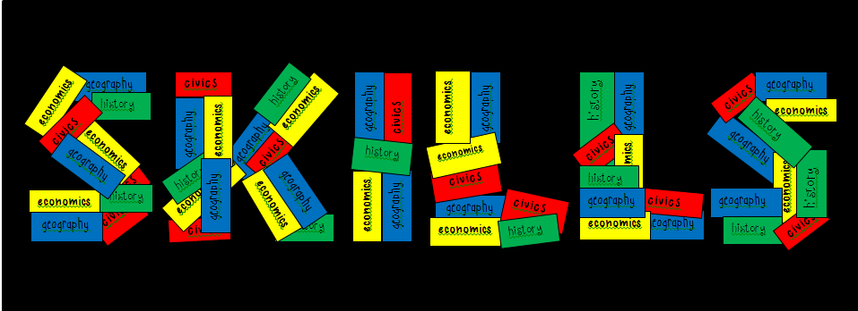
The Essential Skills, which are found in Standard 1 for each grade level or course, serve as tools to facilitate active engagement in learning, to deepen student understanding of content material and to create better-informed citizens.

Slide 29
Standard 1
Use information sources.
Apply geography skills.
Organize information.
Demonstrate critical thinking.
Compare and contrast.
Determine cause and effect.
Make connections.
Make economic decisions.
Exercise civic responsibilities.
Demonstrate comprehension.

Slide 30
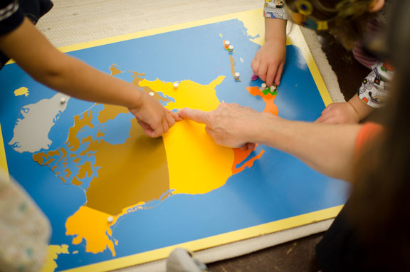
Let’s Explore:
Rigorous Social Studies
Learning Experiences
Notes:
Now we are going to take some time to explore some possible learning experiences for students that will help teachers grasp ways to embed skills from Standard 1 into content. As we look at and model each lesson idea, be thinking about ways to raise the rigor of social studies instruction and make literacy connections through these skills. Think about how the experience can be expanded to other grade levels.

Slide 31
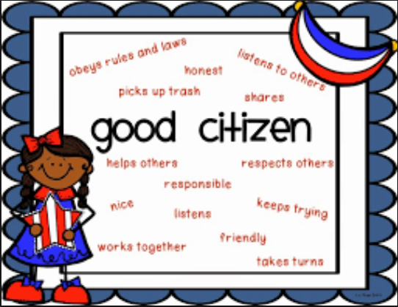

Kindergarten
Notes:
The first strand we will take a look at is Civics.
9:45-10:15

Slide 32
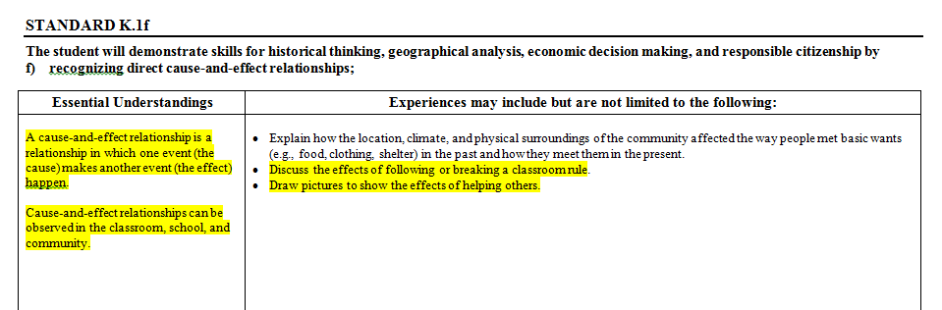
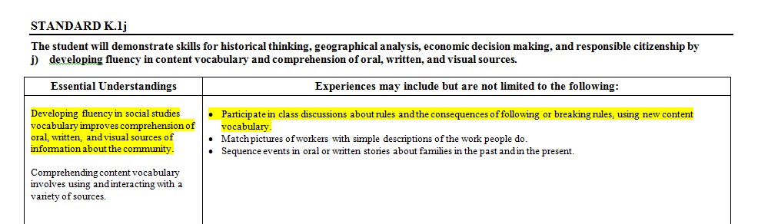
Application of Skills Standard 1: Kindergarten K.1f

Slide 33
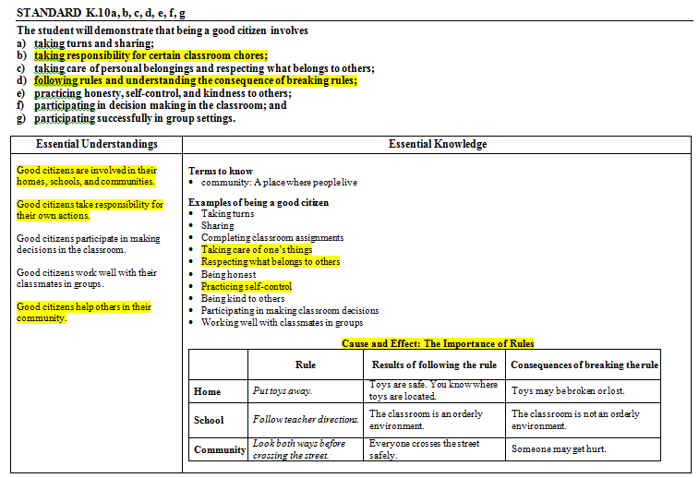
Content: Being a Good Citizen

Slide 34

Content Example
Conduct an interactive read-aloud of What
If Everybody Did That? By Ellen Javernick.
Make a T-chart as a group that would answer the question of what if everyone exhibited a certain behavior (blurted, left backpacks in the floor, went to the bathroom during whole group, etc.).
Notes:
Learning Experience: Discuss the effects of following or breaking a classroom rule
Read or view (http://safeshare.tv/v/ss578d91edd3f22) on Youtube: What if Everybody did that by Javernick & Madden Pause and discuss actions that impact the community and if they were good or bad (interactive read aloud) Consider stopping 2-3 times during the story (modeling the discussion with participants)
Stop on page with police officer (1:00): Model strategy
Stop on page with librarian on it (1:48): Participants turn and talk
Stop on page with teacher Ms. Sanders (2:58) : Participants turn and talk

Slide 35
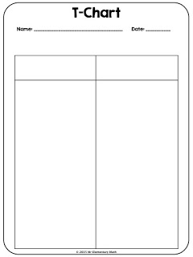
Creating A T-Chart For Our Choices
We are going to create a T-Chart to list out our options when it comes to following classroom rules. On one side have the students model following classroom rules and on the other side have students model consequences of not following the rules. Write how each behavior has different outcomes.
Notes:
Pass out T Chart paper. http://whoswhoandnew.blogspot.com/2015/08/how-to-use-t-charts-in-math-class.html

Slide 36
What If Everybody Did _____ ?
Let’s read page 5 together from What If Everybody Did That?
Questions to think about:
How does his action affect his community?
What is a classroom rule that we follow that you see happening on this page?
Turn to a partner and discuss what would happen if everyone littered? How would this affect your classrooms? Schools? Communities?

Slide 37
Rule: Walk inside the classroom.
Follow The Rule | Break The Rule
All students are safe. I am a good role model. There are no distractions. | Accidents may happen. I am a distraction. All behaviors are affected.

Slide 38
Create Your Own Flow Chart
Now you are going to work on your own or with a group to make your own T-Chart.
Choose a classroom rule.
Write a description of the two options: following and breaking the rule.
Weigh your options and decide if you will or will not follow the rule. Share your decision.
Notes:
Use the 2nd T-Chart on the back of the 1st one.

Slide 39
Always Looping Back to the Skill
K 1.f: The Student will demonstrate skills for historical thinking, geographical analysis, economic decision making and responsible citizenship by recognizing direct cause and effect relationships
How do you want others to behave in the classroom?
How do you want to behave in the classroom?
Do you have different ideas for others’ behavior than you do for yourself? If so, why? If not, why?
Once students have practiced this civics skill, you can take this experience and duplicate it within your specific content areas.

Slide 40
Your Turn!
First, think about how you could use a T-Chart in your own classroom.
Then, think about a mini-lesson in another content area or a read aloud lesson that your students could experience with you after having learned this skill. Some examples may be…
  Kindergarten - staging a disappearance of class supplies (shortage) or creating classroom norms
  1st Grade - discussing a law or bond money usage for your state
  2nd Grade - connecting to cause and effect in food chains
  3rd Grade - reading an article about a global news event and connecting it to your class
  All grades - voting in the Presidential Election, weather and temperature and clothing choices, counseling lessons
Remember - These skills are taught and can come up in all content areas throughout the year. Repeat and reuse them!

Slide 41

Independent Practice
Make a class book.
What if everybody . . .?
Notes:
We will share writing samples of this prompt from C. Crump’s Kindergarten Class.

Slide 42

Debrief
What skill was used as a vehicle to deliver the content?
What other skill could be used to deliver the same content?
What other content could be taught using the same skill?

Slide 43
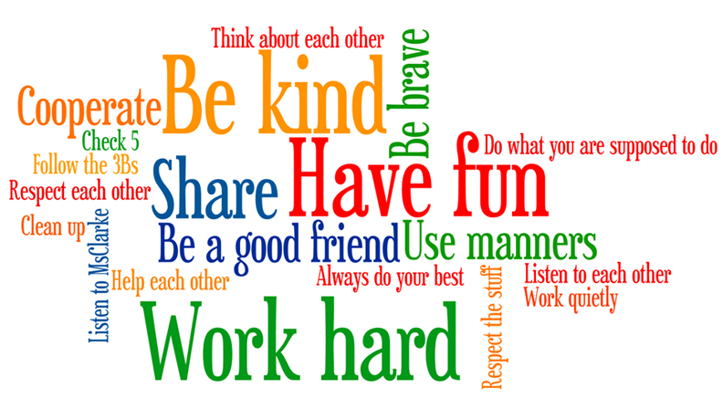
Kindergarten
  K.1f cause and effect relationships
  Experiences to enhance being a good citizen

Slide 44


How can you use this method with another grade?
Notes:
Working with a shoulder partner or small group brainstorm other ways to incorporate this skill into other civics lessons and in other grade levels.

Slide 45

Sharing Our Expertise
Notes:
5 minute share

Slide 46
History and Social Science Updates
On The Web…
VDOE 2015 Standards of Learning
http://www.doe.virginia.gov/testing/sol/standards_docs/history_socialscience/index.shtml
2. VDOE Superintendent Memo #163-15
http://www.doe.virginia.gov/administrators/superintendents_memos/2015/163-15.shtml
Implementation Schedule
http://www.doe.virginia.gov/administrators/superintendents_memos/2015/163-15a.pdf

Slide 47

Skill Experience

Slide 48
Group Skill Experience
  Review the new History and Social Science Skill Heading SOLs. (K.1, 1.1, 2.1, 3.1)
  Choose one SOL bullet for your grade level.
  Create a lesson for your students.
  Share.

Slide 49
Reflections:
3 things you learned,
2 ways you can use this learning in your class, and
1 question you still have
Notes:
Teachers will personally reflect then turn and talk to pair-share
5-10 minutes

Slide 50
Questions?
Notes:
Respond to the parking lot questions that have been posted in each room.

Slide 51
Kindergarten – Grade Three Presenters
Carla Crump | Powhatan | carla.crump@powhatan.k12.va.us
Apryl-Dawn Julien | Richmond | awynter@richmond.k12.va.us
Quoteshia Hargett | Portsmouth | Quoteshia.Hargett@pps.k12.va.us
Melissa Mygas | Newport News | melissa.mygas@nn.k12.va.us
Megan Bush | Stafford | bushme@staffordschools.net
Jennifer Burgin | Arlington | jennifer.burgin@apsva.us
Kathy Nealon | Fairfax | Knealon@fcps.edu
Susan Mayo | Manassas City | smayo@mcpsva.org

Slide 52
Kindergarten – Grade Three Presenters
Jennifer Kettlekamp | Harrisonburg | jkettelkamp@harrisonburg.k12.va.us
Amy Cash | Augusta | acash@augusta.k12.va.us
Dawn Toole | Martinsville | dtoole@martinsville.k12.va.us
Krystal Heath | Floyd | heathk@floyd.k12.va.us
Misty Jeffers | Washington | mjeffers@wcs.k12.va.us
Bethany Collins | Tazewell | bcollins@tazewell.k12.va.us
Tamara Green | Buckingham | tgreen@bcpschools.org
Vanessa Mason | Halifax | vmason@halifax.k12.va.us

Slide 53


Slide 54
and the
Virginia Department of Education
Christonya Brown, K-12, History and Social Science Coordinator
E-mail: Christonya.Brown@doe.virginia.gov
Betsy Barton, Elementary, History and Social Science Specialist
E-mail: Betsy.Barton@doe.virginia.gov
Jill Nogueras, English and History and Social Science Specialist
E-mail: Jill.Nogueras@doe.virginia.gov

