Slide 1
Grade Three
History and Social Science
Fall Institute
2016

Slide 2
Disclaimer
Reference within this presentation to any specific commercial or non-commercial product, process, or service by trade name, trademark, manufacturer or otherwise does not constitute or imply an endorsement, recommendation, or favoring by the Virginia Department of Education.

Slide 3
Questions to Ask During Planning
Essential Components in Planning an Effective Lesson
using the
2015 History and Social Science Standards of Learning
What do students need to know and understand by the end of this lesson?
What do students need to do during this lesson?
Which historical thinking skills are best suited for this standard?
What other content material should be added to provide historical context and richness to the lesson in order to maximize student understanding of the standard?
What student learning experiences would be most effective during this lesson?
How can I check for understanding effectively and accurately to measure the students’ content knowledge and historical thinking skills?

Slide 4

It starts with the . . .

Slide 5
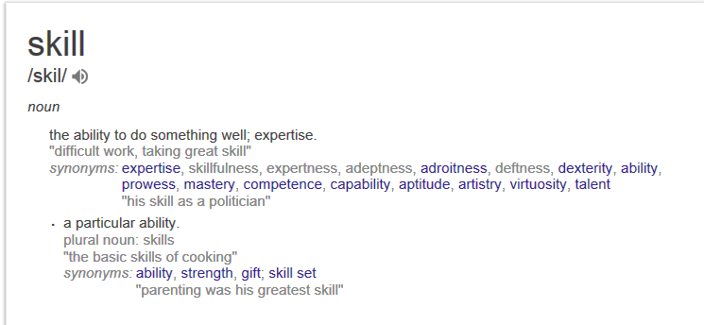

Slide 6
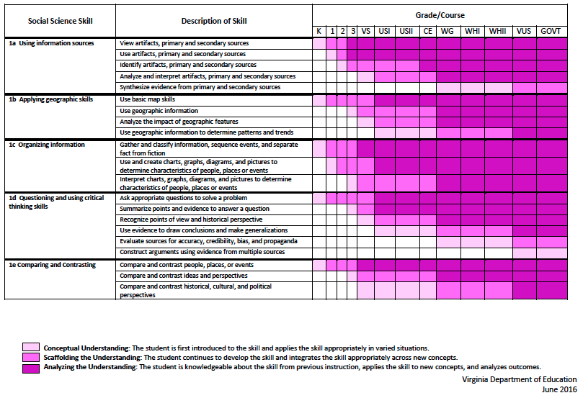
2015 SOL Skill Progression
⇧
Notes:
⇧

Slide 7
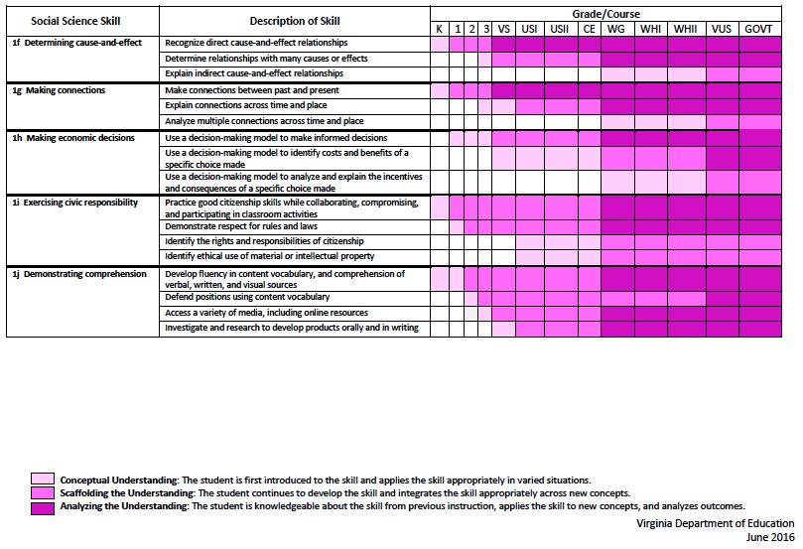
2015 SOL Skill Progression
2008 Standards:
Understand content
2015 Standards:
Understand content by applying the skill.
⇧
Skills are aligned with English Standards
Notes:
Discussion: Conceptual Understanding, Scaffolding the Understanding, Analyzing the Understanding
Arrow will rise up upon click after discussion to summarize difference between 2008 and 2015, then skills aligned with English SOLs. Great opportunity for common planning!
Purpose of today is to “teach” a lesson demonstrating skill based instruction, moving away from Lecture (Sit and Get)

Slide 8
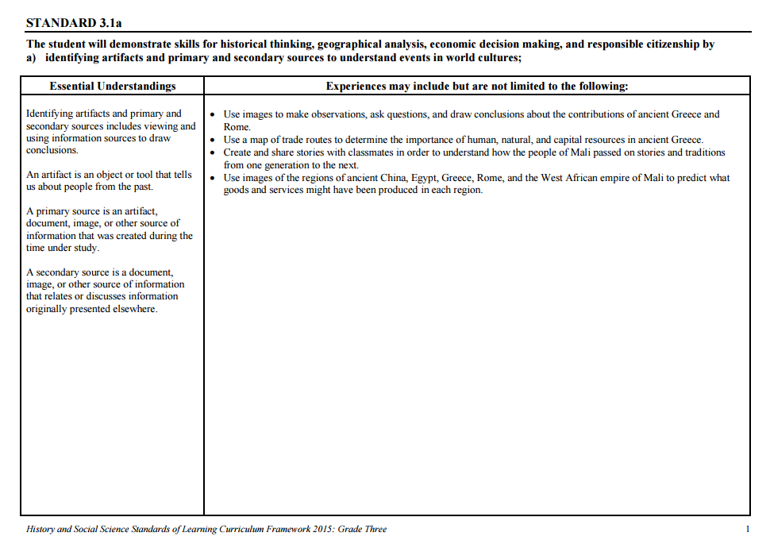
Experiences for Essential Skills
What are Experiences?

Slide 9
Experiences
Bring attention to the Experiences and describe what they are and how they can be used.
Provide teachers with “experiences” and give them an opportunity to:
  discuss what they are and how they can be used; and
  develop their own to share with the group.

Slide 10
The experiences should be –
engaging,
rigorous with higher level thinking questions,
relevant (connecting time periods, places, and events to the present day).

Slide 11
Experiences
Are . . .
Are NOT. . .
Engaging- promoting discussion, collaboration, and understanding
Opportunities to practice social science skills using various content
Varied throughout the lesson to help students make connections
Worksheets
Specific to one Standard, topic, or course

Slide 12

How can Grade Three history & social science skills be incorporated into standards-based lessons?
Notes:
Good practice: Use of aim/objective to give students a concrete goal for the lesson. “By the end of class/end of unit/etc., you should be able to…”

Slide 13
Good practice
Use of aim/objective to give students a concrete goal for the lesson.
“By the end of class/end of unit/etc., you should be able to…”

Slide 14

Today we will . . .
Practice strategies to incorporate new standards-based skills into daily lessons to teach and check for understanding of content

Slide 15
History and Social Science
Standards of Learning 2016 Fall Institute
Welcome
Meet-and-Greet
Agenda for the day
  Presentation of Learning Experiences
  Creating Skill Experiences
Questions

Slide 16
Today’s Working Norms
Be engaged
Be open to new ideas
Limit sidebar conversations
Laptop/Cell phone use

Slide 17
Grounding:
Who Are We?
Introduce yourself to a shoulder partner
  Name, position, school/location you teach
  What is your favorite unit/topic to teach in Social Studies? Why?
Geography
American Indians
Ancient Cultures
Famous Americans
History
Civics
Economics

Slide 18

Just Like Me
When you hear something that applies to you-
Stand up and say…
Just like me!

Slide 19
Implementing the new Social Studies Curriculum!
Getting Ready for 2017-2018

Slide 20
What are these experiences teachers are to provide for the students?
The experiences should be –
engaging,
rigorous with higher level thinking questions,
relevant (connecting time periods, places, and events to the present day).

Slide 21
How do I plan for these experiences?
When planning for these experiences you should think about how we learn about the past.
    Asking questions.
    Gathering the sources, organize them, and evaluate the evidence in the sources.
    Drawing conclusions that are supported by the evidence in the sources.

Slide 22
Questions to ask about the past….
How?
What?
When?
Where?
Who?

Slide 23
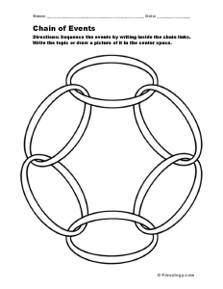
Things to consider→
Cause and Effect- events from the past have a short term and long term (often times unforeseen) effects on the development of societies.

Slide 24
Things to consider→
Change and Continuity- focus on change over time; understanding what changed and what remained the same, fosters a deeper understanding of the uneven pace for which events unfolded throughout history.

Slide 25

Things to consider→
Turning Points- focuses on events of great significance that caused individual experiences and societal developments to go in a different direction.

Slide 26

Things to consider→
Using the Past- finding the usable past and using it to better understand events from that time frame and how it relates to the present. This makes history relevant and gives history meaning.

Slide 27

Things to consider→
Through their Eyes- We need to see the world as they saw it in order to get a deeper understanding of why people thought and acted the way they did and the reasoning for the choices they made.

Slide 28
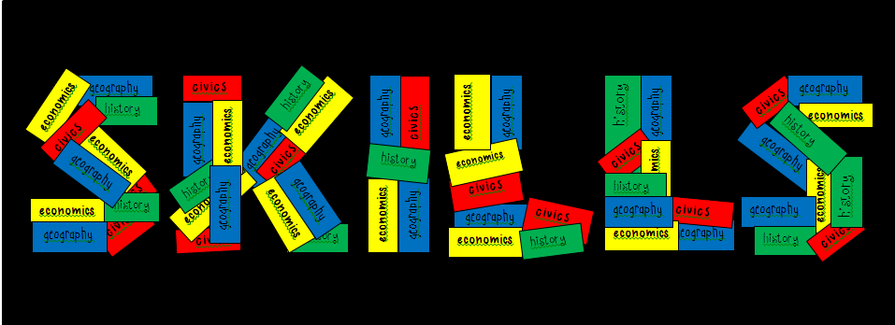
The Essential Skills, which are found in Standard 1 for each grade level or course, serve as tools to facilitate active engagement in learning, to deepen student understanding of content material and to create better-informed citizens.

Slide 29
Standard 1
Use information sources.
Apply geography skills.
Organize information.
Demonstrate critical thinking.
Compare and contrast.
Determine cause and effect.
Make connections.
Make economic decisions.
Exercise civic responsibilities.
Demonstrate comprehension.

Slide 30
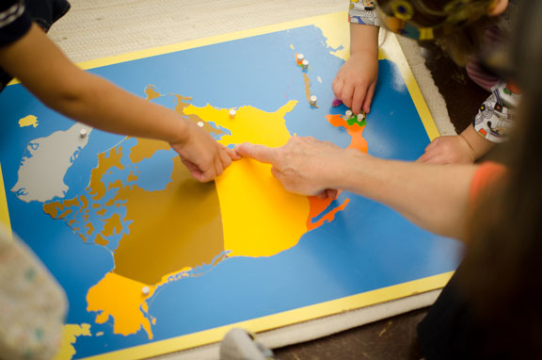
Let’s Explore:
Rigorous Social Studies
Learning Experiences
Notes:
Now we are going to take some time to explore some possible learning experiences for students that will help teachers grasp ways to embed skills from Standard 1 into content. As we look at and model each lesson idea, be thinking about ways to raise the rigor of social studies instruction and make literacy connections through these skills. Think about how the experience can be expanded to other grade levels.

Slide 31
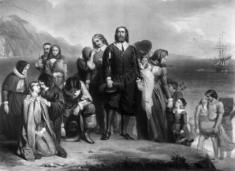
Grade Three
Notes:
The next strand we will take a look at is HISTORY. (40 min)
Slides 70-89
1:05-1:45

Slide 32
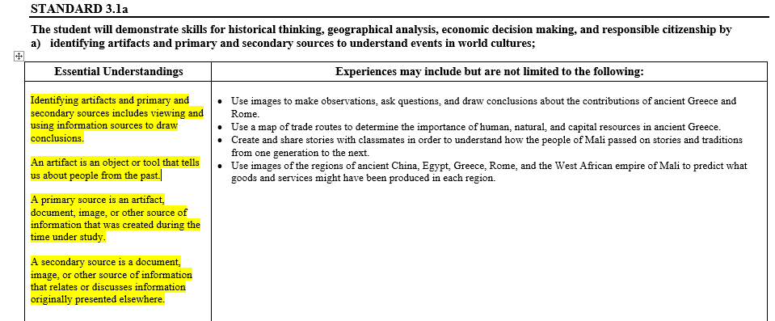
Using Information Sources: 3rd Grade

Slide 33
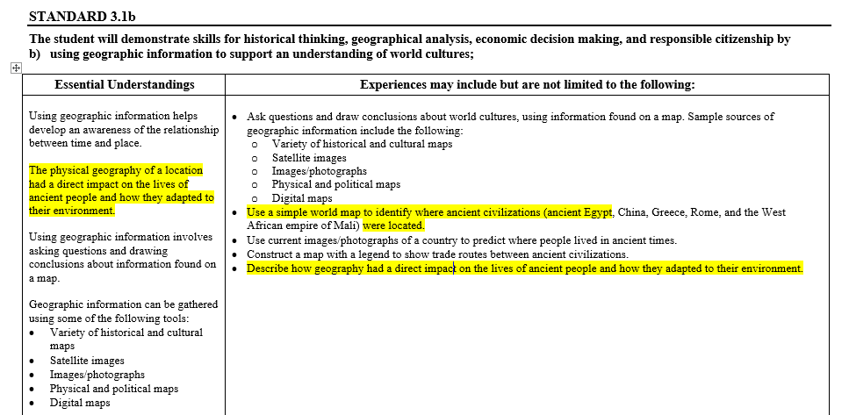
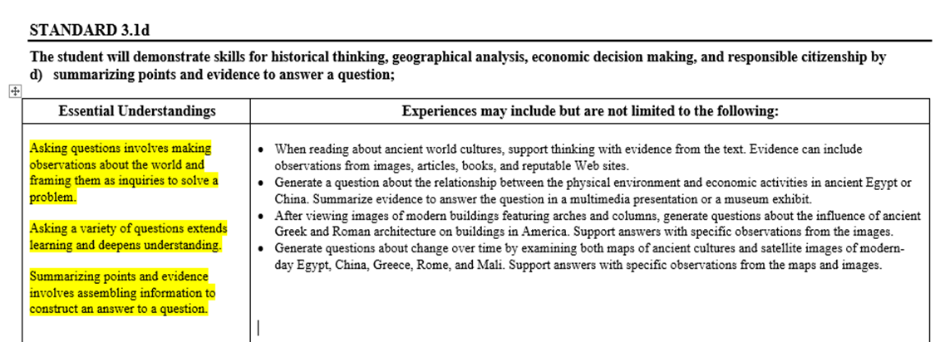
More Standards

Slide 34
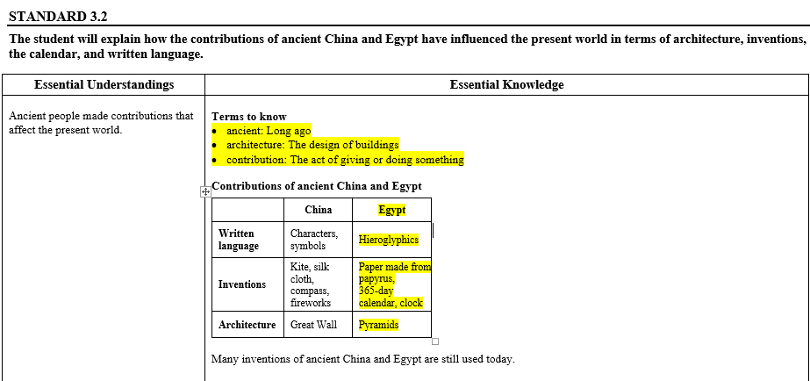
Content: Ancient Egypt

Slide 35
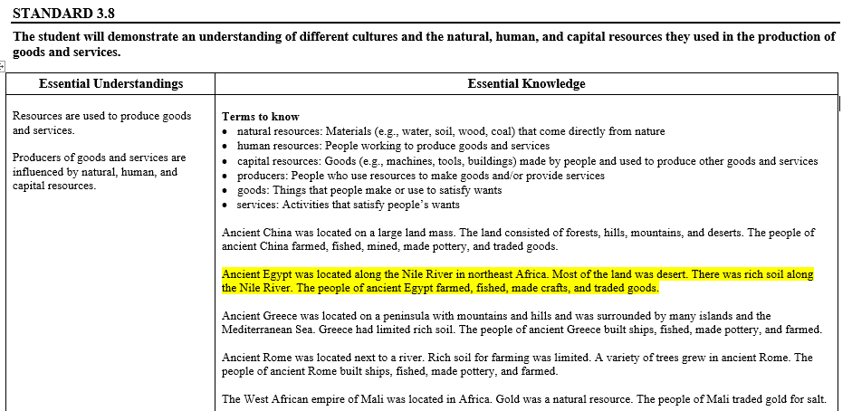
Content: Ancient Egypt

Slide 36
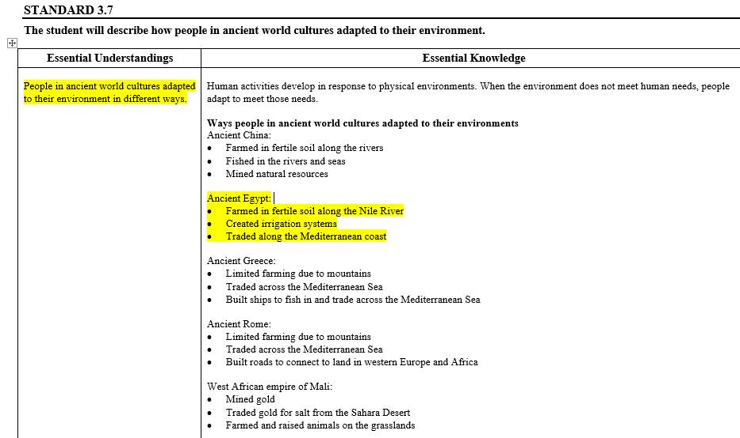
Content: Ancient Egypt

Slide 37

Activating Strategy
What can you learn about someone by observing, asking questions and drawing conclusions using receipts?

Slide 38
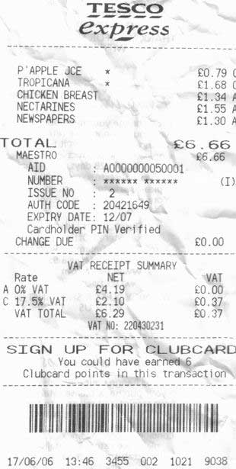
Let’s Try It!

Slide 39
Primary Sources: Receipts!
With partner, look at the collection of receipts and ask each other questions. Then write down what you think that you learned about the person based on the receipts.
Sort your ideas into categories. Example: lifestyle, interests, characteristics
Share Out

Slide 40
Primary and Secondary Sources
What are they?
Primary sources are the raw materials of history — original documents and objects which were created at the time under study. They are different from secondary sources, accounts or interpretations of events created by someone without firsthand experience.
Source: Library of Congress, www.loc.gov/teachers

Slide 41

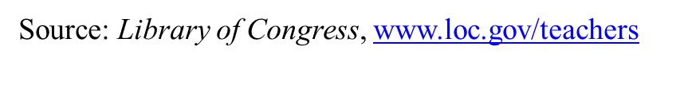
Observe, Question, Reflect
Observe: Identify and Note Details
What do you notice first?
What do you notice that you didn’t expect?
What do you notice that you can’t explain?
What is small but interesting?
Question: Ask questions that lead to more observations and to reflections
What do you wonder about?
Who?
What?
Where?
When?
Why?
How?
Reflect: Encourage students to draw conclusions
Where do you think this came from?
Why do you think someone made this?
Why do you think this item is so important?
What can you learn from examining this?

Slide 42

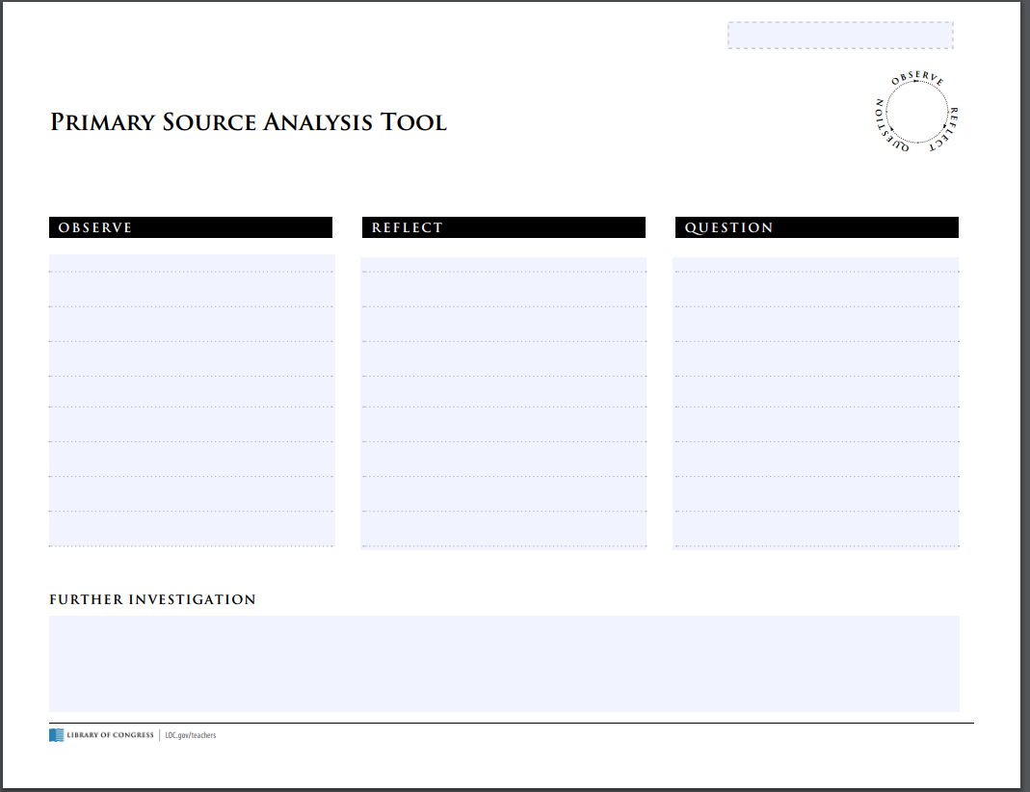
Observe, Question, Reflect
Sticky Notes
Primary Source Analysis Tool

Slide 43

Ancient Egypt
Gallery Walk of Primary and Secondary Sources of Ancient Egypt

Slide 44
More Practice using Standards of Learning!!
SOL 3.1a- The student will demonstrate skills for historical thinking, geographical analysis, economic decision making, and responsible citizenship by identifying artifacts, primary, and secondary resources to understand events in world cultures.

Slide 45

Gallery Walk
Directions: Visit each photograph. Use your sticky notes to make an observation, reflect, or pose a question on three of the photographs.
*One sticky note per photograph.

Slide 46
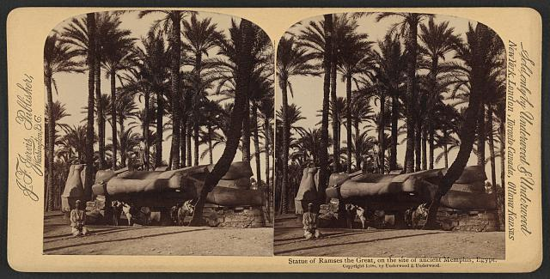
Ancient Egypt

Slide 47
Questions that can be posed…
Who is that a statute of?
What are they doing with that statue?
Why did they build that statue?
When was that statue built?
How was that statue built?
Who built that statue?
Who are the people in the picture?
Where is this statue from?

Slide 48
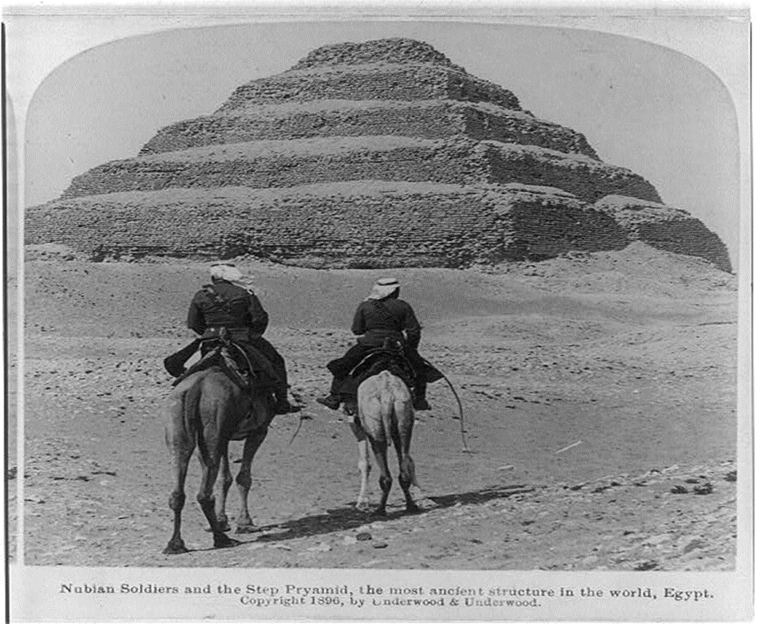
Ancient Egypt

Slide 49
Observations to be made about this artifact….
This pyramid has steps.
It is different from other pyramids we have seen.
There are two people riding on camels.
There is no vegetation in the picture.
The environment for which this pyramid is located is the desert.

Slide 50
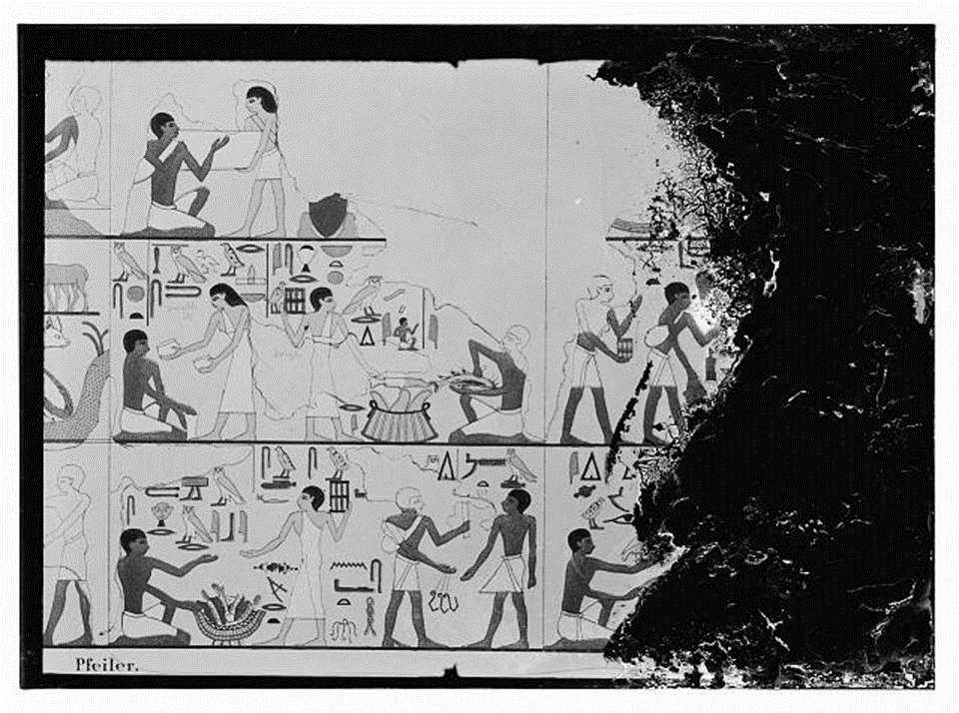
Ancient Egypt
A secondary source- a book illustration of a tomb wall in ancient Egypt.

Slide 51
Reflections anyone???
Egyptians seems to be some hard working people.
The ancient Egyptians were creative and used technology to build and create things as we do today.
Ancient civilizations used their natural, human, and capital resources like we do now.

Slide 52
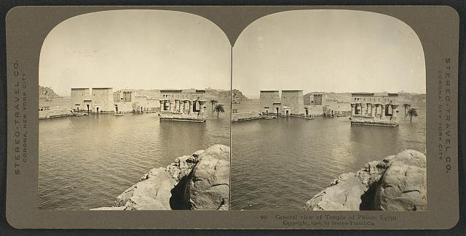
Ancient Egypt

Slide 53
OBSERVATIONS
What did you notice first?
Find something small but interesting.
What did you notice that you didn’t expect?
What do you notice that you can’t explain?
What do you notice that you didn’t earlier?

Slide 54
REFLECT
Where do you think this came from?
Why do you think somebody made this?
What do you think was happening when this was made?
Who do you think was the audience for this item?
What tool was used to create this?
Why do you think this item is so important?
If someone made this today, what would be different?
What can you learn from examining this?

Slide 55
QUESTIONS
What are you wondering about?
Who?
What?
When?
Where?
Why?
How?

Slide 56
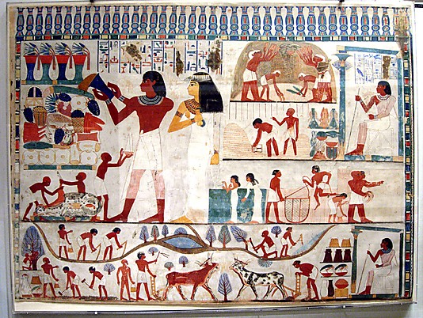
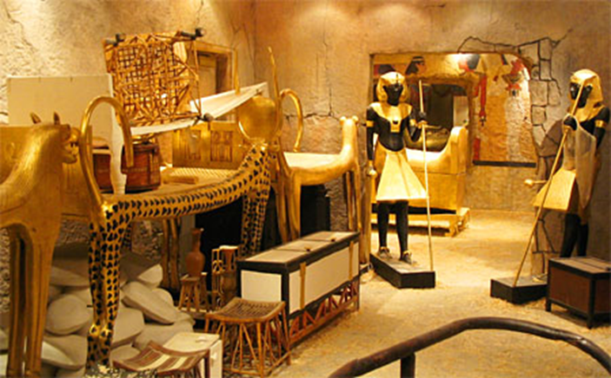
Using primary and secondary sources to identify the human characteristics of ancient Egyptians--
They herded cattle.
They grew crops (farmers).
What items can you identify in the bottom picture?

Slide 57
Virtual Field Trip
Let’s go on a trip…
We are going on a trip to the British Museum. We are going to explore the ancient Egyptians. You will write two paragraphs depicting what you have learned by examining primary and secondary sources (artifacts) while at the museum. Have Fun!!
*Take notes and draw pictures.
www.ancientegypt.co.uk/menu.html

Slide 58
TT can have the students to work in pairs. Bring the class back together to discuss what they have learned and connecting it to the standard.
SOL 3.1a- The student will demonstrate skills for historical thinking, geographical analysis, economic decision making, and responsible citizenship by identifying artifacts, primary, and secondary resources to understand events in world cultures.

Slide 59
Facilitate learning by connecting the dots…
Where is ancient Egypt located (continent)?
What water sources did the ancient Egyptians have access to?
What are some things the ancient Egyptians traded for?
Why did they have to trade for those things?

Slide 60
Pop Quiz
How can what you have learned about ancient Egypt (past) relate to you now (present)?

Slide 61
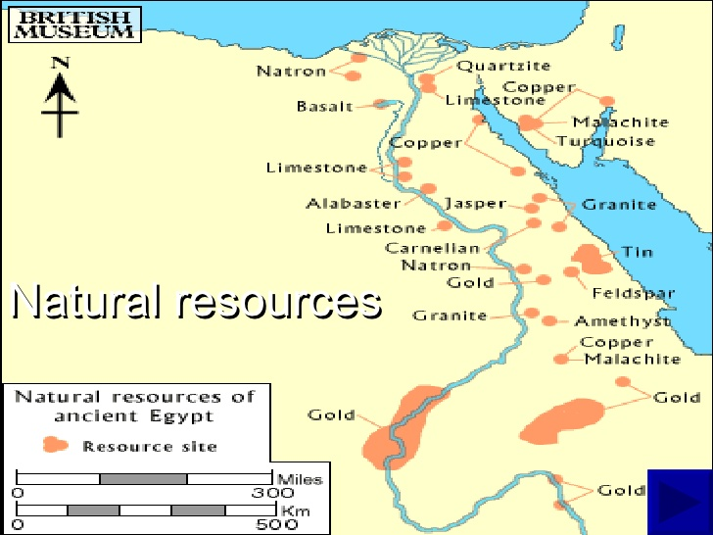
Map of Ancient Egypt
Choose a natural resource to explore.
Explain what goods and/or services could have been made using these natural resource.
Economic Decision Making.

Slide 62
Probe for understanding.
Why didn’t the ancient Egyptians specialize in ship building?
  [trees were not a plentiful natural resource]
Why did the ancient Egyptians trade for timber and wild domesticated animals?

Slide 63

Use this map to answer the following questions. The red area is Egypt.

Slide 64
Ancient Egypt interacting with other civilizations. (anticipation guide)
Who did the ancient Egyptians trade with?
What type of goods or services did the ancient Egyptians trade?
What type of goods or services did the ancient Egyptians have a demand for?

Slide 65
Trade
Supply- The amount of a product or service that is available. (What you have.)
Demand- The desire of buyers for a product or service. (What is wanted.)

Slide 66
Ancient Egypt Trade
1. Name a product or service that the ancient Egyptians produced or provided (supply)?
2. What natural resources were needed to make or produce this good or service?
3. Name a product or service that the ancient Egyptians needed (demand).

Slide 67
Ancient Egypt interacting with other civilizations. (anticipation guide)
Who did the ancient Egyptians trade with?
What type of goods or services did the ancient Egyptians trade?
What type of goods or services did the ancient Egyptians have a demand for?

Slide 68
Use as a guide to help YOU as you FACILITATE learning in YOUR classroom. This is a take away.
A “Historical Thinking Chart” to help learners make sense of the past, understand the present and prepare for the future!!!

Slide 69
Works Cited
Mandell, N.(2008,April).Thinking Like a Historian: A Framework for Teaching and Learning. Organization of American Historians, 55-59.
Statue of Ramses the Great on the site of Ancient Memphis, Egypt. Washington DC: Library of Congress, 9 June 1896.JPEG
Nubian Soldiers (on camel) and the Step Pyramid, the most ancient structure in the world, Egypt. Washington DC: Library of Congress, 1896. JPEG
Book Illustration show painting on tomb wall, Egypt. Washington DC: Library of Congress, 1898-1942. JPEG

Slide 70

How can you use this method with another grade?
Notes:
1:45-1:50

Slide 71

Sharing Our Expertise
Notes:
5 minute share

Slide 72
History and Social Science Updates
On The Web…
VDOE 2015 Standards of Learning
http://www.doe.virginia.gov/testing/sol/standards_docs/history_socialscience/index.shtml
2. VDOE Superintendent Memo #163-15
http://www.doe.virginia.gov/administrators/superintendents_memos/2015/163-15.shtml
Implementation Schedule
http://www.doe.virginia.gov/administrators/superintendents_memos/2015/163-15a.pdf

Slide 73

Skill Experience

Slide 74
Group Skill Experience
  Review the new History and Social Science Skill Heading SOLs. (K.1, 1.1, 2.1, 3.1)
  Choose one SOL bullet for your grade level.
  Create a lesson for your students.
  Share.

Slide 75
Reflections:
3 things you learned,
2 ways you can use this learning in your class, and
1 question you still have
Notes:
Teachers will personally reflect then turn and talk to pair-share
5-10 minutes

Slide 76
Questions?
Notes:
Respond to the parking lot questions that have been posted. (5-10 min)

Slide 77
Kindergarten – Grade Three Presenters
Carla Crump | Powhatan | carla.crump@powhatan.k12.va.us
Apryl-Dawn Julien | Richmond | awynter@richmond.k12.va.us
Quoteshia Hargett | Portsmouth | Quoteshia.Hargett@pps.k12.va.us
Melissa Mygas | Newport News | melissa.mygas@nn.k12.va.us
Megan Bush | Stafford | bushme@staffordschools.net
Jennifer Burgin | Arlington | jennifer.burgin@apsva.us
Kathy Nealon | Fairfax | Knealon@fcps.edu
Susan Mayo | Manassas City | smayo@mcpsva.org

Slide 78
Kindergarten – Grade Three Presenters
Jennifer Kettlekamp | Harrisonburg | jkettelkamp@harrisonburg.k12.va.us
Amy Cash | Augusta | acash@augusta.k12.va.us
Dawn Toole | Martinsville | dtoole@martinsville.k12.va.us
Krystal Heath | Floyd | heathk@floyd.k12.va.us
Misty Jeffers | Washington | mjeffers@wcs.k12.va.us
Bethany Collins | Tazewell | bcollins@tazewell.k12.va.us
Tamara Green | Buckingham | tgreen@bcpschools.org
Vanessa Mason | Halifax | vmason@halifax.k12.va.us

Slide 79


Slide 80
and the
Virginia Department of Education
Christonya Brown, K-12, History and Social Science Coordinator
E-mail: Christonya.Brown@doe.virginia.gov
Betsy Barton, Elementary, History and Social Science Specialist
E-mail: Betsy.Barton@doe.virginia.gov
Jill Nogueras, English and History and Social Science Specialist
E-mail: Jill.Nogueras@doe.virginia.gov

