Slide 1
Grade One
History and Social Science
Fall Institute
2016

Slide 2
Disclaimer
Reference within this presentation to any specific commercial or non-commercial product, process, or service by trade name, trademark, manufacturer or otherwise does not constitute or imply an endorsement, recommendation, or favoring by the Virginia Department of Education.

Slide 3
Questions to Ask During Planning
Essential Components in Planning an Effective Lesson
using the
2015 History and Social Science Standards of Learning
What do students need to know and understand by the end of this lesson?
What do students need to do during this lesson?
Which historical thinking skills are best suited for this standard?
What other content material should be added to provide historical context and richness to the lesson in order to maximize student understanding of the standard?
What student learning experiences would be most effective during this lesson?
How can I check for understanding effectively and accurately to measure the students’ content knowledge and historical thinking skills?

Slide 4

It starts with the . . .

Slide 5
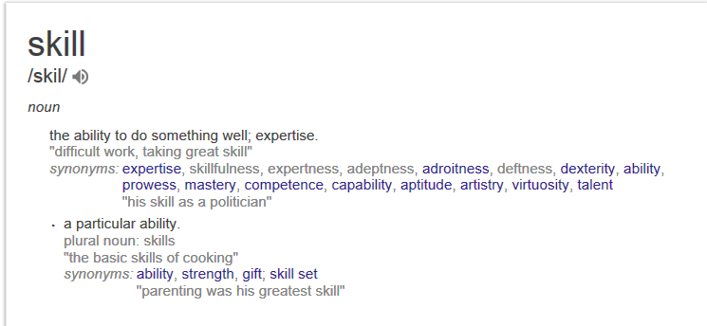

Slide 6
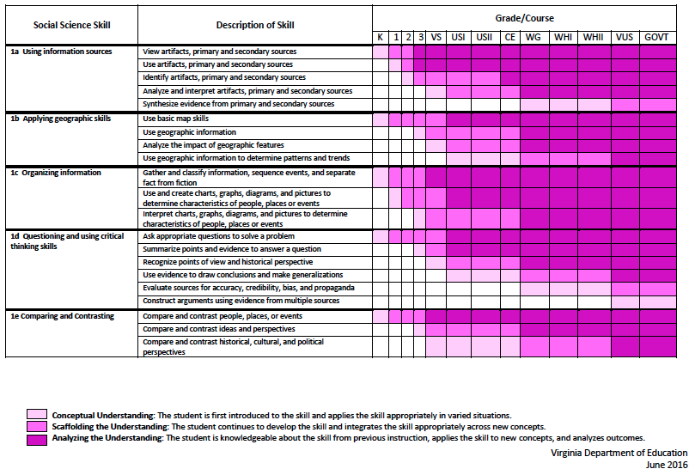
2015 SOL Skill Progression
⇧
Notes:
⇧

Slide 7
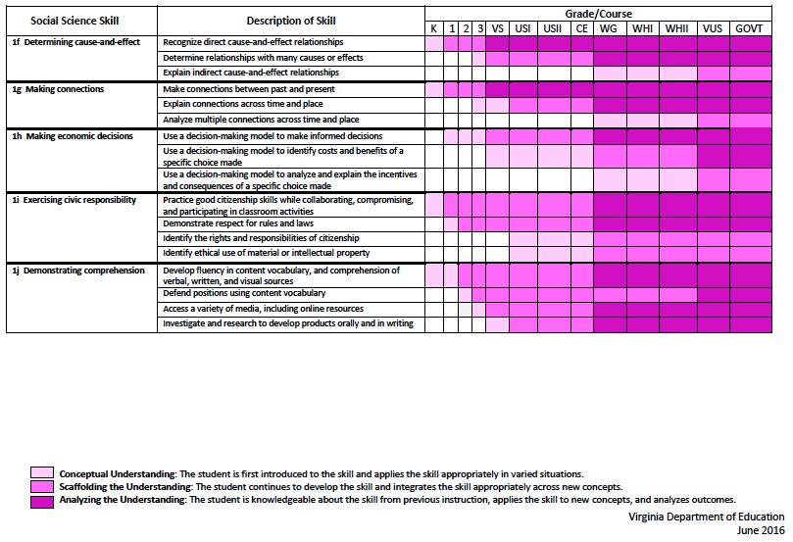
2015 SOL Skill Progression
⇧
2008 Standards:
Understand content
2015 Standards:
Understand content by applying the skill.
Skills are aligned with English Standards
Notes:
Discussion: Conceptual Understanding, Scaffolding the Understanding, Analyzing the Understanding
Arrow will rise up upon click after discussion to summarize difference between 2008 and 2015, then skills aligned with English SOLs. Great opportunity for common planning!
Purpose of today is to “teach” a lesson demonstrating skill based instruction, moving away from Lecture (Sit and Get)

Slide 8
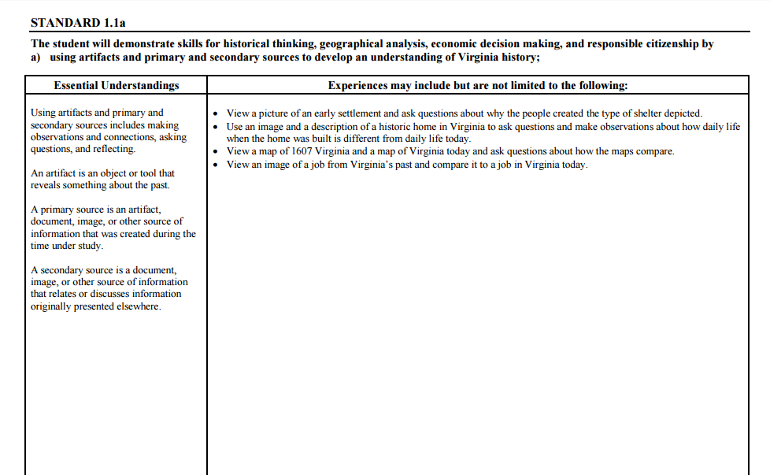
Experiences for Essential Skills
What are Experiences?

Slide 9
Experiences
Bring attention to the Experiences and describe what they are and how they can be used.
Provide teachers with “experiences” and give them an opportunity to:
  discuss what they are and how they can be used; and
  develop their own to share with the group.

Slide 10
The experiences should be –
engaging,
rigorous with higher level thinking questions,
relevant (connecting time periods, places, and events to the present day).

Slide 11
Experiences
Are . . .
Are NOT. . .
Engaging- promoting discussion, collaboration, and understanding
Opportunities to practice social science skills using various content
Varied throughout the lesson to help students make connections
Worksheets
Specific to one Standard, topic, or course

Slide 12

How can Grade One history & social science skills be incorporated into standards-based lessons?
Notes:
Good practice: Use of aim/objective to give students a concrete goal for the lesson. “By the end of class/end of unit/etc., you should be able to…”

Slide 13
Good practice
Use of aim/objective to give students a concrete goal for the lesson.
“By the end of class/end of unit/etc., you should be able to…”

Slide 14

Today we will . . .
Practice strategies to incorporate new standards-based skills into daily lessons to teach and check for understanding of content

Slide 15
History and Social Science
Standards of Learning 2016 Fall Institute
Welcome
Meet-and-Greet
Agenda for the day
  Presentation of Learning Experiences
  Creating Skill Experiences
Questions

Slide 16
Today’s Working Norms
Be engaged
Be open to new ideas
Limit sidebar conversations
Laptop/Cell phone use

Slide 17
Grounding:
Who Are We?
Introduce yourself to a shoulder partner
  Name, position, school/location you teach
  What is your favorite unit/topic to teach in Social Studies? Why?
Geography
American Indians
Ancient Cultures
Famous Americans
History
Civics
Economics

Slide 18

Just Like Me
When you hear something that applies to you-
Stand up and say…
Just like me!

Slide 19
Implementing the new Social Studies Curriculum!
Getting Ready for 2017-2018

Slide 20
What are these experiences teachers are to provide for the students?
The experiences should be –
engaging,
rigorous with higher level thinking questions,
relevant (connecting time periods, places, and events to the present day).

Slide 21
How do I plan for these experiences?
When planning for these experiences you should think about how we learn about the past.
    Asking questions.
    Gathering the sources, organize them, and evaluate the evidence in the sources.
    Drawing conclusions that are supported by the evidence in the sources.

Slide 22
Questions to ask about the past….
How?
What?
When?
Where?
Who?

Slide 23
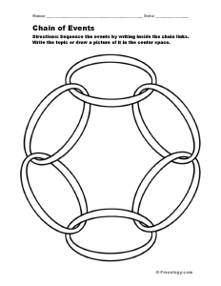
Things to consider→
Cause and Effect- events from the past have a short term and long term (often times unforeseen) effects on the development of societies.

Slide 24
Things to consider→
Change and Continuity- focus on change over time; understanding what changed and what remained the same, fosters a deeper understanding of the uneven pace for which events unfolded throughout history.

Slide 25

Things to consider→
Turning Points- focuses on events of great significance that caused individual experiences and societal developments to go in a different direction.

Slide 26

Things to consider→
Using the Past- finding the usable past and using it to better understand events from that time frame and how it relates to the present. This makes history relevant and gives history meaning.

Slide 27

Things to consider→
Through their Eyes- We need to see the world as they saw it in order to get a deeper understanding of why people thought and acted the way they did and the reasoning for the choices they made.

Slide 28
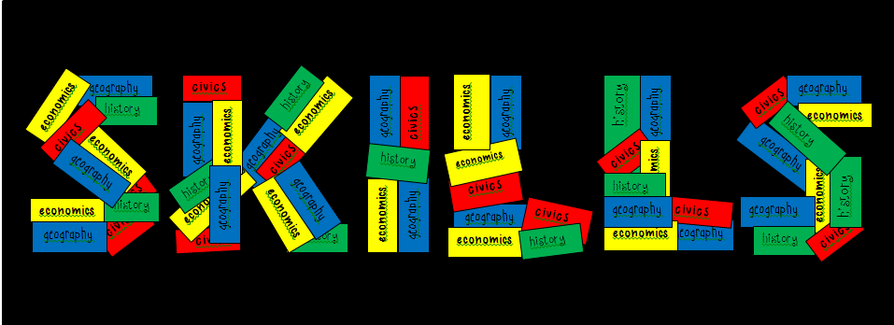
The Essential Skills, which are found in Standard 1 for each grade level or course, serve as tools to facilitate active engagement in learning, to deepen student understanding of content material and to create better-informed citizens.

Slide 29
Standard 1
Use information sources.
Apply geography skills.
Organize information.
Demonstrate critical thinking.
Compare and contrast.
Determine cause and effect.
Make connections.
Make economic decisions.
Exercise civic responsibilities.
Demonstrate comprehension.

Slide 30
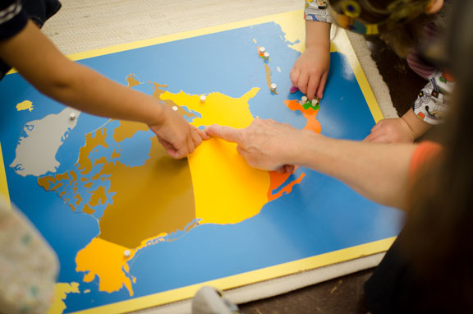
Let’s Explore:
Rigorous Social Studies
Learning Experiences
Notes:
Now we are going to take some time to explore some possible learning experiences for students that will help teachers grasp ways to embed skills from Standard 1 into content. As we look at and model each lesson idea, be thinking about ways to raise the rigor of social studies instruction and make literacy connections through these skills. Think about how the experience can be expanded to other grade levels.

Slide 31

Grade One

Slide 32
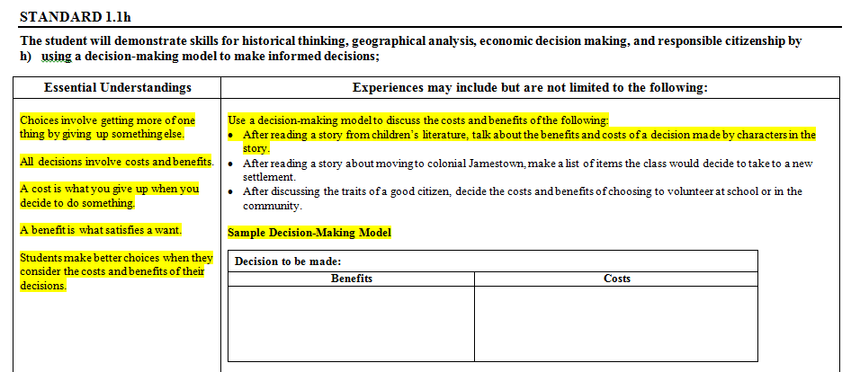
Application of Skills Standard 1 in
First Grade 1.1h

Slide 33
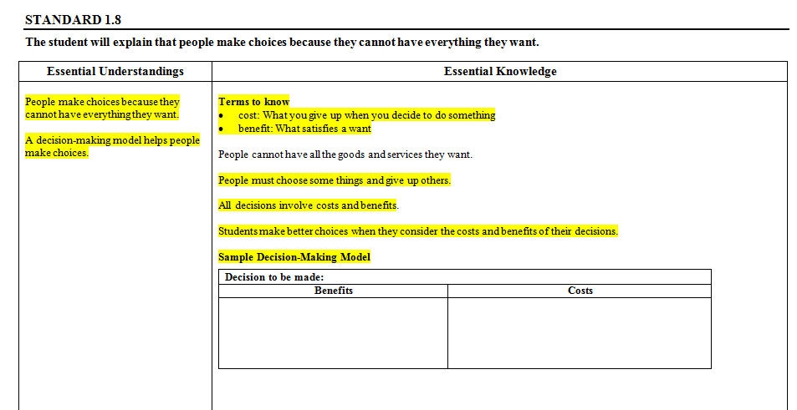
Content: Economics 1.8

Slide 34
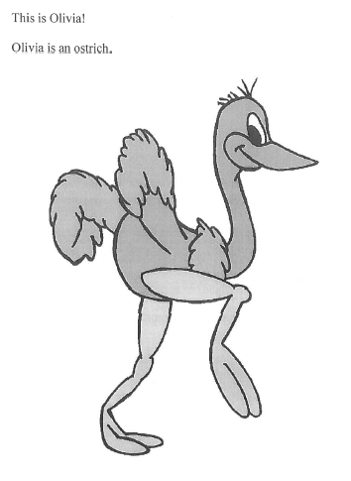
Lesson taken from Gemma Kotula, CNU Center for Economic Education
Notes:
Lesson taken from Gemma Kotula CNU Center for Economic Education

Slide 35
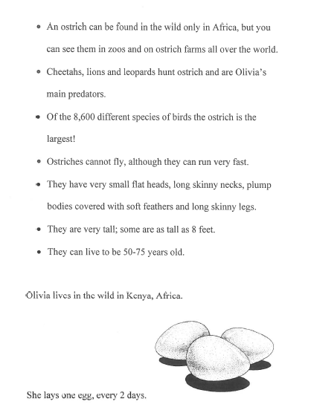

Slide 36
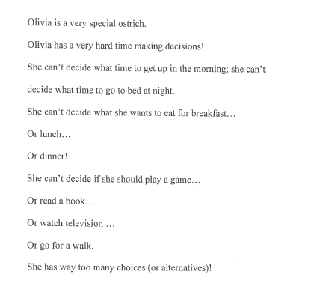
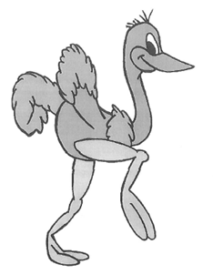

Slide 37
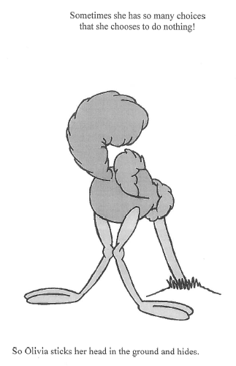

Slide 38
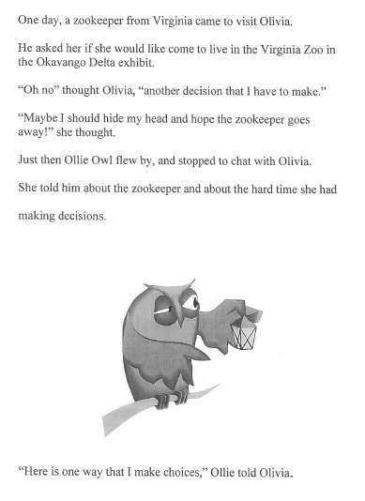

Slide 39
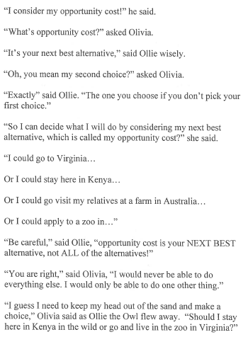

Slide 40
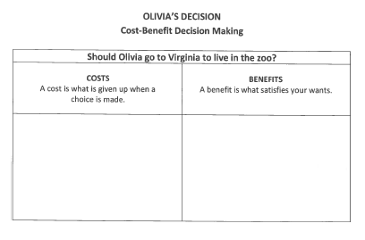
Notes:
Take 3-4 minutes to complete the Cost-Benefit Decision Making Model

Slide 41
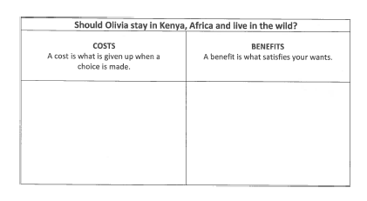

Slide 42
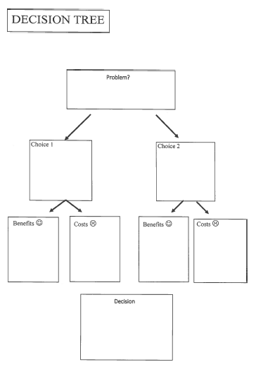
Notes:
Share another model with participants

Slide 43
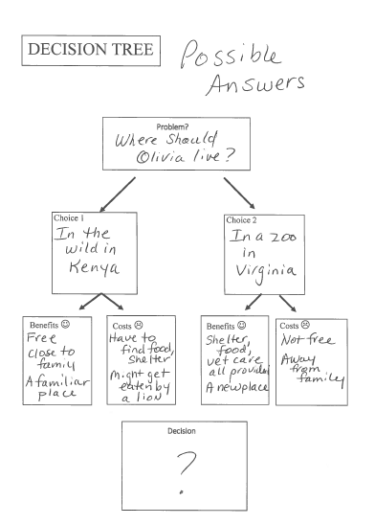
Notes:
Possible answers to decision tree

Slide 44
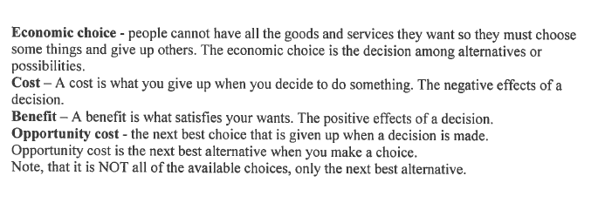
Key Vocabulary
Notes:
Enlist the help from other teachers, cafeteria workers, and parents to point out opportunity cost examples. Students do this everyday with the choices they make, they just may not know the terminology.

Slide 45
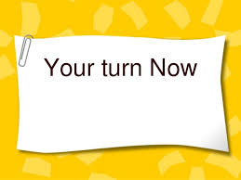
Give One Get One
Take a few minutes to think about others way to incorporate economic decision making models (1.1h) in the economic units you teach.
Write 3 suggestions in the boxes on the left.
Move around the room and exchange ideas. Do this 3 times to get 3 ideas to take back to your school.

Slide 46


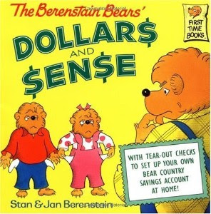
Paradigm Shift - Moving from Activities to Experiences
As we shift from planning content activities to skills based experiences, we have to first look at the skills.
Skill 1.1h - Use a decision making model to make informed decisions
Our goal: Focusing on these skills allows us as educators to integrate more with ELA, Science, and Math.

Slide 47
Cost-Benefit Decision Model
CONGRATULATIONS!
You have just won an award that comes with a cash prize of $100,000!
Make a list or think about what you would use that money for. You might even consider what you would NOT use that money for.

Slide 48
Creating A Cost-Benefit Decision Model
We are going to create a Cost-Benefit Decision Model which lists options for spending the $100,000 cash prize. To save time we will select only two of our favorite options.
Notes:
Pass out copies of Cost Benefit model from Virginia Council on Economic Education.
Picture examples: trip to Fiji, put towards child’s college fund, pay off debt.

Slide 49
Cost-Benefit Decision Making Model With Literature
Use the vocabulary expected of economics at an early age - teach cost, benefit & opportunity cost!
Before your read aloud, start with these words first!

Slide 50
Just Saving My Money
Cost-Benefit Decision Model
Costs - What You Give Up | Benefits - Positive, What You Gain
Playing with my friends Money Jar | Money A Savings Account Having money to buy what I want, like a new toy

Slide 51
Cost-Benefit Tree
A way to extend the lesson would be to use a Cost-Benefit Tree based upon the Cost-Benefit Decision Models.
Back to the $100,000 cash prize example...
Notes:
Pass out copies of VCEE Cost Benefit Tree, double sided (one for this slide, one for class activity)

Slide 52
Cost-Benefit Tree
Now, back to the example for our students…
When using the Cost-Benefit Decision Model with Just Saving My Money, your class may decide that saving money is a better option than not saving money. Using a Cost-Benefit Tree can help the class decide how to spend the saved money. This goes one step further and into the nuances of opportunity cost.

Slide 53
Always Looping Back to the Skill
1.1h - Use a decision making model to make informed decisions
What was your “gut instinct” for using your money before the Decision Making Model?
What was your decision after using the Decision Making Model?
How does using this model help you?
Once students have practiced this economic skill, you can take this experience and duplicate it within your specific content areas.

Slide 54
Your Turn!
First, review your experience with the $100,000 cash prize and the conflict you experienced (or why you didn’t experience conflict!) in what to use the money towards.
Then, think about a decision making model that your students could explore after having learned this skill. Some examples may be…
  Kindergarten - how to spend “free time” during centers
  1st Grade - selecting where to take a field trip
  2nd Grade - costs and benefits of a classroom job/pet/activity
  3rd Grade - describing the pros and cons of living in a specific Ancient Civilization and choosing which civilization a student would have traveled to
  All grades - choices of a character from a read aloud, voting scenarios, how to use time/money/resources, what to do with a challenging situation with friends
Remember - These skills are taught and can come up in all content areas throughout the year. Repeat and reuse them!

Slide 55
First Grade
Content SOL
1.8 The student will explain that people make choices because they cannot have everything they want.
Skill SOL
1.1h The student will demonstrate skills for historical thinking, geographical analysis, economic decision making and responsible citizenship by using a decision-making model to make informed decisions.

Slide 56

Content Example
Have you ever wanted something but did not have enough money to buy it?
A Chair for My Mother
by Vera Williams
Notes:
We will pose the question to generate discussion before reading the given text.

Slide 57
Generate discussion by asking students:
In the story, what did the child want?
How did she get it?
Introduce the terms:
  savings
  choice
  benefit
  cost
What other choices could the family have made?
What would have been the benefit of using the money that they saved to go on an overnight trip?
What would the cost of that same decision have been?
Notes:
Participants will participate in the discussion of the text. We are modeling the lesson as it would be presented to a first grade classroom.

Slide 58

Guided Practice
Decision Tree
Park? Movie?

Slide 59
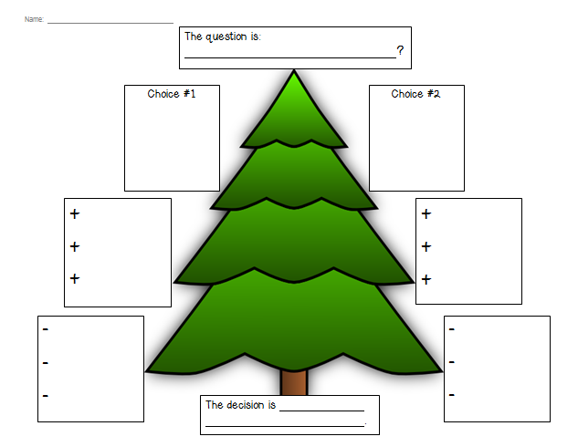
Decision Tree
Notes:
To scaffold instruction, the presenter will model how to complete a decision tree. The group will be answering the question from the previous slide: park or movie?

Slide 60
Independent Practice
Decision Tree
Should I get a cat or a dog?
Should we go to Busch Gardens or Water Country?
Should I play inside or outside?
Should I play baseball or soccer?
Should I help with the laundry or watch TV?
Notes:
Participants will be given a blank design tree to complete with a partner for independent practice. Participants will select one of the five questions listed on this slide.

Slide 61
Extend this learning experience by using decision-making trees throughout the year to help with class decisions such as:
Should our class have a pizza party or an ice cream party?
Should we make gifts for each other or have a book exchange?

Slide 62

Debrief
What skill was used as a vehicle to deliver the content?
What other skill could be used to deliver the same content?
What other content could be taught using the same skill?

Slide 63


How can you use this method with another grade?
Notes:
Working with a shoulder partner or small group brainstorm other ways to incorporate this skill into other civics lessons and in other grade levels.

Slide 64

Sharing Our Expertise
Notes:
5 minute share

Slide 65
History and Social Science Updates
On The Web…
VDOE 2015 Standards of Learning
http://www.doe.virginia.gov/testing/sol/standards_docs/history_socialscience/index.shtml
2. VDOE Superintendent Memo #163-15
http://www.doe.virginia.gov/administrators/superintendents_memos/2015/163-15.shtml
Implementation Schedule
http://www.doe.virginia.gov/administrators/superintendents_memos/2015/163-15a.pdf

Slide 66

Skill Experience

Slide 67
Group Skill Experience
  Review the new History and Social Science Skill Heading SOLs. (K.1, 1.1, 2.1, 3.1)
  Choose one SOL bullet for your grade level.
  Create a lesson for your students.
  Share.

Slide 68
Reflections:
3 things you learned,
2 ways you can use this learning in your class, and
1 question you still have
Notes:
Teachers will personally reflect then turn and talk to pair-share
5-10 minutes

Slide 69
Questions?
Notes:
Respond to the parking lot questions that have been posted in each room.

Slide 70
Kindergarten – Grade Three Presenters
Carla Crump | Powhatan | carla.crump@powhatan.k12.va.us
Apryl-Dawn Julien | Richmond | awynter@richmond.k12.va.us
Quoteshia Hargett | Portsmouth | Quoteshia.Hargett@pps.k12.va.us
Melissa Mygas | Newport News | melissa.mygas@nn.k12.va.us
Megan Bush | Stafford | bushme@staffordschools.net
Jennifer Burgin | Arlington | jennifer.burgin@apsva.us
Kathy Nealon | Fairfax | Knealon@fcps.edu
Susan Mayo | Manassas City | smayo@mcpsva.org

Slide 71
Kindergarten – Grade Three Presenters
Jennifer Kettlekamp | Harrisonburg | jkettelkamp@harrisonburg.k12.va.us
Amy Cash | Augusta | acash@augusta.k12.va.us
Dawn Toole | Martinsville | dtoole@martinsville.k12.va.us
Krystal Heath | Floyd | heathk@floyd.k12.va.us
Misty Jeffers | Washington | mjeffers@wcs.k12.va.us
Bethany Collins | Tazewell | bcollins@tazewell.k12.va.us
Tamara Green | Buckingham | tgreen@bcpschools.org
Vanessa Mason | Halifax | vmason@halifax.k12.va.us

Slide 72


Slide 73
and the
Virginia Department of Education
Christonya Brown, K-12, History and Social Science Coordinator
E-mail: Christonya.Brown@doe.virginia.gov
Betsy Barton, Elementary, History and Social Science Specialist
E-mail: Betsy.Barton@doe.virginia.gov
Jill Nogueras, English and History and Social Science Specialist
E-mail: Jill.Nogueras@doe.virginia.gov

