Slide 1
Virginia and United States Government
History and Social Science
Fall Institute
2016

Slide 2
Disclaimer
Reference within this presentation to any specific commercial or non-commercial product, process, or service by trade name, trademark, manufacturer or otherwise does not constitute or imply an endorsement, recommendation, or favoring by the Virginia Department of Education.

Slide 3
Questions to Ask During Planning
Essential Components in Planning an Effective Lesson
using the 2015 History and Social Science Standards of Learning
What do students need to know and understand by the end of this lesson?
What do students need to do during this lesson?
Which historical thinking skills are best suited for this standard?
What other content material should be added to provide historical context and richness to the lesson in order to maximize student understanding of the standard?
What student learning experiences would be most effective during this lesson?
How can I check for understanding effectively and accurately to measure the students’ content knowledge and historical thinking skills?

Slide 4

It starts with the . . .

Slide 5
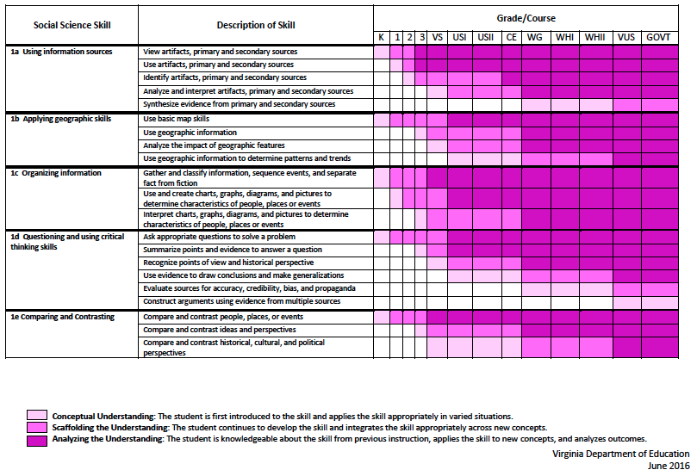
2015 SOL Skill Progression
Notes:
⇧

Slide 6
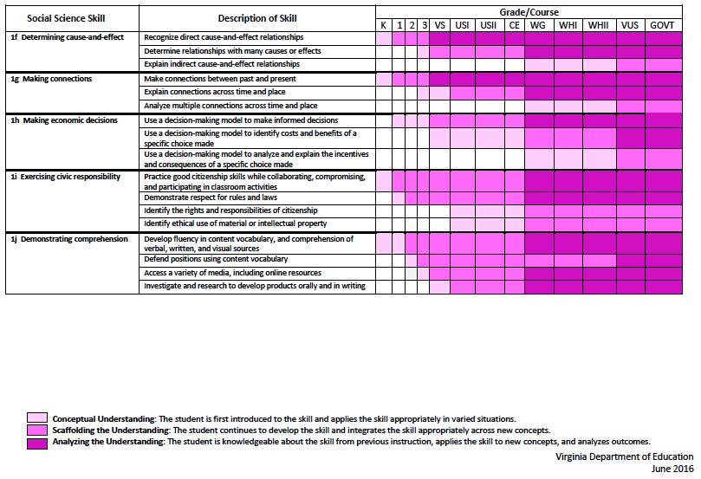
2015 SOL Skill Progression
2008 Standards:
Understand content
2015 Standards:
Understand content by applying the skill.
Skills are aligned with English Standards
Notes:
Discussion: Conceptual Understanding, Scaffolding the Understanding, Analyzing the Understanding
Arrow will rise up upon click after discussion to summarize difference between 2008 and 2015, then skills aligned with English SOLs. Great opportunity for common planning!
Purpose of today is to “teach” a lesson demonstrating skill based instruction, moving away from Lecture (Sit and Get)

Slide 7
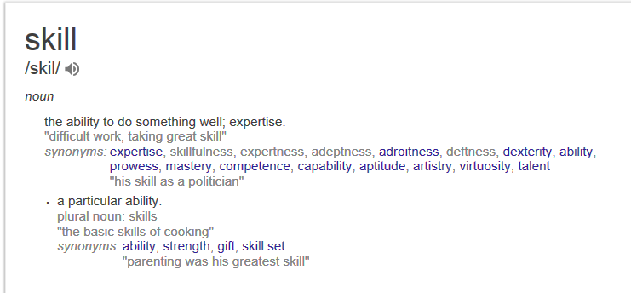

Slide 8
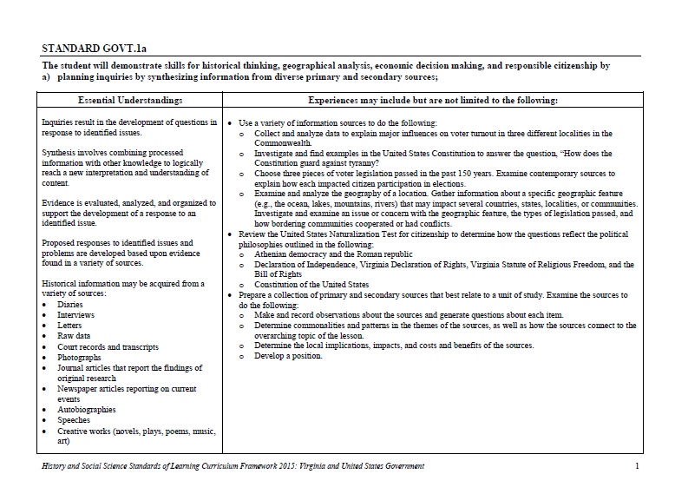
Experiences for Essential Skills
What are Experiences?
Notes:
Bring attention to the Experiences and describe what they are and how they can be used.
Provide teachers with “experiences” and give them an opportunity to:
discuss what they are and how they can be used; and
develop their own to share with the group.

Slide 9
The experiences should be –
engaging,
rigorous with higher level thinking questions,
relevant (connecting time periods, places, and events to the present day).

Slide 10
Experiences
Are . . .
Are NOT. . .
Engaging- promoting discussion, collaboration, and understanding
Opportunities to practice social science skills using various content
Varied throughout the lesson to help students make connections
Worksheets
Specific to one Standard, topic, or course

Slide 11

Notes:
everyone needs a pep talk - play video and icebreaker activity (four corners - CE or GOVT?, Years of Experience, Familiarity with new standards, Whether they have seen Space Jam or not,

Slide 12
Student Learning Experiences
What is a “Student Experience”?
What it means:
Students will be more engaged and active in the process
They will be able to create a “product” that will demonstrate their mastery of the historical content and concepts in a contemporary concept.
bit.ly/CEGOVTskills
Notes:
Emphasize this throughout the presentation.

Slide 13
Start with the Content Standard...
GOVT 6f - ...analyzing voter turnout in local, state, and national elections.

Slide 14
Then choose a skill standard…
GOVT 1b - ...analyzing how political and economic trends influence public policy, using demographic information and other data sources

Slide 15
1b Essential Understandings
Analysis includes identifying important trends based on demographic information and other data sources.
Demographic information is often used by governments and businesses in the development of policies and decisions.

Slide 16
1b Essential Understandings
Demographic information is presented in a variety of forms, including the following:
  Election data
  Economic data
  Census data

Slide 17
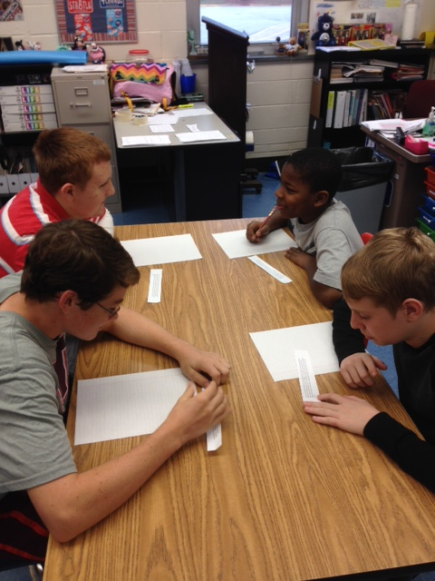
Voter Speed Dating

Slide 18
Let’s Try Another
Notes:
Hook for Next Lesson:
Before moving on, tell group an interesting article just came out that you want to get their opinion on given that they are all civics teachers. Handout a copy of the article linked below and host discussion about it (hoping someone will question the source of the information). Use this to introduce topic of next skills lesson - determining the accuracy and validity of sources
Hook Article from the Onion

Slide 19
Skills – Gov.1a
  The student will demonstrate skills for historical thinking, geographical analysis, economic decision making, and responsible citizenship by planning inquiries by synthesizing information from diverse primary and secondary sources;
  EXPERIENCE: Determine commonalities and patterns in the themes of the sources, as well as how the sources connect to the overarching topic of the lesson
Content – Gov.2b, c, d, e, f, 4d

Slide 20
Context/teaching ideas
Focus #1 – Recall the Articles of Confederation and identify some of weaknesses and issues that emerged with the new nations first government.
Focus #2 - Primary Sources – explain the difference between and primary and secondary sources.
Focus #3 – How can we use primary sources to understand what the people of the time were thinking as it relates to major historical events?

Slide 21
The Lesson is a truly project based assignment. However, students will need to be shown how you want them to sort through the documents.

Slide 22
Teacher
  Place students in groups of 4
  Read the scenario AFTER the Focus question
  Demonstrate how you want students to notate (my demonstration is how I would do it – again, please modify to fit your class)

Slide 23
Let’s Try Another
Notes:
Hook for Next Lesson:
Before moving on, tell group an interesting article just came out that you want to get their opinion on given that they are all civics teachers. Handout a copy of the article linked below and host discussion about it (hoping someone will question the source of the information). Use this to introduce topic of next skills lesson - determining the accuracy and validity of sources
Hook Article from the Onion

Slide 24
Skill: GOVT.1h
  The student will demonstrate skills for historical thinking, geographical analysis, economic decision making, and responsible citizenship by using a decision-making model to analyze the costs and benefits of a specific choice, considering incentives and possible consequences;
Content: GOVT.15f
  The student will apply social science skills to understand the role of government in the Virginia and United States economies by evaluating the trade-offs in government decisions.

Slide 25
What does each of these words mean?
Cost
Benefit
Incentives
Opportunity Cost
Use some sort of mobile technology to have teachers create their own definitions.

Slide 26
Definitions
Cost: what you give up when you decide to do something.
Benefit: what satisfies your wants
Incentives: Incentives are actions or rewards that encourage people to act.
Opportunity Cost: is what is given up when a choice is made, (the second best alternative).

Slide 27
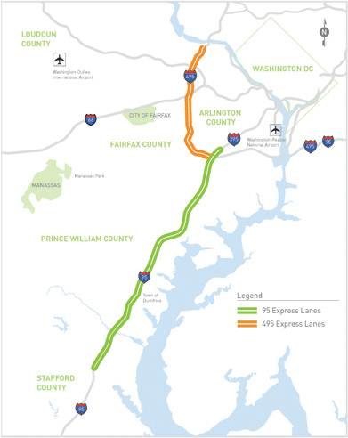
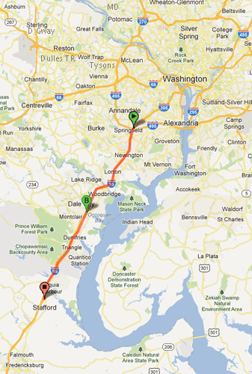
Express Lanes

Slide 28
Should the 95 Express lanes be extended to Fredericksburg?
Benefits of Extending the Express Lanes | Costs of Extending the Express Lanes

Slide 29
Problem: ____________________
PACED Decision Grid: [Problem, Alternatives, Criteria, Evaluate, Decision]
Criteria Alternatives

Slide 30
Problem: How could $500 million be spent?
PACED Decision Grid: [Problem, Alternatives, Criteria, Evaluate, Decision]
Criteria Alternatives | Direct impact on self | Improve Virginia Economy
Extend Express Lanes
Improve Public Transportation
Enhance Higher Education funding
Increase Social Programs (expand Medicaid)

Slide 31
Problem: How could $500 million be spent?
PACED Decision Grid: [Problem, Alternatives, Criteria, Evaluate, Decision]
Criteria Alternatives | Direct impact on self | Improve Virginia Economy
Extend Express Lanes
Improve Public Transportation
Enhance Higher Education funding
Increase Social Programs (expand Medicaid)
If you have a tie – add a multiplier to the criteria that is MOST important to you!

Slide 32
Historical Decision: Building the Interstate Highway System
BEFORE CHOICE WAS MADE – “Assumed” Cost-Benefit Analysis
Costs (things given up) | Benefits (positive things gained)
CHOICE OUTCOME – Actual Intended vs. Unintended Consequences
INTENDED Consequences (thought would happen and actually did) | UNINTENDED Consequences (did not know would happen)

Slide 33
Another Example
Notes:
Hook for Next Lesson:
Before moving on, tell group an interesting article just came out that you want to get their opinion on given that they are all civics teachers. Handout a copy of the article linked below and host discussion about it (hoping someone will question the source of the information). Use this to introduce topic of next skills lesson - determining the accuracy and validity of sources
Hook Article from the Onion

Slide 34
Content Standards
GOVT 6c - ...analyzing the influence of media coverage, campaign advertising, public opinion polls, social media, and digital communications on elections

Slide 35

Detecting Bias
Sort the Source!
Notes:
Define bias for group; in presentation view, audience will see only the image on the left side of the slide, ask they what they see in the picture, click to show image on the right side of the slide and discuss bias/perception, then audience will participate in “Sort the Source” learning experience

Slide 36
Which skill did we practice?
GOVT 1d - ...evaluating critically the quality, accuracy, and validity of information to determine misconceptions, fact and opinion, and bias
Notes:
Do not show skills until after debrief….we want audience to interact with skills and see if they can pick out the skill we were practicing
Debrief: How did it play out? What did you have trouble with? What do you think your students will have trouble with? How can you use it in another way?
How was this a “student learning experience”?

Slide 37
Content Standards
GOVT 6f - ...analyzing voter turnout in local, state, and national elections.

Slide 38
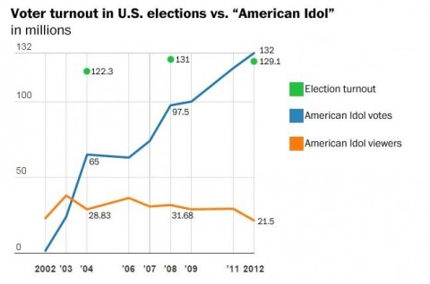
Source: https://www.washingtonpost.com/news/the-fix/wp/2015/05/11/rip-american-idol-the-show-that-gave-us-an-easy-shorthand-for-americans-not-voting/
Notes:
Source: https://www.washingtonpost.com/news/the-fix/wp/2015/05/11/rip-american-idol-the-show-that-gave-us-an-easy-shorthand-for-americans-not-voting/
Click present mode for this to see first graph shown to participants….
Image analysis worksheet - what do you see?, what do know?, what questions do you have?
Participants will share out as a whole group the answers to these questions
Participants will be shown the second graph (as seen above) and will answer the question - what have you learned?

Slide 39

Cost/Benefit Analysis:
Should I vote in this year’s presidential election?
Costs | Benefits
Notes:
Define costs and benefits for audience then teachers complete this individually then share out for discussion
Have discussion about costs/benefits AND consequences of not voting/write in candidacy

Slide 40
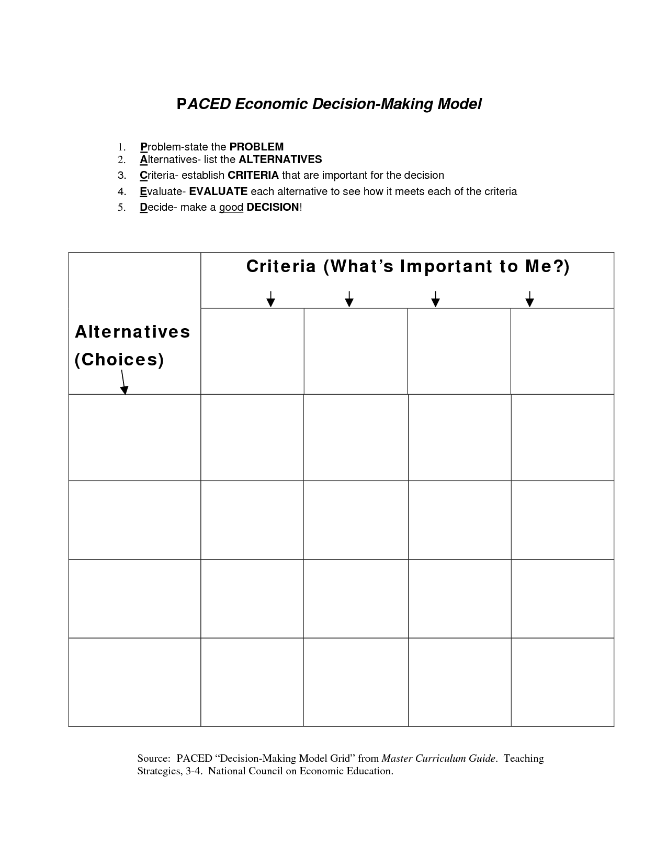
PACED Decision-Making Grid: What should our country do to increase voter turnout?
Notes:
Teachers will do this as a whole group
PACED acronym: Define the PROBLEM 2. List the ALTERNATIVES 3. Select CRITERIA 4. EVALUATE the alternatives 5. Make a DECISION
We are hoping they may suggest as the alternative choices: Make election day a national holiday, election day on a Saturday, online voting, compulsory voting, make it easier to get IDs
We are hoping they may suggest as the criteria: Easy to do, Cost effective, biggest bang for our buck
We will model how to assigned “points” for each alternative based on the criteria set and discuss how the PACED grid can be used to make a decision

Slide 41
Which skill did we practice?
GOVT 1h - ...using a decision-making model to analyze the costs and benefits of a specific choice, considering incentives and possible consequences
Notes:
Do not show skills until after debrief….we want audience to interact with skills and see if they can pick out the skill we were practicing
Debrief: How did it play out? What did you have trouble with? What do you think your students will have trouble with? How can you use it in another way?
How was this a “student learning experience”?

Slide 42
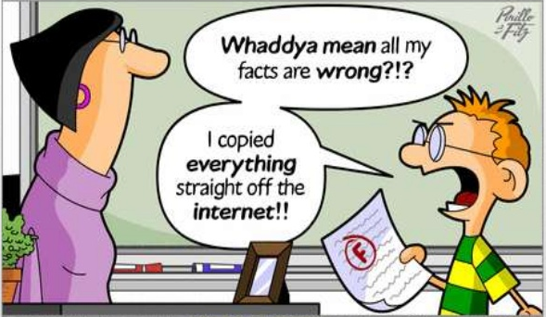
Writing to Learn
Not graded
Prior to lesson
  Assess student background knowledge
End of lesson
  Check understanding
  Make Connections
  Answer BIG QUESTION
  Free-write

Slide 43
Resources
Library of Congress
National Archives (DocsTeach)
Virginia Council for Economic Education
Virginia Geographic Alliance
Political Advertisements

Slide 44
Reflections:
3 things you learned,
2 ways you can use this learning in your class, and
1 question you still have
Notes:
Teachers will personally reflect then turn and talk to pair-share

Slide 45

Questions?
Notes:
Answer parking lot questions that weren’t answered

Slide 46

Nakita Lee | Chesterfield County | nakita_lee@ccpsnet.net
Jessica Mitchell | Newport News | Jessica48.Mitchell@nn.k12.va.us
David Wessel | Spotsylvania County | dwessel@spotsylvania.k12.va.us
Michelle Cottrell-Williams | Arlington | Michelle.cottrell@apsva.us
Tim Duncan | Wise County | tduncan@wisek12.org
Courtney Kelly | Cumberland County | ckelly@cucps.k12.va.us

Slide 47
Virginia Department of Education
Christonya Brown, K-12, History and Social Science Coordinator
E-mail: Christonya.Brown@doe.virginia.gov
Betsy Barton, Elementary, History and Social Science Specialist
Email: Betsy.Barton@doe.virginia.gov
Jill Nogueras, English & History and Social Science Specialist
Email: Jill.Nogueras@doe.virginia.gov

